Slide 1
M MassaPro
The Global Leader in Conversational Agentic AI

Slide 2







One Platform. A Complete Agentic AI Workforce.
MassaPro
M
purpose models, we design and control every layer of our AI technology.
:.•': Advanced Agentic Application Layer Capability
!{! Proprietary Voice Recognition Models
•'I..
Proprietary Voice Synthesis And Cloning
=•• Advanced Fine Tuning / DPO LLM Layer
Ø 100% Owned Single-Vendor Stack
*”
”
,/ê'
Enterprise Implementation Capability
žõ'.
Native Omnichannel Execution Layer For AI Agents
@•. Native AI Ouality Assurance And Analytics Tools

Slide 3
MassaPro
M
MassaPro
Con tents
Unrivaled Full-Stack Agentic Offering
° ° Deep Tech Layer | 6 | Agentic Application Layer | 16 | . ” AI Agent Toolkit | 25
Voice Recognition Model Performance | 7 | Build Your Al Workforce | 17 | Omni | 26
Voice Cloning Model Performance | 8 | Design Agents for Any Role | 18 | Dashboards | 27
How Al Voice Works | 9 | 0 rchestrate Agentic Journeys | 19 | Flow | 28
Clone Real Voices & Customise | 10 | The Building Blocks of Every Journey | 20 | AI Marketplace | 29
The Anatomy of Every Conversa tion | 11 | Confidence in Every Change | 21
Reporting That Turns Data into Action | 12 | Connect to Your Systems | 22
Meet CIara, Your Analytic s Assistant | 13 | From OC to Strategic Coach ing | 23
Equip Agents with Knowledge | 14 | Generate Scorecards with Clara | 24
Foundatio nal Models | 15

Slide 4
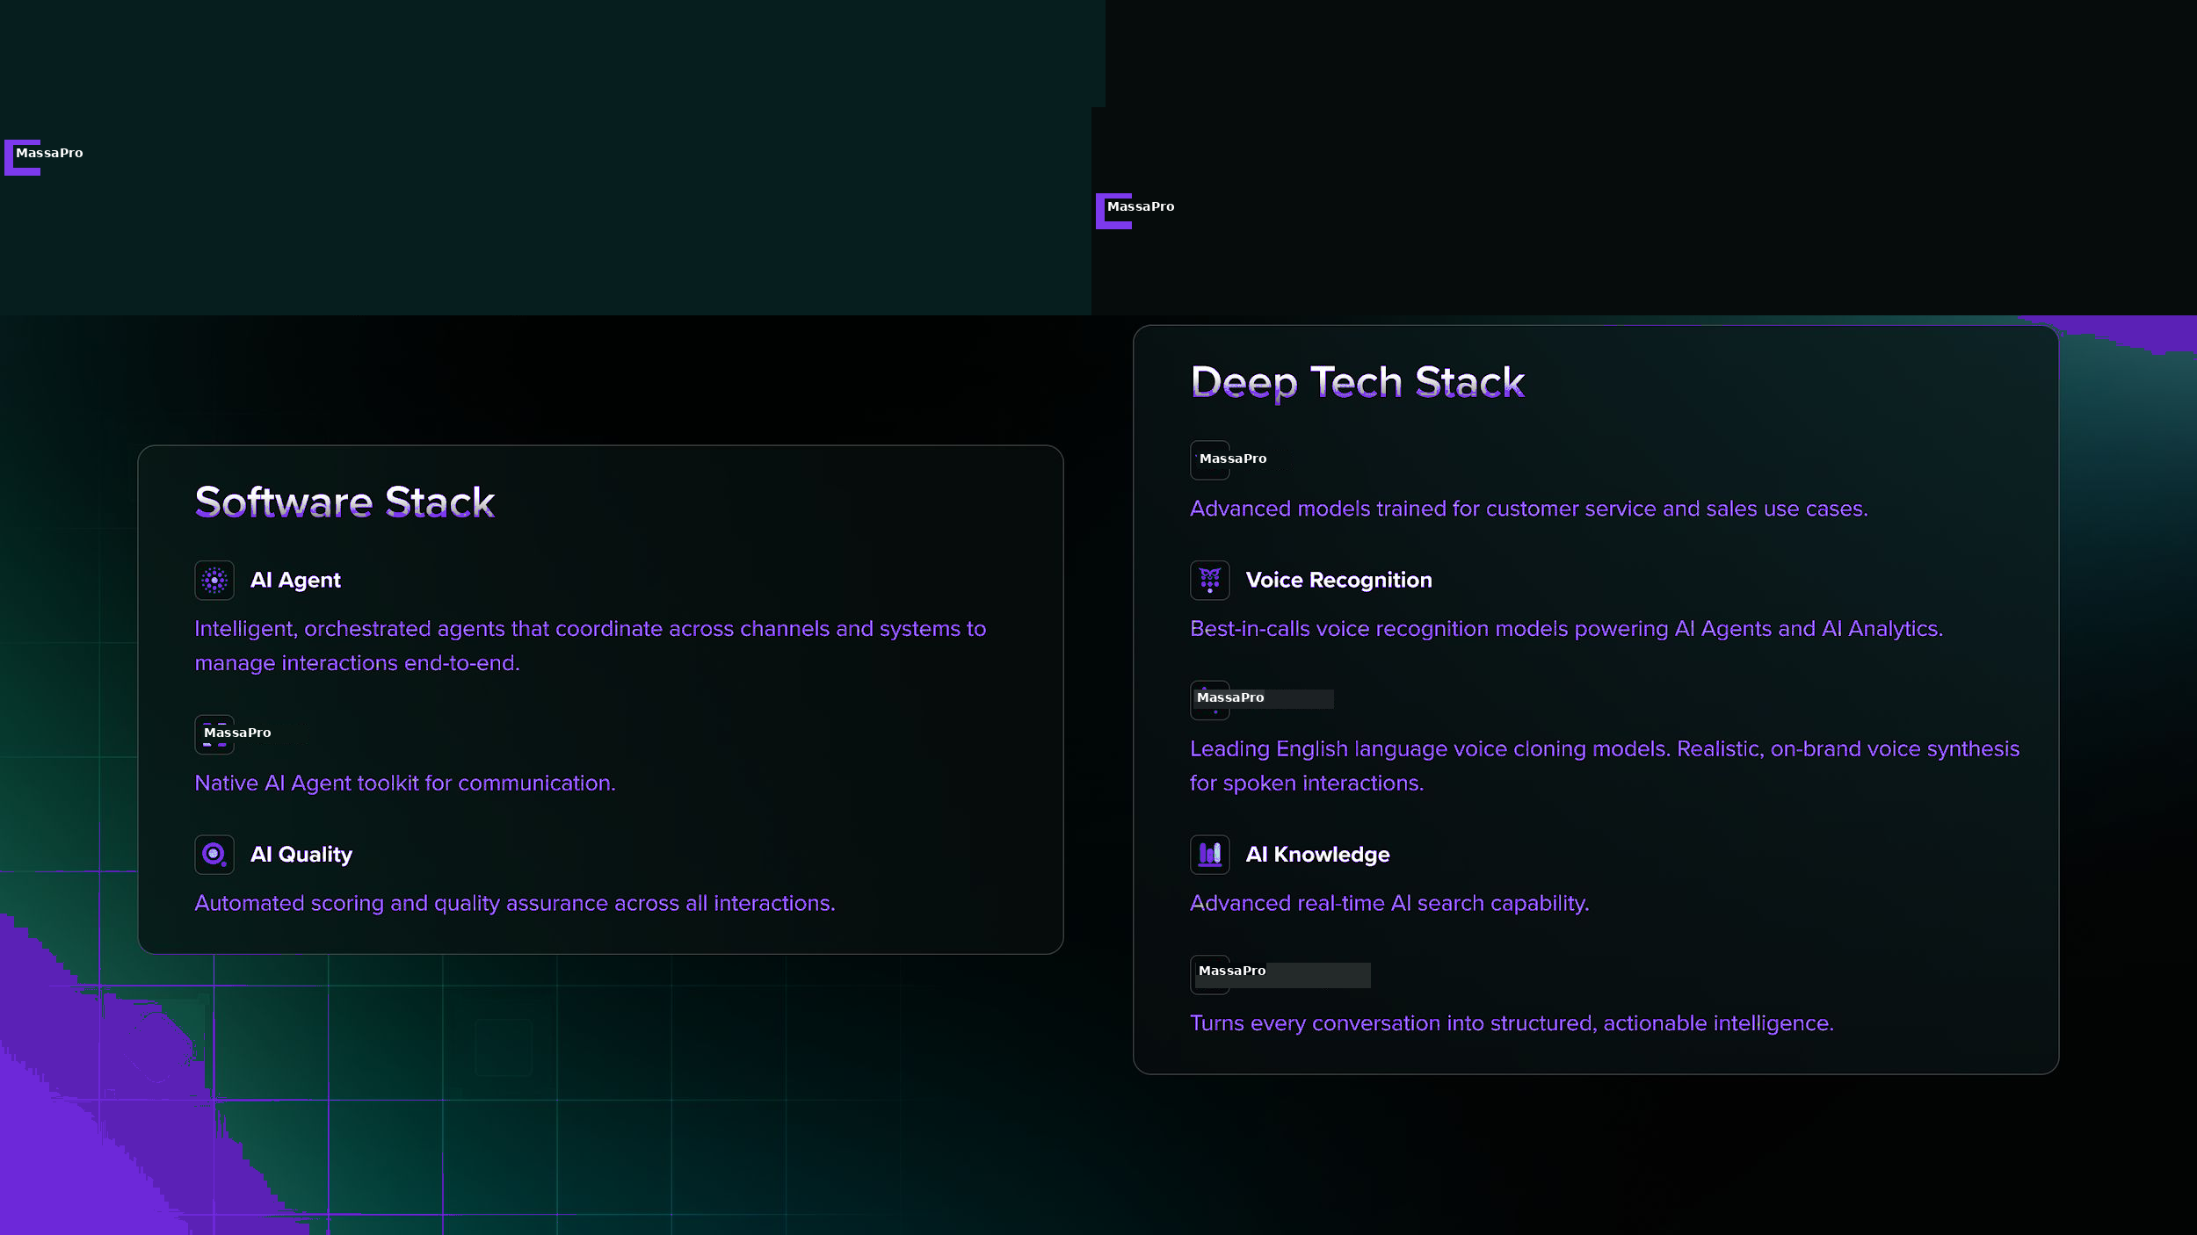
MassaPro
M

Slide 5
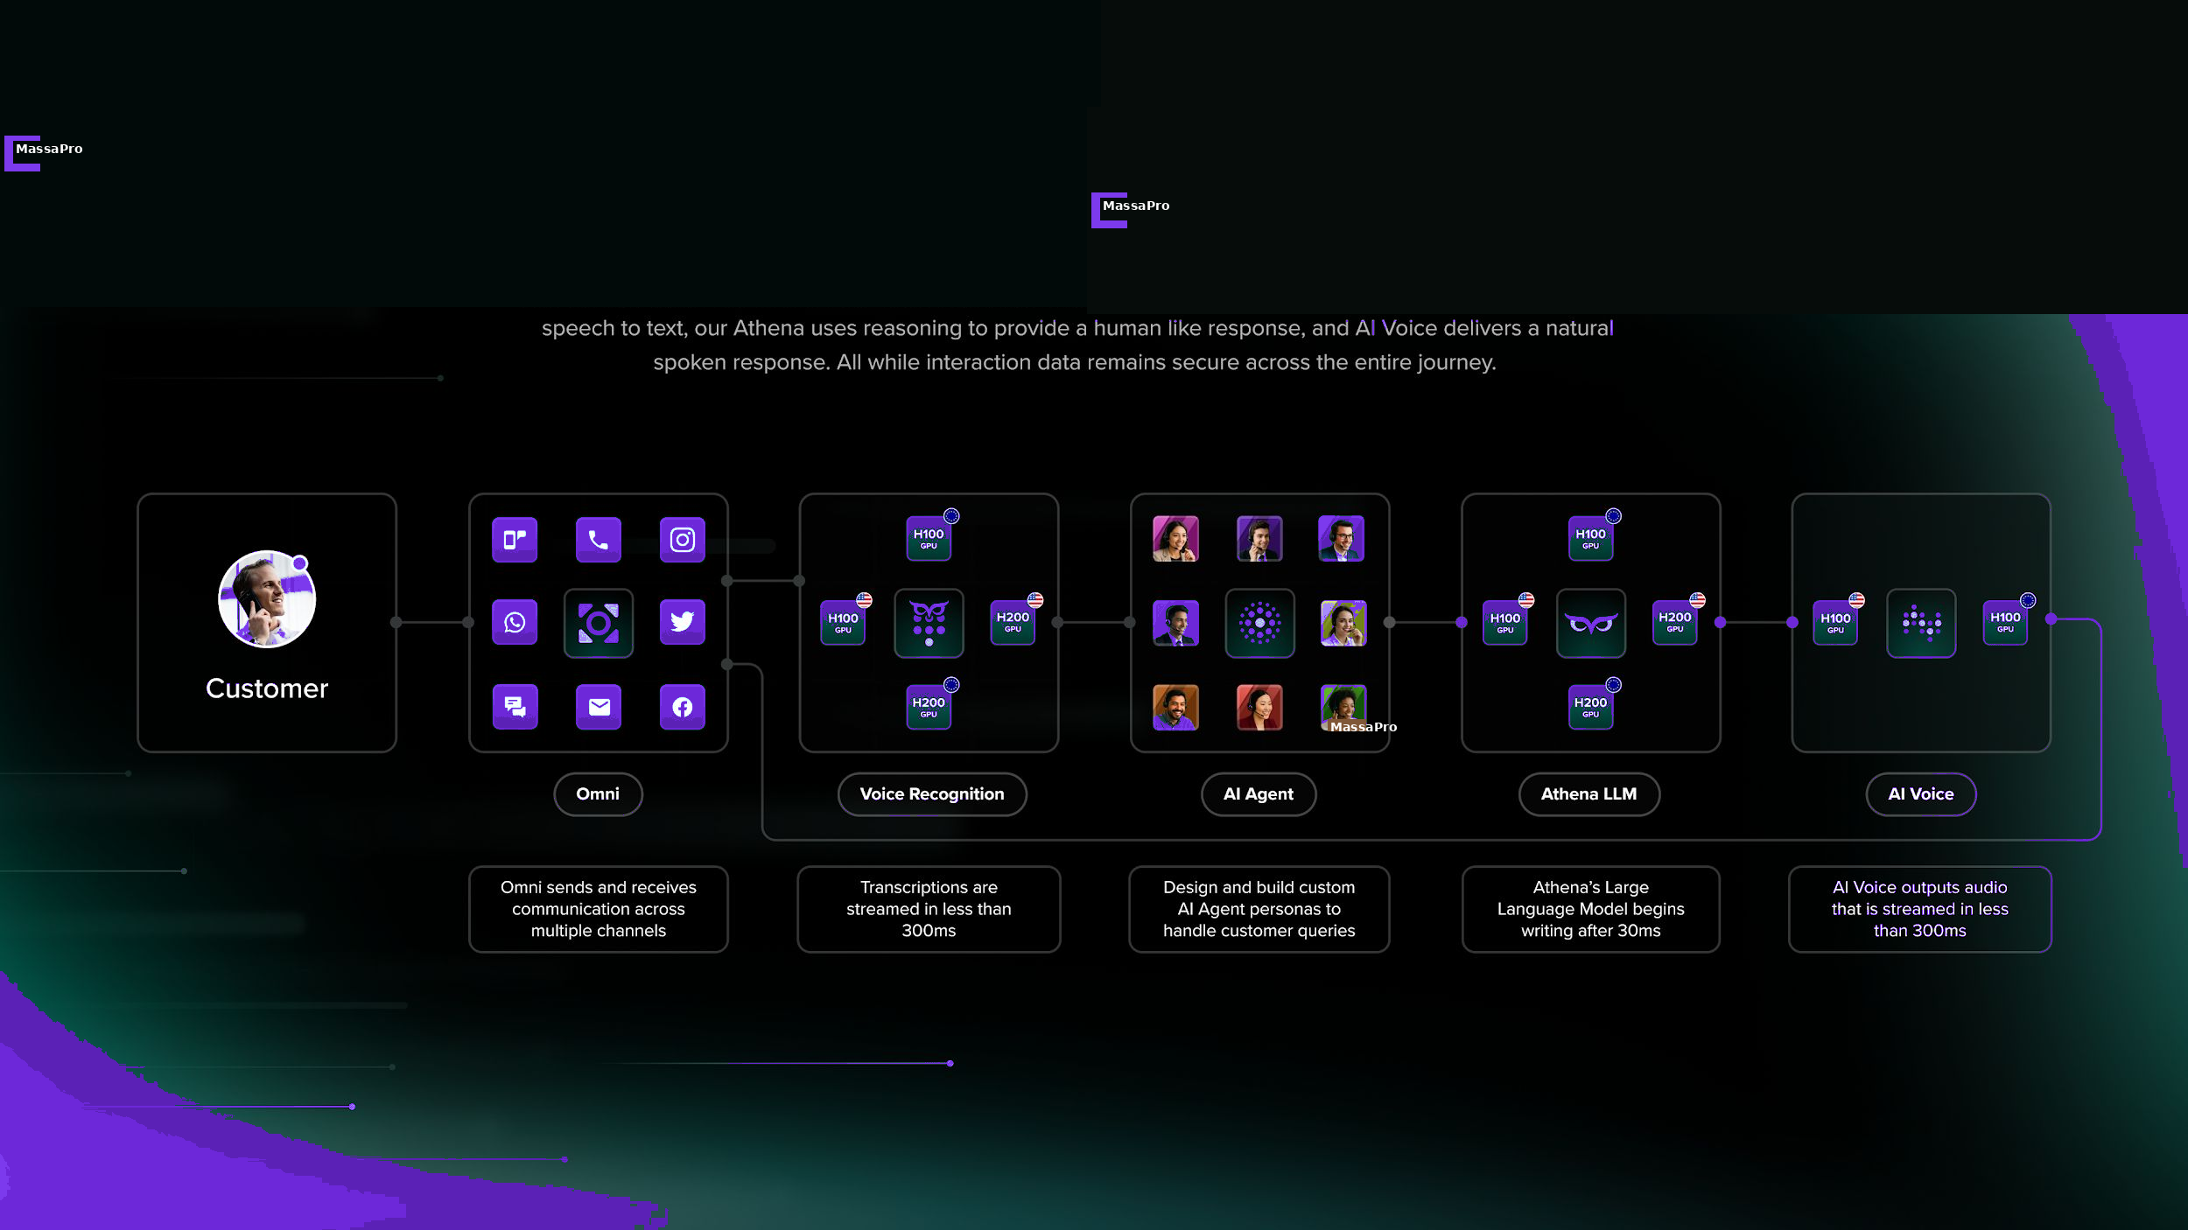
MassaPro
M

Slide 6
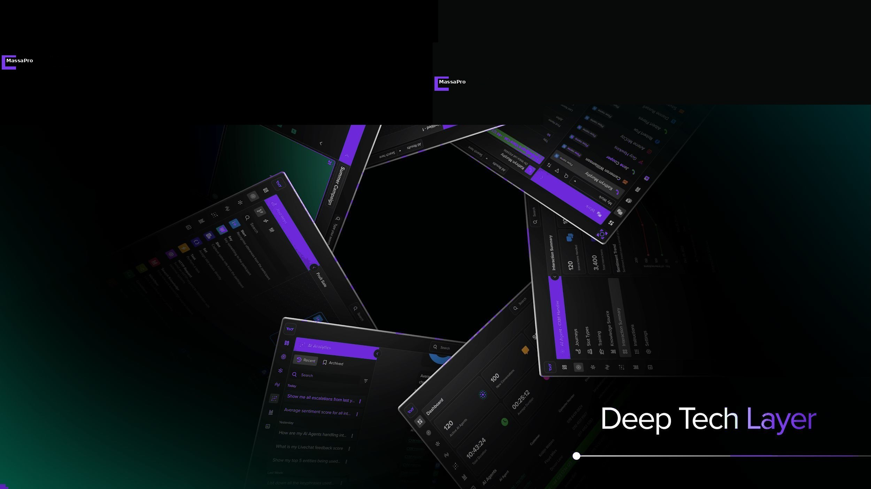
MassaPro
M

Slide 7
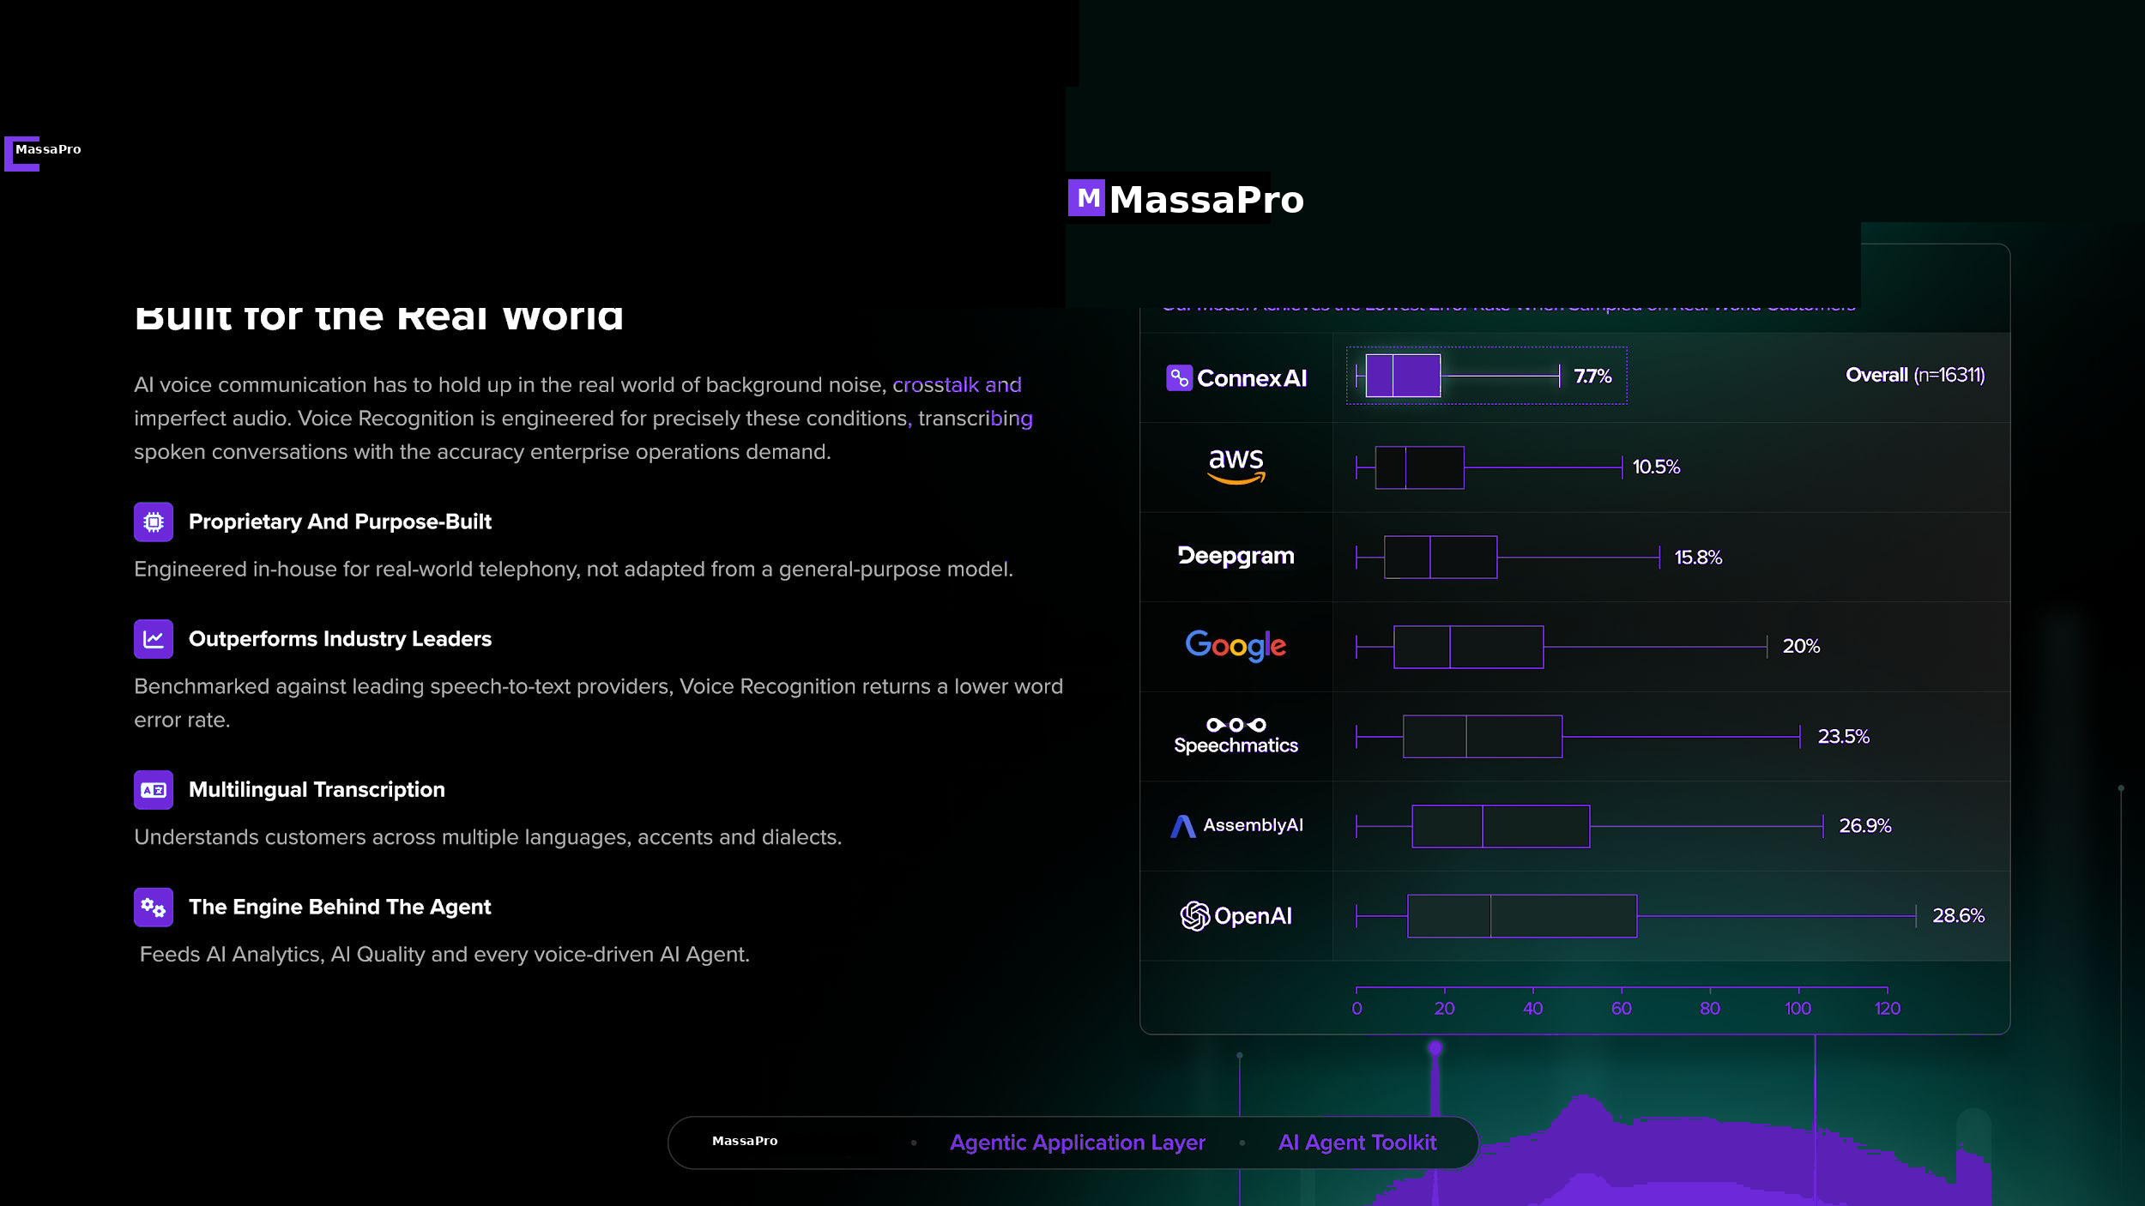
MassaPro
M

Slide 8
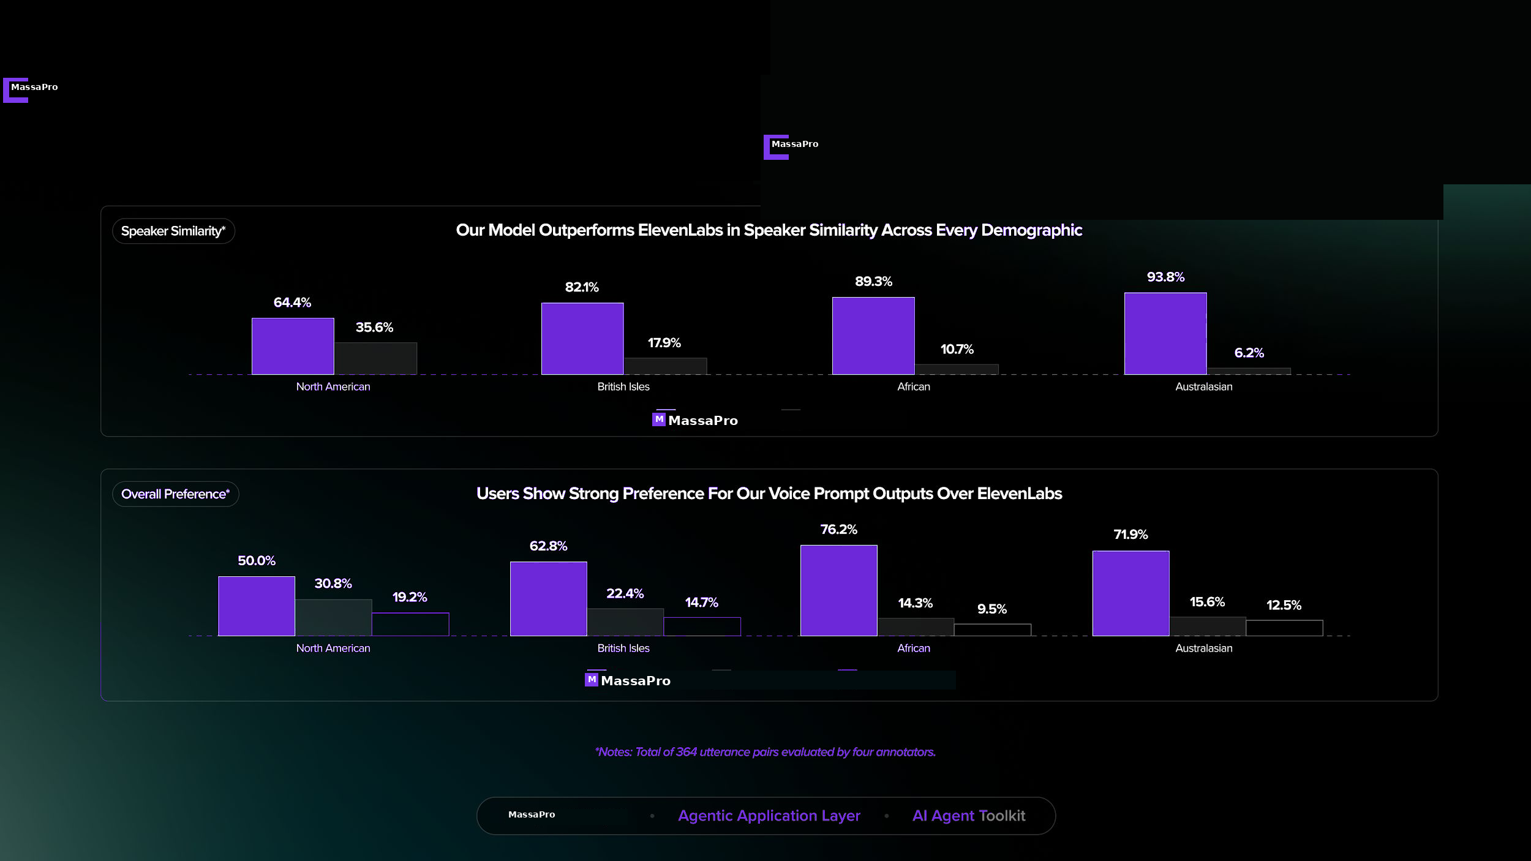
MassaPro
M

Slide 9
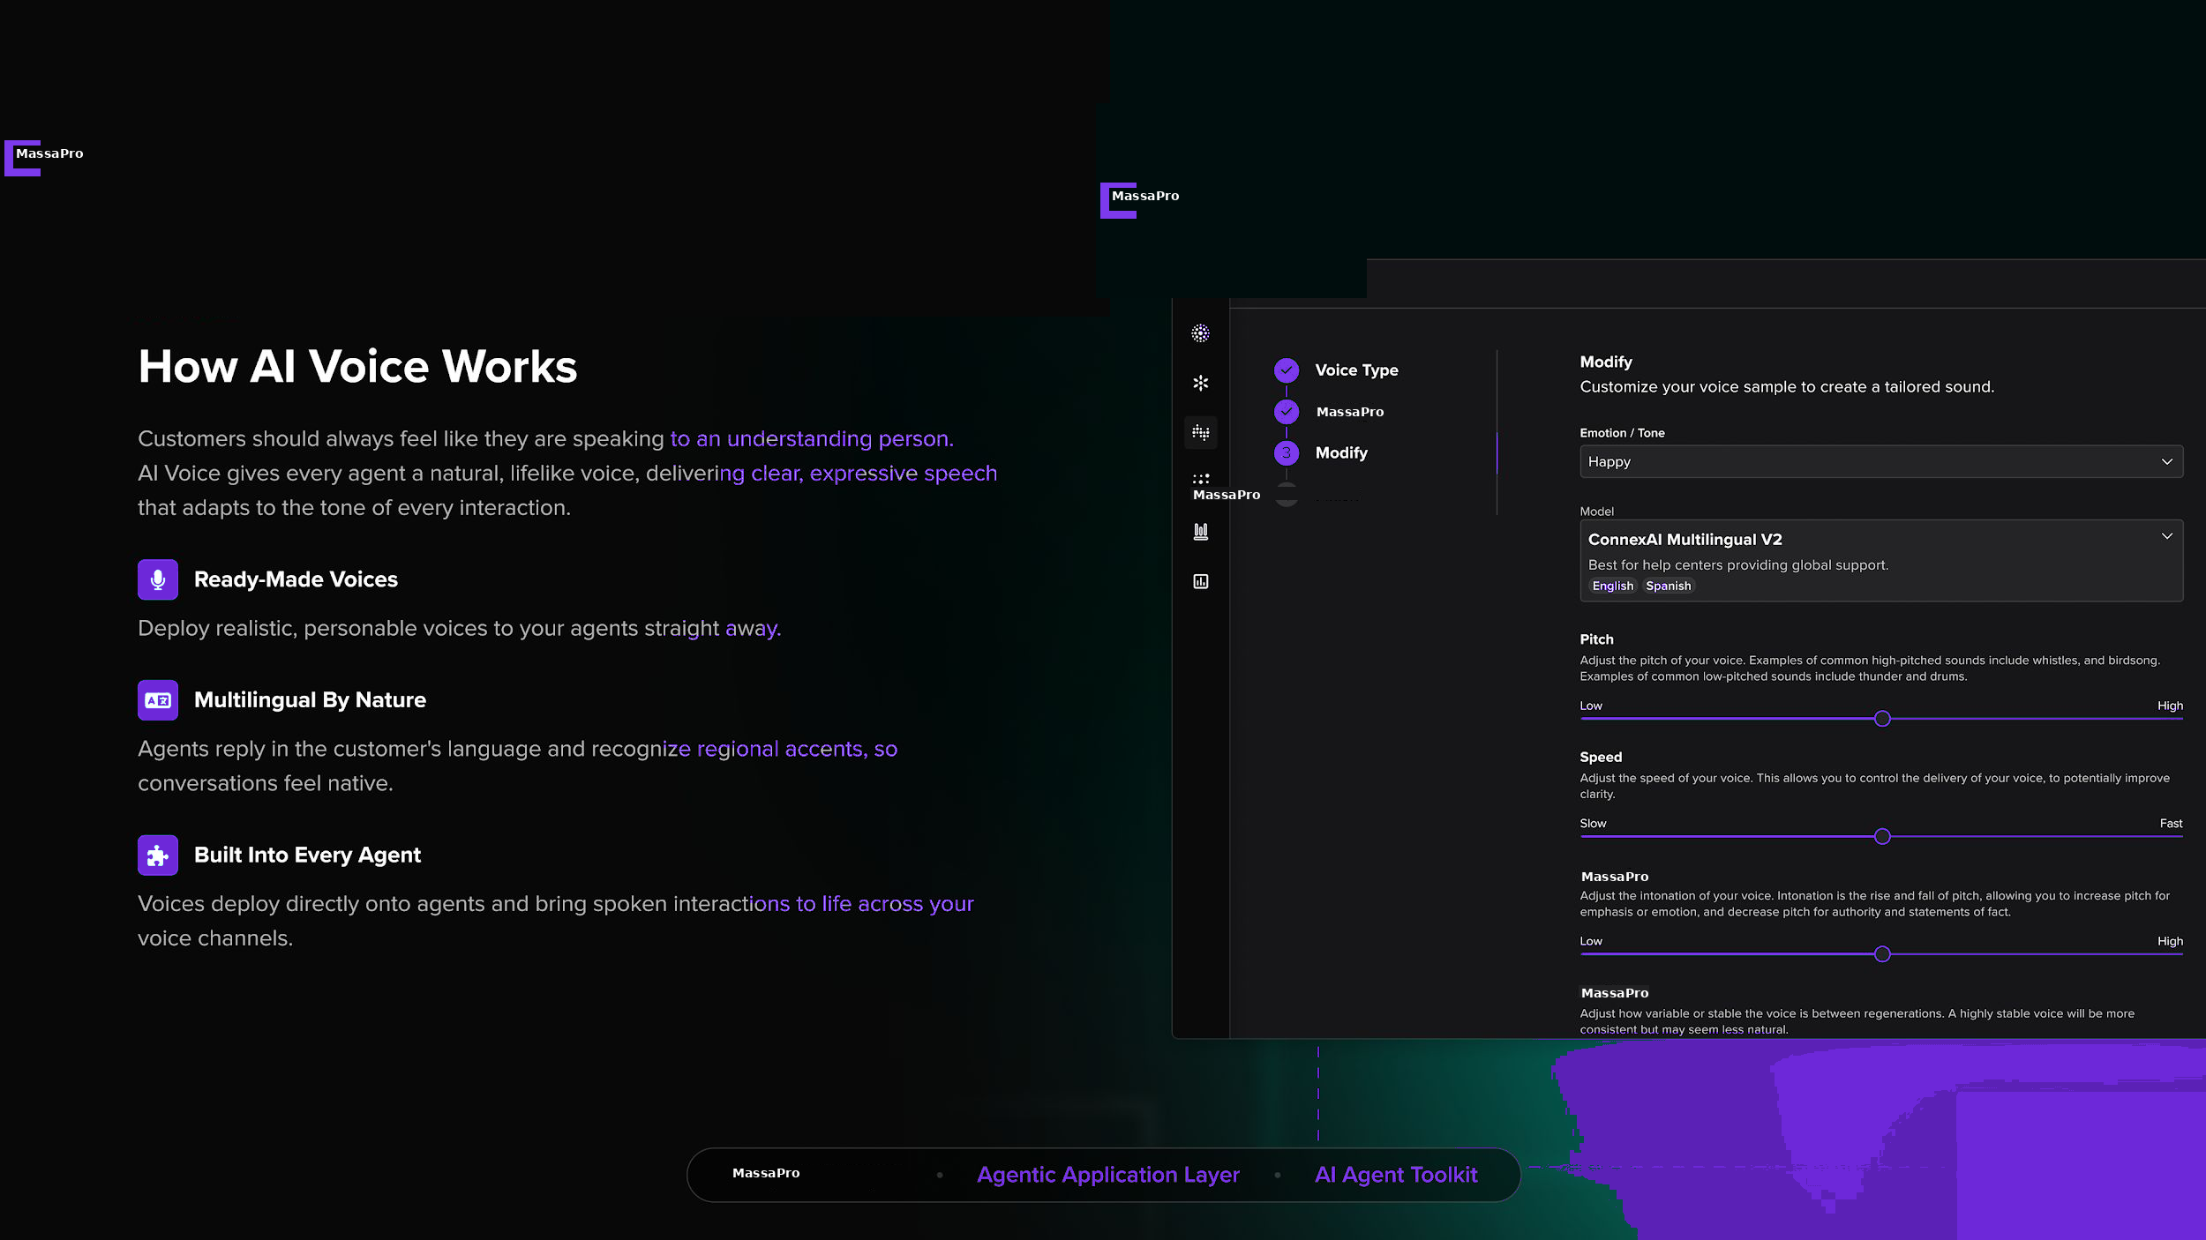
MassaPro
M

Slide 10
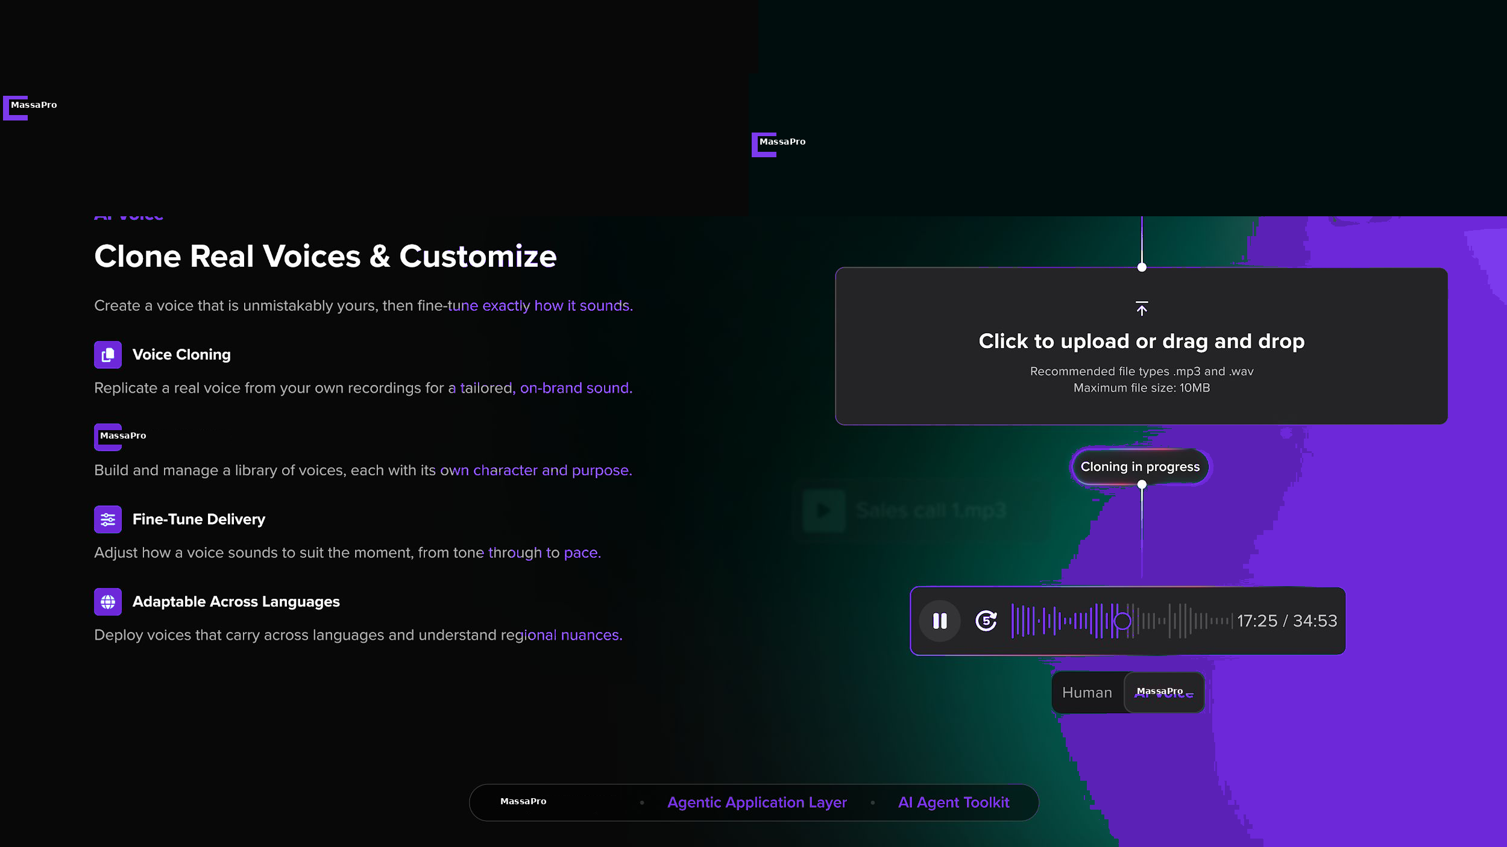
MassaPro
M

Slide 11
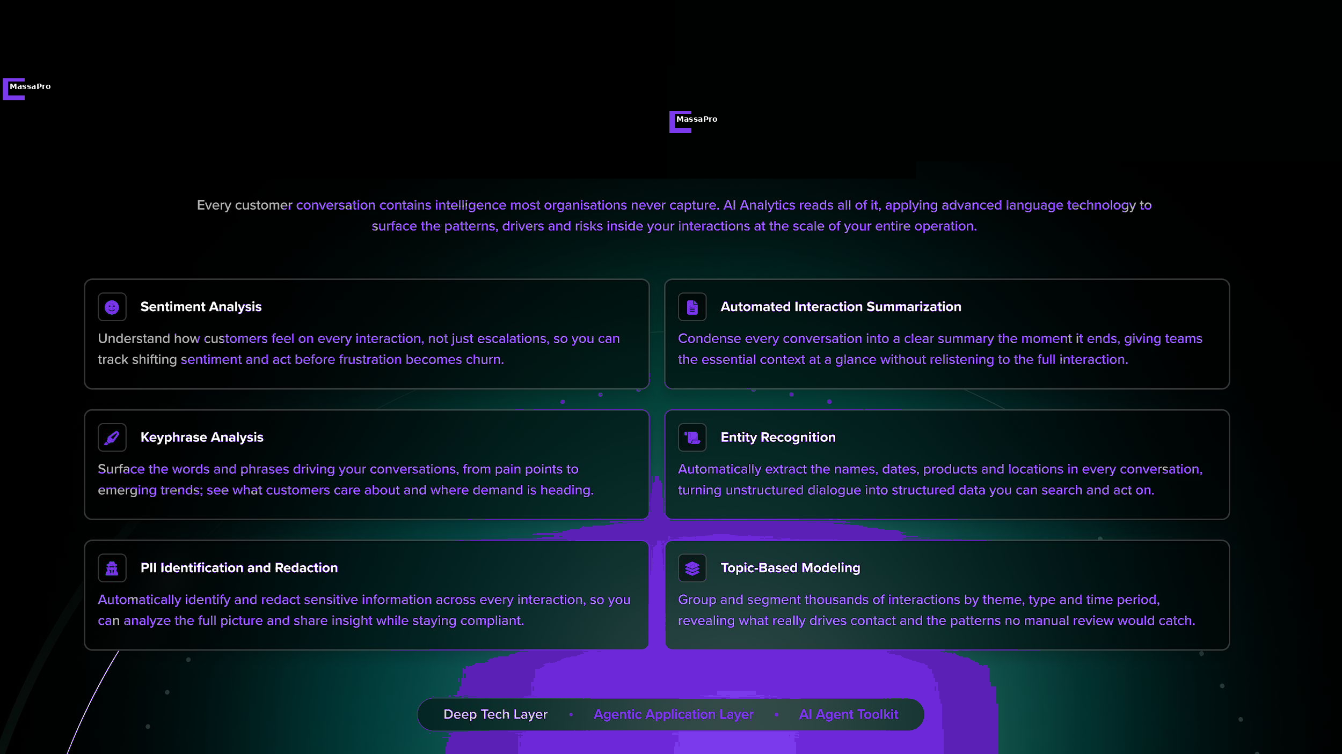
MassaPro
M

Slide 12
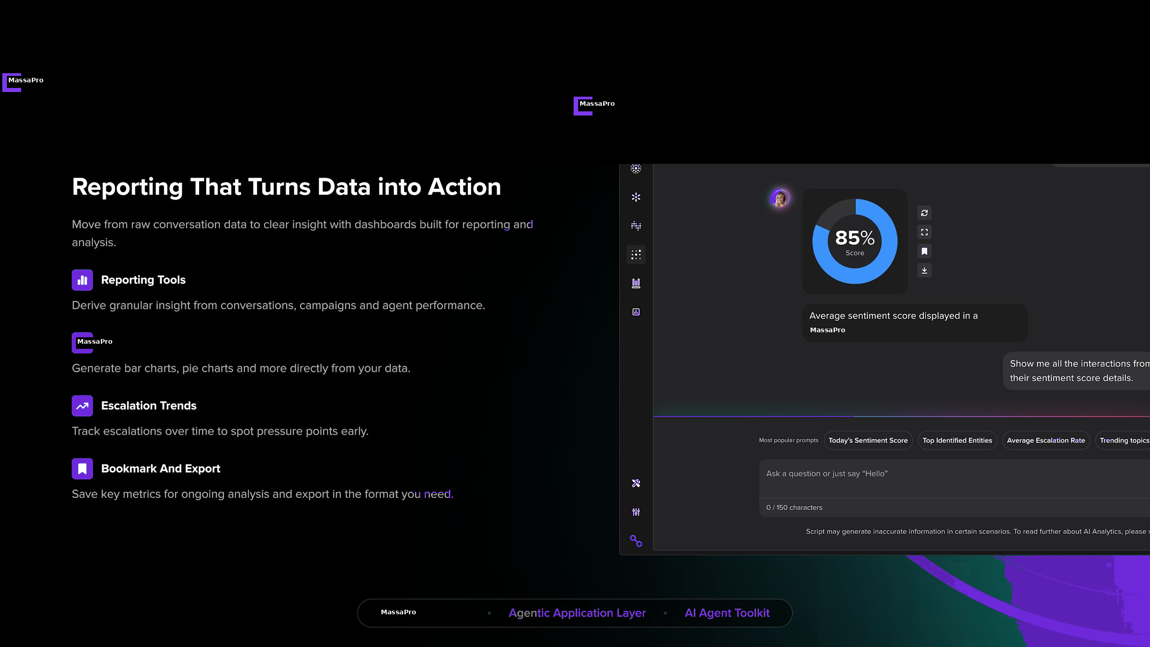
MassaPro
M

Slide 13
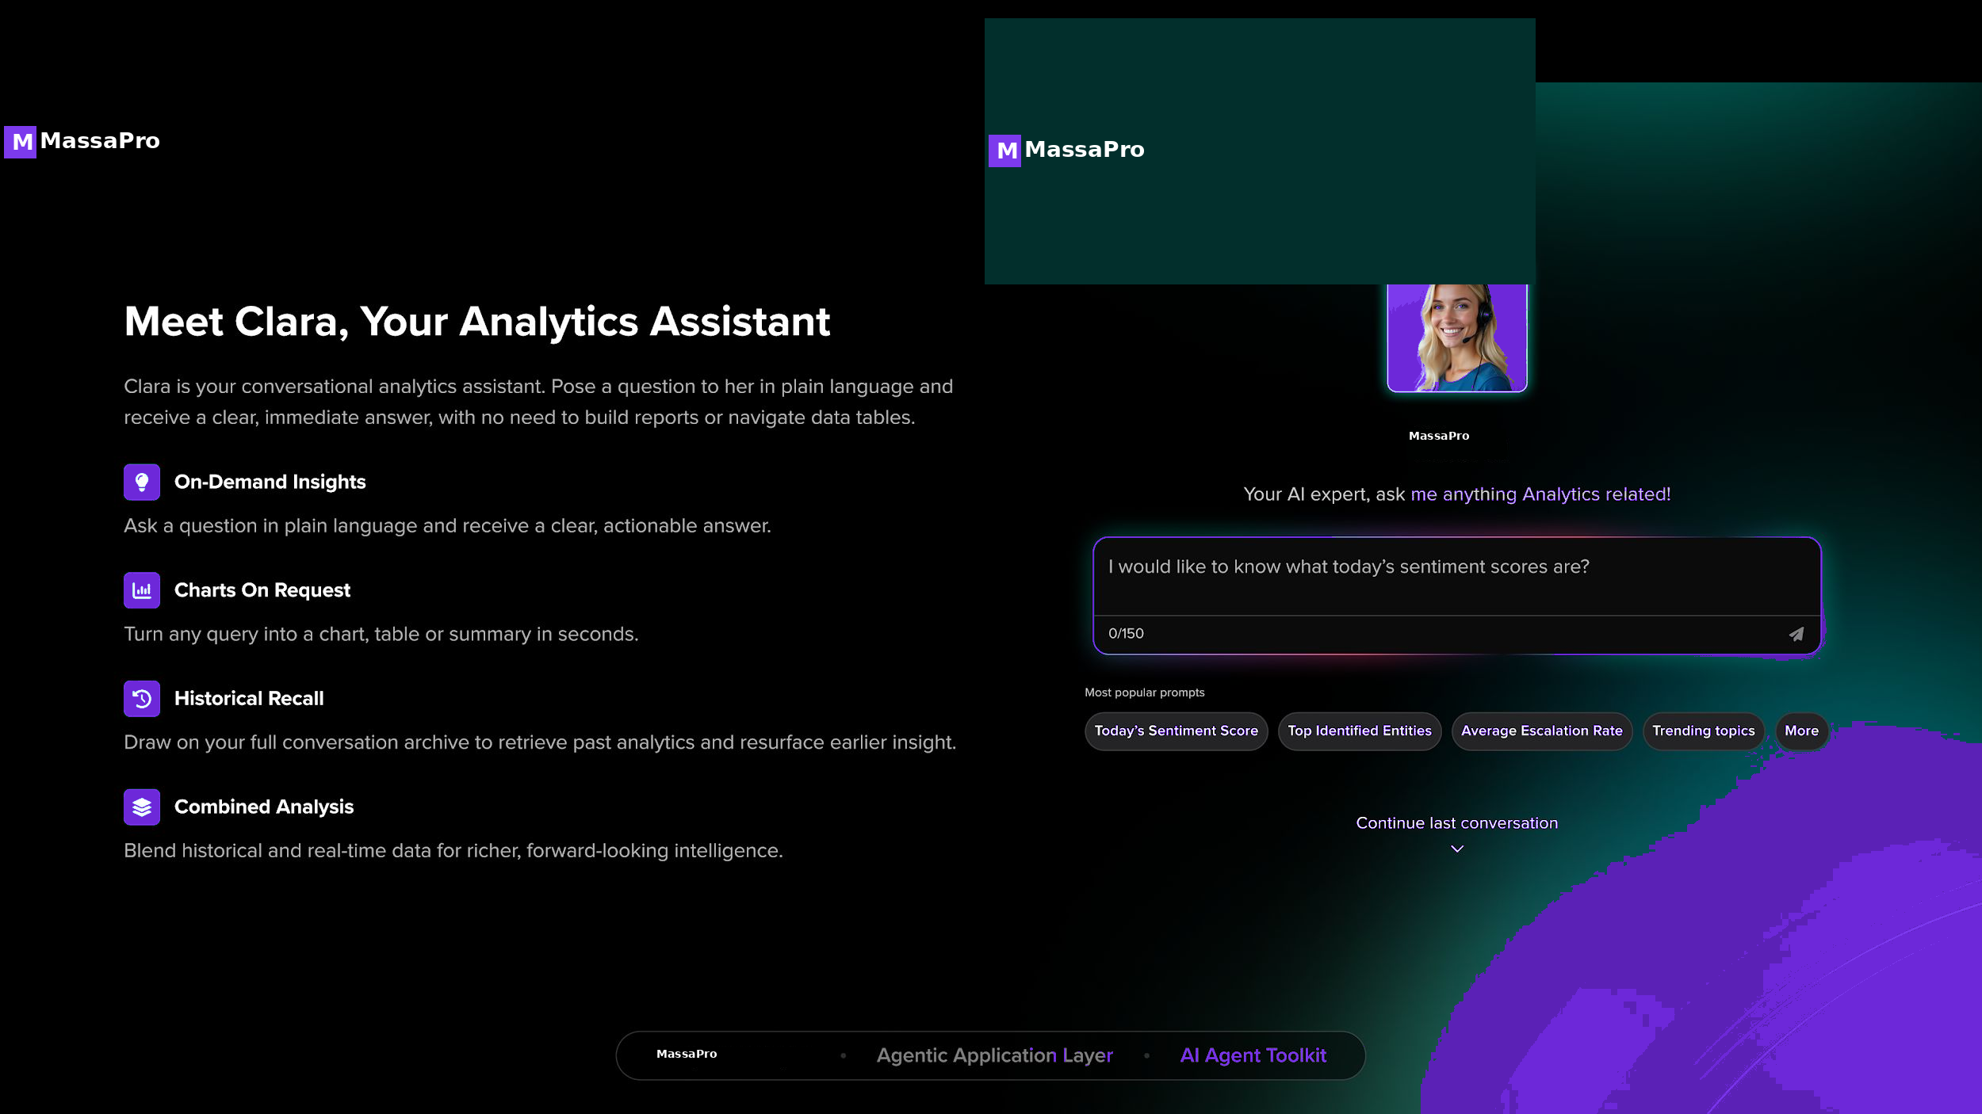
MassaPro
M

Slide 14
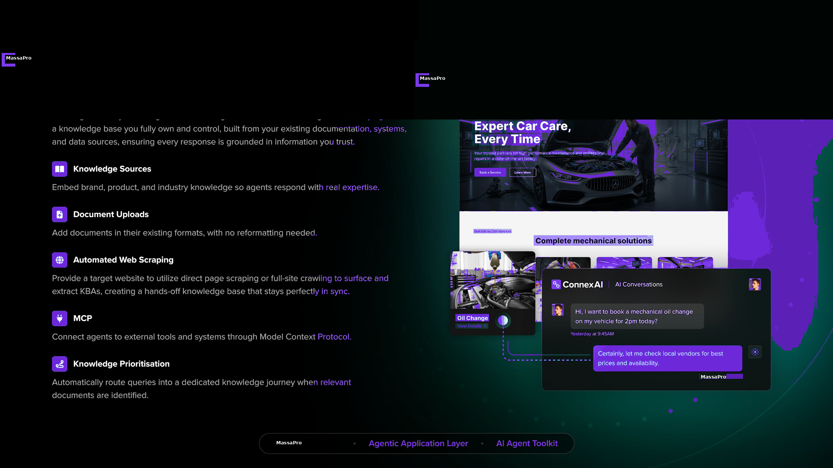
MassaPro
M

Slide 15
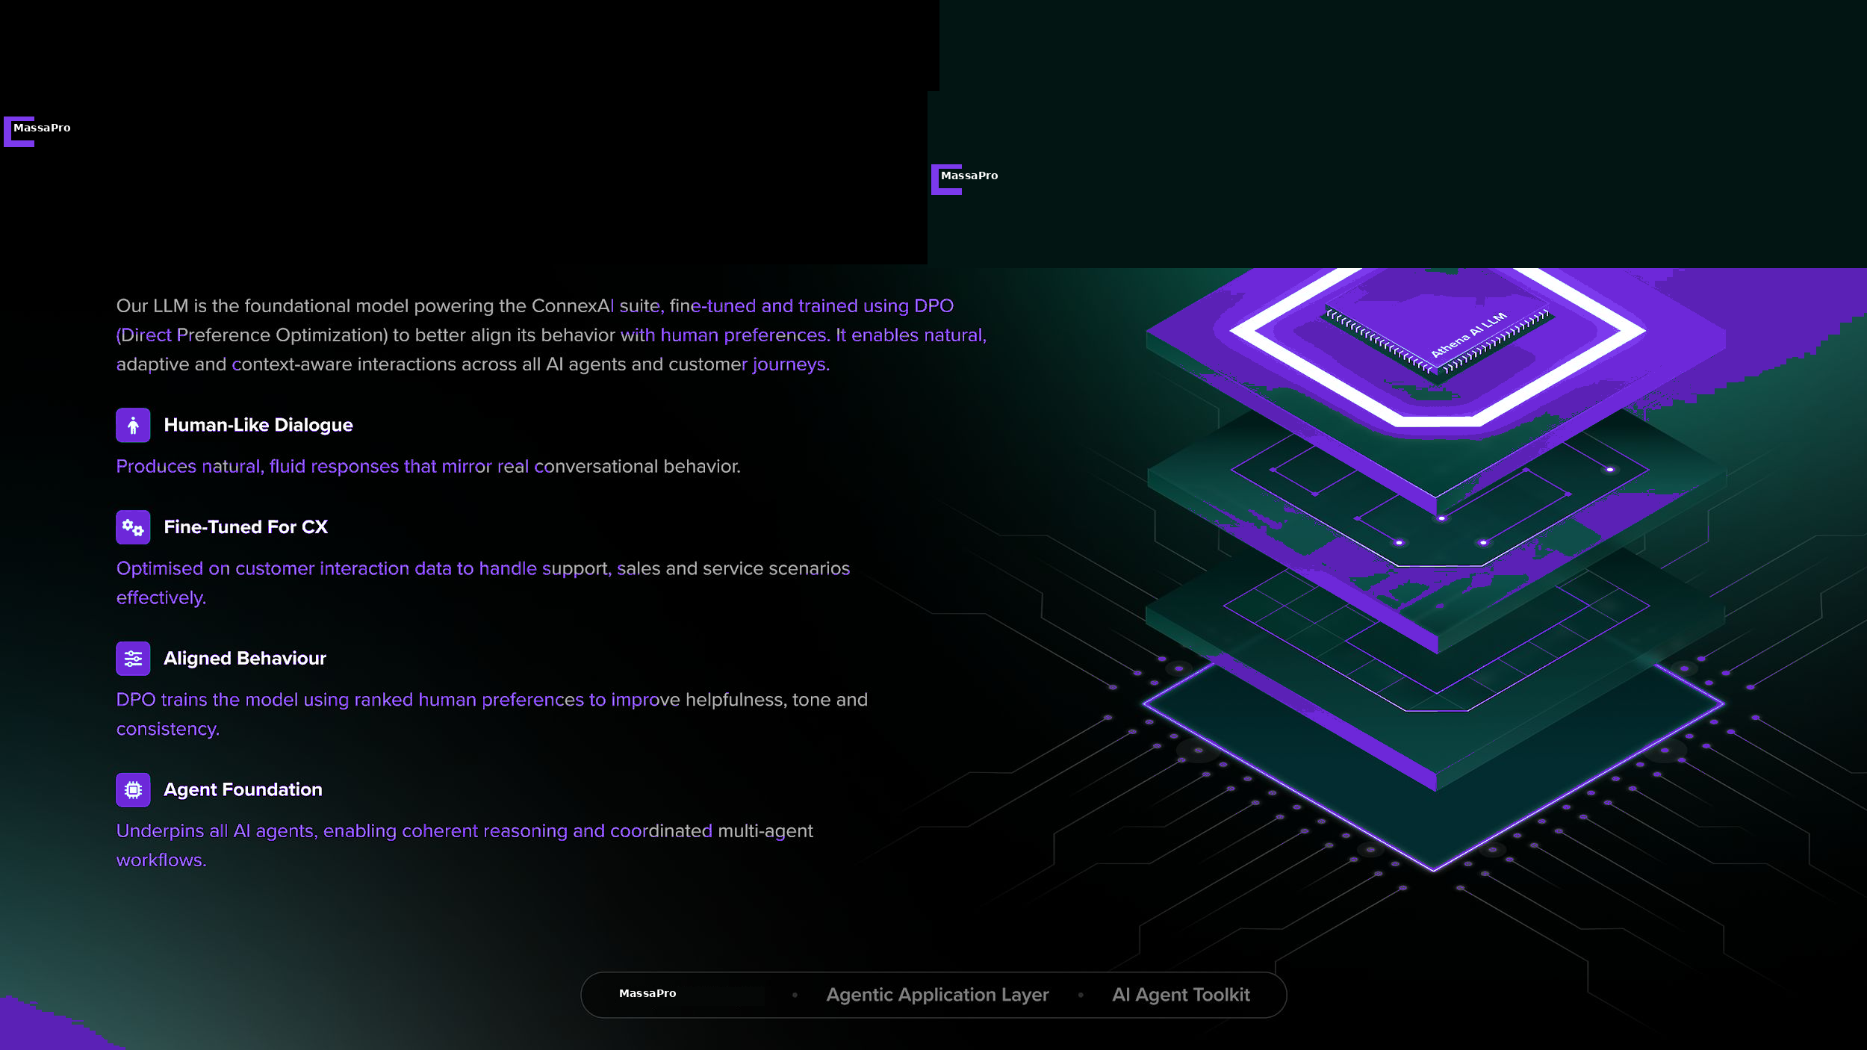
MassaPro
M

Slide 16
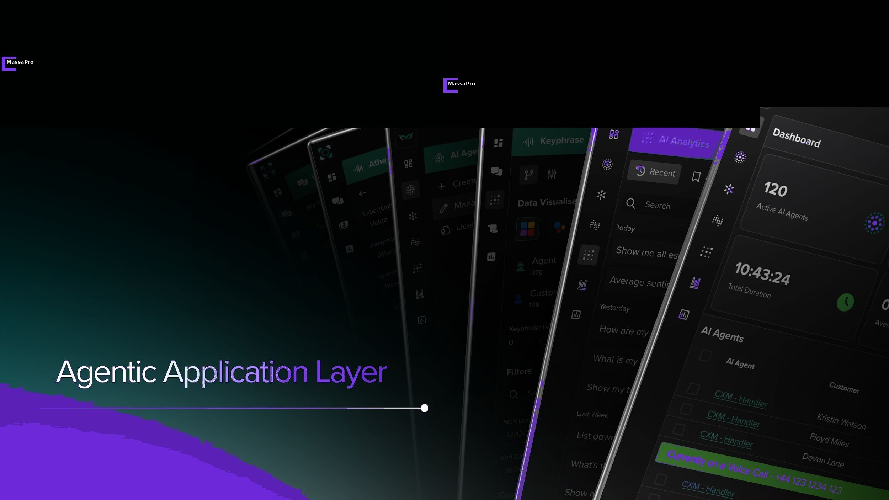
MassaPro
M

Slide 17
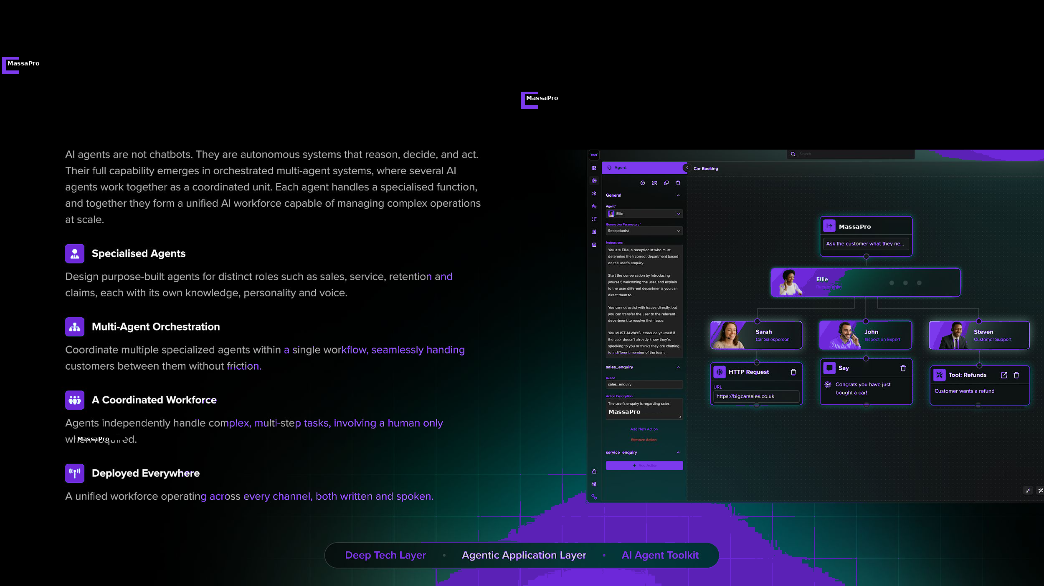
MassaPro
M

Slide 18
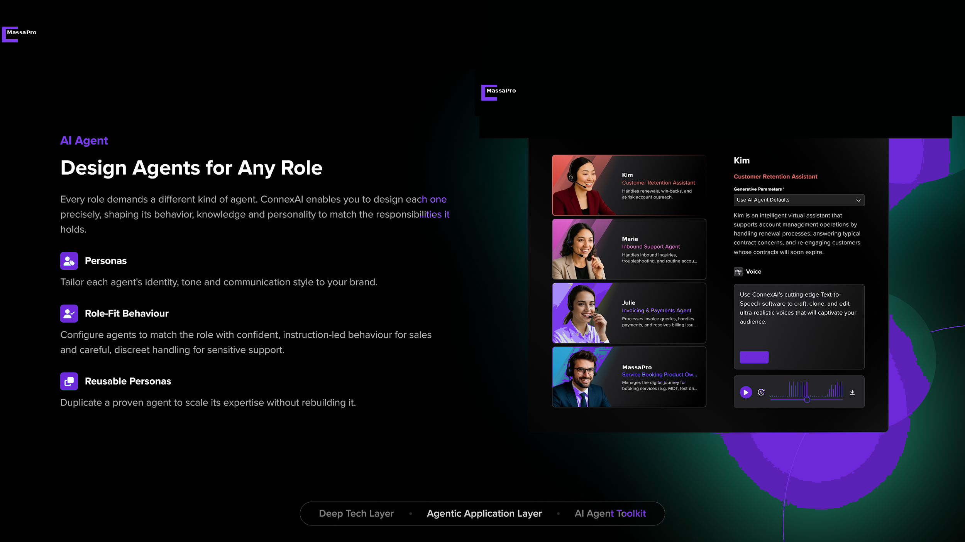
MassaPro
M

Slide 19
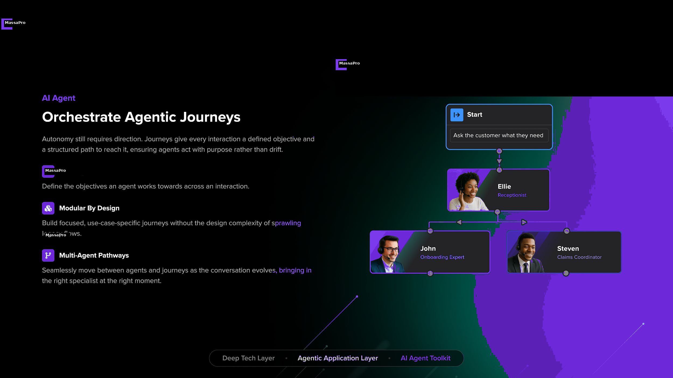
MassaPro
M

Slide 20
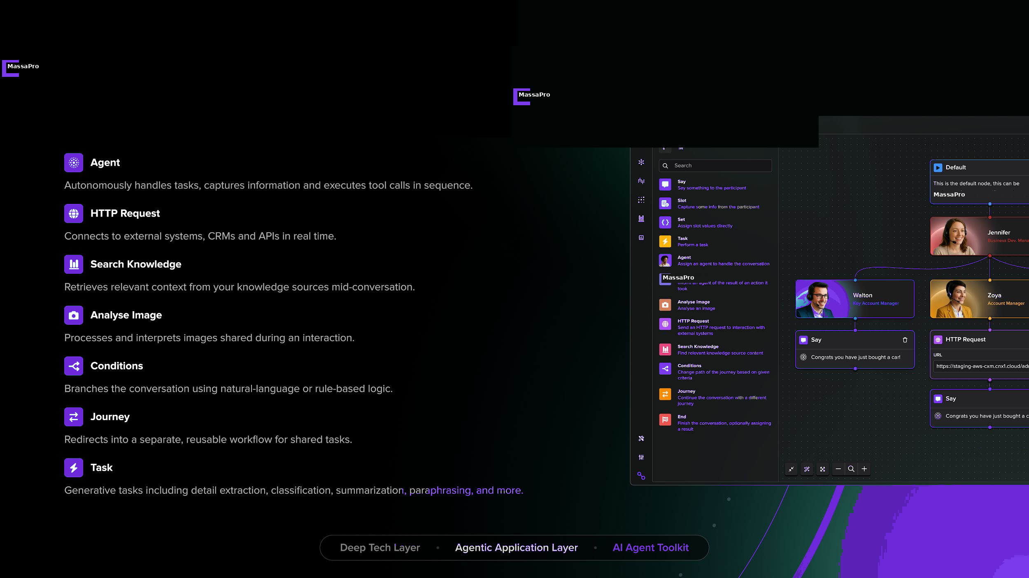
MassaPro
M

Slide 21
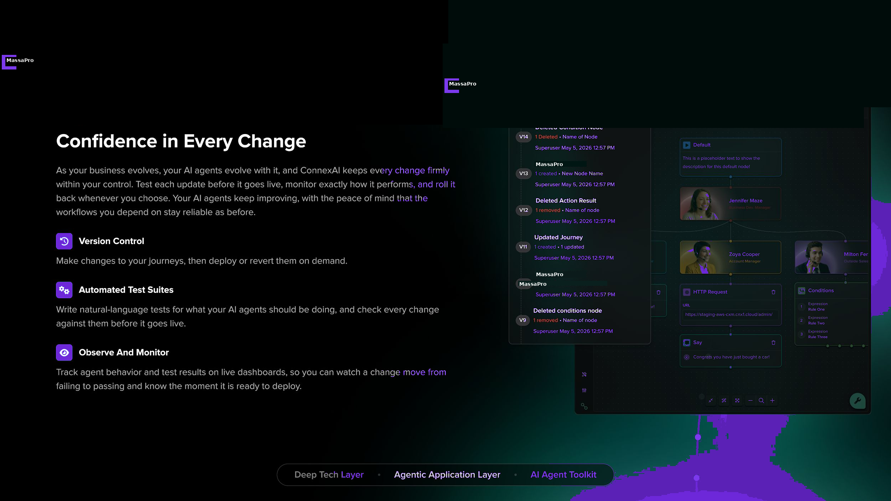
MassaPro
M

Slide 22
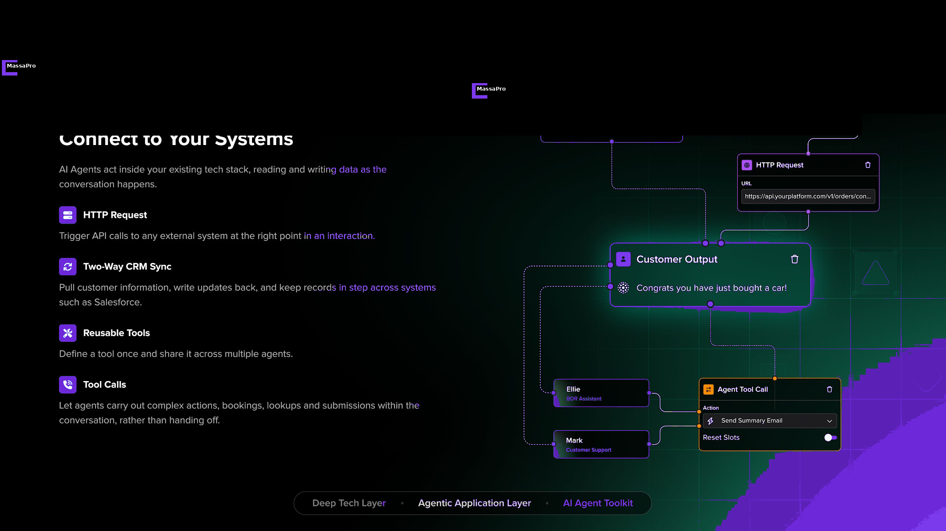
MassaPro
M

Slide 23
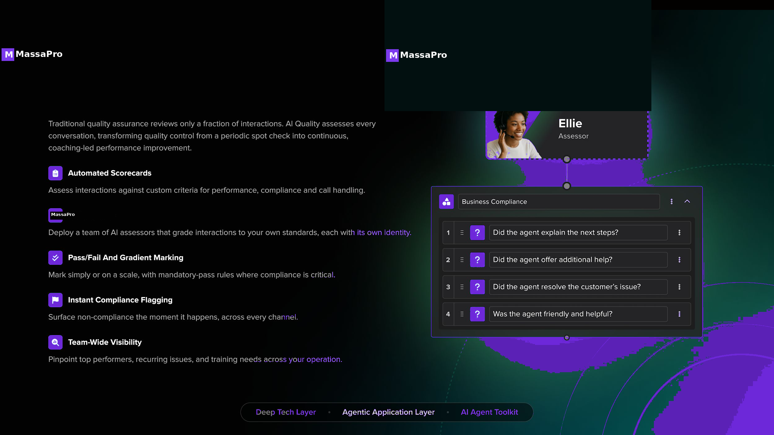
MassaPro
M

Slide 24
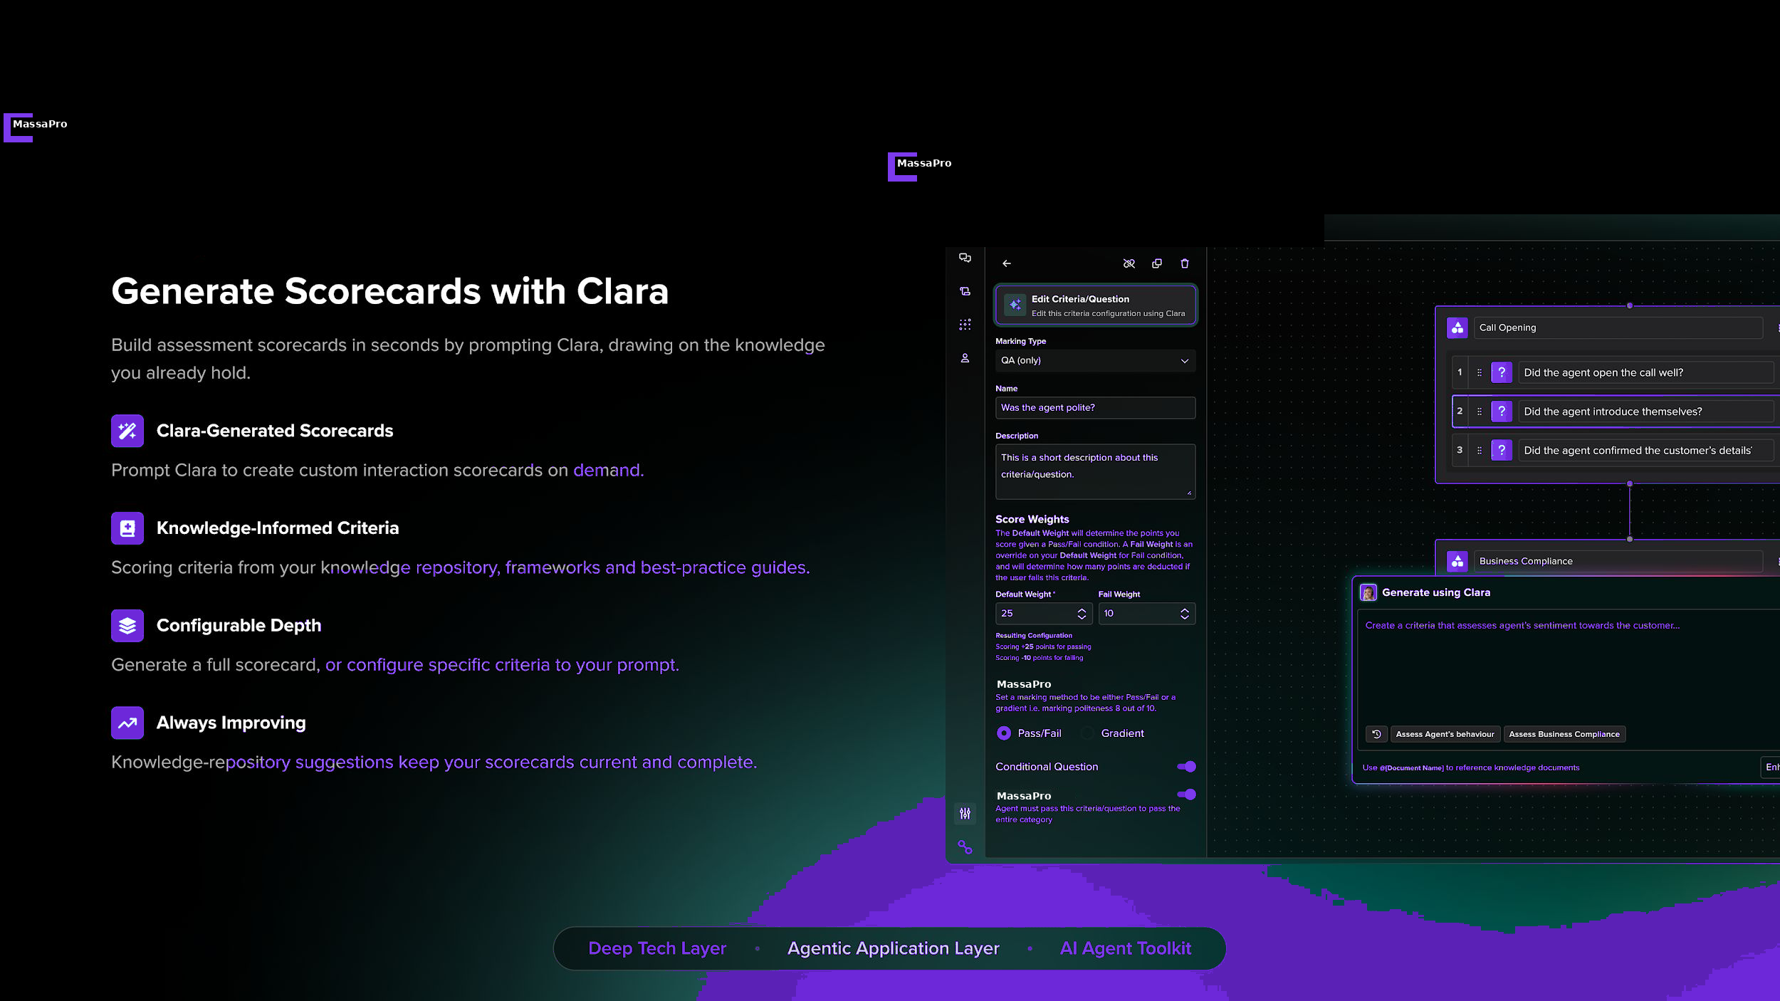
MassaPro
M

Slide 25
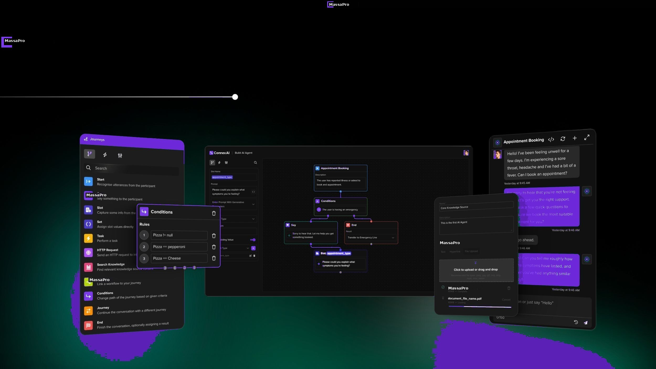
MassaPro
M

Slide 26
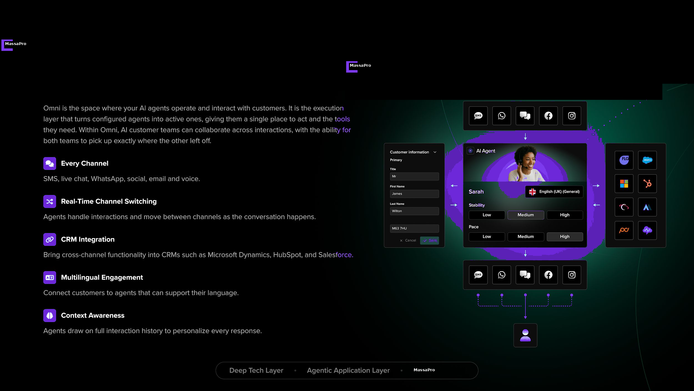
MassaPro
M

Slide 27
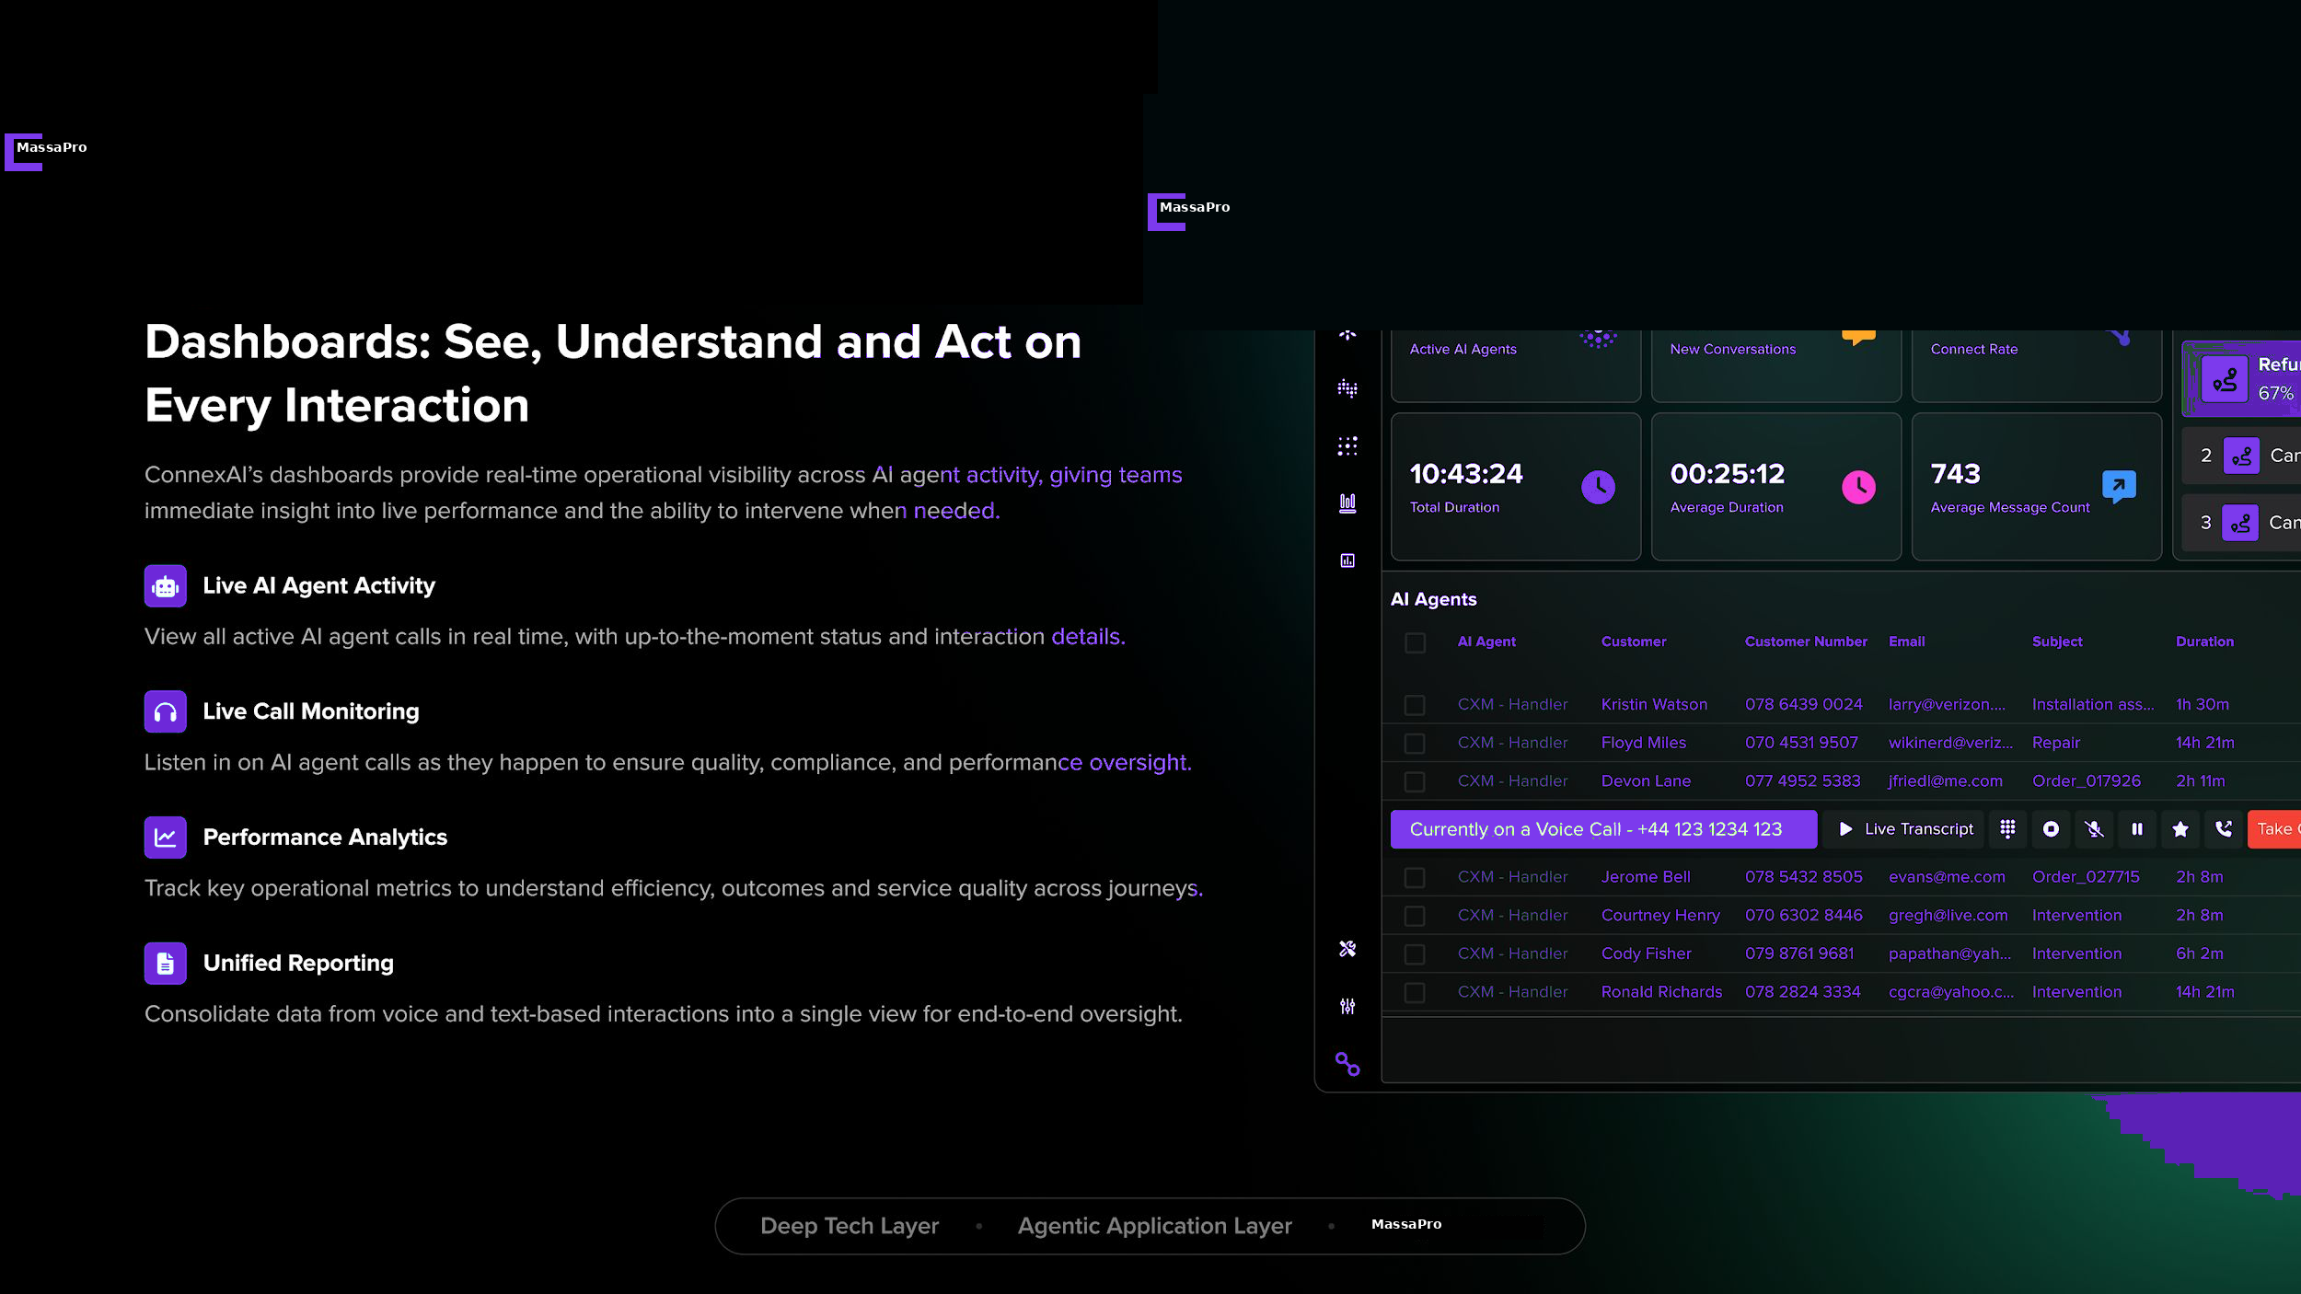
MassaPro
M

Slide 28
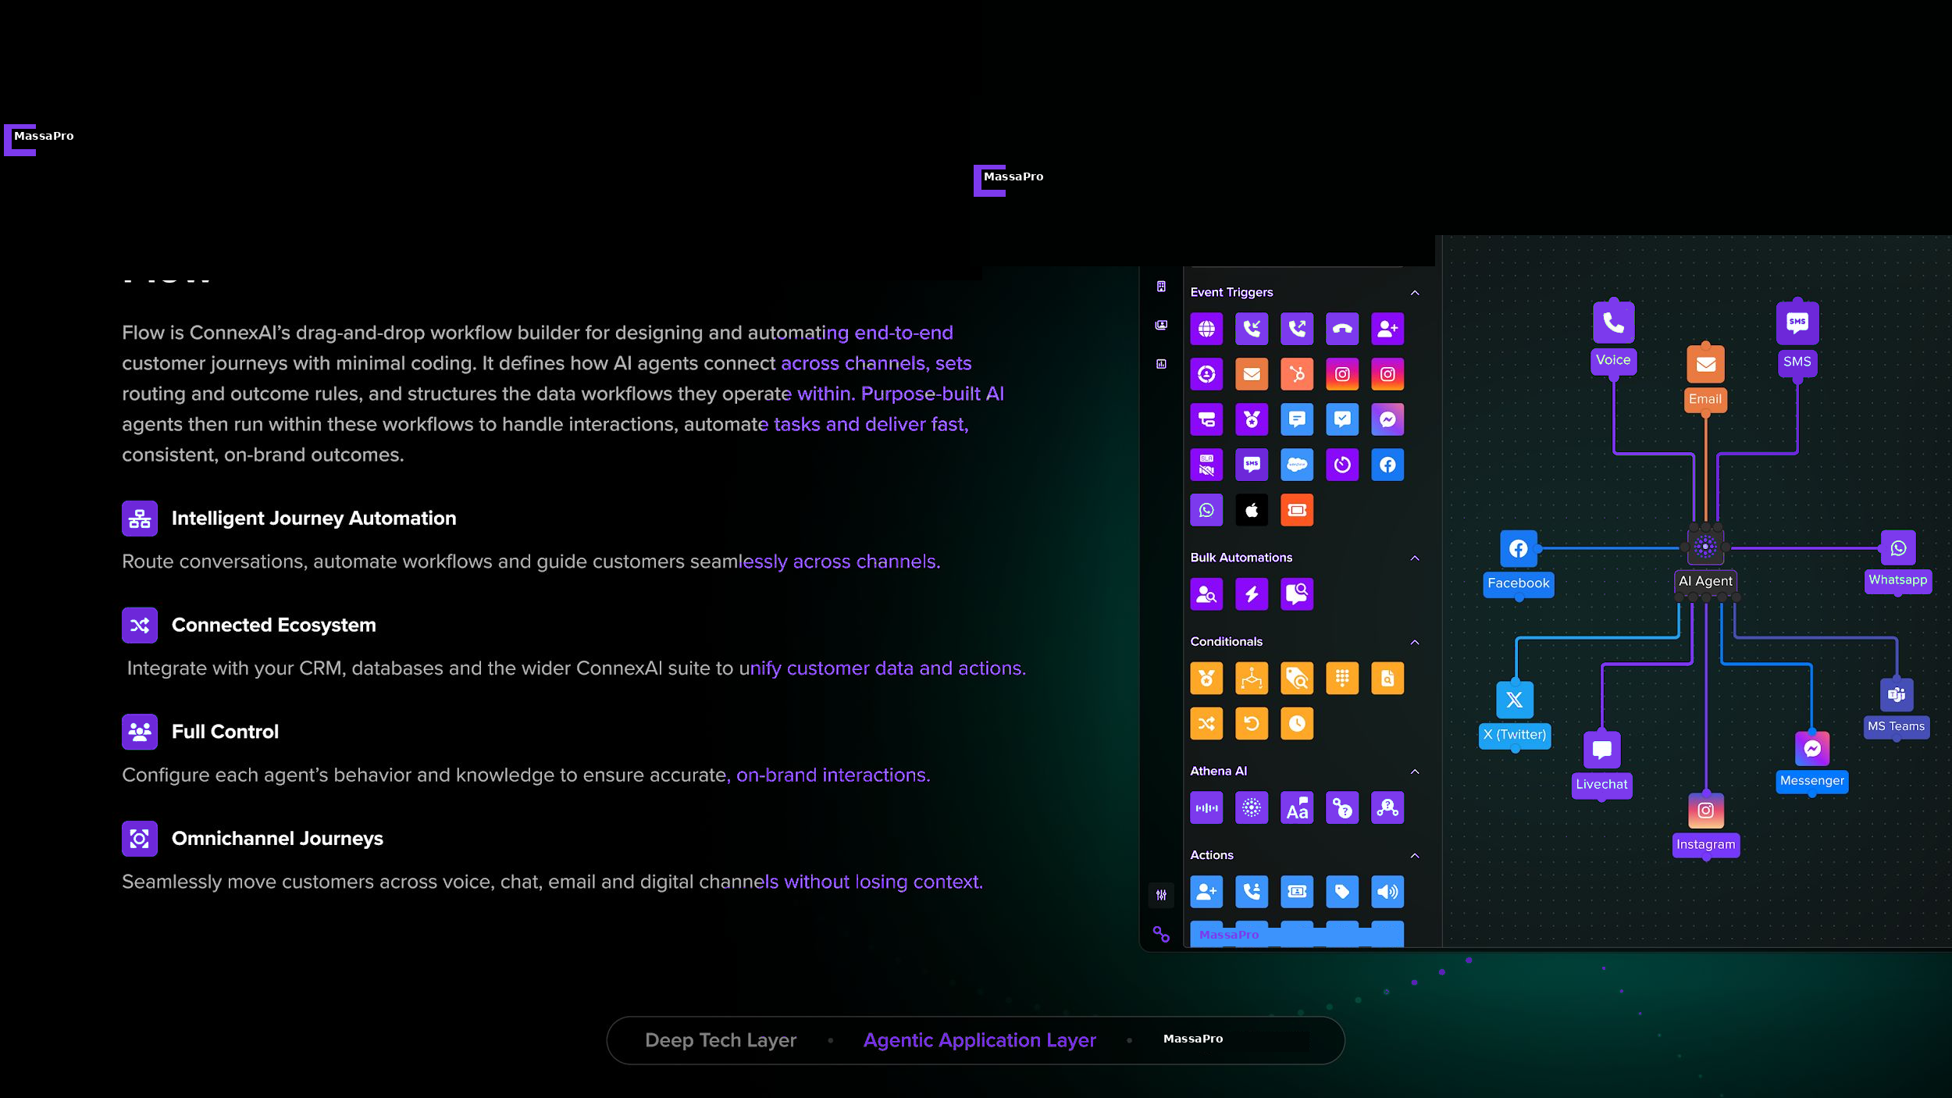
MassaPro
M

Slide 29
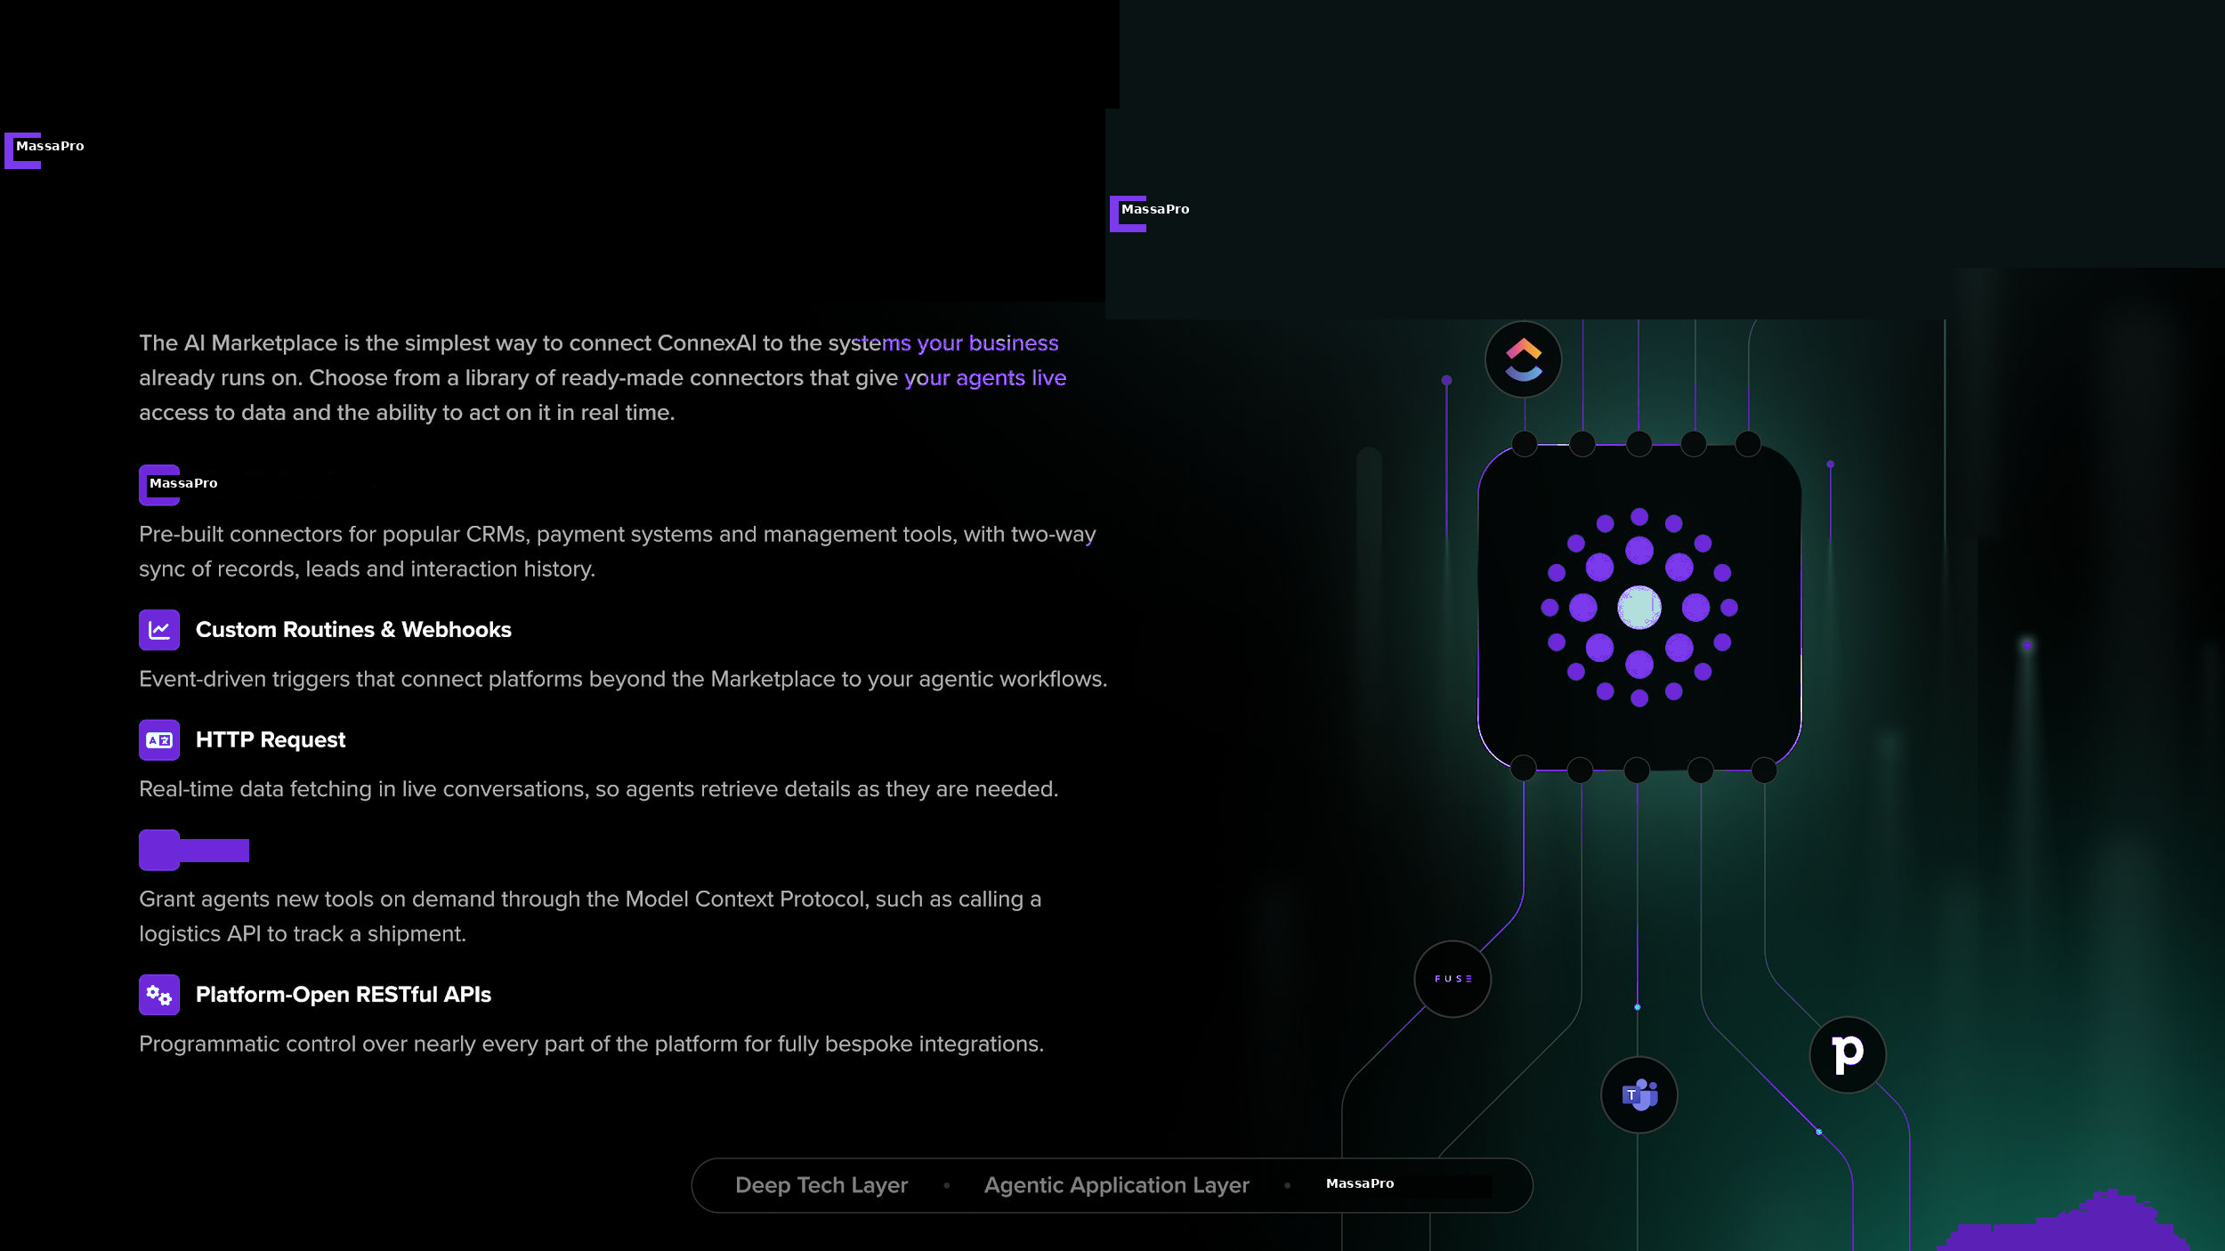
MassaPro
M

Slide 30
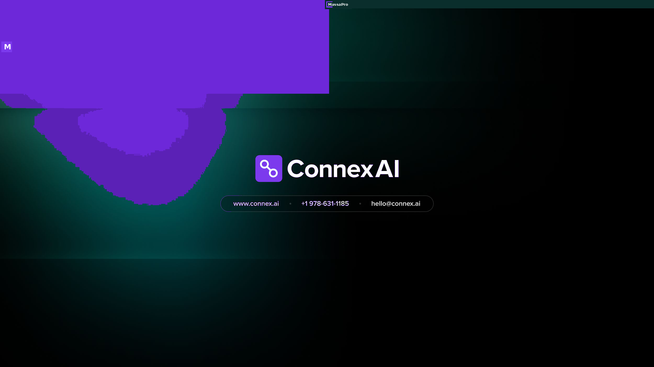
MassaPro
M

