Slide 1
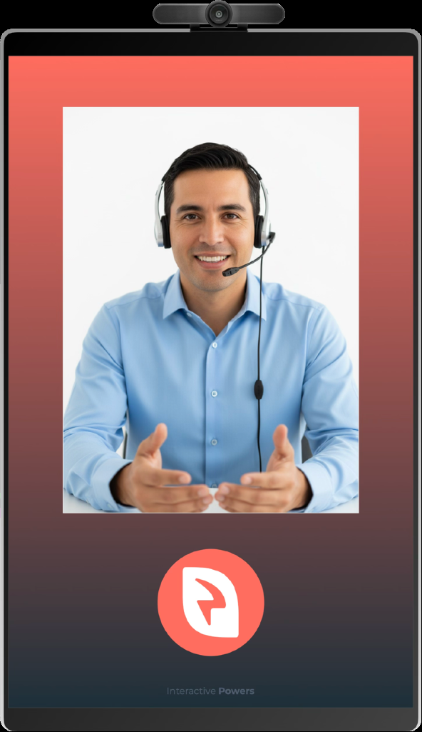
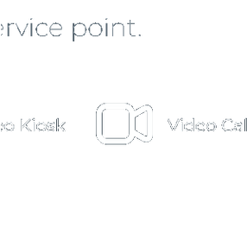

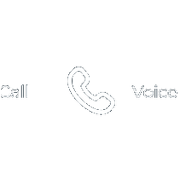

MassaPro
Phygital
Face-to-face service over video, without staff
at the service point.
Video Kiosk
Video Call
Voice Call
WhatsApp
MassaPro
MASSAPRO · 01 / 30

Slide 2
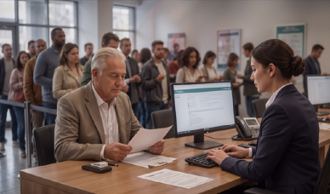
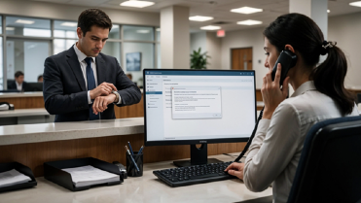


MASSAPRO
M U LT I - S E C T O R P A I N P O I N T S
The current situation at the point of contact
Today, most high-value interactions end up in one of these four scenarios. These aren't execution failures — they're the predictable result of tying
service capacity to a place and a schedule while demand isn't.
Waiting and abandonment
Deferred advice
Self-service with no way out
Incomplete remote channel
The customer sizes up the queue on
They come in hoping someone will
The digital process handles the
Phone and chat connect the
arrival and decides within seconds.
guide them and find a generalist
simple cases, but leaves the
customer, but don't let them view a
The loss happens before any
instead. The answer is an
customer alone right when the
document, share a screen, or verify
interaction takes place and leaves no
appointment, a referral to the call
doubt or exception that decides the
identity and complete a complex
trace in any system.
center, or coming back another day.
outcome shows up.
transaction.
In all four cases, the same thing happens: the company pays for the capacity without generating revenue, and the customer
walks away quietly with an unresolved need. AI doesn't solve these problems, and they don't always show up in KPIs.
MassaPro
MASSAPRO · 02 / 30

Slide 3
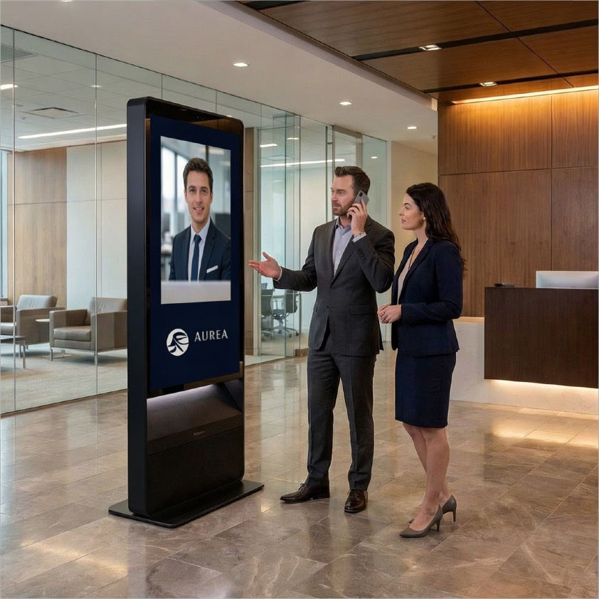
MASSAPRO
T H E S T A R T I N G P O I N T
In-person service
doesn't scale with the business
1
Fixed cost per location
Every service point requires its own staff, space, and hours. Costs grow
linearly with the network.
2
Uneven coverage
Lower-traffic locations can't justify a dedicated specialist, so customers get
a lesser service.
3
Rigid capacity
Demand spikes can't be absorbed: on-site staff can't be redistributed in real
time.
MassaPro
MASSAPRO · 03 / 30

Slide 4
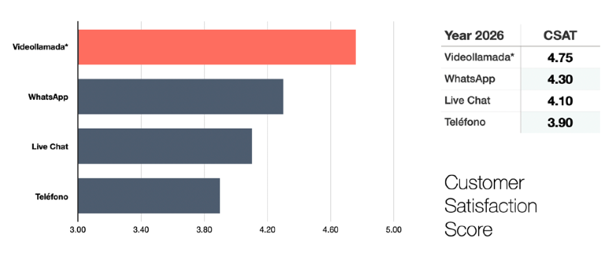
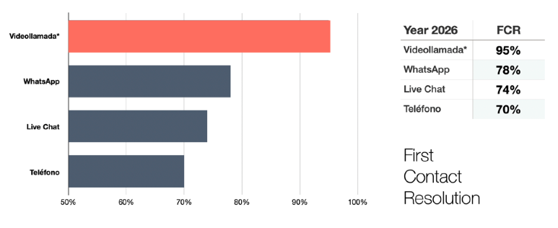
MASSAPRO
K E Y P E R F O R M A N C E I N D I C A T O R S - K P I
Video is the superior digital and human channel
for remote customer service
CSAT - NPS
FCR
CSAT scores typically range between 4.5 and 5, especially when customers
First-contact resolution rates with video calls outperform any digital
compare it with other channels.
channel or phone.
Customer service channel comparison data (CSAT and FCR) reflects consolidated industry averages and trends for 2025-2026, drawn from several MassaPro client reports and cross-checked against independent studies.
MassaPro
MASSAPRO · 04 / 30

Slide 5
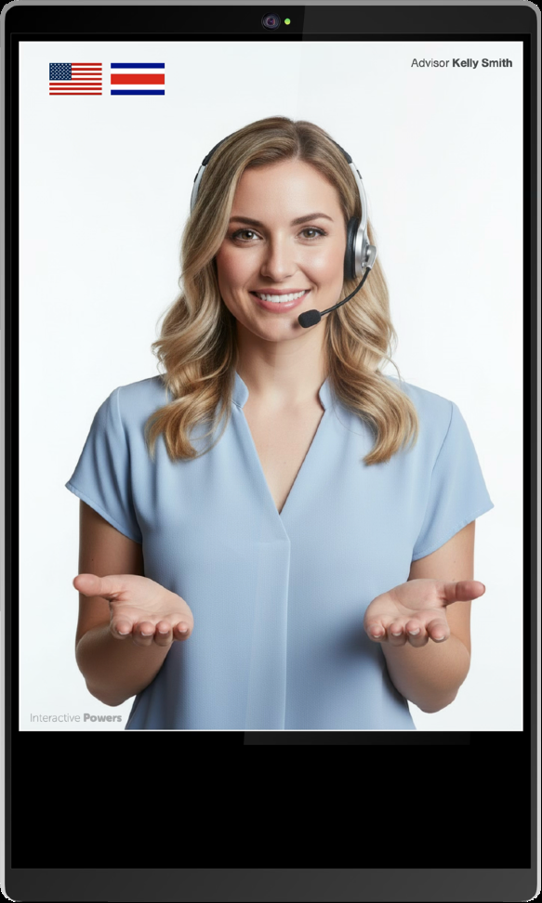
MASSAPRO
T H E C O N C E P T
Physical presence.
Remote operation.
A physical service point — kiosk, tablet, or simply a QR sticker —
connects the customer, in seconds, to a human advisor over high-
definition video. The advisor can be based at any contact center in the
world. The customer experiences high-value, face-to-face service that
gets things resolved.
No app to install
No appointment needed
No on-site staff
MassaPro
MASSAPRO · 05 / 30

Slide 6
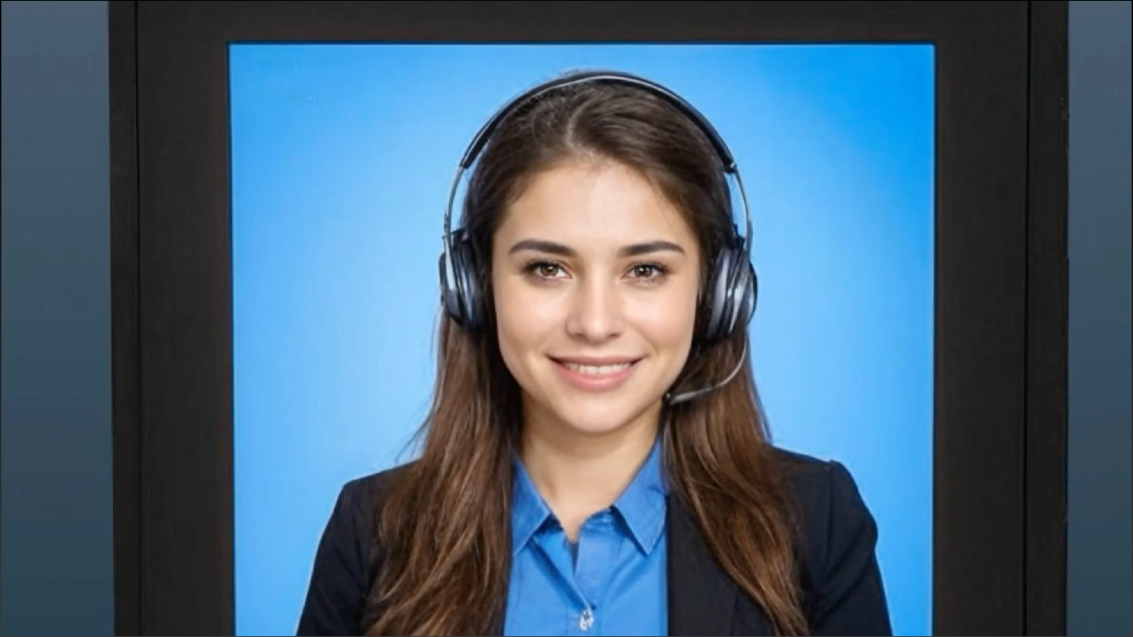
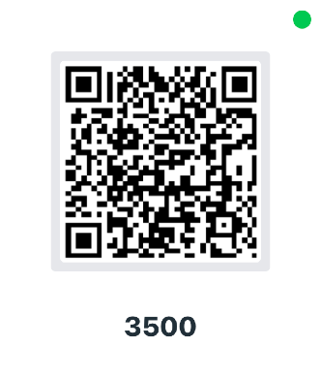

MASSAPRO
Scan the QR code to contact an agent and complete
the registration form. You can speak through your
smartphone while interacting here.
MASSAPRO · 06 / 30

Slide 7

MASSAPRO
MASSAPRO · 07 / 30

Slide 8
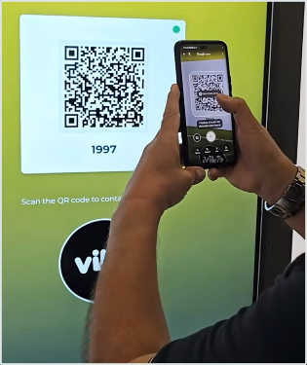
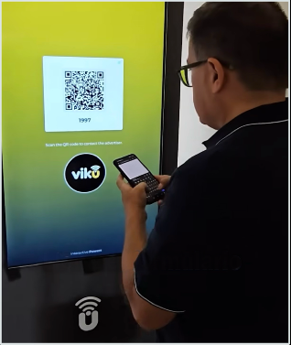
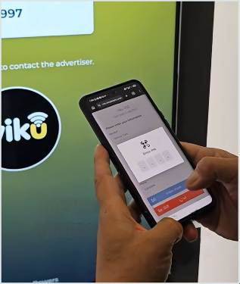
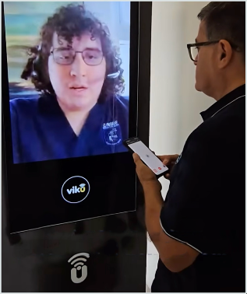
MASSAPRO
I N T E R A C T I O N A R C H I T E C T U R E
Four steps, under 30 seconds
1
Scan
2
Identify
3
Connect
4
Talk
The customer scans the QR
They enter the minimum
They enter a sync PIN. The
Audio runs through the
code on the video kiosk, tablet,
service details on their phone:
system routes the session to
customer's phone: total privacy
or sticker with their own mobile
name, contact info, reason, ID,
the first available advisor.
and HD video quality in any
phone.
or promo code.
environment.
MassaPro
MASSAPRO · 08 / 30

Slide 9

MASSAPRO
A R C H I T E C T U R E · S P L I T
One session, split across two devices
This is the technical piece that sets this technology apart from any video call: the streams of a single session are split between the
service point's screen and the customer's phone.
P H Y S I C A L P O I N T
C U S T O M E R ' S D E V I C E
Kiosk, screen, or tablet
Their own smartphone, no app
Life-size HD video of the advisor
SPLIT
Private two-way audio
Shared document screen
Signaling and session control (RTC)
Receives the RTP media stream
Data capture and service selection
Contact center · ACD · browser-based advisors — receive both streams as a single interaction
One logical session · Passes through corporate firewalls and NAT · WiFi, 5G, or LTE · PWA mode to reconnect later · no VPN · no App · no installation
MassaPro
MASSAPRO · 09 / 30

Slide 10
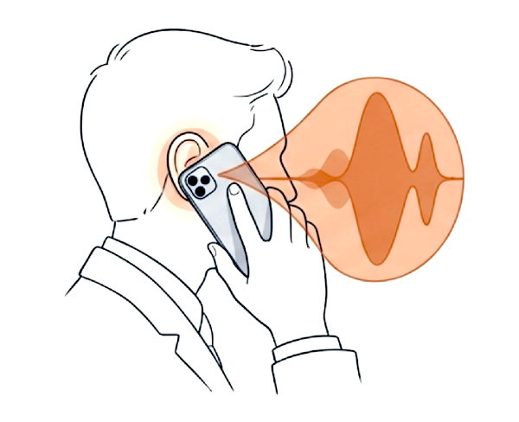
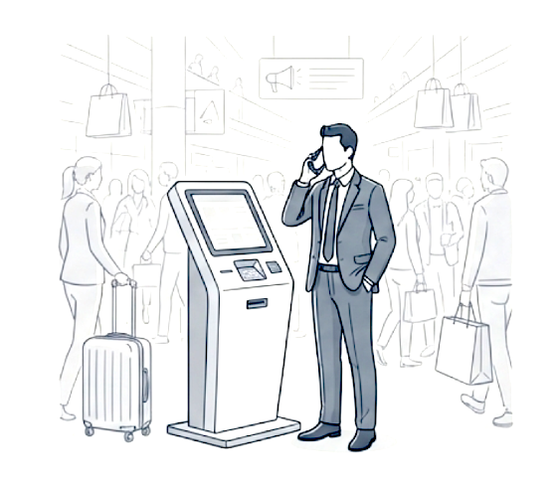
MASSAPRO
P R I V A C Y A N D I N C L U S I O N
Audio never passes through
shared hardware
Thanks to the SPLIT architecture, audio goes in and out through the customer's
own phone — never through a kiosk speaker or microphone. The same mechanism
solves both data privacy and intelligibility in noisy environments.
MULTIMODAL COMMUNICATION
Acoustic isolation
Data confidentiality
No ambient noise in the session, and
Banking, medical, or personal data,
no disturbance to those nearby.
inaudible to bystanders.
Multilingual service
Sign language
Automatic routing to the customer's
Real-time interpreter for deaf
language.
customers.
MassaPro
MASSAPRO · 10 / 30

Slide 11






MASSAPRO
S C A L A B I L I T Y
One expert team serves
the entire physical or digital
Contact center · 24/7
network
Service capacity is no longer tied to a building. A single, centralized team
of advisors covers dozens or hundreds of contact points, with demand
redistributed through intelligent ACD routing based on the real traffic at
each location.
AC
D
Open new locations without hiring local staff
Extended hours without duplicating shifts per branch
Specialists now available across the entire network
Branch
Store
Hotel
Clinic
… and every new location on the network
MassaPro
MASSAPRO · 11 / 30

Slide 12
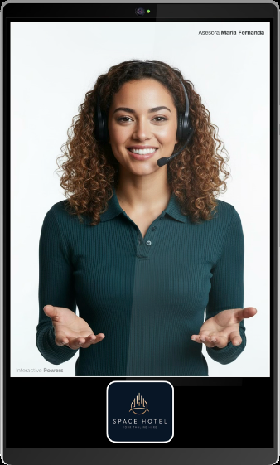
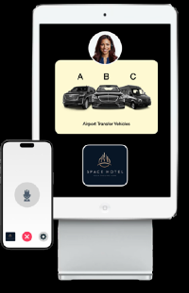
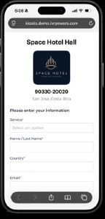
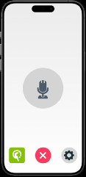
MASSAPRO
C U S T O M E R E X P E R I E N C E
Why customers experience it as in-person service
Human scale
Shared viewing
Control from their phone
The advisor appears life-size, looking
The advisor shares contracts, forms, or
The customer runs the session from
straight at the camera. The perceived
catalogs on screen in real time.
their own phone — no shared
service and trust match that of a staffed
Customers visually review their orders
touchscreens, and they never give up
counter.
before confirming.
control.
MassaPro
MASSAPRO · 12 / 30

Slide 13
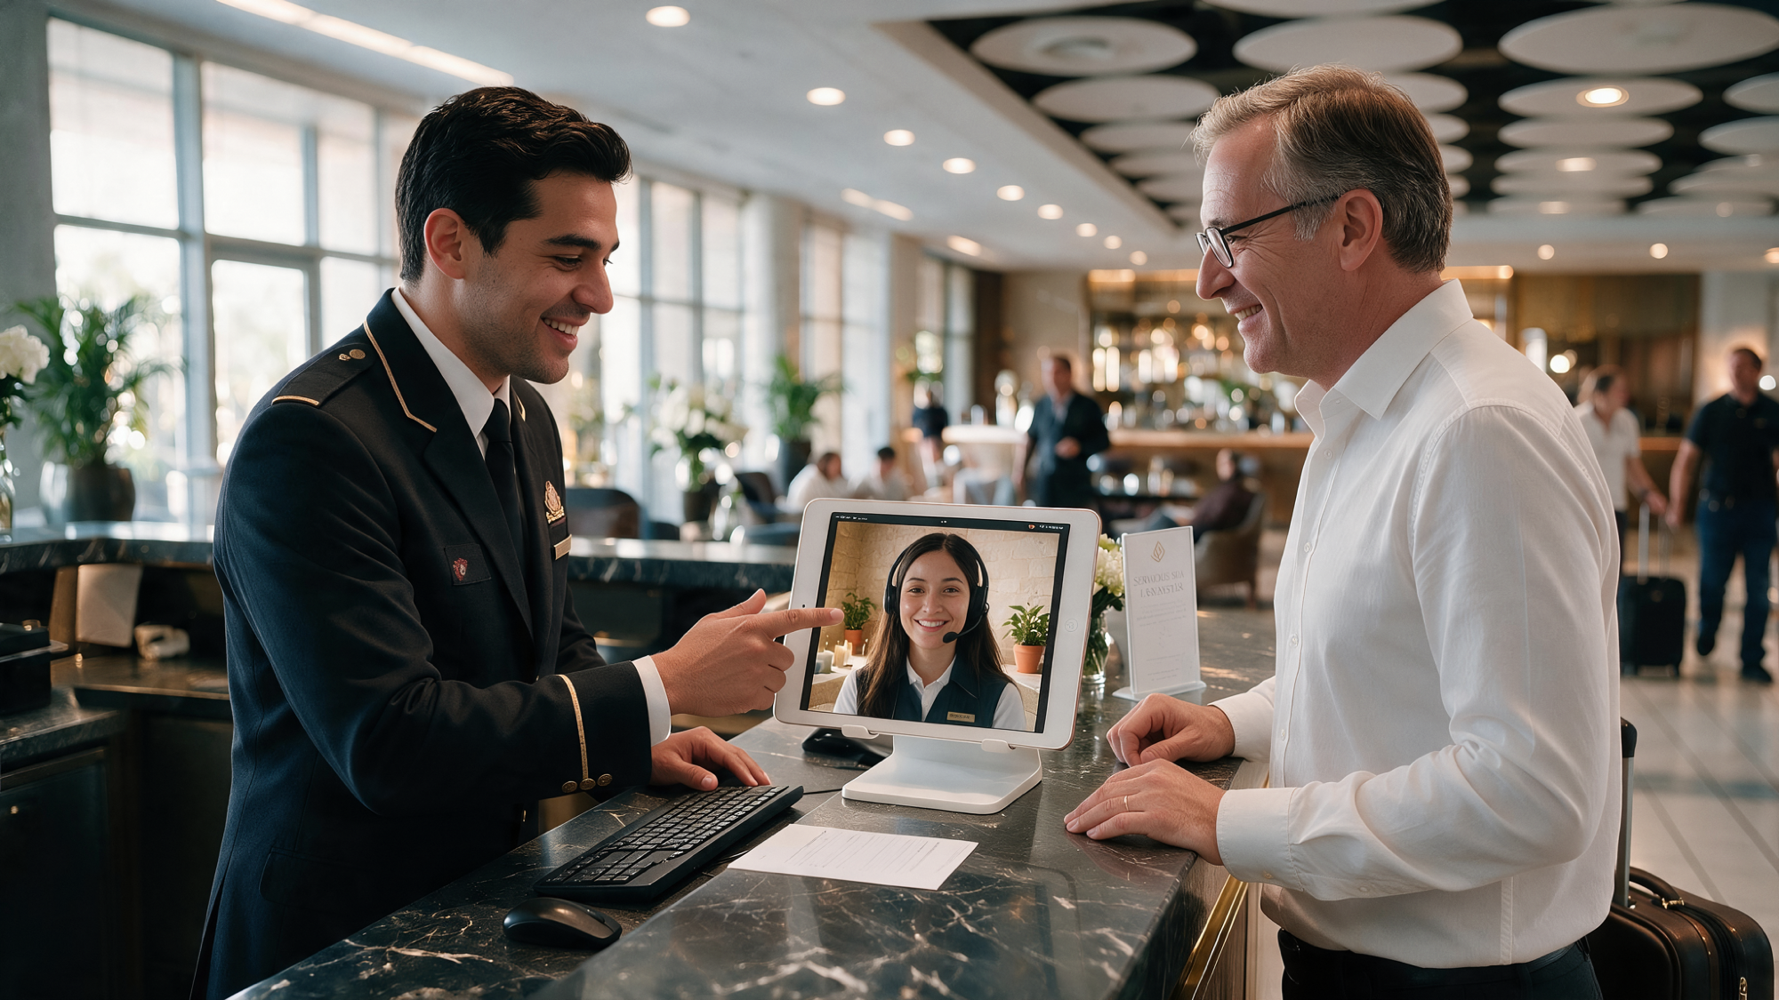
MASSAPRO
MASSAPRO · 13 / 30

Slide 14

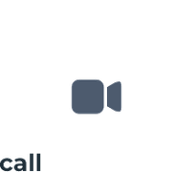


MASSAPRO
O N E P O I N T , F O U R C H A N N E L S
Customers choose how they want to be served
1
2
3
4
Video Kiosk
Mobile video call
Digital call
WhatsApp
Service on the large screen at
The entire session on the
Voice over data only — no
Conversation continuity on
the service point, with audio
customer's phone, on-site or
minutes used, no phone
the channel customers
through their phone.
off.
number needed.
already use every day.
Metadata capture before connecting
PIN sync between devices
Name · email · phone · ID document · promo code · room or file number. The
When choosing kiosk mode, the customer enters a four-digit PIN that pairs
advisor opens the session with the case already identified.
their phone with that specific screen — preventing session mix-ups at sites
with several adjacent points.
MassaPro
MASSAPRO · 14 / 30

Slide 15
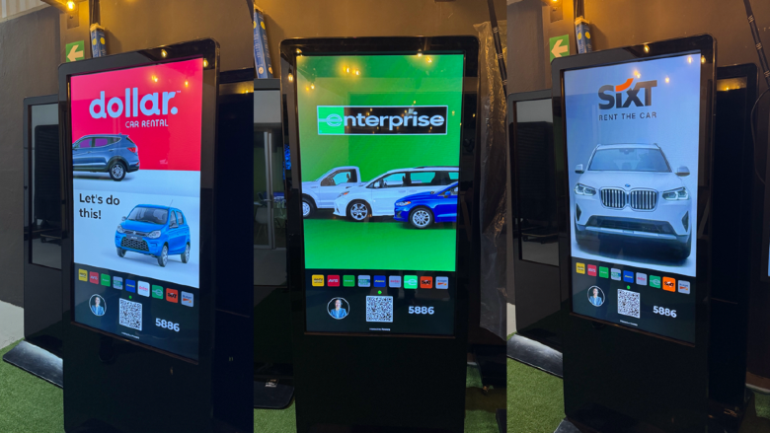

MASSAPRO
S E R V I C E A R C H I T E C T U R E
Dedicated service or
multi-service selector
Every contact point can be configured as a dedicated service — one
queue, one brand — or as a multi-service selector, where each option
routes to a different queue. This is a configuration decision, not a
hardware one, and it can be changed remotely.
Dedicated service
The entire point handles a single process: customer onboarding, technical
support, or concierge.
Multi-service
The same software, with the service and identity tailored to each point
Customers choose between several processes or departments from the same
screen.
Multi-brand
A single point represents multiple brands, each with its own queue, identity, and
content.
Configurable brand slots per location
MassaPro
MASSAPRO · 15 / 30

Slide 16
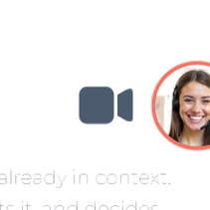
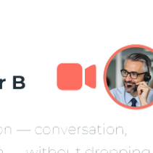
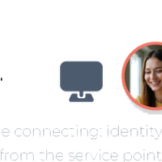

MASSAPRO
R O U T I N G A N D C O N T I N U I T Y
Customers never repeat themselves
across any transfer
1
Customer
2
Advisor A
3
Supervisor B
Data captured before connecting: identity,
Receives the session already in context.
Inherits the full session — conversation,
reason, and context from the service point.
Handles it, documents it, and decides
documents, and data — without dropping
whether to escalate.
the video.
Full context carried through the entire chain · zero repetition · native ACD routing (Genesys, Cisco, Five9, GoContact…)
MassaPro
MASSAPRO · 16 / 30

Slide 17
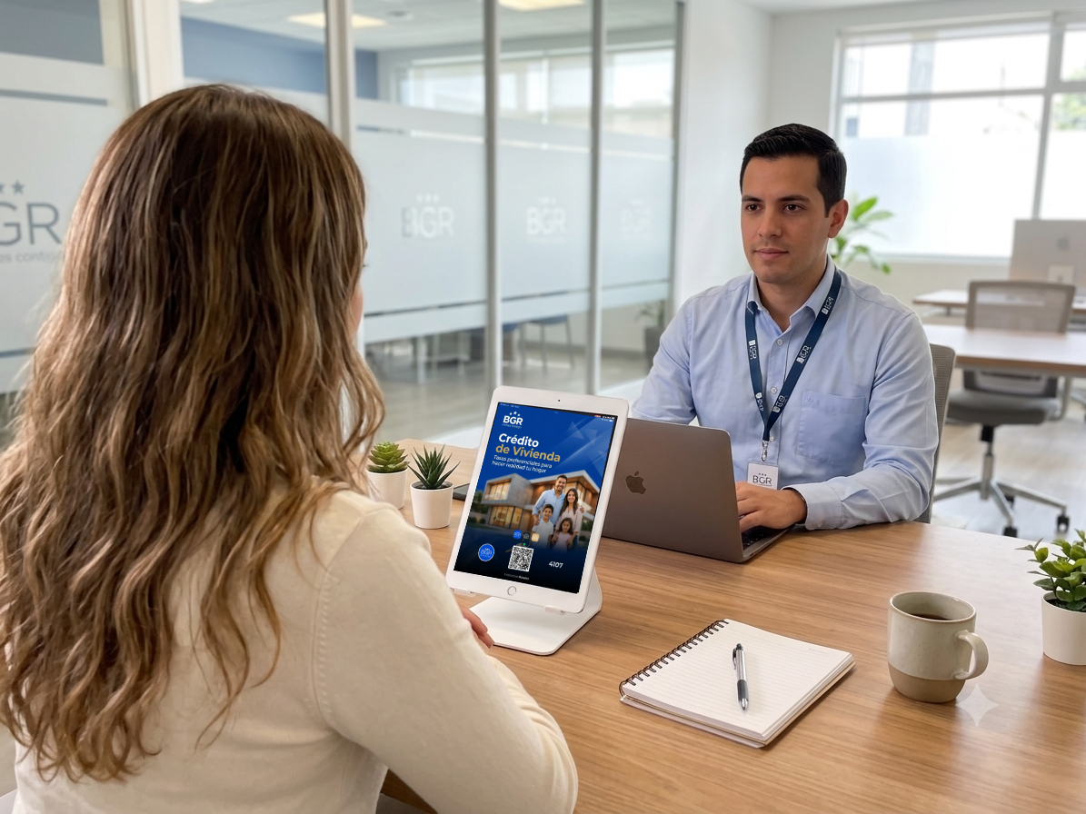
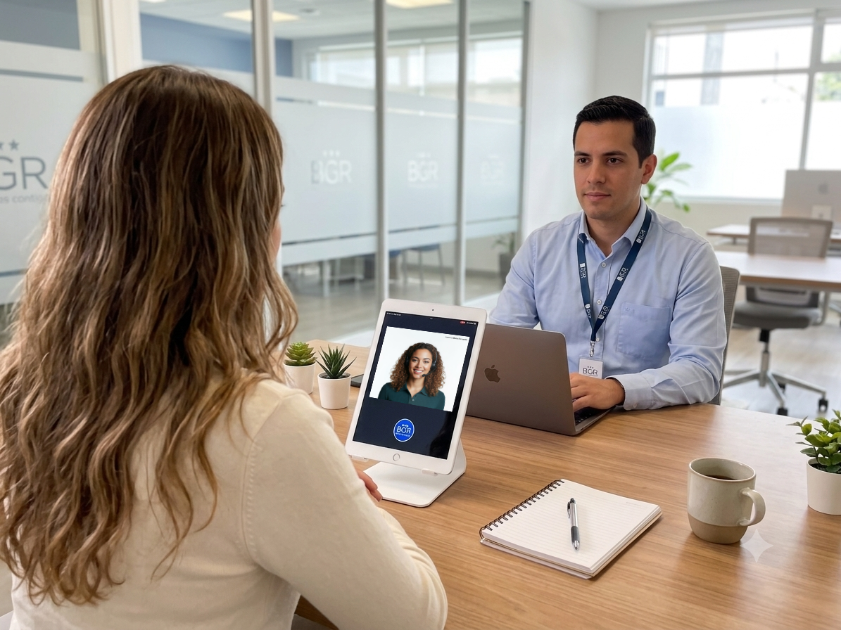
MASSAPRO
MASSAPRO · 17 / 30

Slide 18

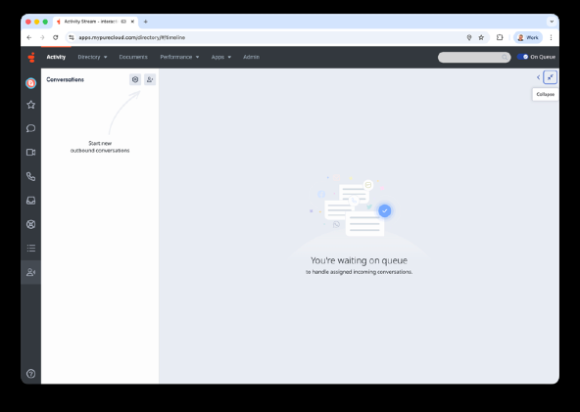
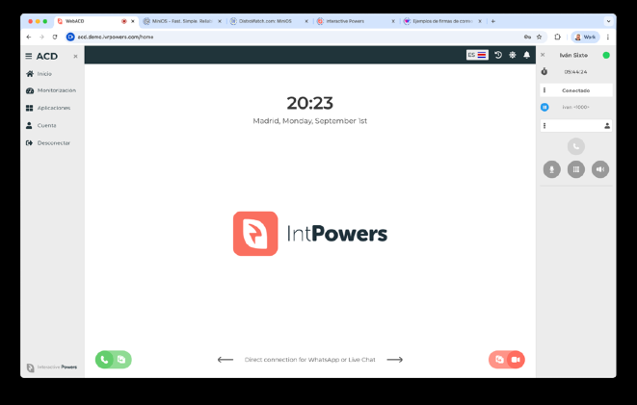













MASSAPRO
I N T E G R A T I O N
Integrates with the contact
center you already have
The platform integrates with the ACD your organization already
has in production, or runs standalone with its own Web ACD. No
migration required, and no need to replace your existing
operations.
Distributed agents
Centralized agents
Makes use of advisors already available at offices, dealerships, or branches,
Maximizes operations with more shifts, queue-based specialization, and
between in-person appointments.
contact center outsourcing.
MassaPro
MASSAPRO · 18 / 30

Slide 19
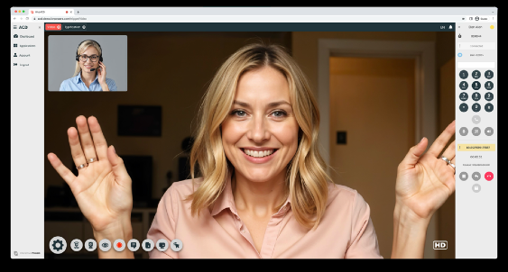
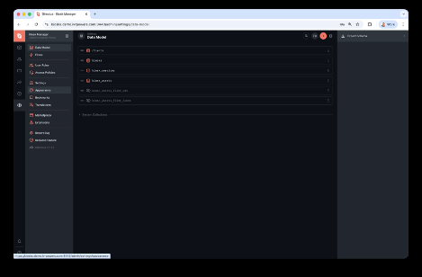
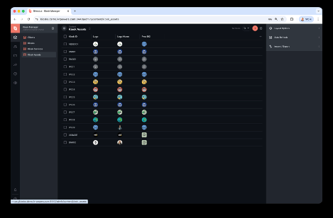
MASSAPRO
P L A T F O R M A N D O P E R A T I O N S
A managed service,
no deployment on your network
VCCaaS · Video Contact Center as a Service
Advisors, supervisors, and sales staff work from a laptop, PC, Mac, or tablet —
with just a web browser and internet access. No heavy client, no proprietary
headsets, no dedicated workstation.
Browser-based advisor console
Kiosk Manager · centralized management
Oversight of the entire network of points, adding and removing locations,
content, logos and advertising per kiosk, supervisor roles and permissions, and
remote configuration settings.
Kiosk Manager · network oversight
MassaPro
MASSAPRO · 19 / 30

Slide 20
MASSAPRO
O P E R A T I O N A L I M P A C T
More coverage on less infrastructure
24/7
1 : N
+0
Continuous availability
One team, the entire network
Staff at the point
Shifts and outsourcing cover time slots
The same group of advisors serves
The service point works even with no
no physical branch could sustain on its
every contact point at once, cutting
assigned staff: just a screen and
own.
operating costs.
connectivity.
The platform scales to hundreds of thousands of interactions per month on the same infrastructure, with no need to physically replicate service
points.
MassaPro
MASSAPRO · 20 / 30

Slide 21











MASSAPRO
O P E R A T I O N A L E F F I C I E N C Y
Every remote point reduces
Sustainable, circular
operating and infrastructure costs
Positive environmental impact
A fixed specialist at a low-traffic point spends much of the day serving no one, yet their payroll and workstation stay active regardless. Centralizing the resource
frees up that time and that geography.
T R A D I T I O N A L M O D E L
PH YG I TA L M O D E L
Active payroll, no interaction
Capacity based on real occupancy
Fixed staff even when the point has no traffic that shift.
The team is sized to aggregate demand.
Infrastructure running regardless
The point carries no staff
Dedicated climate control and lighting for the entire shift.
Just a screen and connectivity — the fixed cost disappears.
Transit time that isn't service
Zero transit time
Travel between sites produces no service.
The specialist serves without leaving their desk.
Absences covered point by point
Absences absorbed by the team
Every absence requires a local substitute or leaves the point empty.
The rest of the pool covers it, no local substitute needed.
Talent tied to geography
Talent with no geographic ties
You can only hire where the point is, whether or not the talent is there.
Concentrate your team in one site, or move it to another country.
The real savings are the payroll, infrastructure, and geography that no longer limit the service.
MassaPro
MASSAPRO · 21 / 30

Slide 22


MASSAPRO
S E C U R I T Y A N D C O M P L I A N C E
Enterprise-grade,
from the infrastructure up
Infrastructure deployed on AWS with full data isolation, encryption,
and per-client segregation. MassaPro never accesses end-
user data.
SOC 2
ISO 27001
GDPR
HIPAA
PCI-DSS
Live identity verification
The advisor visually confirms the customer and their ID document — a direct
barrier against impersonation, and deepfakes can't operate through a kiosk.
Session traceability
Interaction recording and auditing in line with each organization's policy.
Reports, logs, and metadata generated for all activity.
MassaPro
MASSAPRO · 22 / 30

Slide 23

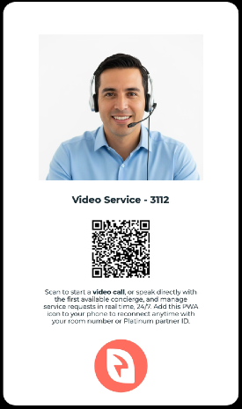
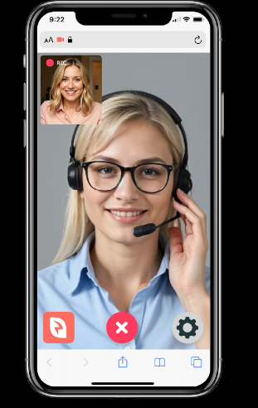
MASSAPRO
S E R V I C E C O N T I N U I T Y
If local hardware fails,
the service never goes down
The contact point is decoupled from the session. If the screen, local
network, or power fails, the interaction continues on the customer's
smartphone via the static QR code, with no on-site technical
intervention needed. It can run over the user's own LTE/5G connection.
Resilient by design
The system is 100% multimodal and keeps running even without fixed screens.
Static QR code backup
The printed sticker works even if the kiosk is completely down.
Full mobile session
Active session from mobile
Customers keep video, audio, and shared screen from their own device.
No technician dispatch · No support ticket
MassaPro
MASSAPRO · 23 / 30

Slide 24
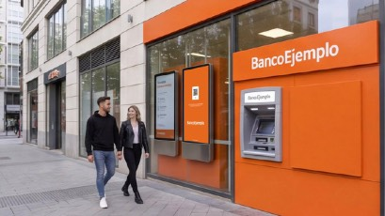
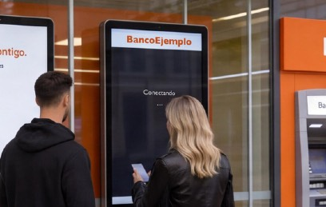
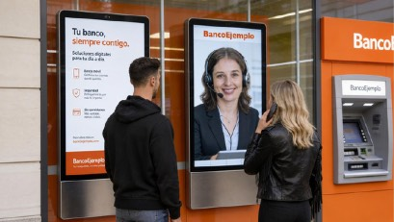
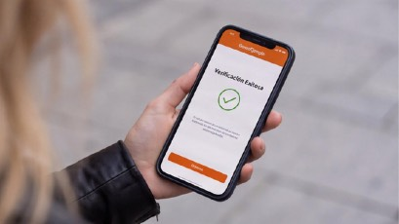
MASSAPRO
F E A T U R E D C A S E · B A N K I N G
Specialized service outside branch hours
1
Arrival
2
Connection
3
Video service
4
Verification
The customer enters the self-service
Scans the kiosk QR code and selects the
A specialized banker assists over video
Identity confirmed and the transaction
lobby, whether or not the branch is
service: onboarding, an issue, or
and shares documentation on screen.
validated on the customer's phone.
open.
advisory.
Applicable processes: account opening · identity verification · credit origination · issue resolution · investment advisory
MassaPro
MASSAPRO · 24 / 30

Slide 25
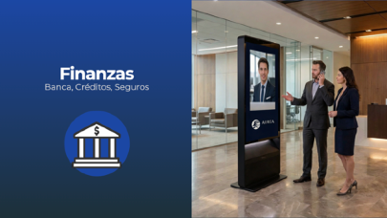
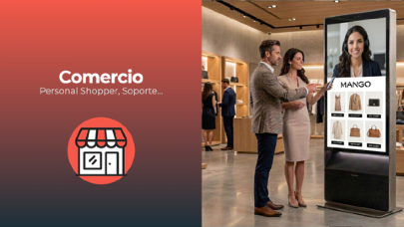
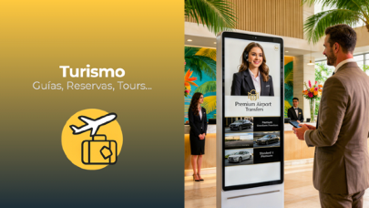
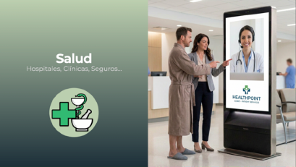
MASSAPRO
S E C T O R A P P L I C A T I O N S
The same model, four different operations
Finance
Retail
Travel &
Healthcare
Hospitality
Assisted claims assessment,
Personal shopper and in-store
Multilingual 24/7 concierge in
Admissions, initial triage, and
account opening, policy
product advisory: one brand
the hotel, resort, or tour lobby,
patient guidance at clinics and
issuance, and claim filing, with
specialist covers the entire
with no need for a staffed desk
centers without permanent
visual verification of the
retail network.
overnight.
front-desk staff.
policyholder and their
document.
MassaPro
MASSAPRO · 25 / 30

Slide 26


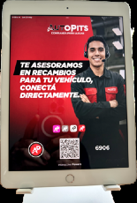

MASSAPRO
P H Y S I C A L D E P L O Y M E N T
Any format, any orientation
The software adapts to whatever hardware is already on site: a vertical totem, horizontal screen, countertop tablet, or embedded
monitor. It doesn't dictate construction work or furniture.
Vertical or Horizontal Screen
Focus or Full-Screen Mode
Touchscreens, PWA
The software automatically detects screen
The system adjusts the advisor's framing
The system also runs on touch devices —
size and orientation.
based on the screen type and use.
iPad or Android — both as a PWA.
Vertical 9:16 · 1080 × 1920 Horizontal 16:9 · 1920 × 1080 From countertop tablets to large-format totems
MassaPro
MASSAPRO · 26 / 30

Slide 27
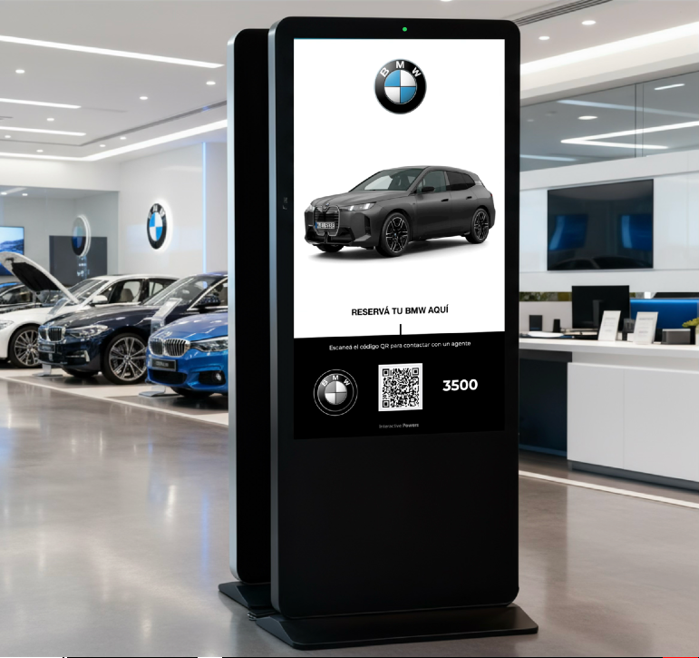
MASSAPRO
B R A N D I D E N T I T Y
Your brand at every
point of contact
100% configurable interface: logo, color palette, typography, legal
text, and promotional content. End customers never perceive a
third-party platform.
Corporate logo, color palette, and typography
Your own text, languages, and legal notices
Custom iconography and service naming
Changes applied remotely across the entire network
Example of customization on the same software
MassaPro
MASSAPRO · 27 / 30

Slide 28



MASSAPRO
C O N T E N T A N D M O N E T I Z A T I O N
The screen keeps working
Programmable ad slideshow per location
even when there is no session
At rest, the point doesn't go dark: it plays content and advertising
carousels scheduled per location from Kiosk Manager. The asset stops
being just a service channel and becomes a communication medium
too.
JPG, GIF, and MP4 formats
Scheduling by location
Static or motion creative, no additional
Each kiosk shows the campaign that
player required.
matches its site, language, and schedule.
Owned or third-party content
Instant transition
Ad carousel at rest · vertical and horizontal
Campaigns from your brand, your partners,
When the QR code is scanned, the carousel
or local advertisers.
steps aside for the video session.
Pays back the point even outside service hours
MassaPro
MASSAPRO · 28 / 30

Slide 29
MASSAPRO
S U M M A R Y F O R T H E C O M M I T T E E
Seven decisions already settled
✓
A category of its own
✓
No adoption friction
✓
Integrates with your ACD
It isn't video conferencing: it's an in-person
Customers install nothing; advisors need only
Works alongside Genesys, Cisco, Avaya, Five9,
service channel designed from the ground
a browser.
or GoContact, among others.
up.
✓
Privacy by design
✓
Regulatory compliance
✓
The asset pays for itself
The SPLIT architecture operates in high-
AWS infrastructure with enterprise-grade
At rest, the point plays scheduled content and
security, high-privacy environments.
certifications.
advertising.
The seventh: the service point stops being a fixed cost and becomes optimized, flexible capacity.
MassaPro
MASSAPRO · 29 / 30

Slide 30
Let's talk about your case
We analyze a specific process from your operation and estimate the
deployment model, contact center integration, and the impact on
your network of service points.
MassaPro
ivan.sixto@massapro.com · massapro.com
MASSAPRO · 30 / 30

