Slide 1
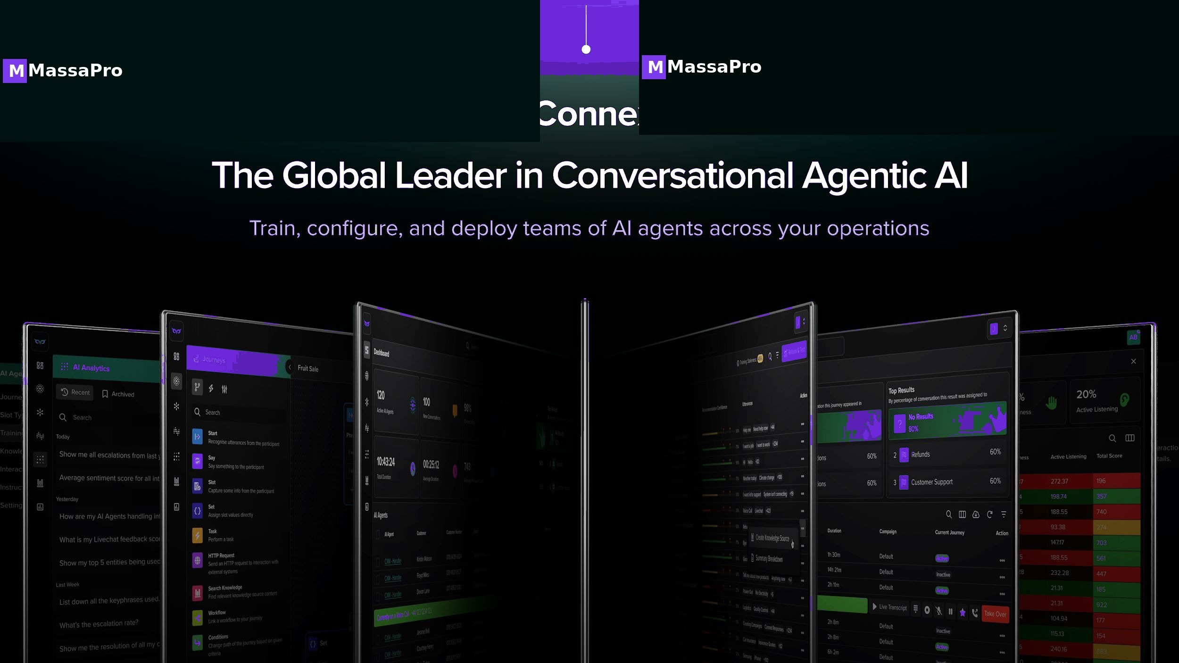
MASSAPRO · 01 / 30

Slide 2
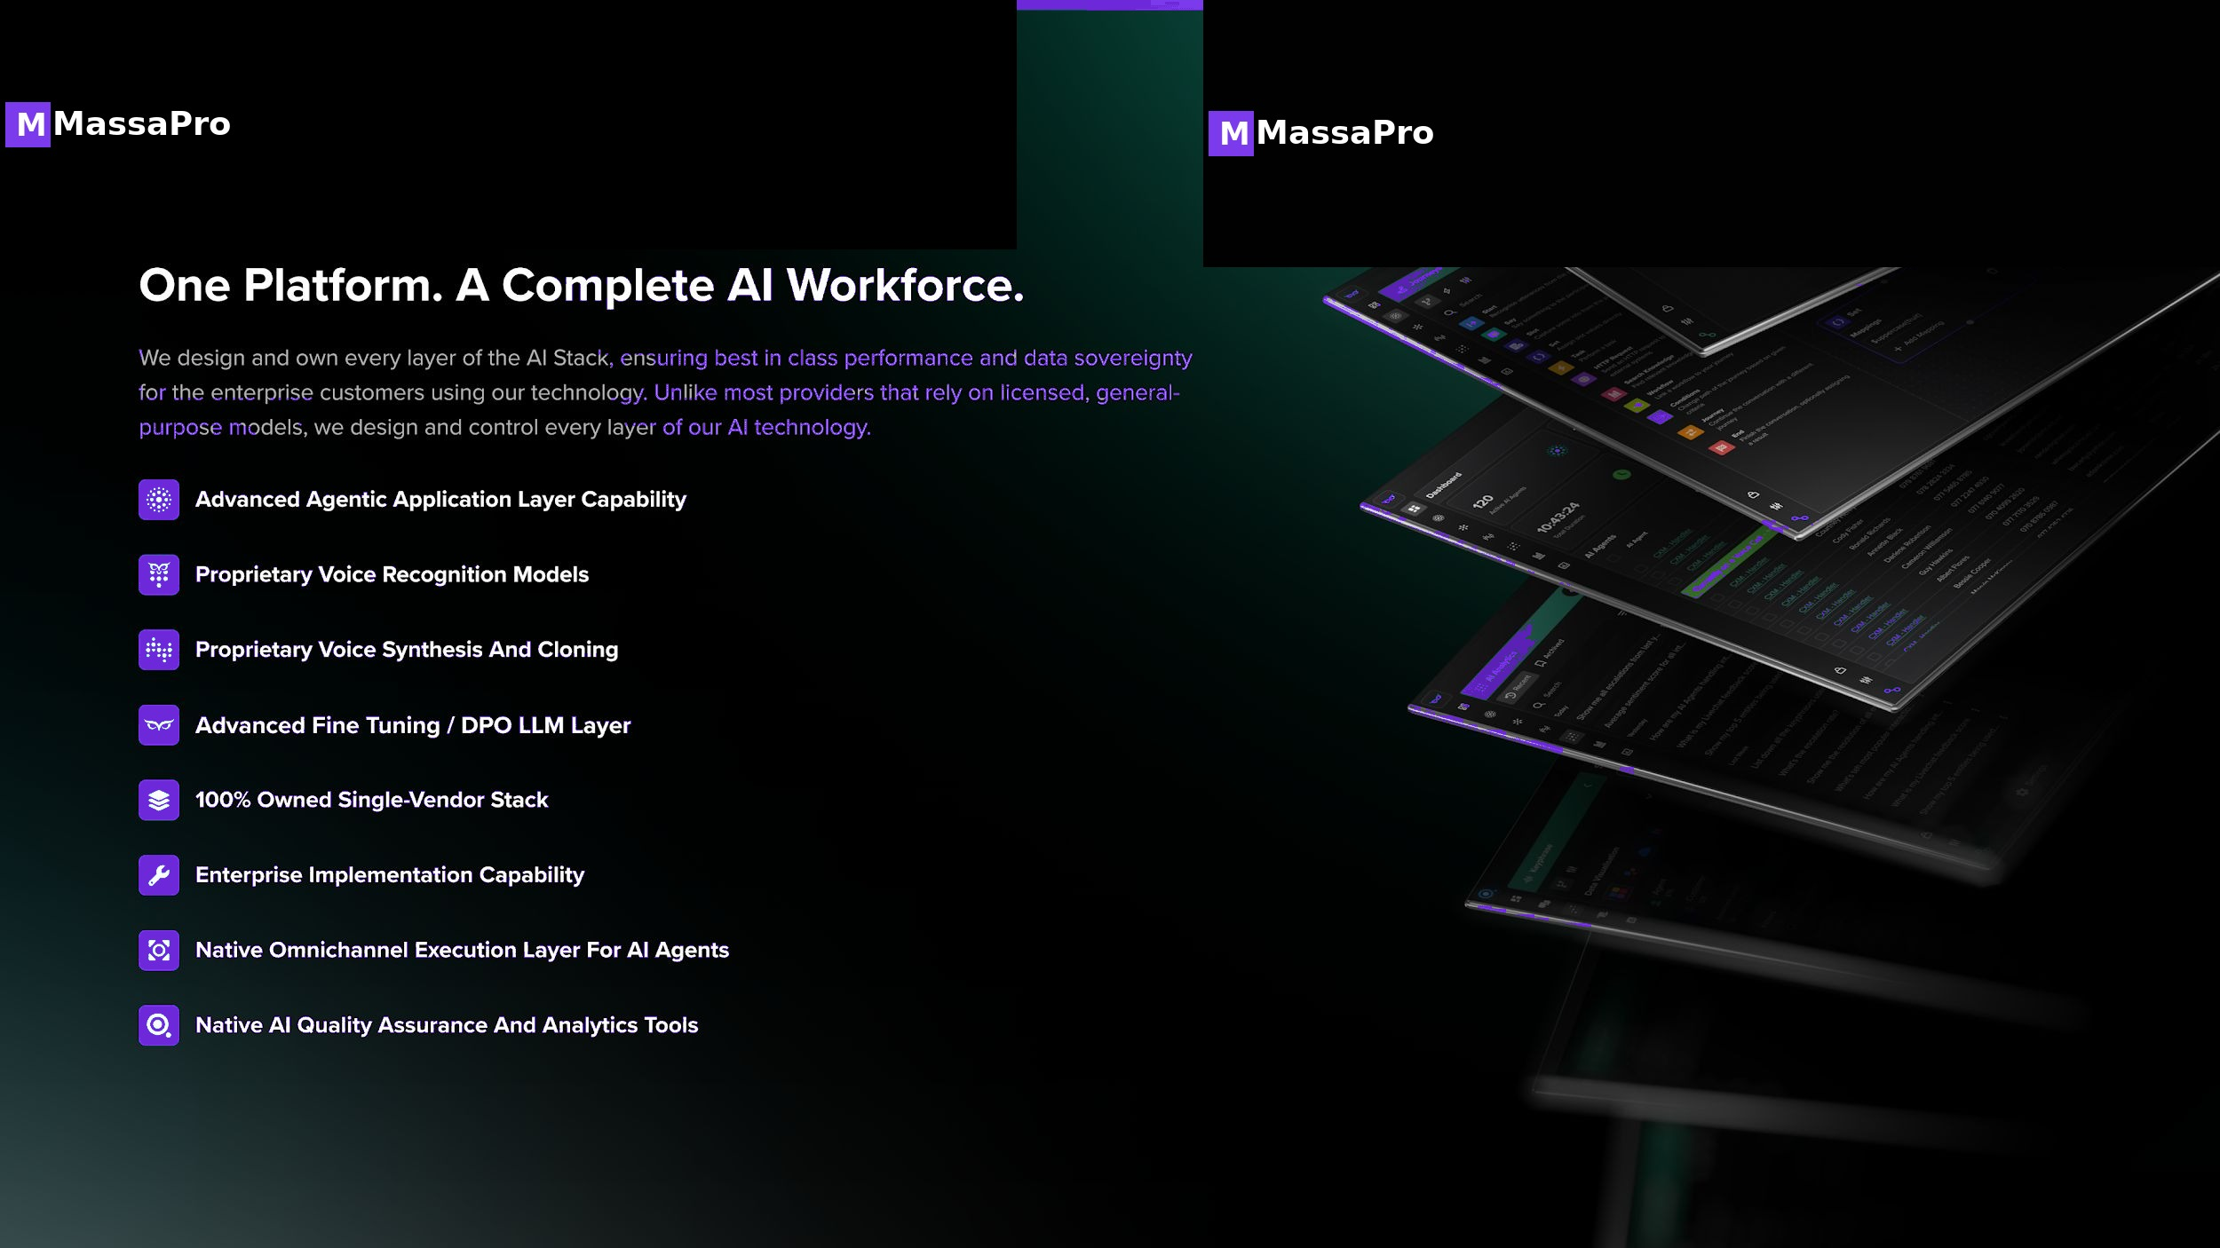
M
MassaPro
THE MASSAPRO PLATFORM
One Platform. A Complete Agentic AI Workforce.
Our proprietary LLM orchestrates the entire customer journey across every channel — replacing the call center with a growth machine powered by Agentic AI. Unlike most providers that charge per-minute AI tokens for voice or text, MassaPro offers a flat pay-per-agent + volume pricing — scaling without surprise bills.
MASSAPRO · 02 / 30

Slide 3
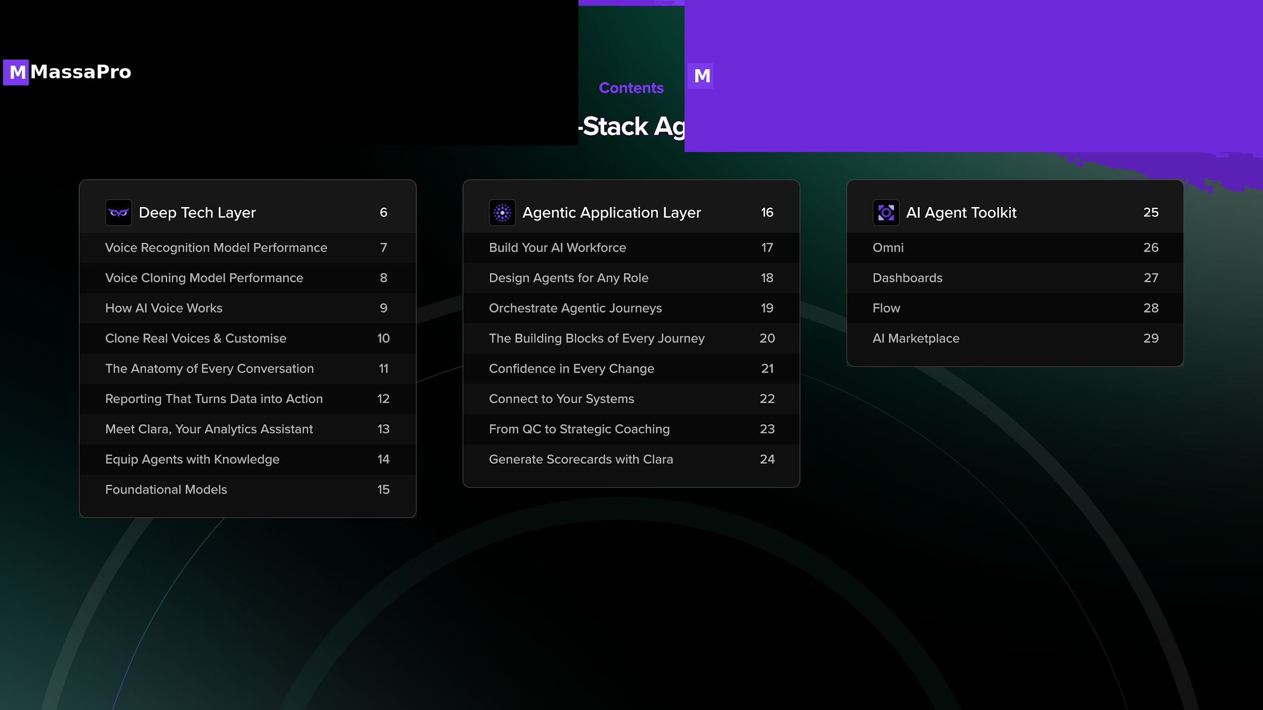
M
MassaPro
MASSAPRO · 03 / 30

Slide 4
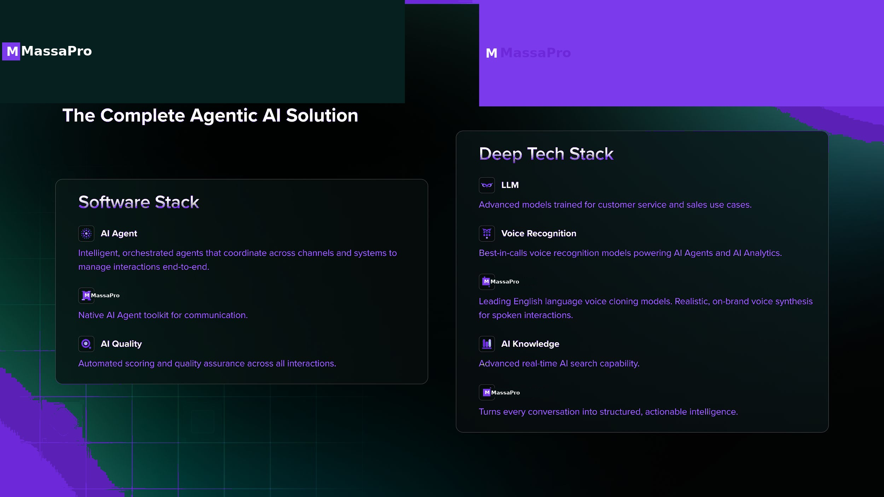
M
MassaPro
MASSAPRO · 04 / 30

Slide 5
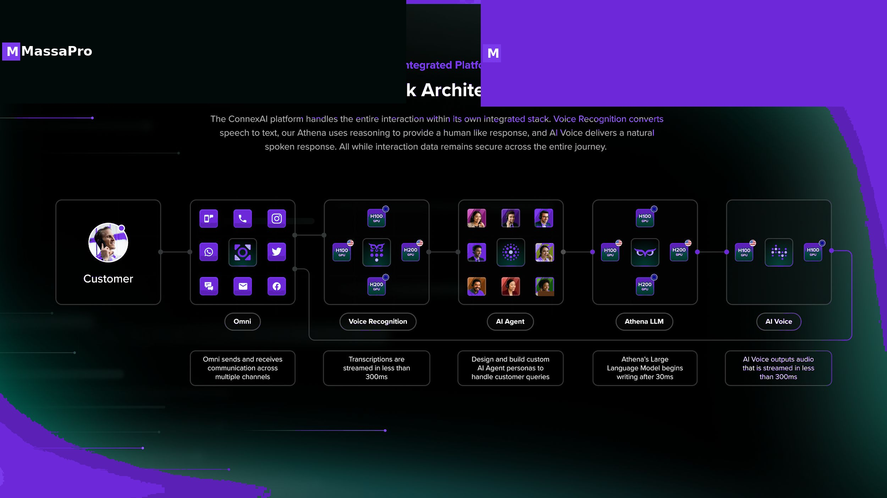
M
MassaPro
PROPRIETARY LLM · OMNI-CHANNEL
A single LLM orchestrating every customer touchpoint.
Voice, video, chat, email, and WhatsApp — all routed through our proprietary LLM. No third-party token fees. No per-minute charges. Just predictable per-agent pricing that scales with your business.
MASSAPRO · 05 / 30

Slide 6
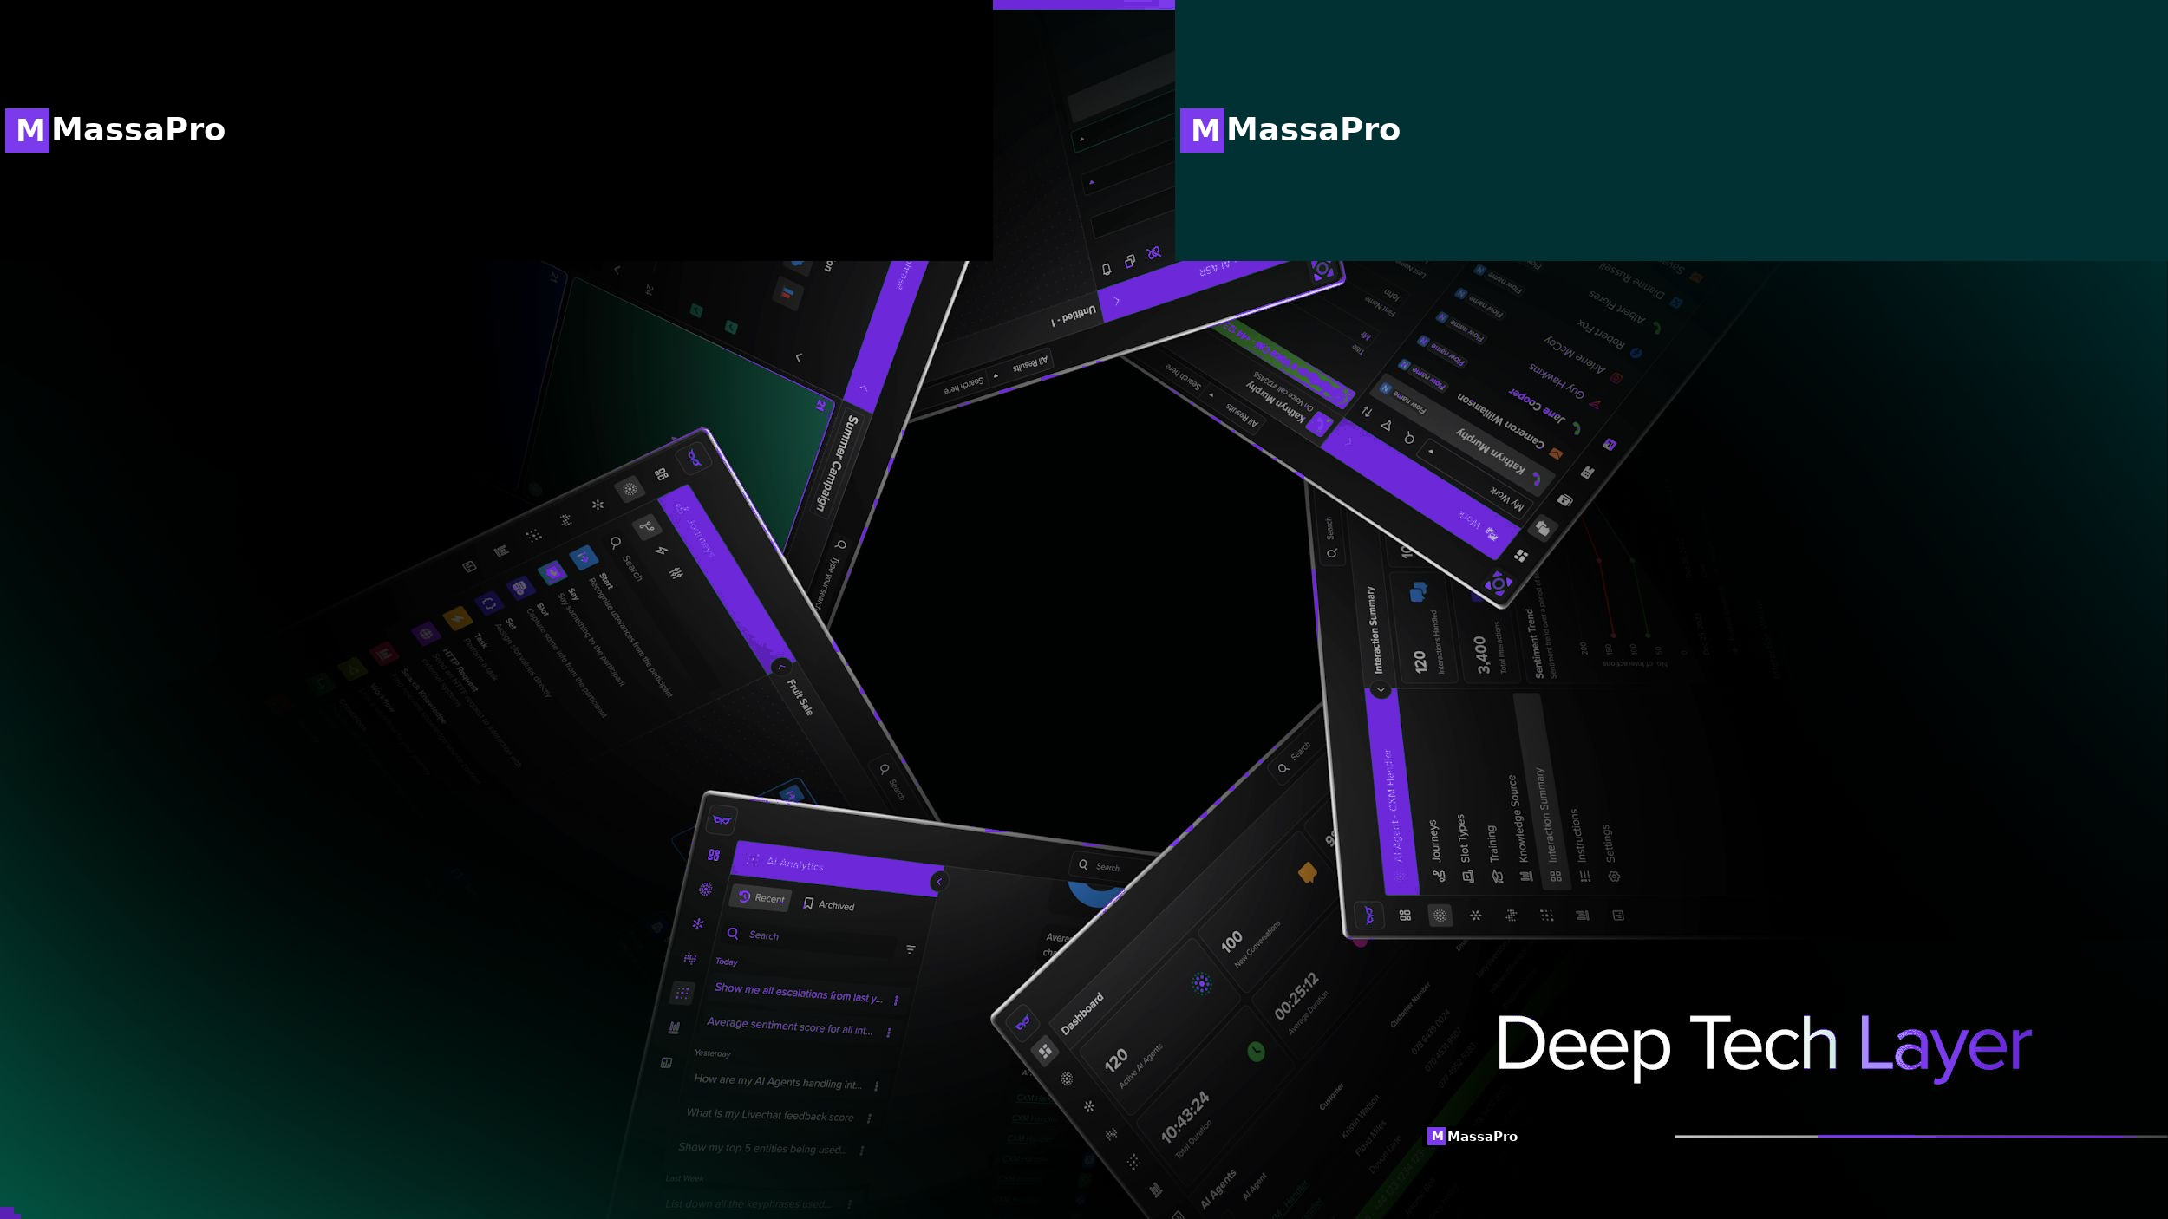
M
MassaPro
MASSAPRO · 06 / 30

Slide 7
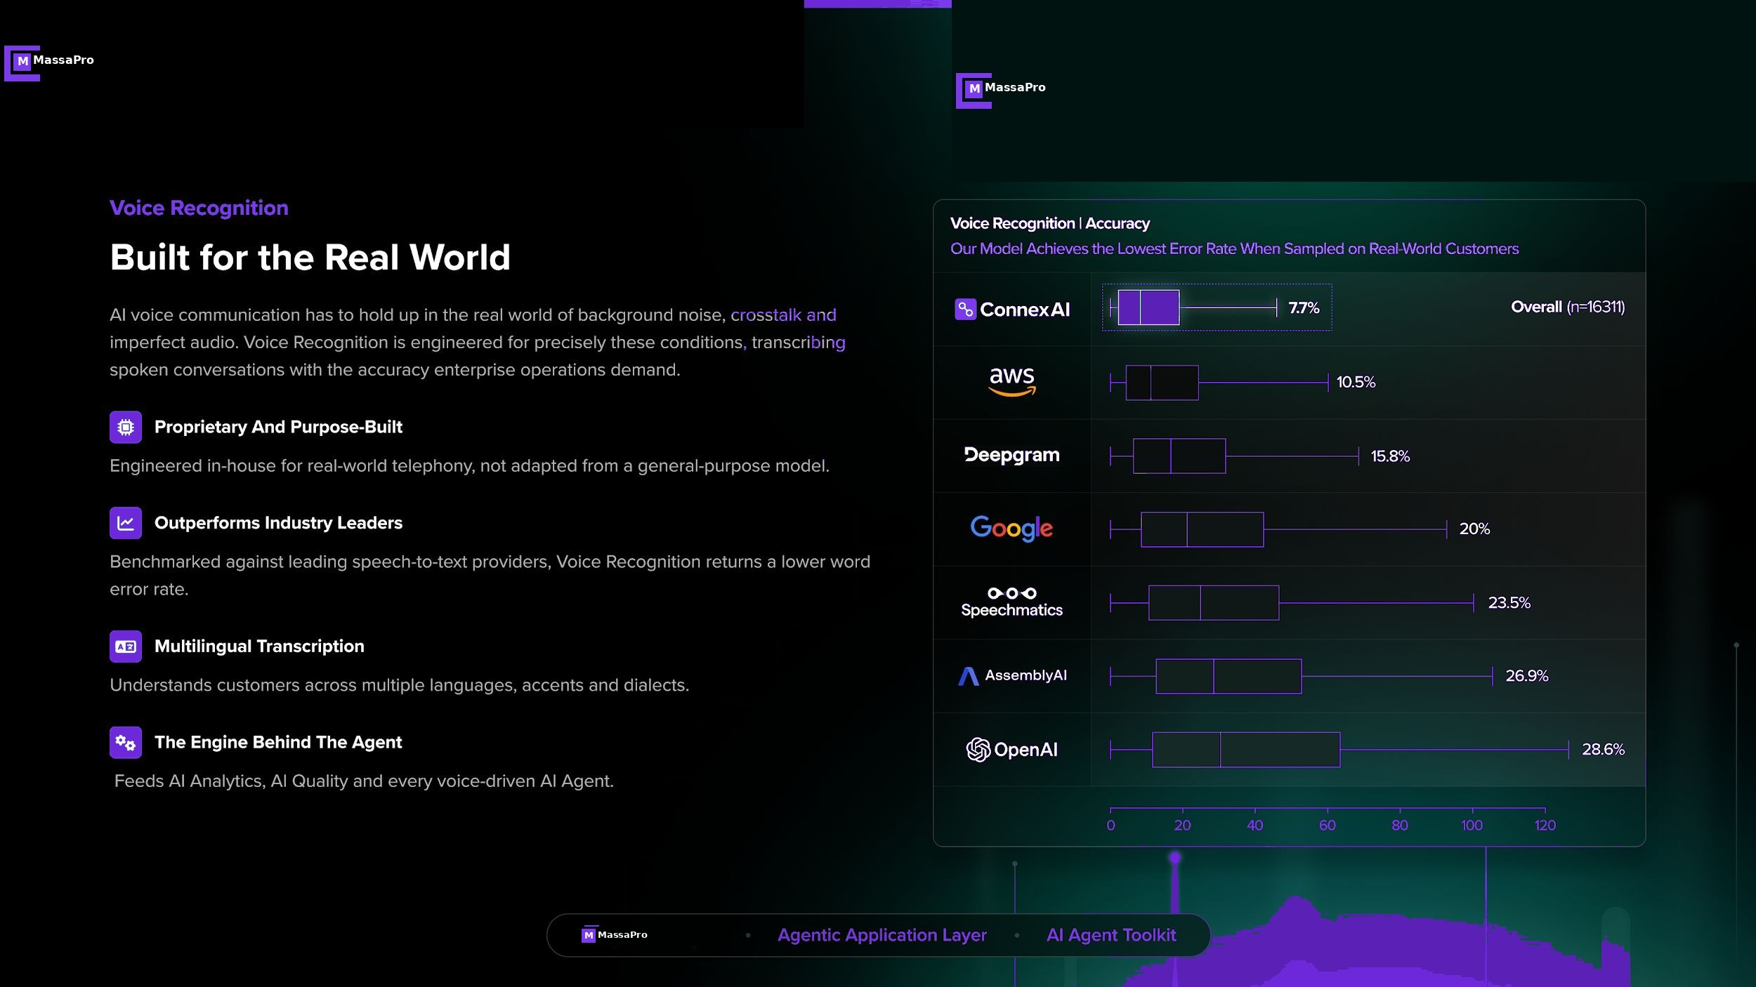
M
MassaPro
MASSAPRO · 07 / 30

Slide 8
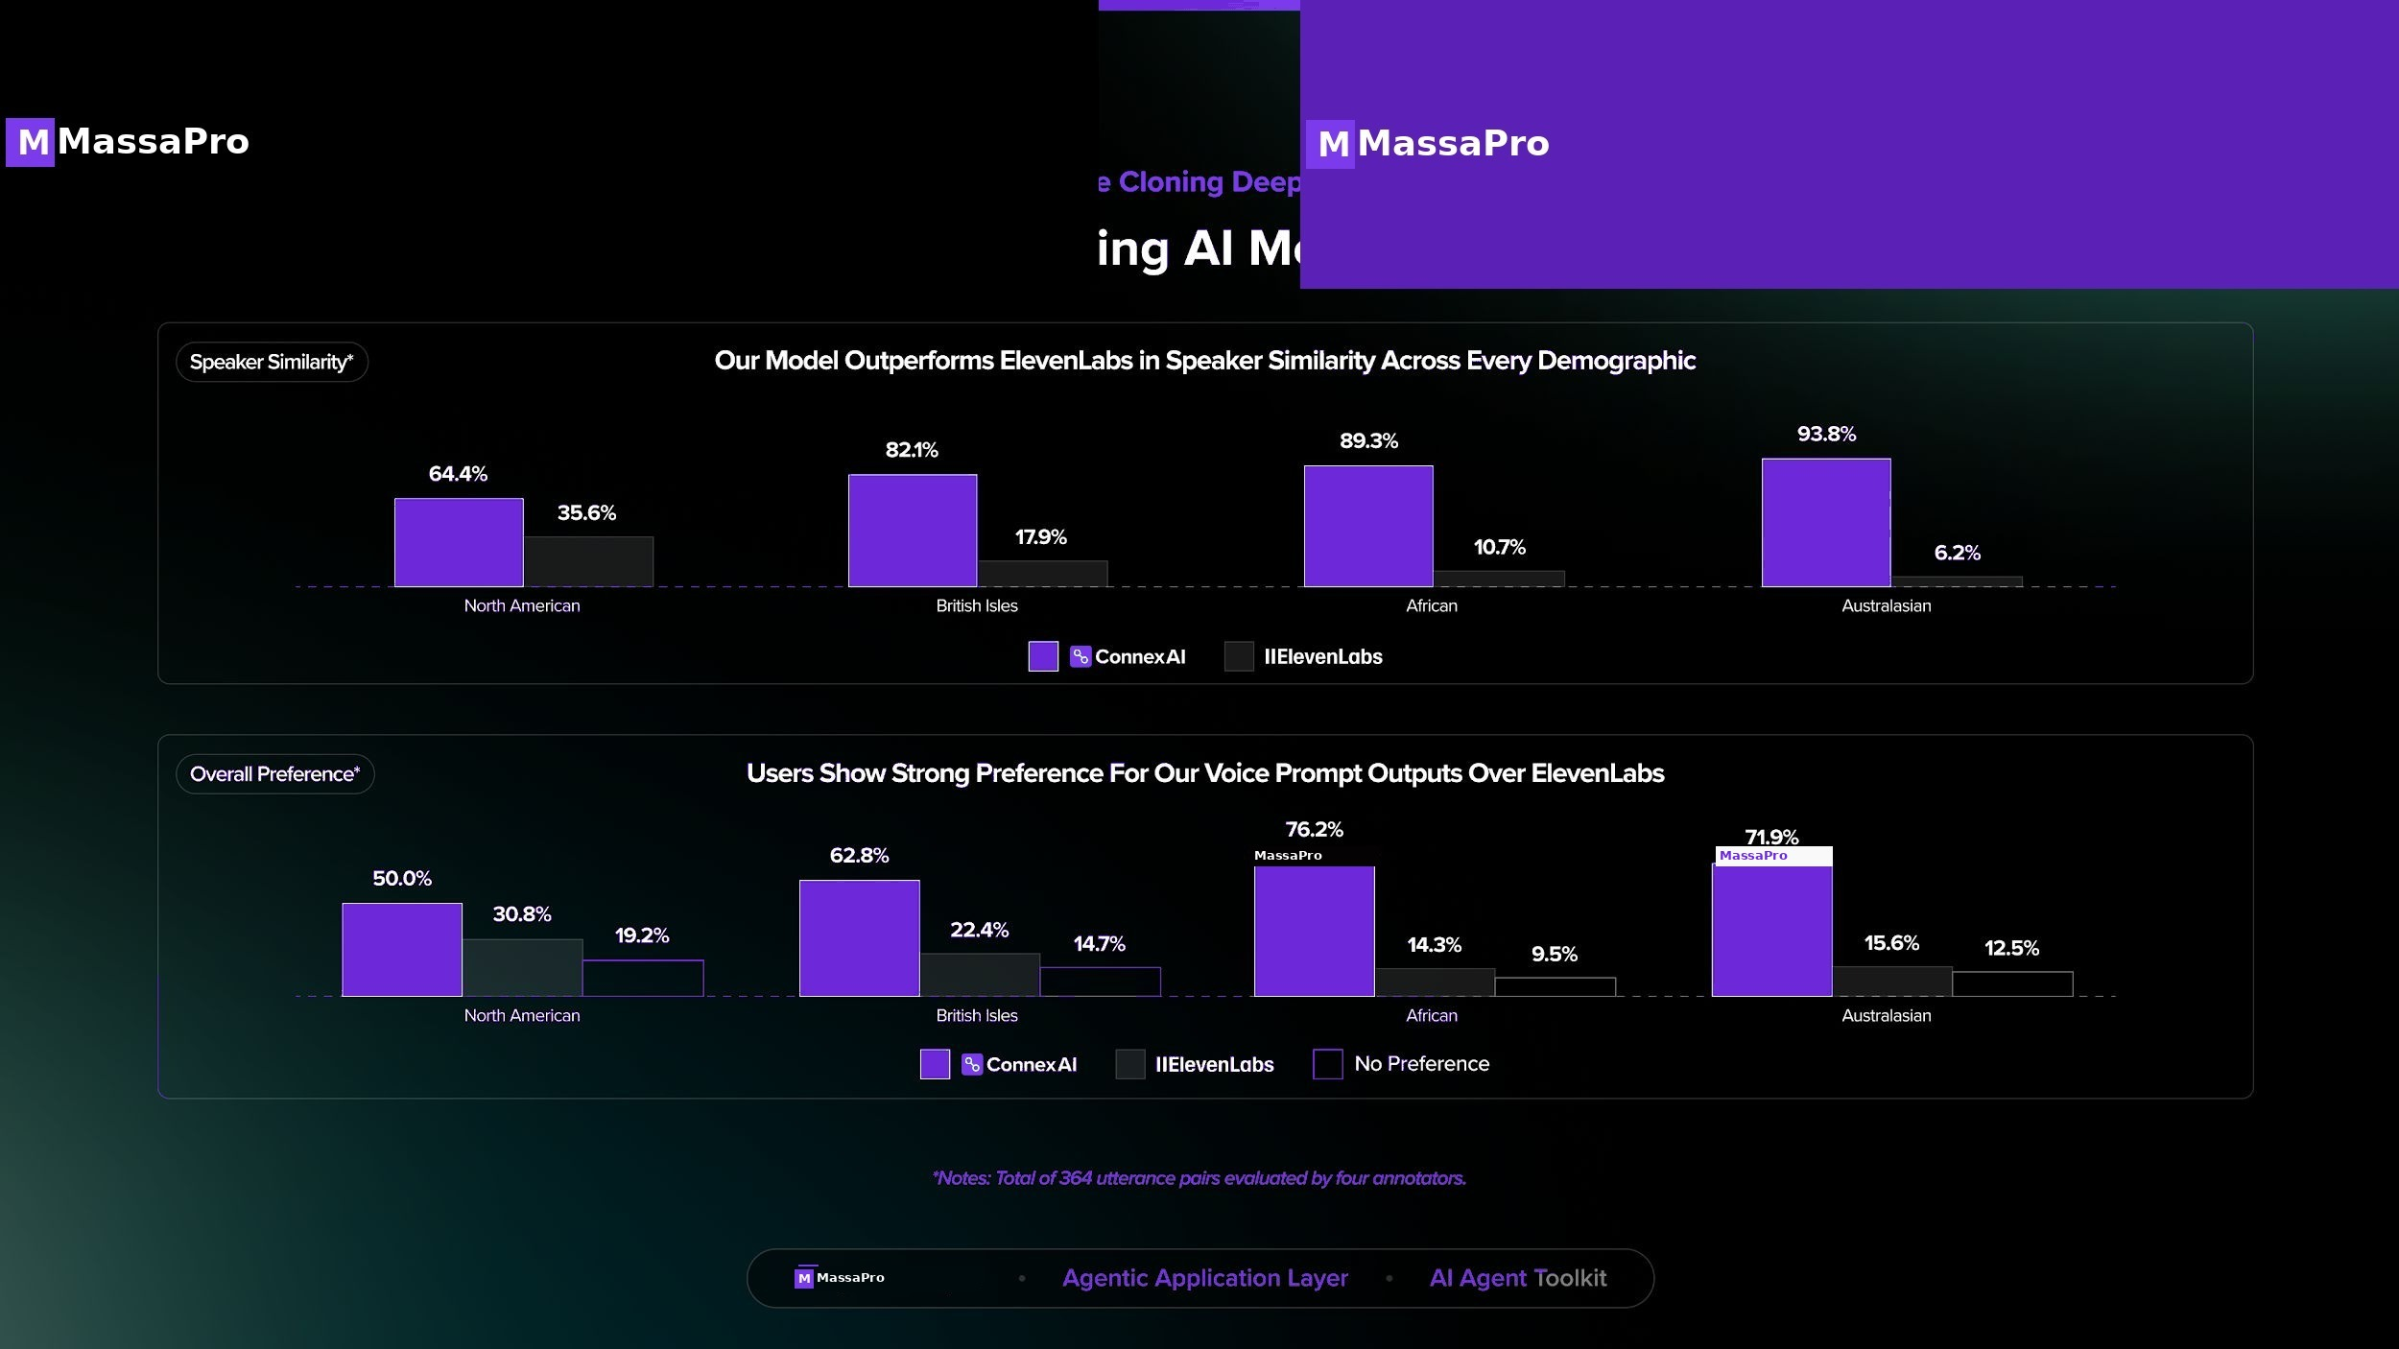
M
MassaPro
MASSAPRO · 08 / 30

Slide 9
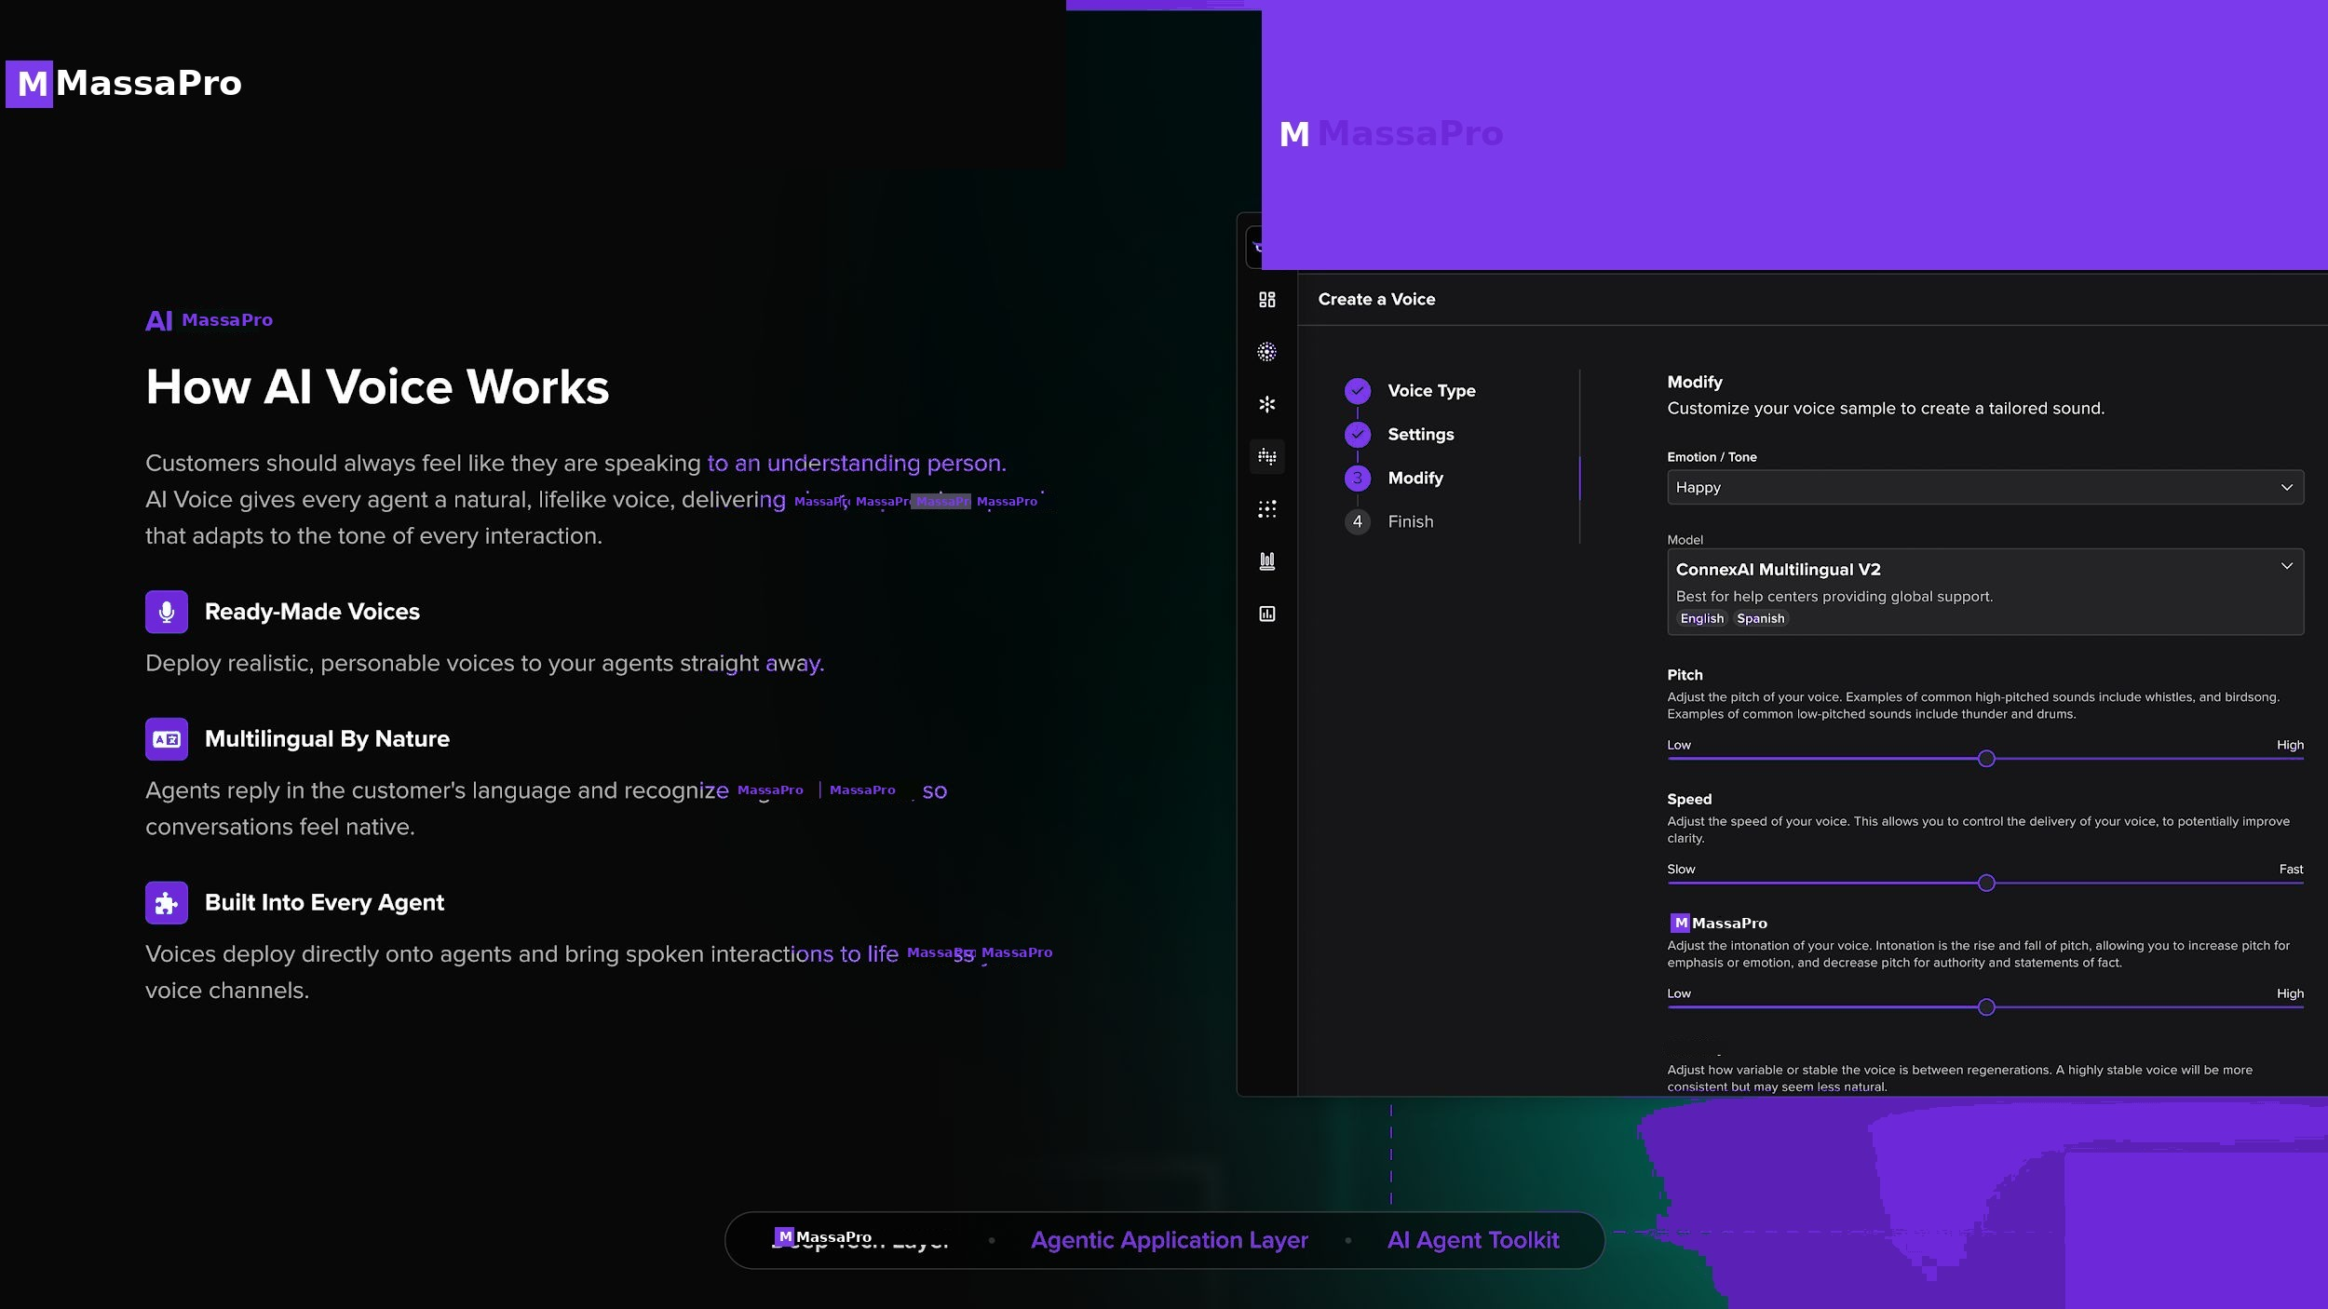
M
MassaPro
MASSAPRO · 09 / 30

Slide 10
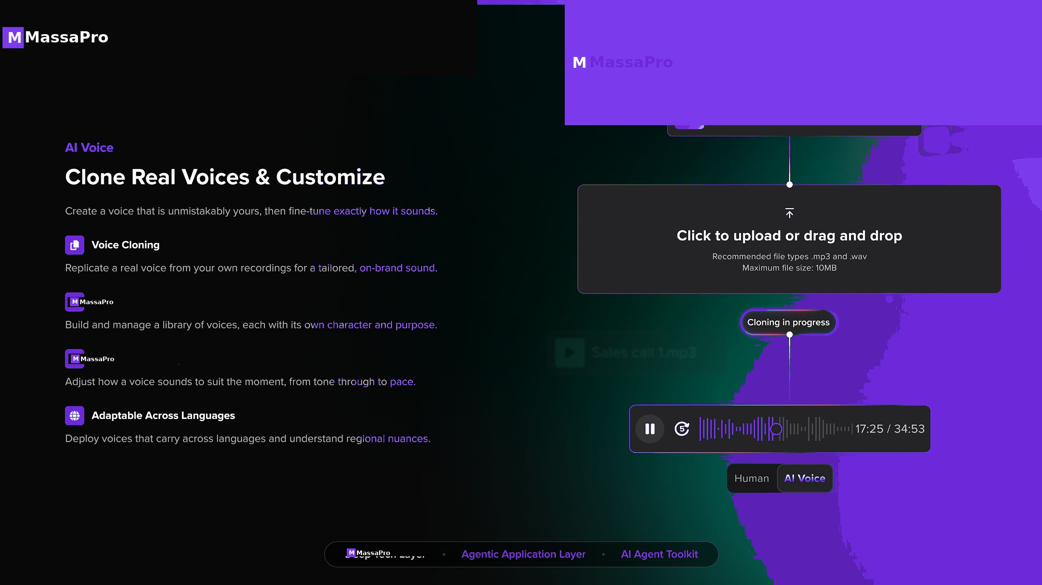
M
MassaPro
MASSAPRO · 10 / 30

Slide 11
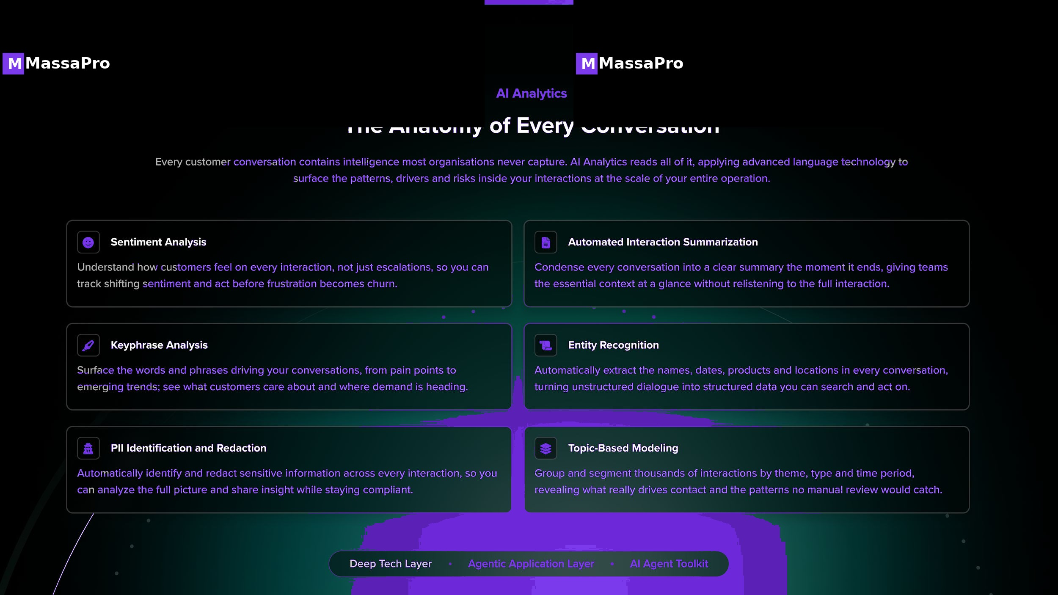
M
MassaPro
MASSAPRO · 11 / 30

Slide 12
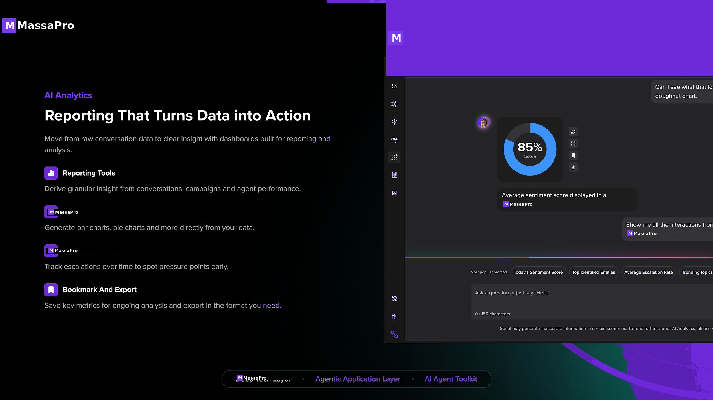
M
MassaPro
MASSAPRO · 12 / 30

Slide 13
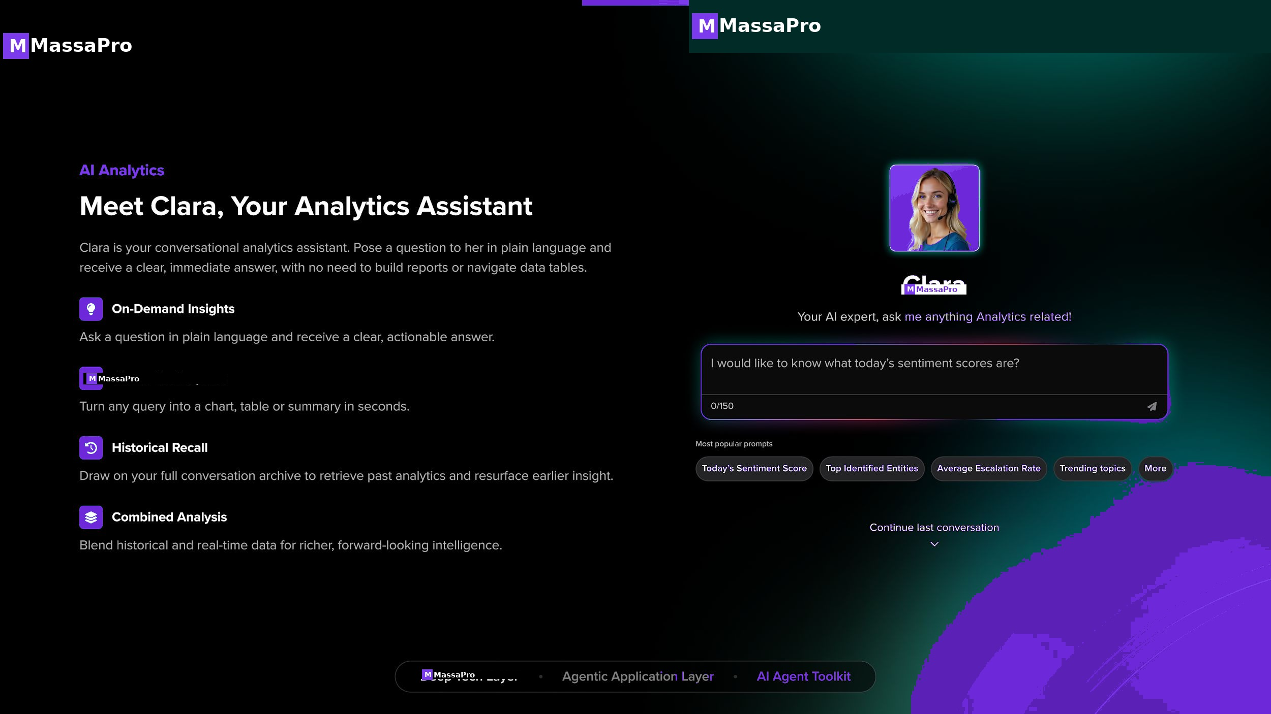
M
MassaPro
MASSAPRO · 13 / 30

Slide 14
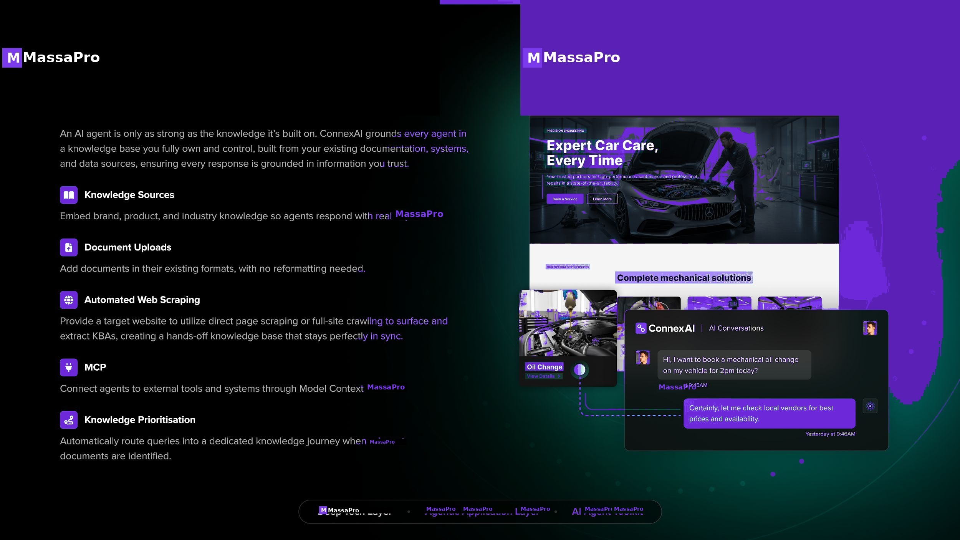
M
MassaPro
MASSAPRO · 14 / 30

Slide 15
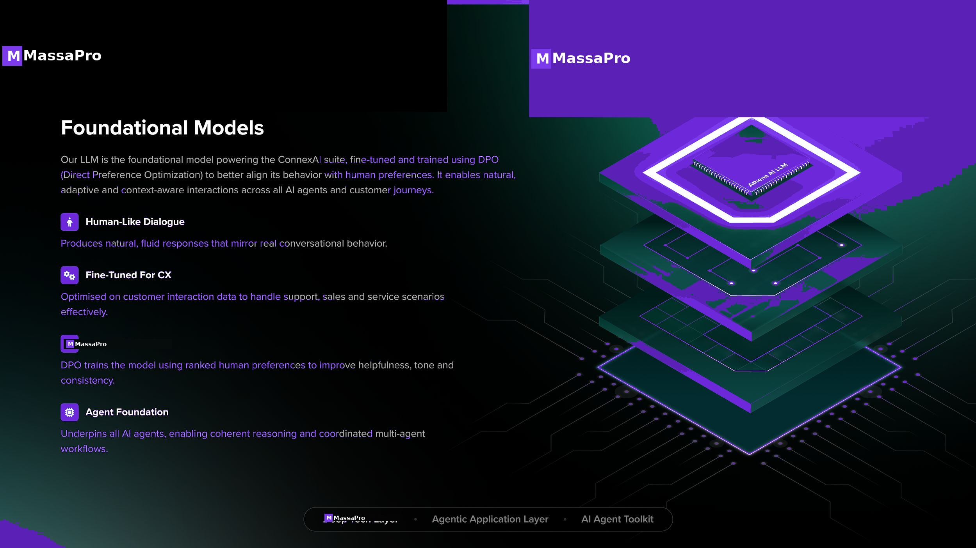
M
MassaPro
MASSAPRO · 15 / 30

Slide 16
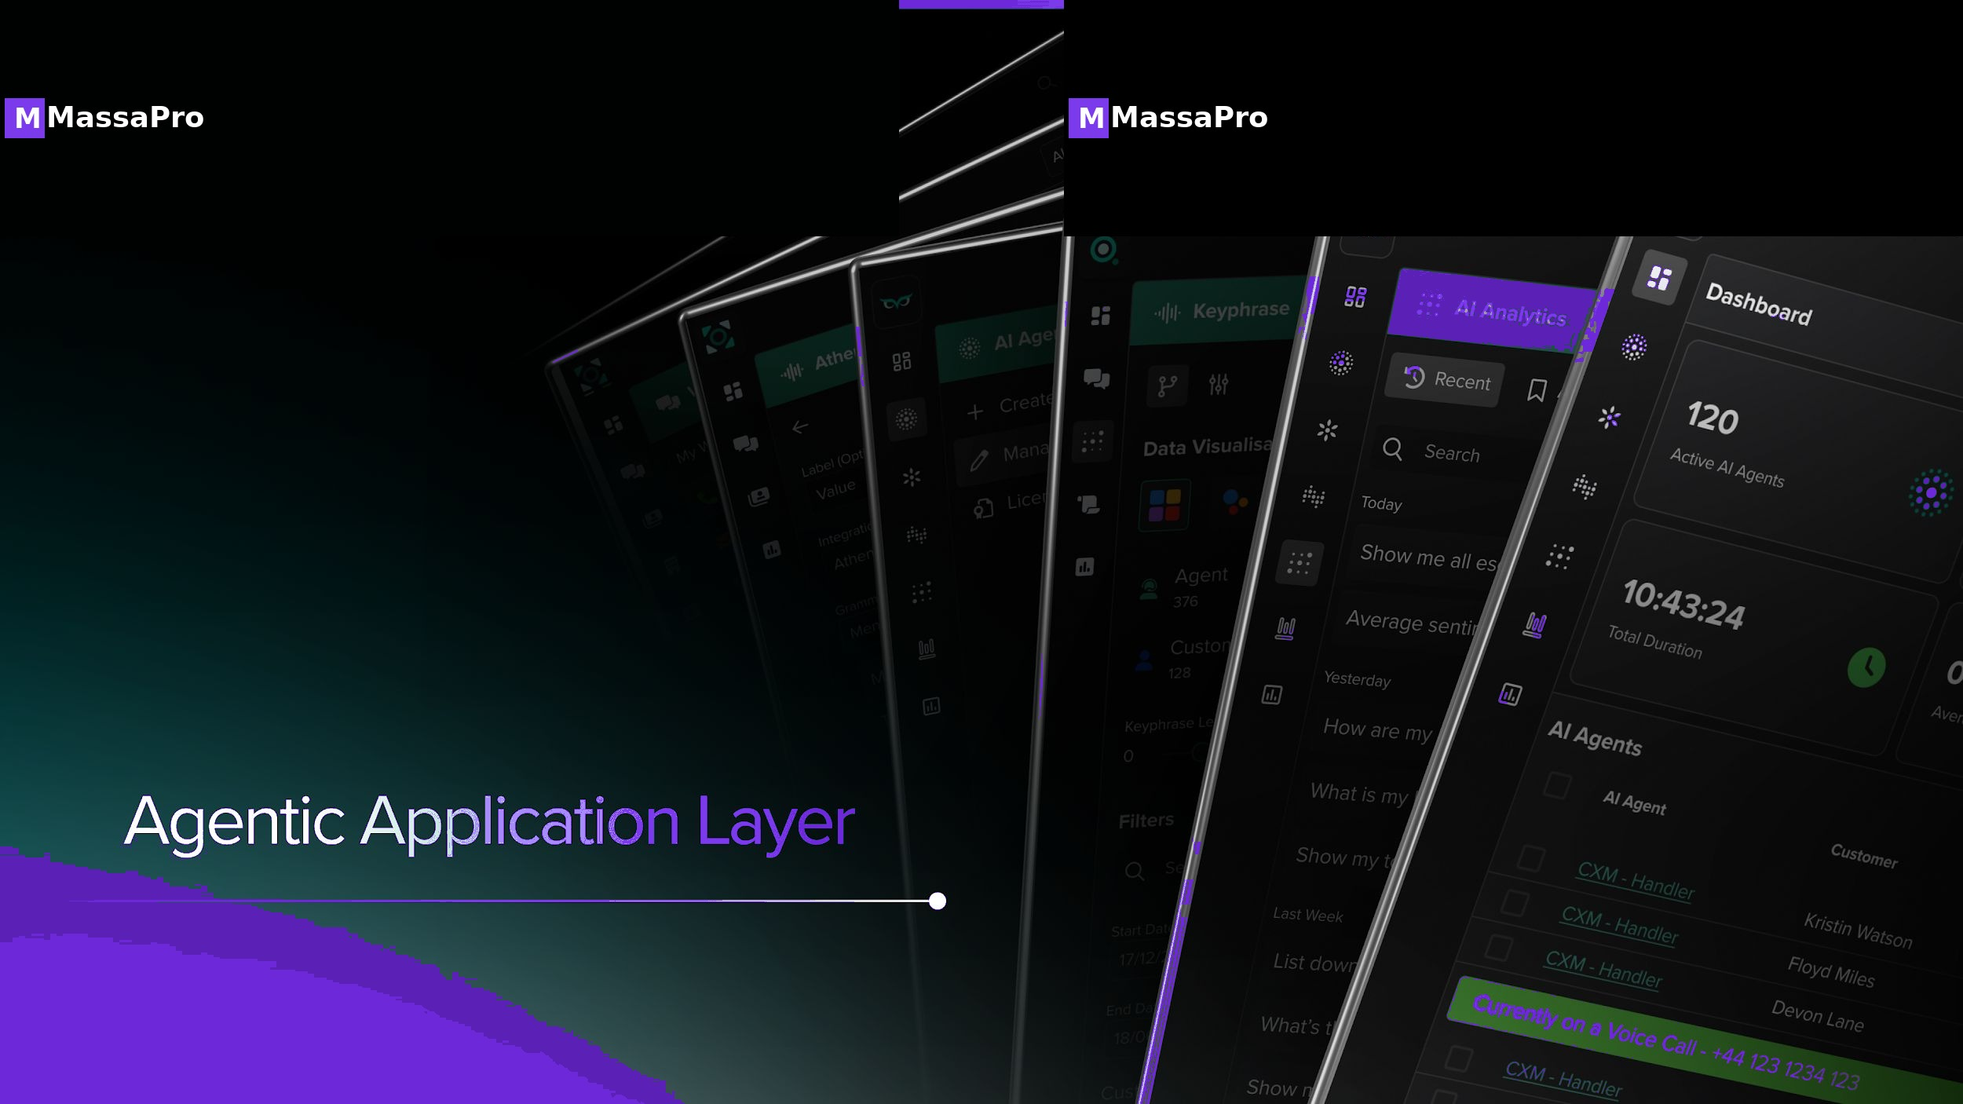
M
MassaPro
MASSAPRO · 16 / 30

Slide 17
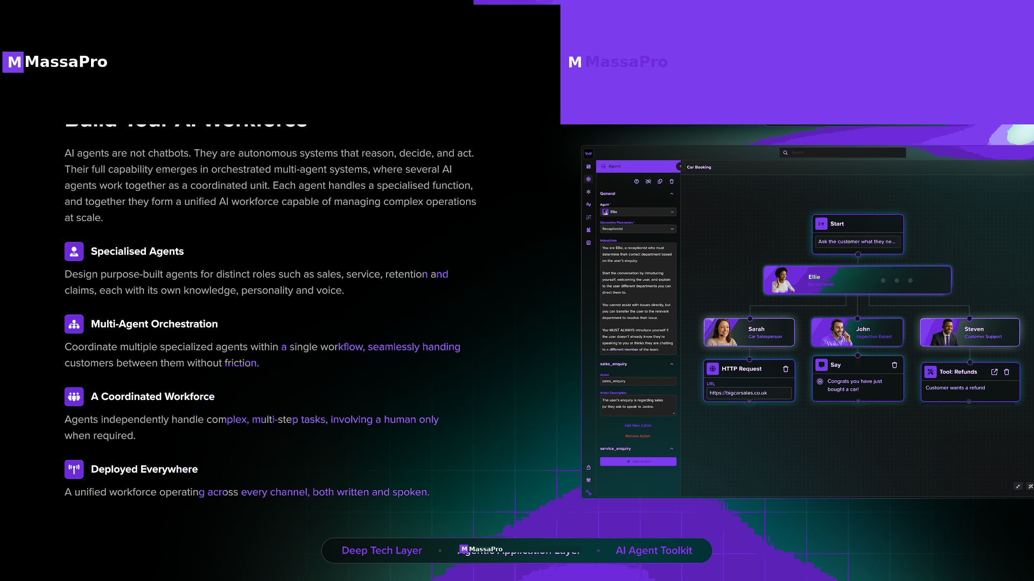
M
MassaPro
MASSAPRO · 17 / 30

Slide 18
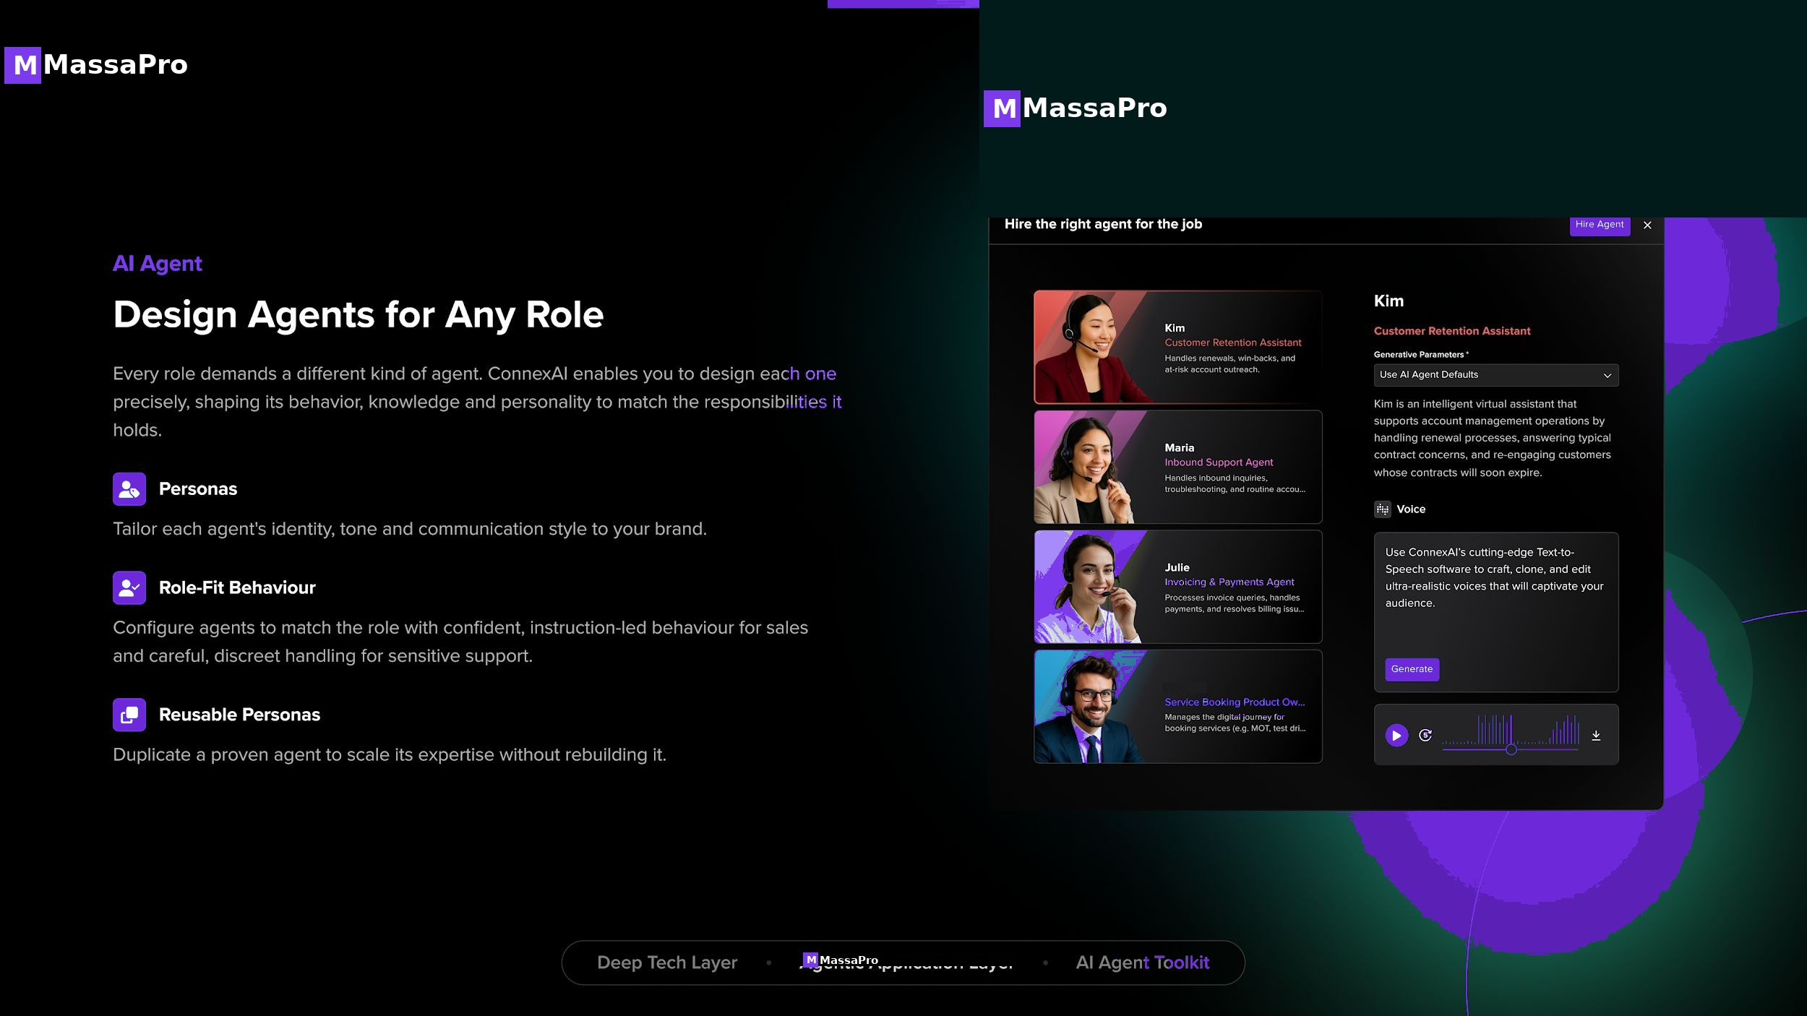
M
MassaPro
MASSAPRO · 18 / 30

Slide 19
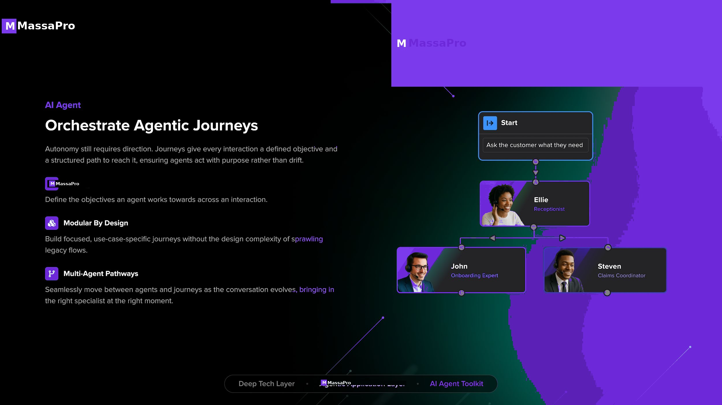
M
MassaPro
MASSAPRO · 19 / 30

Slide 20
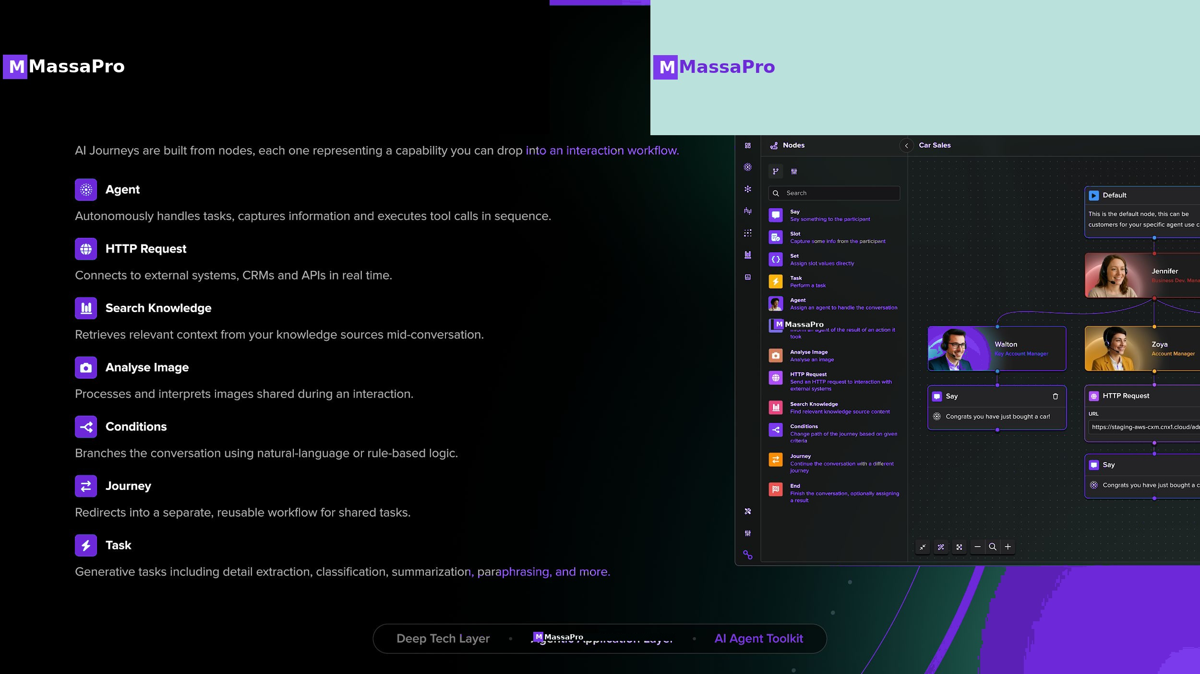
M
MassaPro
MASSAPRO · 20 / 30

Slide 21
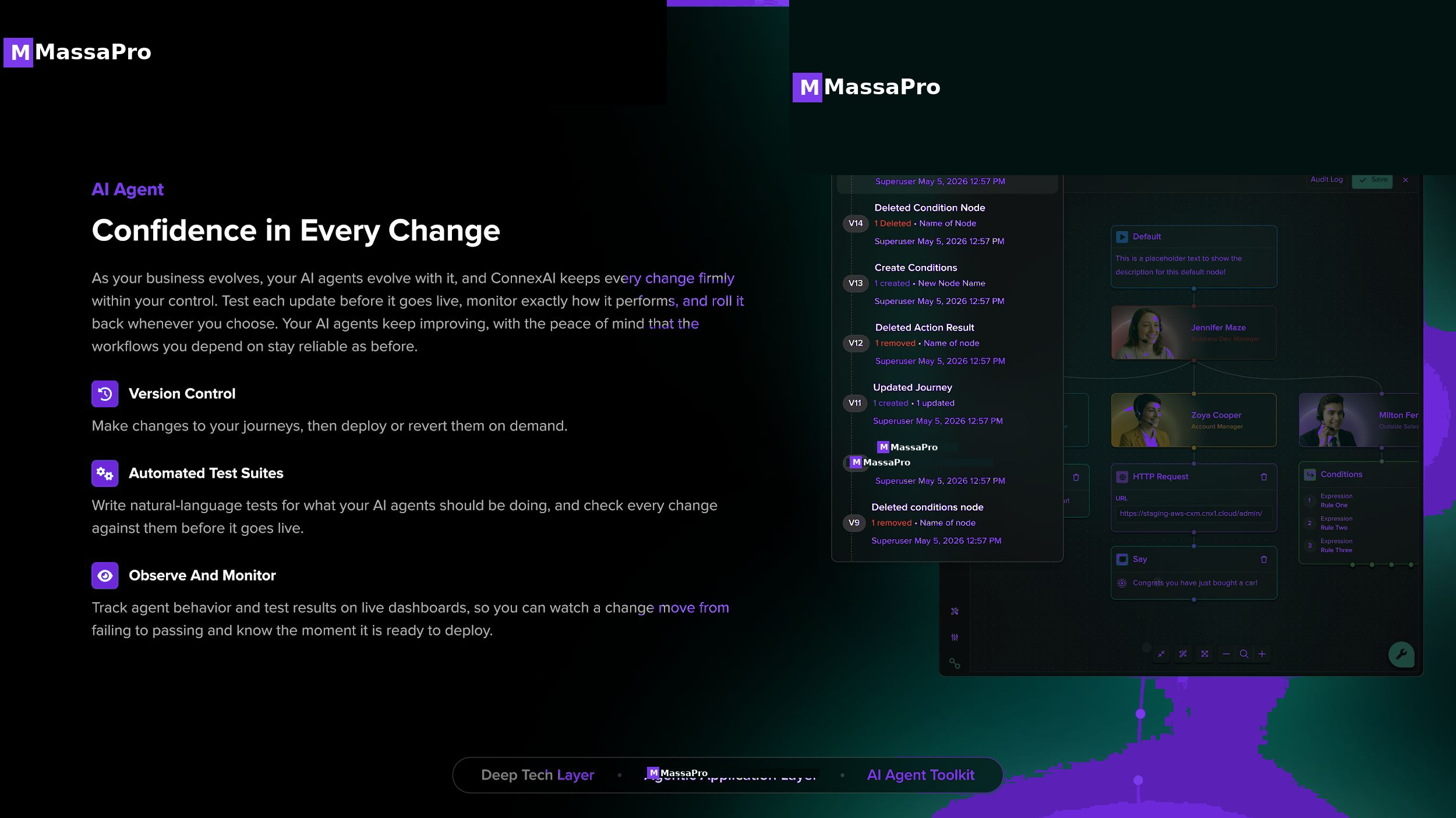
M
MassaPro
MASSAPRO · 21 / 30

Slide 22
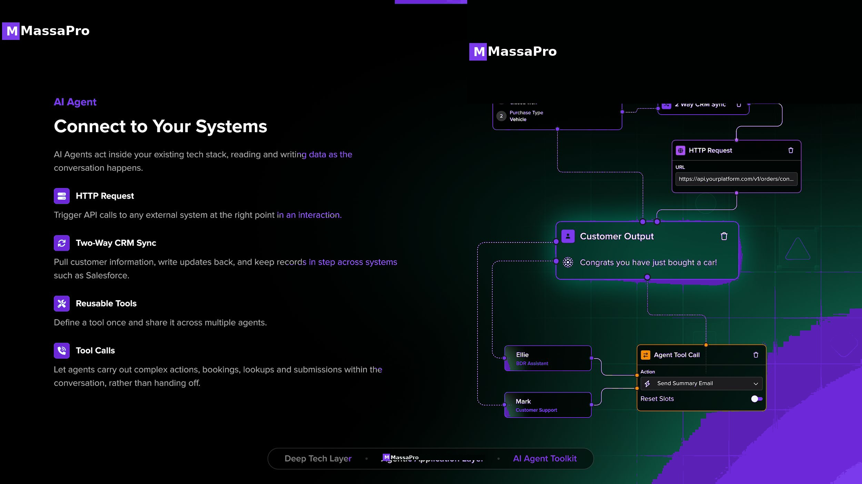
M
MassaPro
AGENTIC AI WORKFORCE
Replace your call center with a coordinated AI workforce.
AI agents are not chatbots. They are autonomous systems that reason, decide, and act — orchestrated by our proprietary LLM. Specialized agents handle sales, service, retention, and claims together, scaling without headcount or per-minute token costs.
MASSAPRO · 22 / 30

Slide 23
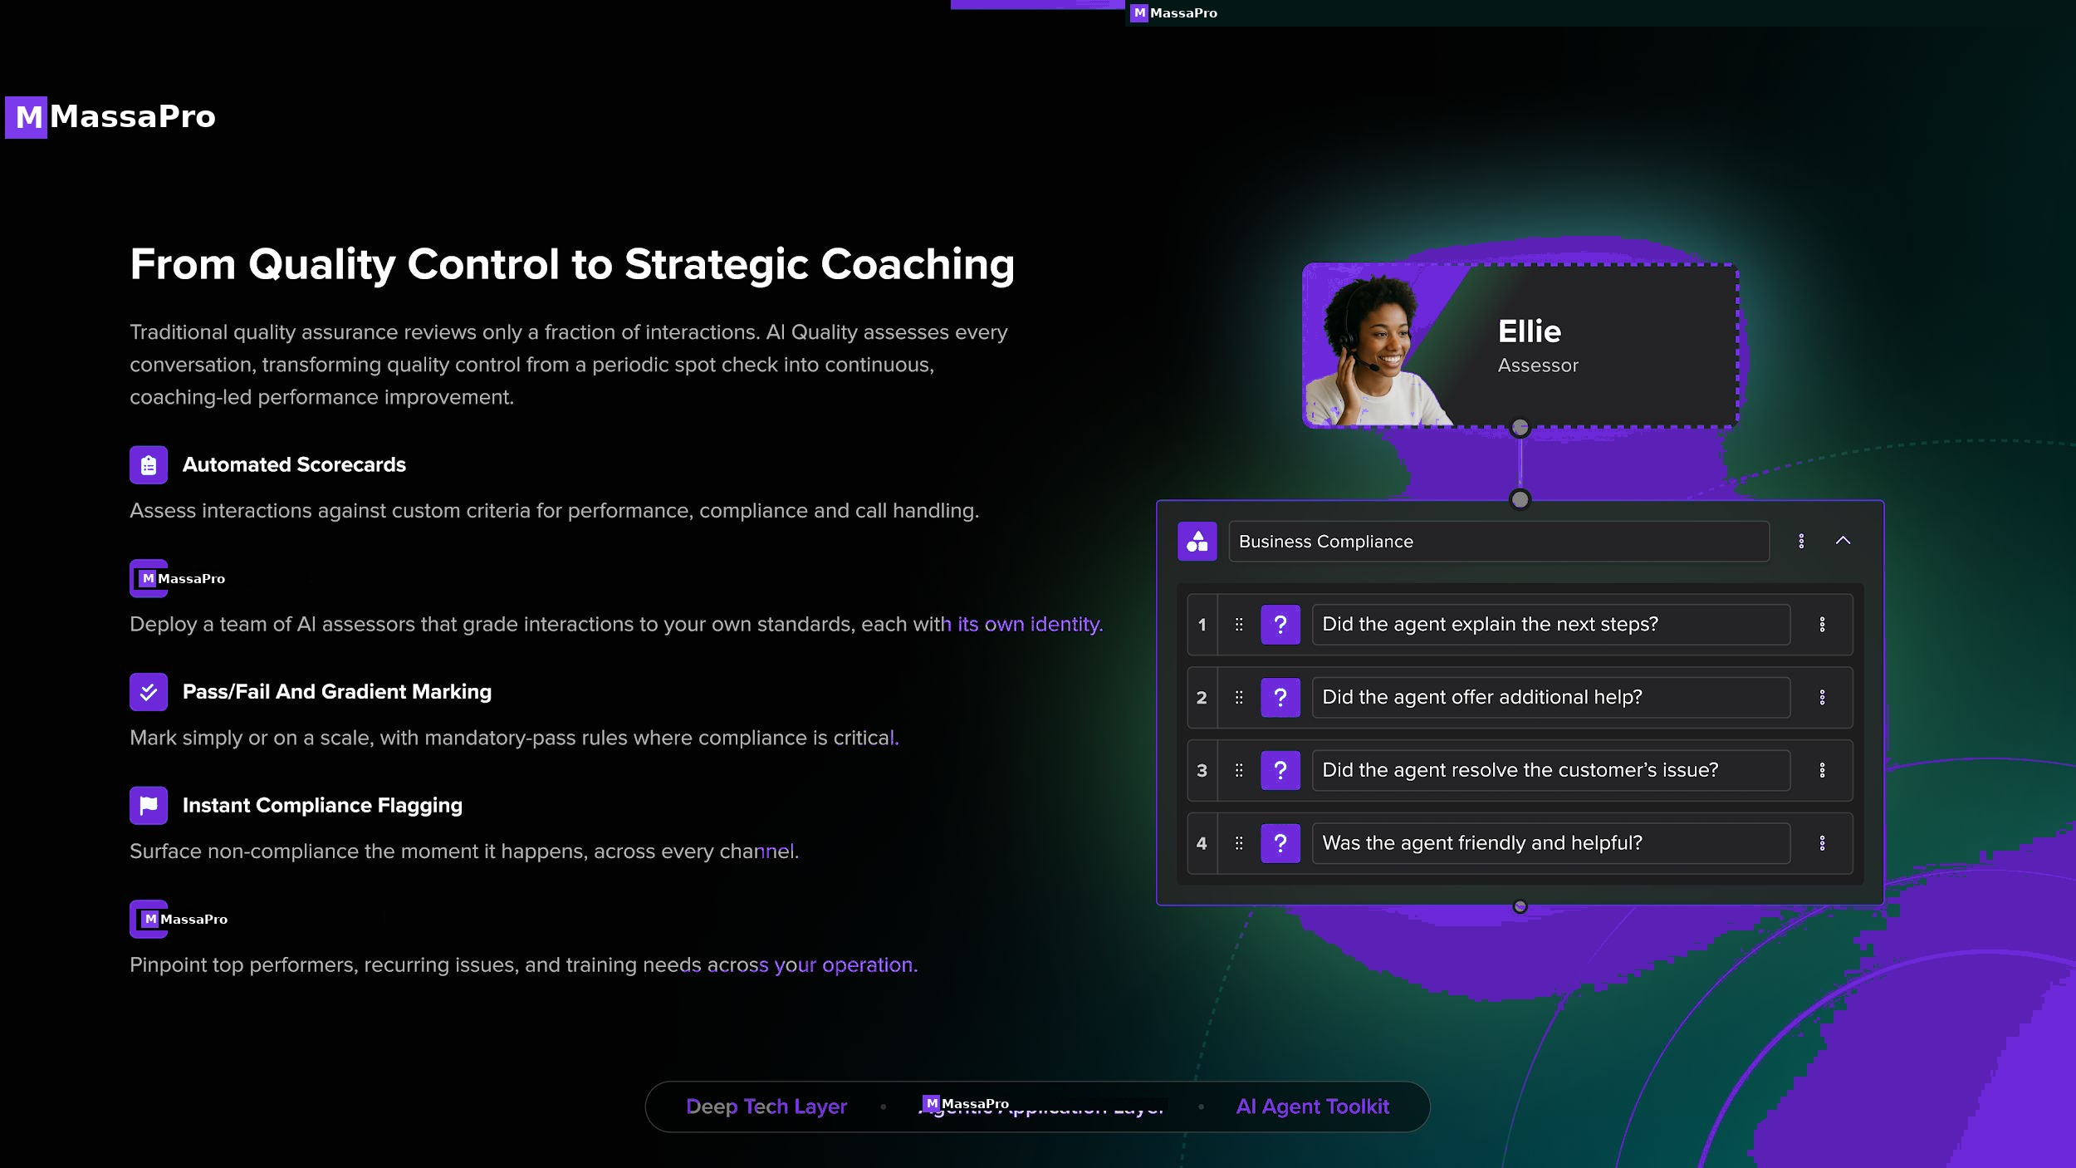
M
MassaPro
MASSAPRO · 23 / 30

Slide 24
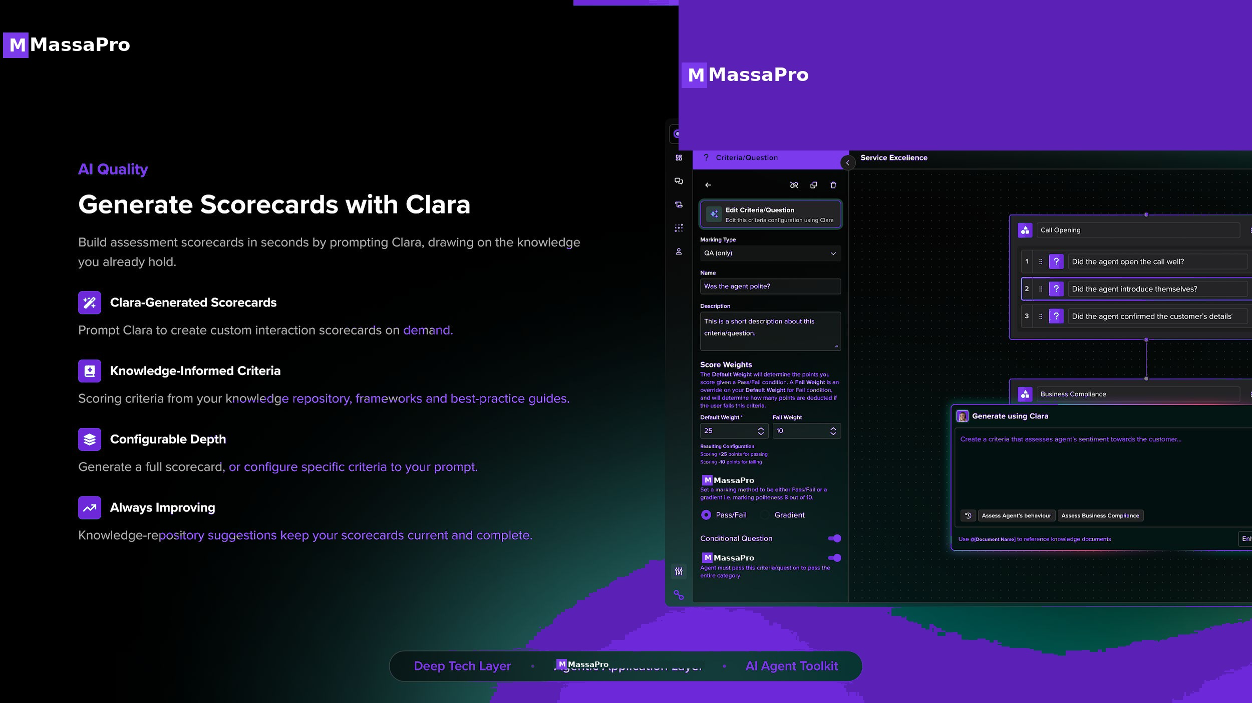
M
MassaPro
MASSAPRO · 24 / 30

Slide 25
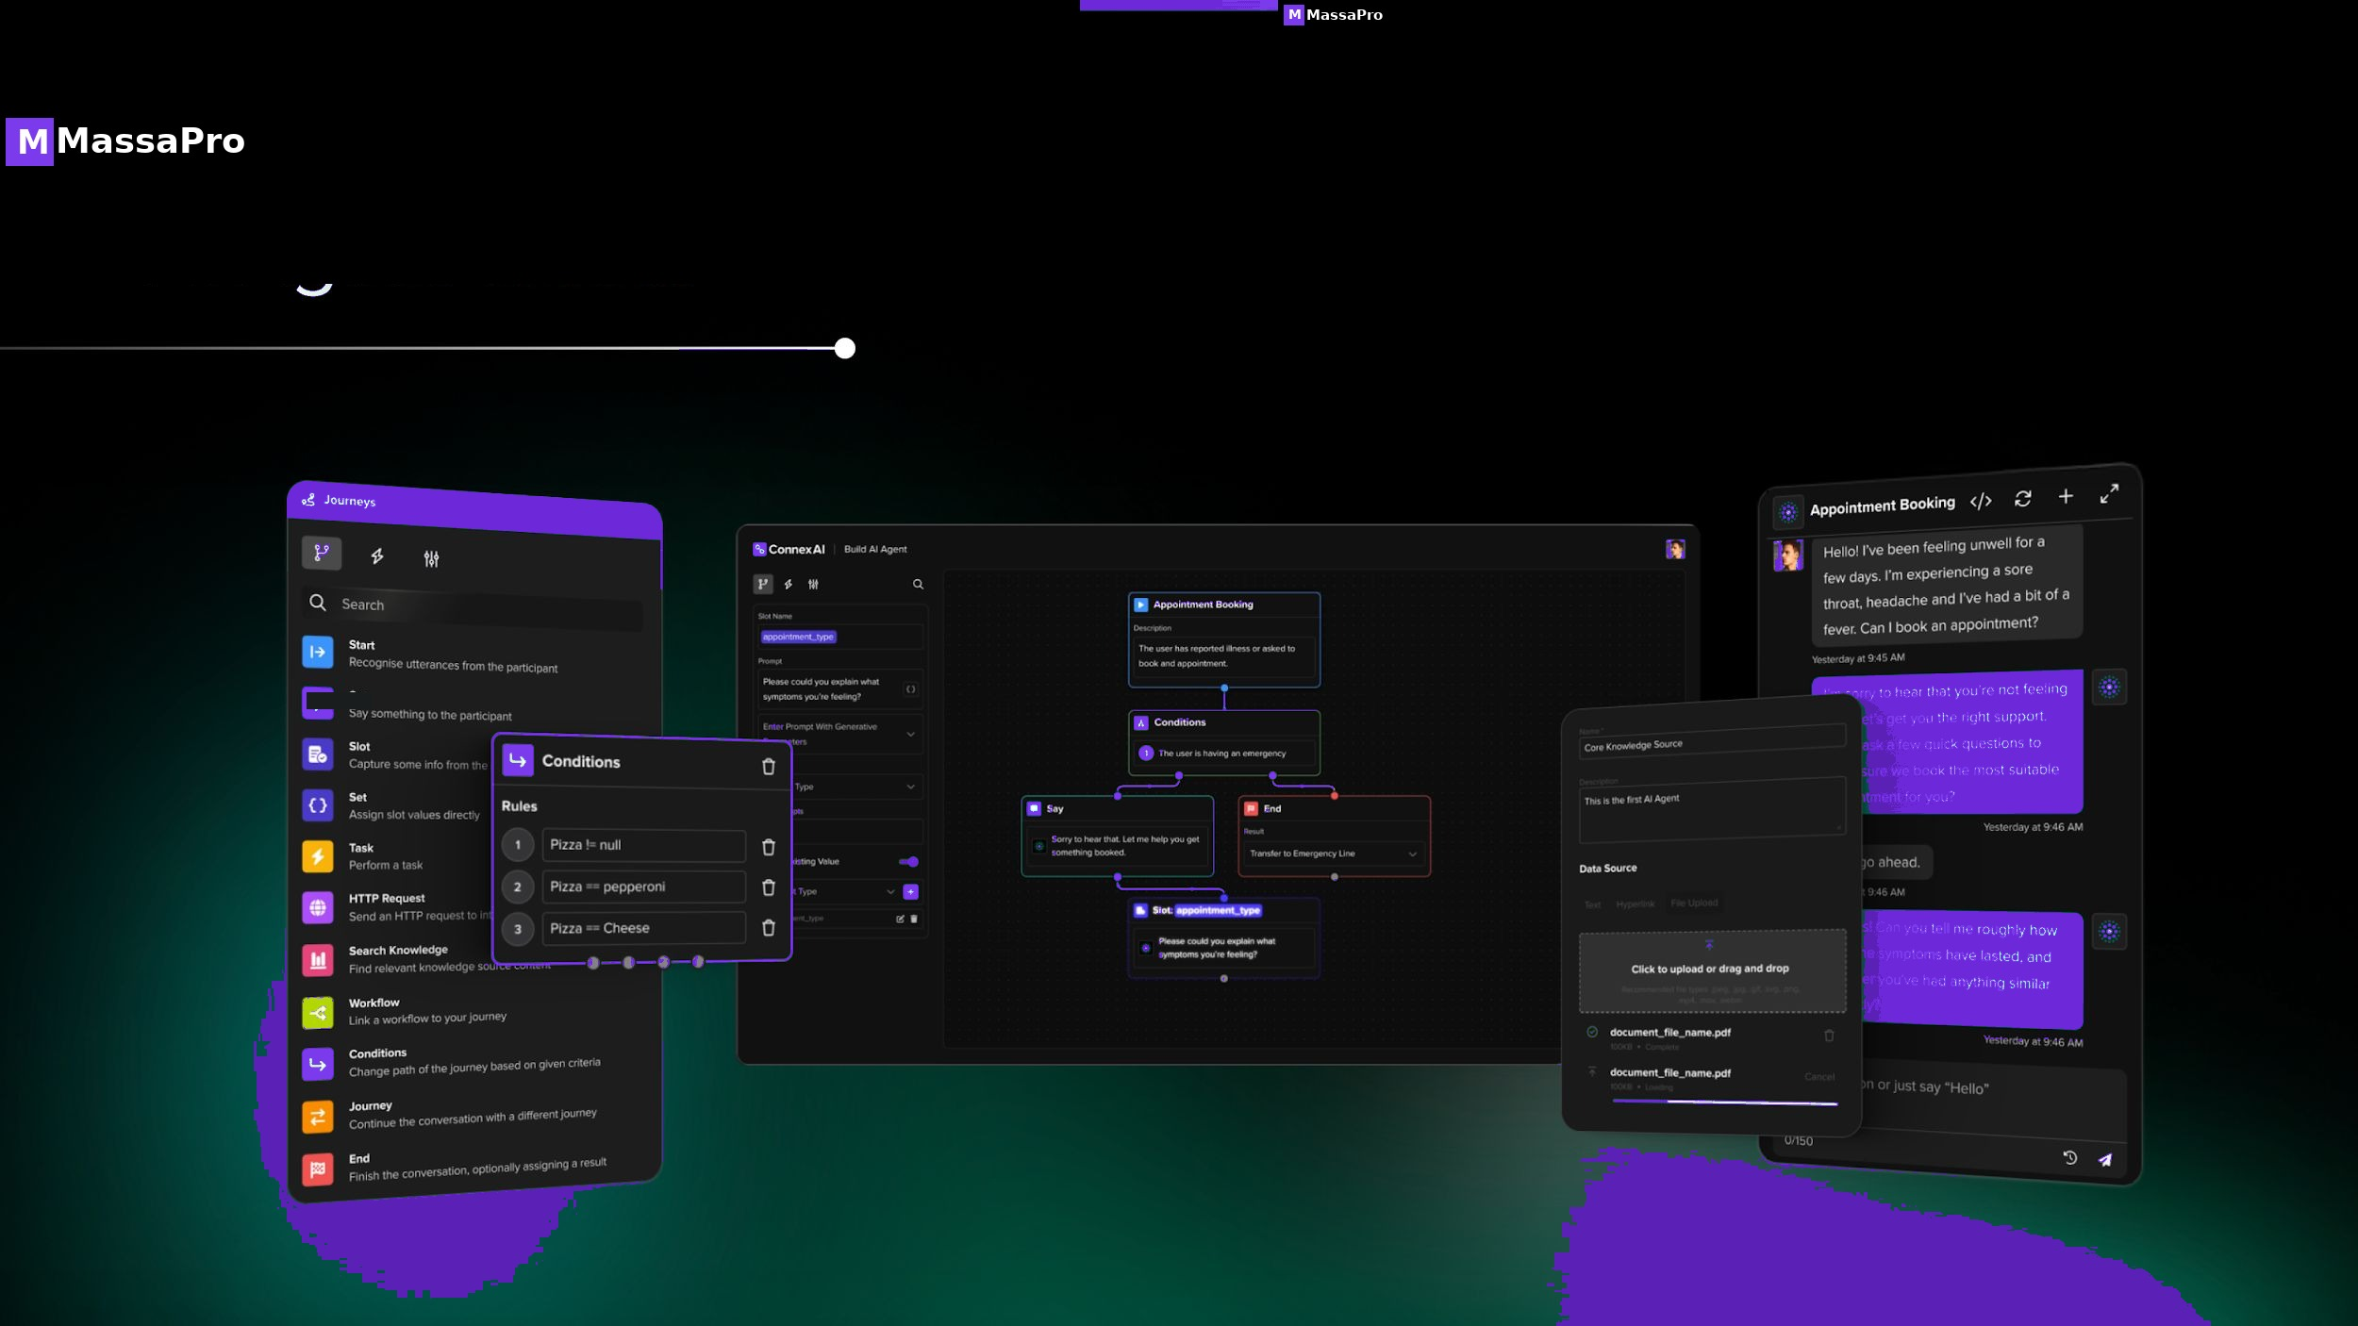
M
MassaPro
MASSAPRO · 25 / 30

Slide 26
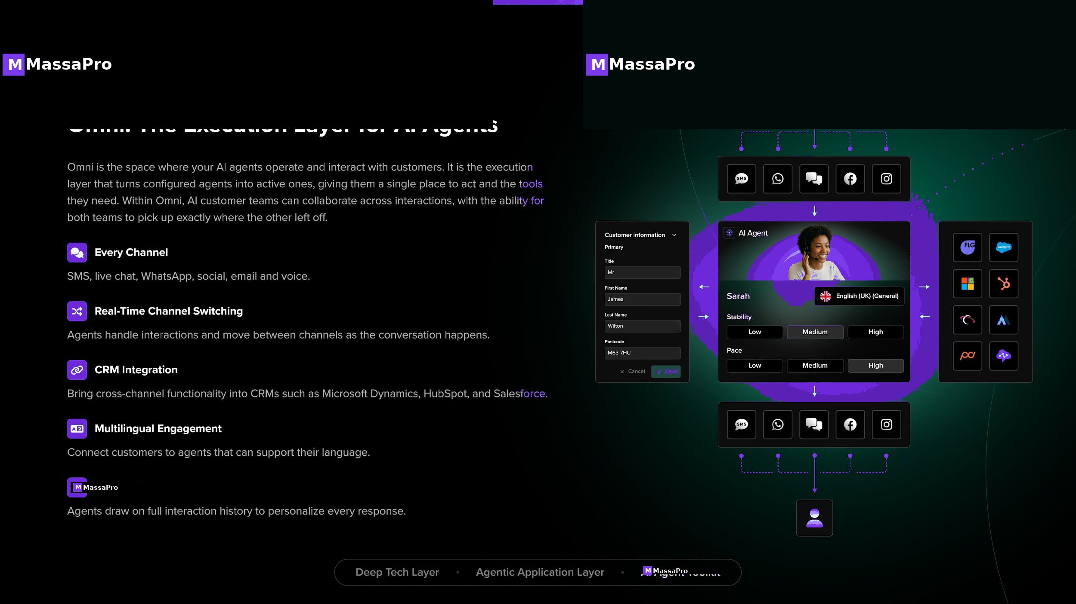
M
MassaPro
MASSAPRO · 26 / 30

Slide 27
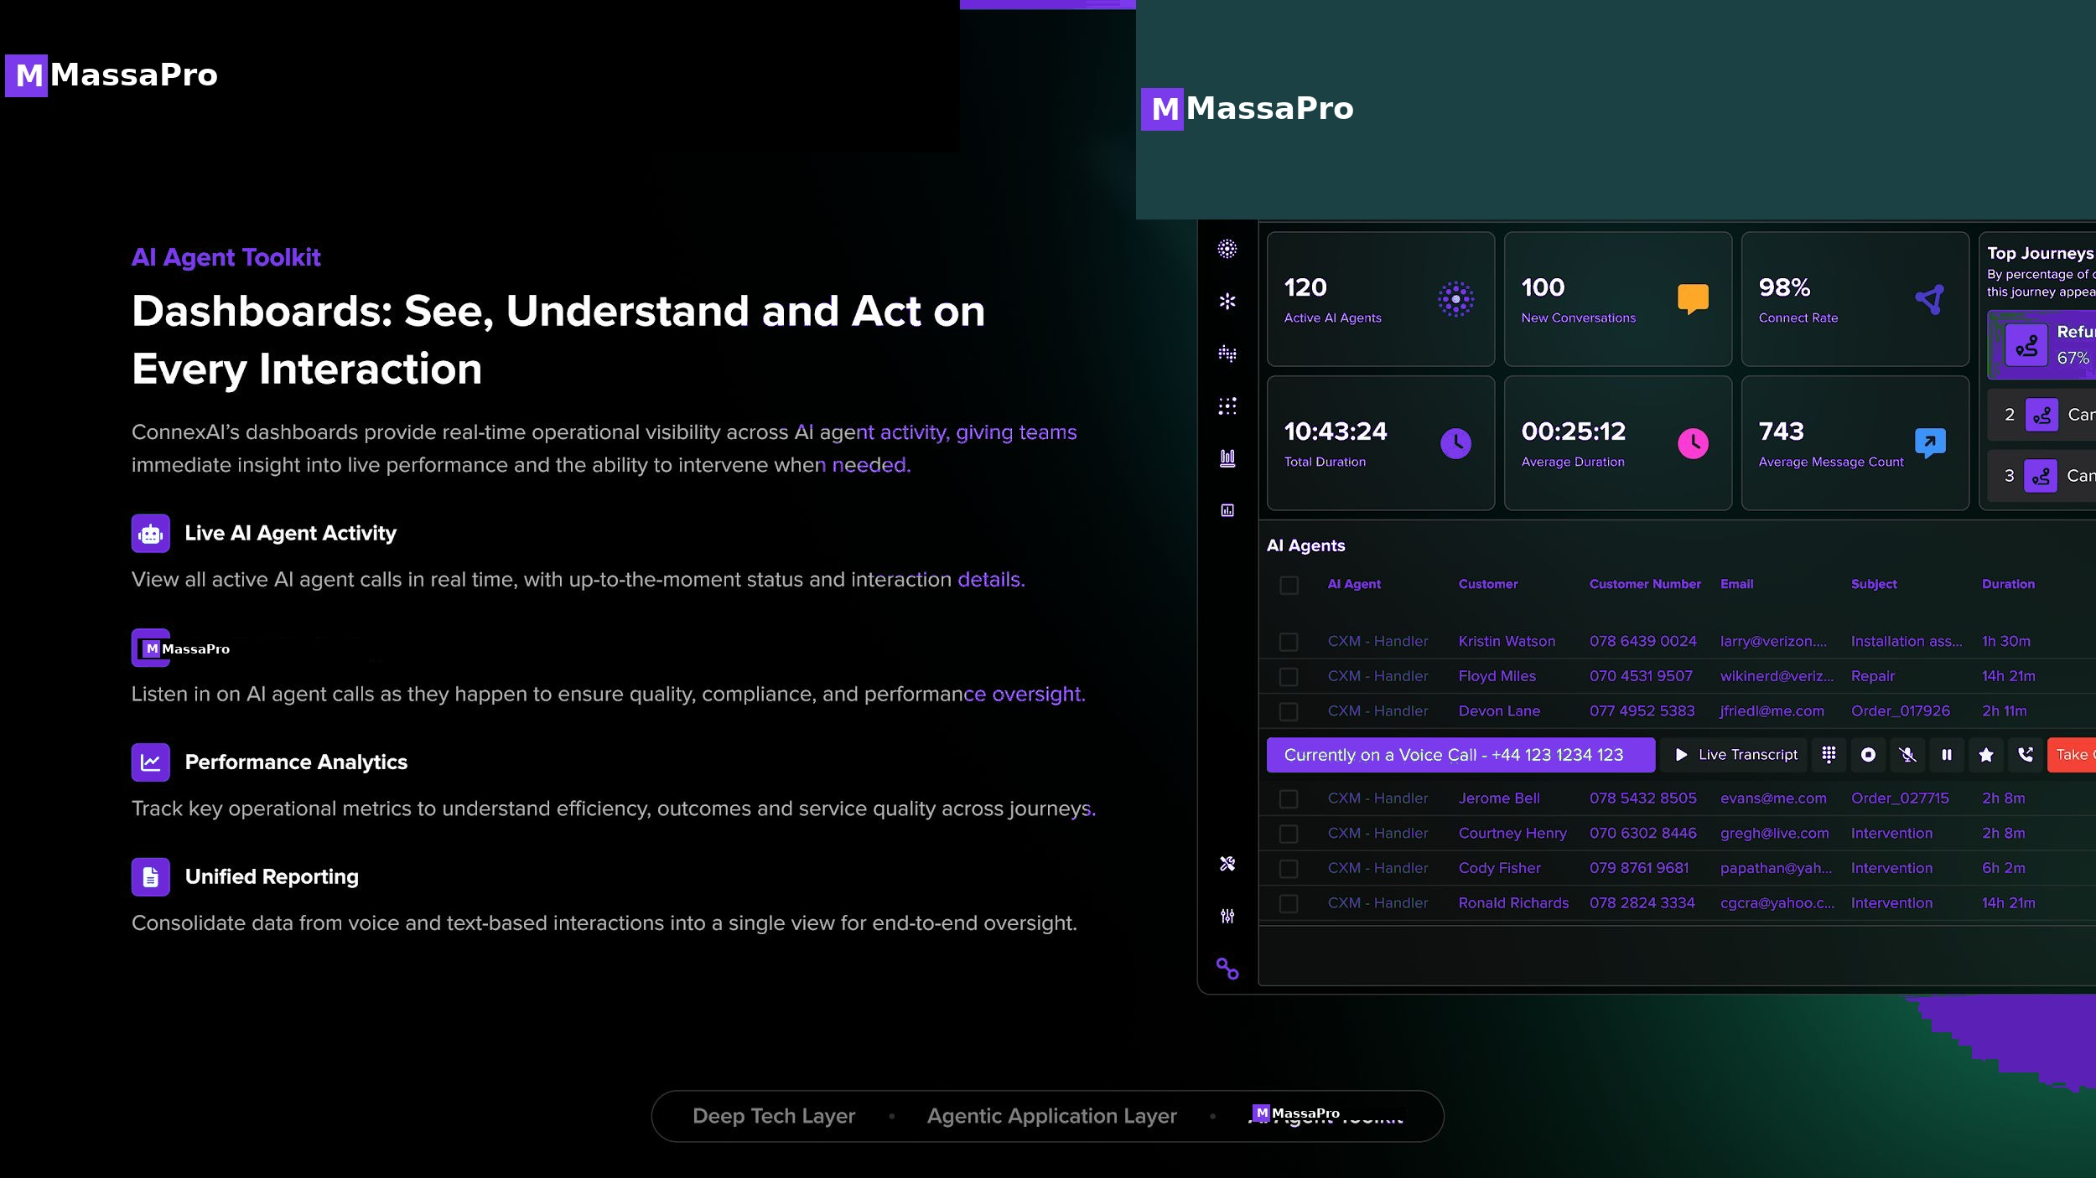
M
MassaPro
MASSAPRO · 27 / 30

Slide 28
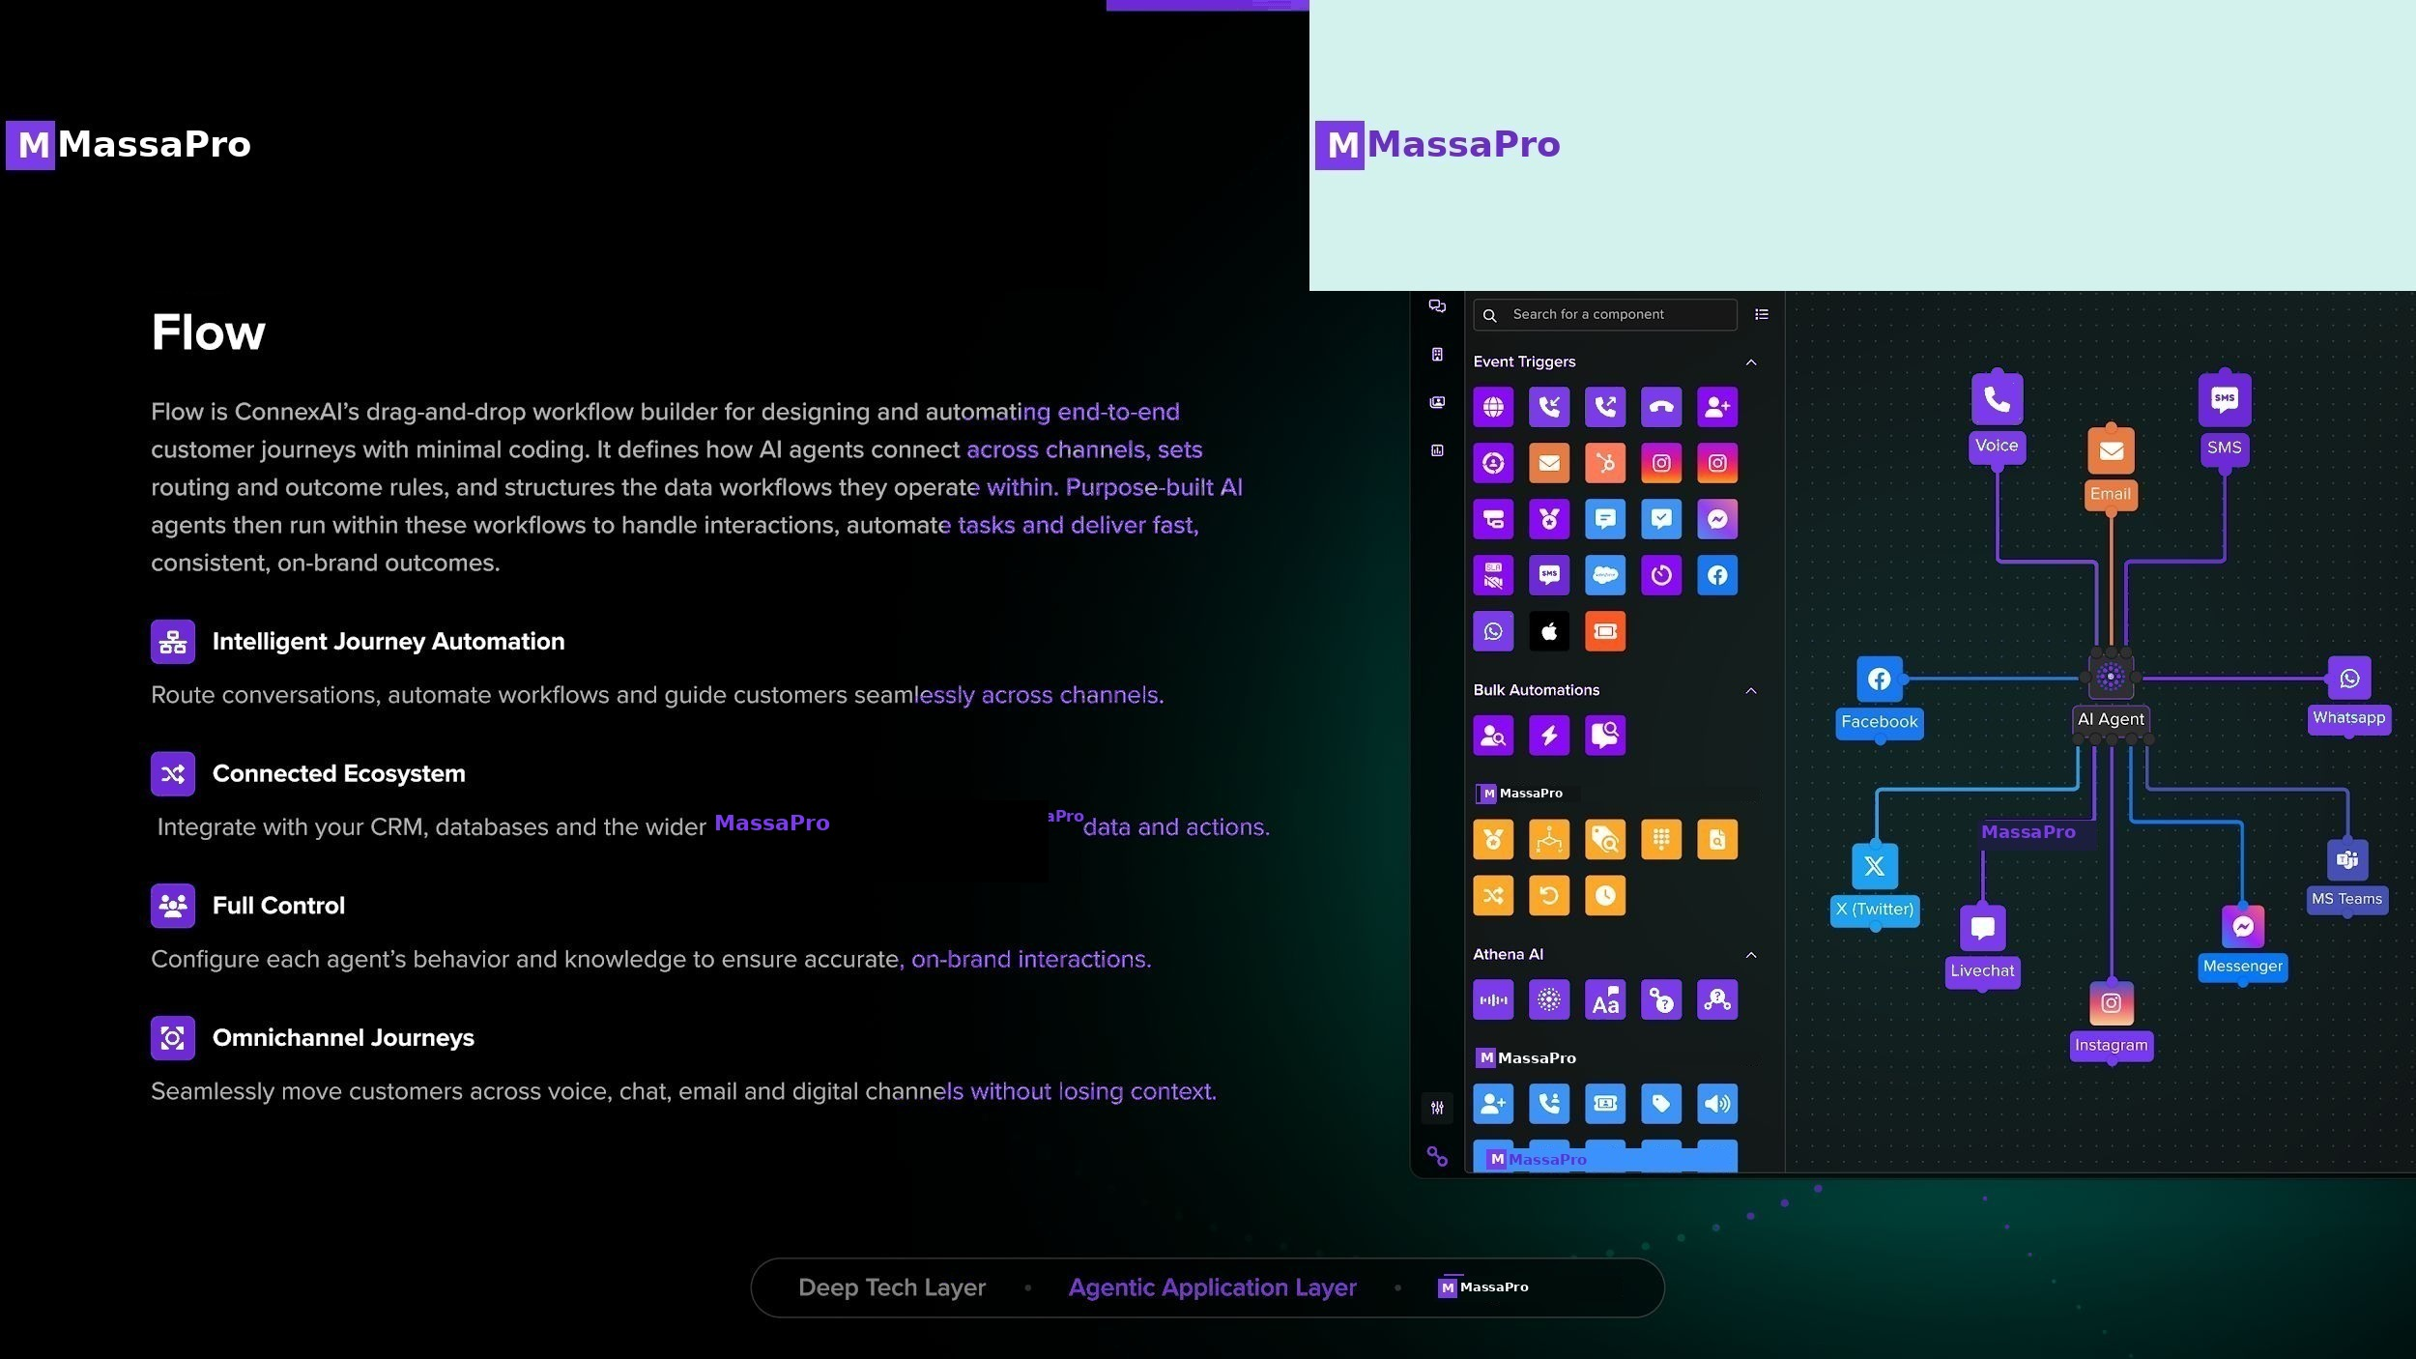
M
MassaPro
THE MASSAPRO ADVANTAGE
A growth machine, not a cost center.
Replace the entire call center and customer journey platform with Agentic AI orchestrated by our proprietary LLM. Scale without per-minute AI token fees — pay a flat per-agent + volume price. Save costs. Boost productivity. Turn service into growth.
MASSAPRO · 28 / 30

Slide 29
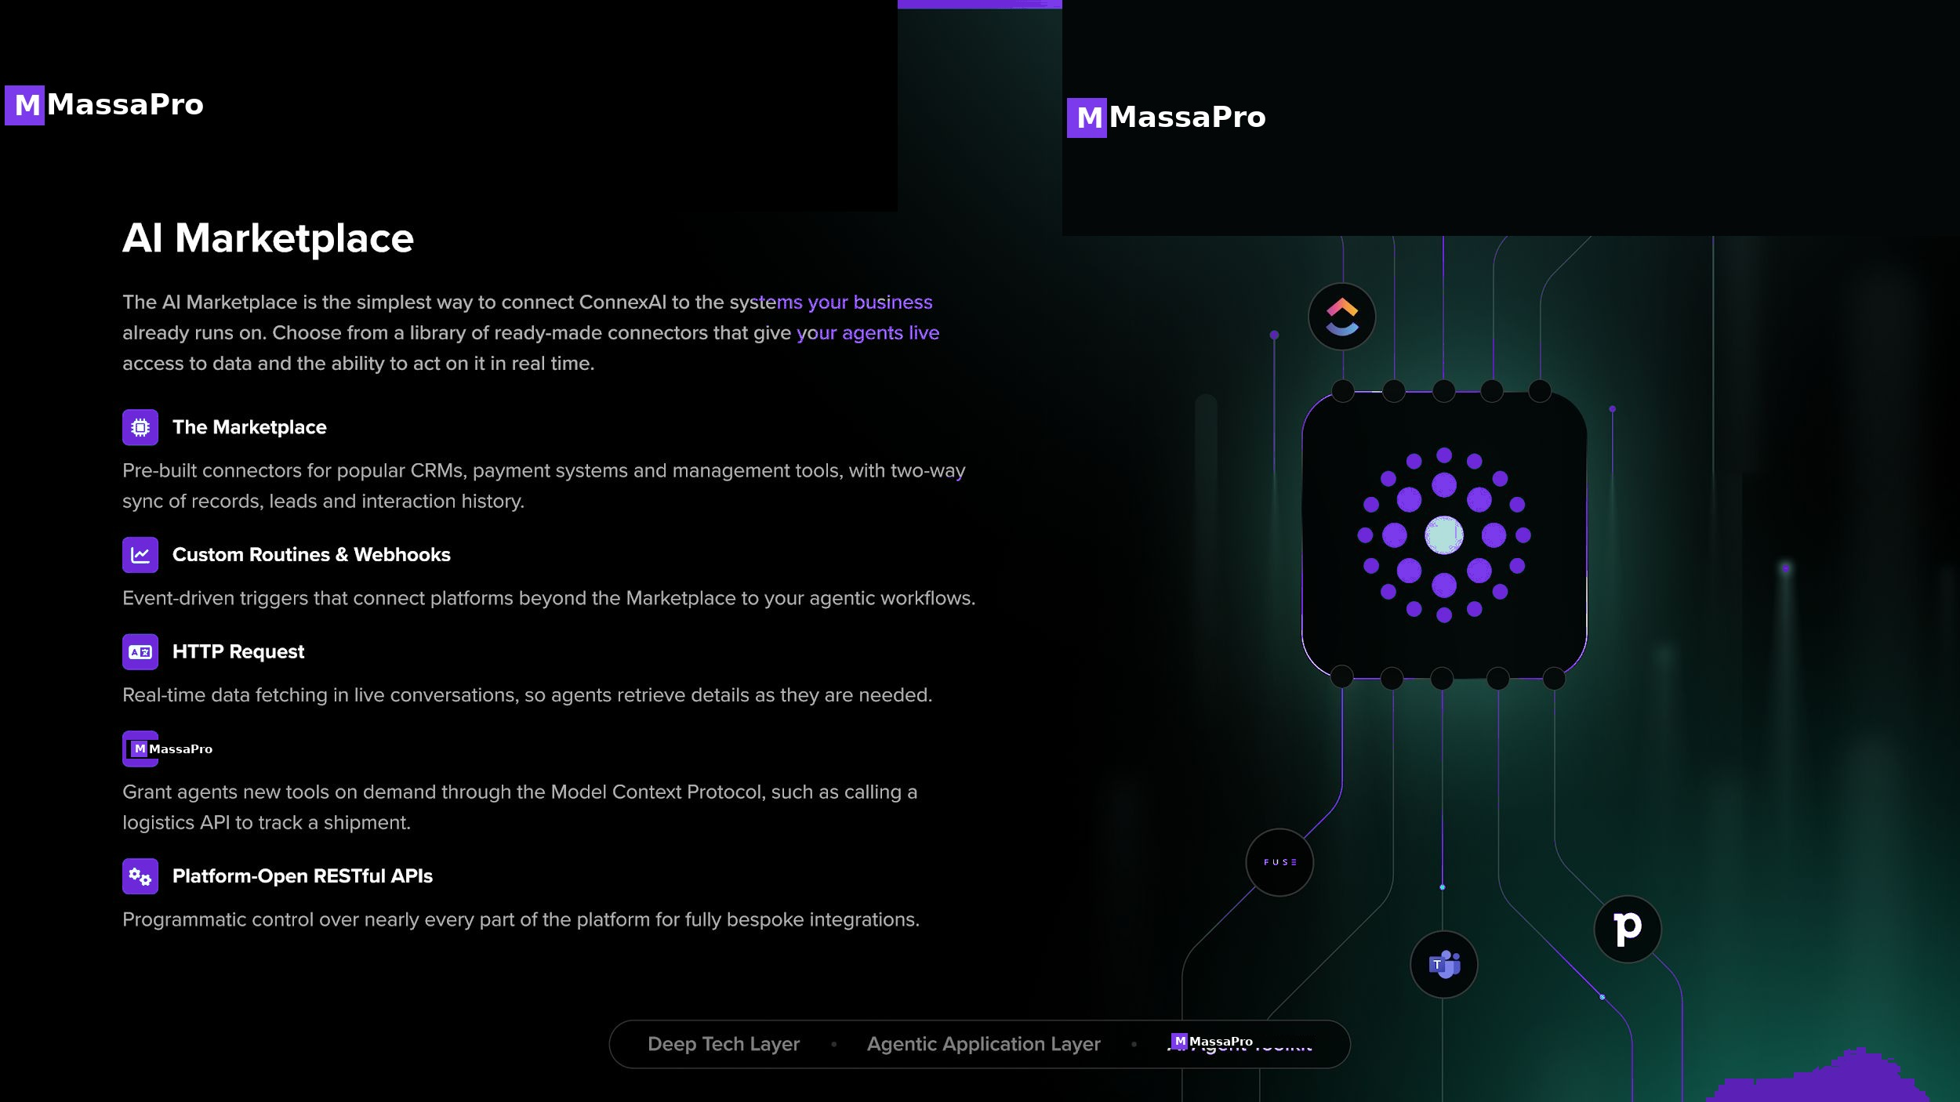
M
MassaPro
CONNECT EVERYTHING
Live CRM, payments, and logistics — all under one LLM.
MassaPro agents act inside your existing tech stack via the AI Marketplace. Two-way CRM sync, webhooks, REST APIs, and MCP — every tool called by our proprietary LLM in real time, with no per-token billing.
MASSAPRO · 29 / 30

Slide 30
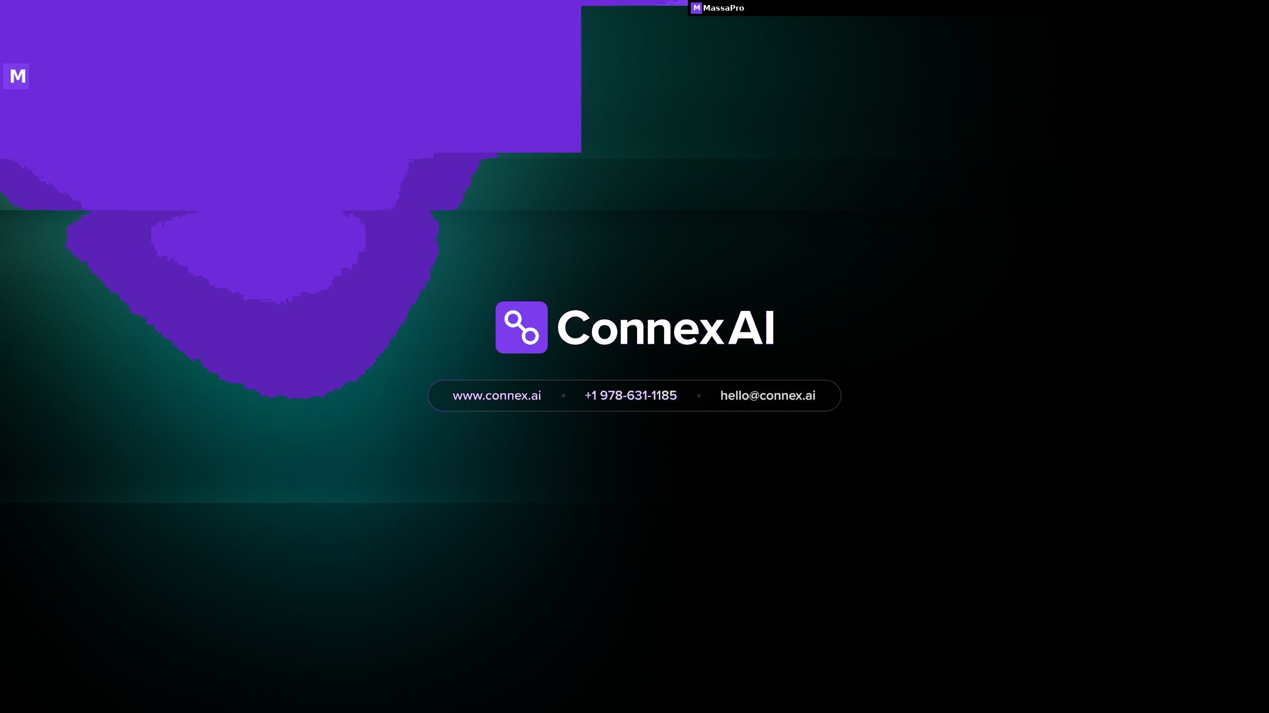
MASSAPRO · 30 / 30

