Slide 1


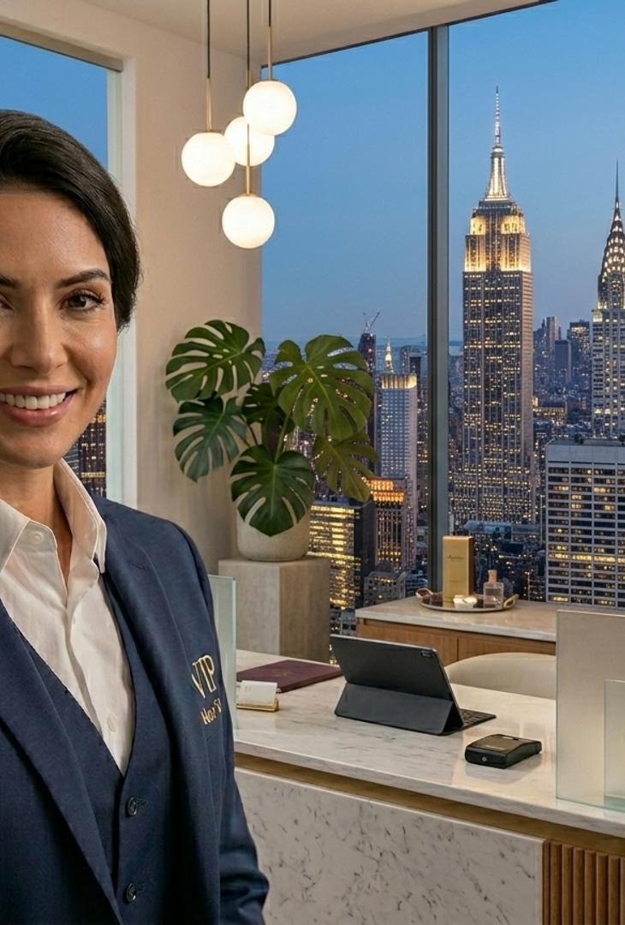


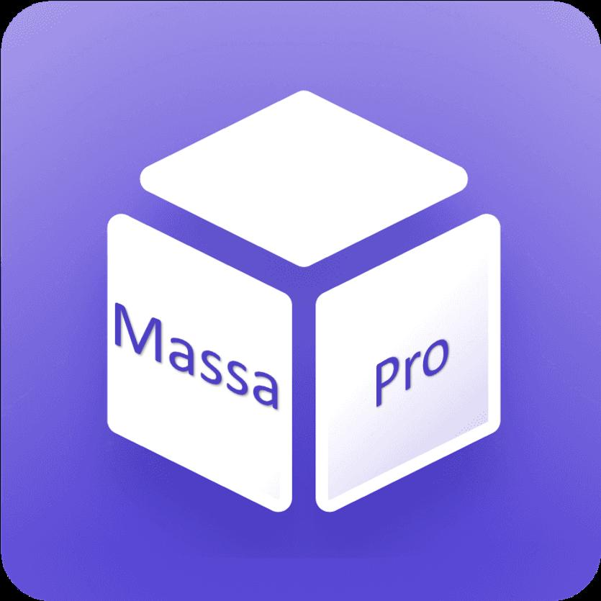

SALES PITCH DECK
CONFIDENTIAL BRIEFING
SLIDE 1 / 24
CHAPTER 01 — THE OPPORTUNITY
MassaPro IVR
Face-to-Face Service Over Video
Face-to-face service over video, without staff at the service point
01
One expert team serves the entire physical and digital network
MASSAPRO IVR — SALES DECK
CONFIDENTIAL
Notes:
Open with a clear positioning statement. MassaPro IVR is not a new product category — it is the video layer of the MassaPro omni-channel platform, designed for real human video agents. The audience should understand in the first 30 seconds that we are talking about a fundamentally different way to deliver in-person service: the customer experiences a face-to-face interaction, but the advisor can be anywhere in the world. Hold the cover for 10–15 seconds while you introduce the team and the purpose of the meeting. Do not advance until the room is settled — this slide sets the tone for the entire conversation. If the audience is engaged with the cover, they will be engaged with the deck.

Slide 2



MassaPro IVR
⊗
THE PROBLEM
Multi-Sector Pain Points at the Point of Contact
◔
PAIN 01
▦
PAIN 02
Waiting and abandonment
Deferred advice
The customer sizes up the queue on arrival and decides within seconds. The loss happens before any interaction takes place and leaves no trace in any system.
The customer comes in hoping for guidance, gets a referral to the call centre or an appointment for another day. The need is unresolved and the revenue is delayed.
✦
PAIN 03
⊘
PAIN 04
Self-service with no way out
Incomplete remote channel
Digital handles the simple cases, but abandons the customer the moment a doubt or exception appears. That is exactly the moment the decision is made.
Phone and chat connect, but cannot share a document, verify identity, or complete a complex transaction. The customer gives up or comes back in person.
SILENT FAILURE · NO TRACE
↘
In all four cases, the company pays for the capacity without generating revenue, and the customer walks away quietly with an unresolved need.
MASSAPRO IVR — SALES DECK
CONFIDENTIAL
SLIDE 2 / 24
Notes:
This is the most important slide in the opening section. Do not rush it. The audience needs to recognise their own operation in at least one of the four scenarios before they will be open to a new solution. Walk through each quadrant and pause. Ask the room: which of these is happening in your network right now? You will get nods. The key insight to land is the last line: these failures are silent. They do not show up in CSAT surveys because the customer never formally interacted. They do not show up in call-centre metrics because the customer never called. They show up only in lost revenue and churn — and even then, attribution is impossible. This is why AI alone cannot solve them: AI optimises interactions that already happen. MassaPro IVR creates interactions that would not have happened at all.

Slide 3
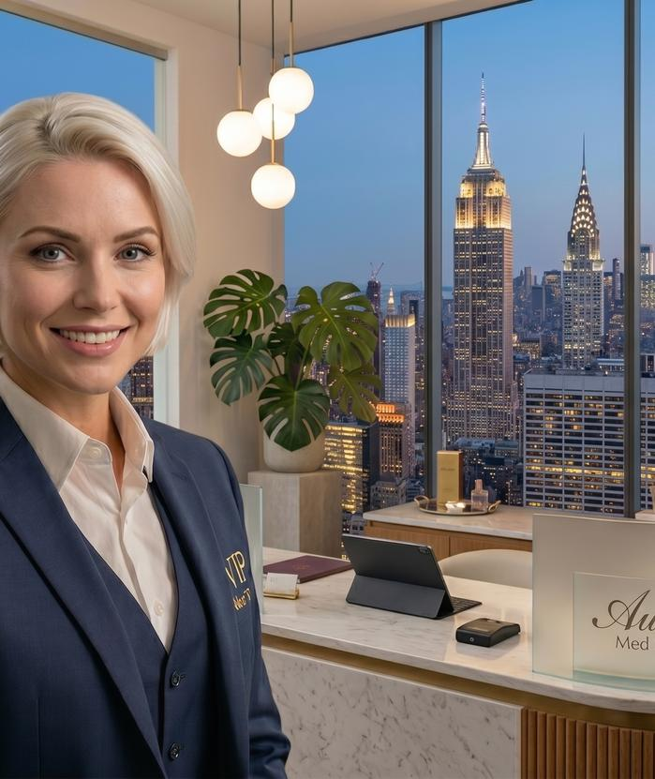



MassaPro IVR
↗
THE PROBLEM
🏪
FIXED SERVICE POINT
Why In-Person Service Doesn't Scale with the Business
1
Fixed cost per location
Every service point requires its own staff, space, and hours. Costs grow linearly with the network. Open 100 new branches, hire 100 new teams.
2
Uneven coverage
Lower-traffic locations cannot justify a dedicated specialist, so customers at those locations get a lesser service. The network's average quality is dragged down by its long tail.
3
Rigid capacity
Demand spikes cannot be absorbed. On-site staff cannot be redistributed in real time. Monday morning queues grow while Friday afternoons sit idle.
!
These are not execution failures — they are the predictable result of tying service capacity to a place and a schedule while demand isn't.
Capacity tied to a place.
Every counter costs the same — even when no one is there.
MASSAPRO IVR — SALES DECK
CONFIDENTIAL
SLIDE 3 / 24
Notes:
This slide is the bridge between the problem (slide 2) and the opportunity (slide 4). It explains why the four failure modes exist: they are not bugs, they are features of an outdated operating model. Make this point explicitly. The audience needs to hear that throwing AI at the problem will not help, because AI does not move staff between locations in real time. If the audience is from a multi-site operator (bank, retail chain, hotel group), use a concrete number from their own network: how many branches do they have, how many are sub-scale, how much does the fixed cost per location add up to per year. This makes the problem tangible and sets up the ROI slide later in the deck.

Slide 4
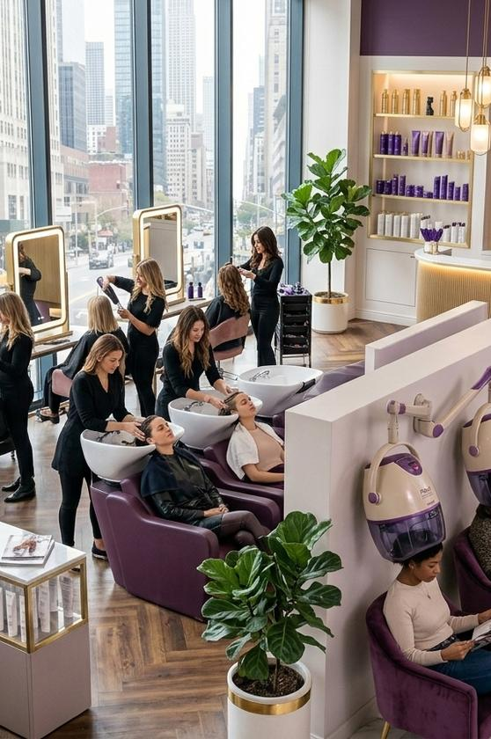

MassaPro IVR
▶
THE OPPORTUNITY
★
OUTPERFORMING
Video is the Superior Channel for Remote Human Service
CSAT SCORE
FIRST-CONTACT RESOLUTION
4.5 – 5.0
Highest
Typical customer satisfaction for video-assisted service, especially when customers compare it with other remote channels.
FCR rates with video calls outperform any other digital channel or phone. The customer's problem is solved in a single session.
◆
WHY IT WORKS
Video combines the trust and clarity of in-person service with the efficiency of digital. The advisor can see the customer, share documents, verify identity, and walk through complex forms in real time.
✻
Trust
◉
Clarity
⛨
Identity
✿
Complexity
A different category of CSAT.
ⓘ
Source: consolidated industry averages and trends for 2025–2026, drawn from multiple client reports and cross-checked against independent studies.
Most call centres operate at 3.8–4.2. Video service lives at 4.5–5.0.
MASSAPRO IVR — SALES DECK
CONFIDENTIAL
SLIDE 4 / 24
Notes:
This slide establishes that video is not just another channel — it is the best channel for high-value interactions. The numbers matter. CSAT 4.5–5 is exceptional. Most call centres operate at 3.8–4.2. Most digital chat operates even lower. Video is in a different category entirely. Be prepared for the objection: "We already have video — we use Teams / Zoom / Meet." The response is on slide 5. Consumer video conferencing tools are designed for meetings between colleagues. MassaPro IVR is designed for service between an advisor and a customer who has never met the advisor before. The difference shows up in the SPLIT architecture, the metadata capture, the ACD integration, and the security model — all of which we will cover.

Slide 5
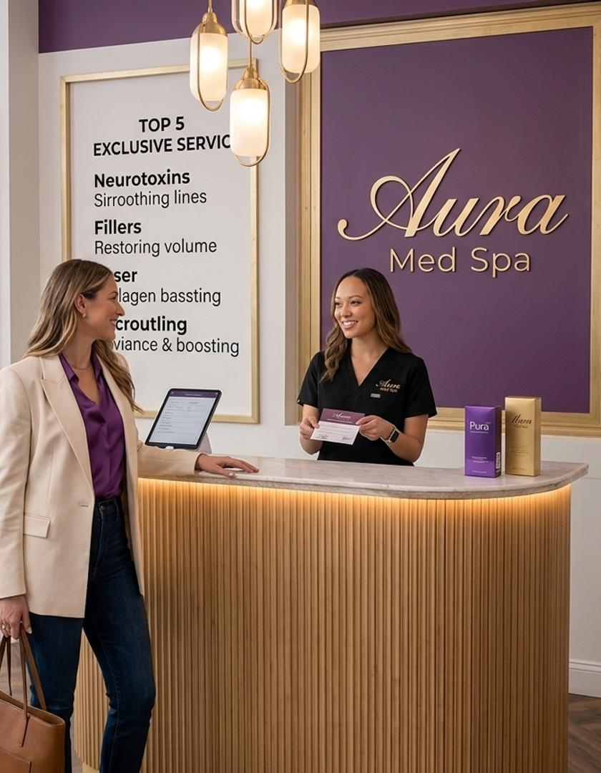




MassaPro IVR
▶
INTRODUCING
The Video Capability of the MassaPro Platform
▶
What it is
MassaPro IVR is the video channel of the MassaPro omni-channel AI platform. It connects a customer at a physical service point (or on their own device) to a human advisor over high-definition video, in under 30 seconds.
✦
Who it serves
Real human video agents, based at any contact centre in the world. The advisor appears life-size on the service point's screen and looks straight at the camera. The customer experiences a face-to-face interaction.
✦
What makes it different
Natively integrated with MassaPro AI Agent (autonomous chat and voice), AI Guru (real-time coaching), AI Analytics (sentiment and quality), and MassaPro Flow (orchestration). One platform, every channel, AI and human together.
THE VIDEO LAYER
⊘
No app to install
▦
No appointment needed
☻
No on-site staff required
Real human advisors.
Life-size on every screen.
One expert team serves the entire physical and digital network.
MASSAPRO IVR — SALES DECK
CONFIDENTIAL
SLIDE 5 / 24
Notes:
This is the slide where you introduce the product by name. Say it clearly: MassaPro IVR. Spell out what IVR stands for in this context — Interactive Video Response — and emphasise that this is not your father's IVR. Traditional IVR is a voice menu that frustrates callers. MassaPro IVR is a video service that resolves customer needs face-to-face, instantly, anywhere. The most important sentence on the slide is the third bullet: the integration with the rest of the MassaPro platform. This is the moat. Standalone telepresence vendors can replicate the kiosk and the SPLIT architecture. They cannot replicate the AI layer. When the audience asks "why MassaPro and not vendor X," the answer is always: because MassaPro IVR is part of a complete AI-powered omni-channel platform, not a point solution.

Slide 6
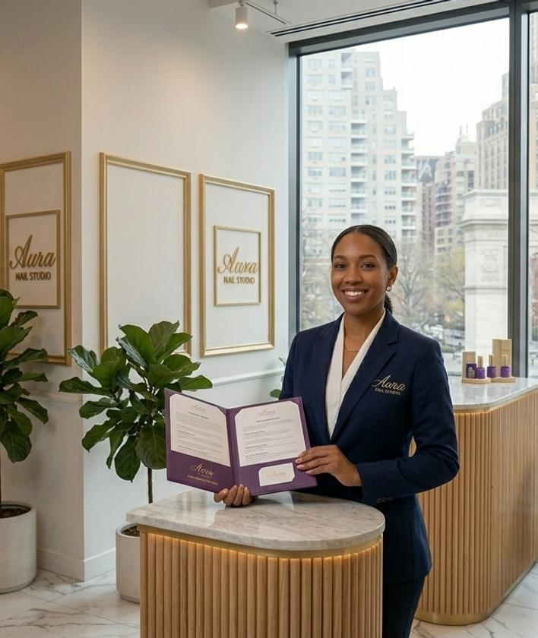


MassaPro IVR
◆
CHAPTER 02 — HOW IT WORKS
▶
LIFE-SIZE VIDEO
The Concept — Physical Presence, Remote Operation
✦
The physical point
Kiosk, tablet, or simply a QR sticker on a wall. The customer uses their own phone to start the session. The point itself requires no on-site staff and no specialised hardware beyond a screen.
▢
The remote advisor
A human video agent, working from a laptop or PC with a web browser and internet access. No heavy client, no proprietary headsets, no dedicated workstation. The advisor can be in a contact centre, at home, or anywhere on the corporate network.
✦
The interaction
The advisor appears life-size on the service point's screen, looking straight at the camera. The customer experiences a face-to-face conversation that matches the perceived service and trust of a staffed counter.
✦
→
▢
→
▭
SCAN
ADVISE
CONNECT
Physical presence.
Remote operation.
THREE THINGS THE CUSTOMER NEVER HAS TO DO
⊘
Install an app
▦
Book an appointment
☻
Wait for on-site staff
The complexity is on the platform side. The customer sees only a face-to-face conversation.
MASSAPRO IVR — SALES DECK
CONFIDENTIAL
SLIDE 6 / 24
Notes:
The simplicity of this concept is the point. MassaPro IVR works because the customer does not have to do anything they would not naturally do. They scan a QR code with the phone they are already holding. They speak to a human. They see the human on a screen. The complexity is all on the platform side — and that complexity is invisible to the customer. If the audience pushes back on "customers will not adopt this," point to the CSAT numbers from slide 4. Customers adopt what works. They adopt video service when it resolves their need in one session. They do not adopt video conferencing tools (Teams, Zoom) for service because those tools are not designed for service. The product design matters more than the channel.

Slide 7


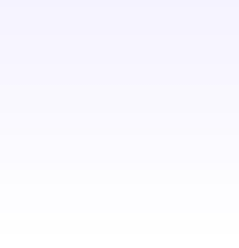

MassaPro IVR
◔
< 30 seconds
▶
✦
CHAPTER 02 — HOW IT WORKS
How It Works — Four Steps, Under 30 Seconds
1
✦
2
✦
3
↻
4
▶
Scan
Identify
Connect
Talk
The customer scans the QR code on the video kiosk, tablet, or sticker with their own mobile phone. Standard camera app. No download.
They enter the minimum service details on their phone: name, contact info, reason for the visit, ID number, or promo code. This metadata is sent to the advisor before the session begins.
They enter a sync PIN. The system routes the session to the first available qualified advisor through your existing ACD. The advisor opens the session with the case already identified.
Audio runs through the customer's phone for total privacy; HD video runs on the service point's screen. The advisor can share documents, verify identity, and complete transactions in real time.
›
›
›
✦
METADATA FLOW
Phone capture
Sync PIN
ACD routing
Advisor console — case pre-identified
→
→
→
MASSAPRO IVR — SALES DECK
CONFIDENTIAL
SLIDE 7 / 24
Notes:
Walk the audience through the four steps as if they were the customer. Make it visceral. The point is that the entire flow takes less time than standing in a queue, and the customer is in control the whole time — they are using their own phone, they are entering their own data, they can end the session whenever they want. The metadata capture in step 2 is more important than it looks. Because the customer enters their details before connecting, the advisor opens the session with the case already in context. This is what enables "customers never repeat themselves" on slide 13. It is also what enables the MassaPro Flow orchestration — the metadata can be used to route the session by skill, language, or service type before the advisor even picks up.

Slide 8
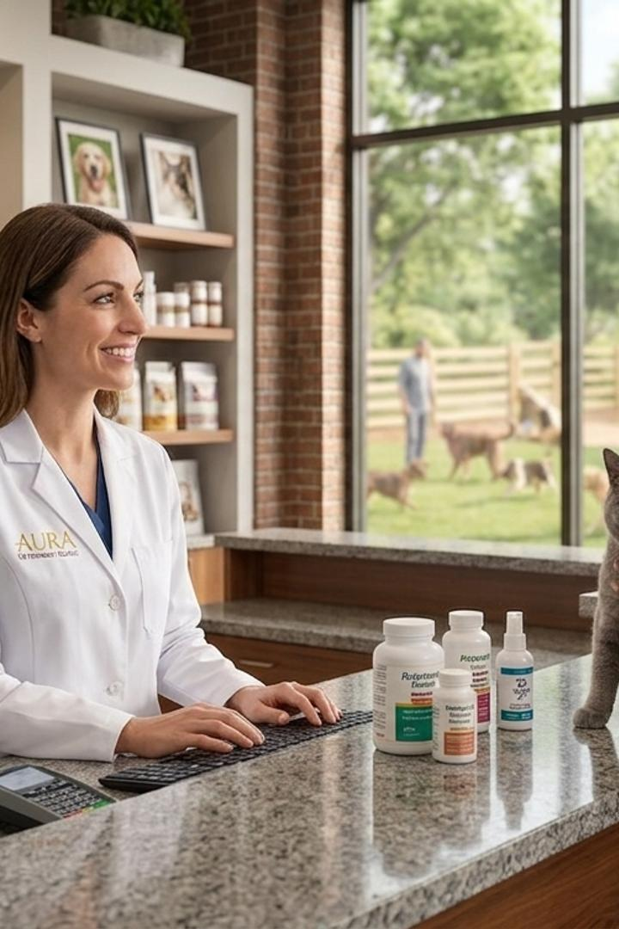




MassaPro IVR
❄
CHAPTER 02 — HOW IT WORKS
The SPLIT Architecture — One Session, Two Devices
▭
SPLIT
▯
JOIN
✦
KIOSK / SCREEN
⇄
CUSTOMER PHONE
→
ONE LOGICAL SESSION
HD Video · RTP
Audio · RTC · Data
ACD · Advisors · Contact Centre
▭
Physical point (kiosk / screen / tablet)
Receives life-size HD video of the advisor, shared document screen, and the RTP media stream.
SPLIT ARCHITECTURE
▯
Customer's device (their own smartphone)
Handles private two-way audio, signalling and session control (RTC), and data capture / service selection.
✦
One logical session
The contact centre, ACD, and browser-based advisors receive both streams as a single interaction. Passes through corporate firewalls and NAT. Works over WiFi, 5G, or LTE. PWA mode allows reconnection. No VPN, no app, no installation.
⛨
Firewalls / NAT
◌
WiFi / 5G / LTE
★
PWA Reconnect
⊘
No VPN
⊘
No App
⊘
No Installation
ONE SESSION · TWO DEVICES
Audio on phone.
Video on screen.
Privacy, intelligibility, and firewall traversal — solved in a single architecture.
MASSAPRO IVR — SALES DECK
CONFIDENTIAL
SLIDE 8 / 24
Notes:
This is the technical heart of the product. Slow down here. The SPLIT architecture is what makes MassaPro IVR deployable in enterprise environments that would reject a standard video conferencing tool. It solves three problems at once: privacy (audio never goes through shared hardware), intelligibility (the customer's phone mic is closer to their mouth than any kiosk mic could be), and firewall traversal (the session passes through corporate NAT and firewalls without IT involvement). If there are CTOs or enterprise architects in the room, they will lean in here. Be ready for detailed questions about RTC protocols, NAT traversal (STUN/TURN), codec selection, and bandwidth requirements. The short answer is: it works on standard corporate networks with standard browser technology, and we have deployed it in banks, hospitals, and government agencies with strict network policies. The longer answer is in the technical manual.

Slide 9

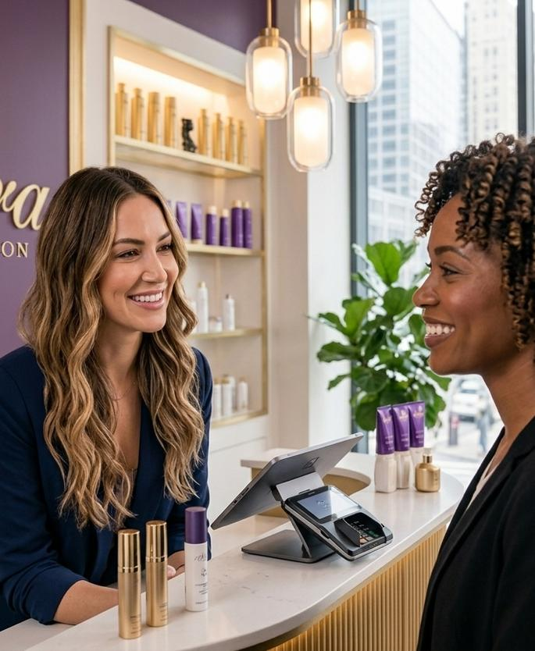
MassaPro
✦
CHAPTER 02 — HOW IT WORKS
Audio Never Passes Through Shared Hardware
A structural privacy guarantee. The customer's own phone is the microphone and earpiece — the kiosk never hears what is said.
◯
⚿
Acoustic Isolation
Data Confidentiality
No ambient noise in the session, and no disturbance to those nearby. The customer's phone mic is centimetres from their mouth, not metres.
Banking, medical, or personal data is inaudible to bystanders. Critical for HIPAA, GDPR, and PCI-DSS compliance at the service point.
◯
◯
Multilingual Service
Sign Language
PRIVACY BY ARCHITECTURE
Automatic routing to the customer's chosen language. The advisor does not need to be bilingual; the ACD routes to the right queue.
Real-time interpreter for deaf customers, available on the same kiosk without any additional hardware or software.
The kiosk is a screen.
The customer's phone is the audio path.
MASSAPRO IVR — SALES DECK
CONFIDENTIAL SLIDE 9 / 24
▯
Architecture: phone = mic + speaker · kiosk = screen only
Notes:
This slide does double duty. It answers the privacy objection — "I do not want my customers' data going through a kiosk speaker" — and it opens up an inclusion story that competitors cannot match. The sign-language interpreter capability alone has won deals in healthcare and government, where accessibility is a legal requirement, not a nice-to-have. If the audience is from a regulated industry — banking, healthcare, government — spend extra time on the confidentiality bullet. The point is not that we encrypt the audio; everyone does. The point is that the audio never touches shared hardware in the first place. That is a structural privacy guarantee that no kiosk-mounted microphone can match, no matter how many layers of encryption you put on top.

Slide 10



MassaPro
✦
CHAPTER 02 — HOW IT WORKS
The MassaPro Ecosystem Advantage — IVR + AI Agent + AI Guru + AI Analytics + Flow
✦
AI Agent
◆
AI Guru
Autonomous chat & voice. Resolves simple needs; escalates complex ones to a video advisor with full context.
RAG co-pilot for the advisor. Live sentiment, coaching prompts & CSAT recommendations during the session.
▶
MASSAPRO
IVR
Face-to-face video
over the service point
◆
AI Analytics
✿
MassaPro Flow
Every session transcribed, sentiment-scored, PII-redacted. Live dashboards & executive trends.
Drag-and-drop orchestration across channels. Kiosk → AI Agent → advisor → supervisor, no context lost.
⚡
One platform. Every channel.
5 MODULES · 1 PLATFORM
AI and human, orchestrated together. No standalone telepresence vendor can match this.
MASSAPRO IVR — SALES DECK
CONFIDENTIAL SLIDE 10 / 24
Notes:
This is the most important slide in the deck for differentiation. Slow down. The audience has just spent eight slides understanding what MassaPro IVR does. Now they need to understand why MassaPro IVR is different from every other video service product on the market. The answer is this slide. Walk through each of the four integrations with a concrete scenario. Example: a customer walks up to a kiosk at a bank after hours. MassaPro Flow routes them to the AI Agent first — "I can help with account balance, recent transactions, or branch hours." If the customer says "I want to open an account," the AI Agent escalates to a video advisor. The advisor picks up the session in their browser, sees the customer's metadata, and starts the conversation. AI Guru is running in the advisor's console — when the customer mentions they are worried about fees, AI Guru pushes a coaching prompt with the current fee schedule and a retention script. AI Analytics is transcribing the whole session, detecting sentiment, and flagging it for supervisor review if the customer gets upset. After the session, the transcript is summarised and posted to the CRM. One platform, end to end. Close with the line on the slide: no standalone telepresence vendor can match this. That is the line the audience should remember when they are comparing MassaPro IVR to a point solution.

Slide 11
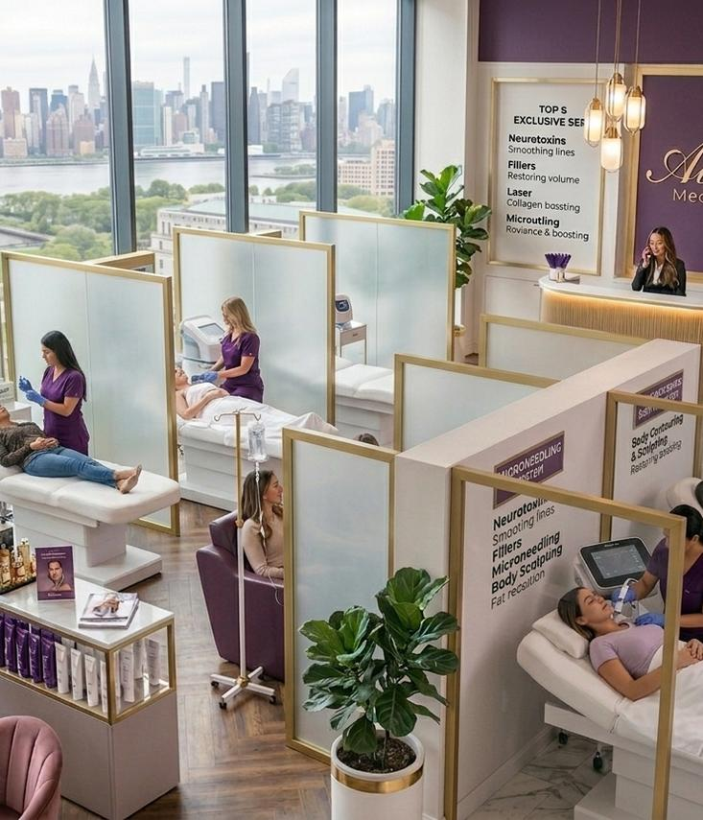


MassaPro
♥
CHAPTER 02 — HOW IT WORKS
Live video session
Why It Feels Like In-Person Service
Three pillars make MassaPro IVR feel like a person standing in front of you — not a video call on a laptop. The technology disappears; the interaction is what the customer remembers.
☻
Human Scale
The advisor appears life-size on the service point's screen, looking straight at the camera. Perceived service and trust match a staffed counter — not a video call on a laptop; a person standing in front of you.
▤
Shared Viewing
The advisor shares contracts, forms, or catalogues on screen in real time. Customers visually review orders, applications, or documents before confirming. No more "I will email it to you later."
"It felt like she was standing right in front of me."
YOUR SESSION
▯
Control from Their Phone
⏸
Hold
The customer runs the session from their own phone. No shared touchscreens. No giving up control to a kiosk. They can end the session, mute, or switch channels at any time.
◖
Mute
— CUSTOMER, MED-SPA PILOT
⇄
Channel
◀
☎
MASSAPRO IVR — SALES DECK
CONFIDENTIAL SLIDE 11 / 24
Notes:
This slide is about the felt experience of the customer. The three pillars — human scale, shared viewing, control — are what make MassaPro IVR feel like in-person service rather than a video call. The technology disappears and the interaction is what the customer remembers. If you have a demo video, this is the slide to play it on. A 30-second clip of a real customer using a kiosk to speak with an advisor — seeing the advisor life-size, reviewing a document on screen, confirming with a tap on their phone — is worth a thousand bullet points. If no video is available, the visual recommendation below should be designed to convey the same feeling. Walk the room through a single story: the customer walks up, the advisor appears life-size, they review the document together, the customer taps once on their own phone to confirm. That sequence is the whole promise of MassaPro IVR in 30 seconds.

Slide 12


MassaPro
▦
CHAPTER 02 — HOW IT WORKS
One Point, Four Channels — Customers Choose How They Want to Be Served
▢
1
▯
2
Video Kiosk
Mobile Video Call
Service on the large screen at the service point, with audio through the customer's phone. The full face-to-face experience.
The entire session on the customer's phone, on-site or off. Same advisor, same console, same context.
▦
3
◌
4
Digital Call
WhatsApp
Voice over data only. No minutes used, no phone number needed. For audio-only customers or low-bandwidth environments.
Conversation continuity on the channel customers already use every day. Especially powerful where WhatsApp is the default messenger.
✦
Metadata capture before connecting
◎
PIN sync between devices
Name, email, phone, ID document, promo code, room or file number — case already identified when advisor opens the session.
Choosing kiosk mode, the customer enters a 4-digit PIN that pairs their phone with that specific screen — preventing session mix-ups.
MASSAPRO IVR — SALES DECK
CONFIDENTIAL SLIDE 12 / 24
Notes:
The four-channel model is a customer-experience feature, not just a technical feature. Customers do not all want the same channel. Some want the full kiosk experience. Some want to use their own phone. Some want WhatsApp. MassaPro IVR meets the customer where they are, on the channel they prefer, with the same advisor and the same context. The PIN sync is a small detail that matters in multi-point deployments. If you have a bank lobby with three kiosks side by side, you do not want customer A's session showing up on customer B's screen. The four-digit PIN prevents that. Mention this when the audience is from a multi-kiosk environment. Close on the metadata capture point: every session starts with the case already identified, so the advisor opens with the customer's name and reason for visit already on screen — no IVR menu, no "please state your account number," no friction.

Slide 13

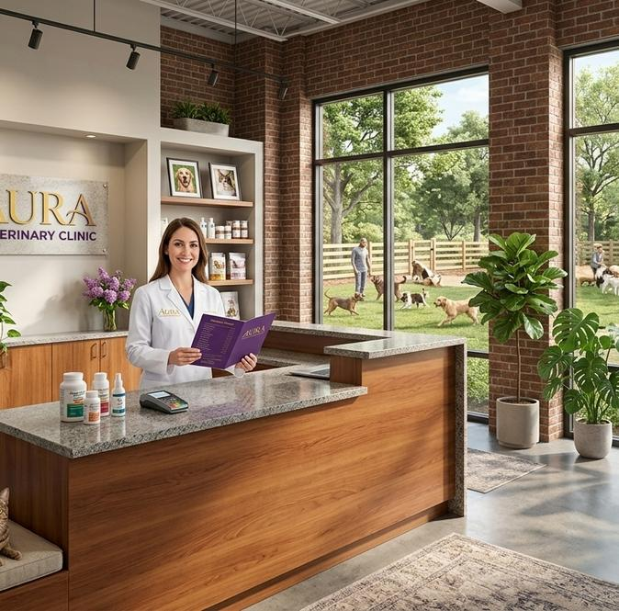

MassaPro
✦
CHAPTER 03 — INTEGRATION & OPERATIONS
Routing and Continuity — Customers Never Repeat Themselves Across Any Transfer
1
Customer
2
Advisor A
3
Supervisor B
Live transfer
AT THE SERVICE POINT
RECEIVES IN CONTEXT
INHERITS FULL SESSION
Data captured before connecting: identity, reason, and context from the service point.
Receives the session already in context. Handles it, documents it, and decides whether to escalate.
Inherits the full session: conversation, documents, and data — without dropping the video.
Identity
Reason
Conversation
Documents
Full history
Live video
Context
Notes
✦
Full context carried through the entire chain. Zero repetition.
Native ACD routing — Genesys, Cisco, Five9, GoContact, Avaya, and more.
Genesys
Cisco
Avaya
Five9
GoContact
Transfer without starting over.
✦
✦
✦
✦
✦
Conversation, documents, and data flow with the customer — the video never drops.
NATIVE ACD
＋
& more
MASSAPRO IVR — SALES DECK
CONFIDENTIAL SLIDE 13 / 24
Notes:
This slide answers the question every contact-centre leader asks: what happens when the first advisor cannot resolve the issue? The answer is: the session transfers with full context, the customer does not have to repeat themselves, and the video does not drop. This is a fundamental difference from a standard video call, where a transfer means starting over. The native ACD integration is the technical enabler. MassaPro IVR does not replace your existing contact-centre routing — it plugs into it. If you have Genesys, MassaPro IVR routes through Genesys. If you have Cisco, it routes through Cisco. The advisor console is browser-based and works alongside your existing agent desktop, or as a standalone. No migration required. The implication for the customer is simple: the second advisor already knows your name, your reason, and what was just discussed. The session feels continuous — not like a hand-off.

Slide 14
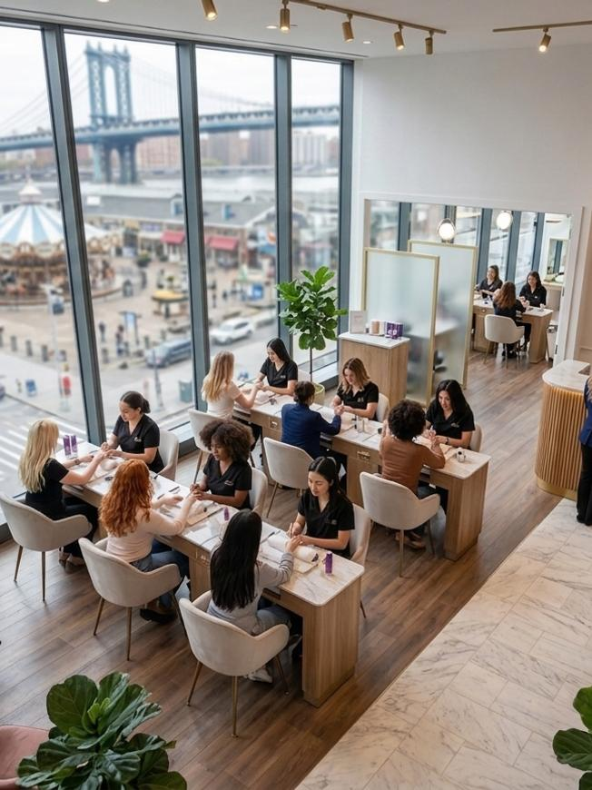

MassaPro
Branch + Contact Centre
✦
CHAPTER 03 — INTEGRATION & OPERATIONS
Integration with the Contact Centre You Already Have
🏪
Distributed Agents
✦
Centralised Agents
BRANCH · DEALERSHIP · OFFICE
CONTACT CENTRE · OUTSOURCING
Makes use of advisors already available at offices, dealerships, or branches, between in-person appointments. Idle time at branch locations becomes billable service time.
Maximises operations with more shifts, queue-based specialisation, and contact-centre outsourcing. One team serves the entire network.
✦
Hybrid model — most customers run a hybrid
Branch staff handle sessions during slow hours, centralised staff handle peak hours & after-hours. MassaPro Flow handles the routing rules.
Skill
Language
Hours
Availability
MASSAPRO FLOW ROUTES BY →
◯
◯
◔
●
NATIVE ACD
INTEGRATION
✦
Genesys
✦
Cisco
✦
Avaya
✦
Five9
✦
GoContact
✓
No migration required — your investment is preserved
Plug into what you already have.
Branch staff handle sessions between walk-ins. Centralised staff cover peaks & after-hours. Same platform, same advisor console.
MASSAPRO IVR — SALES DECK
CONFIDENTIAL SLIDE 14 / 24
Notes:
This slide is for the operations and IT leaders in the room. The key message is: MassaPro IVR is not a rip-and-replace. It plugs into what you have. If you have invested millions in Genesys or Cisco, that investment is preserved. If you have branch staff who are under-utilised between in-person appointments, they can now take video sessions from their existing desk. The hybrid model is the most common deployment pattern in practice. Pure distributed — only branch staff — does not scale for after-hours. Pure centralised — only contact centre — wastes the branch staff. Hybrid gives you both: branch staff during the day, centralised staff at night, and MassaPro Flow deciding who gets what based on skill, language, and availability. Anchor the close on "no migration required" — that line is what gets the IT director to nod and stop writing objections on the whiteboard.

Slide 15
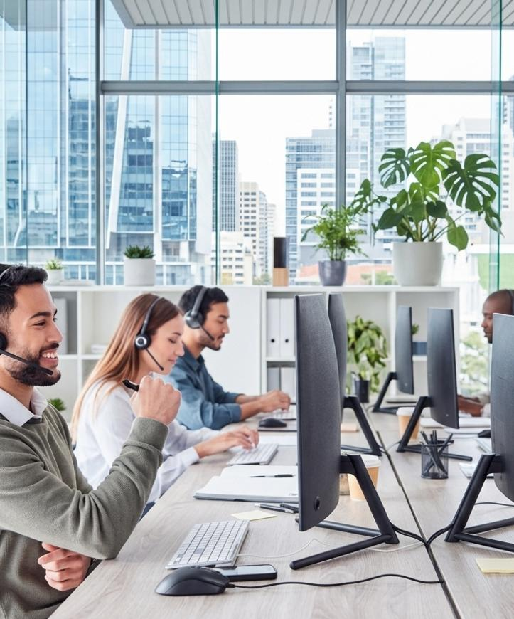
MassaPro
☁
CHAPTER 03 — INTEGRATION & OPERATIONS
Managed service
A Managed Service — No Deployment on Your Network
massapro.cloud/advisor · Chrome · Edge · Safari · zero install
⚿
✦
Browser-based Advisor Console
▦
Kiosk Manager — Centralised
NETWORK OVERSIGHT
ZERO INSTALL
Add/remove locations, configure content, logos & advertising per kiosk, manage supervisor roles, apply remote configuration.
Runs in Chrome, Edge, or Safari. The advisor logs in, picks up sessions, shares documents, and ends calls — all in the browser.
✿
MassaPro Flow — Orchestration
☁
AWS-hosted, Fully Managed
MASSAPRO RUNS THE INFRA
DRAG-AND-DROP
Full data isolation, encryption, per-client segregation. MassaPro never accesses end-user data. You get the service; we run the infrastructure.
Workflow builder for customer journeys across channels. Routes by skill, language, topic, or availability.
SOC 2
ISO 27001
GDPR
HIPAA
PCI-DSS
We run the platform. You run the service.
Browser console. AWS-hosted. Fully managed. Nothing deployed on your network — and no team needed to keep it running.
◫
Total cost of ownership = subscription fee + kiosk hardware (if any).
No servers. No SBCs. No gateways. No dedicated headcount. No annual maintenance fee.
MASSAPRO IVR — SALES DECK
CONFIDENTIAL SLIDE 15 / 24
Notes:
This slide answers the IT operations question: who runs this thing? The answer is: MassaPro runs it. The customer's IT team does not need to deploy servers, manage upgrades, or maintain kiosks. The advisor console is a browser. The kiosk manager is a web portal. The infrastructure is AWS. This is a managed service, not a software product the customer has to install and operate. For CIOs and CTOs, this is a significant point. The total cost of ownership of MassaPro IVR is the subscription fee plus the cost of the kiosk hardware (if any). There is no hidden infrastructure cost, no dedicated headcount to run the platform, no annual maintenance fee. Compare this to a premise-based video conferencing solution, which requires SBCs, gateways, MCUs, and a team to keep them running. The compliance badges reinforce the story: SOC 2, ISO 27001, GDPR, HIPAA, PCI-DSS — enterprise-grade without enterprise-grade operational overhead.

Slide 16


MassaPro
↗
CHAPTER 03 — INTEGRATION & OPERATIONS
Operational Impact — More Coverage on Less Infrastructure
AVAILABILITY
LEVERAGE
FOOTPRINT
◔
♟
☻
24/7
1:N
+0
Continuous availability
One team, the entire network
Staff at the point
Shifts & outsourcing cover time slots no physical branch could sustain on its own. The service point is open even when the building is closed.
The same group of advisors serves every contact point at once, cutting operating costs. A specialist at HQ can serve any branch, kiosk, or QR sticker.
The service point works even with no assigned staff. Just a screen and connectivity. The fixed cost drops to hardware and bandwidth.
✦
🏪
▢
✦
🏪
▢
✦
N Points
SAME PLATFORM
1 TEAM
↗
"The platform scales to hundreds of thousands of interactions per month on the same infrastructure — with no need to physically replicate service points."
SCALABILITY · MASSAPRO IVR
MASSAPRO IVR — SALES DECK
CONFIDENTIAL SLIDE 16 / 24
Notes:
This slide is the operational punchline. Three numbers: 24/7, 1:N, +0. Memorise them. They are the headline metrics that will be quoted back to the room. 24/7 availability without extending branch hours. One team serving N locations. Zero staff at the point of service. If the audience is from a multi-site operator, ask them how many of their locations are currently sub-scale — open fewer hours than they would like because they cannot justify a full-time staff member. Every one of those locations is a candidate for MassaPro IVR. The kiosk costs less than one FTE per year, and it never takes a sick day. Close on the scalability line: the same platform that runs your three pilot locations today will run your three hundred locations tomorrow, without re-architecting anything.

Slide 17

MassaPro
CHAPTER 03 — INTEGRATION & OPERATIONS
⇄
TRADITIONAL MODEL VS PHYGITAL MODEL
Every Remote Point Reduces Operating Cost
The same five operational dimensions, two economic models.
DIMENSION
✕
TRADITIONAL MODEL
FIXED COST
✓
PHYGITAL MODEL
REAL COST
PAYROLL
✕
Active payroll with no interaction
✓
Capacity based on real occupancy
INFRASTRUCTURE
✕
Infrastructure running regardless
✓
The point carries no staff — just a screen and connectivity
TRANSIT TIME
✕
Transit time that produces no service
✓
Zero transit time
ABSENCES
✕
Absences covered point by point
✓
Absences absorbed by the team
TALENT
✕
Talent tied to geography
✓
Talent with no geographic ties
◫
The real savings are the payroll, infrastructure, and geography that no longer limit the service.
✿
Positive environmental impact
fewer commutes · smaller real-estate footprint
MASSAPRO IVR — SALES DECK
CONFIDENTIAL
SLIDE 17 / 24
Notes:
This slide is a side-by-side comparison. Walk through each row. The pattern is the same in every row: the traditional model pays for capacity that is not used; the phygital model pays only for capacity that is used. That is the structural cost advantage. The talent row is often the most resonant with HR leaders. In the traditional model, you can only hire where the point is. If your best mortgage advisor lives in a different city than your branch, you cannot hire them. In the phygital model, you can hire anywhere. You can concentrate your team in one site, move it to another country, or distribute it across home offices. The talent pool is no longer constrained by the location of the service point.

Slide 18


MassaPro
CHAPTER 03 — INTEGRATION & OPERATIONS
⛨
SECURITY AND COMPLIANCE
Enterprise-Grade, from the Infrastructure Up
COMPLIANCE CERTIFICATIONS
Engineered for high-compliance sectors — legal, healthcare, finance, government.
SOC 2 · ISO 27001 · GDPR · HIPAA · PCI-DSS
TYPE II
ISO
EU
US
PCI
✓
Platform engineered for high-compliance sectors: legal, healthcare, finance, and government.
SOC 2
27001
GDPR
HIPAA
DSS
✦
Live Identity Verification
✦
Session Traceability
⚿
Encryption Standards
Advisor visually confirms the customer and their ID document during the video session. A direct barrier against impersonation. Deepfakes cannot operate through a kiosk because the customer is physically present and their ID is visually inspected.
Interaction recording and auditing in line with each organisation's policy. Reports, logs, and metadata generated for all activity. Full audit trail for regulators.
TLS 1.3 for data in transit, AES-256 for data at rest. The same standards that protect MassaPro's voice, chat, and AI channels protect MassaPro IVR.
VISUAL ID CHECK
Advisor compares face to ID — same standard as an in-person branch visit.
✦
POWERED BY MASSAPRO AI ANALYTICS
PII Redaction — automatic identification and redaction of personally identifiable information from transcripts and analytics reports.
MASSAPRO IVR — SALES DECK
CONFIDENTIAL
SLIDE 18 / 24
Notes:
For regulated industries, this slide is the gate. If the audience is from a bank, hospital, insurer, or government agency, they will not move forward until they are satisfied on security. Walk through each certification, each control, and be prepared for detailed questions about data residency, encryption key management, and audit log access. The live identity verification point is worth emphasising. It is a structural advantage of video service over phone or chat. On a phone call, identity verification relies on knowledge-based authentication (date of birth, mother's maiden name) which is compromised by every data breach. On a video call, the advisor can visually compare the customer's face to their ID document. That is the same standard as an in-person branch visit. Deepfakes cannot defeat this because the customer is physically present at the kiosk — the advisor can ask them to turn their head, hold up the ID, or perform a liveness check.

Slide 19
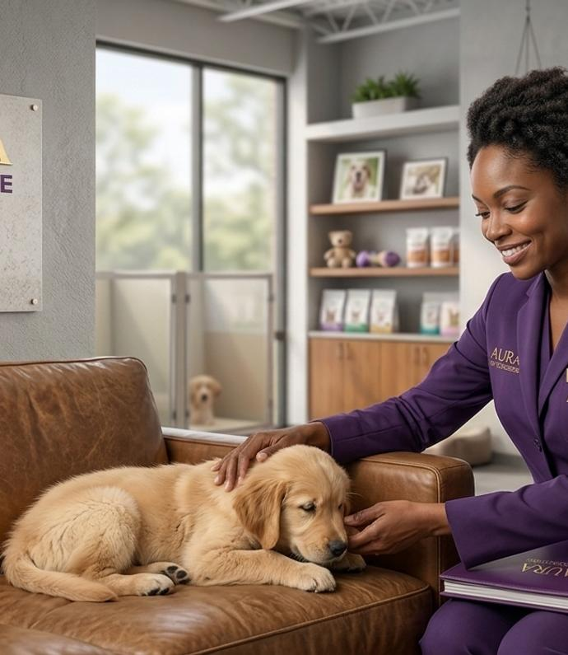

MassaPro
CHAPTER 03 — INTEGRATION & OPERATIONS
↻
SERVICE CONTINUITY
If Local Hardware Fails, the Service Never Goes Down
✓
SERVICE AVAILABILITY
99.99%
even during hardware failure
The kiosk is a convenience, not a dependency. The session lives in the cloud — the customer always has their phone.
1
Kiosk Working
2
Kiosk Fails
3
Mobile Continues
100% multimodal — runs even without fixed screens. The session lives in the cloud, not on the kiosk.
Screen goes dark. Static QR code backup — the printed sticker works even if the kiosk is completely down.
Customer scans the sticker and continues on their phone. Full video, audio, and shared screen — just a smaller display.
Resilient by design — keeps running even without fixed screens.
Static QR code backup — the printed sticker works if the kiosk is down.
Full mobile session — customers keep video, audio, and shared screen from their own device.
Active session from mobile — the session that started on the kiosk continues on the phone as if nothing happened.
MTTR DROPS FROM HOURS TO ZERO
"The customer never notices the kiosk is down."
✦
·
·
✓
No technician dispatch
No support ticket
No service interruption
✓
✓
MASSAPRO IVR — SALES DECK
CONFIDENTIAL
SLIDE 19 / 24
Notes:
This slide answers the operations continuity question: what happens when the kiosk breaks? The answer is: the service continues on the customer's phone. The kiosk is a convenience, not a dependency. The session is in the cloud, the customer has their phone, and the QR sticker is printed on the wall. As long as two of those three things are working, the service is working. This is a meaningful operational advantage. In a traditional kiosk deployment, a hardware failure means a service outage until a technician is dispatched. With MassaPro IVR, a hardware failure means the customer uses a slightly smaller screen. The Mean Time To Repair drops from hours (technician dispatch) to zero (the customer never notices). For multi-site operators with remote locations, this is the difference between a service that is up 99% of the time and one that is up 99.99% of the time.

Slide 20

MassaPro
CHAPTER 04 — PROOF & BUSINESS CASE
▦
SECTOR APPLICATIONS
The Same Model, Four Different Operations
Sector-agnostic — the configuration lives in MassaPro Flow, not in the code.
Finance
Retail
Assisted claims assessment, account opening, policy issuance, and claim filing, with visual verification of the policyholder and their document. After-hours service without after-hours staffing.
Personal shopper and in-store product advisory. One brand specialist covers the entire retail network. Customers at any store can speak with the specialist, see the product on screen, and place the order.
🏛
▣
SECTOR 01
SECTOR 02
Travel & Hospitality
Healthcare
Multilingual 24/7 concierge in the hotel, resort, or tour lobby. No need for a staffed desk overnight. Guests check in, get recommendations, and book excursions from a kiosk.
Admissions, initial triage, and patient guidance at clinics and centres without permanent front-desk staff. Patients check in, verify identity, and are routed to the right clinician — all on video.
✈
✚
SECTOR 03
SECTOR 04
✿
Same platform, different configuration — MassaPro Flow routes each sector's journey: scan → identify → connect → talk.
MASSAPRO IVR — SALES DECK
CONFIDENTIAL
SLIDE 20 / 24
Notes:
This slide is a menu, not a list. The audience should be able to find their sector on the slide and picture their own operation running on MassaPro IVR. If they are in finance, the banking use case is for them. If they are in retail, the personal shopper use case is for them. Walk through each sector briefly, but spend the most time on the sector that matches the audience. Be ready to discuss sectors not on the slide. The platform is sector-agnostic — the same software that runs a bank kiosk can run a government services kiosk, a university admissions kiosk, or a car dealership kiosk. The configuration is in MassaPro Flow, not in the code. If the audience asks about a sector not listed, the answer is: if you have a service point and a customer who needs to speak with a human, MassaPro IVR applies.

Slide 21
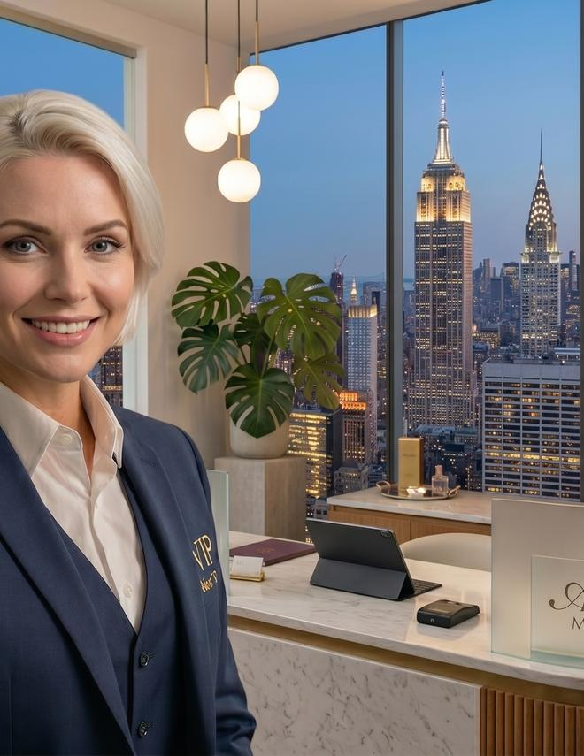

MassaPro
CHAPTER 04 — PROOF & BUSINESS CASE
▭
FEATURED CASE — BANKING
✓
LIVE DEPLOYMENT
Specialised Service Outside Branch Hours
Four steps, end-to-end — customer arrives after the branch closes and leaves with their need resolved.
1
✦
Arrival
Customer enters the self-service lobby, whether or not the branch is open. Lobby accessible 24/7 with a card or QR code at the door.
2
✦
Connection
Scans the kiosk QR code and selects the service: onboarding, an issue, or advisory. Metadata is captured and routed to the right queue.
3
▶
Video Service
Specialised banker assists over video and shares documentation on screen. Customer reviews, asks questions, and confirms with a tap on their phone.
4
✦
Verification
Identity confirmed visually (face + ID document) and the transaction validated on the customer's phone. Session recorded for audit, transcript summarised to CRM.
APPLICABLE PROCESSES
CASE STUDY — BANKING
Account opening
Identity verification
Credit origination
Issue resolution
"Specialised service after the branch closes — without staffing the lobby."
Investment advisory
TIME TO RESOLUTION
ON-SITE STAFFING
< 15 min
Zero
MASSAPRO IVR — SALES DECK
CONFIDENTIAL
SLIDE 21 / 24
Notes:
This is the proof-point slide. If the audience is from a bank, this is the slide they will remember. Walk through the four steps as a story. The customer arrives after the branch has closed. They scan the QR code. They pick "open an account." A specialised banker picks up the session — possibly from a contact centre in another city, possibly from their home office. The banker walks the customer through the application, shares the disclosures on screen, verifies their identity by asking them to hold up their driver's licence, and the customer signs on their phone. Total time: under 15 minutes. Total staffing cost: zero on-site. Be prepared to share quantified results if available — CSAT scores, transaction completion rates, cost-per-interaction comparisons with in-branch. If you do not have hard numbers for this specific case, use the industry benchmarks from slide 4 (CSAT 4.5-5) and note that the actual results from deployed customers are tracked in the customer success programme.

Slide 22

MassaPro
CHAPTER 04 — PROOF & BUSINESS CASE
↗
BUSINESS CASE
The Asset Pays for Itself
Four lines on the business case — together they typically pay back the deployment within 6–12 months.
✂
QUADRANT 01
↗
QUADRANT 02
Cost Savings
Revenue Uplift
Eliminate fixed payroll at low-traffic points, reduce infrastructure (climate control, lighting, workstations) at unstaffed locations, and absorb absences centrally instead of covering them point by point.
Capture interactions that previously ended in abandonment or deferral. Every customer who would have walked out now has a path to resolution. CSAT 4.5–5 drives retention and word-of-mouth.
▶
QUADRANT 03
◯
QUADRANT 04
Content & Advertising Monetisation
Talent Arbitrage
At rest, the kiosk plays scheduled content and advertising carousels per location (JPG, GIF, MP4). Owned or third-party campaigns. The asset becomes a communication medium, not just a service channel.
Concentrate your team in one lower-cost site, or move it to another country. The talent pool is no longer constrained by the location of the service point.
⚡
The seventh decision: the service point stops being a fixed cost and becomes optimised, flexible capacity.
MASSAPRO IVR — SALES DECK
CONFIDENTIAL
SLIDE 22 / 24
Notes:
This is the slide the CFO cares about. Walk through the four quadrants of value: cost savings, revenue uplift, monetisation, and talent arbitrage. Each one is a separate line on the business case. Together, they typically pay back the deployment within 6-12 months for a multi-site operator. If you have a concrete ROI calculator or a worked example for the customer's sector, this is the slide to show it. A simple table comparing traditional cost per interaction (fully-loaded branch staff cost / interactions per month) vs. MassaPro IVR cost per interaction (subscription + amortised kiosk / interactions per month) is often the most persuasive element of the entire deck. The number for MassaPro IVR is usually 40-70% lower, depending on volume. The advertising monetisation point is often underestimated. A kiosk in a high-traffic location that runs ads 12 hours a day (when not in service) can generate meaningful advertising revenue. In some deployments, the advertising revenue alone covers the subscription cost of the kiosk, making the service effectively free.

Slide 23

MassaPro
CHAPTER 05 — ROADMAP & NEXT STEPS
⌇
IMPLEMENTATION ROADMAP
TYPICAL END-TO-END
From Kick-Off to Go-Live in 8–12 Weeks
8–12 weeks
Managed end-to-end by MassaPro — eight phases on a defined critical path.
W1
W2
W3
W4
W5
W6
W7
W8
W9
W10
W11
W12+
1
W1
Project plan · dedicated PM assigned
Kick-Off
Discovery & Design
Solution Design Document — journeys, integrations, branding
2
W2–3
3
W4–6
ACD · API · CRM · SSO · Kiosk configured by MassaPro eng.
Tech Integration
4
W5–7 parallel
AI Agent · AI Guru · Flow prompts, routing rules
AI Configuration
5
W7–9
Functional · Security · UAT with iterative refinement
Testing
6
W9–10
Role-based training — admins, supervisors, advisors
Training
7
W10–11
Production deployment with hypercare support
Go-Live
8
W12+
Continuous optimisation — CSM + Account Manager
Hypercare
✻
Managed end-to-end by MassaPro. Customer provides SMEs, access, and UAT resources.
MASSAPRO IVR — SALES DECK
CONFIDENTIAL
SLIDE 23 / 24
Notes:
This slide answers the "how long does it take" question. The answer is: 8-12 weeks for a standard deployment, depending on the scope of integrations and the complexity of the workflows. The eight-phase methodology is the same one documented in the MassaPro Technical Manual — point the audience there if they want the full detail. Emphasise that the deployment is managed end-to-end by MassaPro. The customer's team provides subject-matter expertise, access to source systems, and acceptance testing resources. MassaPro provides the project manager, the engineering team, the AI specialists, and the training. This is not a software-licence sale; it is a managed-service deployment with a defined outcome. Be ready to discuss what accelerates or delays the timeline. Accelerators: existing ACD that we have integrated with before (Genesys, Cisco), standard CRM (Salesforce, HubSpot), clear success criteria, available subject-matter experts. Decelerators: custom CRM with poor API documentation, multi-country regulatory approval, complex multi-brand deployment, customer IT team capacity constraints.

Slide 24
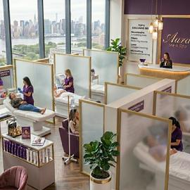
MassaPro
CHAPTER 05 — ROADMAP & NEXT STEPS
▦
NEXT STEPS
Let's Talk About
Your Case
Book your discovery session — 30 minutes, no obligation.
✦
YOUR TEAM
▶
CTA 01
✦
CTA 02
◎
CTA 03
Book a Demo
Request a Worked ROI Example
Schedule a Site Visit
WHAT THE DISCOVERY SESSION INCLUDES
✓
Workshop session (60–90 min) — bring one specific process (account opening, claims intake, technical support, concierge, etc.). We map it to MassaPro IVR end-to-end and identify the integration points.
✓
Custom ROI estimate — we model the cost-per-interaction comparison between your current model and MassaPro IVR for the specific process, using your volumes and your fully-loaded staffing costs.
✓
Reference architecture — we produce a one-page reference architecture for your IT team, showing the ACD integration, the API gateway, the CRM connectors, and the security boundary.
✓
Pilot proposal — if the ROI case holds, we propose a pilot deployment at 1–3 locations, 60–90 days, with success criteria agreed up front. Pilot includes kiosk hardware, platform subscription, and MassaPro implementation team.
✓
Decision points — at the end of the pilot, you have the data to decide: scale to the full network, iterate on the configuration, or stop. No long-term lock-in.
$
·
$
·
◯
|
No commitment
No cost
No obligation
✉
hello@massapro.com
◯
receptionist.massapro.com
MASSAPRO IVR — SALES DECK
CONFIDENTIAL
SLIDE 24 / 24
Notes:
This is the close. Be specific about what you are asking for. The ask is a 60-90 minute workshop with one specific process from the customer's operation. Not a generic demo, not a capabilities presentation — a working session on their process. This is the lowest-friction next step that produces the highest-quality outcome, because it forces the customer to engage with the product on their own terms rather than yours. End with the line on the slide: no commitment, no cost, no obligation. The workshop is free. The ROI estimate is free. The reference architecture is free. The only thing the customer has to provide is the process and the people who know it. MassaPro provides everything else. If the customer is not ready to commit to a pilot, the workshop still produces value — both sides learn whether there is a fit, and the customer has a concrete artefact (the ROI estimate and the reference architecture) to take to their internal decision-makers. Close the deck by thanking the audience and asking for the workshop date directly. "I have Tuesday next week or Thursday the week after open — which works better for your team?" This is the classic sales close: assume the next step, offer a binary choice. Do not leave the room without a calendar invitation.

