Slide 1

InfoSysTrade
Overview: Data-Driven Business Insights for Customer Engagement, Sales Growth, and Inventory Optimization

Slide 2
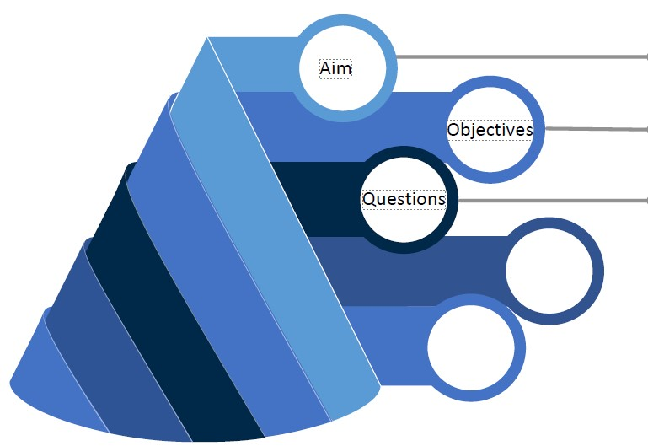
InfoSysTrade
Aim & Objectives
Aims:
Leverage data-driven insights to improve customer engagement, sales, and inventory management.
Identify key trends in customer behavior, sales performance, and inventory optimization.
Provide actionable recommendations to enhance business efficiency and profitability.
Objective of the Analysis
Identify top-selling products, customer segments, and seasonal trend

Slide 3
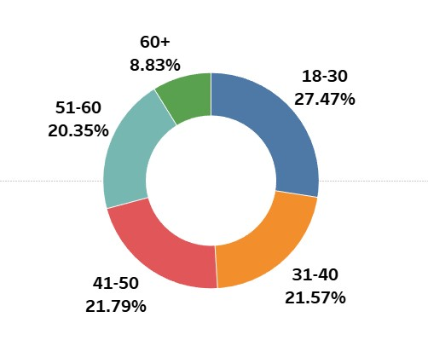
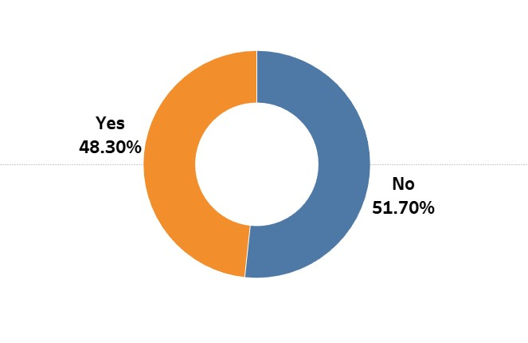
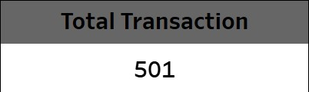

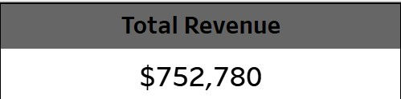
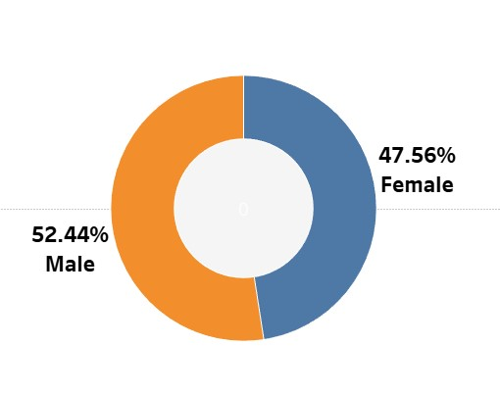
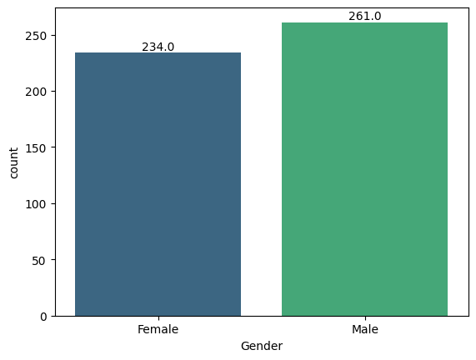
DEMOGRAPHICS
InfoSysTrade
KPI
Total Sales By Subscribers
Sales By Age Group
Sales Distribution By Gender
Gender Distribution

Slide 4
KEY OBJECTIVES
InfoSysTrade
Top-selling products
Customer segments
Seasonal trends

Slide 5
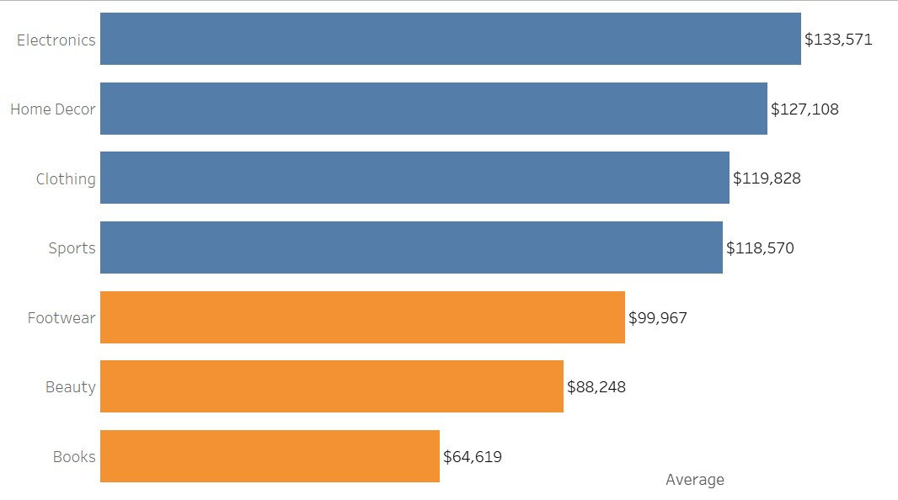
TOP SELLING PRODUCTS
InfoSysTrade

Slide 6
InfoSysTrade
Summary of Findings
Top-Selling Product Analysis
High-Performing Categories (Above Average Sales)
Electronics ($133,571) is the highest-grossing category, indicating strong demand and customer preference.
Home Decor ($127,108) follows closely, showing a high level of consumer interest in home aesthetics.
Clothing ($119,828) and Sports ($118,570) are also strong performers, suggesting stable demand in the fashion and fitness segments.
Underperforming Categories (Below Average Sales)
Footwear ($99,967) is slightly below the average sales threshold, indicating potential but requiring stronger market positioning.
Beauty ($88,248) is underperforming, suggesting a need for better promotion, pricing strategies, or bundling with complementary products.
Books ($64,619) have the lowest sales, implying low demand, lack of promotional efforts, or shifting customer preferences toward digital alternatives.
Key Insights & Implications
Customer preferences lean toward electronics, home decor, and fashion, requiring continued inventory support and targeted marketing.
Low sales in Books may indicate changing consumer habits, such as a preference for e-books or alternative reading formats.
Beauty & Footwear need stronger engagement, possibly through influencer partnerships, loyalty programs, or promotional discounts.
Cross-selling opportunities exist between high and low-performing categories to improve overall revenue (e.g., pairing Clothing with Beauty products).

Slide 7
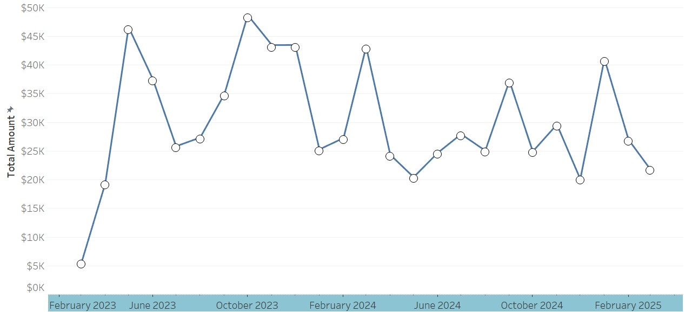
SALES TREND
InfoSysTrade

Slide 8
InfoSysTrade
Key Findings, & Insights
Key Findings:
Sales show significant fluctuations over the analyzed period, with multiple peaks and dips.
Highest sales spike occurred around October 2023 and February 2023, reaching above $45K.
Lowest sales points are observed in early June 2024 and mid-2024, where total sales drop below $20K.
There is seasonality or periodic trends, with sales peaking in certain months and dipping in others.
Key Insights:
Sales growth early in the period: A rapid increase in sales from February 2023 to October 2023 suggests a strong business expansion or seasonal demand.
Cyclical fluctuations: Repeated rises and falls in sales could indicate seasonal trends, external economic conditions, or promotional events driving short-term increases.
Mid-2024 sales volatility: Unlike earlier periods, mid-2024 shows inconsistent performance, with sharp ups and downs, hinting at possible external influences like market conditions, inventory challenges, or shifting consumer demand.
Recommendations:
Identify peak season drivers – Analyze what led to high sales in October 2023 and February 2024 (e.g., promotions, holidays, product launches) and leverage similar strategies.
Stabilize sales dips – Investigate causes behind low sales in mid-2024. Introduce targeted discounts, bundling, or advertising to sustain revenue.
Enhance demand forecasting – Use predictive analytics to anticipate fluctuations and adjust inventory, marketing, and supply chain decisions proactively.
Optimize marketing efforts – Allocate more resources to periods of high consumer engagement and experiment with new promotions in traditionally slow months.
Diversify revenue streams – Introduce new product lines, upselling strategies, or subscription models to reduce dependency on seasonal demand spikes.

Slide 9
SEGMENTS
InfoSysTrade
Sales By Age Group
Total Sales By Subscribers
Sales Distribution By Gender

Slide 10
InfoSysTrade
Key Findings & Insights
Sales by Age Group:
The 18-30 age group contributes the highest sales (27.47%).
Sales are well-distributed among 31-50 age groups (~21-22% each).
Older consumers (51-60 and 60+) account for a smaller share, indicating a lower engagement.
Sales by Subscription Status:
Subscribers (48.30%) contribute almost equally to sales as non-subscribers (51.70%).
A slight dominance of non-subscribers suggests potential for improving subscription-based sales.
Sales by Gender:
Male buyers (52.44%) slightly outnumber female buyers (47.56%), showing near-equal gender engagement.
Marketing strategies should remain inclusive of both genders.
Recommendations:
Target young adults (18-30) with loyalty programs and tailored promotions.
Encourage subscriptions through exclusive benefits to convert more non-subscribers.
Engage the 51+ age group with personalized offers and improved product awareness.
Ensure gender-neutral marketing strategies to maintain balanced sales distribution.

Slide 11
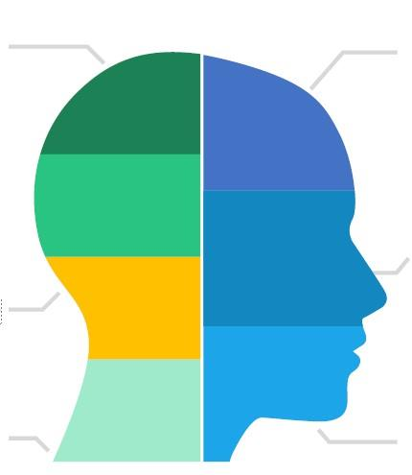

Recommendations
InfoSysTrade
Final Target Young Adults (18-30):
Since this age group contributes the highest sales (27.47%), design promotions, loyalty programs, and exclusive product offerings tailored for them.
Increase Subscription Conversions:
With 51.70% of sales from non-subscribers, introduce exclusive discounts, early access, or rewards to convert them into long-term subscribers.
Balance Gender Marketing:
Sales and gender distribution are almost equal. Ensure marketing campaigns are inclusive and cater to both male and female consumers effectively.
Expand Senior Market Engagement:
The 51+ age group has lower engagement (~29.18% combined). Use targeted ads, simplified UX, and value-driven promotions to attract and retain them.
Leverage High Order Value & Transactions:
With 501 transactions and an Average Order Value of $1,503, optimize upselling and bundling strategies to further increase revenue.
Data-Driven Customer Retention Strategies:
Use analytics to track repeat purchases, customer preferences, and churn risks to tailor personalized retention strategies.
Enhance Digital Presence & Accessibility:
Invest in an optimized online experience, mobile-friendly interfaces, and seamless checkout processes to maximize conversions.

