Slide 1

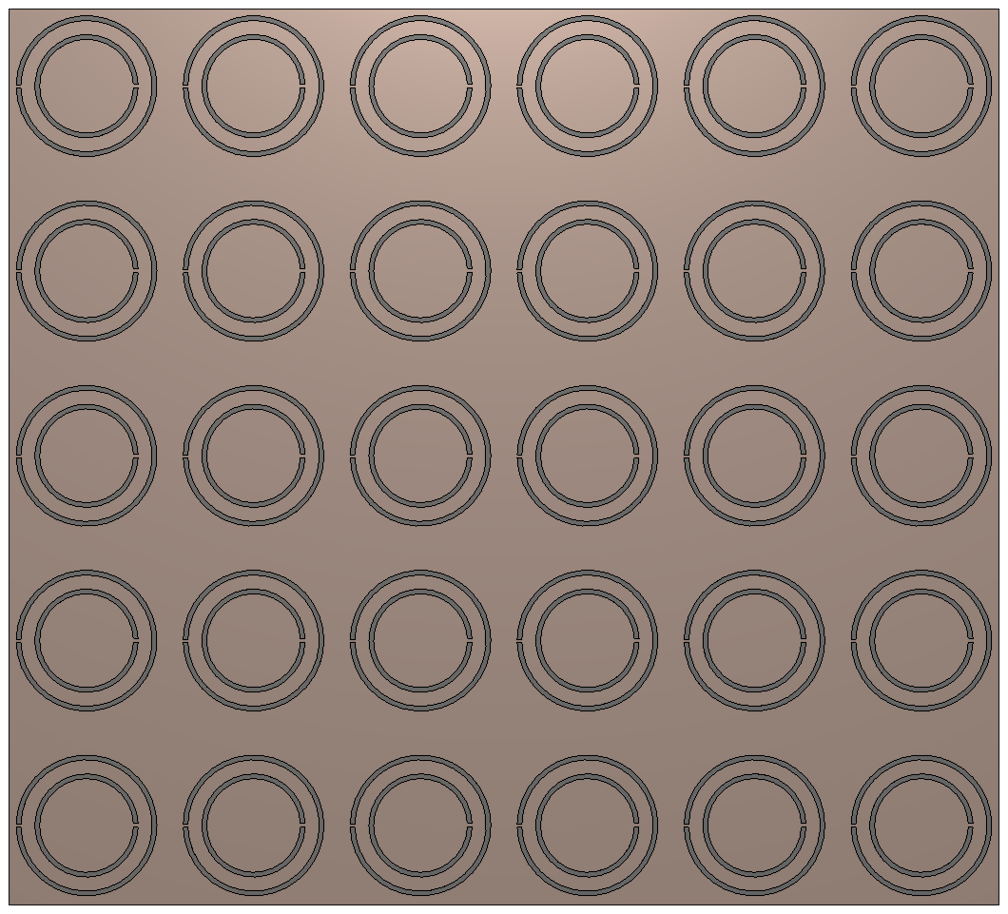
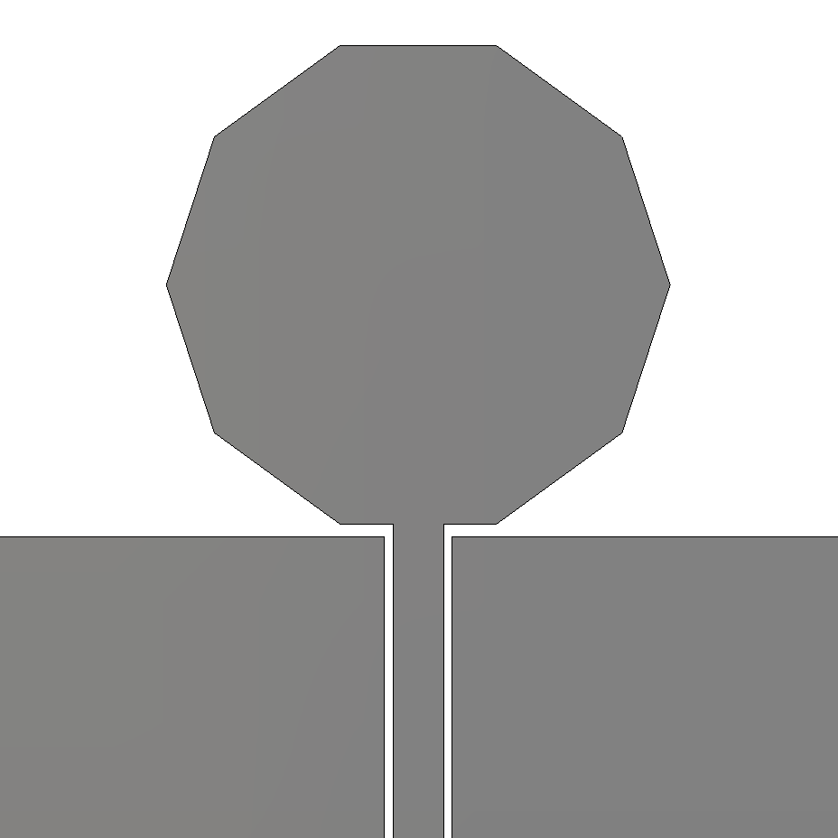
B.TECH PROJECT · MID-SEMESTER EVALUATION
Dept. of Electronics & Communication Engineering, NIT Silchar
Wideband MIMO Antenna
with Metasurface
Checkpoint 1 — a CPW-fed wideband antenna with a split-ring metasurface reflector
Presented by
Chanswarang Boro (2314143)
Nishit Baishya (2314088)
Anushka Dam (2314115)
Sanjana (2314060)
Under the guidance of
Dr. Ujjal Chakraborty
Associate Professor, ECE
Co-guide
Mr. Sovan Bhattacharya
PhD Scholar, ECE
B.Tech 7th Semester · Session 2026–27 · October 2026
our antenna (front) + split-ring metasurface (behind)
Notes:
Introduce the project and the team. This is checkpoint 1: one wideband antenna, optimised, with a metasurface added behind it. MIMO comes in Phase II.

Slide 2






What is an antenna?
BASICS
transmit: signal → wave
receive: wave → signal
signal in a cable
signal in a cable
Transmitter
Antenna
radio waves through the air
Antenna
Receiver
A converter
Everywhere
Size follows wavelength
Electrical signal ↔ radio wave, in both directions
Phones, Wi-Fi routers, GPS, radar
Higher frequency → shorter wave → smaller antenna
Notes:
An antenna turns the electrical signal in a cable into radio waves, and catches radio waves and turns them back into a signal. Phones, Wi-Fi routers and GPS all use one. Its size depends on the wavelength: higher frequency means a shorter wave and a smaller antenna.

Slide 3


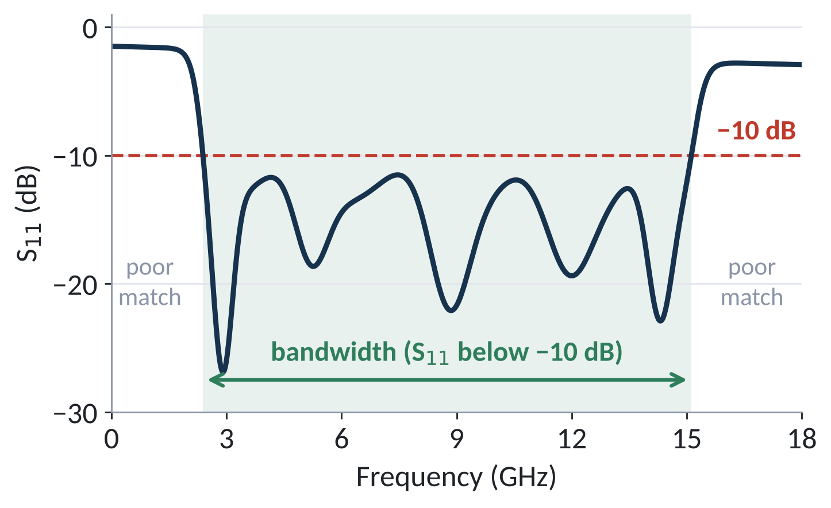
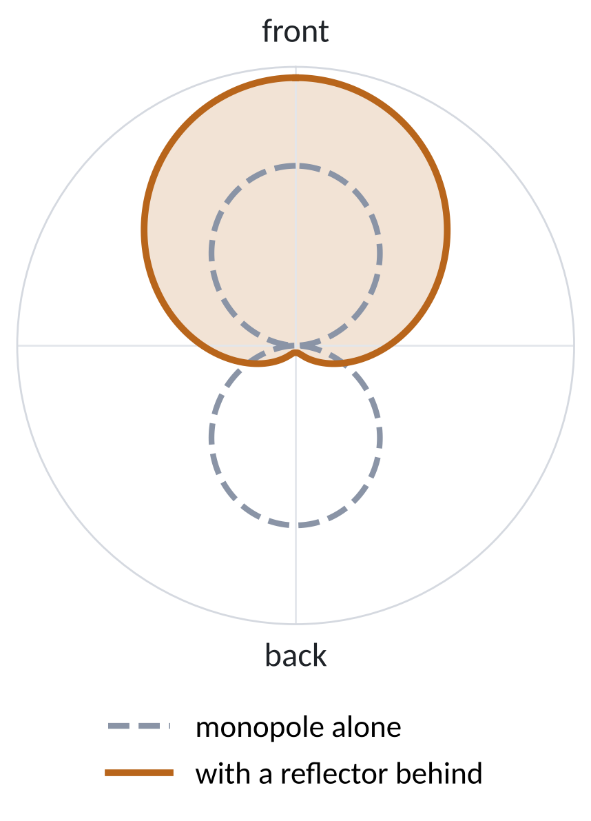
How do we judge an antenna?
BASICS
Matching — S₁₁
Gain & radiation pattern
how much power bounces back
how strongly, and in which direction
Gain (dBi): power in the best direction, compared with an antenna that radiates equally everywhere
A monopole sends front and back → part of the power is wasted
A reflector behind it sends more power forward → higher gain
Below −10 dB → less than 10 % reflected → good match
concept sketches, not our results
Notes:
Two questions. First, matching: how much of the power we feed in bounces back. That is S11. Below minus 10 dB means less than 10 percent comes back, and the frequency range where that holds is the bandwidth. Second, gain and the radiation pattern: how strongly and in which direction the antenna sends its power. A plain monopole sends equally to the front and the back; a reflector behind it folds the back lobe forward, which raises the gain.

Slide 4





Why wideband, why MIMO — and what is the problem?
INTRODUCTION & PROBLEM STATEMENT
Wideband
MIMO
Printed monopole
One antenna covers many services (about 2–15 GHz)
Several antennas on one device → more data, more reliable link
Small, cheap, easy to make and naturally wideband
The problem
Our question
A printed monopole radiates to the front and the back → part of the power goes the wrong way → low gain
A plain metal sheet behind it must sit about a quarter-wavelength away → the antenna becomes thick
How can we raise the gain and still keep the antenna thin and wideband?
[1]–[3]
Notes:
Wideband means one antenna serves many services. MIMO means several antennas on one device, for more data and a more reliable link. Printed monopoles are small, cheap and wideband — but they radiate equally front and back, so the gain is low. A plain metal sheet behind them only helps if it is far away, which makes the antenna thick. So our question is how to raise the gain while keeping the antenna thin and wideband.

Slide 5



Our antenna: a CPW-fed printed monopole
OUR STRUCTURE
CPW feed — cross-section
ground
signal
ground
FR-4 substrate (1.6 mm)
Decagon patch
back of the board: no metal
Why printed on FR-4?
Cheap, light and easy to fabricate
Why a decagon patch?
Ground
Close to a circle → smooth current paths → several resonances merge into one wide band
Why a CPW feed?
Signal line
Signal and ground on one side → one copper layer, no vias, easy connector, wideband
FR-4 board · 50 × 50 × 1.6 mm · copper
[1], [3], [4]
Notes:
This is our optimised antenna. The ten-sided patch is the part that radiates. It is fed by a coplanar waveguide: the signal line runs between two ground planes on the same side of the board, and the back of the board is bare. We chose FR-4 because it is cheap and easy to fabricate; a near-circular decagon because smooth current paths give several resonances that merge into one wide band; and CPW because it needs only one copper layer, no vias, and it is easy to attach a connector.

Slide 6
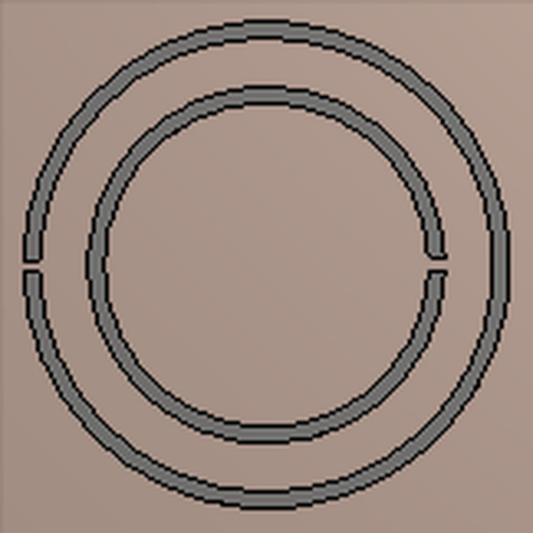



Our idea: a metasurface reflector
OUR STRUCTURE
Side view (not to scale)
forward
reflected, adds forward
antenna
2 mm
backward
One cell:
two split rings
(outer + inner)
small cut = “split”
metasurface
copper back
Thin board with repeated small metal cells
6 × 5 cells (top view)
Split ring = tiny resonator → two rings, two resonances
Goal: send the backward wave forward → more gain
CST: peak directivity 3.7 → 8.8 dBi (slide 14)
Placed only 2 mm behind → can stay thin
[5], [6]
Notes:
A metasurface is a thin board printed with many small, repeated metal cells. Each of our cells has two split rings: a ring with a small cut behaves like a tiny resonant circuit, and two rings of different size give two resonances. The board has solid copper on the back and sits only 2 millimetres behind the antenna. The copper reflects the backward wave and the rings shift how it reflects, so that it can add to the forward wave instead of cancelling it. The CST directivity result on slide 14 shows that it does: the peak rises from 3.7 to 8.8 dBi.

Slide 7


Four objectives
OBJECTIVES
1
2
3
4
Design
Optimise
Metasurface
Extend & test
A compact CPW-fed wideband antenna covering about 2–15 GHz
Ground position, then patch size, in CST, for S₁₁ below −10 dB
Split rings behind the antenna to raise the gain while keeping it thin
Phase II: MIMO version, fabrication and measurement
Objectives 1–3: this phase · Objective 4: Phase II
Notes:
First, design a compact CPW-fed wideband antenna for about 2 to 15 GHz. Second, optimise it in CST: the ground position first, then the patch size. Third, add the split-ring metasurface behind it to raise the gain while keeping it thin. Fourth, in Phase II, build the MIMO version, fabricate it and measure it.

Slide 8

Reflectors add gain, but sit 9–20 mm away
LITERATURE REVIEW
Work | Reflector behind the antenna | Gap | Peak gain
Al-Gburi 2022 [7] | 19 × 19 loop FSS | 10 mm* | 6.7 → 11.5 dBi
Hussain 2023 [8] | 5 × 5 ring-frame FSS | 9 mm | 6.5 → 10.5 dBi
Hammache 2024 [9] | 7 × 7 FSS | 20 mm | 2.2 → 8.4 dBi
Sen 2017 [10] | double split-ring metasurface | — | ≈ +5.5 dB
Hasan 2022 [11] | 10 × 10 split-ring MS (MIMO) | 12 mm | 5.4 → 8.3 dBi
This work | 6 × 5 double split-ring MS | 2 mm | 3.7 → 8.8 dBi†
FSS = frequency selective surface · MS = metasurface · * total height · — not given in the abstract
† directivity, φ = 0° plane (CST)
Research gap
A metasurface only a few mm behind an antenna that works from about 2 to 15 GHz is rarely reported → our aim: 2 mm, then MIMO
Notes:
We reviewed ten papers; here are the closest five. Reflectors behind wideband antennas raise the gain by about 4 to 6 dB. But as the chart shows, most of them sit 9 to 20 millimetres behind the antenna. Our metasurface sits only 2 millimetres behind. In our row the number is the CST directivity, not yet the realized gain: the peak rises from 3.7 to 8.8 dBi. A gap this thin over a band as wide as 2 to 15 GHz is rarely reported — that is our research gap.

Slide 9

Eight steps — seven done
PROPOSED METHODOLOGY
1
2
3
4
5
6
7
8
Initial antenna
in CST
Ground position
sweep
Patch size
sweep
Optimised
antenna
Metasurface
design
Antenna +
metasurface
Directivity vs
frequency
Phase II: MIMO
& testing
Done
Planned (Phase II)
Simulation tool
Material
Method
CST Studio Suite 2019, frequency-domain solver, 0–18 GHz
FR-4 board (1.6 mm) with copper conductors
Change one dimension at a time; keep the value with the best S₁₁
Notes:
We work in eight steps. Steps one to seven are done: the initial antenna, the ground sweep, the patch-size sweep, the optimised antenna, the metasurface design, the S11 with the metasurface, and step seven, the directivity with and without the metasurface. Realized gain over the whole band and tuning still remain in this phase. Step eight is Phase II. All simulations run in CST Studio Suite 2019, and we change one dimension at a time and keep the value with the best S11.

Slide 10
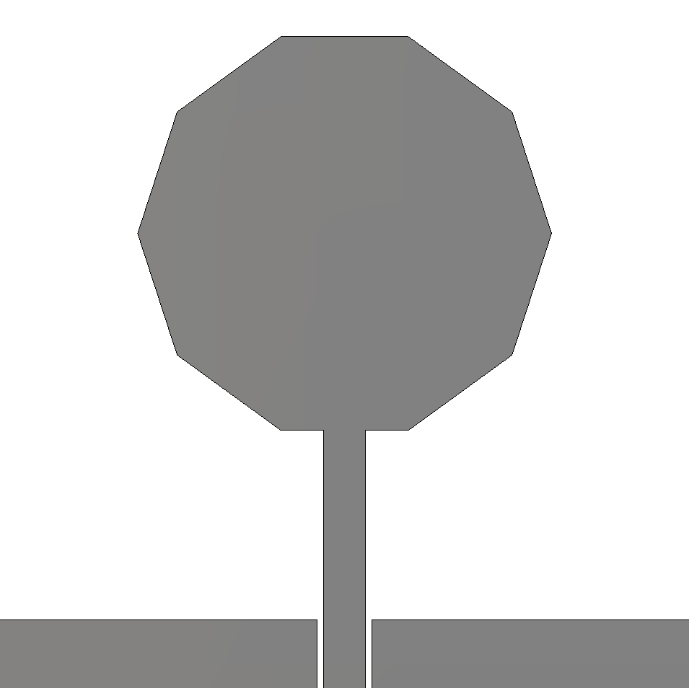
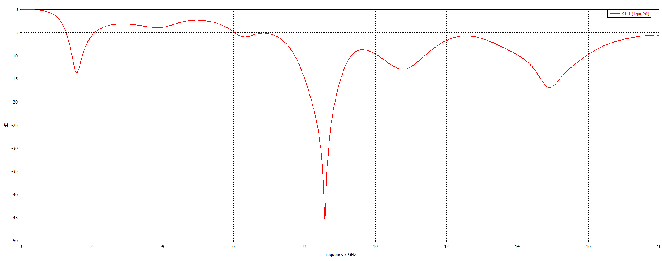
Starting point: the initial antenna is poorly matched
S₁₁ of the initial antenna
poor match: 2 – 7.7 GHz
Initial design: ground far from the patch (L_{g} = −20 mm)
S₁₁ stays above −10 dB from 2 to 7.7 GHz; only a few narrow dips below it higher up → not usable yet
Notes:
This is where we started: the decagon patch with the ground edge far away, at minus 20 millimetres. The S11 stays above minus 10 dB from 2 to 7.7 GHz — shaded red — with only a few narrow dips below the line higher up. So the antenna is not usable yet. The first thing to fix is the ground position.

Slide 11
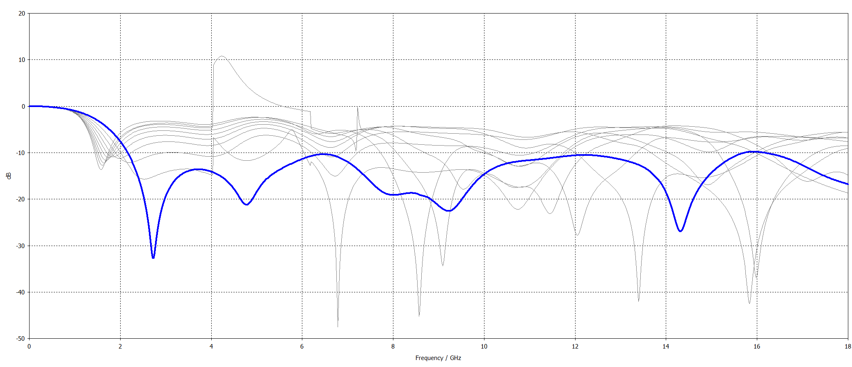
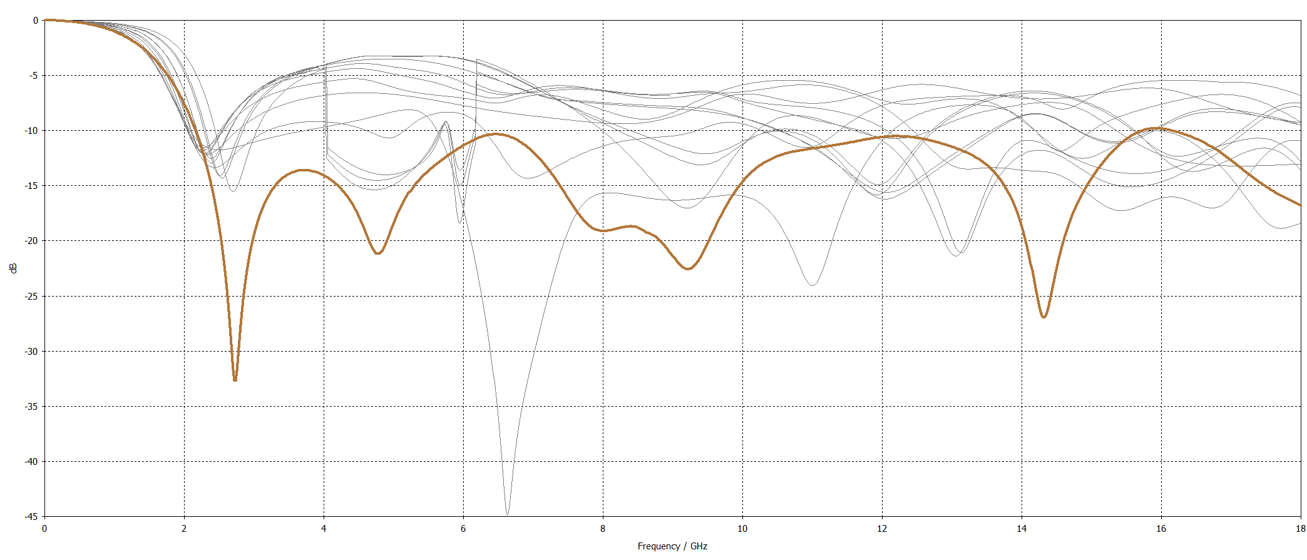
Optimisation: ground position first, then patch size
Step 1 · Ground position
Step 2 · Patch size
Best: L_{g} = −7 mm
other values
Best: R = 15 mm
other values
10 positions: L_{g} = −20 → −7 mm
13 sizes: R = 4 → 15 mm
Closer ground → stronger coupling → better low-band match
Bigger patch → resonances join into one band
Notes:
Step one: we moved the ground edge towards the patch in ten steps, from minus 20 to minus 7 millimetres. A closer ground couples more strongly to the patch and fixes the low-frequency match; only minus 7 millimetres, the blue curve, stays below minus 10 dB across the band. Step two: with the ground fixed, we changed the patch radius from 4 to 15 millimetres. Small patches leave big unmatched regions; the 15 millimetre patch, brown, joins all the resonances into one band. A bigger patch also sits closer to the ground, which helps too.

Slide 12
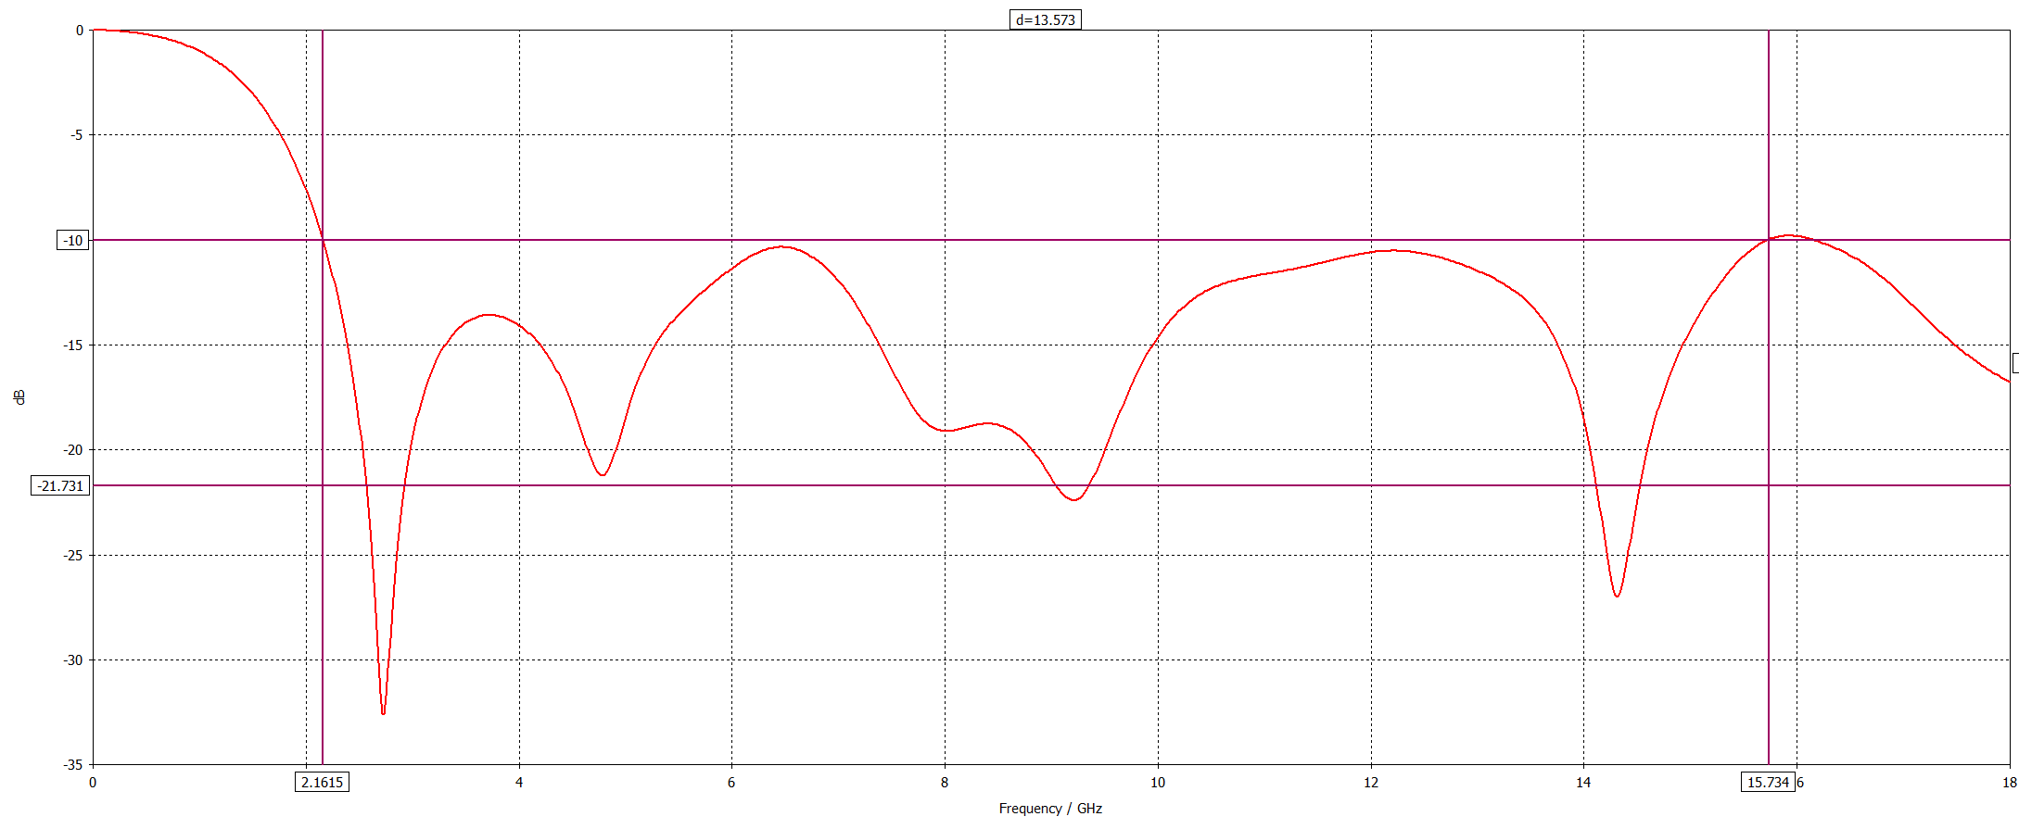

Optimised antenna: matched from 2.16 to 15.73 GHz
Board
FR-4, 50 × 50 × 1.6 mm
2.16 – 15.73 GHz
about 13.6 GHz wide
Patch
decagon, R = 15 mm
resonances: 2.7 · 4.8 · 9.2 · 14.3 GHz
Ground edge
L_{g} = −7 mm
S₁₁ below −10 dB (green band)
covers the 2–15 GHz target
Notes:
This is the optimised antenna: the 15 millimetre decagon with the ground edge at minus 7 millimetres. S11 stays below minus 10 dB from 2.16 to 15.73 GHz — one band about 13.6 GHz wide, with four resonances. It covers our 2 to 15 GHz target. One honest note: near 6.5 and 12.2 GHz the curve only just stays below the line.

Slide 13
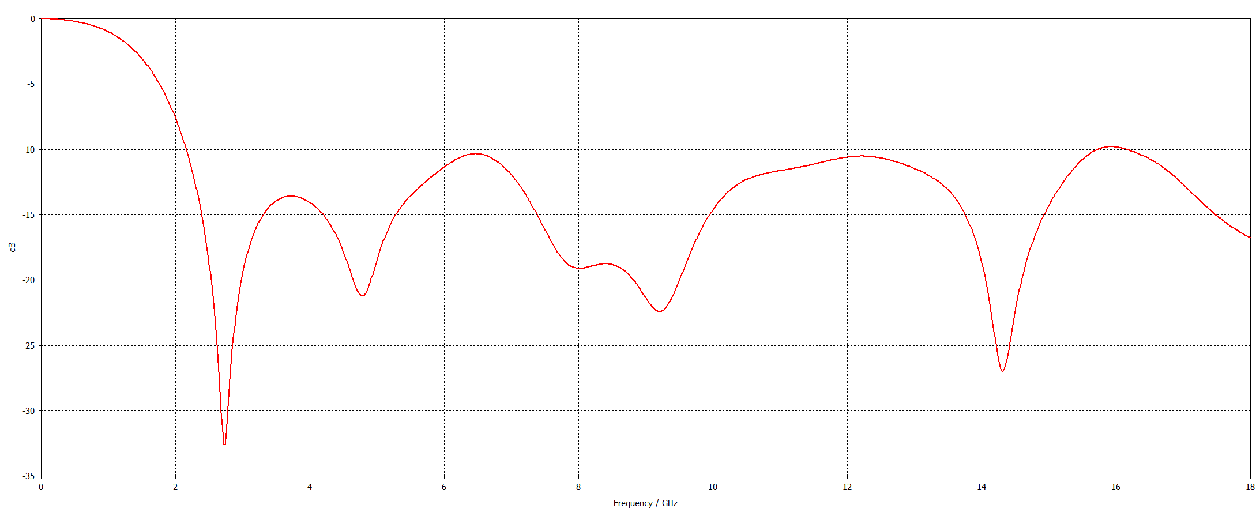
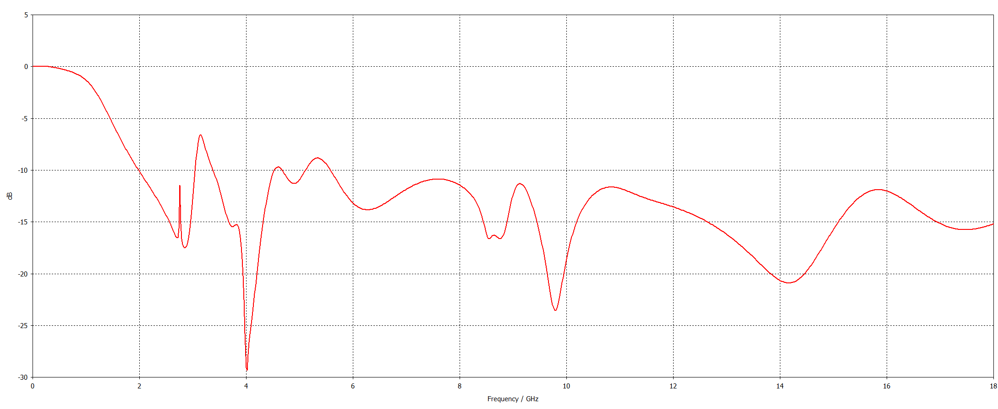

Metasurface added: wider band, three small gaps
Antenna alone
Wider band
about 2.0 → 18 GHz
3 narrow gaps
3.0–3.4 · 4.5–4.7 · 5.1–5.6 GHz
(worst −6.6 dB near 3.1 GHz)
Antenna + metasurface (2 mm gap)
Next: tune
air gap, ring size and ground position
18 GHz is the end of the simulated range · gain: next slide
Notes:
Top: the antenna alone. Bottom: the same antenna with the metasurface 2 millimetres behind it, on the same frequency axis. The band now starts lower, at about 2 GHz, and stays matched up to 18 GHz — the end of our simulation. But there are three narrow regions, shaded red, where S11 rises above minus 10 dB, the worst being minus 6.6 dB near 3.1 GHz. At such a small gap the metasurface also changes the antenna's input match, so it needs tuning. The next slide shows what it does to the directivity.

Slide 14
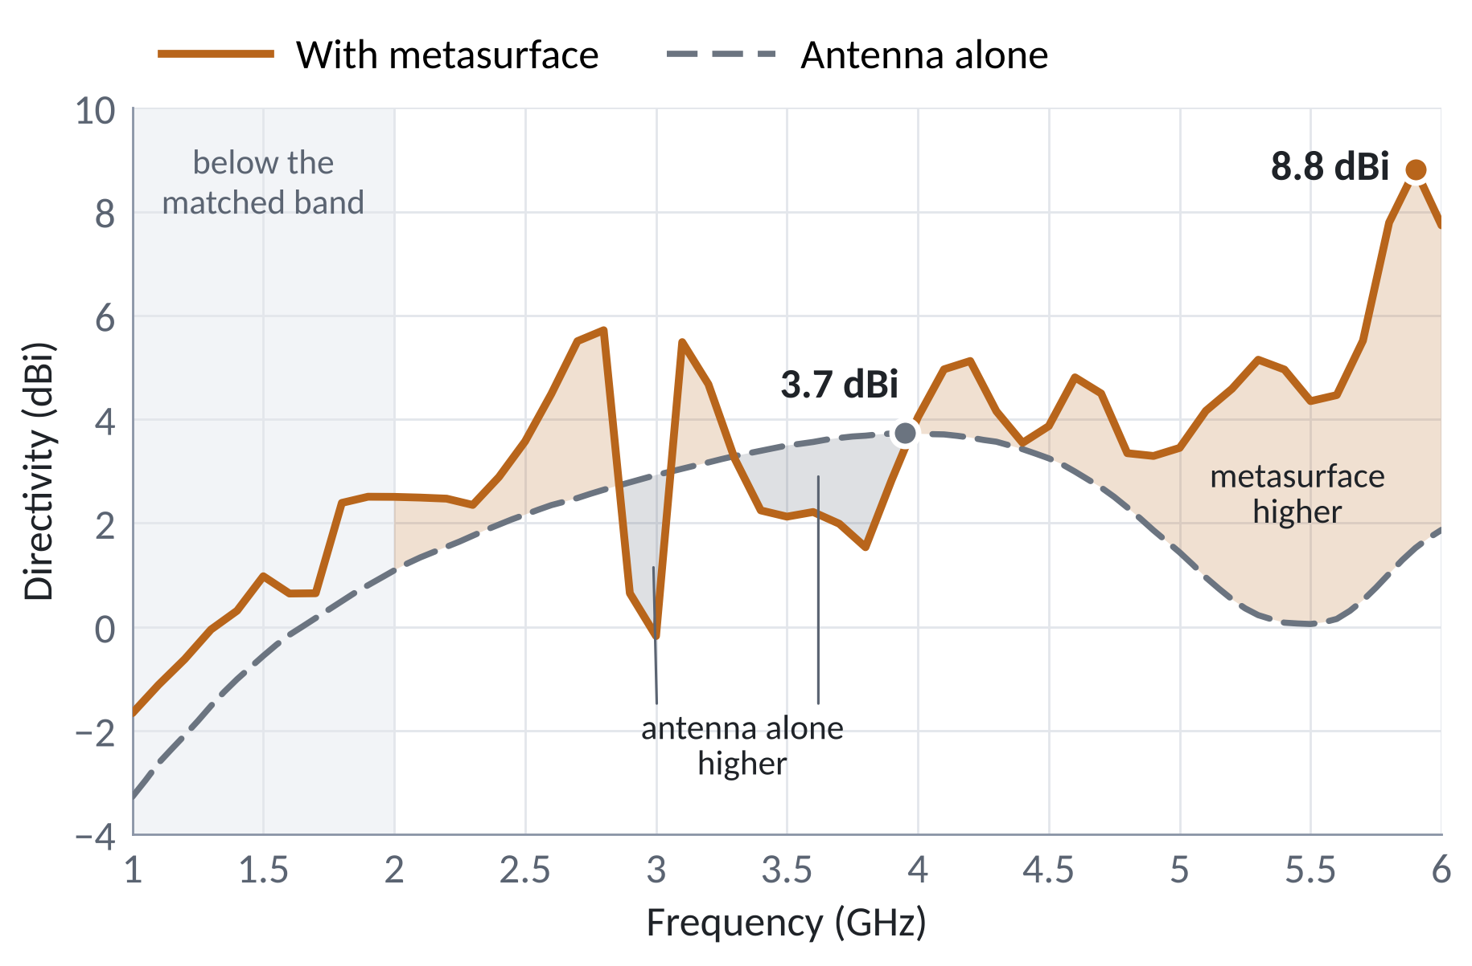

Metasurface raises the directivity: 3.7 → 8.8 dBi
GAIN COMPARISON
Peak 3.7 → 8.8 dBi
+5.1 dB with the metasurface
(peak now at 5.9 GHz)
Higher on 78 % of 2–6 GHz
average 2.3 → 3.9 dBi (+1.6 dB)
Two dips
≈ 2.9–3.1 and 3.3–4.0 GHz
(worst −3.1 dB at 3.0 GHz)
CST directivity, maximum in the φ = 0° plane
Metasurface run covers 1–6 GHz
Directivity = gain without losses; realized gain is next
Notes:
This CST plot compares the antenna alone, the grey dashed line, with the antenna plus the metasurface, the copper line. It shows directivity — the gain the antenna would have with no losses — taking the highest value in the phi equals zero degree plane at each frequency. With the metasurface the peak rises from 3.7 dBi near 4 GHz to 8.8 dBi at 5.9 GHz, and from 2 to 6 GHz the directivity is higher over 78 percent of the band: 3.9 instead of 2.3 dBi on average. That is what we wanted: the copper-backed metasurface reflects the backward wave forward, so more of the power goes to the front. There are two dips, near 3 GHz and from 3.3 to 4 GHz, where the antenna alone is up to about 3 dB higher; the first sits right next to the S11 gap at 3 GHz, so tuning should help. The metasurface run covers only 1 to 6 GHz so far, so next we simulate the realized gain over the whole band, which also counts the losses and the mismatch.

Slide 15

What were the challenges, and what comes next
CHALLENGES & FUTURE WORK
Challenges
Remaining in this phase
Phase II
Long run times
antenna + metasurface needs a large mesh
1
Realized gain over the whole 2–15 GHz band
4
4-port MIMO (elements turned 90°) + metasurface
Sweep glitches
jumps near 4 and 6 GHz from too few frequency points → re-run
Tune the metasurface: close the S₁₁ gaps and the directivity dips
Isolation and correlation (ECC) between ports
2
5
Thin margin
only just below −10 dB near 6.5 and 12.2 GHz
3
Radiation patterns at a few frequencies
6
Fabricate on FR-4 and measure
Metasurface detuning
three narrow S₁₁ gaps (3.0–5.6 GHz) and two directivity dips near 3–4 GHz
Expected outcomes
Thin wideband antenna with higher gain
Compact MIMO antenna, good isolation
Tested prototype vs simulation
Notes:
Our challenges: long simulation times for the full model; a few glitches in the sweep curves near 4 and 6 GHz from too few frequency points, which we will re-run; a thin matching margin near 6.5 and 12.2 GHz; and the metasurface detuning — three narrow mismatch gaps and two directivity dips near 3 to 4 GHz. The directivity comparison with and without the metasurface is done. Next, in this phase: the realized gain over the whole 2 to 15 GHz band, tuning the metasurface to close the gaps and the dips, and radiation patterns at a few frequencies. Then Phase II: a four-port MIMO antenna with the metasurface, isolation and correlation checks, fabrication and measurement.

Slide 16

Conclusion
CONCLUSION
Antenna done
Metasurface added
Next
CPW-fed decagon matched from 2.16–15.73 GHz
6 × 5 split rings, 2 mm behind: wider band, peak directivity 3.7 → 8.8 dBi
Realized gain and tuning
→ MIMO antenna
References
[1] N. P. Agrawall, G. Kumar, and K. P. Ray, “Wide-band planar monopole antennas,” IEEE Trans. Antennas Propag., vol. 46, no. 2, pp. 294–295, Feb. 1998.
[2] M. S. Sharawi, “Printed multi-band MIMO antenna systems and their performance metrics,” IEEE Antennas Propag. Mag., vol. 55, no. 5, pp. 218–232, Oct. 2013.
[3] C. A. Balanis, Antenna Theory: Analysis and Design, 4th ed. Hoboken, NJ, USA: Wiley, 2016.
[4] R. N. Simons, Coplanar Waveguide Circuits, Components, and Systems. New York, NY, USA: Wiley, 2001.
[5] C. L. Holloway et al., “An overview of the theory and applications of metasurfaces,” IEEE Antennas Propag. Mag., vol. 54, no. 2, pp. 10–35, Apr. 2012.
[6] J. B. Pendry, A. J. Holden, D. J. Robbins, and W. J. Stewart, “Magnetism from conductors and enhanced nonlinear phenomena,” IEEE Trans. Microw. Theory Techn., vol. 47, no. 11, pp. 2075–2084, Nov. 1999.
[7] A. J. A. Al-Gburi et al., “High gain of UWB planar antenna utilising FSS reflector for UWB applications,” Comput. Mater. Contin., vol. 70, no. 1, pp. 1425–1436, 2022.
[8] M. Hussain et al., “Bandwidth and gain enhancement of a CPW antenna using frequency selective surface for UWB applications,” Micromachines, vol. 14, no. 3, Art. no. 591, 2023.
[9] B. Hammache et al., “Gain enhancement of compact CPW-fed ultra-wideband antenna using an FSS reflector,” Microw. Opt. Technol. Lett., vol. 66, no. 10, Art. no. e34344, 2024.
[10] G. Sen, A. Banerjee, M. Kumar, and S. Das, “An ultra-wideband monopole antenna with a gain enhanced performance using a novel split-ring meta-surface reflector,” Microw. Opt. Technol. Lett., vol. 59, no. 6, pp. 1296–1300, 2017.
[11] M. M. Hasan et al., “Gain and isolation enhancement of a wideband MIMO antenna using metasurface for 5G sub-6 GHz communication systems,” Sci. Rep., vol. 12, Art. no. 9433, 2022.
Notes:
To conclude: the single wideband antenna is designed and matched from 2.16 to 15.73 GHz. The split-ring metasurface is designed and simulated with it: the band widens, with three narrow gaps that need tuning, and the peak directivity rises from 3.7 to 8.8 dBi, higher over most of 2 to 6 GHz. Next come the realized gain over the whole band and the tuning, and then the MIMO antenna. Thank you — we are happy to take questions.

