Slide 1
Laser Induced Plasma
This work is supported by Michigan State University faculty startup funding
Wencheng Lin
Spark Group
Department of Mechanical Engineering, Michigan State University, East Lansing, MI, US

Slide 2
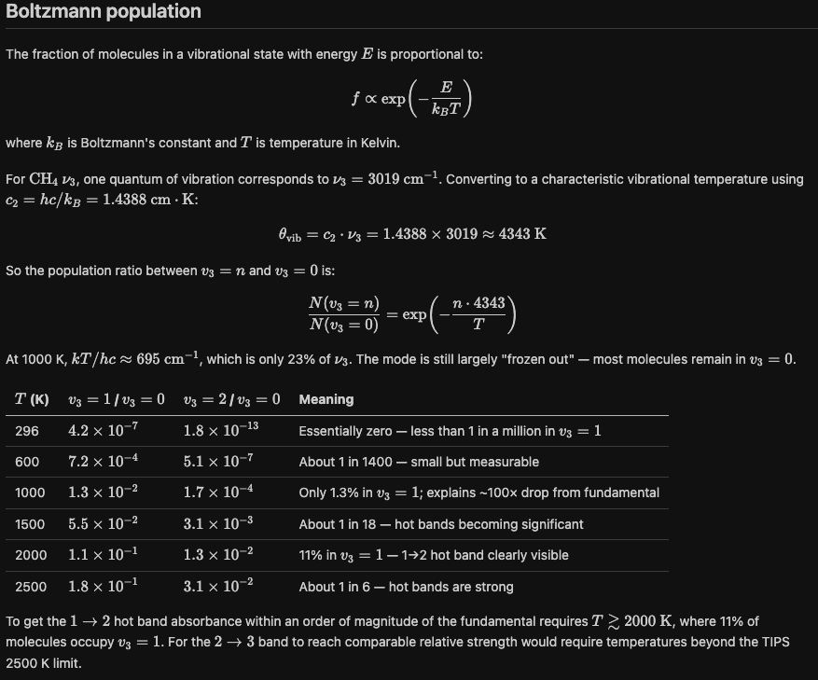
Why hot bands vanish at low temperature

Slide 3
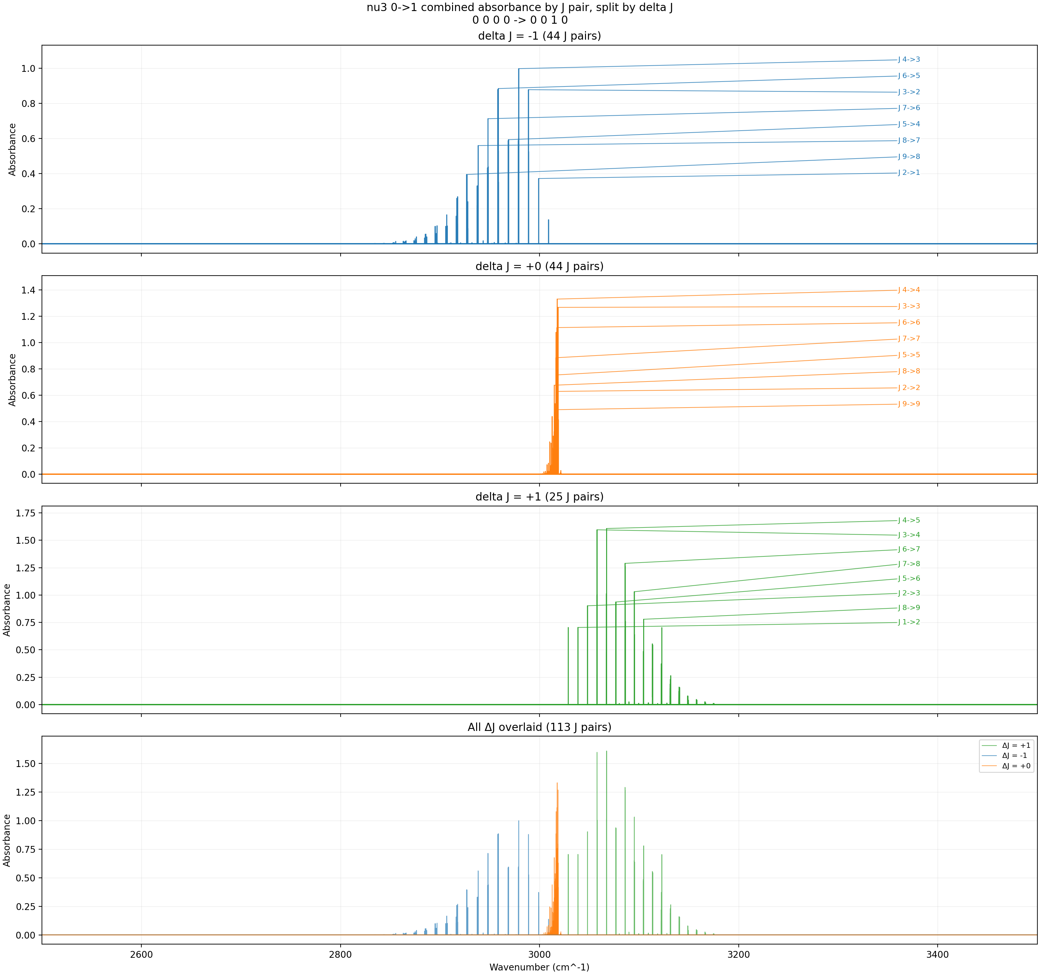
ν₃: 0→1 (fundamental) — Combined ExoMol I1 + HITRAN — 300 K
Strong fundamental band. At 300 K, nearly all molecules are in v₃ = 0. This is the only progression with significant absorbance.
T = 300 K, P = 3 Torr, x = 0.008, L = 100 cm, Δν = 0.001 cm⁻¹

Slide 4
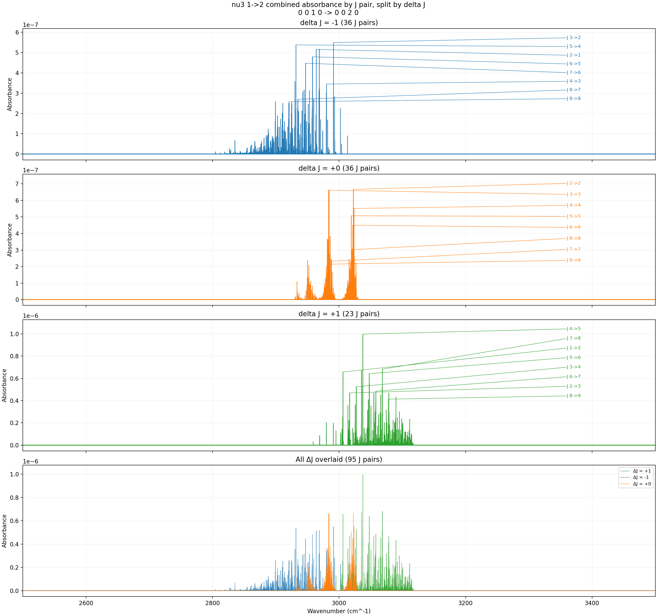
ν₃: 1→2 (1st hot band) — Combined ExoMol I1 + HITRAN — 300 K
Peak absorbance ~10⁻⁷. The Boltzmann population of v₃ = 1 at 300 K is only 4.2×10⁻⁷ — less than 1 in a million molecules.
T = 300 K, P = 3 Torr, x = 0.008, L = 100 cm, Δν = 0.001 cm⁻¹

Slide 5
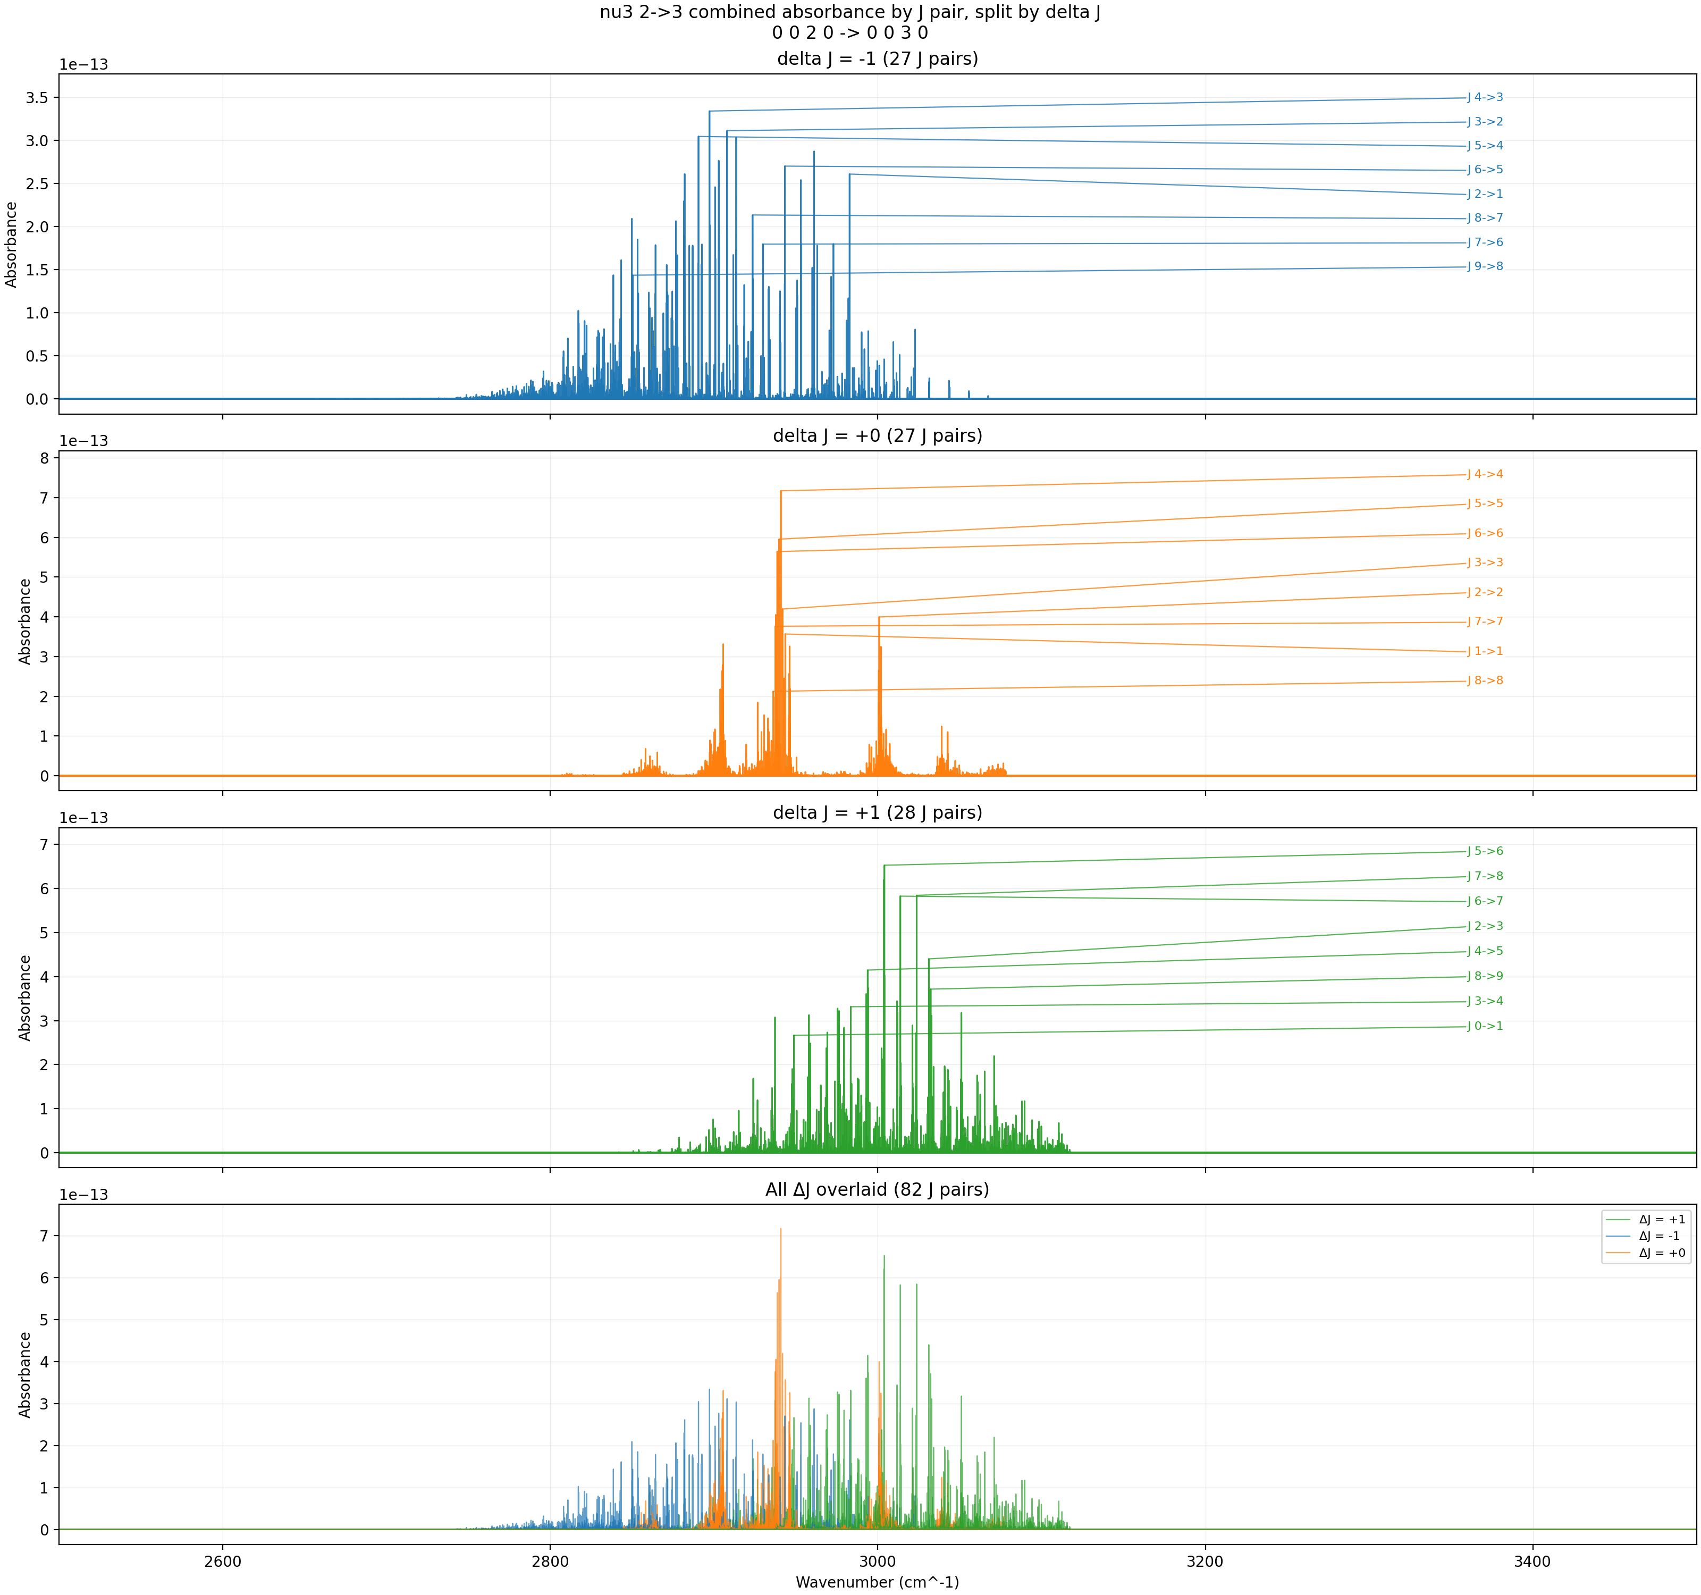
ν₃: 2→3 (2nd hot band) — Combined ExoMol I1 + HITRAN — 300 K
Peak absorbance ~7×10⁻¹³. The v₃ = 2 population is the square of the v₃ = 1 factor, making this band essentially invisible.
T = 300 K, P = 3 Torr, x = 0.008, L = 100 cm, Δν = 0.001 cm⁻¹

Slide 6
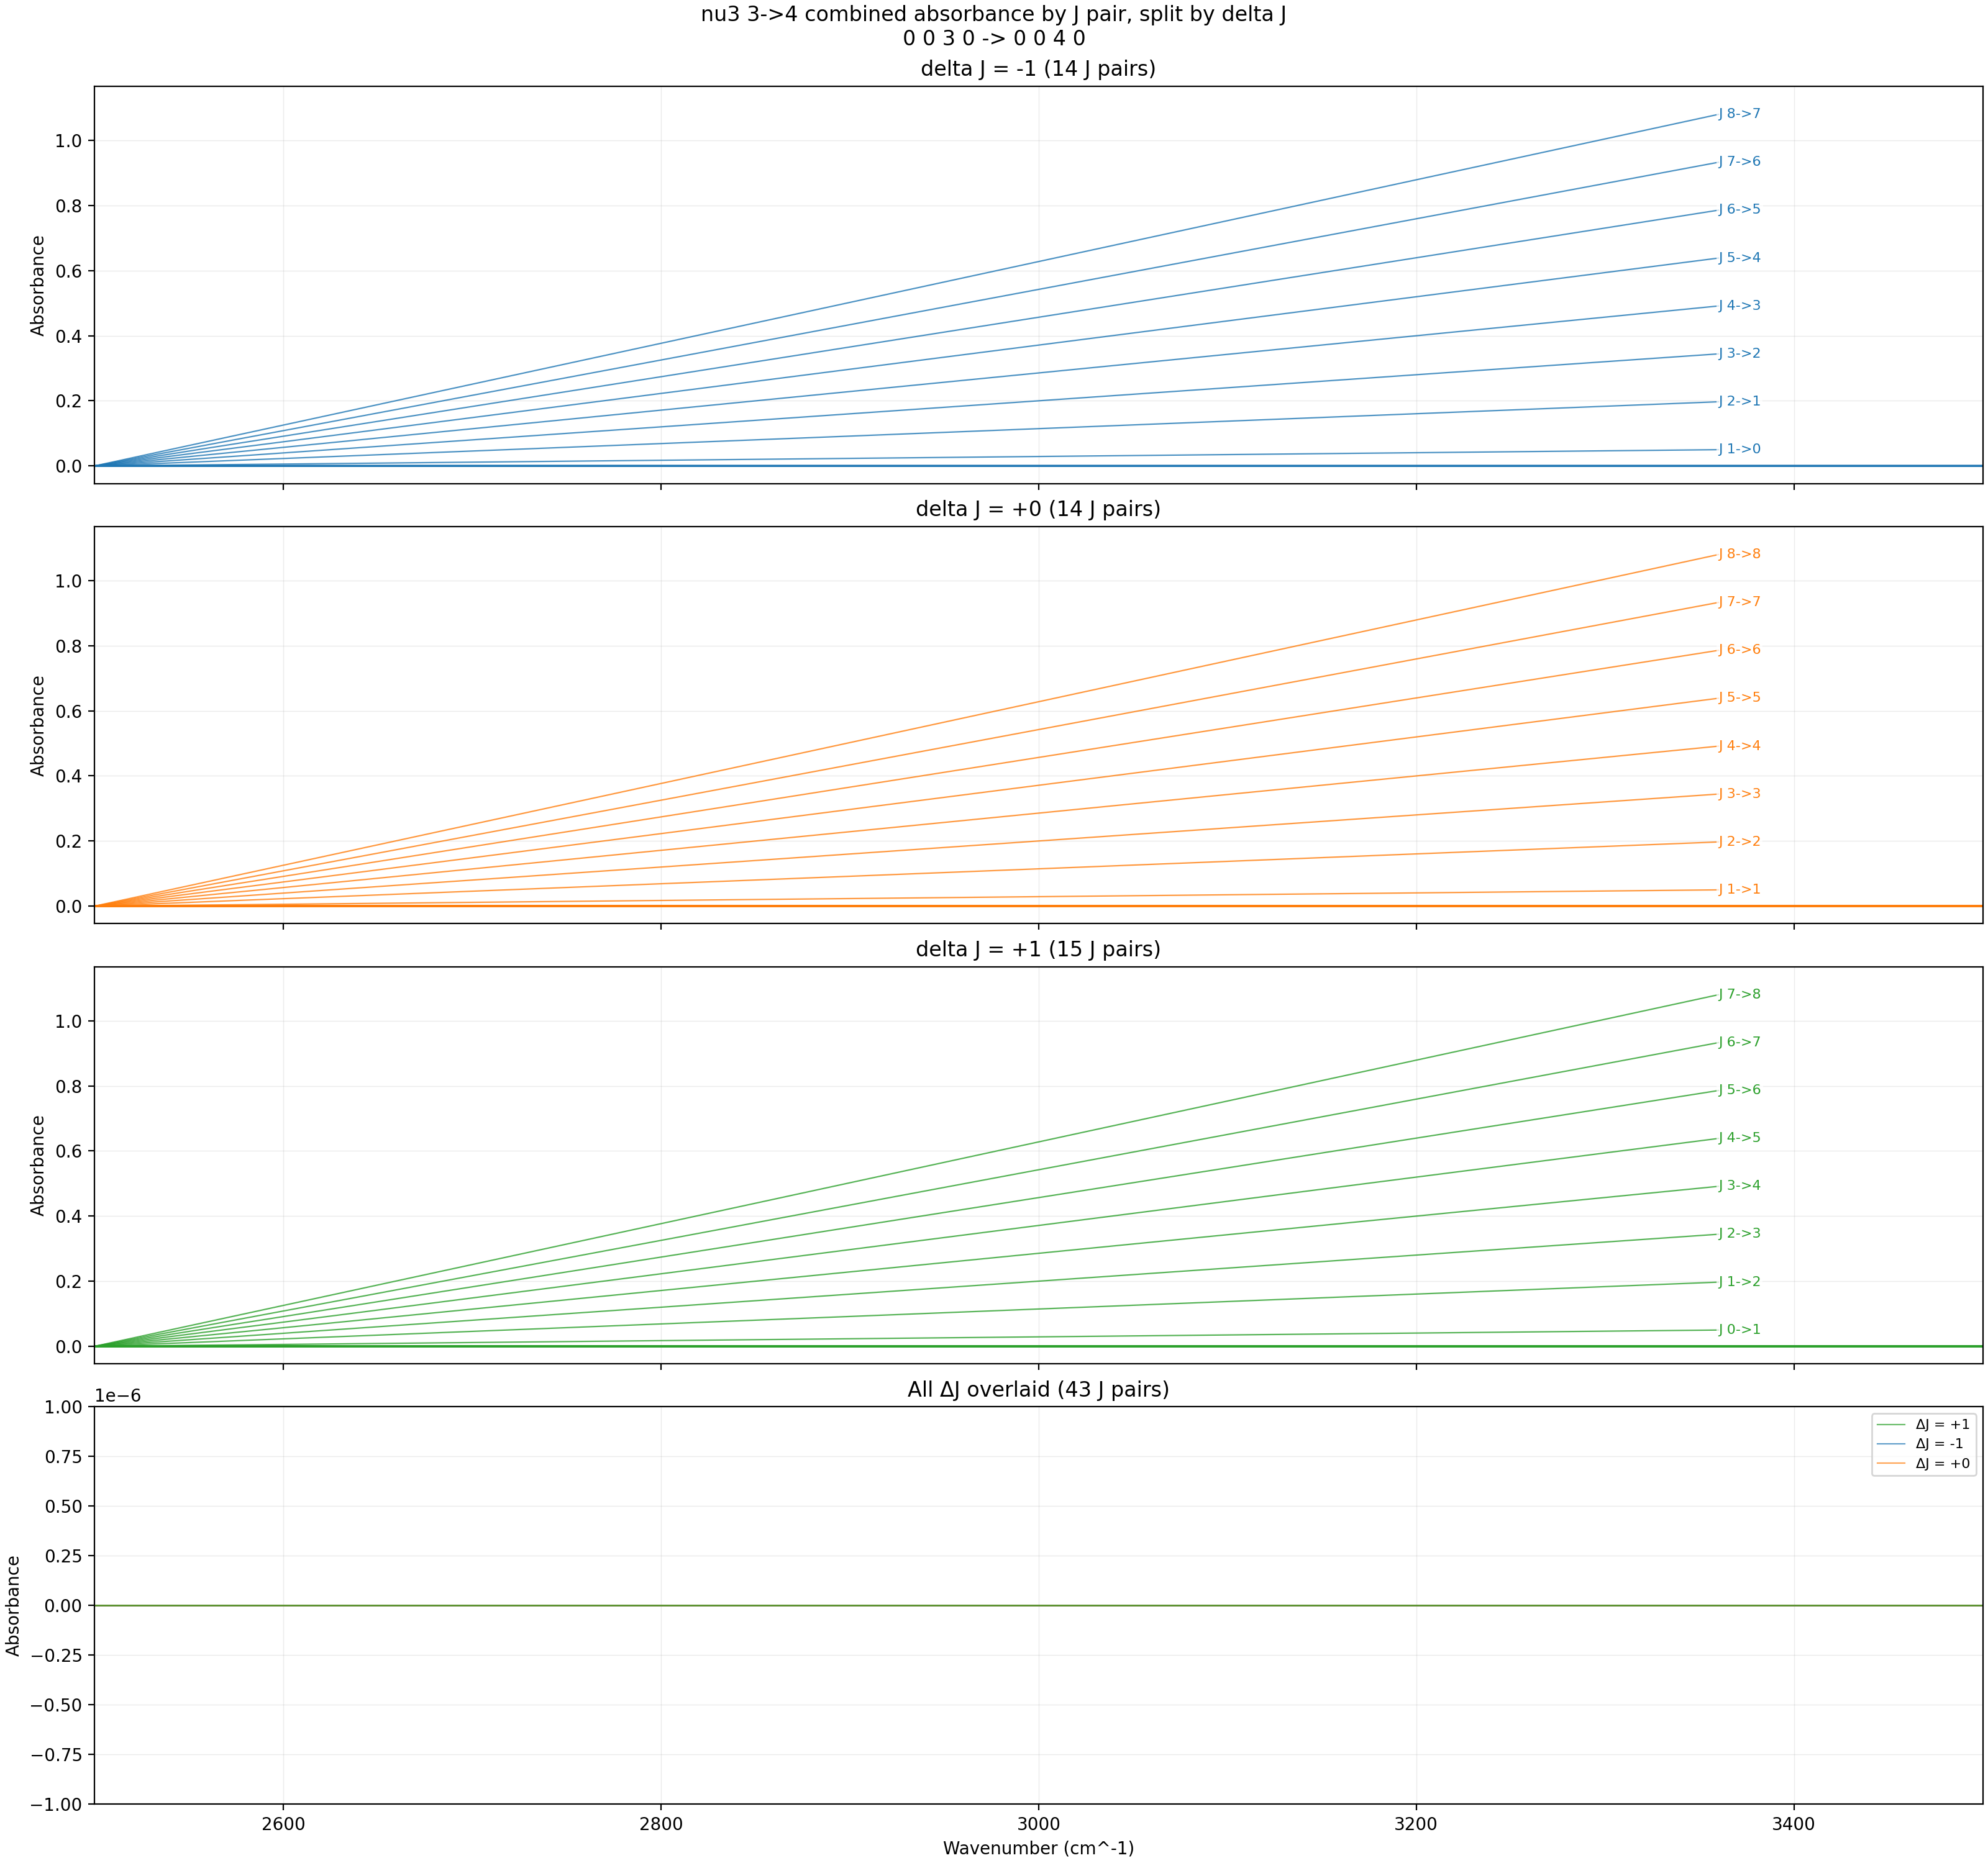
ν₃: 3→4 (3rd hot band) — Combined ExoMol I1 + HITRAN — 300 K
Peak absorbance = 0 (peak_source = none). The v₃ = 3 population at 300 K is below floating-point significance.
T = 300 K, P = 3 Torr, x = 0.008, L = 100 cm, Δν = 0.001 cm⁻¹

Slide 7
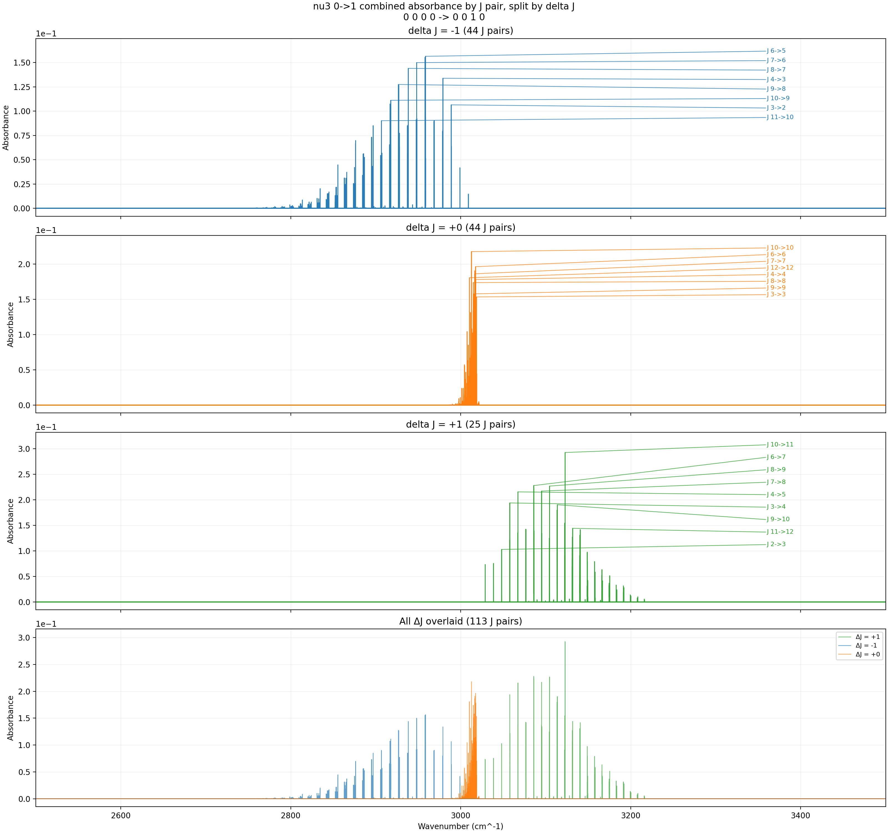
ν₃: 0→1 (fundamental) — Combined ExoMol I1 + HITRAN — 600 K
Fundamental weakens compared to 300 K due to partition function dilution. Peak drops from ~1.6 to ~0.29 as population spreads to excited states.
T = 600 K, P = 3 Torr, x = 0.008, L = 100 cm, Δν = 0.001 cm⁻¹

Slide 8
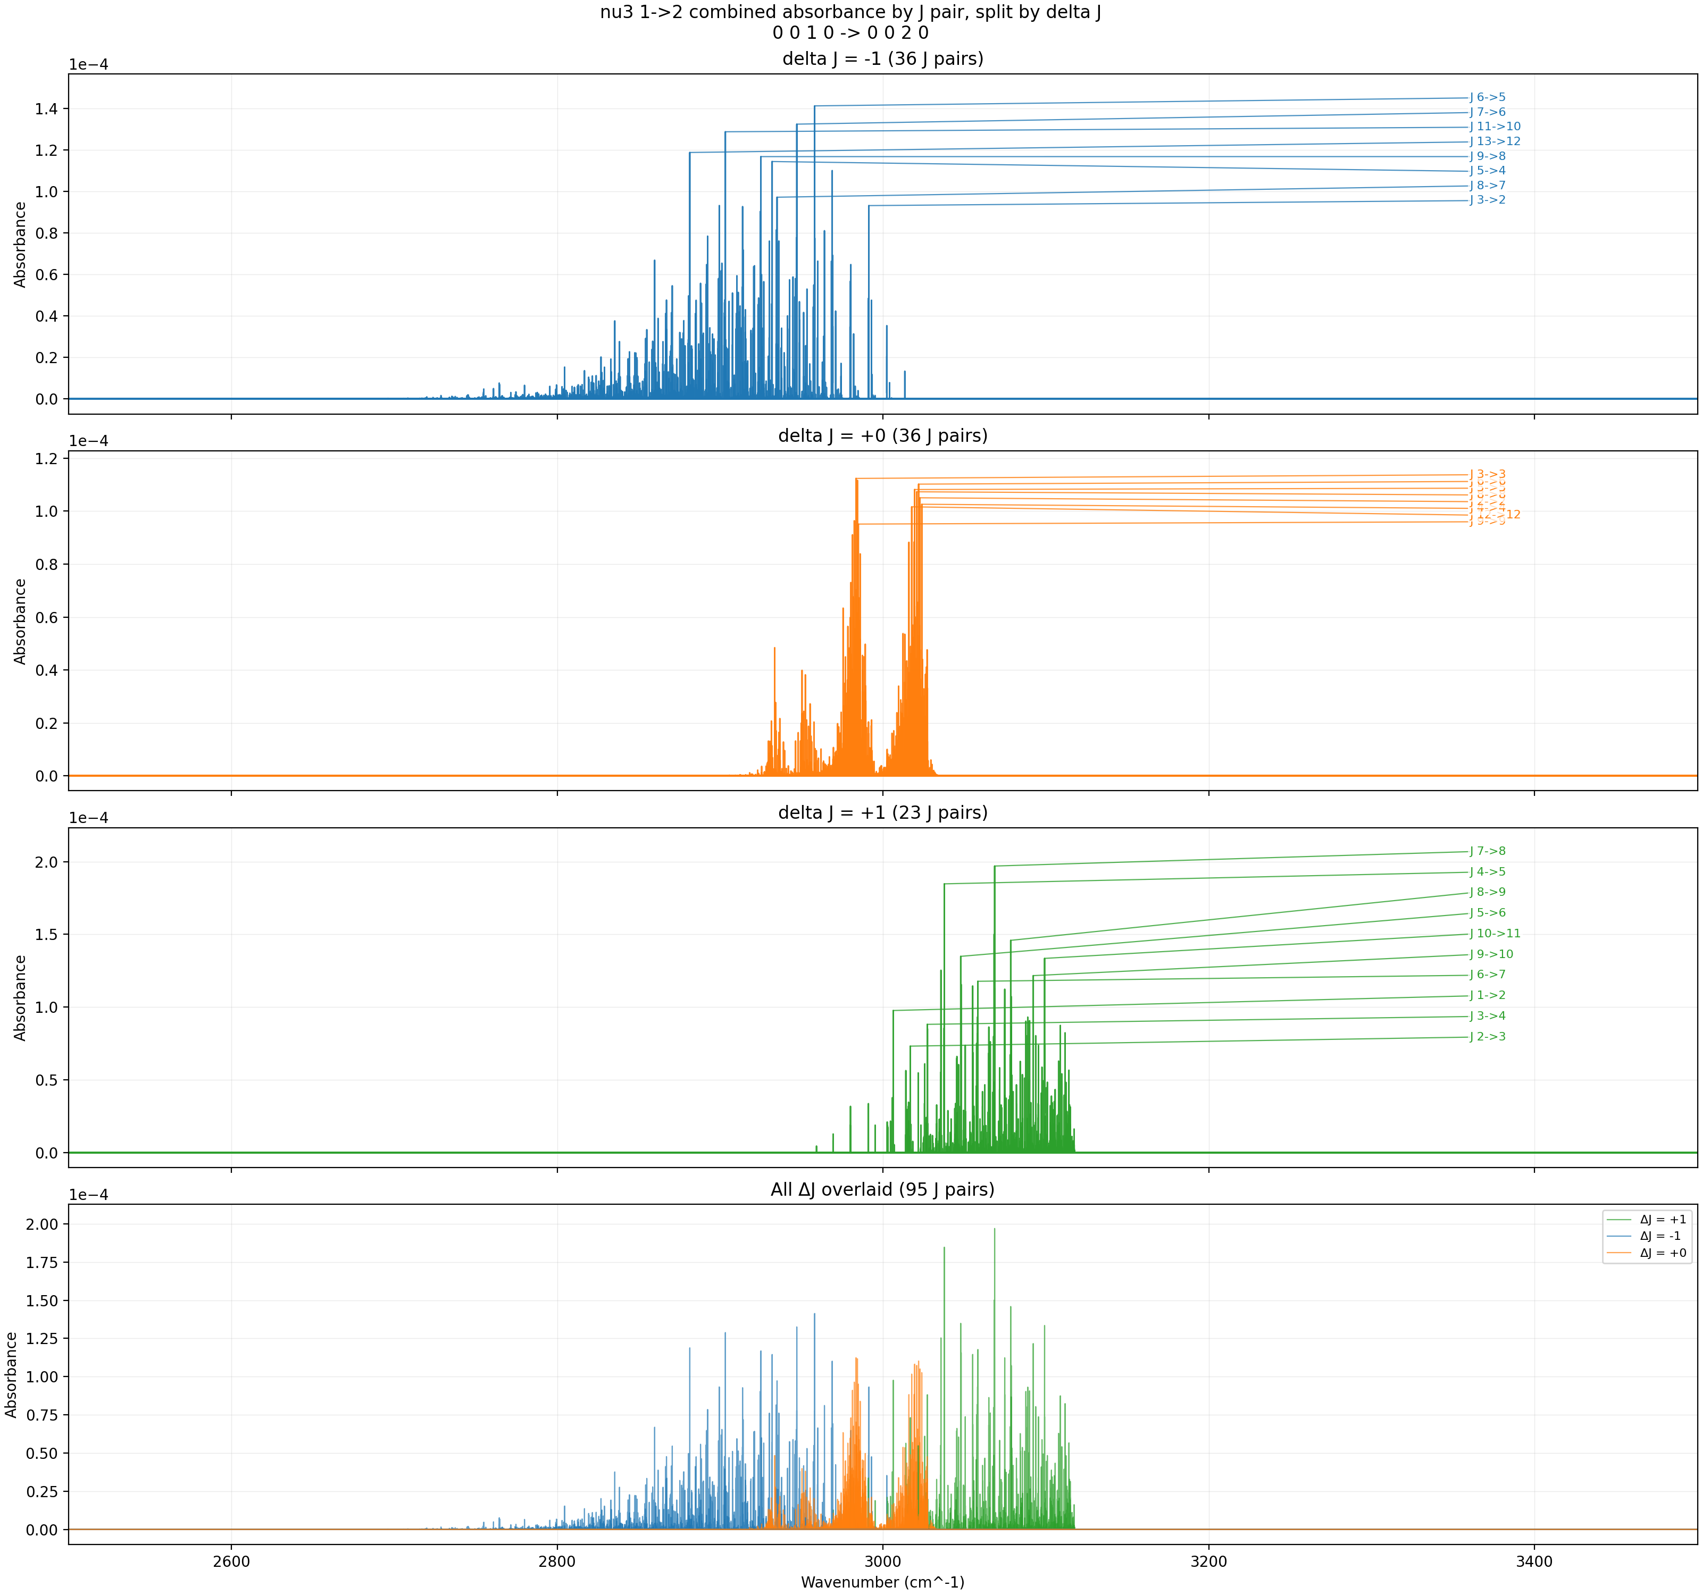
ν₃: 1→2 (1st hot band) — Combined ExoMol I1 + HITRAN — 600 K
Peak absorbance ~2×10⁻⁴. The v₃ = 1 population reaches 7.2×10⁻⁴ (1 in 1400), enough to produce measurable hot band absorption.
T = 600 K, P = 3 Torr, x = 0.008, L = 100 cm, Δν = 0.001 cm⁻¹

Slide 9
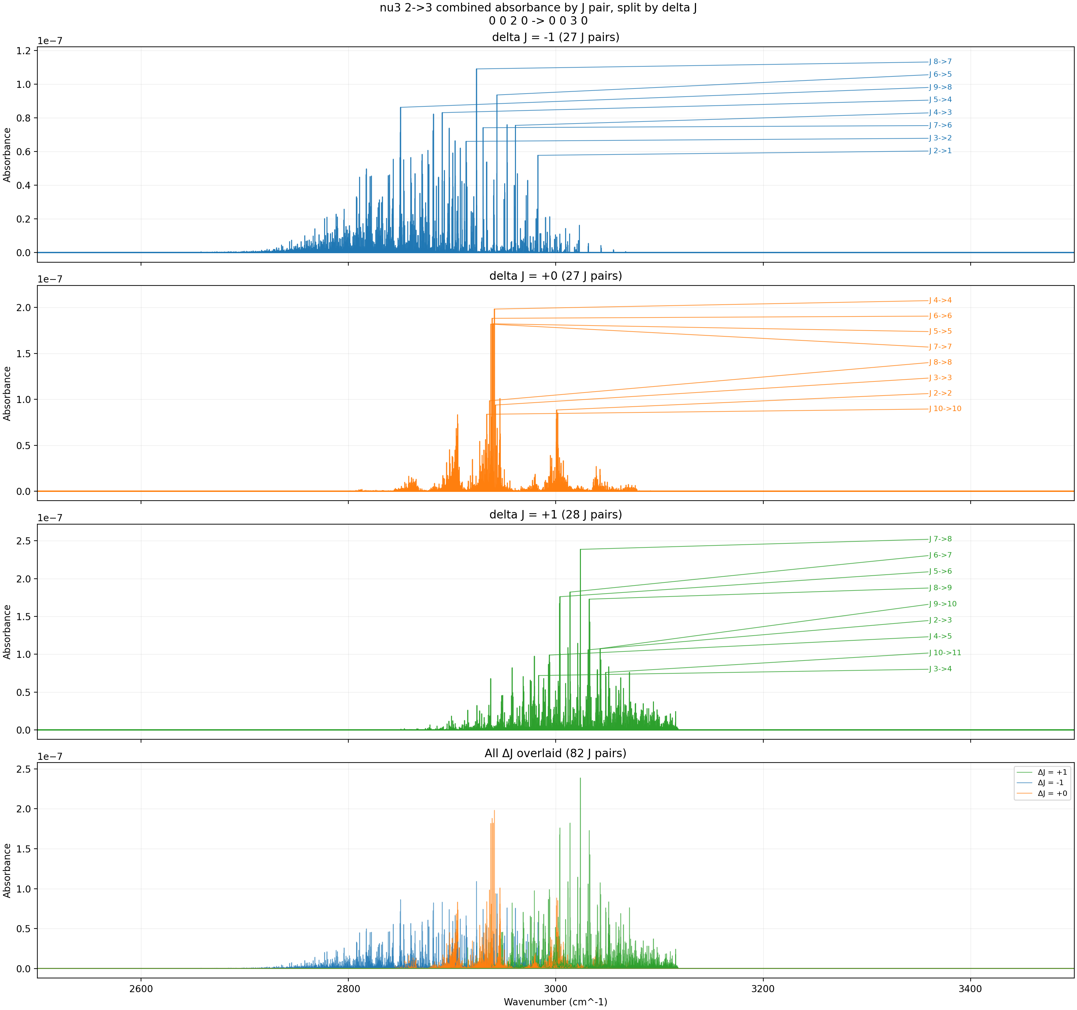
ν₃: 2→3 (2nd hot band) — Combined ExoMol I1 + HITRAN — 600 K
Peak absorbance ~2×10⁻⁷. Weak but nonzero — the v₃ = 2 population is 5.1×10⁻⁷ at 600 K.
T = 600 K, P = 3 Torr, x = 0.008, L = 100 cm, Δν = 0.001 cm⁻¹

Slide 10
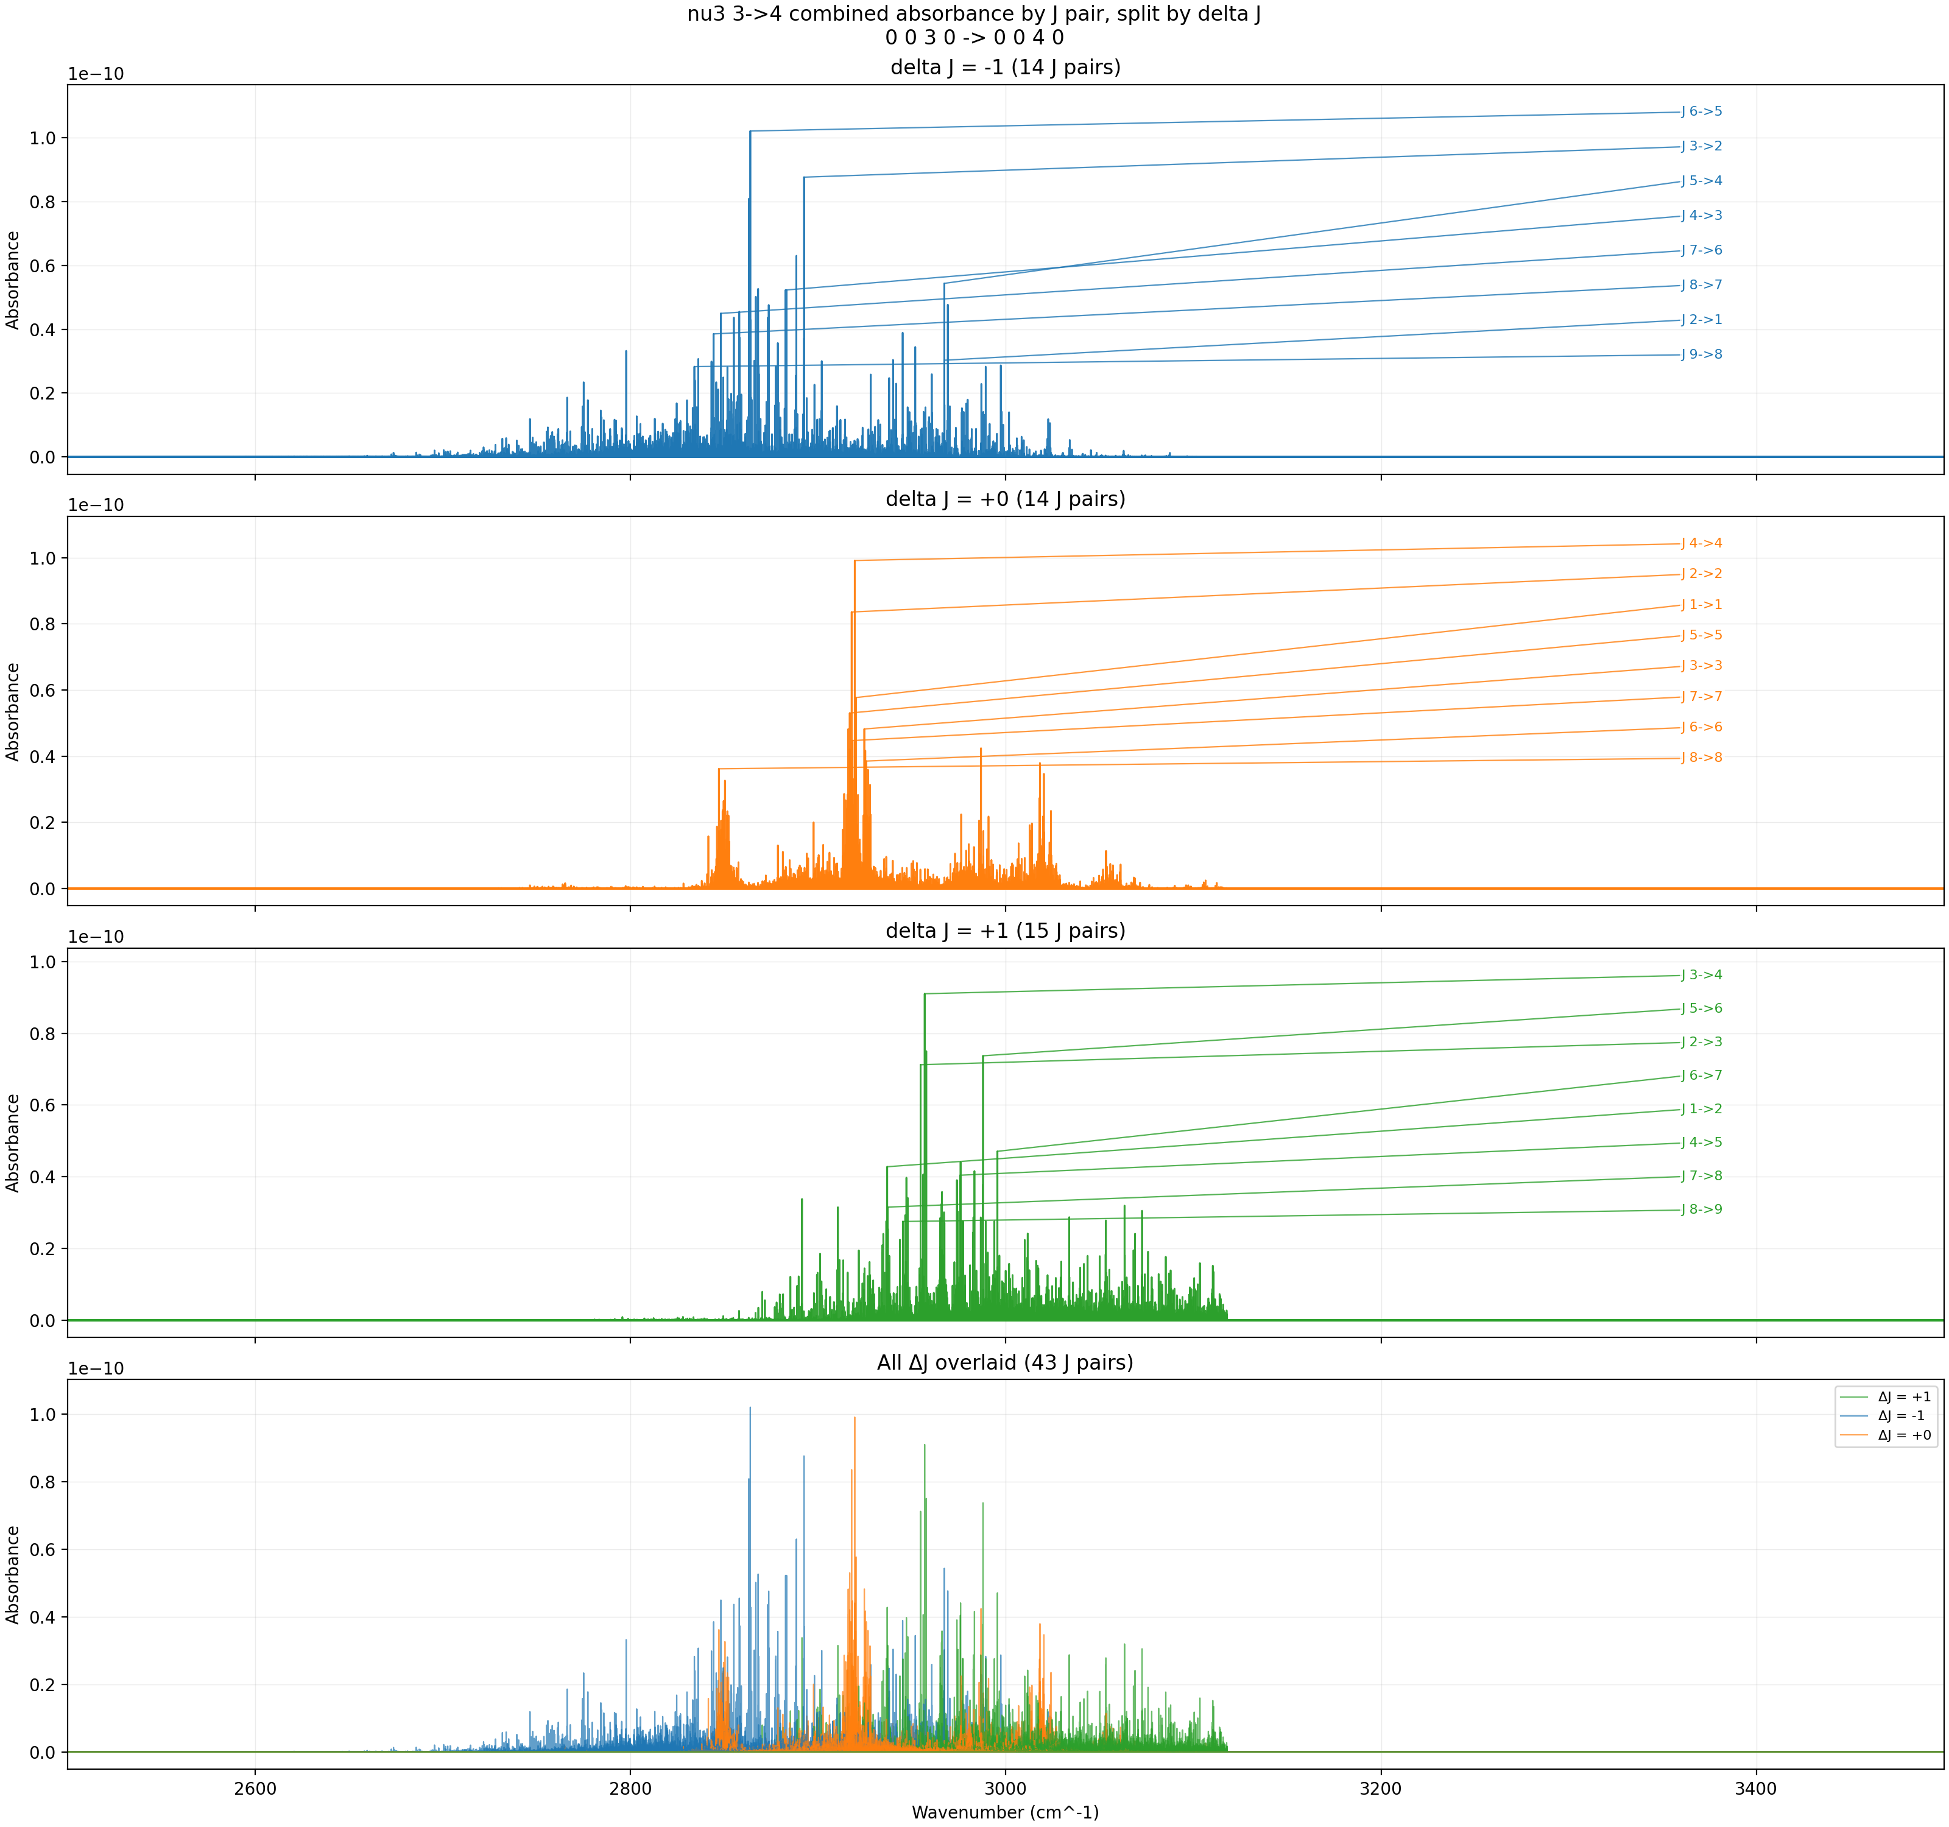
ν₃: 3→4 (3rd hot band) — Combined ExoMol I1 + HITRAN — 600 K
Peak absorbance ~10⁻¹⁰. Extremely weak. The v₃ = 3 population at 600 K is still negligibly small.
T = 600 K, P = 3 Torr, x = 0.008, L = 100 cm, Δν = 0.001 cm⁻¹

Slide 11
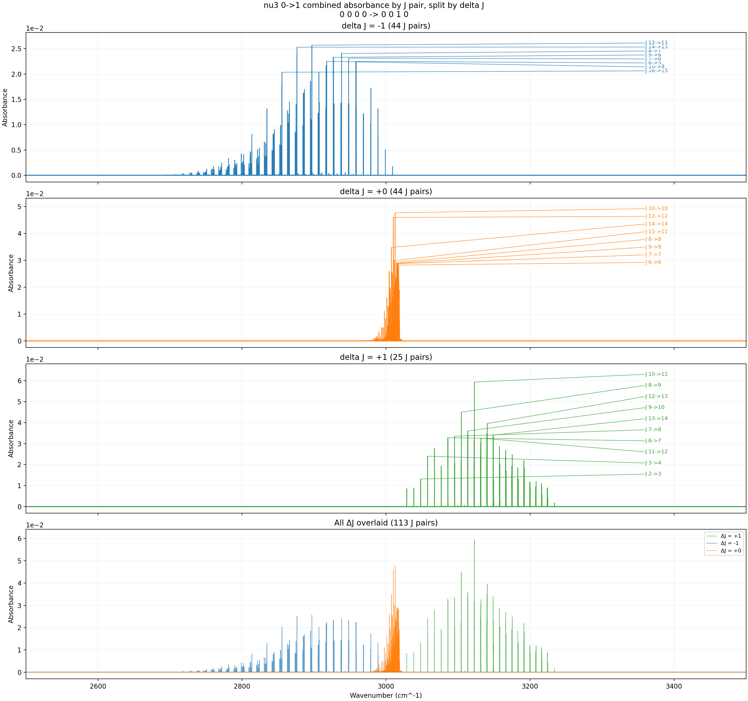
ν₃: 0→1 (fundamental) — Combined ExoMol I1 + HITRAN — 1000 K
Fundamental continues to weaken (peak ~0.06). The Q(T)/Q(296) ratio significantly dilutes all transitions.
T = 1000 K, P = 3 Torr, x = 0.008, L = 100 cm, Δν = 0.001 cm⁻¹

Slide 12
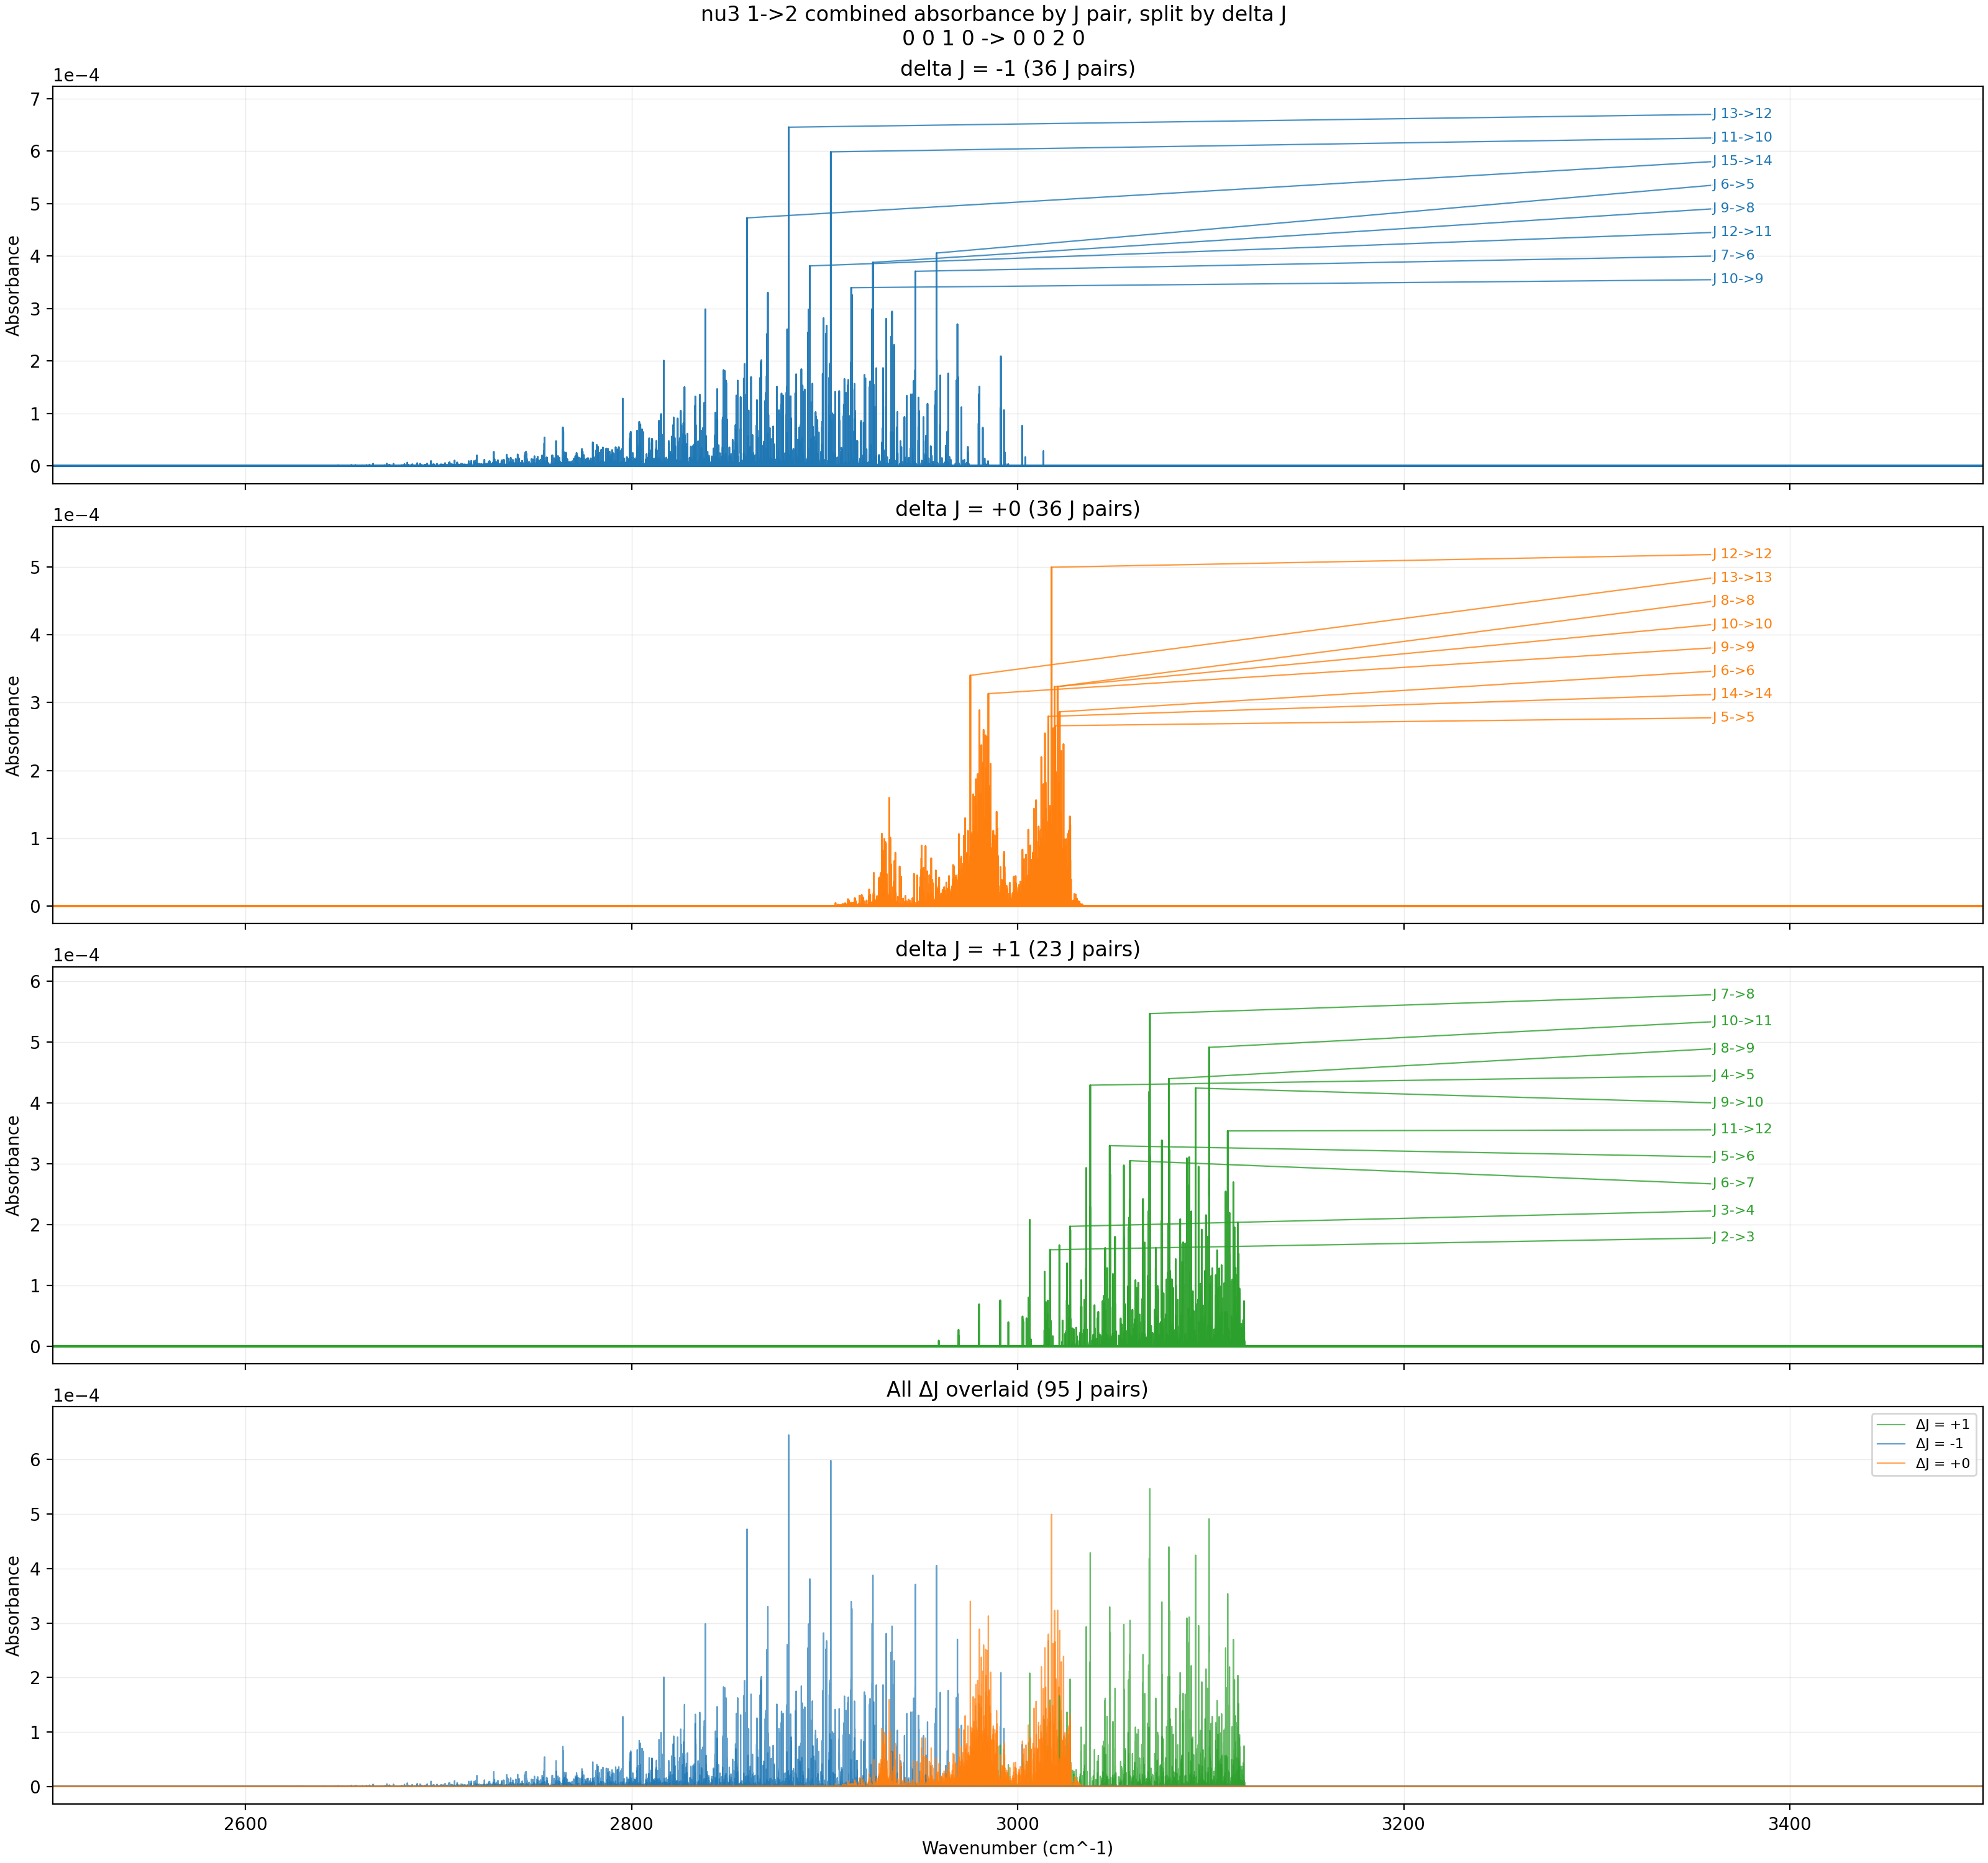
ν₃: 1→2 (1st hot band) — Combined ExoMol I1 + HITRAN — 1000 K
Peak absorbance ~6×10⁻⁴. This is near the peak for the 1→2 band — 1.3% of molecules now occupy v₃ = 1, but the partition function dilution will soon dominate.
T = 1000 K, P = 3 Torr, x = 0.008, L = 100 cm, Δν = 0.001 cm⁻¹

Slide 13
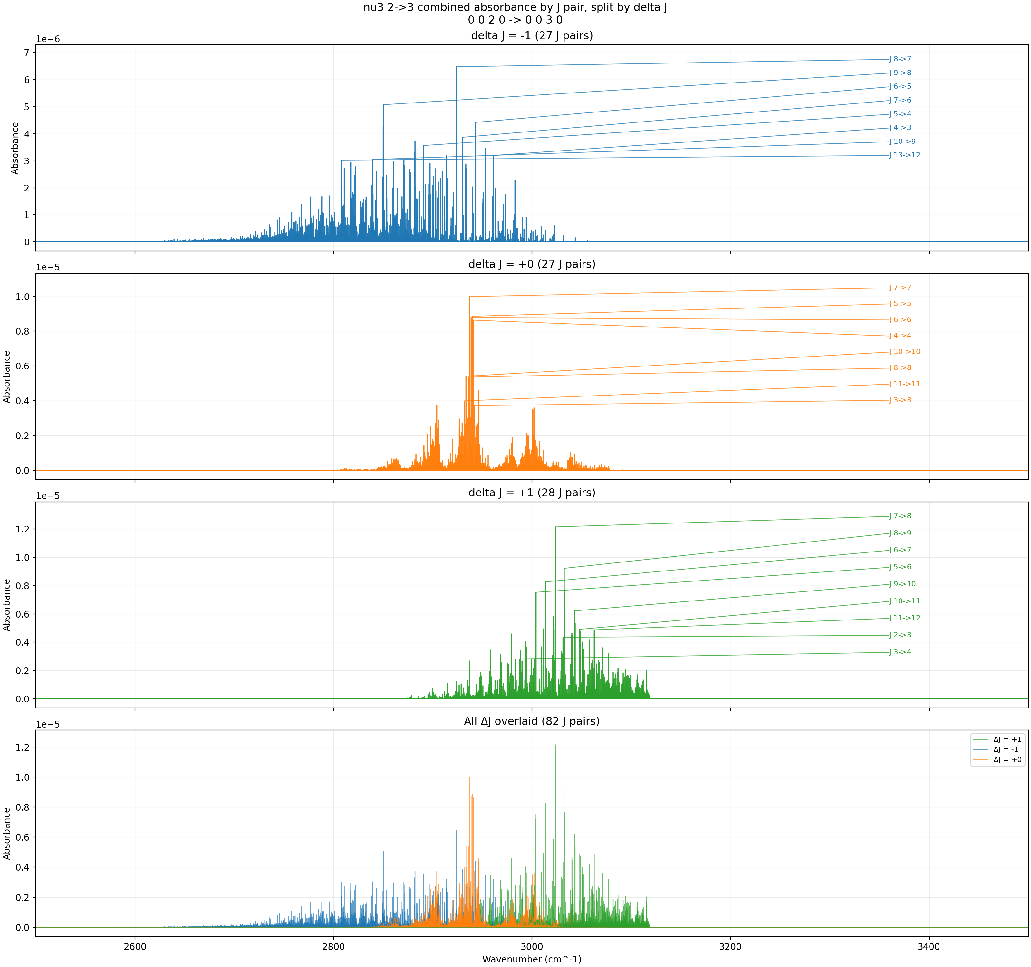
ν₃: 2→3 (2nd hot band) — Combined ExoMol I1 + HITRAN — 1000 K
Peak absorbance ~10⁻⁵. The v₃ = 2 population reaches 1.7×10⁻⁴, making this band clearly detectable.
T = 1000 K, P = 3 Torr, x = 0.008, L = 100 cm, Δν = 0.001 cm⁻¹

Slide 14
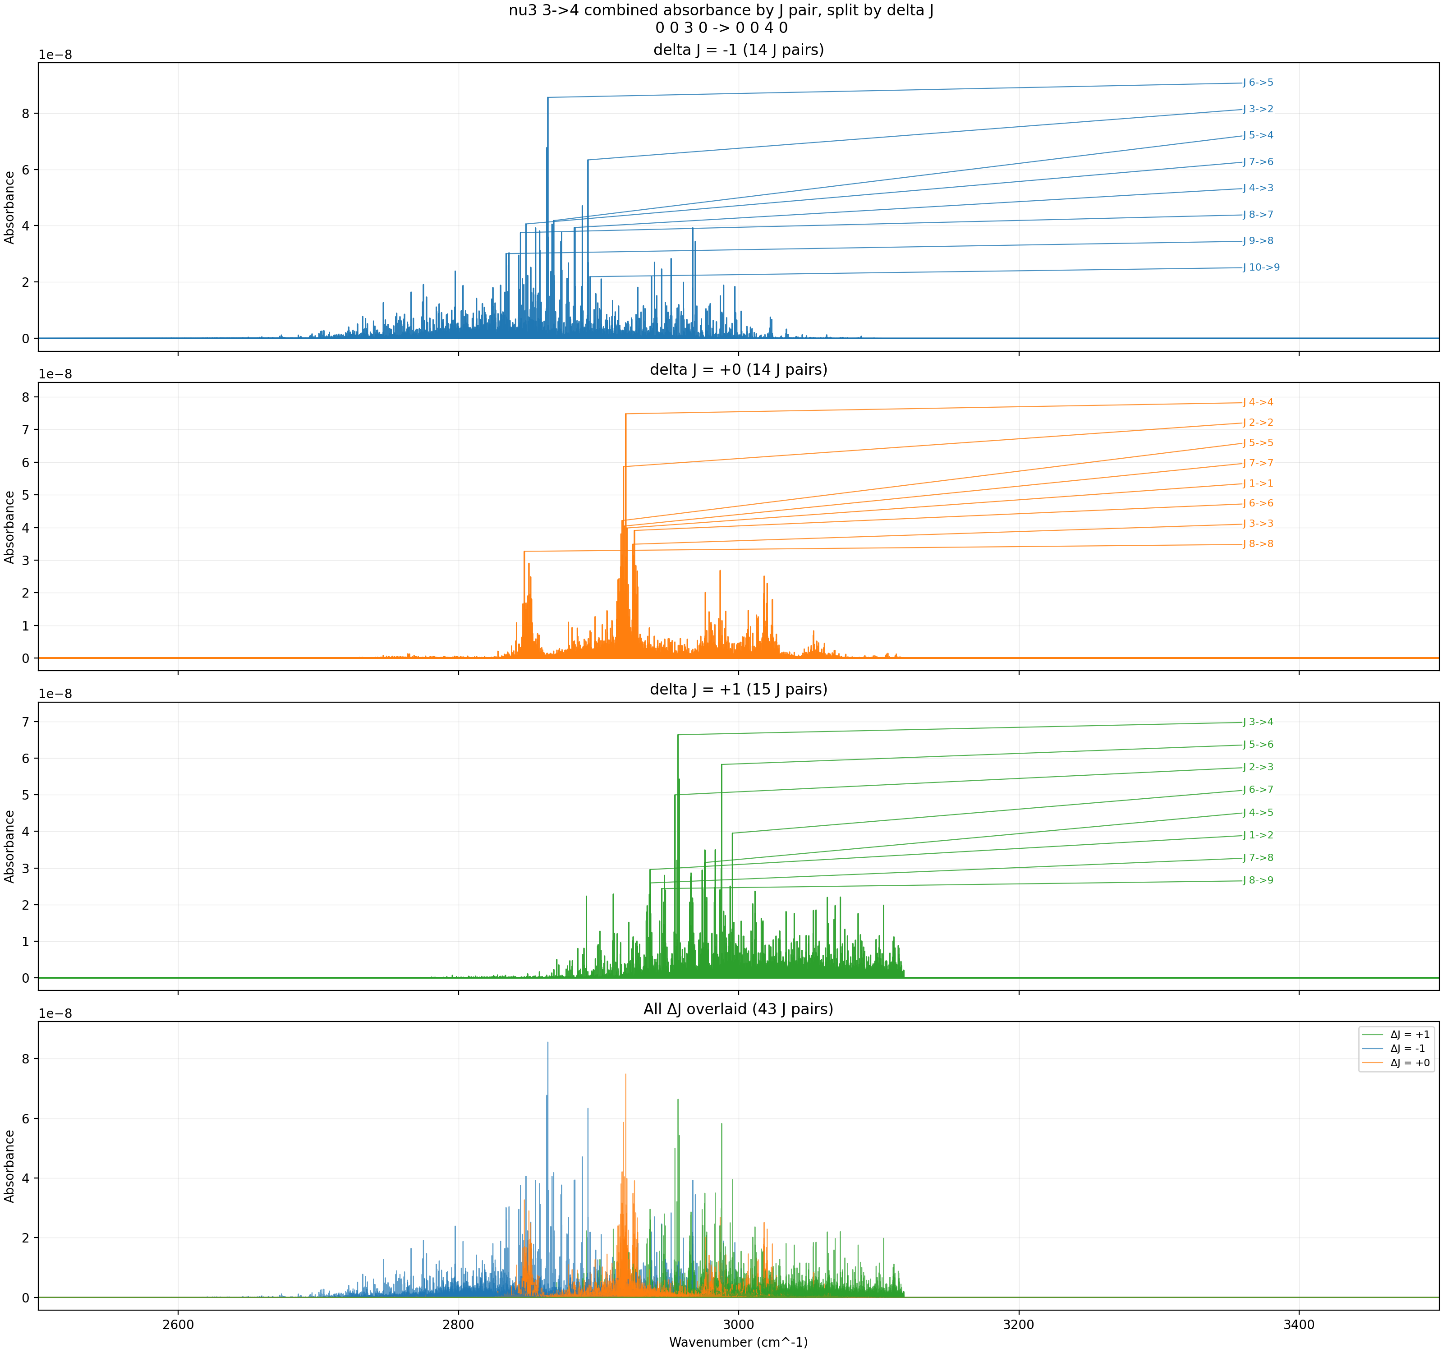
ν₃: 3→4 (3rd hot band) — Combined ExoMol I1 + HITRAN — 1000 K
Peak absorbance ~9×10⁻⁸. Finally nonzero and measurable. The v₃ = 3 population at 1000 K is ~2.2×10⁻⁶.
T = 1000 K, P = 3 Torr, x = 0.008, L = 100 cm, Δν = 0.001 cm⁻¹

Slide 15
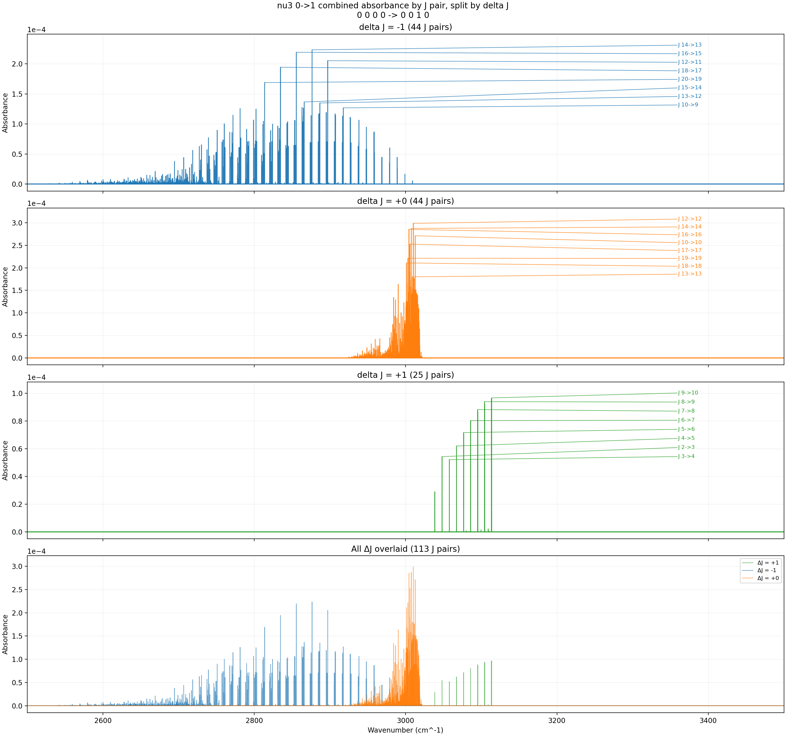
ν₃: 0→1 (fundamental) — Combined ExoMol I1 + HITRAN — 2500 K
Fundamental is now very weak (peak ~3×10⁻⁴). The partition function at 2500 K is orders of magnitude larger than at 296 K, heavily diluting all transitions.
T = 2500 K, P = 3 Torr, x = 0.008, L = 100 cm, Δν = 0.001 cm⁻¹

Slide 16
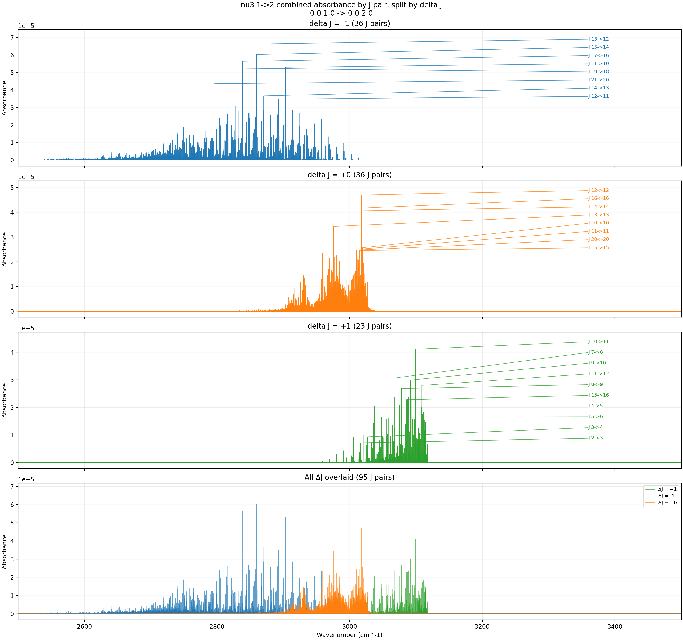
ν₃: 1→2 (1st hot band) — Combined ExoMol I1 + HITRAN — 2500 K
Peak absorbance ~7×10⁻⁵. The 1→2 band has passed its peak and is declining — partition function dilution now outweighs the Boltzmann population gain.
T = 2500 K, P = 3 Torr, x = 0.008, L = 100 cm, Δν = 0.001 cm⁻¹

Slide 17
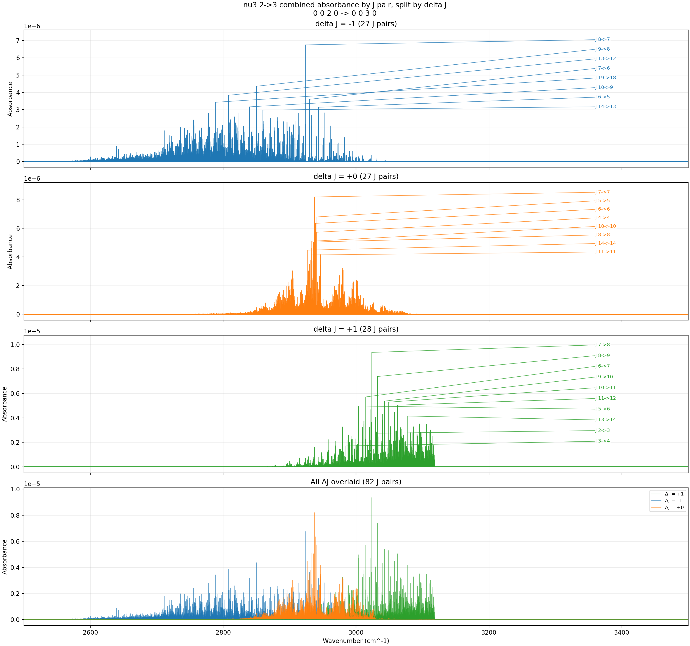
ν₃: 2→3 (2nd hot band) — Combined ExoMol I1 + HITRAN — 2500 K
Peak absorbance ~9×10⁻⁶. Still growing — the v₃ = 2 Boltzmann factor has a steeper exponential rise (larger E″) so its peak temperature is higher.
T = 2500 K, P = 3 Torr, x = 0.008, L = 100 cm, Δν = 0.001 cm⁻¹

Slide 18
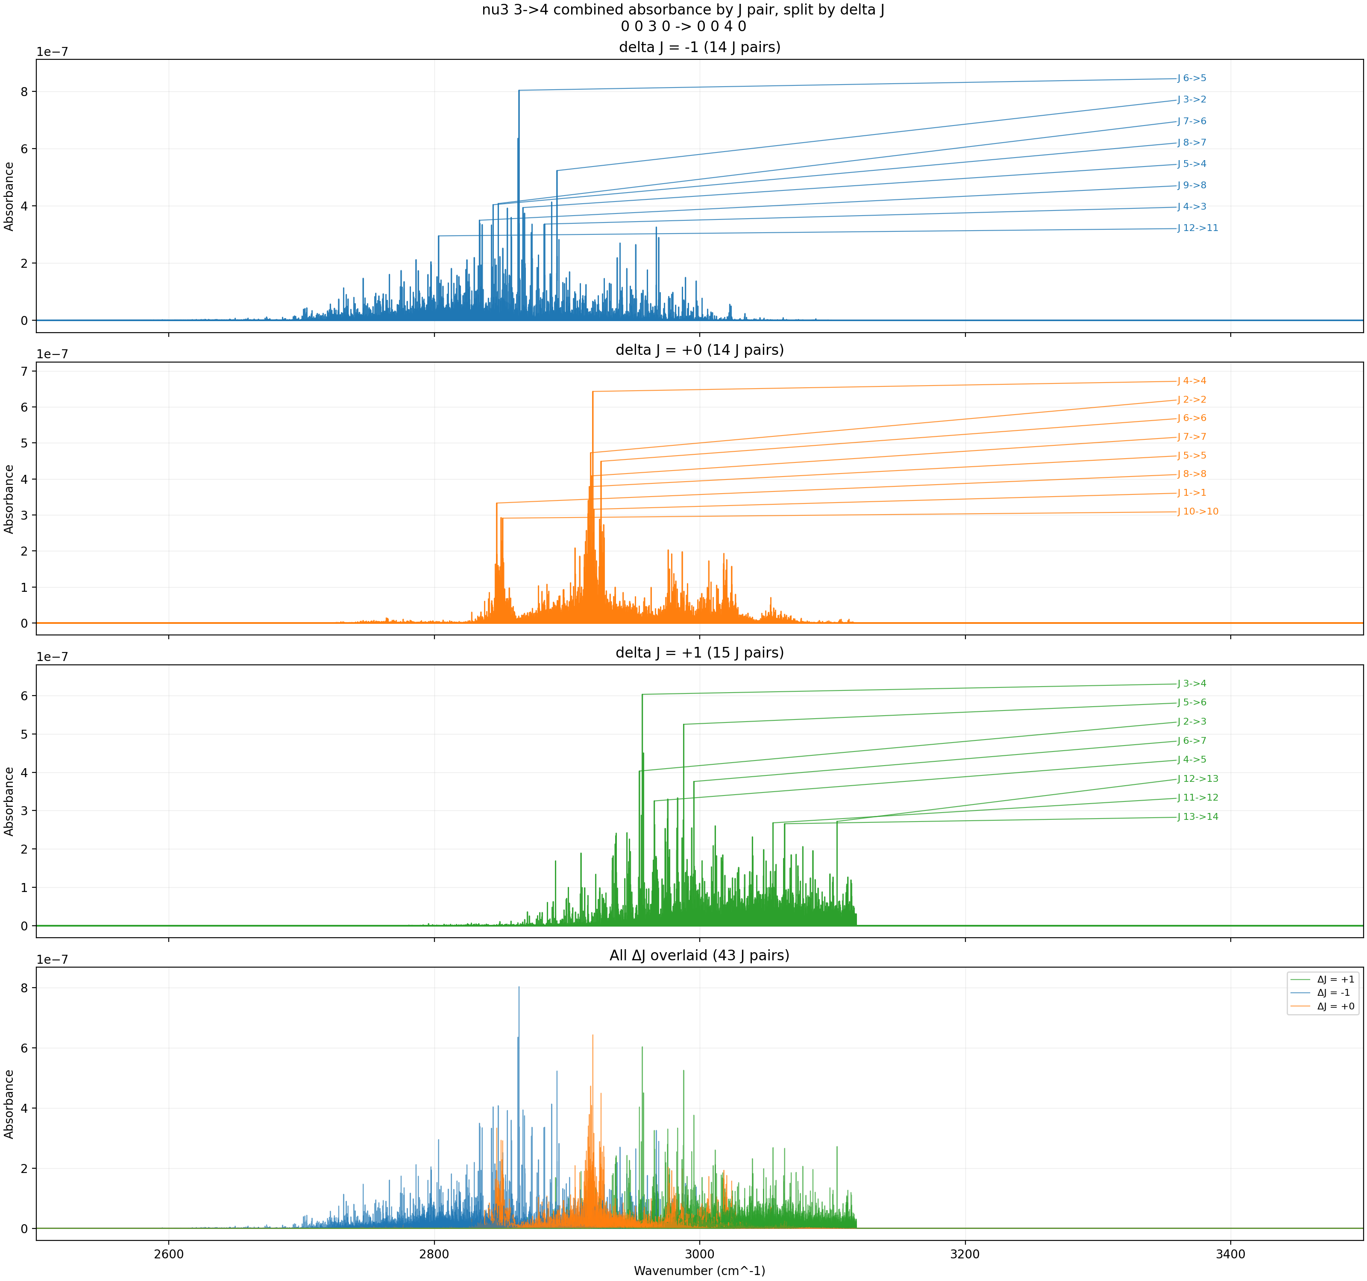
ν₃: 3→4 (3rd hot band) — Combined ExoMol I1 + HITRAN — 2500 K
Peak absorbance ~8×10⁻⁷. Still growing at 2500 K. The v₃ = 3 band would peak at even higher temperatures.
T = 2500 K, P = 3 Torr, x = 0.008, L = 100 cm, Δν = 0.001 cm⁻¹

Slide 19
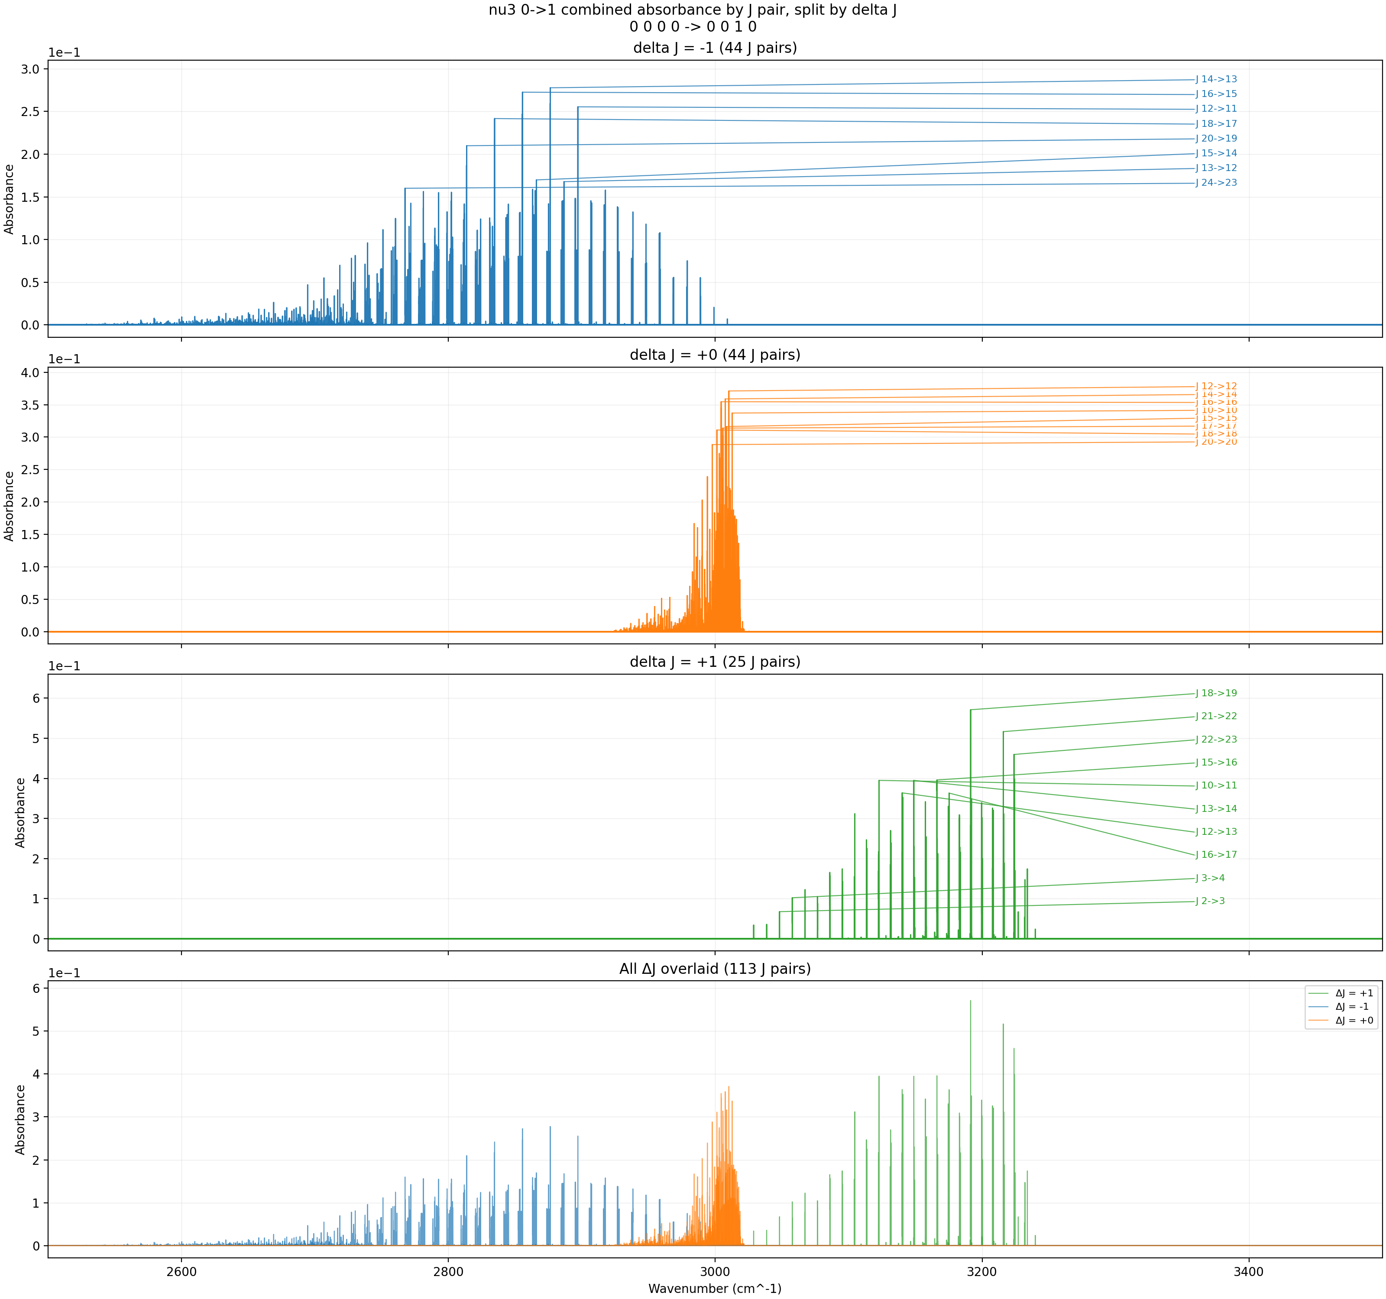
ν₃: 0→1 (fundamental) — Combined ExoMol I1 + HITRAN — 2500 K (pure CH₄, L = 1000 cm)
Pure CH₄ with 10× longer path amplifies the fundamental by ~125×. Even at 2500 K the fundamental is clearly visible under these conditions.
T = 2500 K, P = 3 Torr, x = 1.0, L = 1000 cm, Δν = 0.001 cm⁻¹

Slide 20

ν₃: 1→2 (1st hot band) — Combined ExoMol I1 + HITRAN — 2500 K (pure CH₄, L = 1000 cm)
The amplified conditions (x=1.0, L=1000 cm) make the 1→2 hot band clearly visible. Compare with the dilute case at the same temperature.
T = 2500 K, P = 3 Torr, x = 1.0, L = 1000 cm, Δν = 0.001 cm⁻¹

Slide 21

ν₃: 2→3 (2nd hot band) — Combined ExoMol I1 + HITRAN — 2500 K (pure CH₄, L = 1000 cm)
The 2→3 band becomes clearly resolved with pure CH₄ and long path length. Individual J-pair structure is now visible.
T = 2500 K, P = 3 Torr, x = 1.0, L = 1000 cm, Δν = 0.001 cm⁻¹

Slide 22
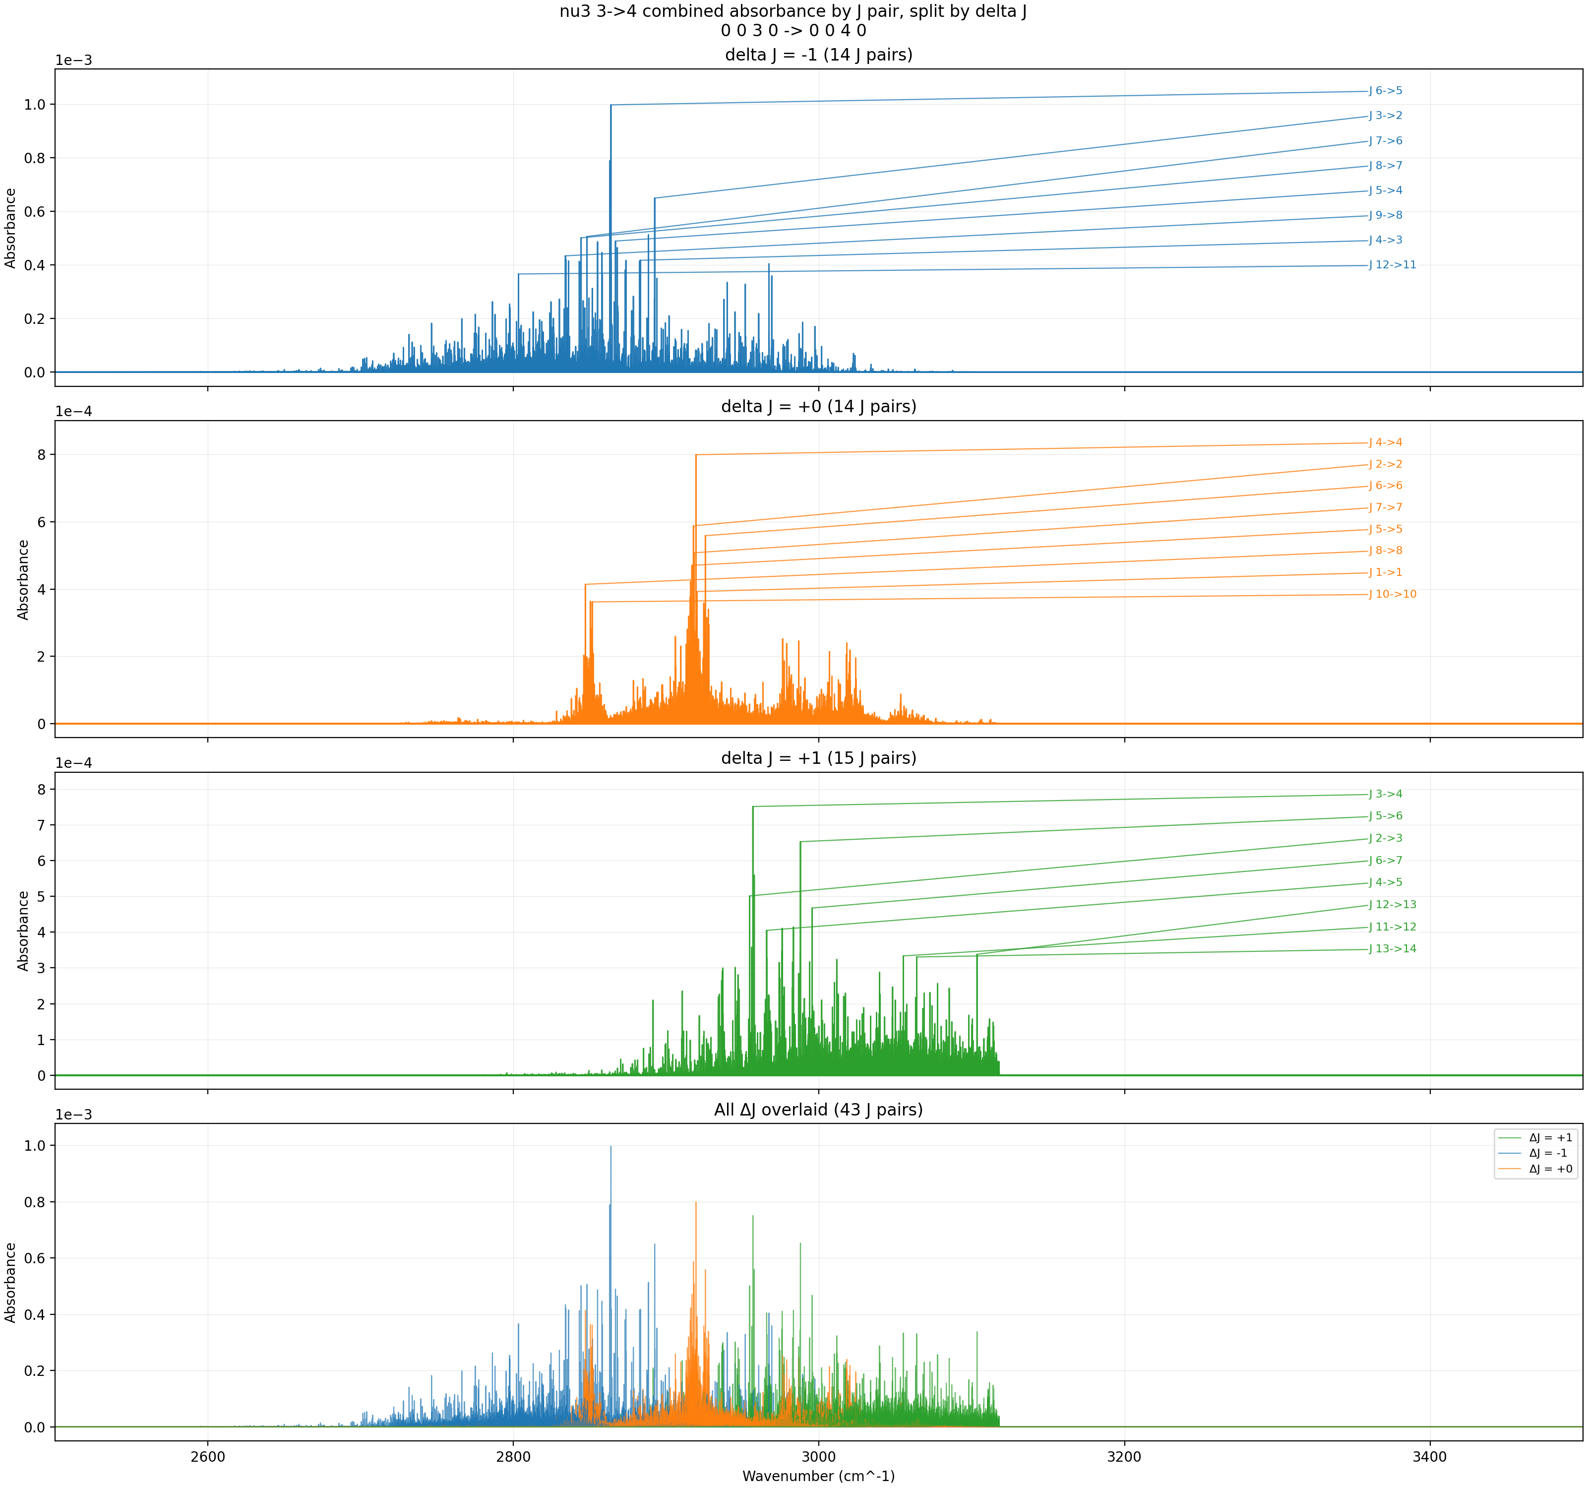
ν₃: 3→4 (3rd hot band) — Combined ExoMol I1 + HITRAN — 2500 K (pure CH₄, L = 1000 cm)
Even the 3→4 band shows resolved structure under these amplified conditions. This demonstrates that the transitions exist but require extreme sensitivity to detect.
T = 2500 K, P = 3 Torr, x = 1.0, L = 1000 cm, Δν = 0.001 cm⁻¹

Slide 23
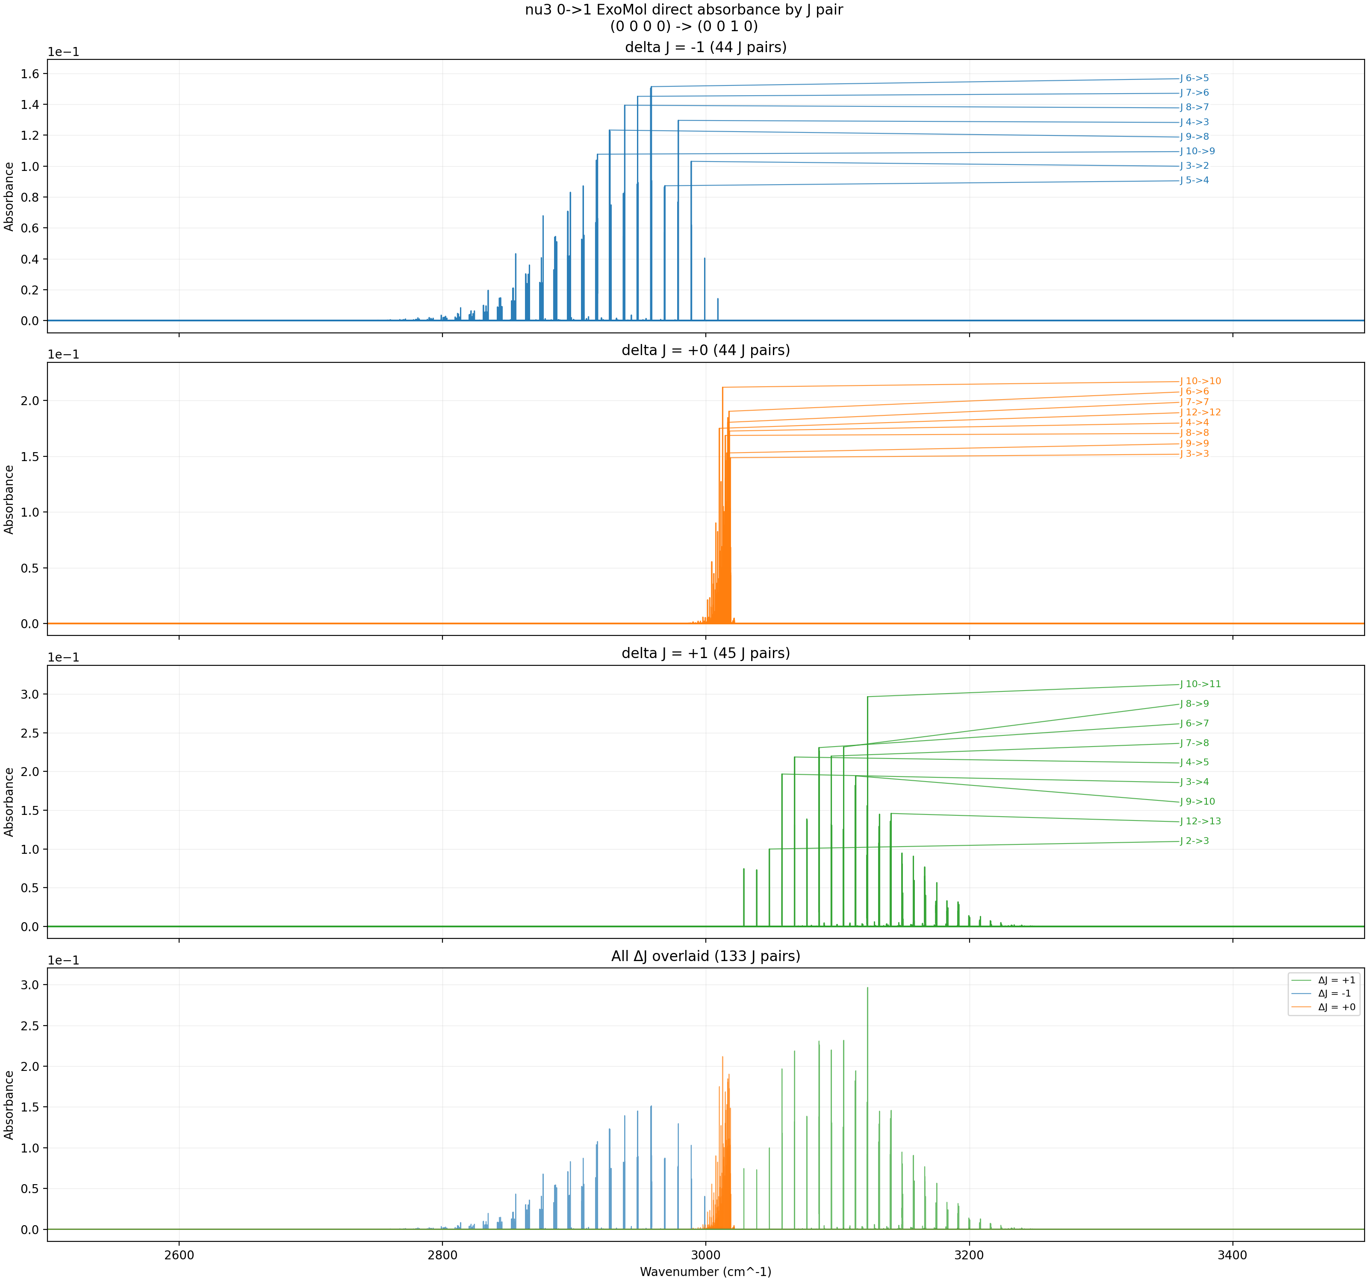
ν₃: 0→1 (fundamental) — ExoMol Direct — 600 K
ExoMol direct rendering at 600 K. Line intensities computed at the target temperature using LTE formula, not scaled from 296 K reference. Broadening uses ExoMol default parameters from .def file.
T = 600 K, P = 3 Torr, x = 0.008, L = 100 cm, Δν = 0.001 cm⁻¹ Rendered directly from ExoMol MM database (γ₀ = 0.0488 cm⁻¹/bar, n = 0.4)

Slide 24
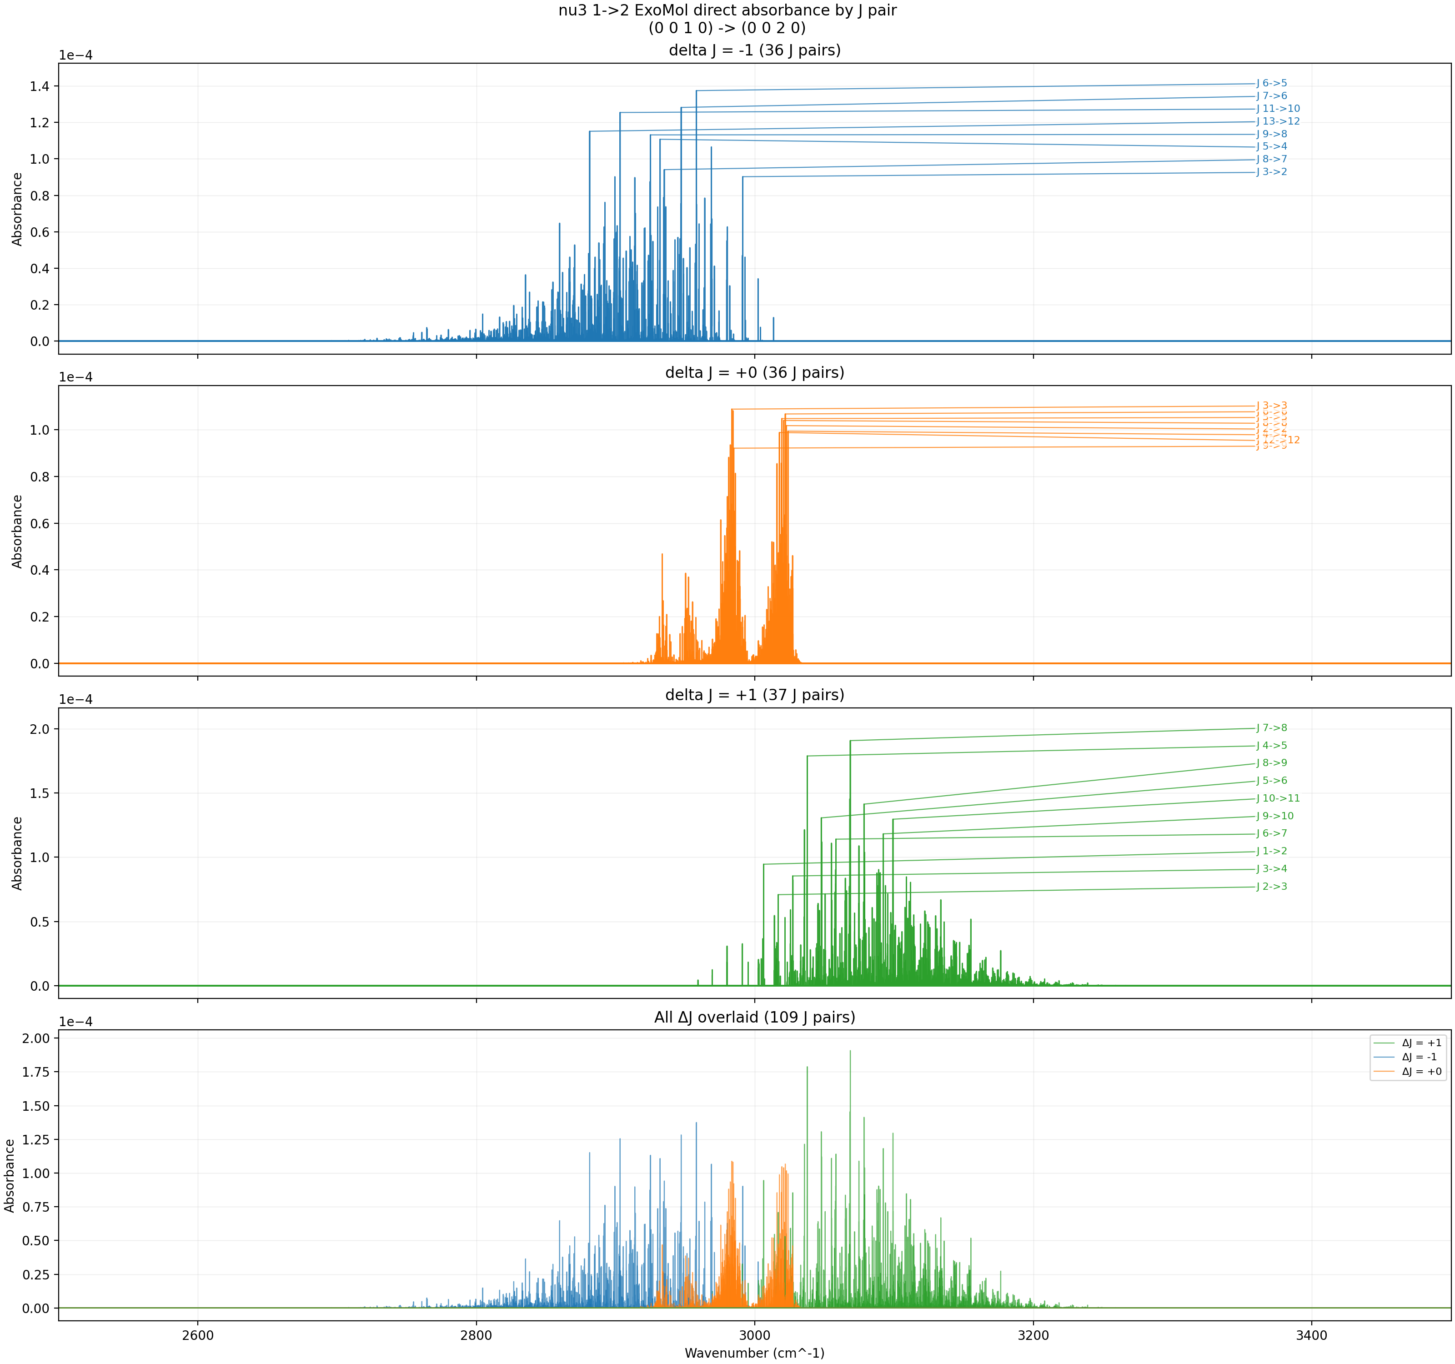
ν₃: 1→2 (1st hot band) — ExoMol Direct — 600 K
Compare with the Combined I1 result at 600 K. Differences arise from the broadening model: ExoMol uses a single γ₀ for all lines, while HAPI uses per-line broadening parameters.
T = 600 K, P = 3 Torr, x = 0.008, L = 100 cm, Δν = 0.001 cm⁻¹ Rendered directly from ExoMol MM database (γ₀ = 0.0488 cm⁻¹/bar, n = 0.4)

Slide 25

ν₃: 2→3 (2nd hot band) — ExoMol Direct — 600 K
ExoMol direct rendering of the 2→3 hot band. The line intensities are computed at 600 K using the ExoMol partition function (covers up to 5000 K).
T = 600 K, P = 3 Torr, x = 0.008, L = 100 cm, Δν = 0.001 cm⁻¹ Rendered directly from ExoMol MM database (γ₀ = 0.0488 cm⁻¹/bar, n = 0.4)

Slide 26
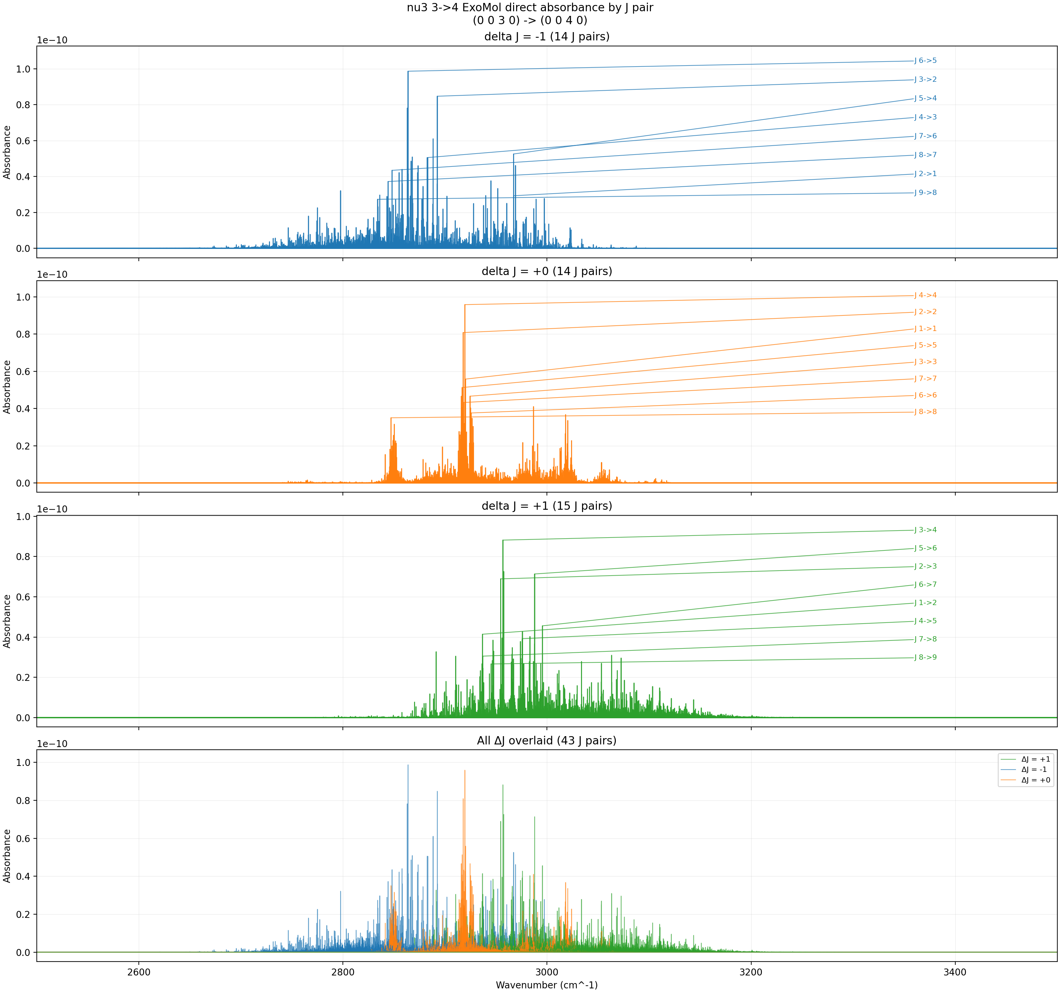
ν₃: 3→4 (3rd hot band) — ExoMol Direct — 600 K
ExoMol direct rendering of the 3→4 hot band at 600 K. This workflow can reach temperatures beyond HAPI's 2500 K limit.
T = 600 K, P = 3 Torr, x = 0.008, L = 100 cm, Δν = 0.001 cm⁻¹ Rendered directly from ExoMol MM database (γ₀ = 0.0488 cm⁻¹/bar, n = 0.4)

