Slide 1

STACKOVERFLOWER · DSS WEARABLE APP
Sprint 2 Scrum Master Review
Sprint 2 · 3 – 17 Aug 2026 · La Trobe Capstone Project
Presented by Young
Scrum Master (Sprint 2) · Backend Developer
DSS Wearable App · StackOverflower
1

Slide 2
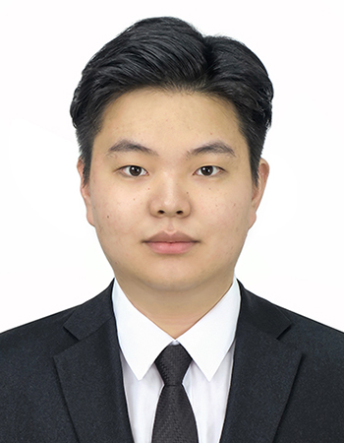
INTRODUCTION
About Me
Young
Scrum Master (Sprint 2) · Backend Developer · 3rd-Year Software Engineering Student, La Trobe University
Career goal: Graduate Software Engineer role in Melbourne, with a growing focus on backend/cloud systems and Agile delivery — expected to graduate in 2026.
Specialization: Full-stack development with a backend focus: FastAPI, PostgreSQL, Firebase, React/React Native, TypeScript, plus a strong C++/OOP foundation.
Industry alignment: Wearable health-tech sits across mobile (Expo/React Native), backend APIs, and IoT/BLE — a space actively hired for by health-tech startups and cloud-native consultancies in Melbourne.
Certification pathway (draft — to confirm): Considering Professional Scrum Master I (PSM I) to formalize this sprint’s scrum-master experience, alongside an AWS Certified Cloud Practitioner track for the backend/cloud direction.
DSS Wearable App · StackOverflower
2

Slide 3
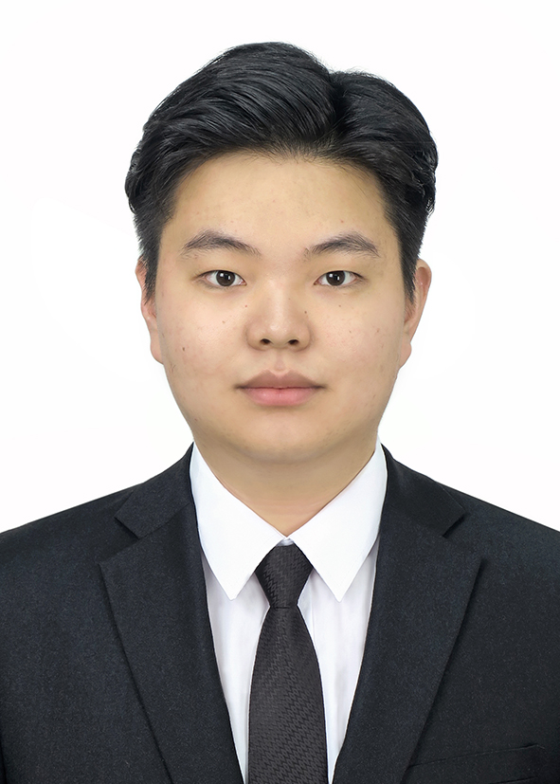
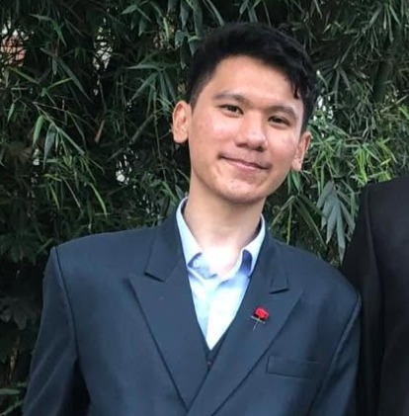
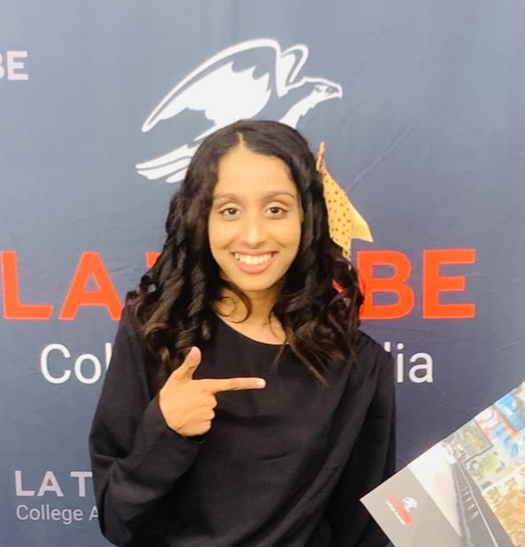
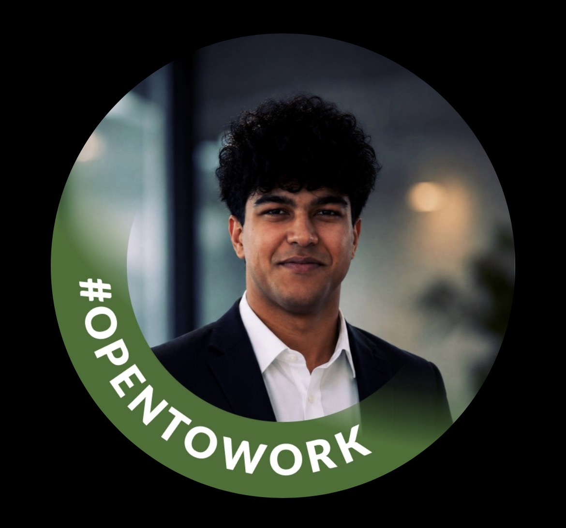
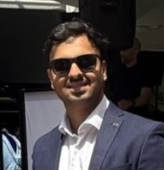
OUR TEAM
Meet the StackOverflower Team
Five students building the DSS Wearable App together this sprint.
Young-ho Lee
Iman Singh Gurung
Amodya Indmini
Scrum Master (Sprint 2) · Backend Developer
Frontend Developer
UI Designer
Leads backend development and this sprint’s Scrum Master duties — full intro on the previous slide.
Drives the mobile frontend — from the sign-in flow to the navigation shell — and owns UI polish work
Shapes the app's UI direction and partners with iman on Sprint 3's auth and connection-history screens
Nishad GOYAL
Sarvesh Kumar
Cloud Engineer
Fullstack Developer
Owns the cloud infrastructure — cloud DB schema and CI/CD pipeline — that the whole team's deploys depend on.
Bridges frontend and backend work
DSS Wearable App · StackOverflower
3

Slide 4





PROJECT TRACKING
Sprint 2 Snapshot
Sprint goal: core auth, navigation shell, BLE pairing prototype, and the first live-data screens.
15 days
11
10 / 11
1
Sprint window
10–24 Aug
Backlog items
in Sprint 2
Items Done
(82%)
Items In Progress
(both auth-related)
As Scrum Master this sprint: ran sprint planning and daily stand-ups, groomed the backlog, tracked the board above, and cleared cross-team blockers between backend, mobile, and BLE/firmware.
DSS Wearable App · StackOverflower
4

Slide 5
PROJECT TRACKING
Sprint 2 Burndown (from Jira)
Reading the burndown
Fast start: 58 → 35 pts in the first 2 days, clearing carryover-adjacent work.
Flat middle (12–16 Aug): acceptance guidelines were locked in on day 2 (Tue 11 Aug) — the team then spent several days reworking in-flight items to match, so the line held flat even though work was happening.
Dip-then-rise (~16 Aug): a mutual-understanding gap on the login screen and Firebase setup was caught in review and fixed within a day — the small up-tick before the final push.
Today: 8 pts left (86% burned) a late push cleared most of the backlog, but the trend still trails the ideal guideline — 3 infra items remain at risk (next slide).
DSS Wearable App · StackOverflower
5

Slide 6






PROJECT TRACKING
What Shipped This Sprint
Firebase-authenticated login / signup flow
DWSO-36
Live sensor dashboard (basic)
DWSO-45
Done
Done
Expo Router navigation shell (tab layout)
DWSO-15
BLE reconnect / connection-status UI
DWSO-50
Done
Done
BLE pairing prototype
DWSO-12
API contract doc + integration support
DWSO-18
Done
Done
Device registration & list screen
DWSO-41
Done
Backend test suite: 21 automated tests (auth sync, device ownership isolation, sensor ingestion, alert thresholds) — all pass without a live Postgres DB or Firebase project.
DSS Wearable App · StackOverflower
6

Slide 7
PROJECT TRACKING
GitHub Contributions (mobile/main)
Actual commit history — traceable evidence behind the Jira status on the previous slides.
added api client for user sync
DWSO-36 (login/signup)
Aug 16, 2026 · e2e8782 · committed by I-S-G
added signup page
DWSO-36 (login/signup)
Aug 16, 2026 · 030b997 · committed by I-S-G
added sign-in screen (react-hook-form + zod), Google/Apple sign-in buttons
DWSO-36 (login/signup)
Aug 16, 2026 · d1eff04 · committed by I-S-G
grouped backend files, created mobile app shell (tabs & routes)
DWSO-15 (nav shell) + backend app/ refactor
Aug 3, 2026 · 0dbd0cc · committed by I-S-G
initialize new Expo RN app with NativeWind (SDK 57)
DWSO-15 (mobile scaffold)
Aug 3, 2026 · 19c85be · committed by I-S-G
DSS Wearable App · StackOverflower
7

Slide 8

PROJECT TRACKING
Risks & Blockers
3 backlog items missed their 9 Aug target date — all infrastructure work, not user-facing screens.
Cloud database schema · DWSO-14
CI/CD pipeline (basic setup) · DWSO-17
BLE hardware status + Sprint 3 grooming
In Review · 7 days overdue
In Progress · 7 days overdue
To Do · 7 days overdue
Finalizing production schema before the team commits to Alembic migrations.
Repo + CI skeleton exists; automated test/deploy stages not wired up yet.
Blocked on firmware/BLE team confirming hardware availability.
DSS Wearable App · StackOverflower
8

Slide 9
BUG REPORT / ISSUE
Issue Spotlight: Postgres-Only IDs Broke Testing
BEFORE — root cause
AFTER — decision & fix
models.py used sqlalchemy.dialects.postgresql.UUID directly as the primary-key type on every table.
Added a custom cross-dialect GUID type (app/types.py): native UUID on Postgres in production, CHAR(36) on SQLite for tests.
main.py called Base.metadata.create_all() at import time — the app crashed on startup whenever Postgres wasn’t reachable.
Wrapped table creation in a lifespan hook with try/except — a missing DB now logs a warning instead of crashing the app.
Net effect: the pytest suite couldn’t run against SQLite, and local dev broke without a live DB.
Result: all 21 backend tests run in-memory, with no Postgres instance or Firebase project required.
Owner: Backend team (self). Unblocks CI and lets any teammate run the test suite locally with zero environment setup.
Git history confirms it: commit 0dbd0cc "grouped backend files, created mobile app shell" (Aug 3) is where the app/ package landed — the root-level files are pre-refactor leftovers.
DSS Wearable App · StackOverflower
9

Slide 10

TEAM DISCUSSION
Key Decisions Shaping Sprint 2
Backend stack — Chose Python / FastAPI over C++ or Java — keeps mobile and backend teams aligned on one contract-first workflow.
Authentication — Replaced the custom JWT skeleton with Firebase Authentication — Firebase owns credential storage; the backend only verifies ID tokens.
Client requirements (kickoff w/ Dr. Sundar) — Wi-Fi/BLE prioritized, NFC explicitly deferred; app must work offline; cloud sync required for continuous monitoring — this directly shaped Sprint 2’s BLE-pairing and device-registration priorities over NFC work.
Scope decision — device_sessions API endpoints deliberately deferred past Sprint 2 — the DB table exists, but connect/disconnect tracking endpoints are not built yet (carried into Sprint 3 planning).
Tech-debt flagged — Legacy duplicate backend files from before the app/ package refactor (root-level main.py, models.py, etc.) still sit in the repo — team agreed to delete them next sprint to avoid two competing sources of truth.
DSS Wearable App · StackOverflower
10

Slide 11
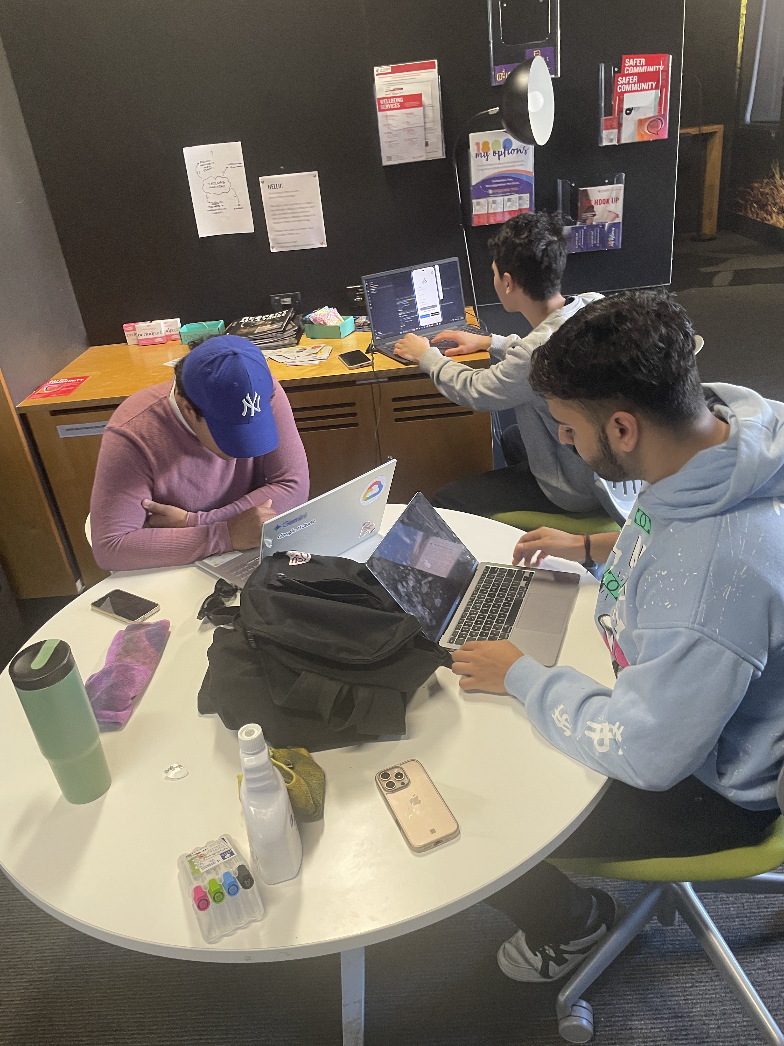
TEAM DISCUSSION
Team Meetings This Sprint
How the team stayed aligned during the 10–24 Aug sprint — cadence and a snapshot from one of our sessions.
4 team meetings this sprint
Trade Show Meetings (×2) · 6 Aug
Short check-ins with the attendees from both the morning and afternoon trade-show sessions.
Client Meeting Follow-up · 11 Aug
After the client meeting, the team used the meeting log to discuss and agree on app-design revisions.
Regular Team Meeting (in-person) · 17 Aug, 1–3pm · TLS-211
Finalized the items the team had previously discussed.
DSS Wearable App · StackOverflower
11

Slide 12
ALLOCATION OF NEW TASKS
Sprint 3 — Proposed Task Allocation
Task
Owner
Priority
Why
Finish login/signup + Firebase project setup (carryover)
iman (Frontend) / Amodya (UI)
Blocks every auth-gated screen already built
P0
Finalize cloud DB schema + CI/CD pipeline
Nishad (Cloud)
7 days overdue; blocks reliable deploys & Alembic migrations
P0
device_sessions API endpoints (connect/disconnect)
Youngho (Backend)
DB model already exists; completes data-model coverage
P1
BLE hardware status validation + Sprint 3 grooming
Sarvesh (Fullstack)
Blocked on firmware/BLE team; needs early follow-up
P1
Connection-history UI + sensor-data seed/simulation tool
iman / Amodya
Needed for a demoable trends screen, not launch-blocking
P2
Research spike: API+normalizer vs. raw BLE for sensor ingestion
Young / Sarvesh
Alternative to raw BLE parsing under evaluation — needs more research before committing
P2
NFC pairing (research spike only)
Whole team (light touch)
Client explicitly deferred NFC — backlog spike, not a sprint commitment
P3
DSS Wearable App · StackOverflower
12

Slide 13


REFLECTION
Reflection on Sprint 2
What went well
To improve
Contract-first approach from Sprint 1 (API contract doc) let 5+ screens ship in parallel without integration churn.
Infra/DevOps tickets (DB schema, CI/CD, hardware) consistently slip behind visible UI work — need a dedicated infra owner and earlier grooming.
Firebase Auth decision reduced the backend’s security surface — no password handling to get wrong.
.
The GUID/test-suite fix means anyone on the team can run all 21 tests in under a minute, no environment setup.
Readiness for final deliverables: the core MVP loop (auth → device registration → live sensor read → alerts) is on track for the demo; stretch scope (NFC, AI insights, multi-device streaming) is realistically at risk this semester and should be a descoping conversation with the client sooner rather than later.
DSS Wearable App · StackOverflower
13

Slide 14


Thank You
Questions?
github.com/Ezekiel-Lee · StackOverflower
gongdeaseang@gmail.com
DSS Wearable App · StackOverflower
14

