Slide 1

CISC3003 Web Programming
Simple Shopping Cart System & Simple Login System with PHP, MySQL
Project Assignment Part 02
DC326264 Cheang Ngou Hin (Henry)

Slide 2
Content
Part A
Simple Shopping Cart System
Part B
Create a OOP PHP Login System
Create a Login System in PHP
Create a User Profile Page in PHP
Create a Signup System in PHP
Create a Forgotten Password System In PHP
LOGIN !

Slide 3
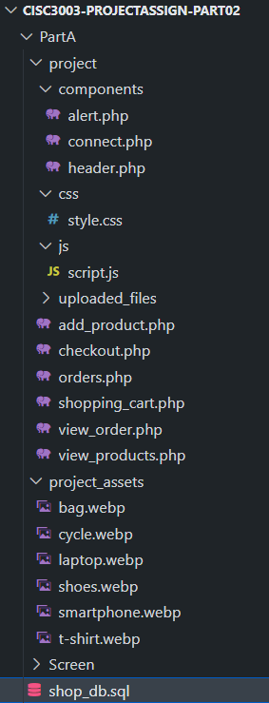
Introduction
Part A
Simulate a Shopping Cart System using PHP and MySQL
Lots of practice for creating Login System using PHP and MySQL
Part B

Slide 4
Part A: Simple Shopping Cart System
Frontend Design
HTML, CSS, JavaScript
Backend Design
PHP, PDO extension, MySQL for database

Slide 5
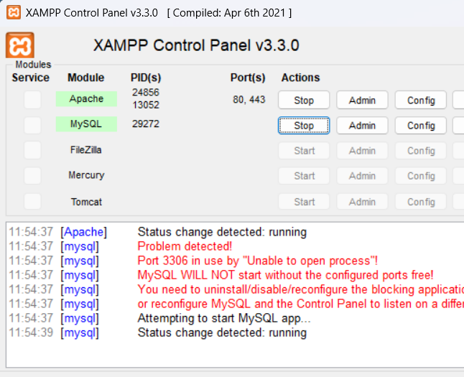

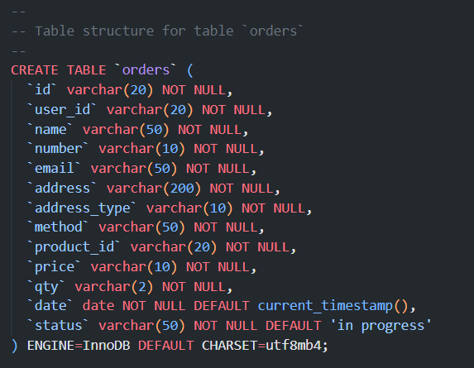
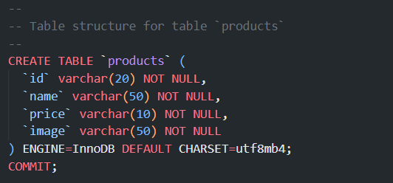
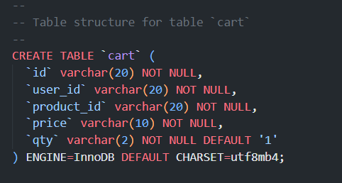
Development Environment

Slide 6
Part A: Simple Shopping Cart System
Database Design

Slide 7
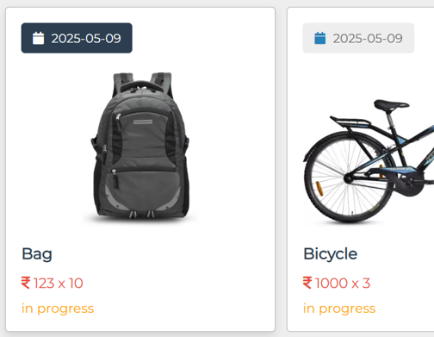
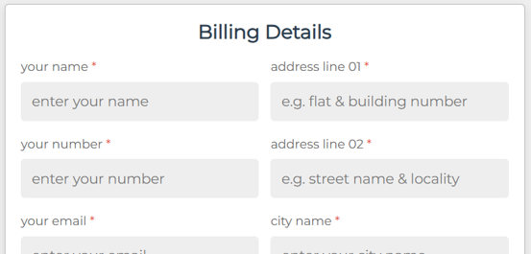
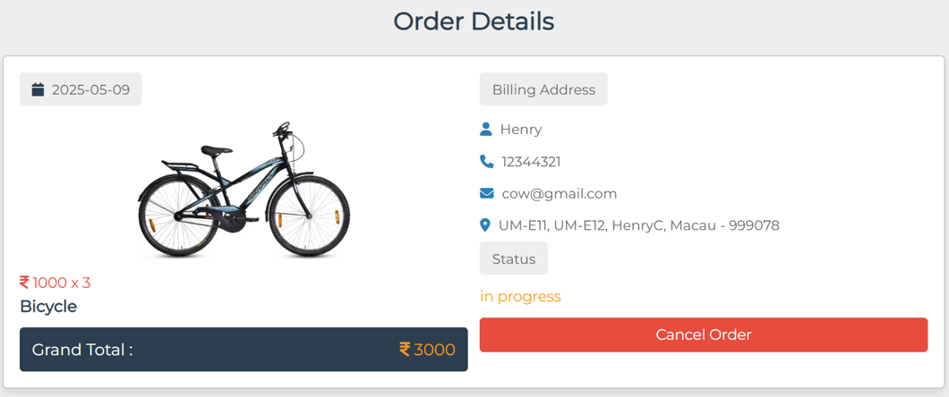
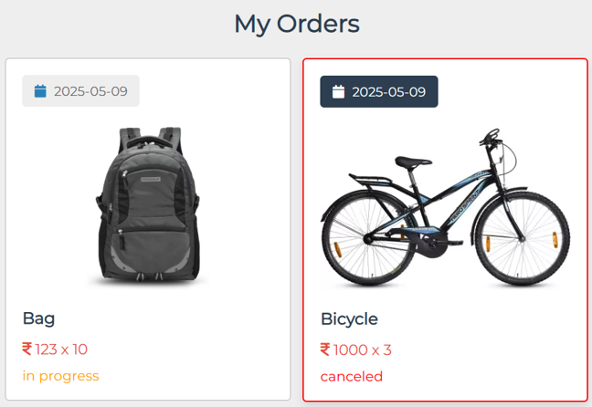
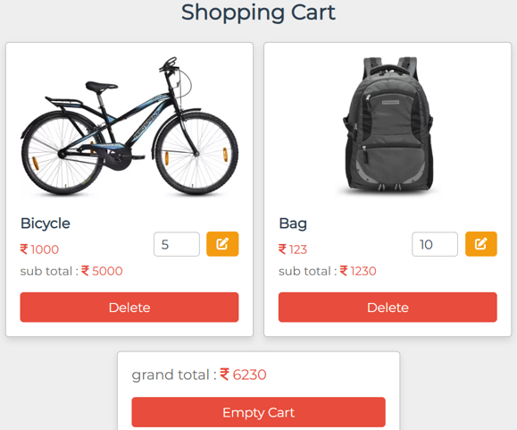
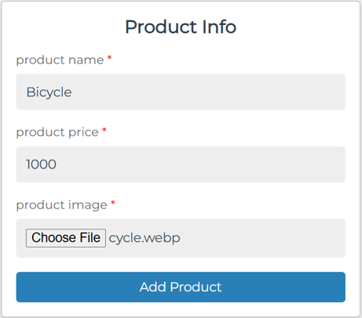
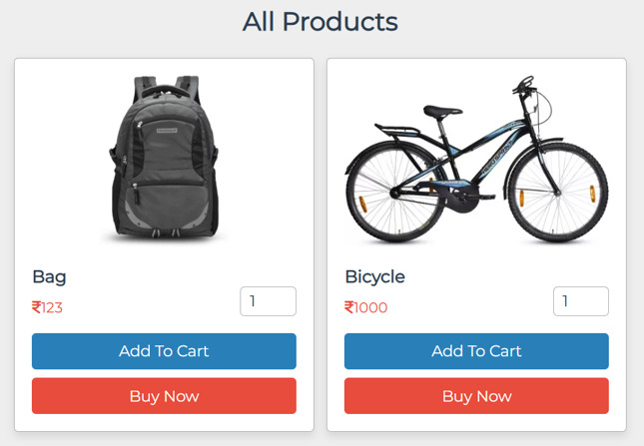
Managing your orders
What you can do in the system?
Adding to Cart
Adding Products
Seeing all Products

Slide 8
Managing your orders
Adding to Cart
Adding Products
Seeing all Products

Slide 9

Sales Performance Analysis
Current Sales Trends:
Over the past years, we've observed Warner & Spencer’s product sales going down because of some reason.
Market Insights:
Through comprehensive market analysis, we've identified shifts in consumer preferences, competitive landscape changes, and emerging market segments.
Customer Feedback:
Direct feedback from our customers has highlighted areas for improvement

Slide 10



Project Objectives
Analysis Phase
Strategy Development
Analyze sales performance, market trends, and consumer behavior.
Conduct a SWOT analysis of existing sales strategy.
Create new strategies using marketing, sales promotions,
Customer engagement to leverage strengths and opportunities.
Implementation Plan
Create a timeline with milestones
And responsibilities. Set KPIs to measure success.

Slide 11

Expected Outcomes
Increased Sales Figures:
Target a 25% increase in sales over the next years.
Measure success by tracking sales metrics and revenue growth.
Improved Customer Engagement:
Foster stronger relationships with customers through personalized engagement strategies.
Increase customer retention rates and loyalty.
Enhanced Market Reach:
Expand market reach by tapping into new demographics or geographical regions.
Strengthen brand presence through effective marketing campaigns.

Slide 12

Methodology
Data Collection:
Gather sales data, market research, and consumer feedback through surveys and analysis tools.
Utilize both primary and secondary research methods to gather comprehensive insights.
Brainstorming Sessions:
Collaborate to generate innovative ideas for product positioning, pricing, and promotional campaigns.
Consider various channels such as online platforms, partnerships, and offline marketing.
Testing and Refinement:
Pilot the proposed strategies on a smaller scale to assess their effectiveness.
Gather feedback, iterate, and refine the strategies based on initial results.

Slide 13
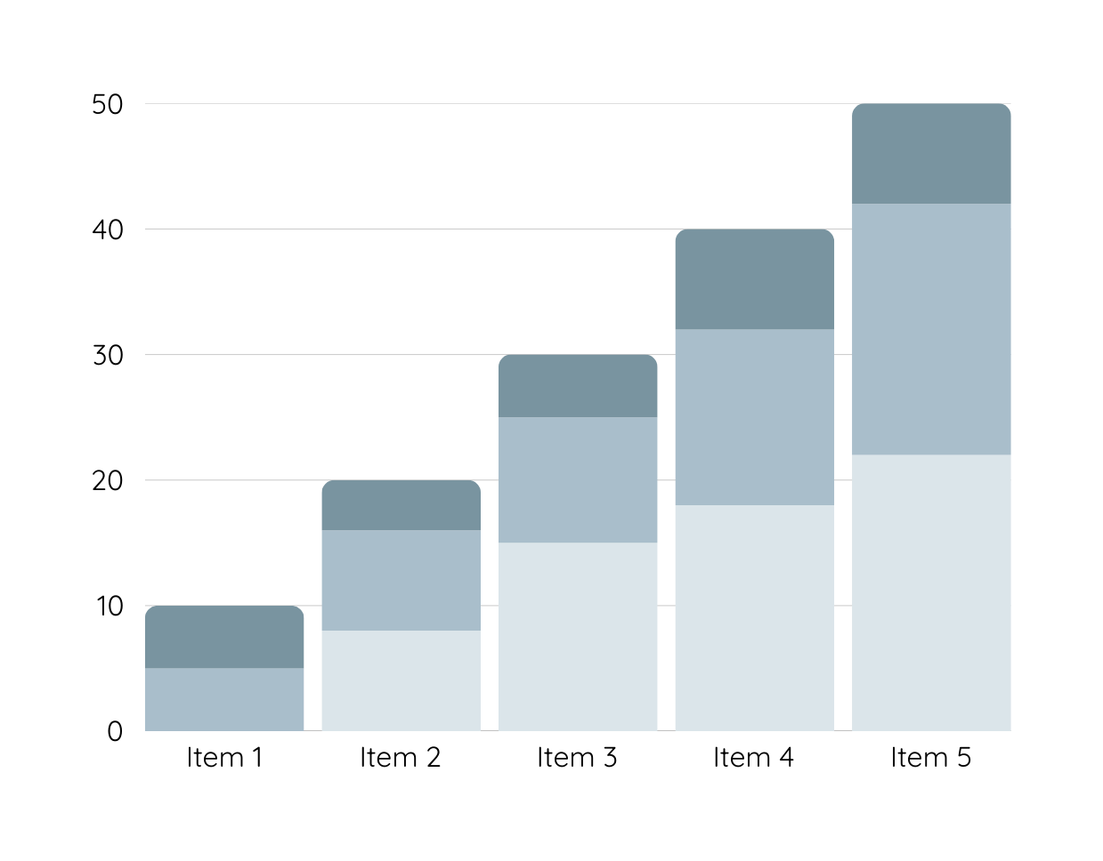
Data Analysis
Over the past year, sales for Warner & Spencer have experienced a consistent decline, dropping month-on-month. The graphical representation of sales volumes reveals a noticeable downward trend, especially in the last quarter.
Product 1
Product 2
Product 3

Slide 14
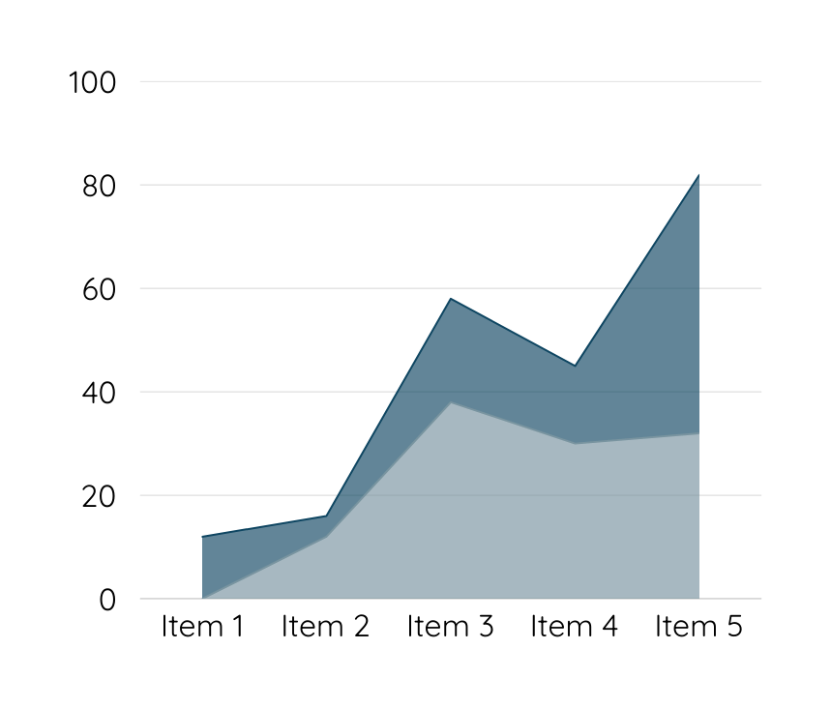
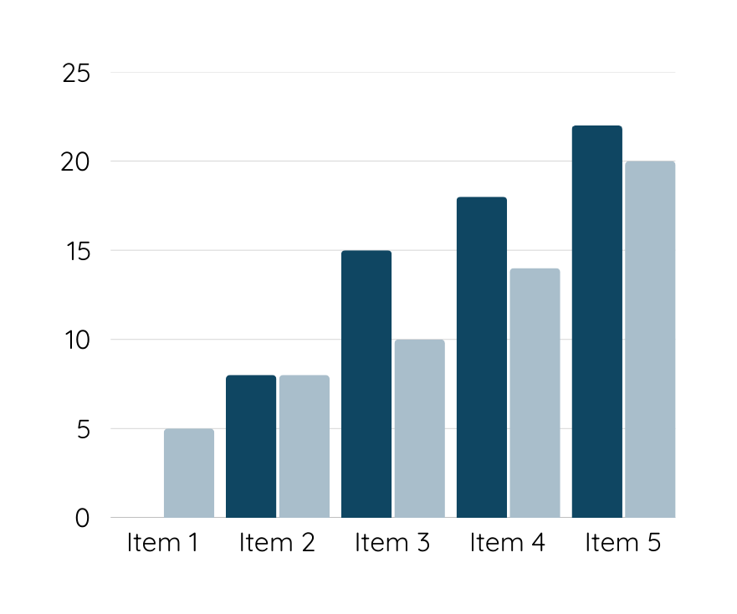
Data Analysis
Customers are unhappy with Warner & Spencer's new packaging, which may be contributing to a decline in sales. Competitors offer better features and pricing, making it difficult for our product to stand out in the market.

Slide 15
Conclusion
By implementing a well-researched and innovative sales strategy, our goal is not only to boost immediate sales figures but also to establish a sustainable framework for continued growth and success.

Slide 16
Thank you

