Slide 1

Rockbuster Stealth LLC
Ezeonyeasi Chibuzo Malachy
5th January 2024

Slide 2
Background and Objectives
Rockbuster Stealth LLC is a movie rental company that is ready to transition into online streaming. This is in response to the competition from online streaming service giants like Amazon Prime and Netflix.
The management team plans to set up online movie rental service using the current movies from their catalogue to quickly retain their place in the movie market competition.

Slide 3
Key Questions
Which countries are Rockbuster customers based in?
Which movies contribute to Rockbuster revenue growth?
What was the average rental duration for all movies?
Do sales figures vary between geographical regions?
…

Slide 4
Data Overview
Film - 1000
Customer - 599
Country - 109
Average Rental Duration - 5
Release Year - 2006

Slide 5
Statistics of Film Rental
Minimum Rental Duration | Maximum Rental Duration | Average Rental Duration
3 | 7 | 4.985
Minimum Rental Rate | Maximum Rental Rate | Average Rental Rate
0.99 | 4.99 | 2.98
Minimum Replacement Cost | Maximum Replacement Cost | Average Replacement Cost
9.99 | 29.99 | 19.984

Slide 6
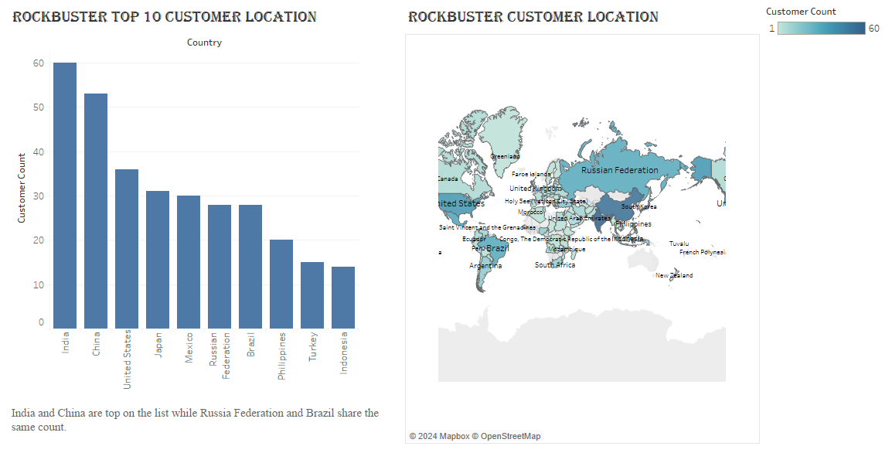
Customers Worldwide

Slide 7
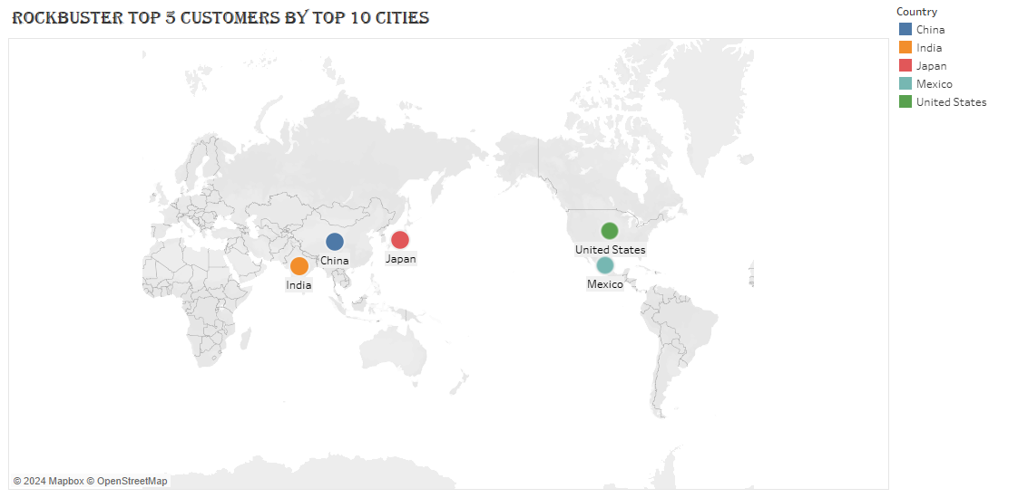
Top 5 Loyal Customers
Customer ID | First Name | Last Name | City | Country | Total Amount Paid
225 | Arlene | Harvey | Ambattur | India | 111.76
424 | Kyle | Spurlock | Shanwei | China | 109.71
240 | Marlene | Welch | Iwaki | Japan | 106.77
486 | Glen | Talbert | Acua | Mexico | 100.77
537 | Clinton | Buford | Aurora | United States | 98.76

Slide 8
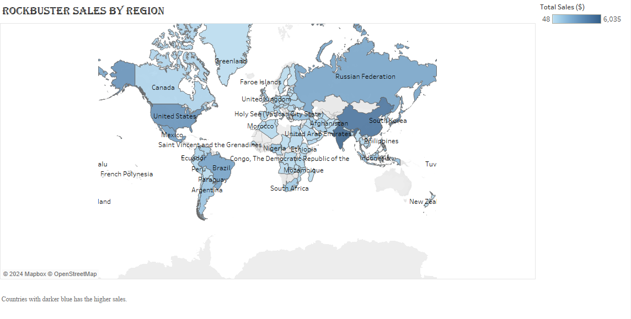
Global Revenue

Slide 9
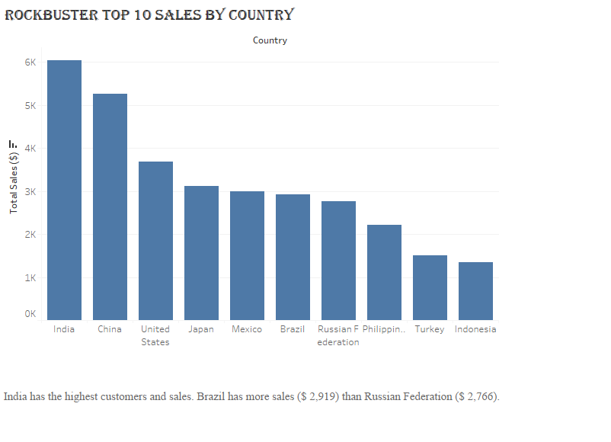
Top 10 Countries in Revenue

Slide 10
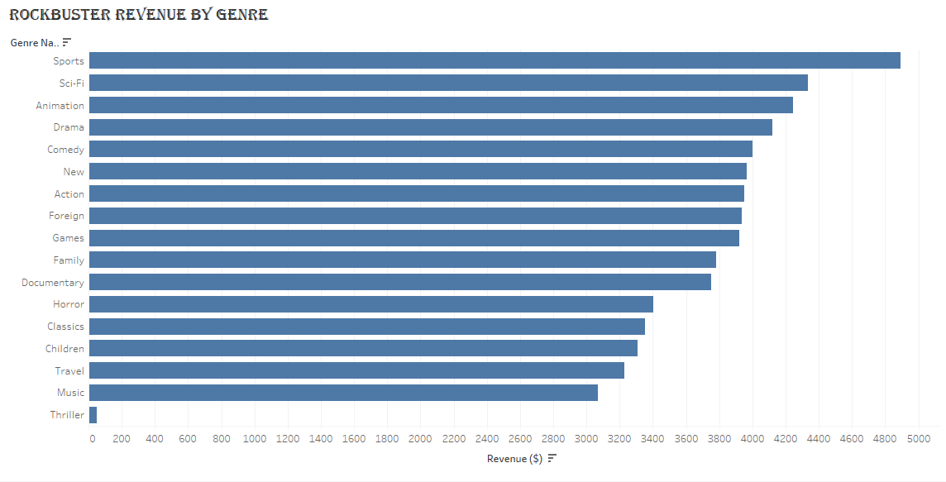
Movie Revenue
MOVIE REVENUE BY RATING
Rating | Revenue
PG-13 | 13855.56
NC-17 | 12634.92
PG | 12236.65
R | 12073.03
G | 10511.88

Slide 11
Genre Performance by Revenue
High 3 Performing Genre
Sports
Sci-fi
Animation
Low 3 Performing Genre
Travel
Music
Thriller

Slide 12
Insights and Recommendation
Insights
Sports, Sci-Fi and Animation are the top-selling genre.
PG-13 has the highest rating.
Asia has more customers and sales.
Recommendation
There is need for more marketing campaign in Asia.
High performing genres should be prioritized when planning for key market.
These should be considered while they transitioning from physical to online stores.

Slide 13

Thank you

