Slide 1
CSE 111
Justin Ly, Ezequiel Carlos

Slide 2
System Description
Our project is a database that simulates an application that lets users post images
Each user can post images with fun facts and can create a puzzle for it
Users can receive a random image and solve the puzzle
A user’s solved puzzles/questions are kept count of
User’s ‘level up’ as they solve more problems

Slide 3
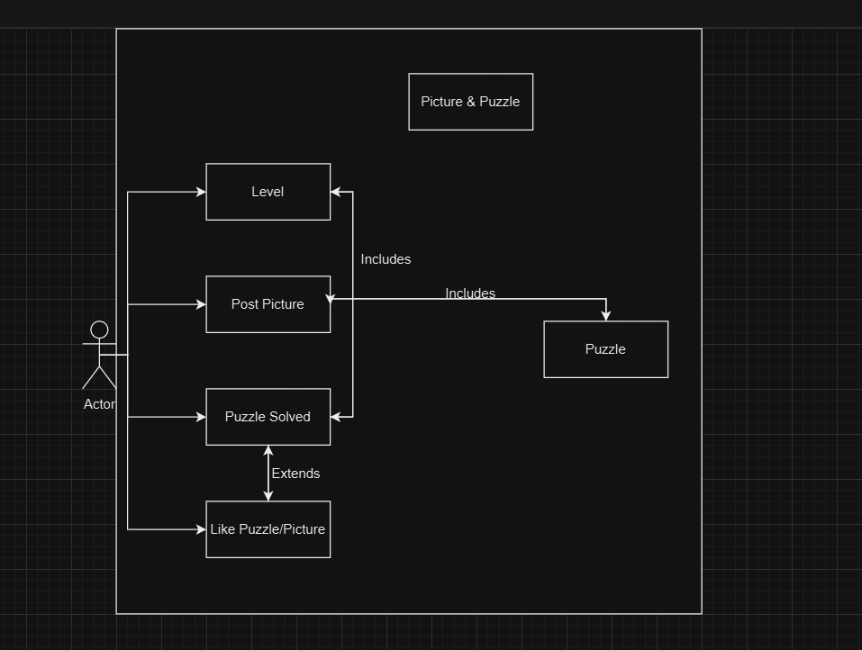
UML Diagram

Slide 4
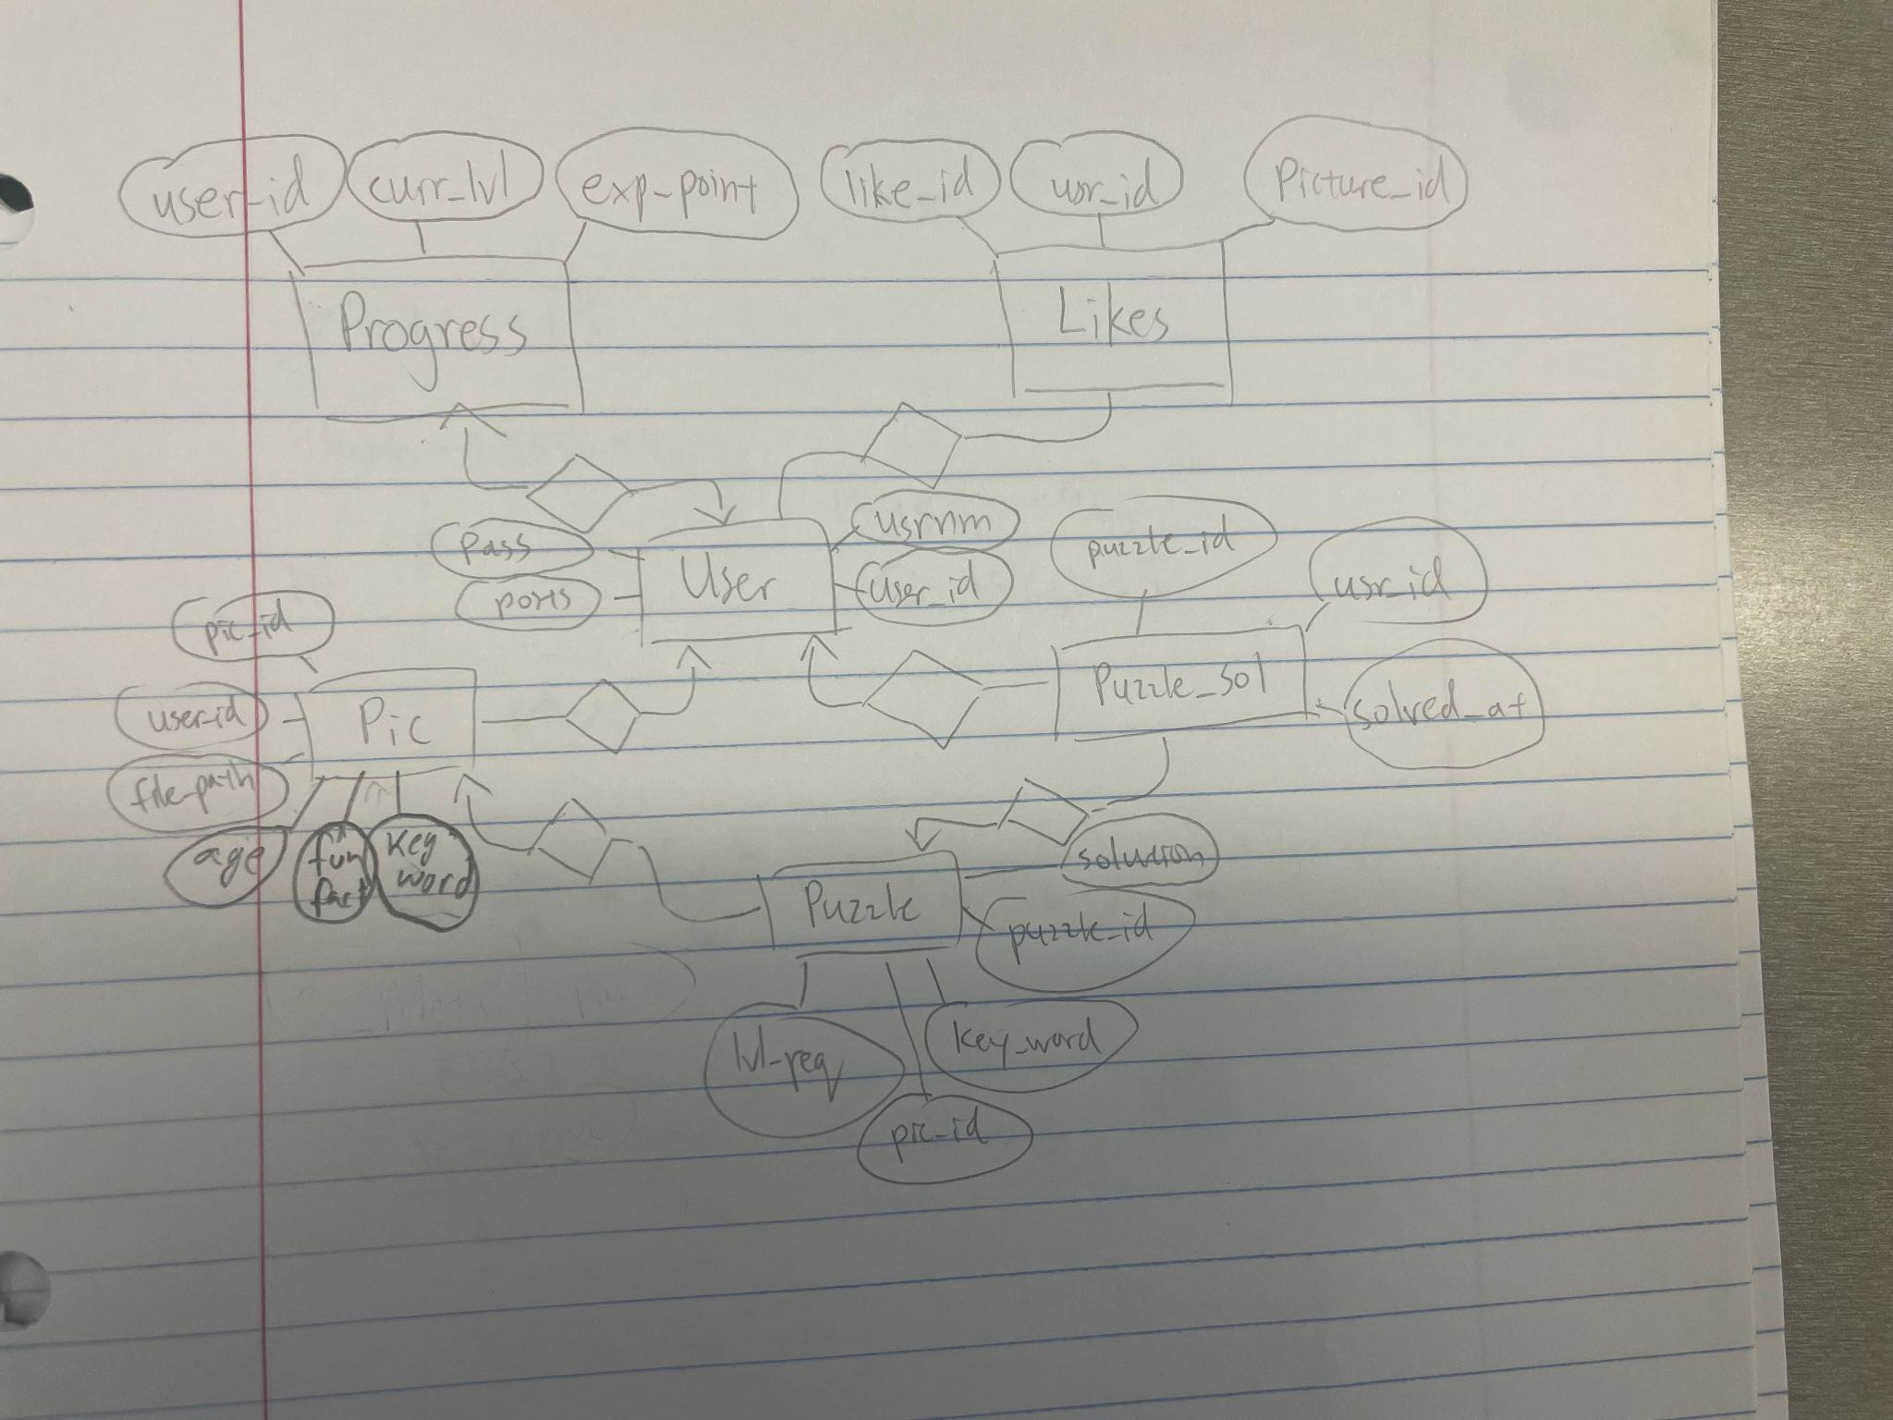
ER-Diagram

Slide 5
Relational Schema
User
User_id, userName, pass_hash, posts, posts_solved
Post
Pic_id, user_id, file_path, upload_date, fun fact, age,key_word
Puzzle
Puzzle_id, key_word, lvl_req, pic_id
Solved
Sol_id, puzzle_id, user_id, solved_at
Likes
Like_id, user_id, pic_id
Progress
User_id, curr_lvl, exp_points

