Slide 1

ENIMO
Energy Information Monitoring
Team Ezerka
The IBM Hack Challenge

Slide 2

Problem statement:
Real time energy consumption monitoring of appliances in home
Most conventional prepaid power meters currently installed in households only display the total real time usage of its power .
There is no option to see what the day’s, week’s or month’s consumption was and often these power meters are placed in an inconvenient location which makes regular viewing somewhat difficult.
These power meters also lack the ability to monitor appliances individually; thus hiding vital information about individual appliances.
Traditional meter

Slide 3
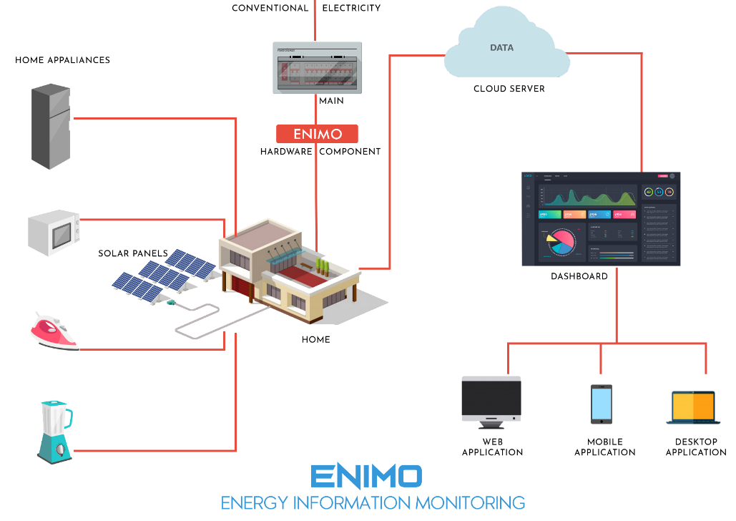
Our Solution
ENIMO is a energy monitor system which uses IOT to send real time readings of a appliances to the cloud, generate predictions and the insights are displayed on dashboard to help in decision making of a household.

Slide 4
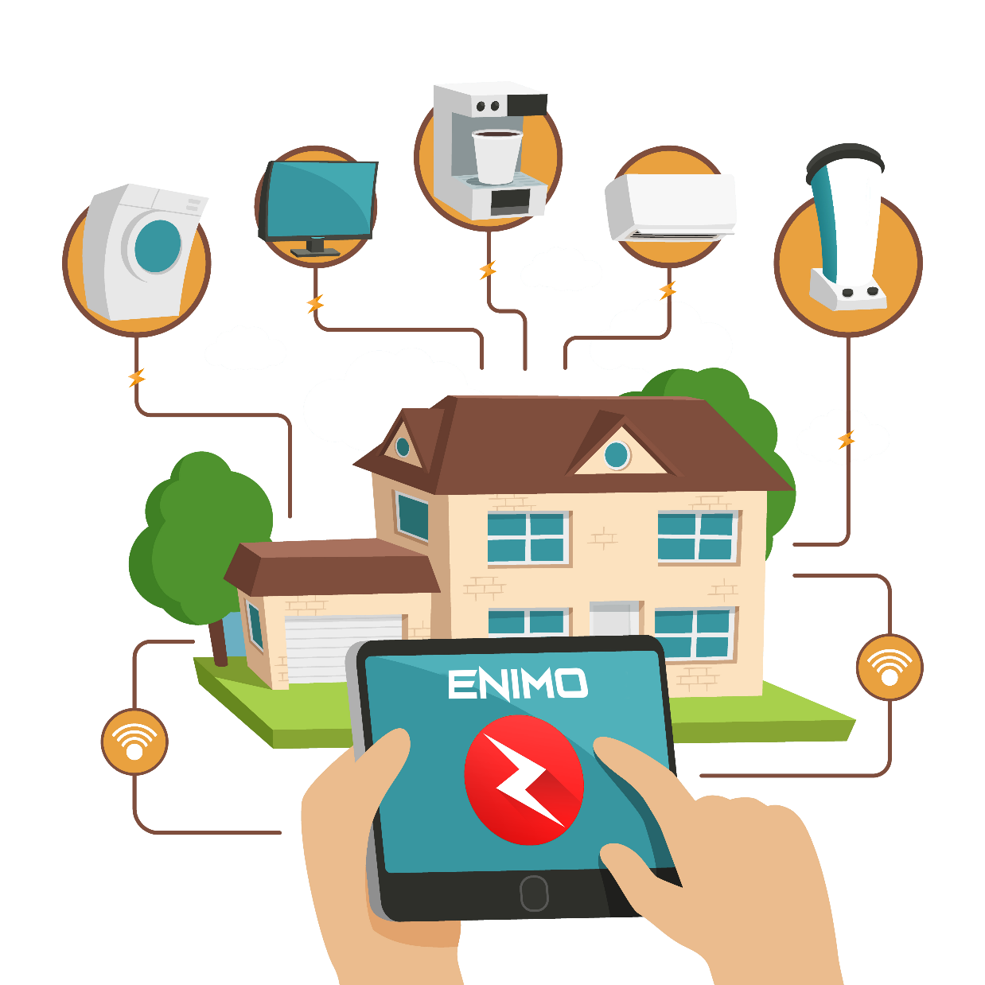
Our Solution
The major goal of ENIMO is to develop a system which is capable of tracking each and every individual appliance in the home.
The information of these appliances is send to the server by the ENIMO hardware component installed at the main power supply of the home.
Now the user will be able to view all the real time insights on phone or computer just by logging in into the ENIMO dashboard

Slide 5
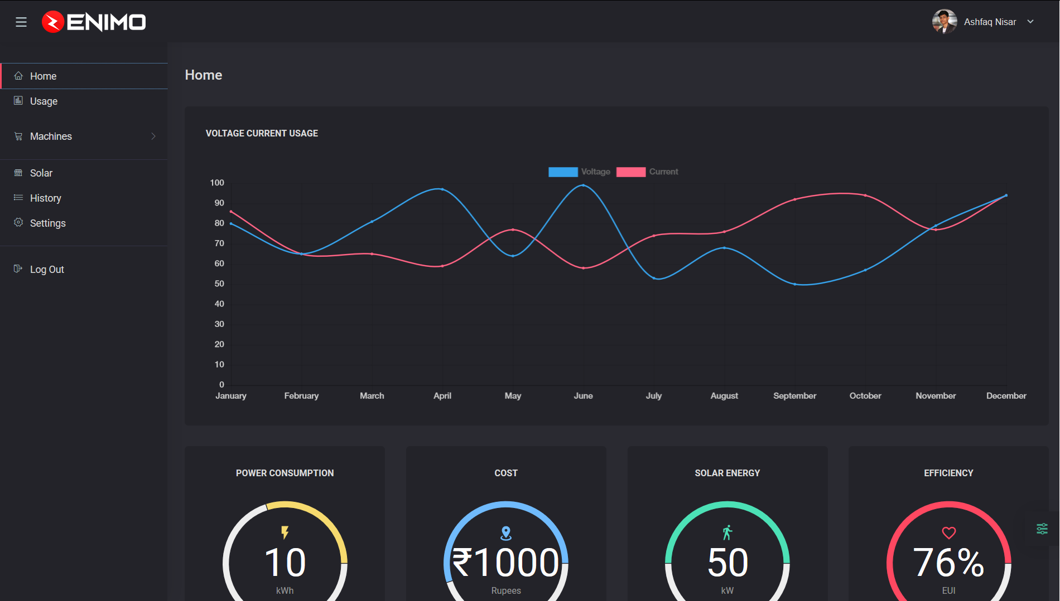
Software Contains
Home Page
Usage Page
Appliances Page
History Page

Slide 6
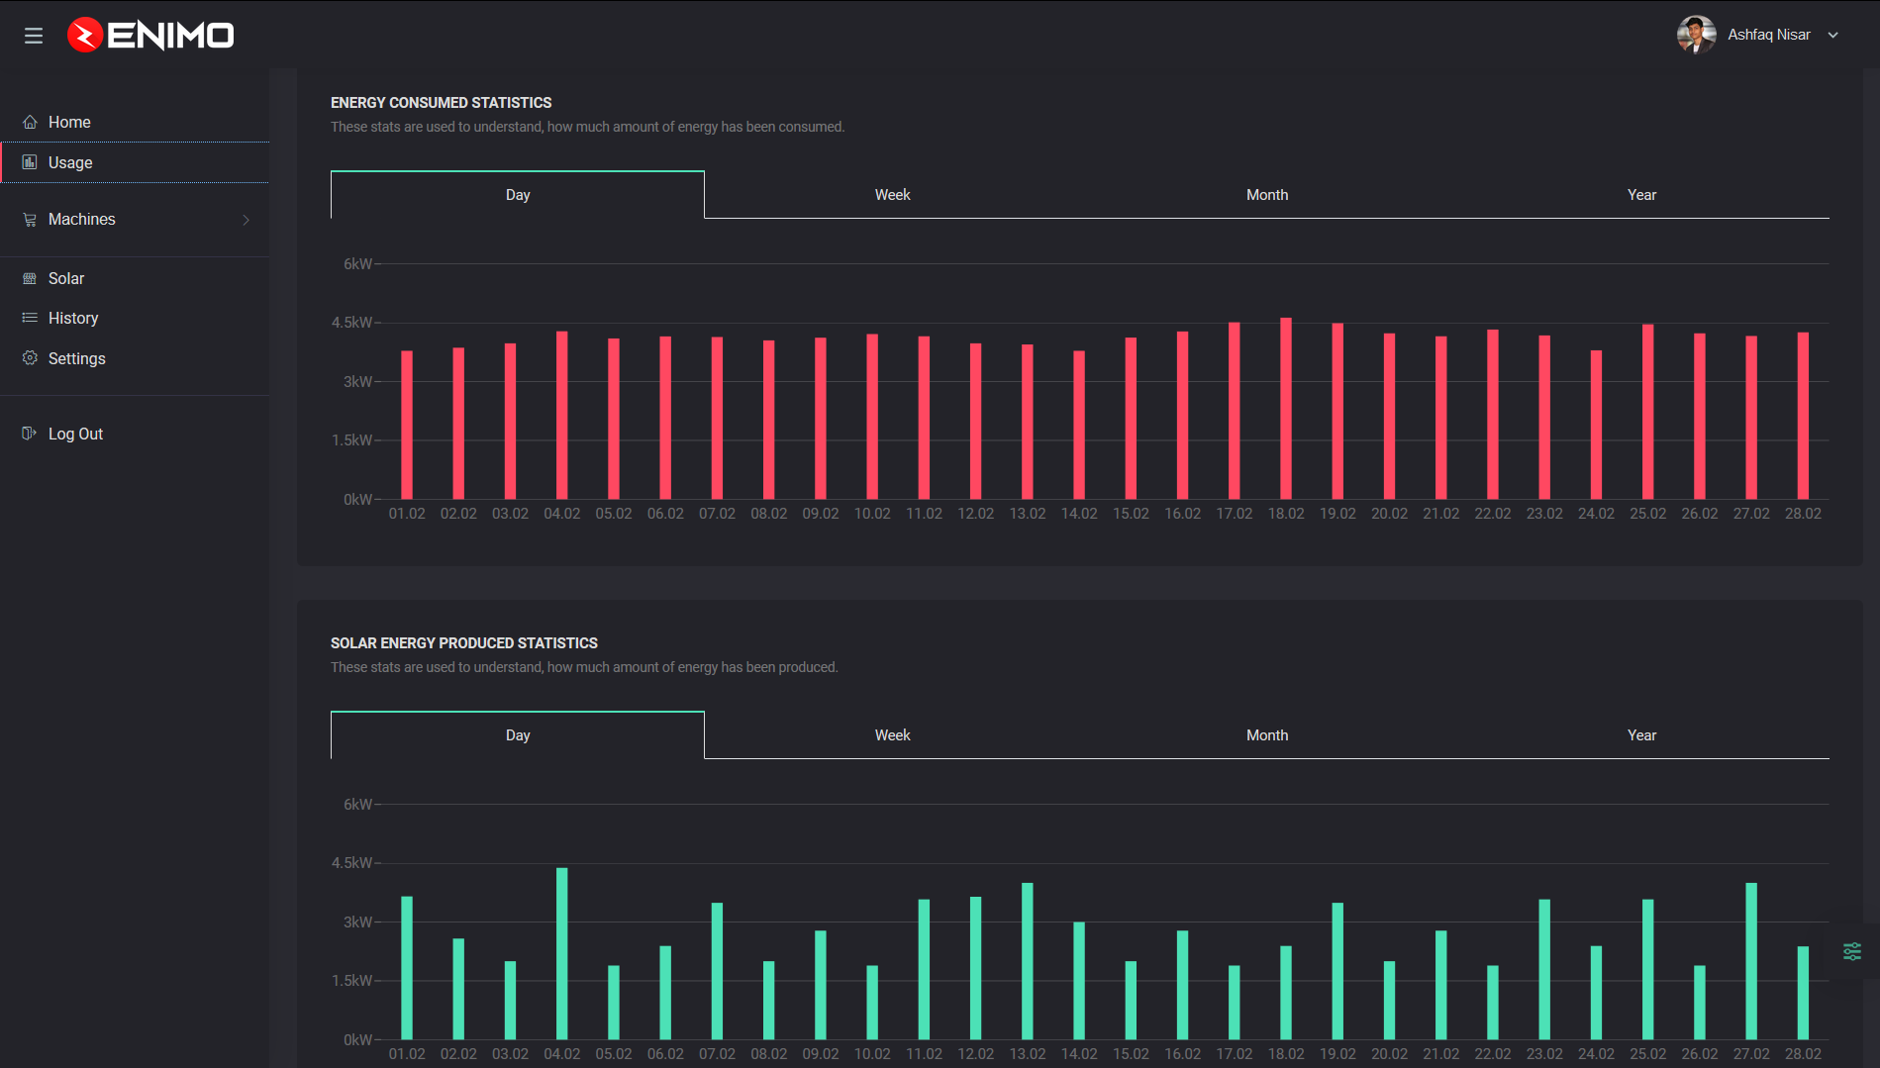
Software Contains
Home Page
Usage Page
Appliances Page
History Page

Slide 7
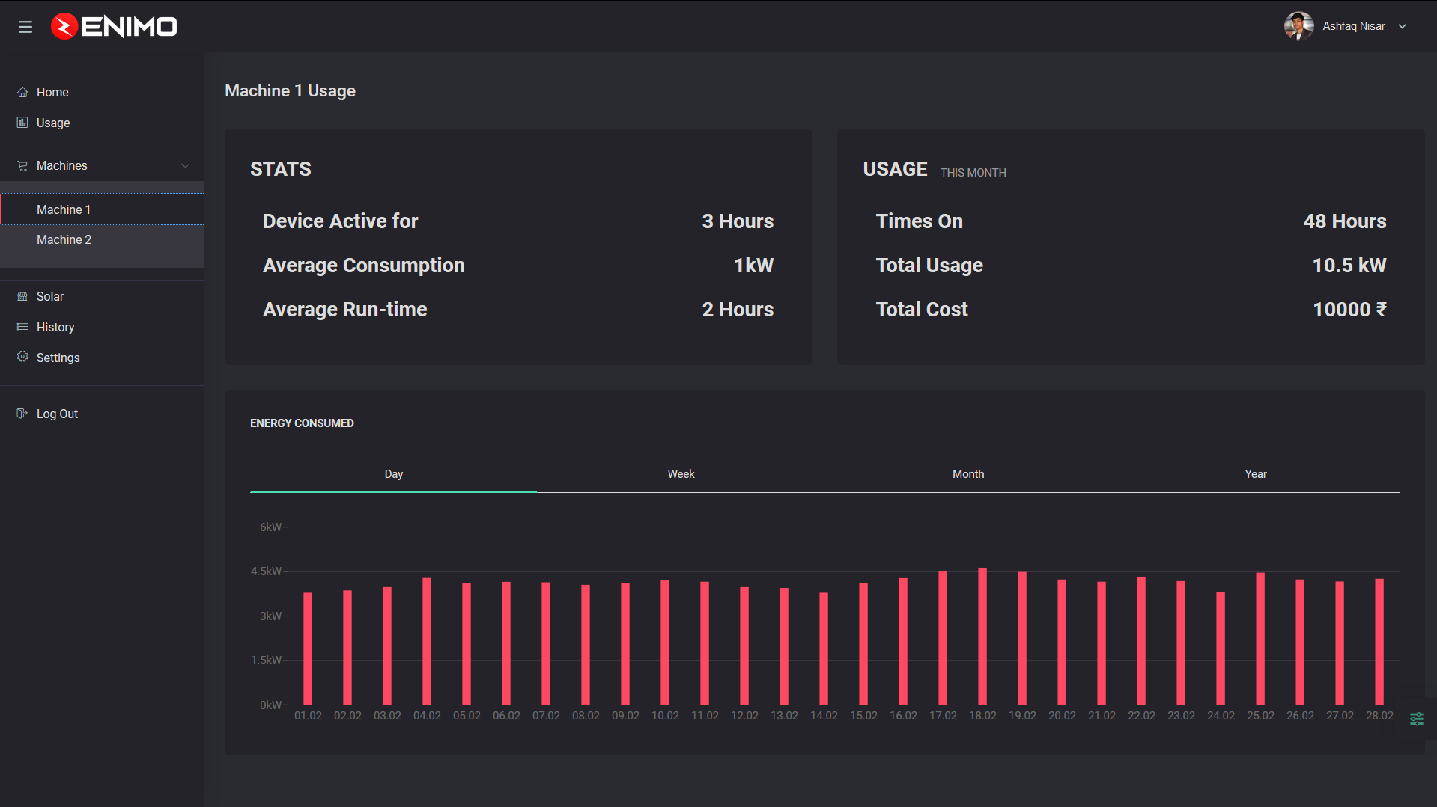
Software Contains
Home Page
Usage Page
Appliances Page
History Page

Slide 8
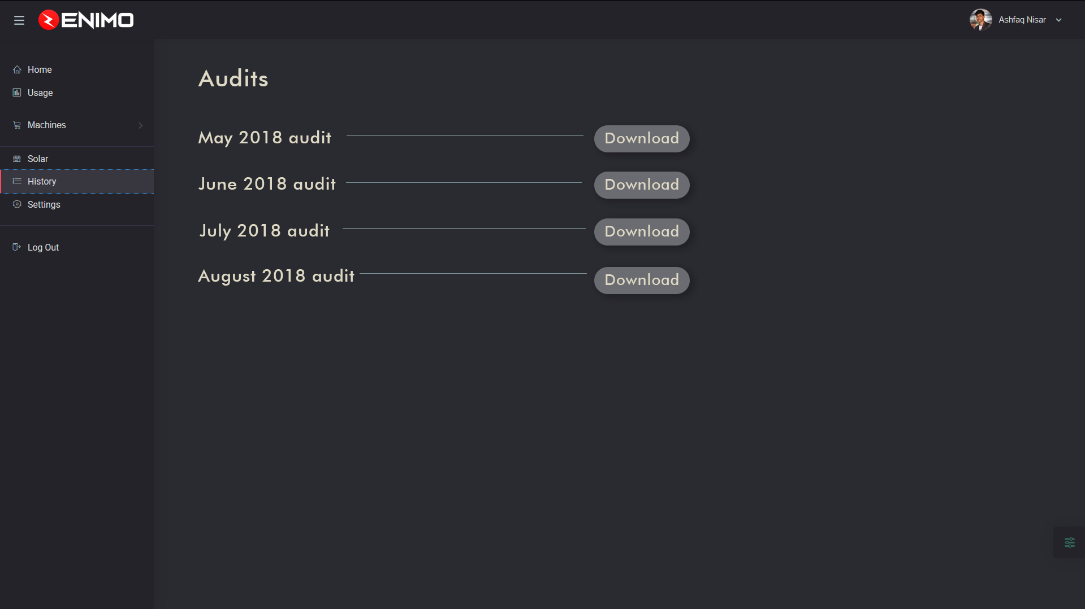
Software Contains
Home Page
Usage Page
Appliances Page
History Page

Slide 9




TECHNOLOGIES STACK
The below are some of the technologies that we will be using to build ENIMO
ANDROID & WEB APPLICATION
CHART JS FRAMEWORK
We will be making an android application and website for the user to work with the ZENCO. So, we are going to use different technologies such as JS,PHP, SASS for the website and Kotlin for the application.
We will be using the CHART JS open source library to display the amount of energy being generated by the solar panel. This will help the user to understand more about the energy that is generated from the solar panel.
NOSQL DATABASE
DATA VISUALIZATION
NoSQL database is used to store information on device when offline and pushes the information to database on connecting to internet. . The read and writes of the database is also very fast compared to any other database
We will be using the seaborn data visualization library instead of the matplotlib library because it is built upon the matplotlib but very much attractive than it

Slide 10




TECHNOLOGIES STACK
The below are some of the technologies that we will be using to build ENIMO
OPEN WEATHER MAP
SOLECAST FRAMEWORK
Using this kind of requests you can get weather data in any location on the earth. The current weather data are updated online based on data from more than 40,000 weather stations.
With the help of the sol cast framework, we will be able to easily visualize the data provided by the solar panel in the past week and provide the approximate energy generation in the upcoming week.
REACT & REDUX
MACHINE LEARNING
Poor UI makes a even a great software ordinary one. Therefore react and redux is used for the front end development.
We will be using the Scikit-Learn library to understand the daily routines of the user and change the patterns of the software according to it.

Slide 11
Front END Technologies
01
REACT JS AND REDUX
06
CHART JS AND RECHARTS
02
BOOTSTRAPE AND REACT STRAPE
07
WEATHER ICONS AND LINEAR ICONS
03
SASS And SCSS
08
AWESOME FONT ICONS
04
PARTICLE JS
09
SOLECAST AND OPEN WEATHER API
05
FIREBASE
10
AXIOS LIBRARY

Slide 12
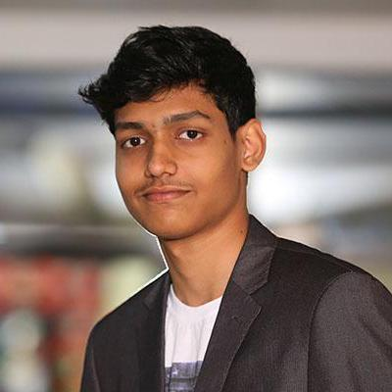
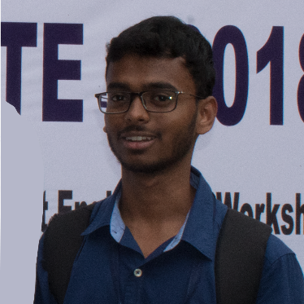
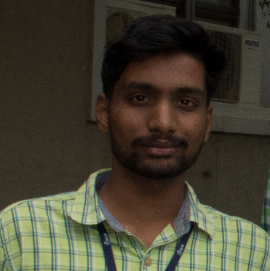
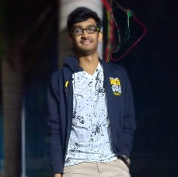
MEET OUR TEAM
Keeping together is progress.
Ashfaq Nisar Developer
Vamshi Krishna Designer
Vinay Reddy R&D, Designer
Sai Yuva Teja Android Developer
The React Development of the website and the integration of all the APIs and database was developed by Ashfaq.
The UI for all the platforms was designed by Vamshi
The R&D of the project and UI for the website was handled by Vinay
The android application was developed by Teja. He also contribute in all the phases of the project.

Slide 13
THANKS for WATCHING

