Slide 1

Real Estate Investment Analysis for Charles Christensen
Data-Driven Insights for Maximum Profit Optimization
Notes:
Hello everyone! Today, I will present a real estate investment analysis for Charles Christensen.. The goal is to help him make the best decision about selling his property.

Slide 2

Client : Charles Christensen (Seller)
Introduction & Business Context
Charles Christensen is a property seller looking for maximum ROI.
Key factors affecting property sales:
Location & Neighborhood Trends
Impact of Renovation on Pricing
Timing of Sales & Market Seasonality
Data-driven decisions will optimize selling strategy.
Notes:
If we want to konow him, Charles Christensen is a property seller who wants to maximize his return on investment.
Three key factors affect his selling strategy:
OKU
By analyzing these factors, we can make data-driven recommendations to help him achieve the best possible outcome.
[SEYİRCİYE BAKARAK KONUŞ, EV HAKKINDA BİŞİ BİLMİYORUZ Other than that, we don't have any details about Charles Christensen's house.
Like Location, size, view, or other features

Slide 3
Hypotheses
🔹 H1: Location Counts Homes in certain neighborhoods attract higher offers and sell faster.
🔹 H2: Size Matters Larger homes tend to sell for higher prices.
🔹 H3: Renovation Pays Off Well-renovated houses sell for higher prices
🔹 H4: Market Timing is Key Buying and selling at the right time impacts ROI
Notes:
Before analyzing the data, we made four key hypotheses about what influences house prices…
OKU HEPSİNİ
Now, let's look these hypotheses with data"

Slide 4
Overview
Minimum House Price: $78,000
Maximum House Price: $7,700,000
Average House Price: $540,254
Oldest House Built in : 1900
Newest House Built in : 2015
Notes:
Here is a general overview of the housing market according to our data . Prices vary widely, from very affordable homes to luxury properties.
The data also includes both historic and newly built houses, making pricing and renovation decisions important.

Slide 5
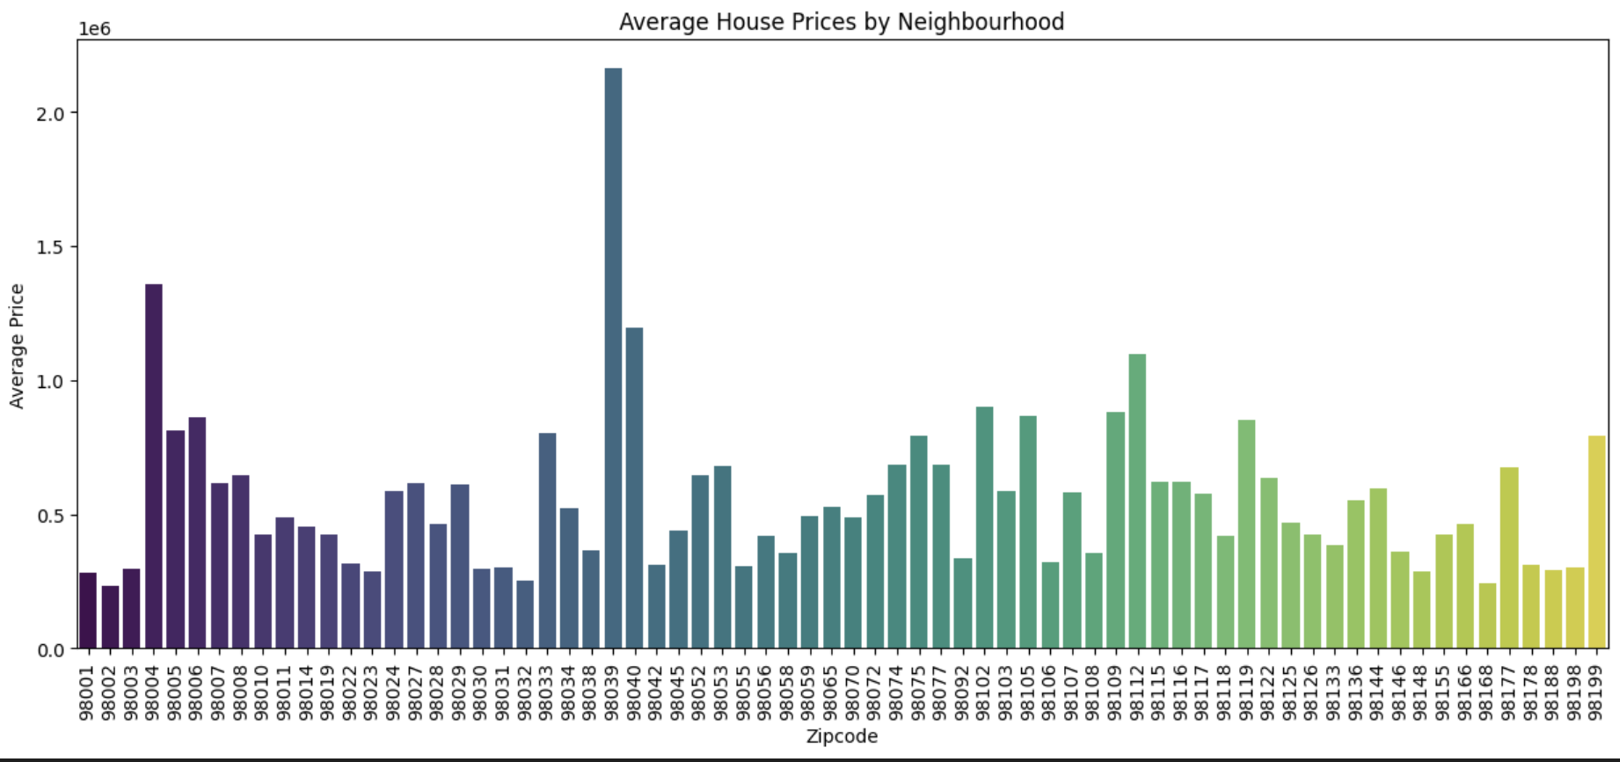
H1 : Location Counts Homes in certain neighborhoods attract higher offers and sell faster
House Prices Vary Significantly by Area
Certain neighborhoods are considerably more expensive than others.
Most expensive areas: Locations such as 98112, 98039 and 98004 have the highest property values.
Most affordable areas: Neighborhoods like 98001, 98168 and 98002 offer more budget-friendly housing options.
Notes:
Let's look at our hypotheses
Hypotesis 1 [SOLDAKİ HİPOTEZİ OKU] When we look at the Barplot we see this
House prices change a lot depending on the neighborhood. Some areas are more expensive and attract buyers who pay more. Other areas are more affordable and better for budget-friendly buyers."

Slide 6
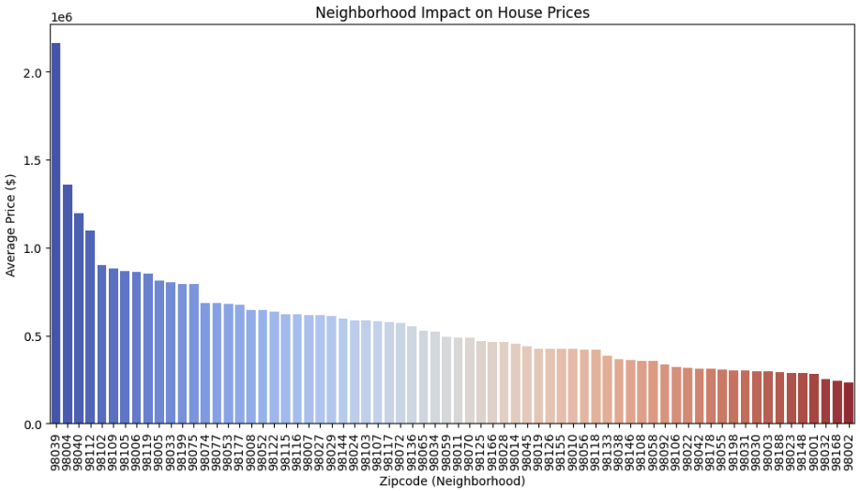
H1: Location Counts Homes in certain neighborhoods attract higher offers and sell faster / Heatmap
Recommendation:
✅ If Charles Christensen's home is in a prime location, these areas offer high yields.
✅ If in a lower-priced area, it may be necessary to adjust the price accordingly to make the sale faster.
✅ In some areas the impact of renovation may be greater, so it may make sense to analyse on a zipcode-by-zipcode basis.
Notes:
As I said we don't know any detail about his house
But as a Recommendation:
We can say [BU SLAYTI OKU]
✅ If Charles Christensen's home is in a prime location, these areas offer high yields.
✅ If in a lower-priced area, it may be necessary to adjust the price accordingly to make the sale faster.
We will come back to this issue, but if I want to say briefly
✅ In some areas the impact of renovation may be greater, so it may make sense to analyse on a zipcode-by-zipcode basis.

Slide 7
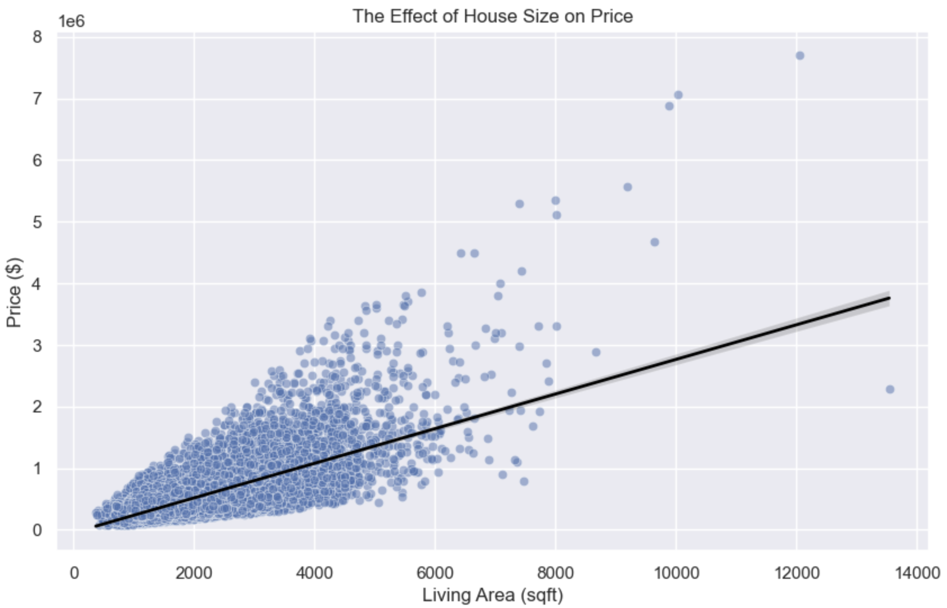
H2: Size Matters Larger homes tend to sell for higher prices.
House Size (sqft_living) has a big impact on price
Generally, larger houses are sold more expensive.
But houses between 2000-4000 sqft have the best price/performance ratio.
Recommendation:
✅ If selling: Highlight the living area, especially if the house falls within the optimal 2,000-4,000 sqft range.
✅ If renovating: Focus on increasing usable living space (e.g., finishing basements or attic conversions).
Notes:
The other hypotehesis is Size Matters
[SOLDAKİ HİPOTEZİ OKU]
Generally, larger houses are sold more expensive.
If Charles wants to sell, he should highlight the living area, especially if the house is within the 2,000-4,000 sqft range.
If he decides to renovate, he should focus on increasing usable living space, such as finishing basements or converting attics."

Slide 8
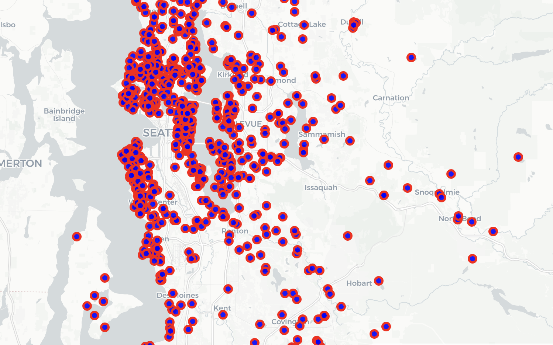
H3: Renovation Pays Off Well-renovated houses sell for higher prices
Number of Renovated Houses: 744
Notes:
The third hypothesisis [SOLDAKİ HİPOTEZİ OKU]
When we look at the scattermap, we can see that:
Renovation is very common in this area, as many homeowners invest in upgrades to increase their property's value.
In total, there are 744 renovated houses in the dataset, showing that improving a home is a popular strategy for selling at a higher price.

Slide 9
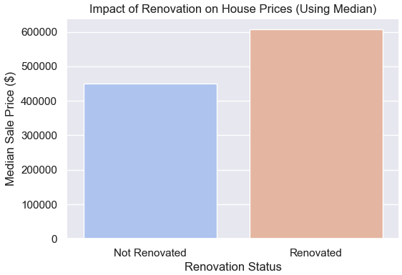
H3: Renovation Pays Off Well-renovated houses sell for higher prices
Median price of unrenovated homes: $449,000
Median price of renovated homes: $607,502
Price difference: +$158,502
Recommendation: ✅ If the renovation cost is under $142,652(with a safety margin of 90% ) it may still be profitable to renovate!
Notes:
We can also see this in the barplot here:
Renovated houses sell for higher prices than unrenovated ones. The median price of a renovated home is about $158,502 (One hundred fifty-eight thousand dollars) more than one that is not renovated. If the renovation cost is under $142,652(One hundred forty-two thousand dollars), it could still be a profitable investment.
[NEDEN 158 DEĞİL 142] Of course we need to think about Ongoing expenses during the renovation (taxes, loans, maintenance costs)
Taxes, loan, Real estate agent commission

Slide 10
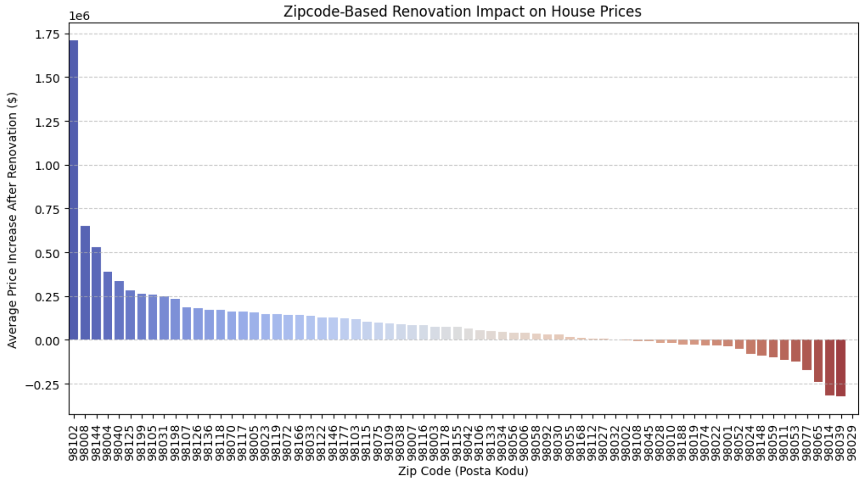
H3: Renovation Pays Off Well-renovated houses sell for higher prices
Recommendation:
✅ We do not know the zip code in which he will sell his house, but if it is in one of the first 10 zip codes, it may make sense to renovate and sell it.
✅ If it is in the red zip codes on the right side, it may make more sense to consider direct sale instead of renovation.
✅ Once the zip code is determined, we can make the best decision by making a detailed analysis.
Notes:
when we look at this bar plot we see that
On the left we can see Zip codes where renovation increased the price the most.
On the right we can see Zip codes where renovation did not add value or caused losses.
Especially in the first 10 zip codes there are big price increases after renovation!
In some zip codes (on the right side) the renovation may have even caused losses.
Once the zip code is determined, we can make the best decision by making a detailed analysis.

Slide 11
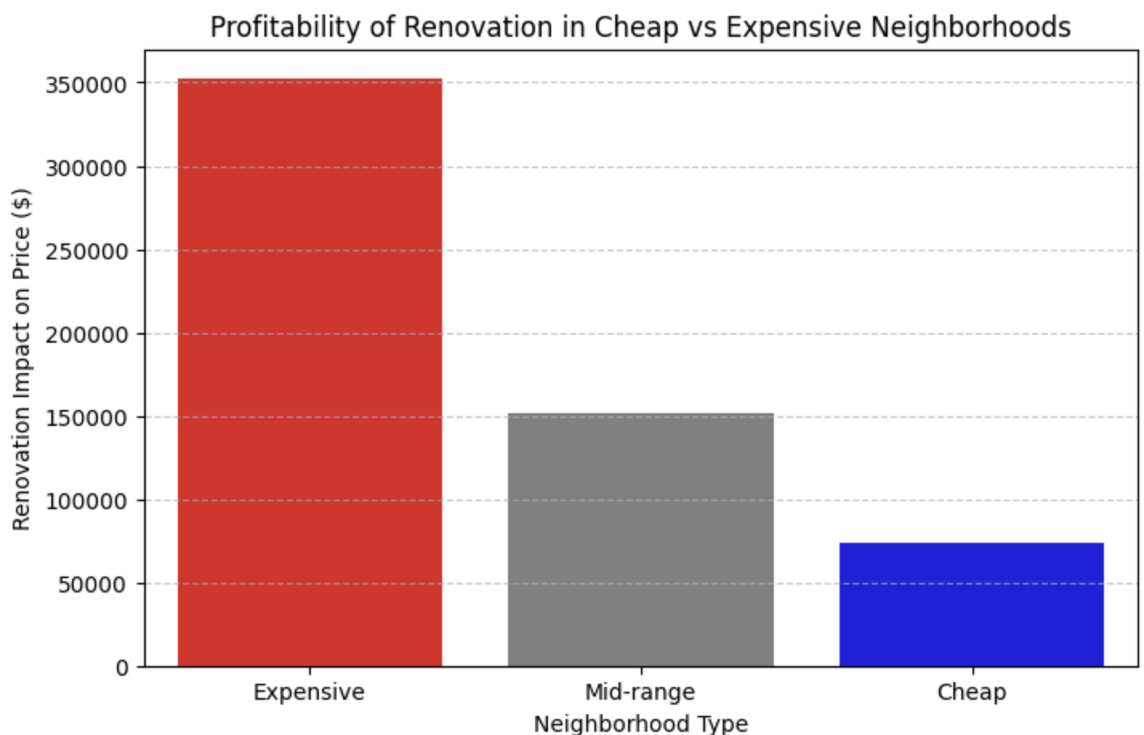
H3: Renovation Pays Off Well-renovated houses sell for higher prices
Renovations in rich neighbourhoods (red) increase the price the most.
In mid-range neighbourhoods (grey) the profit is lower.
Renovations in cheap neighbourhoods (blue) have much less impact.
Recommendation:
✅ If he wants to make a profit, renovate in rich neighbourhoods!
Renovation in cheap neighbourhoods yields less.
✅ However, in some neighbourhoods the price difference may be lower, so it is important to analyse which area to sell in
Notes:
When we look at another bar plot comparison we notice that:
"Renovating in expensive neighborhoods increases the price the most.
In mid-range neighborhoods, the profit is lower.
In cheap neighborhoods, renovations have much less impact on price.
If he wants to maximize profit, he should renovate in high-value areas.
However, he should also analyze the specific neighborhood to ensure it’s worth the investment."

Slide 12
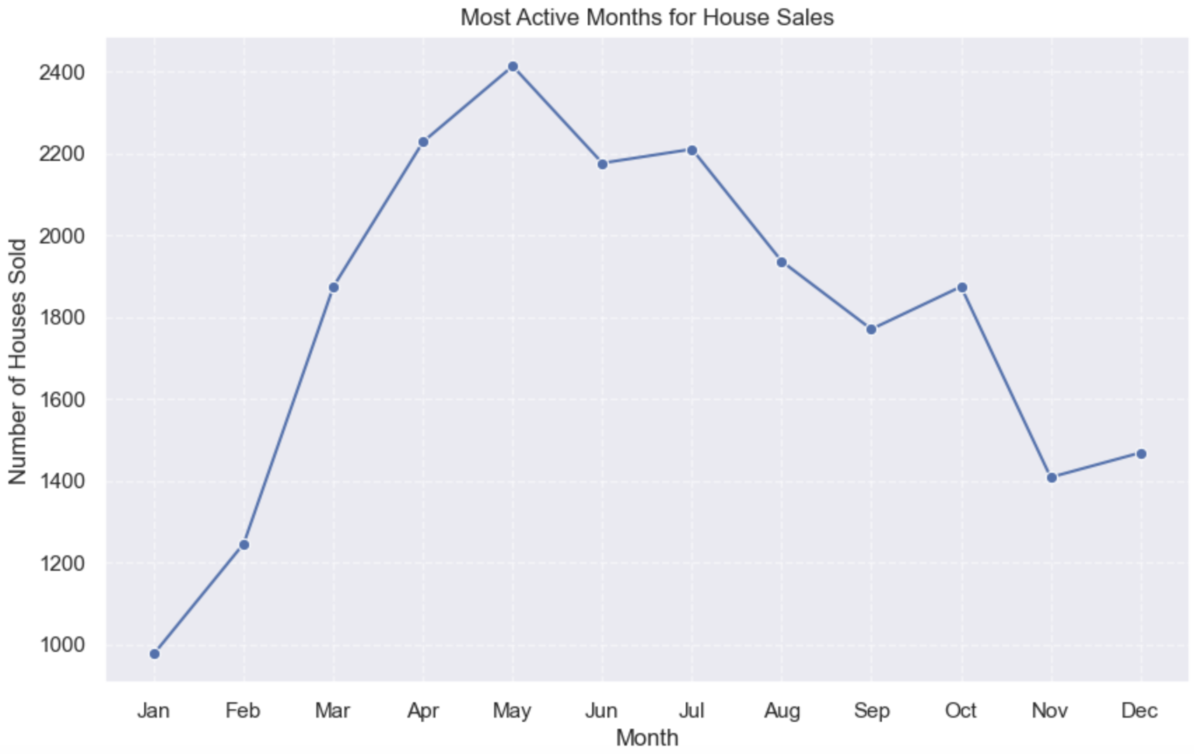
H4: Market Timing is Key Buying and selling at the right time impacts ROI
The most house sales took place in May.
Sales are at the lowest level in January, February and November.
Recommendation:
✅ If Charles Christensen wants to sell his house the fastest, he should list it in May.
✅ The most difficult months to sell are January, February and November, so it may make more sense to postpone the sale during the winter months.
Notes:
Fourth and final hypothesis is [SOLDAKİ HİPOTEZİ OKU]
As we can see
Most house sales happen in May, making it the best time to sell. The lowest sales occur in January, February and November, so selling during these months may take longer.
If Charles wants to sell quickly, he should list his house in May.

Slide 13
Most Common Renovations in Seattle Homes:
Kitchen Remodeling – One of the most popular renovations, increasing home value and functionality.
Duration: 4 to 8 weeks
Bathroom Renovation – Enhances both aesthetics and functionality.
Duration: 3 to 6 weeks
Energy Efficiency Improvements – Includes window replacements, insulation upgrades, and installing energy-efficient appliances.
Duration: A few days to several weeks, depending on the project scope
Exterior Upgrades – Improves curb appeal and structural durability.
Duration: 2 to 4 weeks
H4: Market Timing is Key Buying and selling at the right time impacts ROI
Recommendation:
✅ If Charles wants to renovate, he should start immediately to ensure the work is completed by May, allowing him to sell at peak season.
✅ If the renovation takes too long, he may miss the best selling period, which could result in a slower sale or lower offers.
https://seattleagentmagazine.com/2024/02/13/exterior-renovation-trends-seattle/
https://modelremodel.com/blog/seattle-remodeling-costs/
Notes:
Meanwhile, we should not overlook the following regarding timing:
Here we see the most common renovations and their duration in the Seattle region. Since it’s March, Charles has limited time before the peak selling season in May-June.
✅ If Charles wants to renovate, he should start immediately to ensure the work is completed by May, allowing him to sell at peak season.
✅ If the renovation takes too long, he may miss the best selling period, which could result in a slower sale or lower offers.

Slide 14
Final Recommendation for Charles Christensen
✅ If the property is in a premium neighborhood, full renovation is worth it—selling in May-June maximizes returns.
✅ For mid-range neighborhoods, minor upgrades (e.g., fresh paint, staging) are effective, but full renovations may not justify the cost. Selling in April-May is the best option.
✅ In budget-friendly areas, renovations have minimal impact on resale value—selling as-is in early spring is the most practical strategy.
✅ Market timing matters—May sees the highest sales, while winter months (November-January) have the lowest demand.
✅ If renovation costs stay below ~$142,000, it's a worthwhile investment, especially in high-value neighborhoods.
✅ Further analysis of the property's specific location will refine the best strategy.
Conclusion
Notes:
In summary, here are our recommendations for Charles Christensen:

Slide 15

Thank You for Your Attention!

Slide 16

Thank You for Your Attention!

