Slide 1

DATA ANALYTICS PROJECT
Customer Shopping
Behavior Analysis
Turning transactional data into clearer business decisions
3,900
18
Python
purchases
columns
PostgreSQL • Power BI
Analyze • Understand • Act
Source: Uploaded PDF, p. 1
Notes:
Transition: Fade 0.6s
Entrance: title first, then subtitle and KPI cards.
Use Morph-like visual continuity into Slide 2.

Slide 2
01 / CONTEXT
Project objective & dataset snapshot
The source project combines transactional data, customer attributes, and shopping behavior to uncover actionable patterns.
3,900
18
37
Purchases
Columns
Missing values
Transactional records
Customer + purchase + behavior fields
Review Rating column
PROJECT OVERVIEW
KEY FEATURES
Analyze customer shopping behavior across product categories to uncover spending patterns, customer segments, product preferences, and subscription behavior.
Customer demographics
Purchase details
Shopping behavior
Age, Gender, Location, Subscription Status
Item, Category, Amount, Season, Size, Color
Discount, Promo, Previous Purchases, Frequency, Rating, Shipping
SPENDING PATTERNS
CUSTOMER SEGMENTS
PRODUCT PREFERENCES
Source: Uploaded PDF, pp. 1–2
Notes:
Transition: Morph from title/hero into overview cards.
Entrance: dataset metrics → project overview → feature columns.

Slide 3
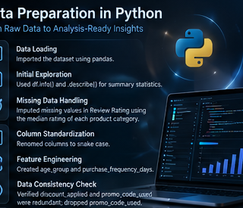
02 / DATA PREPARATION
From raw records to analysis-ready data
Python handles cleaning, feature engineering, consistency checks, and PostgreSQL integration.
01
LOAD
02
EXPLORE
03
CLEAN
Import dataset with pandas.
Use df.info() and .describe() for structure and summary statistics.
Impute missing Review Rating values using the median rating of each product category.
04
STANDARDIZE
05
ENGINEER
06
INTEGRATE
Rename columns to snake_case for readability.
Create age_group and purchase_frequency_days.
Verify discount redundancy, drop promo_code_used, then load cleaned data into PostgreSQL.
PYTHON → POSTGRESQL
Source: Uploaded PDF, pp. 1–2
Notes:
Transition: Push/Reveal or Morph.
Entrance: each numbered stage appears left-to-right, then the integration badge.

Slide 4
03 / SQL ANALYSIS
Ten business questions, one analytical workflow
PostgreSQL turns the cleaned dataset into decision-focused business transactions.
01
Revenue by Gender
02
High-Spending Discount Users
03
Top 5 Products by Rating
04
Shipping Type Comparison
05
Subscribers vs. Non-Subscribers
06
Discount-Dependent Products
07
Customer Segmentation
08
Top 3 Products per Category
09
Repeat Buyers & Subscriptions
10
Revenue by Age Group
Business lens
The analysis is organized around questions that can inform customer, product, pricing, shipping, and retention decisions.
Source: Uploaded PDF, pp. 2–6
Notes:
Transition: Morph.
Entrance: question cards reveal in two-column reading order.

Slide 5
04 / REVENUE
Revenue by gender + high-spending discount users
The source SQL outputs quantify revenue differences and identify 839 high-spending discount users.
REVENUE BY GENDER
HIGH-SPENDING DISCOUNT USERS
839
Customer ID
Purchase Amount
157,890
2
64
customers identified
150K
3
73
4
90
7
85
100K
75,191
9
97
12
68
50K
13
72
16
81
20
90
0K
22
62
Female
Male
Identified from the SQL query for customers who used discounts but still spent above the average purchase amount.
Source: Uploaded PDF, pp. 2–3
Notes:
Transition: Morph.
Entrance: chart frame → bars → 839 KPI → table rows.

Slide 6
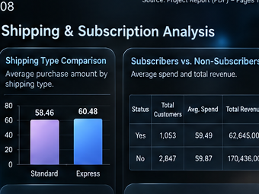
05 / PRODUCT SIGNALS
Top-rated products + shipping comparison
Product ratings and shipping behavior provide two complementary purchase signals.
TOP 5 PRODUCTS BY AVERAGE RATING
AVERAGE PURCHASE AMOUNT
Gloves
3.86
STANDARD
58.46
Sandals
3.84
60.48
EXPRESS
Boots
3.82
Hat
3.80
DELTA
+2.02
average purchase amount for Express vs. Standard
Skirt
3.78
Source: Uploaded PDF, pp. 3–4
Notes:
Transition: Push.
Entrance: ratings bars left-to-right; shipping comparison follows with emphasis on 58.46 vs 60.48.

Slide 7
06 / CUSTOMER SEGMENTS
Loyalty, subscriptions, and repeat-buyer behavior
Purchase history drives segmentation; subscription status adds a second lens on customer behavior.
CUSTOMER SEGMENTATION
SUBSCRIBERS VS. NON-SUBSCRIBERS
YES
1,053
59.49 avg. spend
62,645 revenue
NO
2,847
59.87 avg. spend
170,436 revenue
3,116
Loyal
REPEAT BUYERS
Loyal
3,116
Repeat buyers here are customers with more than 5 purchases; the source checks their subscription status.
2,518
958
Returning
701
No
Yes
New
83
Source: Uploaded PDF, pp. 5–6
Notes:
Transition: Morph.
Entrance: segmentation ring → segment labels → subscription figures → repeat-buyer comparison.

Slide 8
07 / PRODUCT + AGE INSIGHTS
Discount dependency, category leaders, and age-group revenue
The source combines product-level purchasing patterns with demographic revenue contribution.
TOP DISCOUNT RATES
TOP PRODUCTS BY CATEGORY
REVENUE BY AGE GROUP
Hat
50.00%
Accessories
Jewelry
171
Young Adult
62,143
Accessories
Sunglasses
161
Sneakers
49.66%
Accessories
Belt
161
Middle-aged
59,197
Coat
49.07%
Clothing
Blouse
171
Adult
55,978
Sweater
48.17%
Clothing
Pants
171
Clothing
Shirt
169
Senior
55,763
Pants
47.37%
Footwear
Sandals
160
Footwear
Shoes
150
Top 5 products with the highest percentage of discounted purchases.
Source: Uploaded PDF, pp. 5–7
Notes:
Transition: Fade into three-panel insight layout.
Entrance: discount bars → category list → age-group bars.

Slide 9
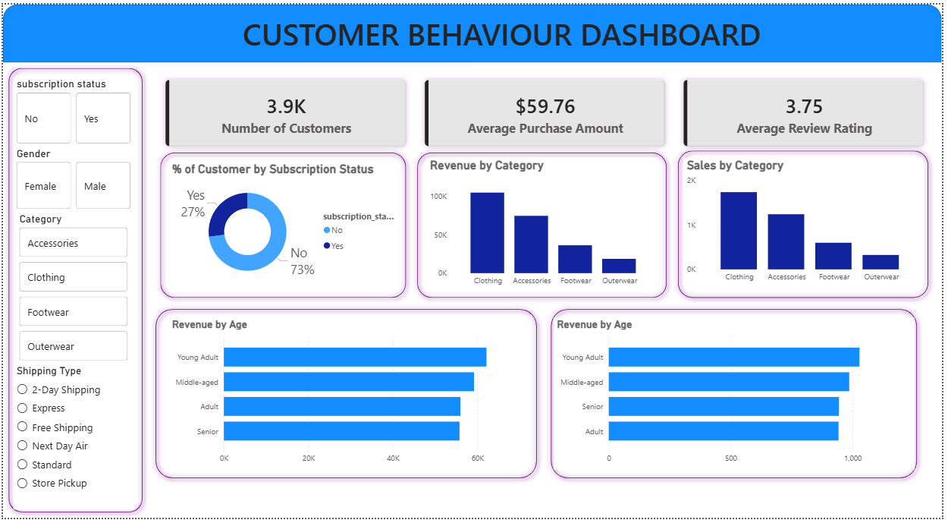
08 / POWER BI
The interactive dashboard turns analysis into a presentation layer
The source reports an interactive Power BI dashboard for visually presenting the customer behavior insights.
DASHBOARD ROLE
Present insights visually
Combine customer, product, shipping, and age-group views
Support filtering and exploration
SOURCE DASHBOARD
Use the interactive report as the visual delivery layer after Python and SQL preparation.
Source: Uploaded PDF, p. 7
Notes:
Transition: Morph.
Entrance: dashboard visual first; supporting explanation cards follow.

Slide 10
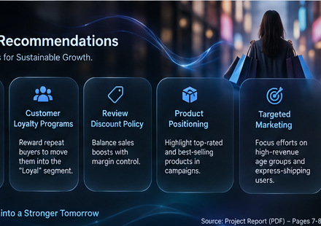
09 / ACTIONS
Business recommendations
The source concludes with five actions tied directly to observed customer, product, and shipping signals.
BOOST SUBSCRIPTIONS
CUSTOMER LOYALTY PROGRAMS
Promote exclusive benefits for subscribers.
Reward repeat buyers to move them into the “Loyal” segment.
REVIEW DISCOUNT POLICY
PRODUCT POSITIONING
Balance sales boosts with margin control.
Highlight top-rated and best-selling products in campaigns.
FROM DATA
to targeted action
Use the report as a decision aid, not a wall of metrics.
TARGETED MARKETING
Focus efforts on high-revenue age groups and express-shipping users.
Source: Uploaded PDF, pp. 7–8
Notes:
Transition: Fade to close.
Entrance: recommendation cards appear in reading order; final statement appears last.

