Slide 1

The Hitchhiker’s Guide to
the Machine Learning
Engineering Galaxy
by Alyona Galyeva

Slide 2
Agenda
Introduction
AI-powered software vs traditional software
MLOPS and AI-pipeline in a nutshell
ML Platform: What is this?
Hands-on with AI-pipelines:
Offline serving – batch
Online serving – near real-time

Slide 4


Slide 6
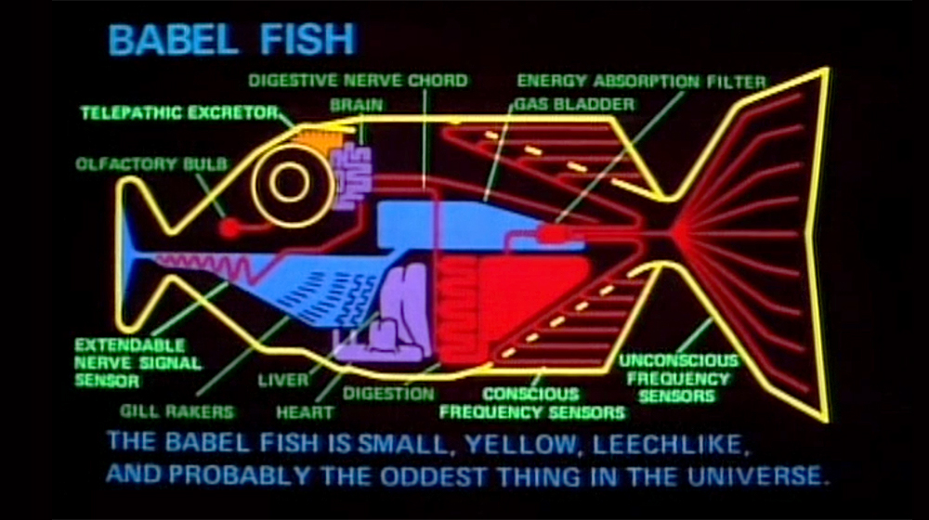

Slide 8
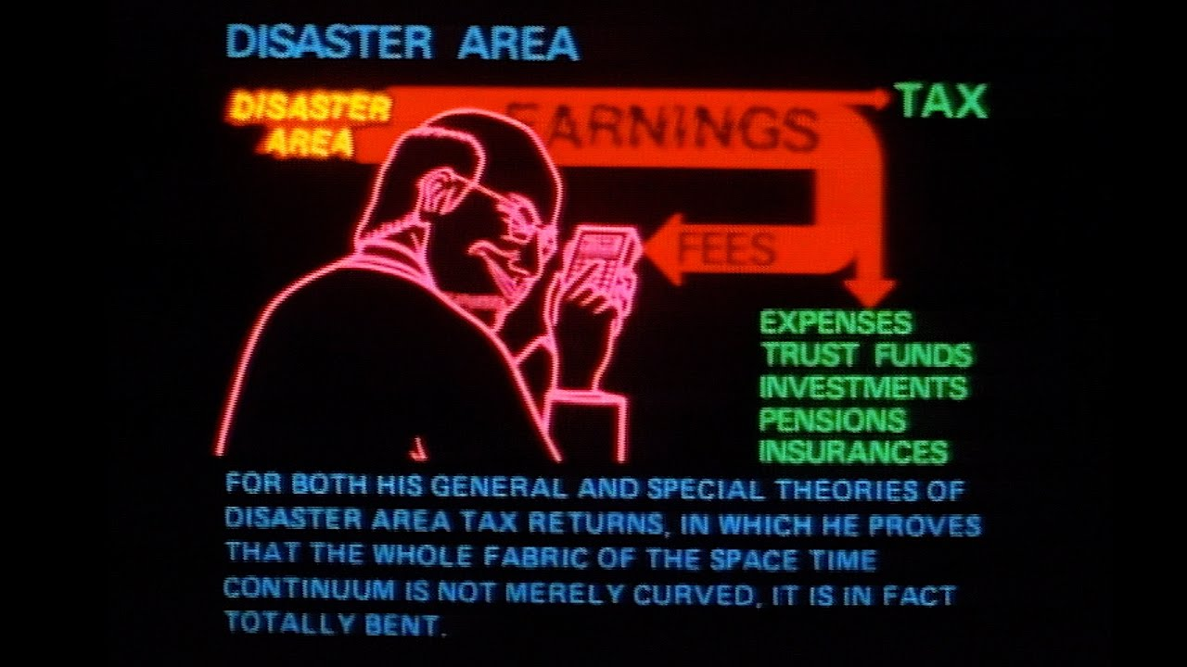

Slide 10
