Slide 1
OpenVAS
Vulnerability Assessment & Scanning
Ezhil Prasaath Se| CB.SC.P2CYS26026
Course: Network Security

Slide 2
Why Vulnerability Scanning?
Vulnerability = a weakness an attacker can exploit
Missing patch · Misconfiguration · Default credentials · Exposed service
Find first
Prioritise
Comply
Track
Before attackers do
Rank by CVSS risk
PCI-DSS · ISO 27001
Continuous attack surface
2

Slide 3
What is OpenVAS?
Open Vulnerability
Assessment Scanner
Open source
Greenbone
GPL licence
Maintainer
Network vulnerability scanner that discovers, rates and reports weaknesses across hosts and services.
100,000+
Nessus fork
Vulnerability tests
Since 2005
3

Slide 4
OpenVAS vs GVM
GVM - Greenbone Vulnerability Management (full framework)
openvas-scanner
gvmd
ospd-openvas
Scan engine · runs VTs
Manager · GMP · tasks
OSP bridge to scanner
gsad / GSA
gvm-tools
PostgreSQL + Feeds
Web UI · HTTPS
CLI · GMP scripting
Data · VTs · SCAP · CERT
OpenVAS = scanner engine | GVM = platform around it
4

Slide 5
How OpenVAS Works
1 Target
2 Discovery
3 VT Execution
4 Results
IP · CIDR · hostname
Port list
Ping / ARP
Port scan
Service + OS fingerprint
NASL scripts run
per open service
Severity · QoD
CVE · solution
Redis Knowledge Base shares per-host findings across VTs
5

Slide 6
OpenVAS Architecture
GSA / gsad
Web interface · HTTPS 9392
PostgreSQL
gvmd data: tasks, results
gvmd
Manager · GMP protocol
Redis
ospd-openvas
OSP daemon · scanner bridge
Scanner knowledge base
openvas-scanner
Executes VTs (NASL)
Feeds
Target hosts
Network under assessment
NVT · SCAP · CERT
6

Slide 7
Vulnerability Assessment Workflow
Create
Target
Configure
Scan
Execute
Task
Analyze
Report
Remediate
& Rescan
Hosts · ports
Credentials
Scan config
Scanner · schedule
Start scan
Monitor progress
Filter by QoD
Triage CVSS
Patch · harden
Verify fix
Repeat: every fix is verified by a rescan
7

Slide 8
Types of Scans
Discovery
Hosts, ports, services only
Unauthenticated
Host Discovery
Liveness check only
Remote, attacker view
Banners · open ports
System Discovery
OS + hardware fingerprint
Base
No dangerous checks
Authenticated
Full and fast
Default · uses discovery results
SSH · SMB · SNMP creds
Local patch checks
Fewer false positives
Full and deep
All VTs · slowest · thorough
8

Slide 9
Vulnerability Tests (VTs)
Feed sync
NVT (.nasl)
Run on target
Finding
Anatomy of a VT
Detection
Feed matters
OID · Family
CVE refs · CVSS
QoD · Solution
Version / banner
Active probe
Local credentialed check
Community vs Enterprise
Stale feed = blind scanner
Sync before every scan
9

Slide 10
Reports & Severity
Log
Low
Medium
High
0.0
0.1 - 3.9
4.0 - 6.9
7.0 - 10.0
CVSS-based severity
Every finding carries
Host
Port / Proto
NVT OID
CVE
CVSS
QoD %
Solution
Export: PDF · XML · CSV · TXT
10

Slide 11
Example: vsftpd 2.3.4 Backdoor
Cause
Backdoored source tarball
9.8
Trigger
Username ending in ":)"
CRITICAL
Impact
Root bind shell on port 6200
CVE-2011-2523
Detection
VT sends trigger, probes 6200
Port 21/tcp · QoD ~99%
Fix
Upgrade · verify checksums
11

Slide 12
Advantages & Limitations
Advantages
Limitations
Free & open source
100k+ VTs, feed-driven
Authenticated scanning
Scheduling + GMP API
Reports: PDF / XML / CSV
False positives / negatives
Heavy, slow full scans
Can disrupt fragile hosts
No exploit proof: validate
Weak on deep web-app flaws
Point-in-time snapshot
12

Slide 13
OpenVAS in a Security Workflow
Recon
Scan
Validate
Remediate
Rescan
Nmap · Amass
OpenVAS
Metasploit · manual
Patch · harden
OpenVAS
Continuous loop: scan, fix, verify
13

Slide 14
LIVE DEMONSTRATION
1
2
3
4
Target
Task
Scan
Report
Authorised target only

Slide 15
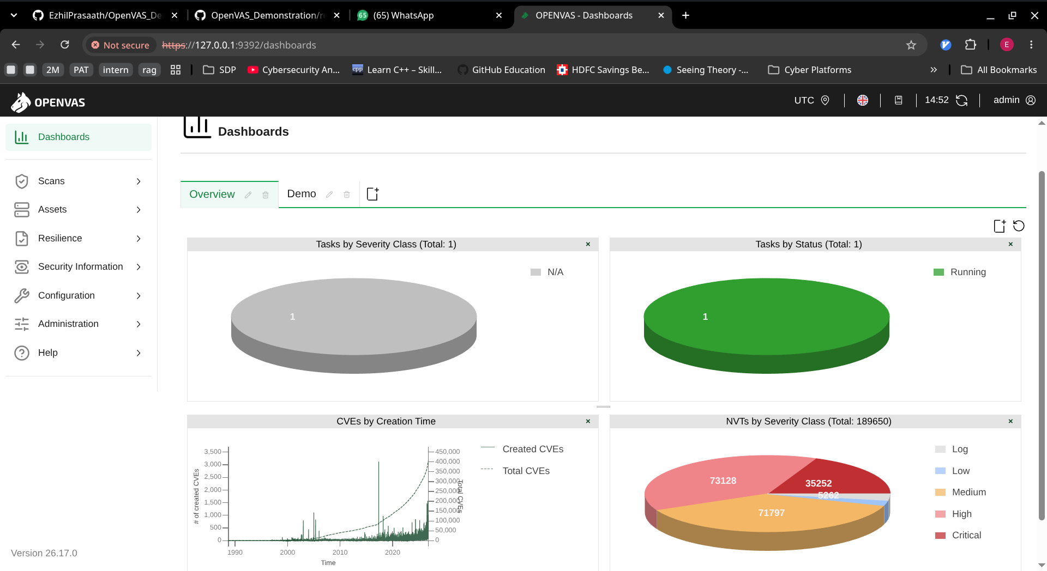

Slide 16
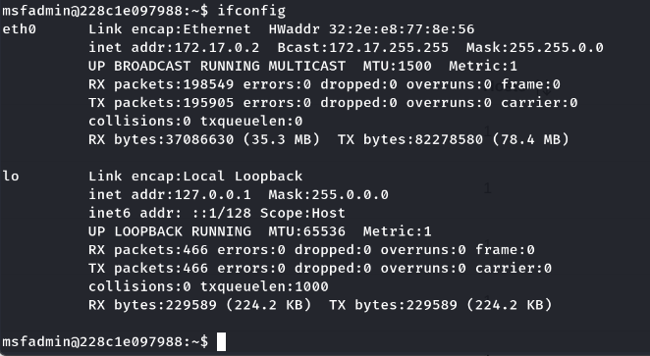
Github Link : https://github.com/EzhilPrasaath/OpenVAS_Demonstration

Slide 17
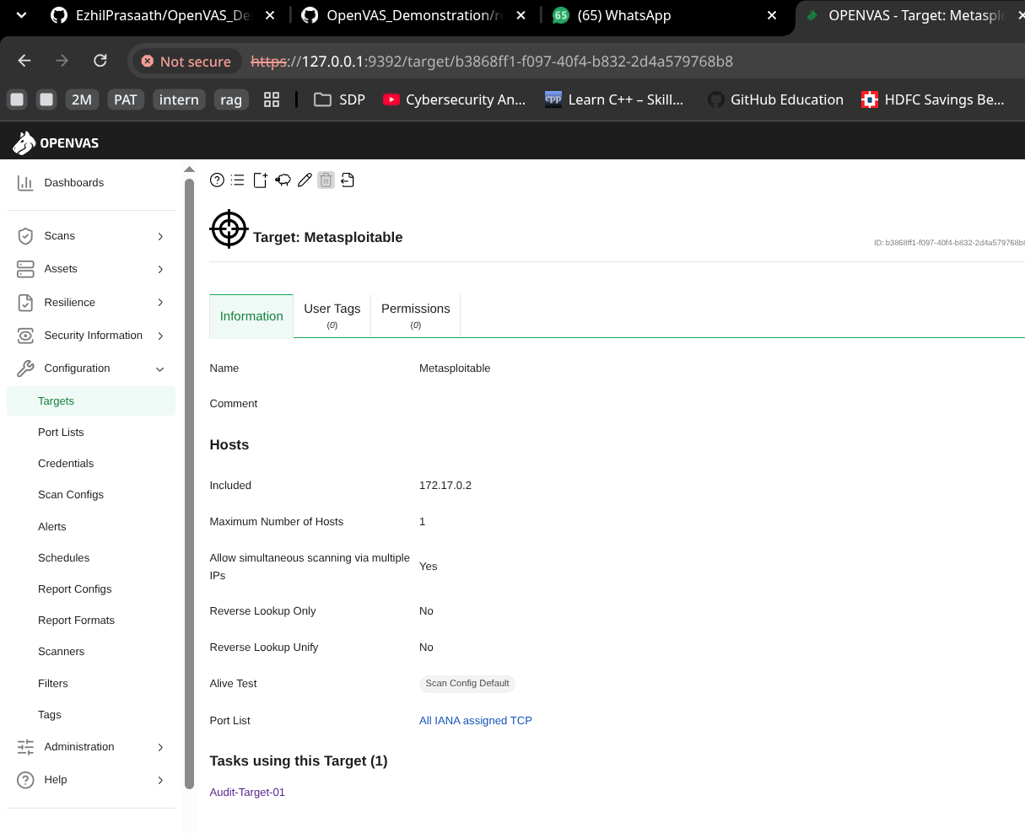

Slide 18
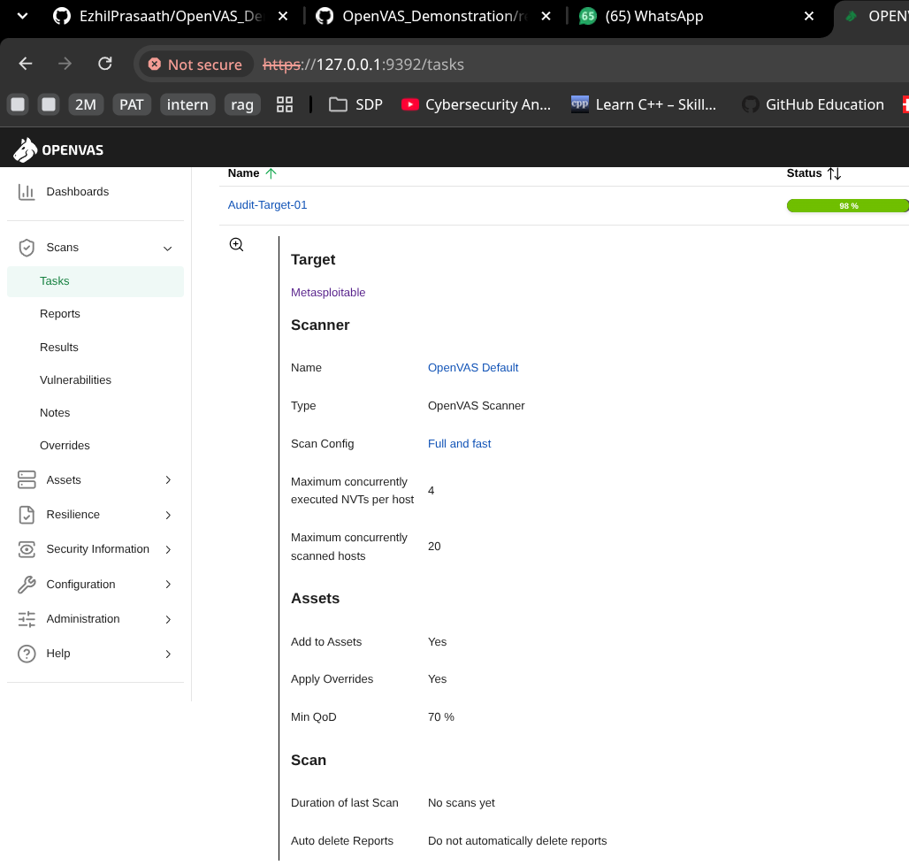

Slide 19
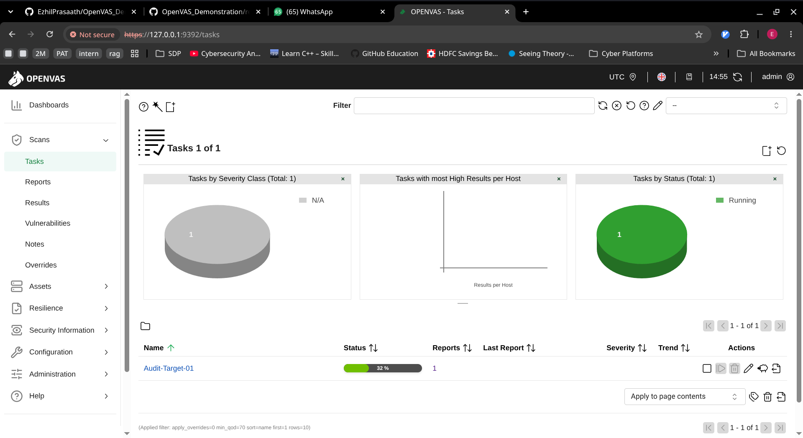

Slide 20
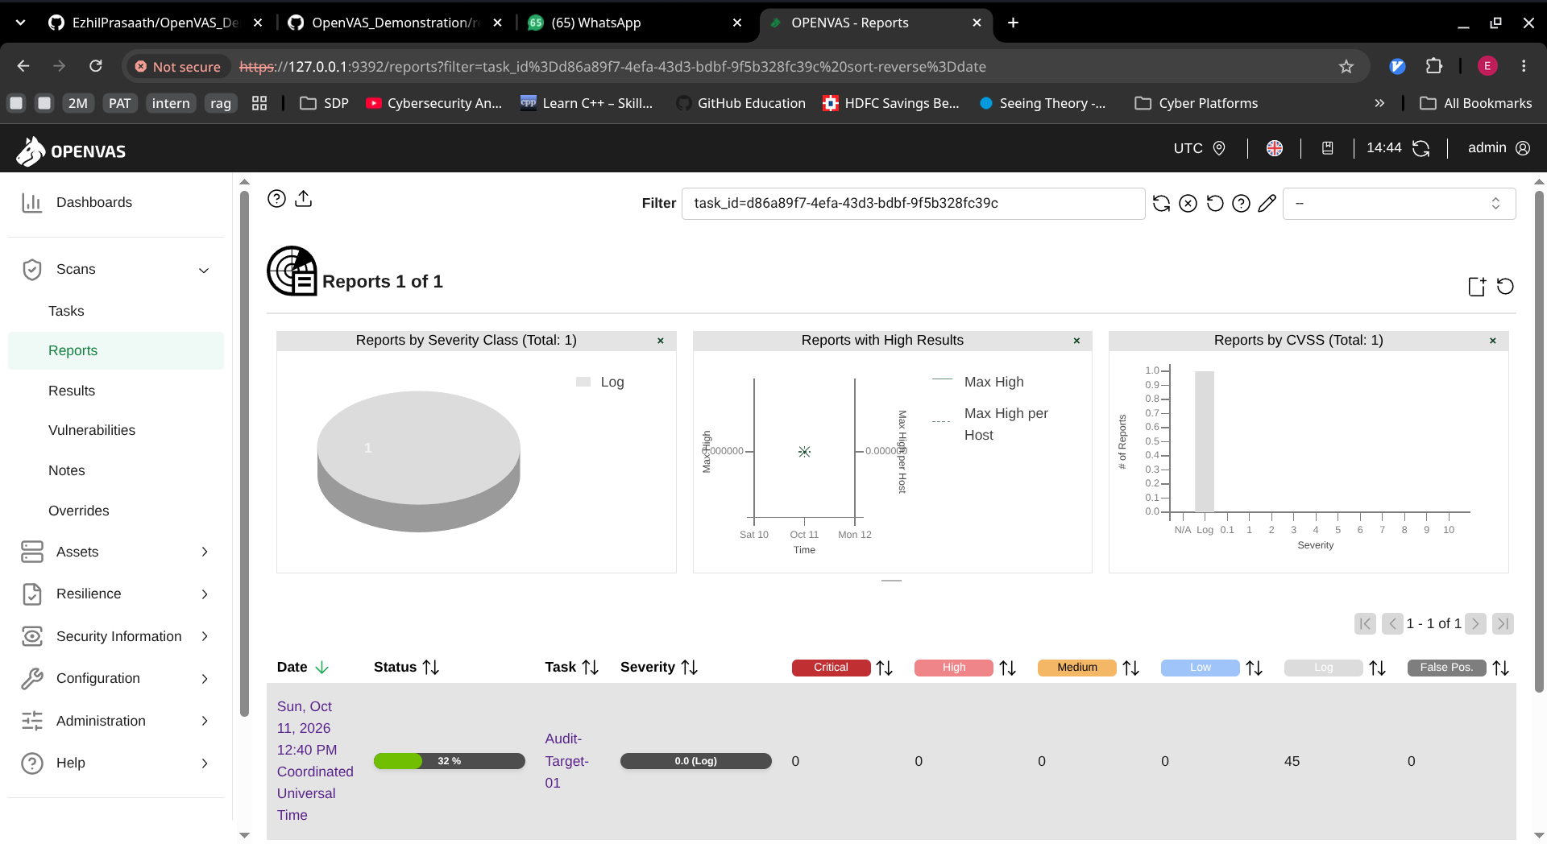

Slide 21
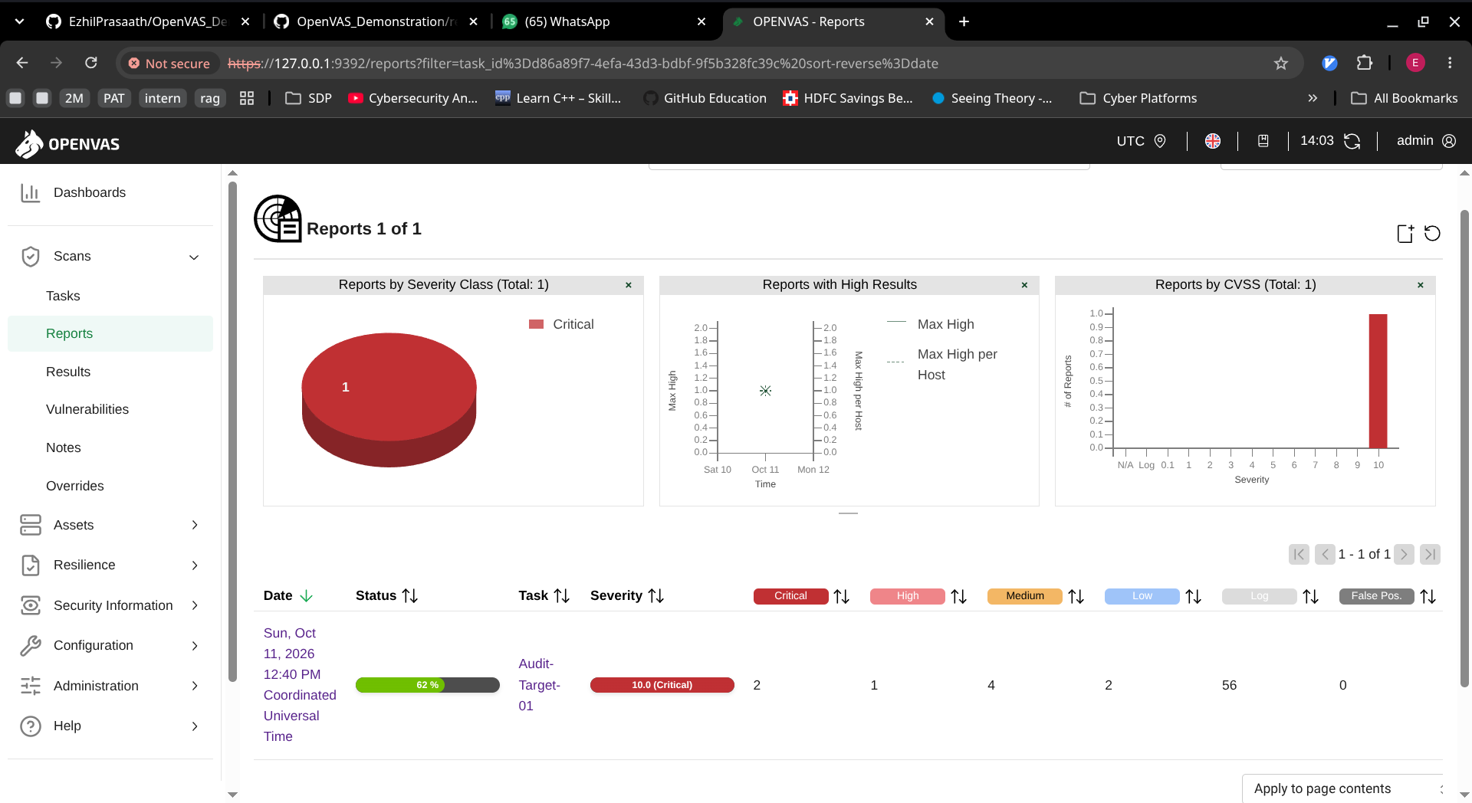

Slide 22
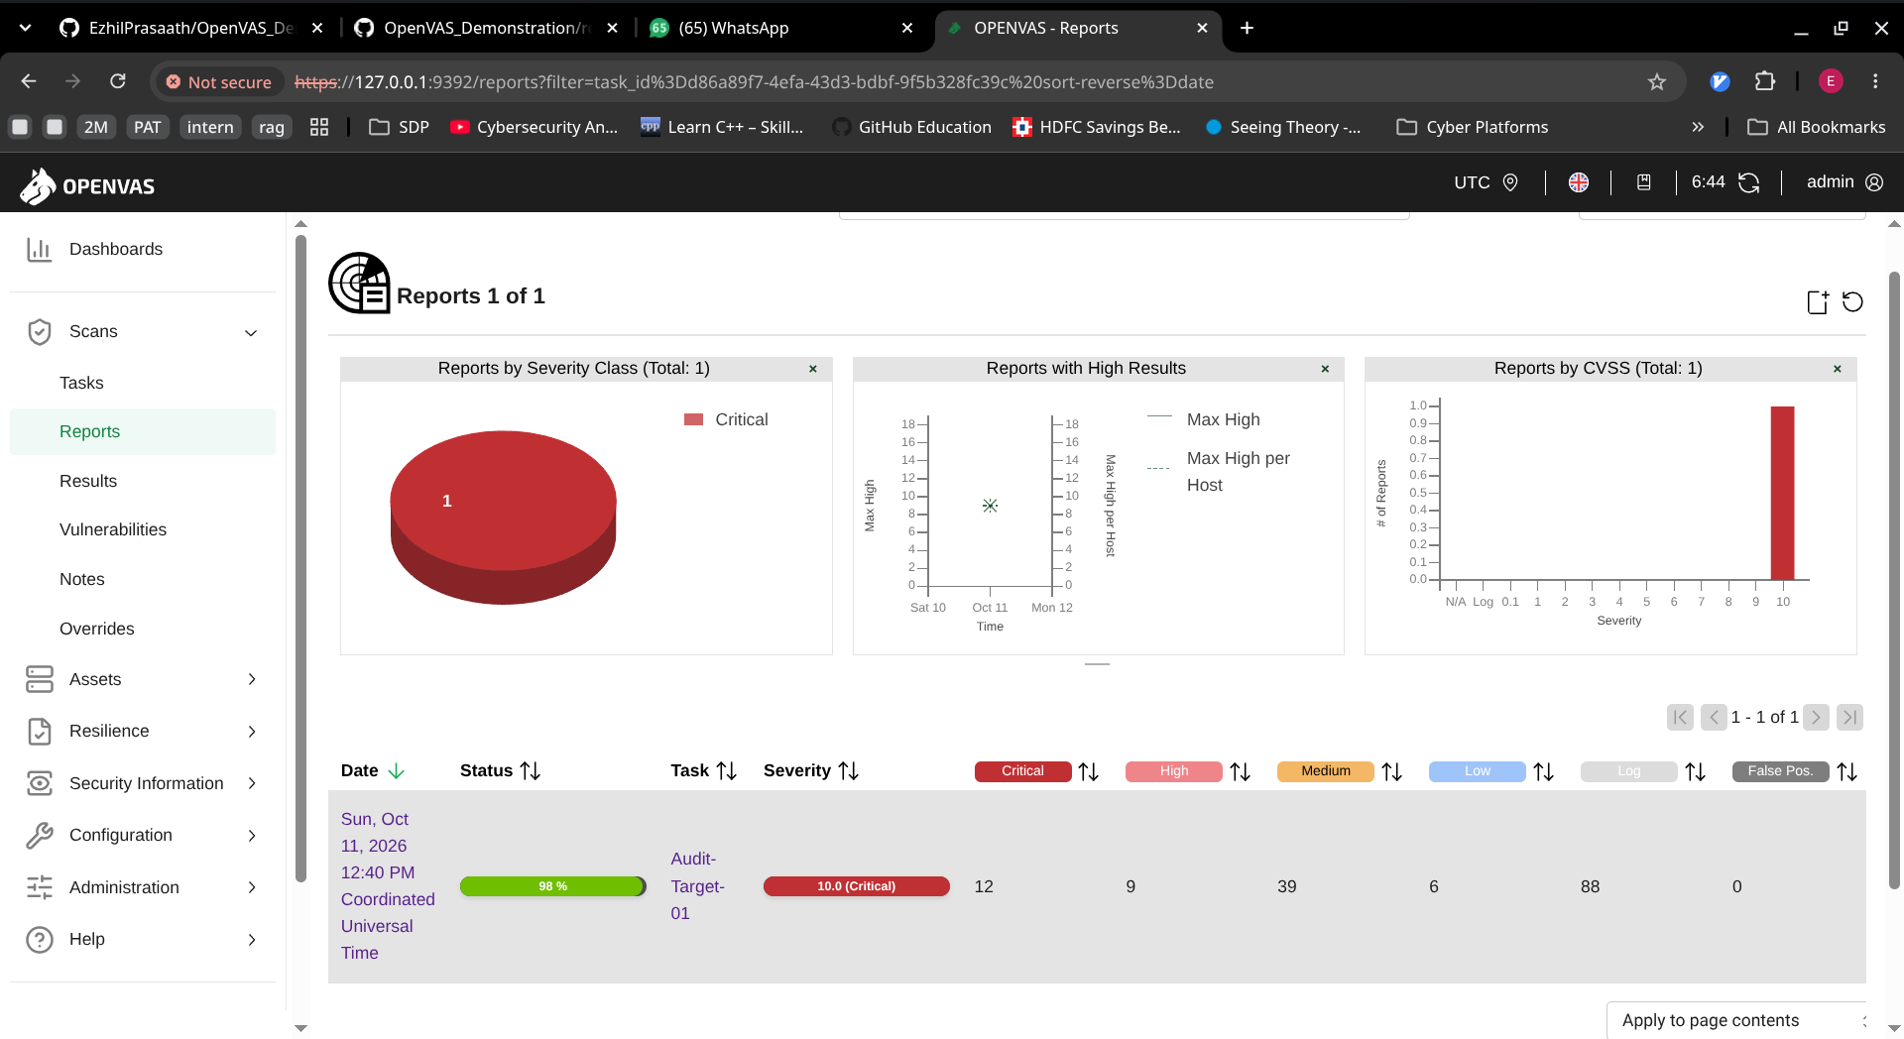

Slide 23
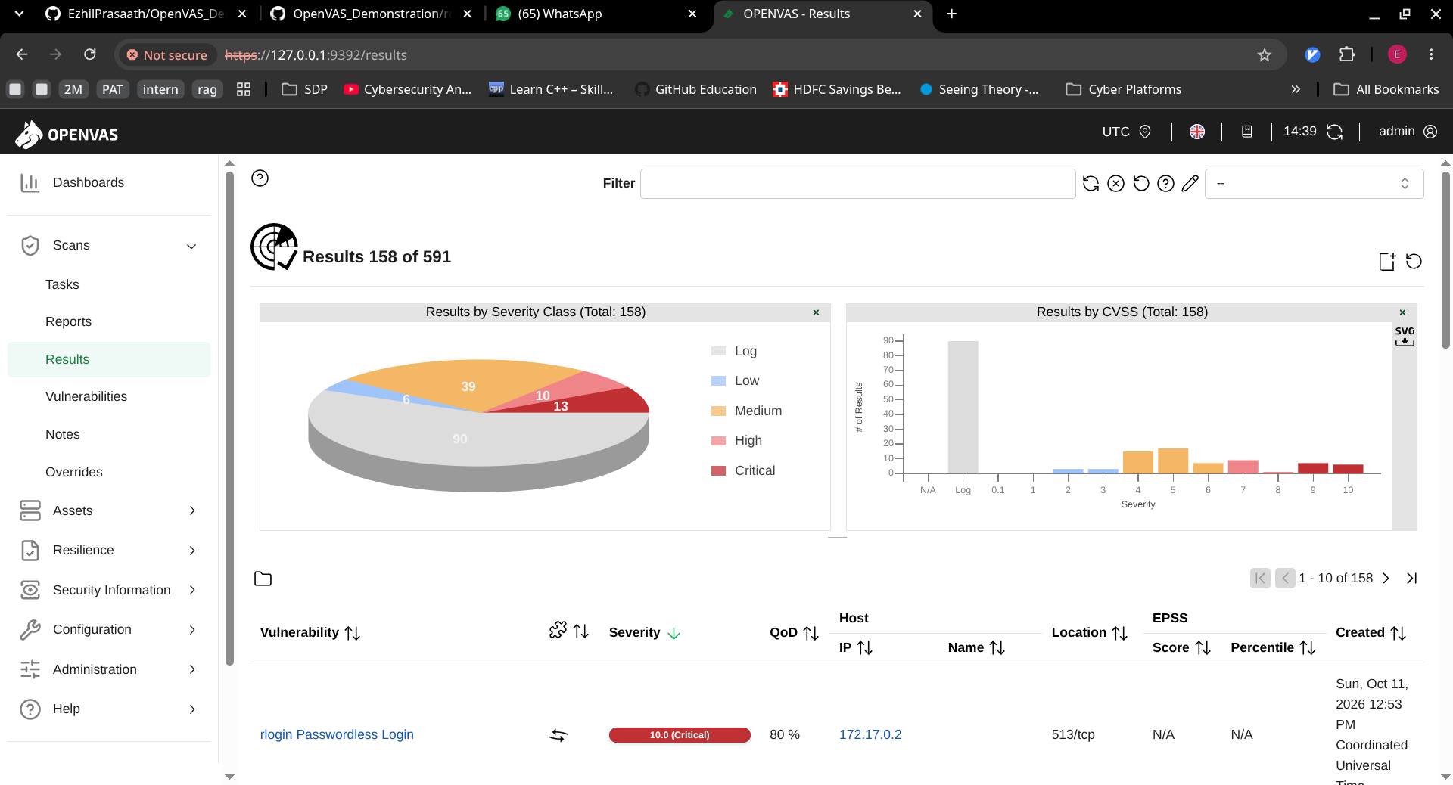

Slide 24
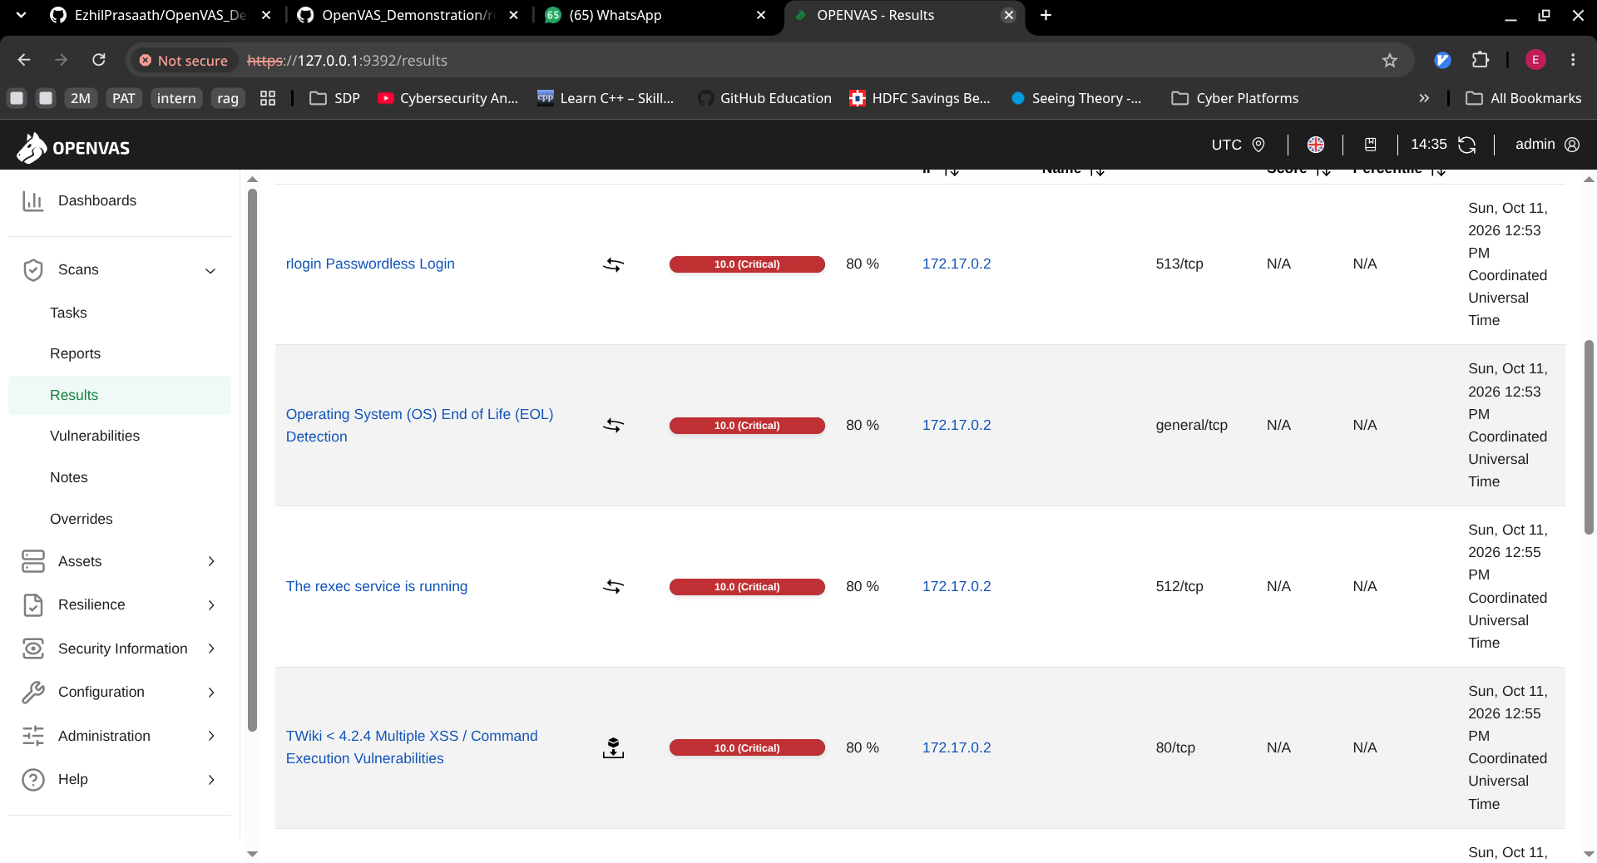

Slide 25
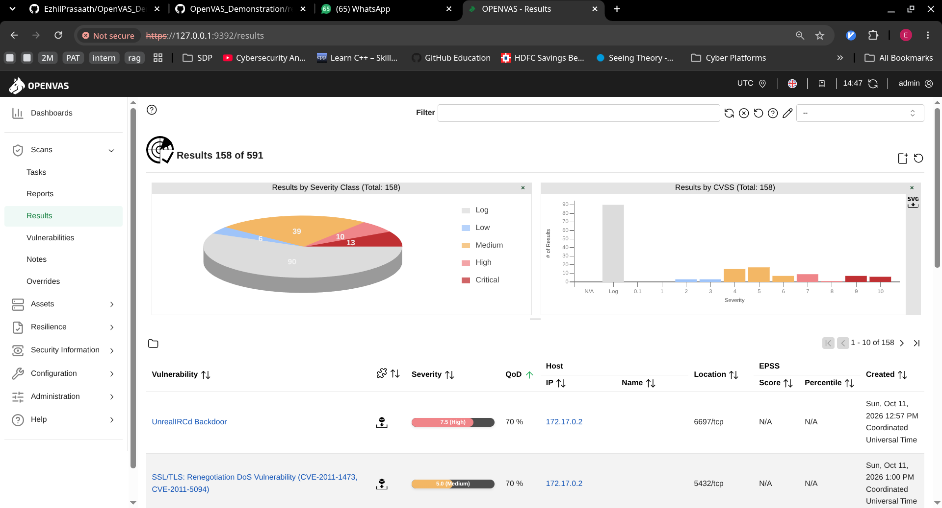

Slide 26
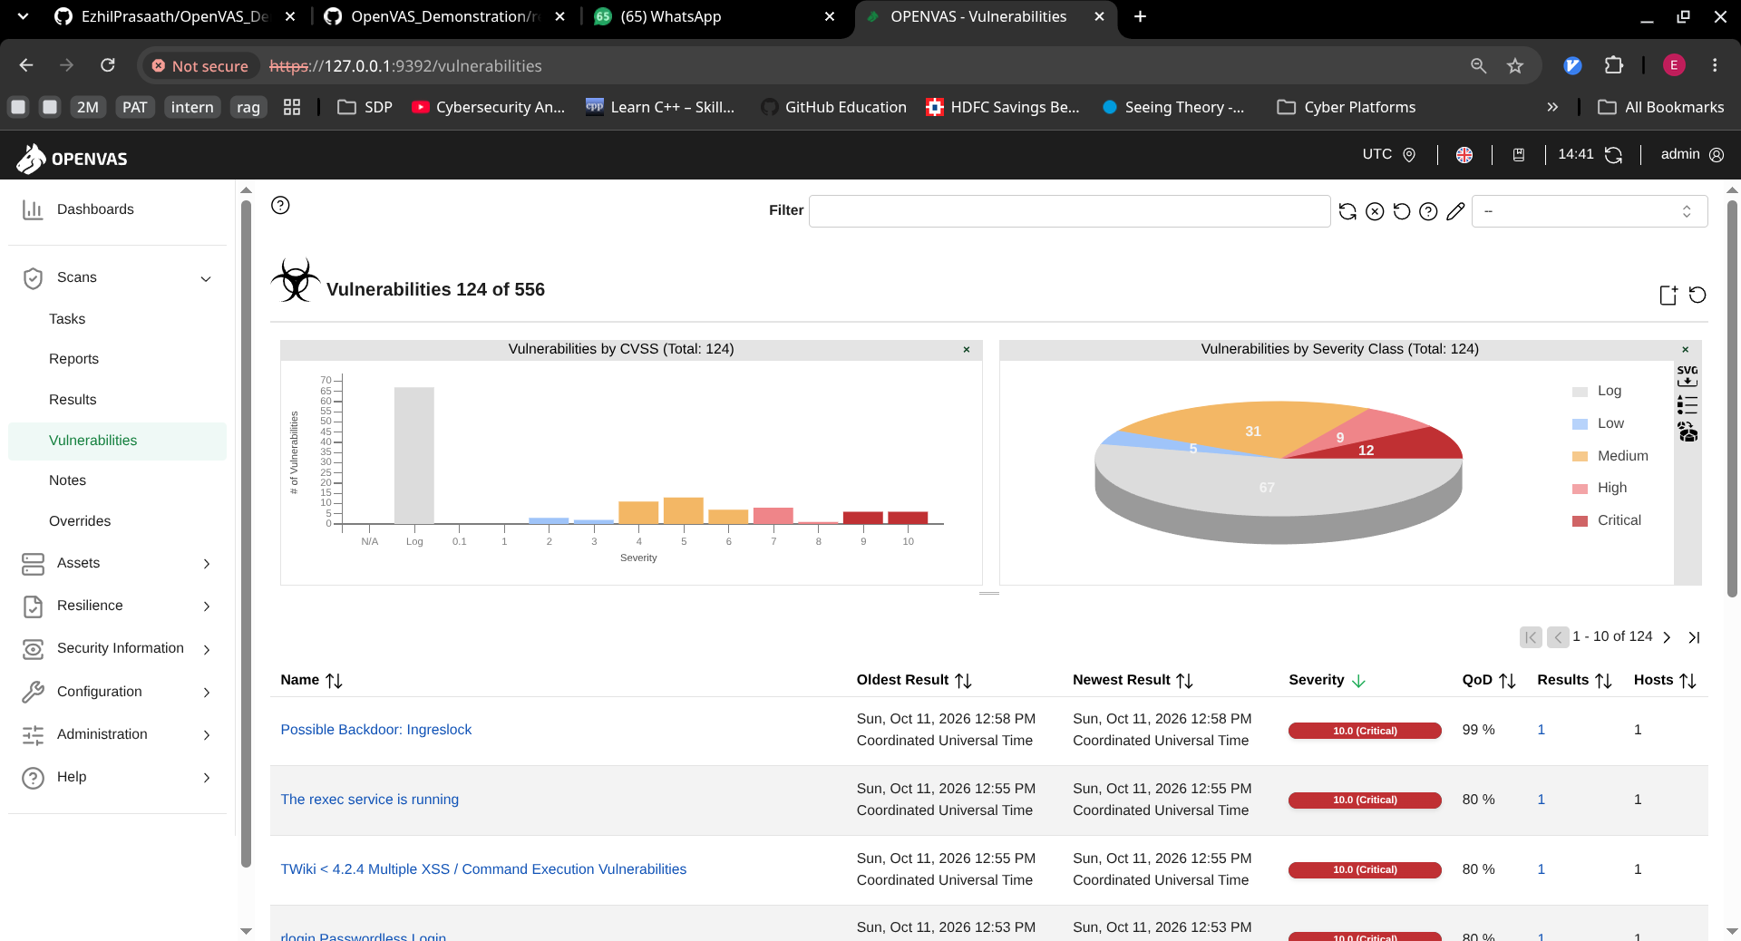

Slide 27
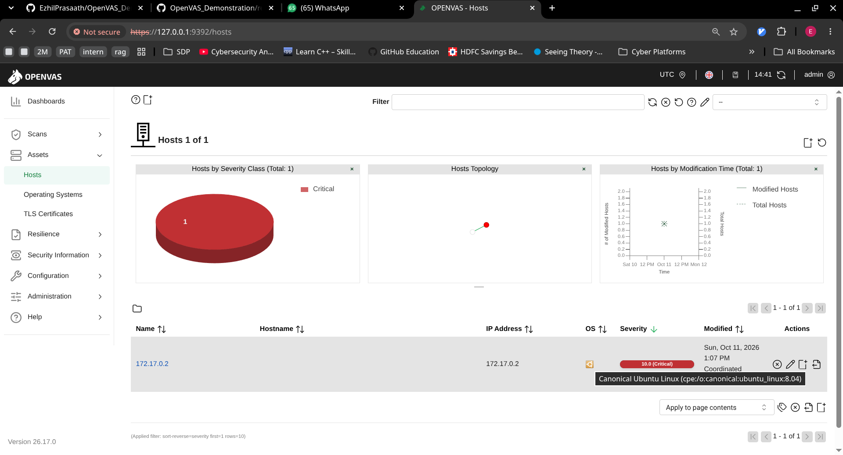

Slide 28
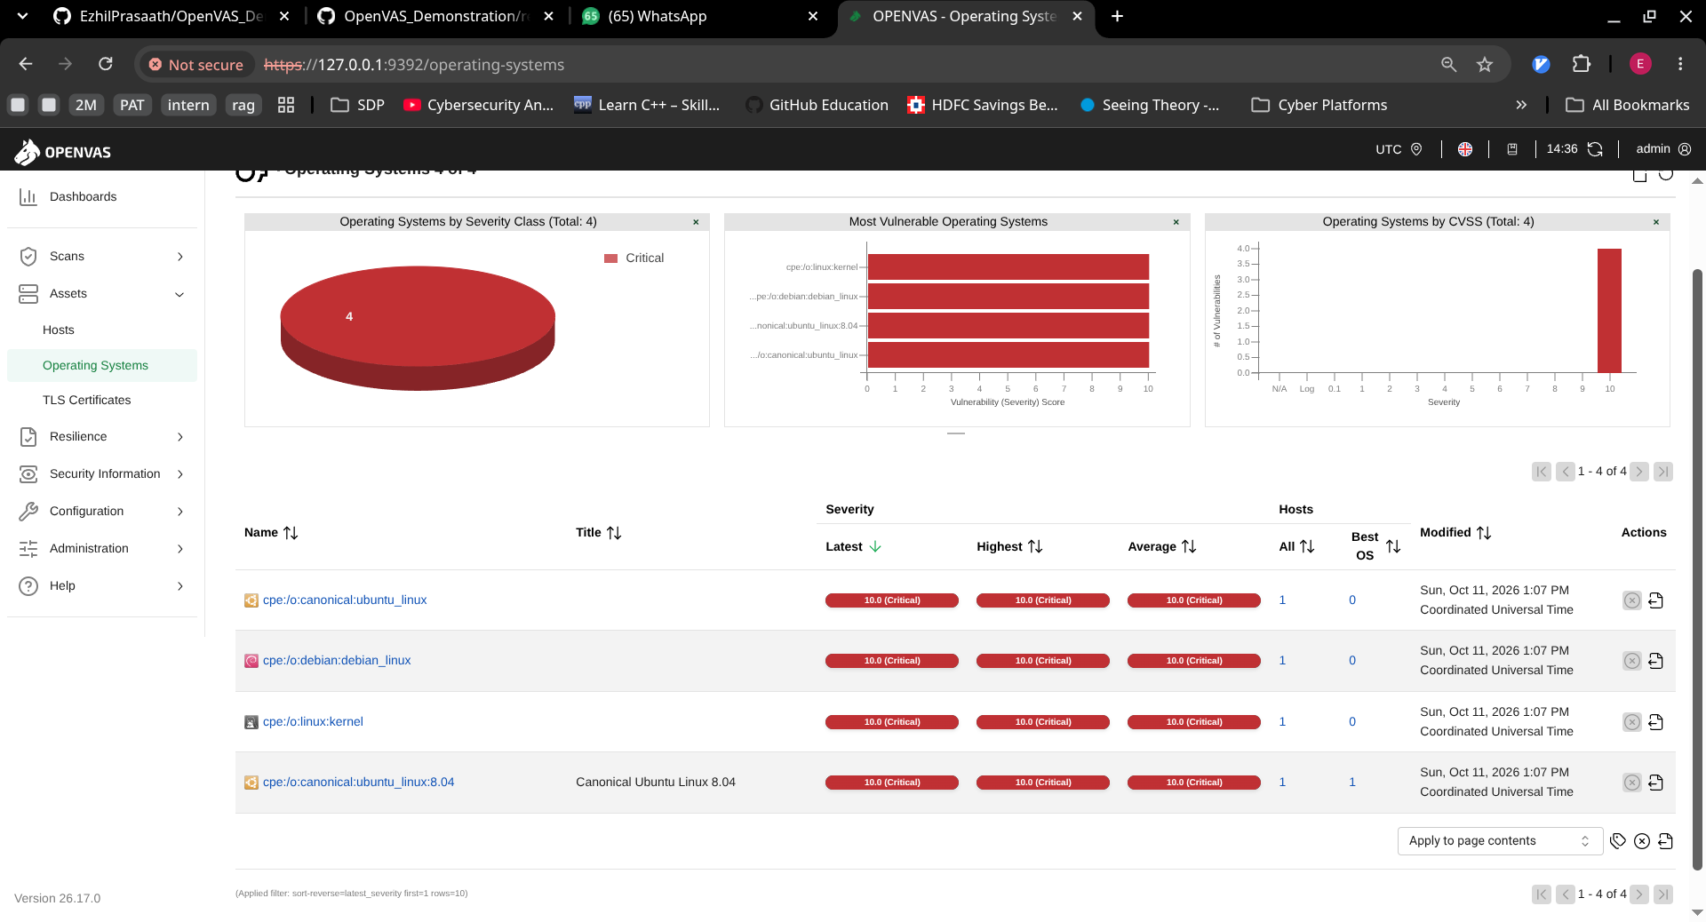

Slide 29
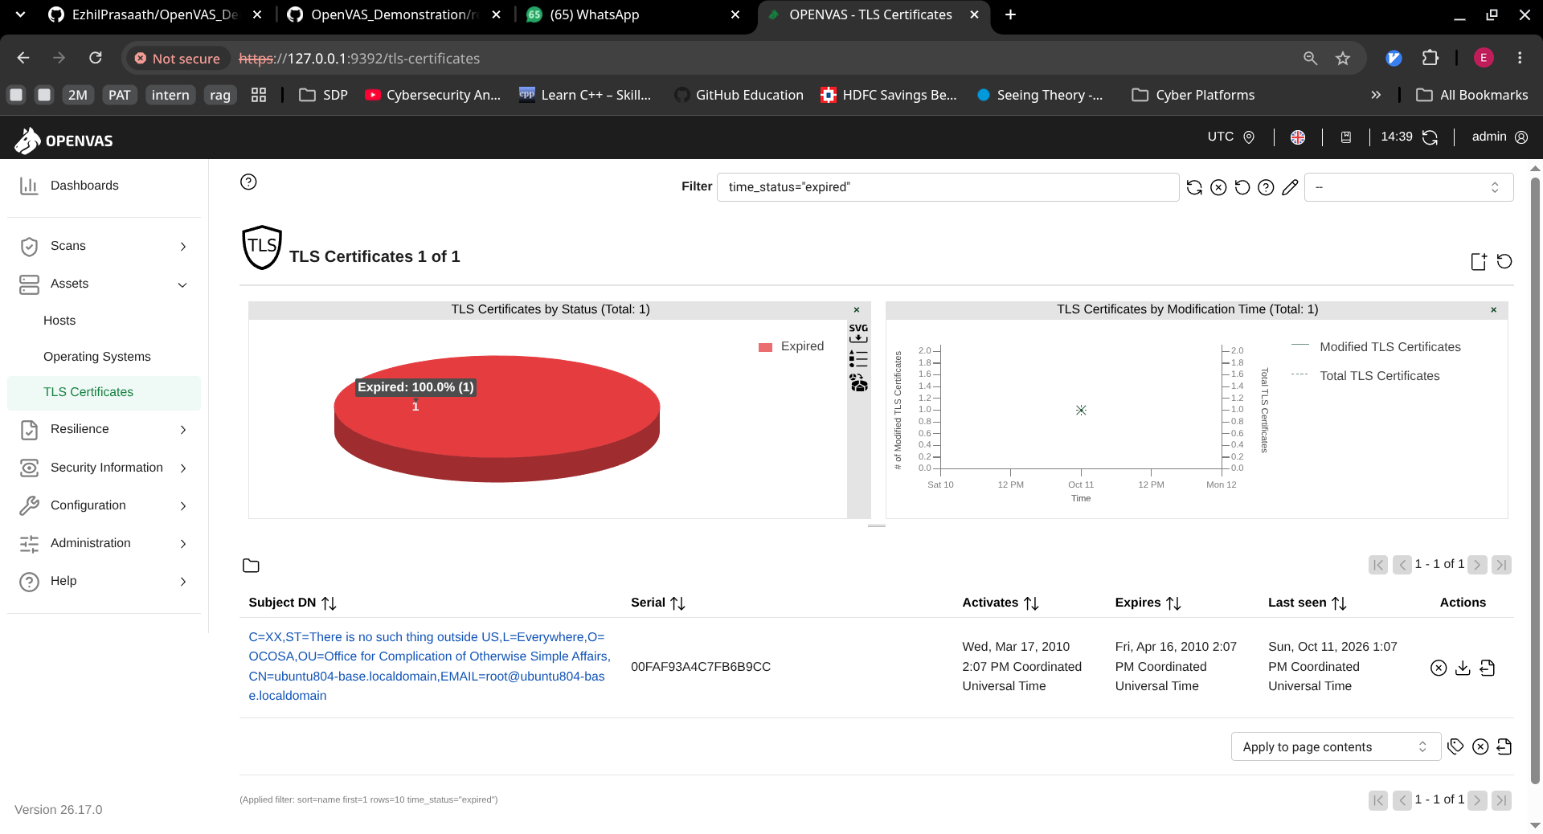

Slide 30
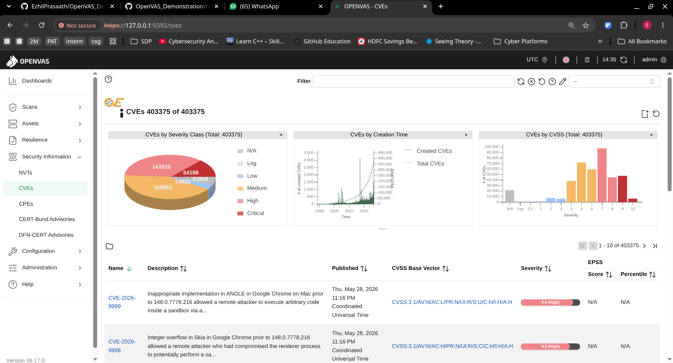

Slide 31
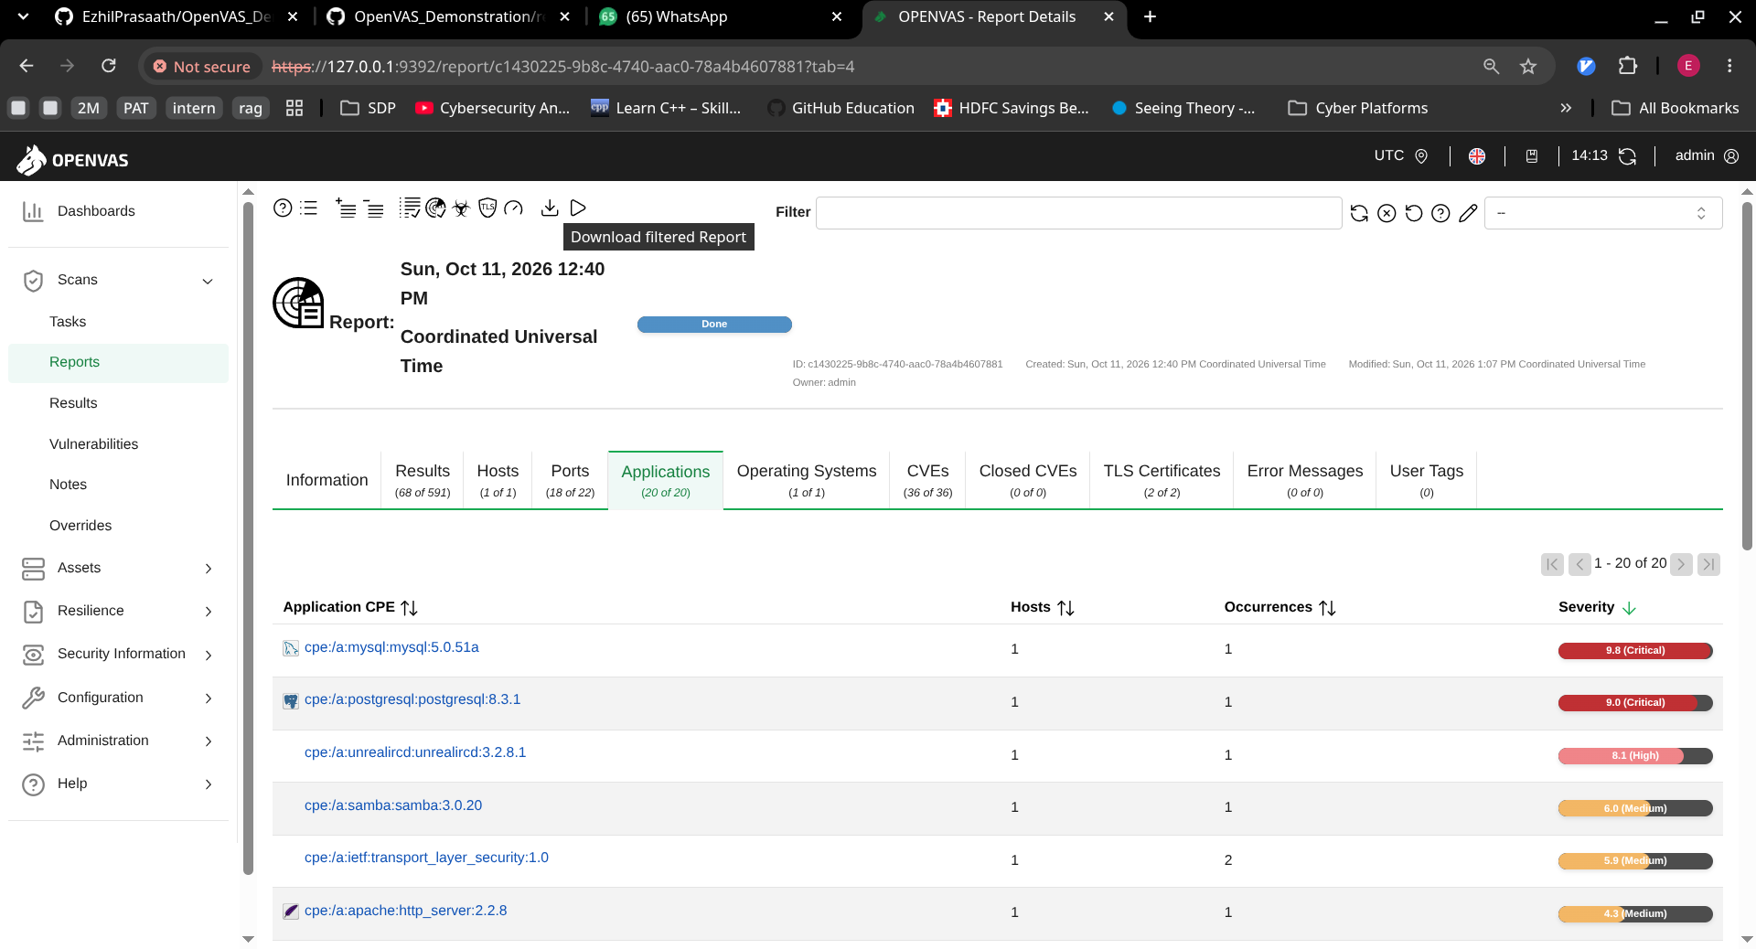

Slide 32
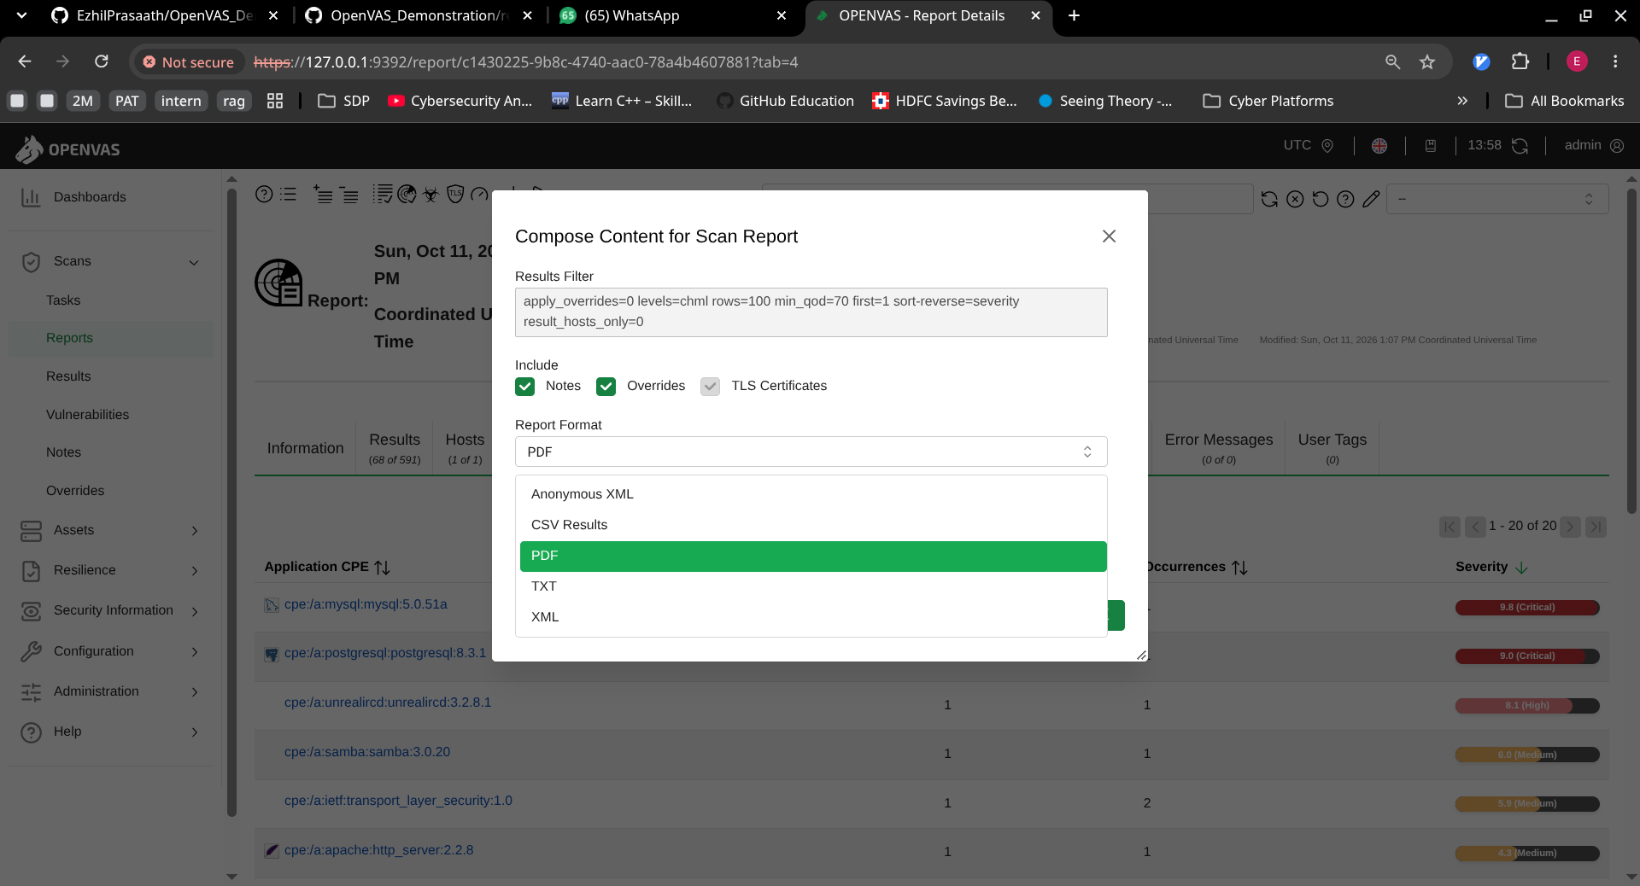

Slide 33
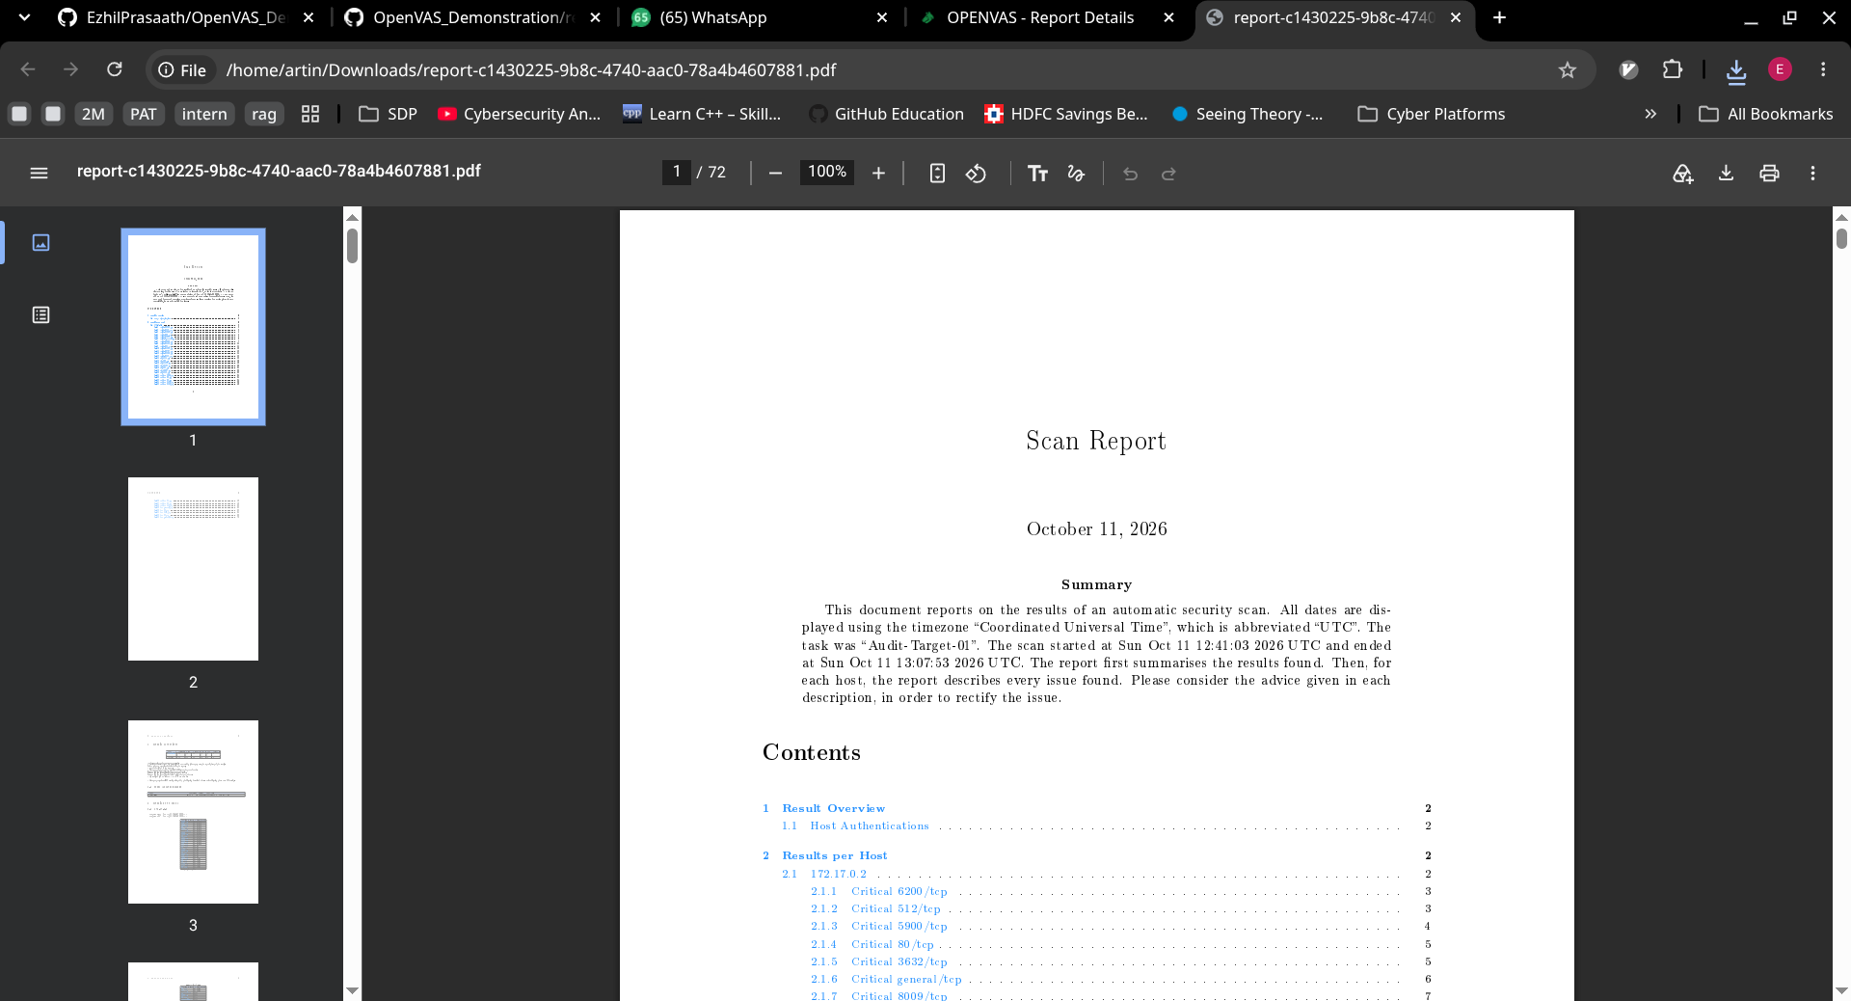

Slide 34
Key Takeaways
01
OpenVAS scans; GVM manages
02
Feed freshness = detection quality
03
CVSS + QoD drive triage
04
Scan, validate, fix, rescan
15

Slide 35
Questions?
Thank you

