Slide 1
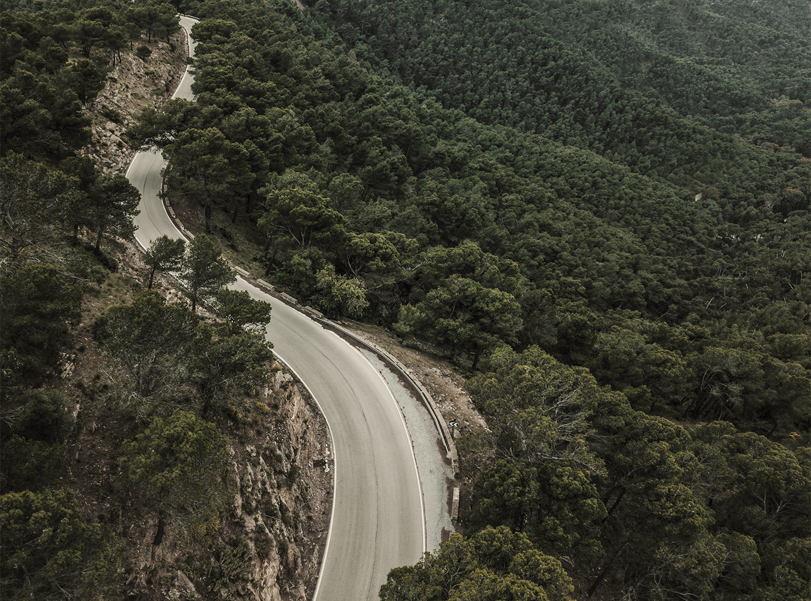
TIGER IN THE ZOO
Here is where your presentation begins

Slide 2
ABOUT THE POET
01
ABOUT THE TIGER
02
TABLE OF CONTENTS
FIRST STANZA
03
SECOND STANZA
04
THIRD STANZA
05
Here you could describe the topic of the section
Here you could describe the topic of the section
Here you could describe the topic of the section
Here you could describe the topic of the section
Here you could describe the topic of the section

Slide 3
05
FOURTH STANZA
04
TABLE OF CONTENTS
FIRST STANZA
FIFTH
05
THIRD STANZA
SECOND STANZA
Here you could describe the topic of the section
Here you could describe the topic of the section
Here you could describe the topic of the section
Here you could describe the topic of the section
Here you could describe the topic of the section

Slide 4
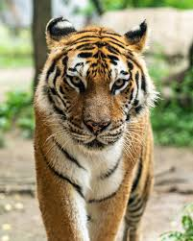
ABOUT THE POEM
Early Life and Career: Born in Merthyr Tydfil, Wales, Norris initially worked as a teacher and headmaster and served in the Royal
Air Force during World War II. He began writing full-time in 1974.
Teaching and Residencies: Norris taught at various institutions in Britain and the United States, including the University of Washington and Brigham Young University (BYU), where he was a Humanities professor and Poet-in-Residence.
Writing Style and Themes: Known for his lyrical style and vivid imagery, Norris's work often explored themes of his Welsh heritage, childhood, nature, and the human experience, including the contrast between freedom and captivity.
Awards and Recognition: Considered a significant Welsh writer, he received numerous awards, such as the Cholmondeley Poetry Prize and the Katherine Mansfield Memorial Award, and was a Fellow of the Royal Society of Literature and the Welsh
Academy.
Later Life and Legacy: Norris settled in Provo, Utah, and remained there until his death in 2006. His prolific writing, including poetry and short stories, left a lasting legacy, and he was admired by his students and colleagues at BYU.

Slide 5
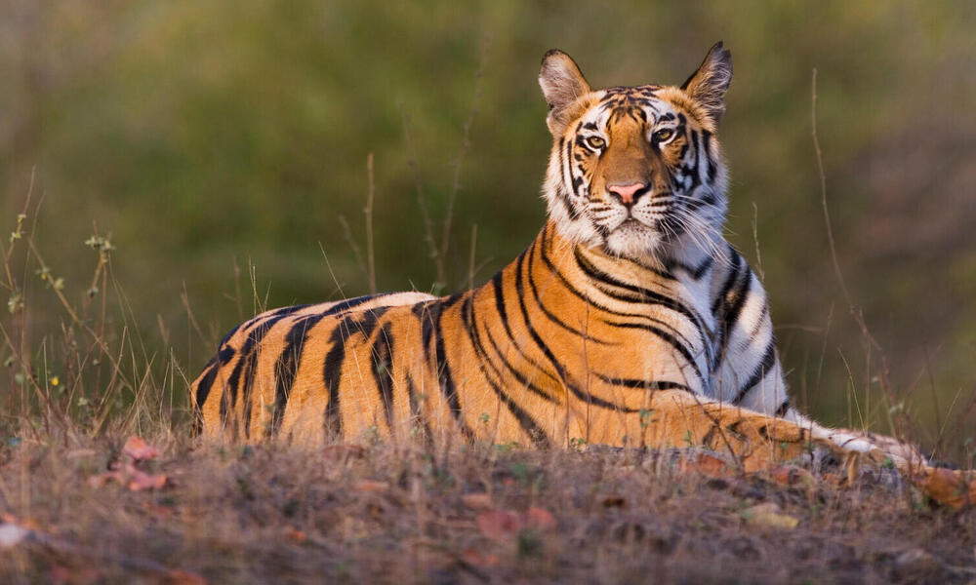
ABOUT THE TIGER IS
GAS PIPELINES
TUNNEL WORKS
WATER TREATMENT PLANTS
Yes, Saturn is the ringed one. This planet is a gas giant, and it’s composed mostly of hydrogen and helium
Jupiter is a gas giant and the biggest planet in our Solar System. It’s the fourth-brightest object in the sky
Despite being red, Mars is a cold place, not hot. It’s full of iron oxide dust, which gives the planet its reddish cast

Slide 6
FIRST STANZA
He stalks in his vivid stripes
The few steps of his cage,
On pads of velvet quiet,
In his quiet rage.

Slide 7
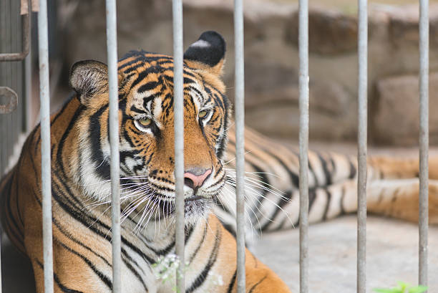
The poet says here that the zoo tiger moves around in his cage under his brightly coloured skin. He goes on to say that the tiger can only take a few steps because the cage is small and difficult to move around in. His footsteps are unheard because he has very soft feet, like velvet, and there is no sound of the tiger's footsteps. The tiger attempts to control his rage by quietly walking around the confines of his cage. He is irritated because he is not free.
—SOMEONE FAMOUS

Slide 8
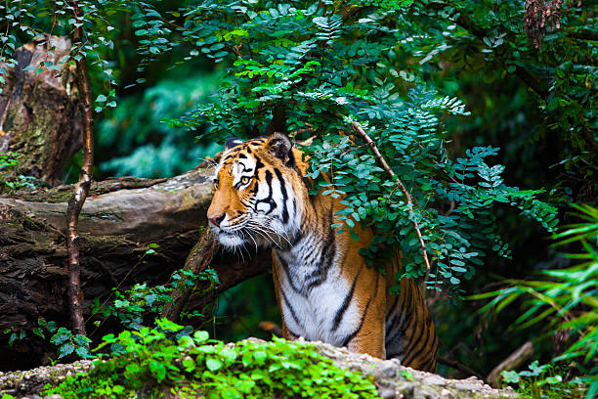
poetic devices in stanza 1

Slide 9
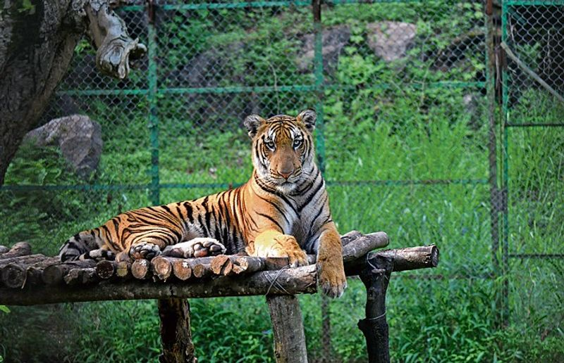
first STANZA
Imagery: "vivid stripes", "pads of velvet quiet" (creates a clear mental picture)
Alliteration: "stalks in his stripes"
Metaphor: "quiet rage" (his anger is compared to quietness)
Personification: Tiger is shown as having emotions like "rage".

Slide 10
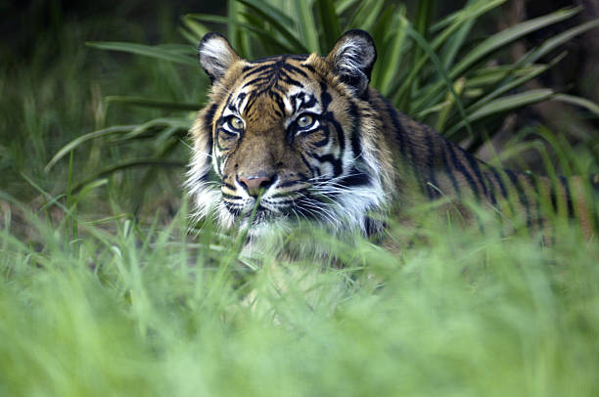
SECOND STANZA
He should be lurking in shadow,
Sliding through long grass
Near the water hole
Where plump deer pass.

Slide 11
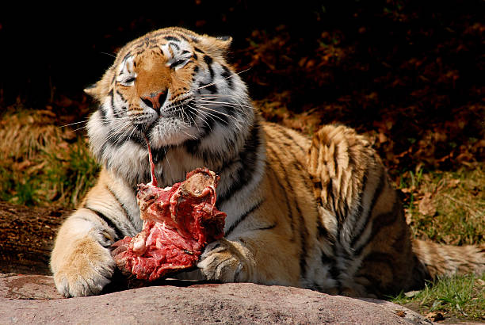
summary
According to the poet, if this tiger was free, he would have hidden behind the long grass near the water bodies so that he could easily catch a deer for food. Essentially, the poet is saying that a tiger's natural life is to live in the jungle where he can catch and eat his prey, whereas the tiger in the cage cannot.

Slide 12
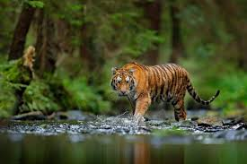
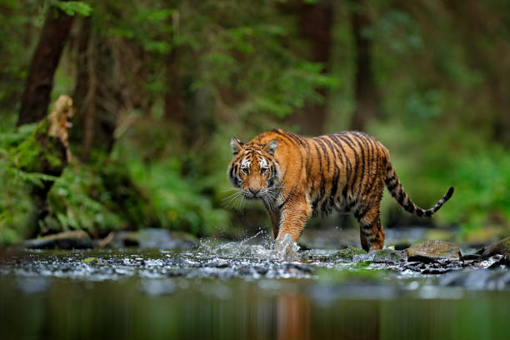
poetic devices in stanza 2

Slide 13
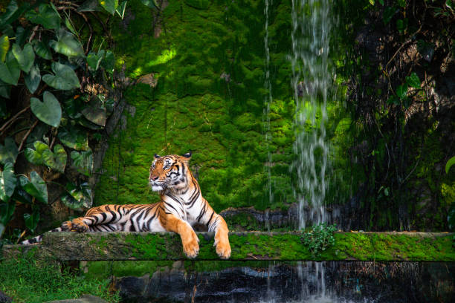
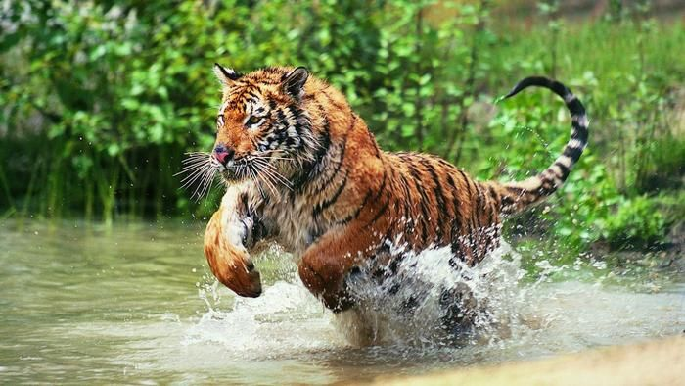
02 STANBZA
Imagery: "vivid stripes", "pads of velvet quiet" (creates a clear mental picture) Alliteration: "stalks in his stripes" Metaphor: "quiet rage" (his anger is compared to quietness) Personification: Tiger is shown as having emotions like "rage".

Slide 14
THIRD STANZA
He should be snarling around houses
At the jungle’s edge,
Baring his white fangs, his claws,
Terrorising the village!

Slide 15
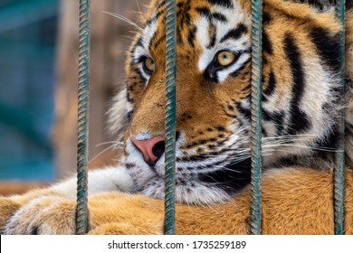
03 STANBZA
According to the poet, if the tiger had been free, he would have snarled around the houses on the outskirts of the forest. With his razor-sharp teeth and claws, he would terrorise people. The people living in the villages would be terrified.

Slide 16
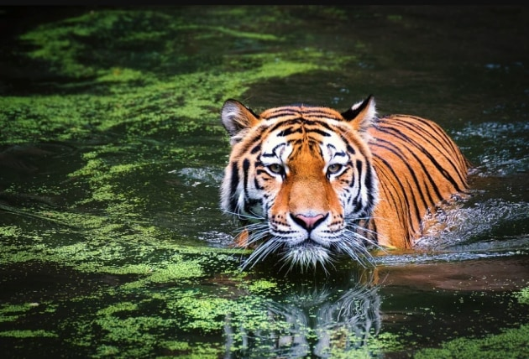
poetic devices in stanza 3

Slide 17
03 STANZA
Imagery: "baring his white fangs", "terrorising the village" Alliteration: "his white" (h-sound), "fangs, his claws" Personification: Tiger "terrorising" humans gives him human-like intent. Enjambment: Sentences continue across lines.

Slide 18
Fourth STANZA
But he’s locked in a concrete cell,
His strength behind bars,
Stalking the length of his cage,
Ignoring visitors.

Slide 19
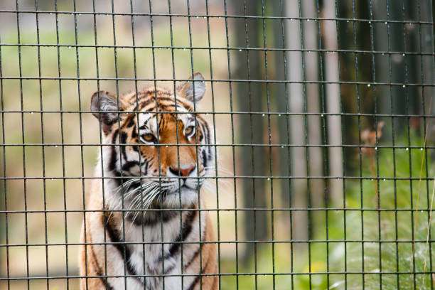
04 STANBZA
The poet has arrived at the reality of the tiger inside the cage. He claims that the tiger is imprisoned in a strong cell made of strong building material. He goes on to say that because the tiger is imprisoned, his ferocity is also imprisoned. He just stalks around in the cage. Because his power is limited by the cage, he never tries to terrorise the visitors. As a result, he never attempts to terrorise the visitors because he cannot attack them.

Slide 20
poetic devices in stanza 4

Slide 21
04 STANZA
Metaphor: "His strength behind bars" – strength symbolizes lost freedom. Imagery: "concrete cell" and "stalking the length of his cage" Alliteration: "behind bars" (b-sound) Contrast: His present reality vs his natural habitat.

Slide 22
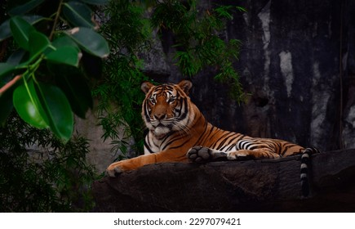
fifth STANZA
He hears the last voice at night,
The patrolling cars,
And stares with his brilliant eyes
At the brilliant stars.

Slide 23
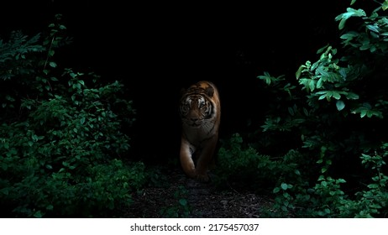
05 STANBZA
According to the poet, the tiger hears the patrolling cars in the middle of the night. Patrolling cars are police vehicles that are used to patrol at night. As a result, the tiger hears the sounds of these cars at night. He then looks up at the stars with his shining eyes. The poet wishes to express that the tiger is sad and helpless because he is confined in the cage. As a result, he stares at the stars in the night, attempting to divert his thoughts to them.

Slide 24
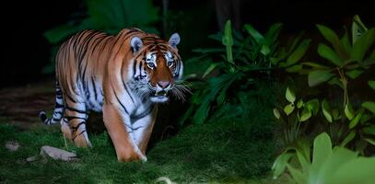
poetic devices in stanza 5

Slide 25
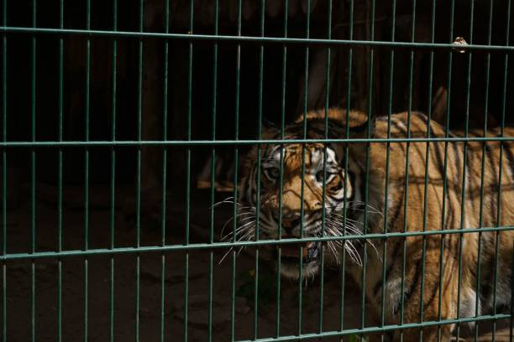
05 STANZA
Repetition: "brilliant eyes" / "brilliant stars" (emphasizes the tiger’s lost freedom) Imagery: "stares with his brilliant eyes" Alliteration: "brilliant... brilliant" Symbolism: Stars symbolize freedom that is far away and unattainable. Enjambment: Sentences run across lines.

Slide 26
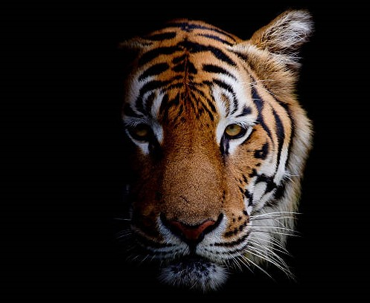
THANKS

