Slide 1
Critically Evaluating Artificial Intelligence as an Emerging Technology
Critically evaluate AI and discuss how enterprises can balance innovation with security and ethical considerations.
Covers: human research | technical overview | enterprise use | ethics | security | regulation | Generative AI response | critical comparison
July 2026

Slide 2
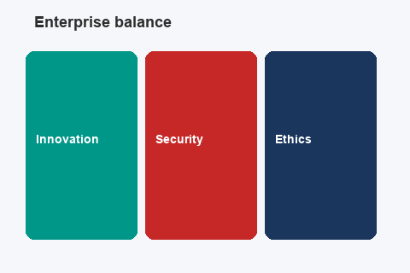
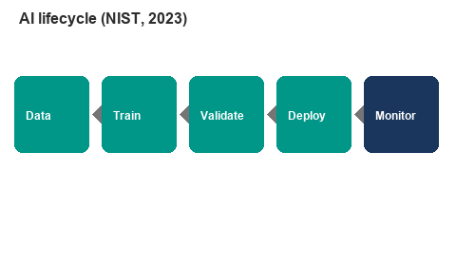
Research-Based Response
Evaluation: AI is high-value but not neutral, it amplifies bias, opacity and attack surface at scale (Jobin, Ienca and Vayena, 2019).
Enterprises must balance three pillars: technical controls (secure MLOps, testing), regulation (AI Act, GDPR, NIST), and ethical culture (oversight, auditing) (NIST, 2023).
Method: peer-reviewed papers, EU/UK law, and industry reports each source verified independently.
Connection to Part A: minor data-quality flaws in scripts mirror production CRM/HR pipelines (O'Regan, 2024 equivalent logic in name deduplication).
Argument: innovation without governance creates legal and reputational debt, not competitive advantage (Floridi et al., 2018).
AI adoption is mainstream in development tooling (Stack Overflow, 2024) professional duty to evaluate risks follows.
Technical Overview of Artificial Intelligence
AI umbrella: machine learning finds patterns; deep learning uses neural networks; generative AI (LLMs) predicts text (Russell and Norvig, 2021).
Enterprise lifecycle: collect data → train → validate → deploy → monitor ongoing loop, not one project (NIST, 2023).
Generative AI does not understand meaning; fluent output can mislead users (Bender et al., 2021 'Stochastic Parrots').
Deployment: cloud APIs (Azure OpenAI, Bedrock), custom models, embedded analytics in CRM/ERP systems.
Technical benefit: speed and scale of prediction and automation across millions of records.
Technical risk: errors, adversarial inputs, and model drift propagate as fast as automation (NIST, 2023).

Slide 3
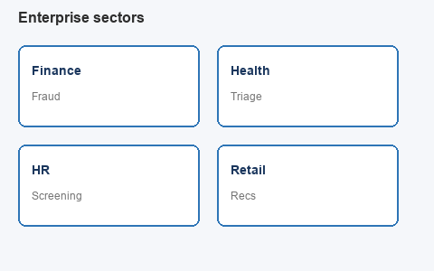
Real-World Enterprise Applications
Finance: ML for fraud detection and anti-money-laundering; AI pipelines hold sensitive transaction data (IBM, 2024).
Healthcare: AI-assisted triage and documentation requires clinical validation before patient-facing use.
HR: automated CV screening and LLM chatbots; Amazon recruiting tool scrapped after gender bias (Dastin, 2018).
Retail: recommendation engines and demand forecasting; data quality directly affects revenue (Grus, 2019).
McKinsey (2024): generative AI economic potential is large, but governance often lags deployment.
Lesson from Amazon case: optimising historical data can encode discrimination technical success ≠ ethical acceptability (Dastin, 2018).

Slide 4

Ethical Concerns
Bias and fairness: Buolamwini and Gebru (2018) Gender Shades study found higher facial recognition error rates for darker-skinned women; disparate impact in access systems.
Opacity and accountability: Mittelstadt et al. (2016) 'black box' decisions undermine due process when algorithms affect rights.
Human dignity: Floridi et al. (2018) AI must support human agency; full automation in dismissal, credit, or care decisions raises ethical red flags.
Social harm and data ethics: Noble (2018) search/classification systems can reinforce inequality; Bender et al. (2021) consent, labour, environmental costs of training.
Professional codes: ACM (2018) 'avoid harm'; BCS (2022) privacy and dignity; code reviews must ask who is harmed if the system fails.
Practical response: algorithmic auditing before and after deployment (Raji et al., 2020).

Slide 5
Security Concerns
Data breaches: IBM (2024) reports global average breach cost of $4.88M; AI centralises training and inference data higher impact if compromised.
Adversarial attacks: crafted inputs fool classifiers; data poisoning corrupts models during training (NIST, 2023).
Generative AI threats: OWASP (2024) LLM Top 10 includes prompt injection, insecure output handling, and model denial-of-service.
Supply-chain risk: third-party APIs (OpenAI, etc.) limited visibility into training data and updates.
Social engineering: deepfakes and voice clones used in CEO fraud and phishing at scale.
Enterprise response: MLOps security, adversarial red-teaming, access controls, incident plans for model drift not generic IT security alone (NIST, 2023).
Balancing innovation: secure-by-design AI reduces cost of breach vs retrofitting controls after deployment (IBM, 2024).

Slide 6
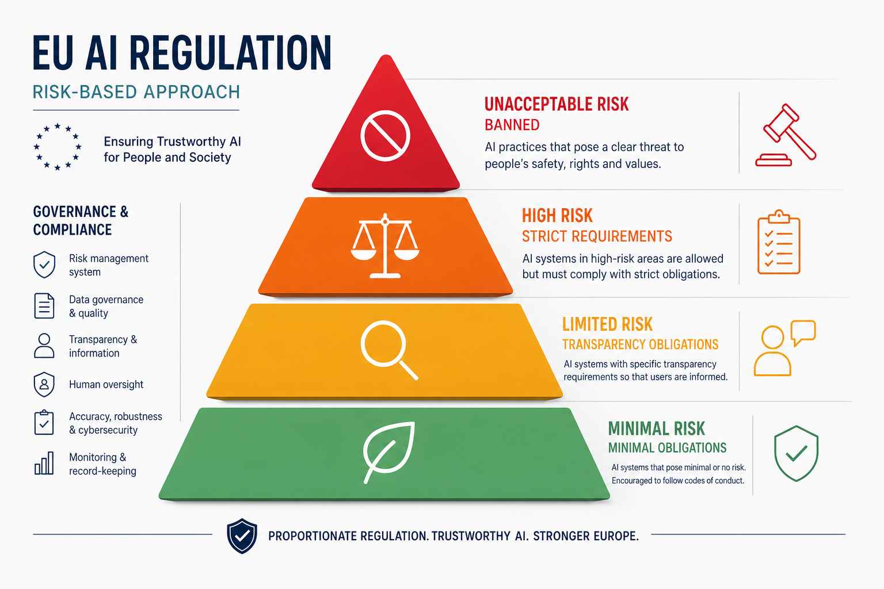
Regulatory and Governance Frameworks
EU AI Act (European Parliament, 2024): risk-based bans unacceptable uses; strict rules for high-risk AI (employment, credit, critical infra).
GDPR (European Union, 2016): accuracy, lawful basis, security; Article 5(1)(d) accuracy principle for personal data.
ICO (2024): UK AI guidance Data Protection Impact Assessments for high-risk automated processing.
NIST AI RMF (2023): Govern | Map | Measure | Manage widely adopted voluntary framework.
ISO/IEC 42001: certifiable AI management system for organisational governance.
Jobin, Ienca and Vayena (2019): 80+ ethics guidelines agree on principles but lack enforcement internal auditing essential (Raji et al., 2020).
Enterprise balance: comply before scale; governance is enabler of trusted innovation, not blocker.
Conclusion: AI is a transformative emerging technology; enterprises balance innovation with security and ethics via governance, regulation, and culture (NIST, 2023; Floridi et al., 2018).
Unchecked AI deployment amplifies harm; proactive auditing and compliance build trust (Raji et al., 2020).
GenAI useful for drafts never substitute for verified research and professional accountability.

Slide 7
Slide 8: Generative AI Response (Same Brief)
Ethics (AI-generated):
"AI raises important ethical issues. Bias in training data can cause discriminatory outcomes against minority groups. Many AI systems operate as 'black boxes' making it difficult to explain decisions."
Excerpt B — Balancing innovation (AI-generated):
"To balance innovation with responsibility, enterprises should establish AI governance committees, conduct ethical impact assessments before deployment, maintain human oversight for critical decisions."
Excerpt C — Case study (AI-generated):
"A well-known example is Amazon's AI recruiting tool, which was reportedly discontinued after showing bias against women because it was trained on historical hiring data dominated by male candidates (Reuters, 2018)."

Slide 8

Slide 9: Critical Comparison — Human Research vs Generative AI
Accuracy and reliability of sources: Human response uses verified Harvard refs (Bender et al., 2021; European Parliament, 2024). AI cited 'Reuters, 2018' incompletely; some claims lacked traceable evidence.
Depth and nuance: Human analysis covers GDPR + LLM fine-tuning trade-offs, supply-chain risk, sector validation. AI listed risks generically without weighing conflicts (Mittelstadt et al., 2016).
Ethical issues (bias, transparency, hallucinations): AI mentioned bias/black boxes but not its own hallucination risk; confident AI prose misleads readers (Bender et al., 2021).
Professional appropriateness: GenAI acceptable for brainstorming; unacceptable unchecked for graded or client work (BCS, 2022; ACM, 2018).
Reflection supports: fast outline, literature prompts, slide structure. Hinders: skips verification, creates false confidence, weak citations.
Conclusion: human critical evaluation remains mandatory; GenAI is assistant, not author.

Slide 9
References
*ACM (2018) ACM Code of Ethics and Professional Conduct. Available at: https://www.acm.org/code-of-ethics (Accessed: 20 July 2026).
*BCS (2022) BCS Code of Conduct. Available at: https://www.bcs.org/membership-and-registrations/become-a-member/bcs-code-of-conduct/ (Accessed: 20 July 2026).
*Bender, E.M., Gebru, T., McMillan-Major, A. and Shmitchell, S. (2021) 'On the Dangers of Stochastic Parrots', Proceedings of FAccT, pp. 610-623.
*Buolamwini, J. and Gebru, T. (2018) 'Gender Shades', Proceedings of Machine Learning Research, 81, pp. 1-15.
*Dastin, J. (2018) 'Amazon scraps secret AI recruiting tool', Reuters, 10 October. Available at: https://www.reuters.com/article/us-amazon-com-jobs-automation-insight-idUSKCN1MK08G (Accessed: 20 July 2026).
*European Parliament (2024) Regulation (EU) 2024/1689 (Artificial Intelligence Act). Available at: https://eur-lex.europa.eu/legal-content/EN/TXT/?uri=CELEX:32024R1689 (Accessed: 20 July 2026).
*European Union (2016) General Data Protection Regulation, Regulation (EU) 2016/679. Available at: https://eur-lex.europa.eu/legal-content/EN/TXT/?uri=CELEX:32016R0679 (Accessed: 20 July 2026).
*Floridi, L. et al. (2018) 'AI4People', Minds and Machines, 28(4), pp. 689-707.
*Grus, J. (2019) Data Science from Scratch. 2nd edn. Sebastopol: O'Reilly Media.
*IBM (2024) Cost of a Data Breach Report 2024. Available at: https://www.ibm.com/reports/data-breach (Accessed: 20 July 2026).

Slide 10
*Information Commissioner's Office (2024) Guidance on AI and data protection. Available at: https://ico.org.uk/for-organisations/uk-gdpr-guidance-and-resources/artificial-intelligence/ (Accessed: 20 July 2026).
*Jobin, A., Ienca, M. and Vayena, E. (2019) 'The global landscape of AI ethics guidelines', Nature Machine Intelligence, 1(9), pp. 389-399.
*McKinsey & Company (2024) The state of AI in early 2024. Available at: https://www.mckinsey.com/capabilities/quantumblack/our-insights (Accessed: 20 July 2026).
*Mittelstadt, B.D. et al. (2016) 'The ethics of algorithms', Big Data & Society, 3(2), pp. 1-21.
*NIST (2023) Artificial Intelligence Risk Management Framework (AI RMF 1.0). Gaithersburg: NIST.
*Noble, S.U. (2018) Algorithms of Oppression. New York: NYU Press.
*OWASP (2024) OWASP Top 10 for LLM Applications. Available at: https://owasp.org/www-project-top-10-for-large-language-model-applications/ (Accessed: 20 July 2026).
*Raji, I.D. et al. (2020) 'Closing the AI accountability gap', Proceedings of FAccT, pp. 33-44.
*Russell, S. and Norvig, P. (2021) Artificial Intelligence: A Modern Approach. 4th edn. Harlow: Pearson.
*Stack Overflow (2024) Developer Survey 2024. Available at: https://survey.stackoverflow.co/2024/ (Accessed: 20 July 2026).

