Slide 1
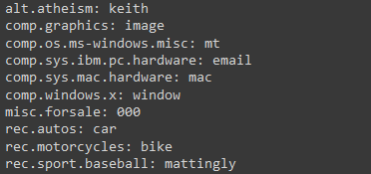
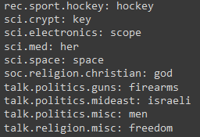
CSC 591 Final Project
Semi-Supervised Text Classification for Twenty Newsgroups Dataset
Ezio Mei, Jack van Welzen
Notes:
Ezio

Slide 2
Outline
Introduction
Data Preprocessing
Naive Bayes
Naive Bayes with Expectation Maximization
Simple Instance-Adaptive Self-Training
Experimental Results
Conclusions
Notes:
Ezio

Slide 3
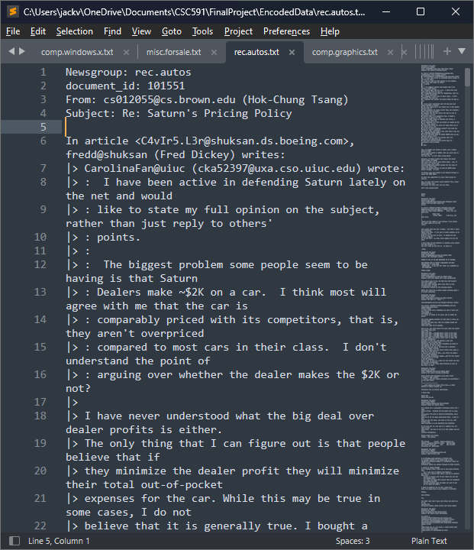
Introduction
Dataset: 20 Newsgroups
Not news; messages sent on Internet forums in 20 different categories
E.g. “rec.autos”, “talk.politics.guns”
Objective: Train and compare semi-supervised text classifiers
Naive Bayes with EM (2000)
Simple Instance-Adaptive Self-Training (2022)
Baseline: Naive Bayes
Notes:
Ezio

Slide 4
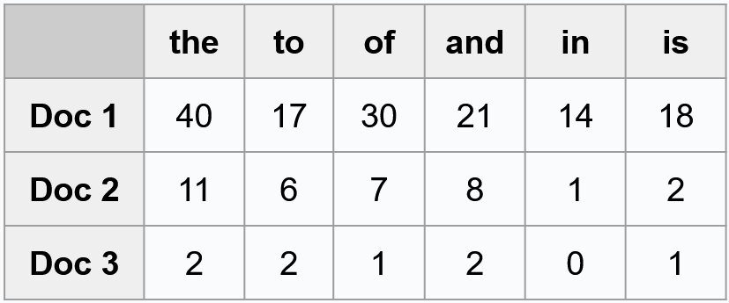
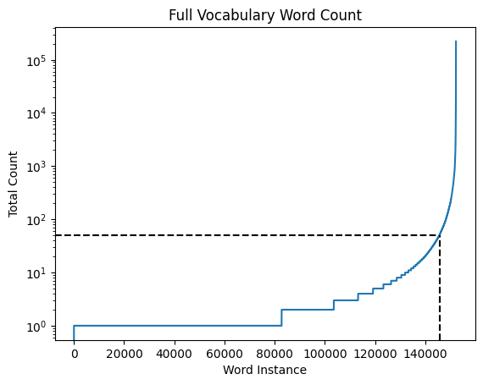
Data Preprocessing
 | the | to | of | and | in | is
Doc 1 | 40 | 17 | 30 | 21 | 14 | 18
Doc 2 | 11 | 6 | 7 | 8 | 1 | 2
Doc 3 | 2 | 2 | 1 | 2 | 0 | 1
Text File to Count Matrix
Separate .txt files (~19000 docs)
Filter to alphanumeric
Digits 1-9 -> 0
Create vocab and count words
Trim Vocab
Full vocab ~150,000 words
Filter words occur <50 times to remove garbage
Final matrix ~19000 by ~6600
Example garbage: mfxplpmcxwmwzg00r0e
Notes:
Ezio
Extract documents from txt files
Avoid overflow of unique text with various digits, we convert 1-9 to 0

Slide 5
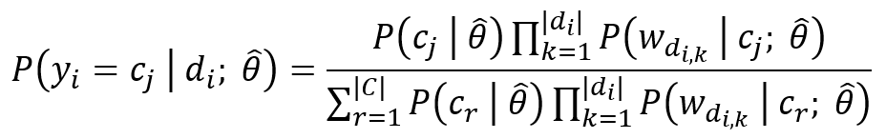
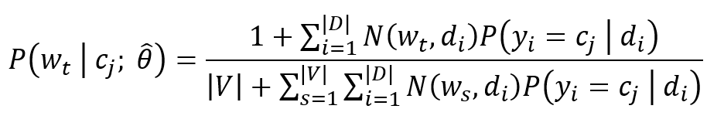
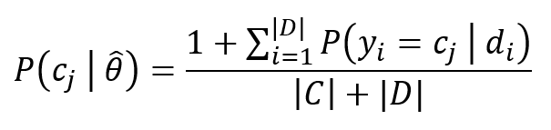
Naive Bayes Classifier
Baseline Supervised Classifier
Classifier:
Word Prob:
Class Prob:
Use {0,1} based on label
Notes:
Jack

Slide 6
Naive Bayes Classifier with EM
Start by training a naive Bayes classifier with labeled docs
Expectation Step:
Compute soft assignments for unlabeled documents
Maximization Step:
Update classifier parameters
**
Labeled docs: use {0,1} based on label
Unlabeled docs: use soft assignment **
Notes:
Jack

Slide 7

Simple Instance-Adaptive Self-Training
Augmented view enhanced semi-supervised learning
Supervised:
BERT: text classification
Minimize Cross-Entropy loss within labeled data
Unsupervised:
Generate two unlabeled augmented views
Evaluate augmentation strength
Similarity with original data
Predict augmented variant with augmented view
Notes:
Ezio

Slide 8


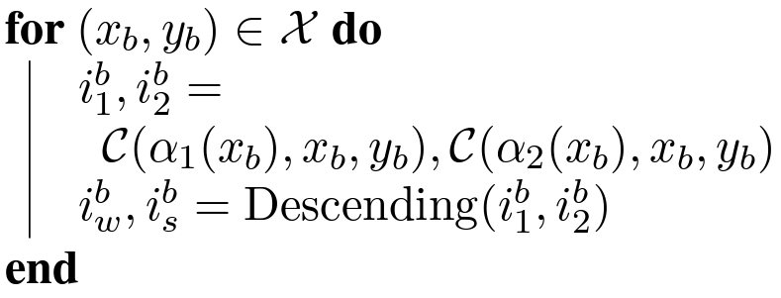


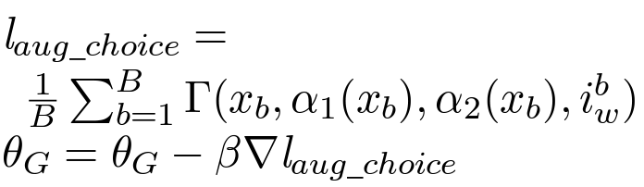


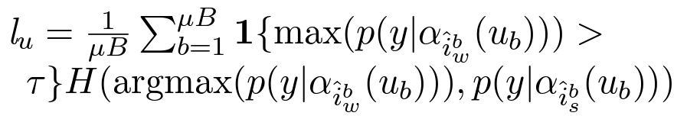


Simple Instance-Adaptive Self-Training (Cont’d)
, : two augmented view chosen with classifier criteria
: weak augmentation
: strong augmentation
: cross-entropy / contrastive loss function
: loss function for unlabeled data prediction
Notes:
Ezio

Slide 9
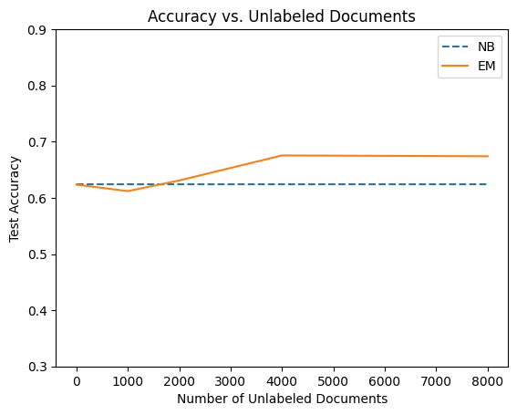
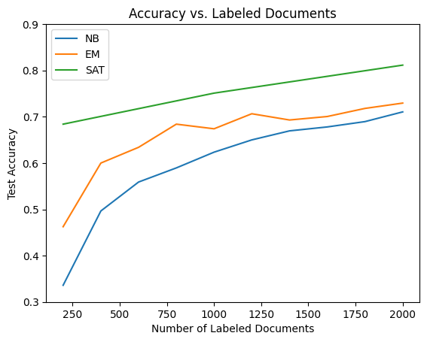
Results
Effect of number of labeled and unlabeled docs
8000 unlabeled, 2000 test
1000 labeled, 2000 test
Notes:
Jack

Slide 10
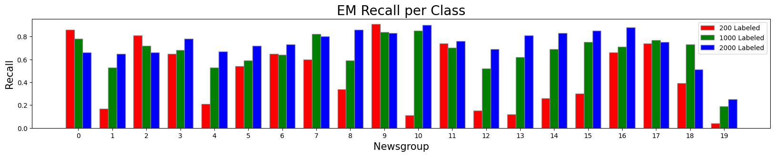
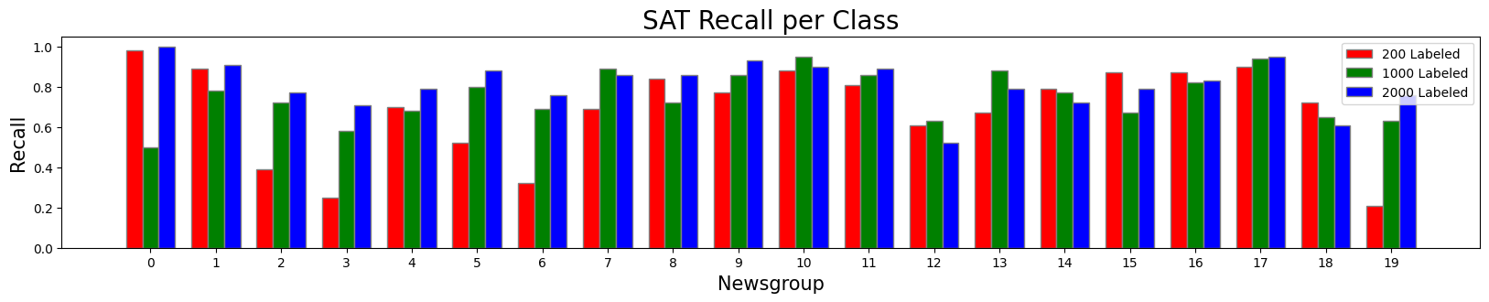
Results (Cont’d)
Recall per class: Recall_{i} = TP_{i}/(TP_{i} + FN_{i})
Notes:
Ezio; Even at small amounts of labeled, SAT performs well
Class by class performance with different label size
Overall the performance grow with the increase of labeled size, but not always
SAT is more robust

Slide 11
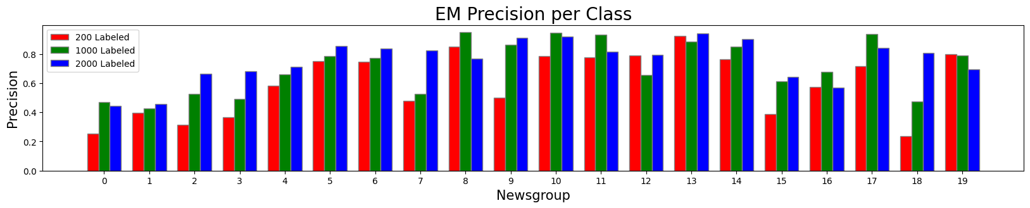
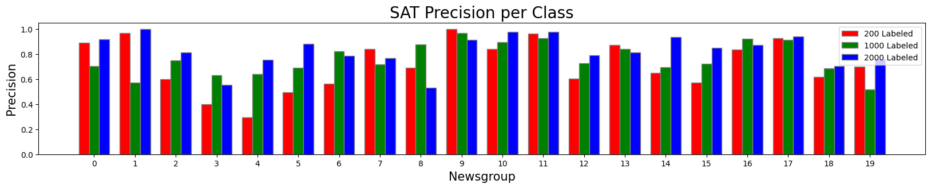
Results (Cont’d)
Precision per class: Precision_{i} = TP_{i}/(TP_{i} + FP_{i})
Notes:
Ezio

Slide 12
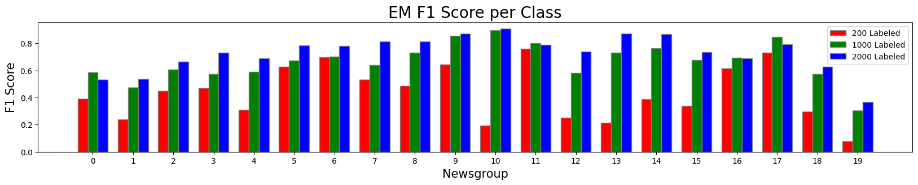
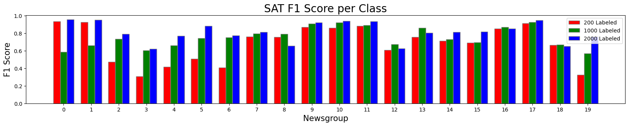
Results (Cont’d)
F1 Score per class: F1_{i} = 2/((Recall_{i} )⁻¹+ (Precision_{i})⁻¹)
Notes:
Ezio

Slide 13
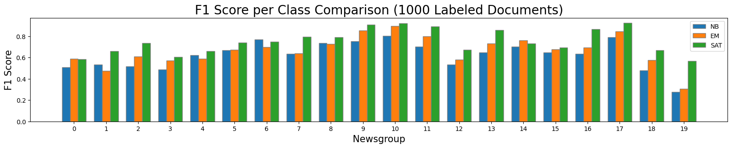
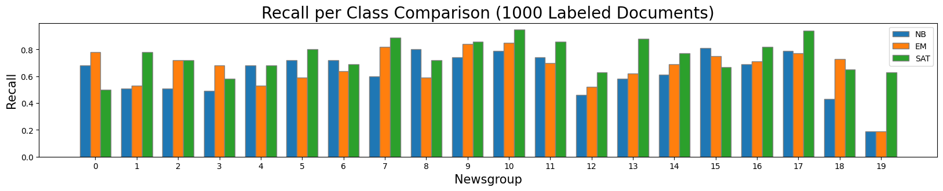
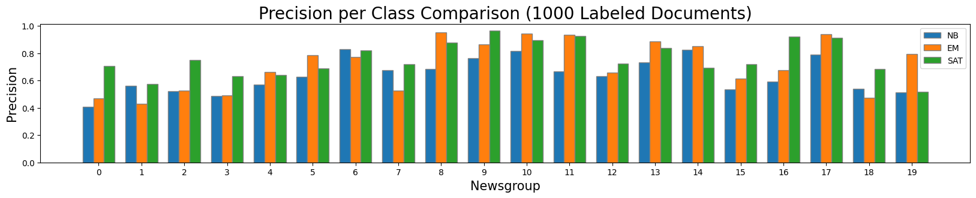
Results (Cont’d)
Notes:
Jack

Slide 14
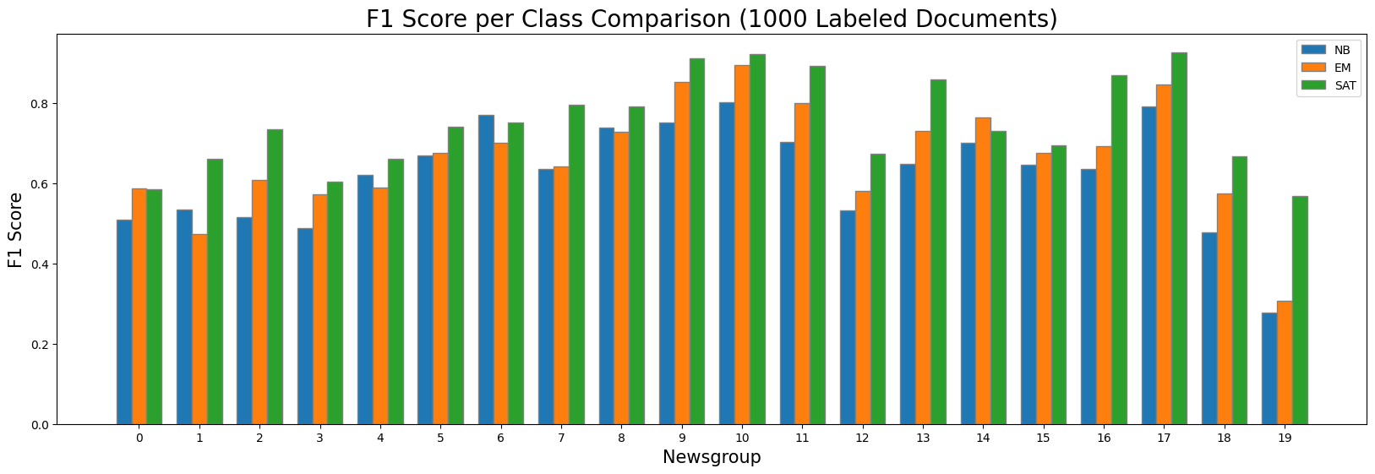
Results (Cont’d)
Notes:
Jack

Slide 15
Results (Cont’d)
Most unique words per class based on EM
Notes:
Jack

Slide 16
Conclusions
Overall, using the unlabeled documents with the semi-supervised methods showed improvements in performance
SAT outperformed EM and NB in terms of accuracy across the board
SAT was more robust to smaller amounts of labeled data
Per class, SAT generally performed better than EM and NB for recall, precision, and F1 score; however, it was not universal
Notes:
Ezio

