Slide 1

Atomics Variables: Not radioactive, but you probably still don’t want to touch them!
Roy Margalit

Slide 2
Parallelism for faster programs!

Slide 3
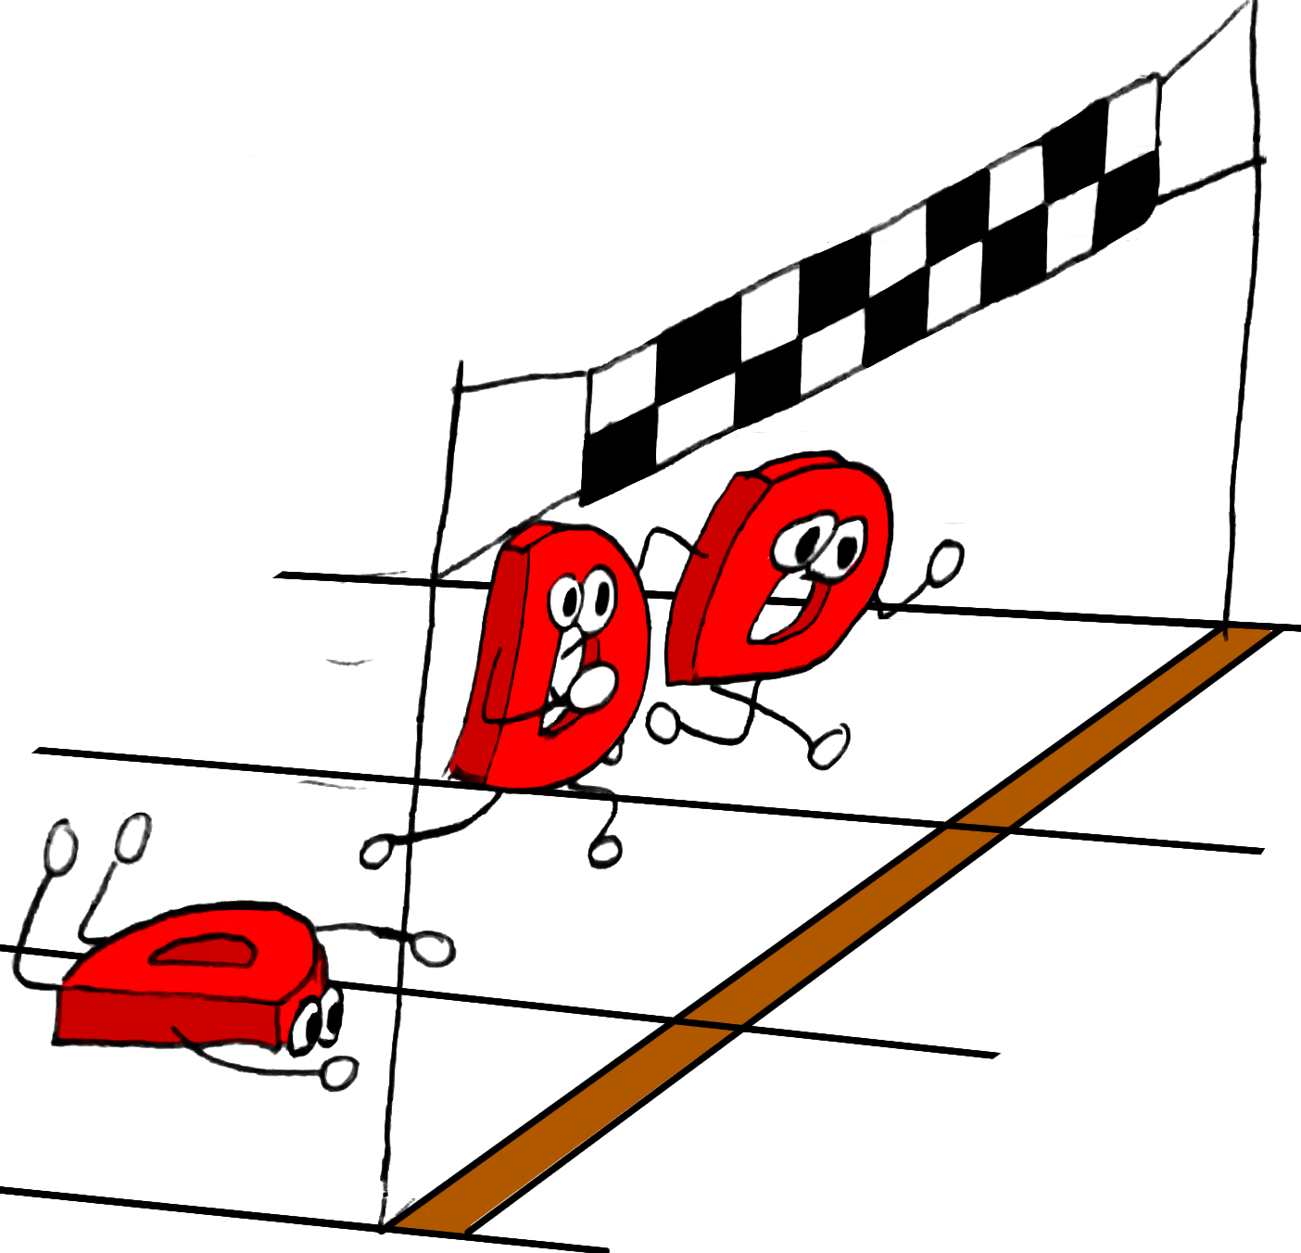
Races Prior To Atomics
Accessing the same memory location from 2 threads where one of them writes is undefined behavior
Undefined behavior
Cache
Optimizations

Slide 4
Cache
RAM
Cache
Cache
CPU 1
CPU 2

Slide 5
Optimization (Single Thread)
for (int j=0; j<COLS; ++j)
for (int i=0; i<ROWS; ++i)
c[i][j] = a[i][j] + b[i][j];
for (int i=0; i<ROWS; ++i)
for (int j=0; j<COLS; ++j)
c[i][j] = a[i][j] + b[i][j];

Slide 6
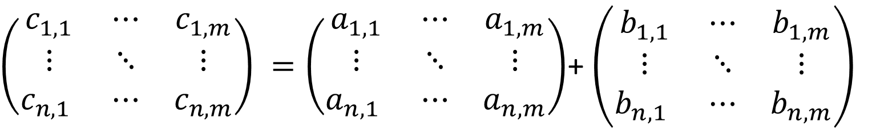
Let’s see a live demo
Matrix summing with optimization from previous slide
Watch for sentinel value
$\left(\begin{matrix}c_{1,1} & ⋯ & c_{1,m} \\ ⋮ & ⋱ & ⋮ \\ c_{n,1} & ⋯ & c_{n,m}\end{matrix}\right) =\left(\begin{matrix}a_{1,1} & ⋯ & a_{1,m} \\ ⋮ & ⋱ & ⋮ \\ a_{n,1} & ⋯ & a_{n,m}\end{matrix}\right)$+ $\left(\begin{matrix}b_{1,1} & ⋯ & b_{1,m} \\ ⋮ & ⋱ & ⋮ \\ b_{n,1} & ⋯ & b_{n,m}\end{matrix}\right)$
Wait for value to change

Slide 7
Memory Access Order
Before compiler optimizations
1
2
3
After compiler optimizations
3
2
1

Slide 8
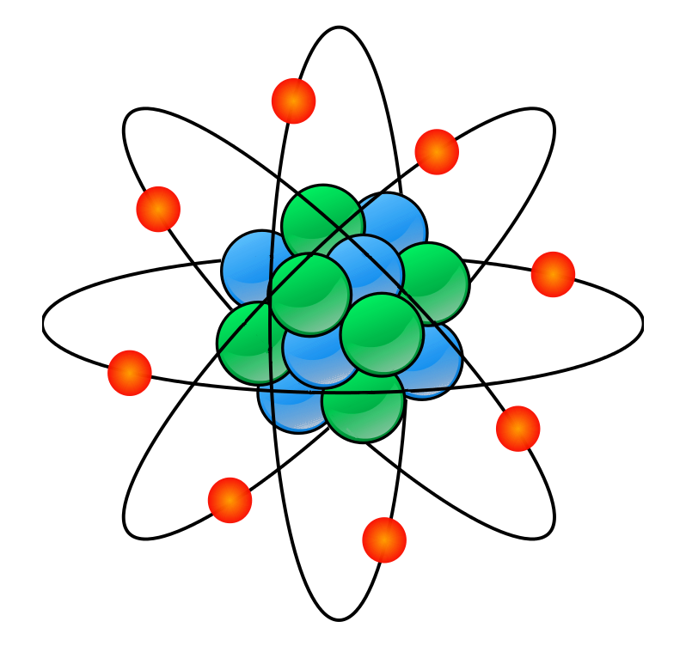
core.atomic To The Rescue
Defined behavior for race
Sequential Consistency
atomicLoad(foo);
atomicStore(foo);

Slide 9
Sequential Consistency (SC) Access
Can be considered in terms of interleaving the statements from various threads.

Slide 10
Sequential Consistency Example (Store-Buffer)
x = 0; y = 0;
x = 1;
a = y;
y = 1;
b = x;
x, y are global variables; a, b are local

Slide 11
Sequential Consistency Example
Variable | Value
x | 0
y | 0
a | 0
b | 0
x = 1;
a = y;
y = 1;
b = x;
x, y are global variables; a, b are local

Slide 12
Sequential Consistency Example
Variable | Value
x | 1
y | 0
a | 0
b | 0
x = 1;
a = y;
y = 1;
b = x;
x, y are global variables; a, b are local

Slide 13
Sequential Consistency Example
Variable | Value
x | 1
y | 0
a | 0
b | 0
x = 1;
a = y;
y = 1;
b = x;
x, y are global variables; a, b are local

Slide 14
Sequential Consistency Example
Variable | Value
x | 1
y | 1
a | 0
b | 0
x = 1;
a = y;
y = 1;
b = x;
x, y are global variables; a, b are local

Slide 15
Sequential Consistency Example
Variable | Value
x | 1
y | 1
a | 0
b | 1
x = 1;
a = y;
y = 1;
b = x;
x, y are global variables; a, b are local

Slide 16
Sequential Consistency Example
Variable | Value
x | 0
y | 0
a | 0
b | 0
x = 1;
a = y;
y = 1;
b = x;
x, y are global variables; a, b are local

Slide 17
Sequential Consistency Example
Variable | Value
x | 1
y | 0
a | 0
b | 0
x = 1;
a = y;
y = 1;
b = x;
x, y are global variables; a, b are local

Slide 18
Sequential Consistency Example
Variable | Value
x | 1
y | 1
a | 0
b | 0
x = 1;
a = y;
y = 1;
b = x;
x, y are global variables; a, b are local

Slide 19
Sequential Consistency Example
Variable | Value
x | 1
y | 1
a | 1
b | 0
x = 1;
a = y;
y = 1;
b = x;
x, y are global variables; a, b are local

Slide 20
Sequential Consistency Example
Variable | Value
x | 1
y | 1
a | 1
b | 1
x = 1;
a = y;
y = 1;
b = x;
x, y are global variables; a, b are local

Slide 21
Sequential Consistency Example
x = 0; y = 0;
a | b | Possible?
0 | 0 | No
0 | 1 | Yes
1 | 0 | Yes
1 | 1 | Yes
x = 1;
a = y;
y = 1;
b = x;
x, y are global variables; a, b are local

Slide 22
Lost Performance
SC forces cache flushes
SC prevents reordering of statements

Slide 23
C++ Memory Model
Weaker memory access that is cheaper
Races are still defined
Price to pay: Less synchronization

Slide 24
Relaxed
Cheapest atomic
No synchronization
Monotonic (Total order over writes to x)
Can be reordered between different variables
x = 0;
x = 1;
x = 2;
a = x;
assert(x >= a);

Slide 25
Release / Acquire
Synchronizes threads.
Things before the release happened before the acquire.
x = 0; y = 0;
x = 1;
y = 1;
a = y; // 1
b = x; // 1

Slide 26

Store Buffer
x = 0; y = 0;
x = 1;
a = y;
y = 1;
b = x;
a = 0 && b = 0
??
Live Demo

Slide 27
Testing Is Not Enough
Testing on one architecture (x86) will not show issues with others (Power-PC, ARM).
X86-TSO gives more guarantees than even Release/Acquire.

Slide 28
Message-Passing
x = 0; y = 0;
x = 1;
y = 1;
a = y;
b = x;
a == 1 && b == 0
??
Live Demo

Slide 29

Current compilers are afraid of optimizing atomics

Slide 30
A Short Story: Peterson’s algorithm in C++
In 1981, Peterson proposed a simple algorithm for critical section in shared memory.
It assumes sequential consistent shared memory (SC).
CPU
CPU
…
CPU
Memory
Q: How to implement Peterson’s algorithm in C/C++11?
W x 0
W y 0
W x 1
W y 1
R y 0
R x 0

Slide 31
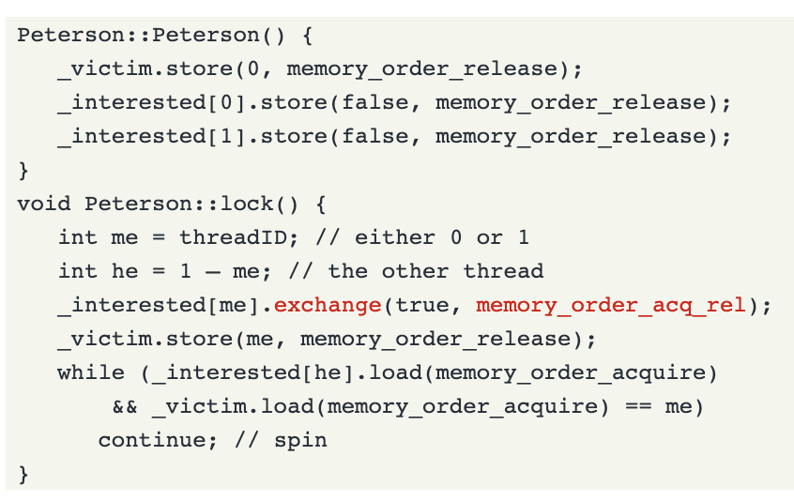
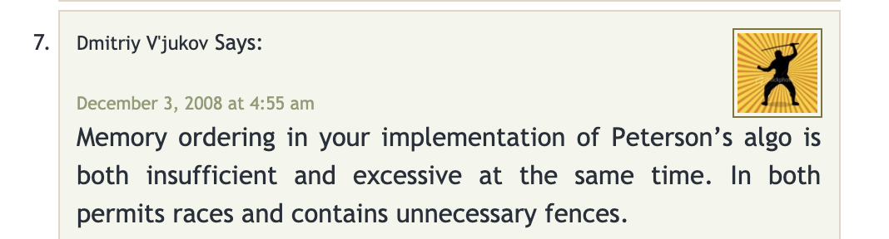
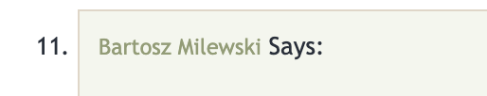
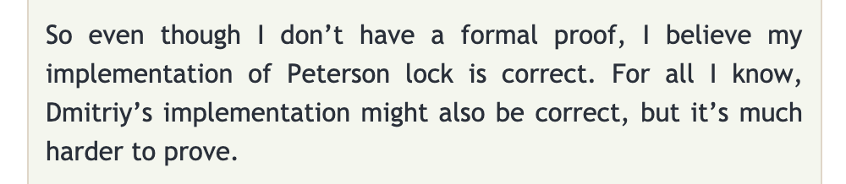
A Short Story: Peterson’s algorithm in C++
…
…
C++ atomics and memory ordering, blog post by Bartosz Milewski https://bartoszmilewski.com/2008/12/01/c-atomics-and-memory-ordering/

Slide 32
A Short Story: Peterson’s algorithm in C++
A subsequent post by Anthony Williams analyzed both algorithms:
Bartosz’s implementation is indeed wrong.
Dmitriy’s implementation is correct.
https://www.justsoftwaresolutions.co.uk/threading/petersons_lock_with_C++0x_atomics.html
"Any time you deviate from SC, you increase the complexity of the problem by orders of magnitude."

Slide 33
Fast forward to 2020
A solution in the future?
Notes:
Maybe if you wait long enough, someone will develop a new method and prove your implementation correct

Slide 34
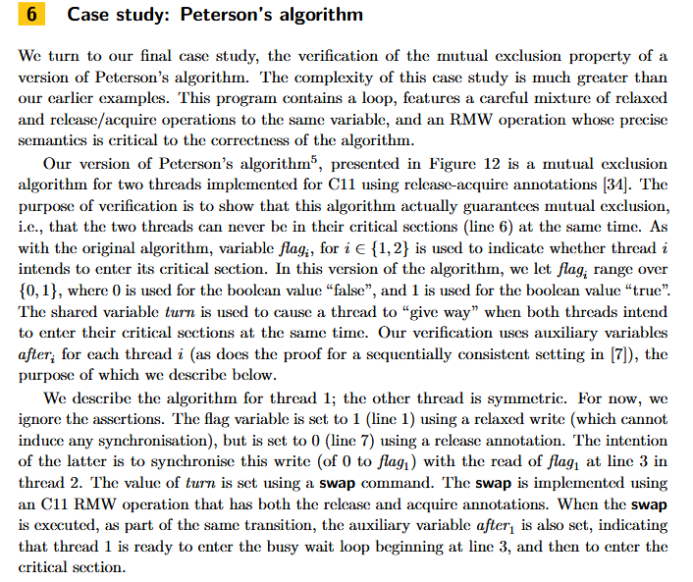
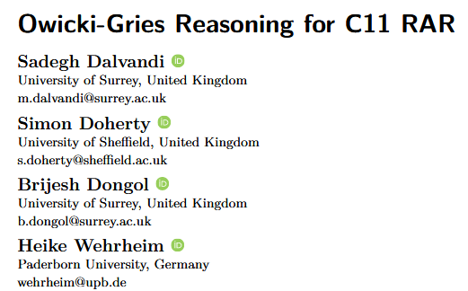

Slide 35
How does my research try to solve this problem?

Slide 36
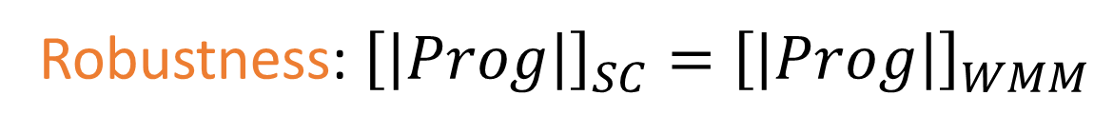
Verification
Verifying programs under weak memory models (WMM) is difficult
We’d like to verify programs assuming SC:
verification under weak memory
=
verification under sequential consistency
+
???
Robustness: ${\left[\left|Prog\right|\right]}_{SC}={\left[\left|Prog\right|\right]}_{WMM}$
Notes:
Difficult both in theory (where the complexity can be very high or the problem is not even decidable) and in practice, and I will mention an illustrative example of Peterson algorithm later.
What is Robustness? Property of concurrent programs. Behaviors under WMM are always observed under SC. (TEACH THE SLIDE!)

Slide 37
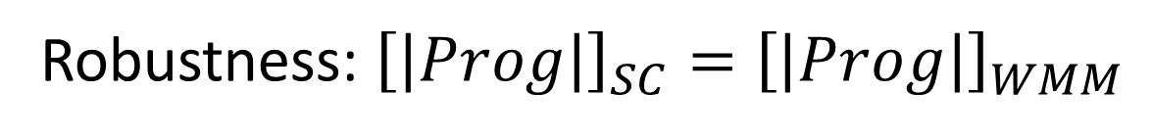
Goal
verification under weak memory
=
verification under sequential consistency
+
robustness
Robustness: ${\left[\left|Prog\right|\right]}_{SC}={\left[\left|Prog\right|\right]}_{WMM}$
Automatically establish robustness of programs against WMM
Our focus is on C/C++11 memory model:
$${\left[\left|Prog\right|\right]}_{SC}={\left[\left|Prog\right|\right]}_{C11}$$
Notes:
Develop a method to automatically establish…
Specifically, our focus is the model of C and C++ that was introduced in 2011 and provides a spectrum of memory accesses that trade consistency for performance.

Slide 38
How does the C++ model describe behaviors?
W x 0
W y 0
x = 0; y = 0;
x = 1;
y = 1;
a = y;
b = x;
W x 1
R y 1
W y 1
R x 0

Slide 39







Example: “message-passing” litmus test
x = 1 y = 1
a = y b = x
y = 1
a = y b = x
a = y b = x
b = x
a = 0 b = 0
a = 0 b = 0
a = 0 b = 0
a = 1 b = 0
a = 1 b = 0
W x 0
W y 0
W x 0
W y 0
W x 0
W y 0
W x 0
W y 0
W x 0
W y 0
W x 1
W x 1
W x 1
R y 1
W x 1
R y 1
W y 1
W y 1
W y 1
R x 0
Wx1
Wy1
Ry1
Rx0
$$(q_{0},G_{0})$$
T1
$$(q_{1},G_{1})$$
T1
$$(q_{2},G_{2})$$
T2
$$(q_{3},G_{3})$$
T2
$$(q_{4},G_{4})$$
$$C11$$
$$C11$$
$$C11$$
$$C11$$
Initial state
final state
Notes:
Although the C11 is not formulated as an operational model, we can still think about it in terms of operational semantics that looks like this
State is made from program state + memory state. C11 uses operational semantics represented by a graph. The graph consists of the entire history of the execution and is not bounded. C11 has constraints on graph being consistent.
The full consistency definition and the definition of when we have synchronization in the graph is a bit complex, but we don't need a precise definition for the rest of the talk.
EXECUTED BEFORE

Slide 40
$$∀q,G.(q_{0},G_{0})→_{C11}^{∗}(q,G)⟹G \text{is} \text{SC}\text{−}\text{consistent}$$
W x 0
W y 0
SC-consistent
Linearization:
W x 1
R y 1
Init: | W x 0 | W y 0
T1: |  |  | W x 1 | W y 1
T2: |  |  |  |  | R y 1
W y 1
W x 0
W y 0
W x 1
R y 1
SC-inconsistent
W y 1
R x 0
Notes:
SC-consistent: Multiple linearizations.
SC-Inconsistent: Induced relation from Rx0 to Wx1

Slide 41




Robustness against C11 is decidable and PSPACE-complete.
Reduction to reachability under an instrumented SC semantics
Proof idea:
SC-consistent
a “minimal” robustness violation:
SC-inconsistent
$$(q_{0},G_{0})→_{C11}(q_{1},G_{1})→_{C11}(q_{2},G_{2})→_{C11}…→_{C11}(q_{n},G_{n})→_{C11}(q_{n+1},G_{n+1})$$
Can take a C11-step to a non-SC execution graph
$$(q_{0},M_{0})→_{SC }(q_{1}^{′},M_{1})→_{SC }(q_{2}^{′},M_{2})→_{SC }…→_{SC }(q_{n},M_{n})$$
Robustness information
$$I_{0}$$
$$I_{1}$$
$$I_{2}$$
$$I_{n}$$
Notes:
Let me say a few words about how the proof works
we identify properties of execution graphs that:
can be tracked;
suffice to detect a “non-robustness witness”.
Finite bounded additional data we can precisely check this condition.
Proof shows we don’t need to remember the whole graph

Slide 42

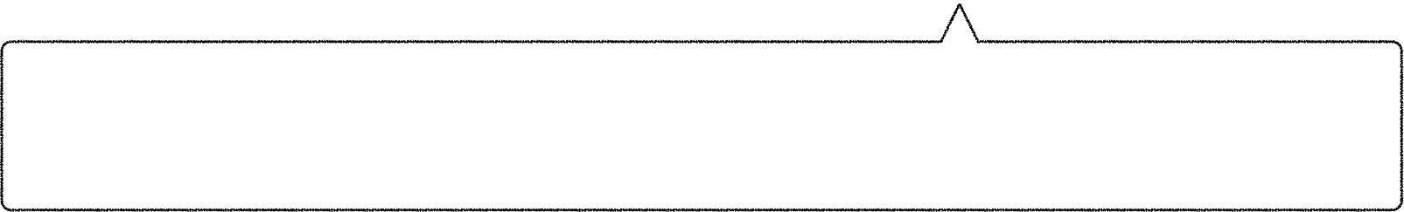

















x = 1 y = 1
y = 1 b = x
y = 1
a = y b = x
a = y b = x
b = x
a = 0 b = 0
a = 0 b = 0
a = 0 b = 0
a = 1 b = 0
a = 1 b = 0
W x 0
W y 0
W x 0
W y 0
W x 0
W y 0
W x 0
W y 0
W x 0
W y 0
W x 1
W x 1
W x 1
R y 1
W x 1
R y 1
W y 1
W y 1
W y 1
R x 0
$$(q_{0},G_{0})$$
Wx1
$$(q_{1},G_{1})$$
Wy1
Ry1
$$(q_{3},G_{3})$$
Rx0
$$(q_{4},G_{4})$$
T1
T1
$$(q_{2},G_{2})$$
T2
T2
$$C11$$
$$C11$$
$$C11$$
$$C11$$
$$(q_{0},M_{0})$$
$$→_{SC}$$
$$(q_{1}^{′},M_{1})$$
$$→_{SC}$$
$$(q_{2}^{′},M_{2})$$
$$→_{SC}$$
$$(q_{3},M_{3})$$
robustness violation!
$$I_{0}$$
$$I_{1}$$
$$I_{2}$$
$$I_{3}$$
In C11, T2 may not read from Wx1, but in SC it must.
Notes:
Let’s see how this work for the MP example from earlier
The instrumentation tells us that in C11 the execution doesn’t have to read Wx1 but in SC it must. Thus, we can detect robustness violation.
So, the crux of this contribution is to identify a finite instrumentation that will allow us to monitor precisely this kind of property.

Slide 43

Rocker
A static automated tool for checking robustness of simple programs.
Robustness is verified under SC

Slide 44
Results (Release/Acquire)
Program | Robustness | Time (seconds)
Peterson (SC) | ❌ | 1.0
Peterson (Bratosz) | ❌ | 1.1
Peterson (Dmitriy) | ✔️ | 1.2
Store-Buffer | ❌ | 0.9
Message-Passing | ✔️ | 0.9

Slide 45
Results (Relaxed)
Program | Robustness | Time (seconds)
Peterson (Dmitriy) | ❌ | 1.2
Peterson (Fix1) | ✔️ | 1.3
Peterson (Fix2) | ✔️ | 1.3
Store-Buffer | ❌ | 0.9
Message-Passing | ❌ | 0.9

Slide 46
Robustness against C11 is decidable and PSPACE-complete.
robust
input program with C11-like atomics and non-atomics
Rocker
verification problem assuming SC
SPIN model checker
not
robust
You can try the tool without having to understand the memory model!
Rocker – https://github.com/rymrg/rocker/
Thank you!
Notes:
Developed. Verification method & a tool.

