Slide 1
Take 1
Hi, I’m Daniel Ezra. This is my WDD 231 final project,
True Focus Photography. I will show my data integration and an
A-synchronous features that uses a try block.
Then I will show the results on the page.

Slide 2
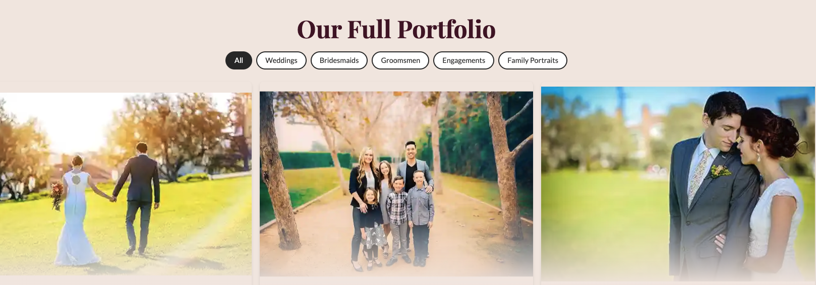
Take 2
This is my Gallery page. The cards are built from my JSON data. I can filter by category. When I open a photo, I added a lightbox. Escape closes it and focus goes back to the thumbnail.

Slide 3
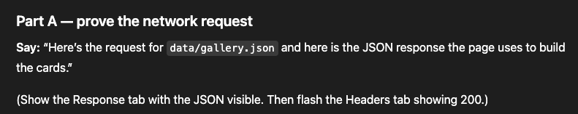
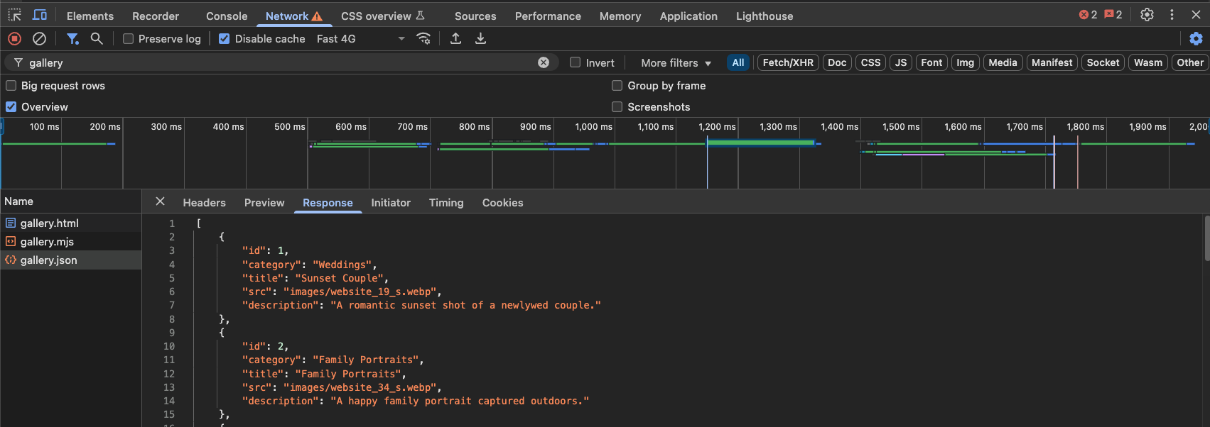

Slide 4
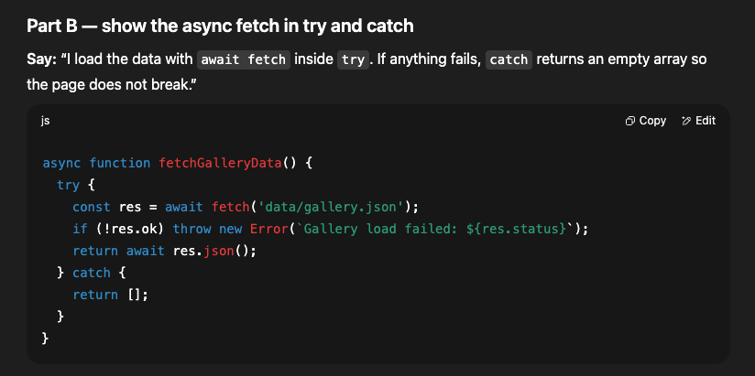

Slide 5
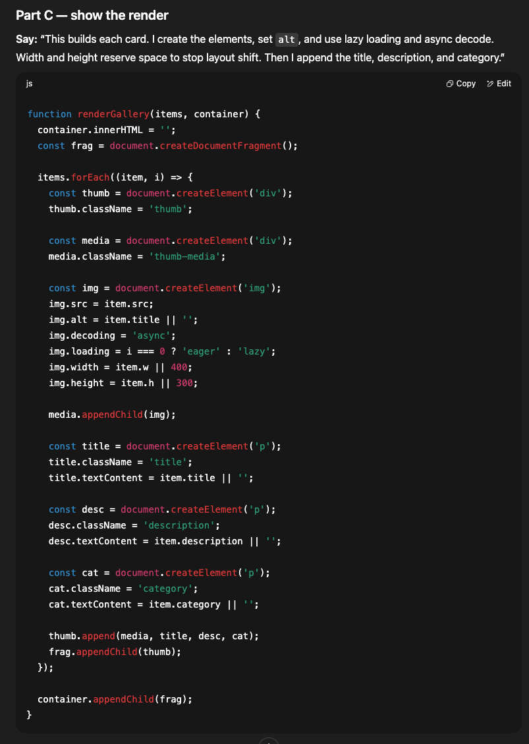

Slide 6
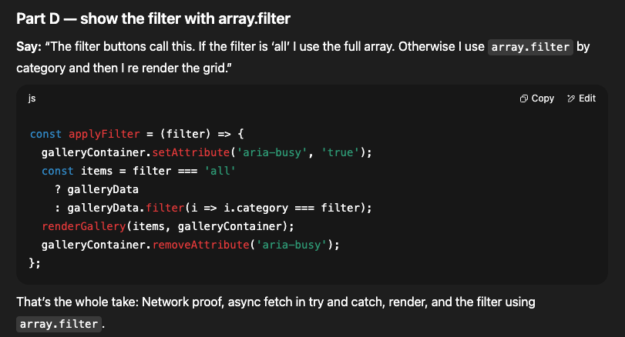

Slide 7
Take 3 – Contact Page 1st Demo!

Slide 8
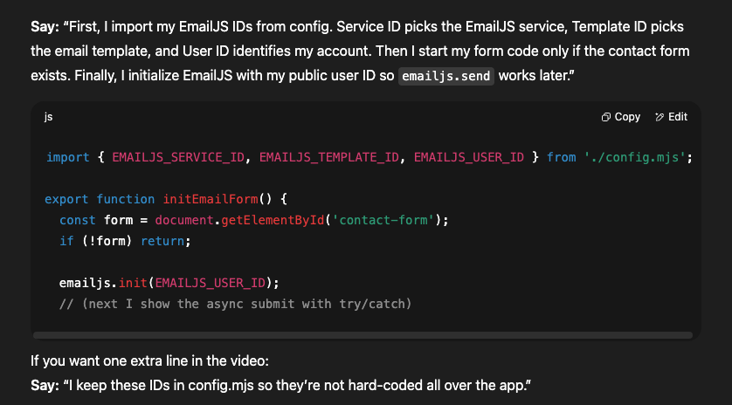

Slide 9
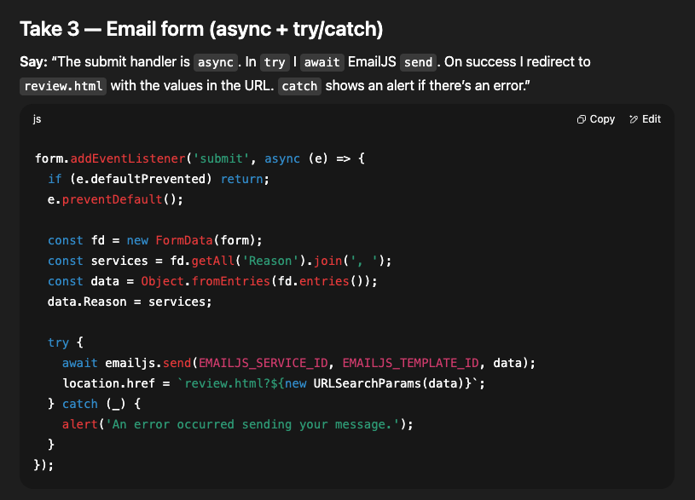
And Then

Slide 10
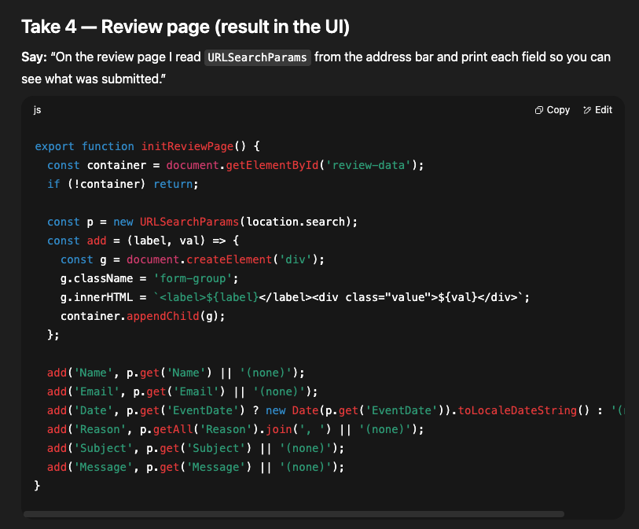

Slide 11
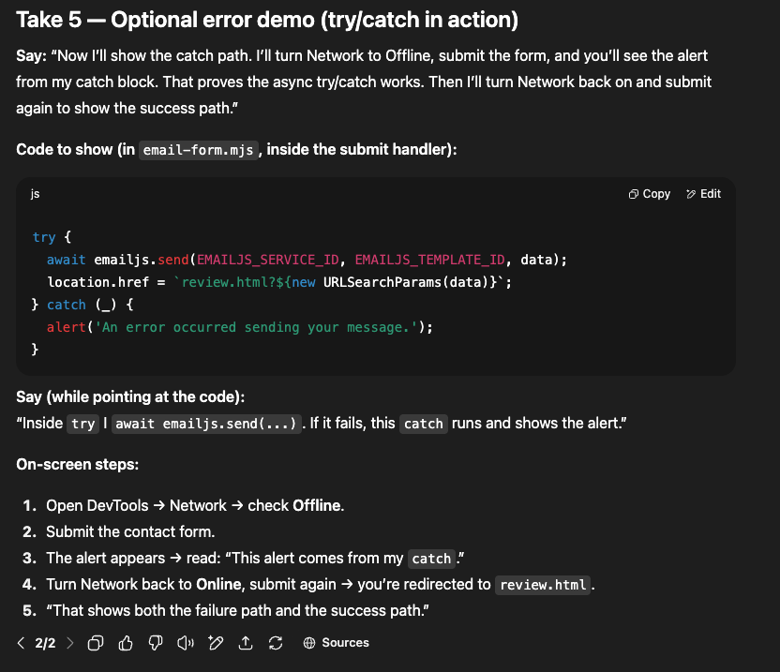

Slide 12
My demo video link is in the footer on each page.
I also listed Email JS and my JSON dataset on the References page.

Slide 13
That is my project. I showed the data integration, the A-synchronous features with a try block,
and the result in the UI.
Thank you.

