Slide 1
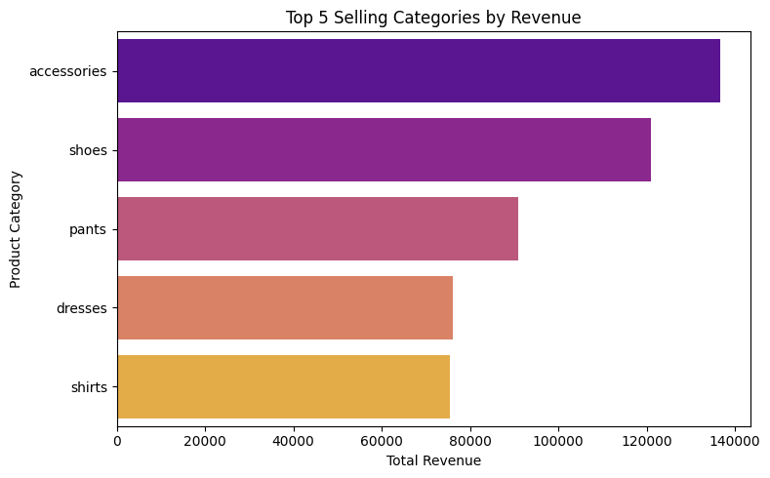
Top 5 Selling Products
These are the top revenue-generating product categories.

Slide 2
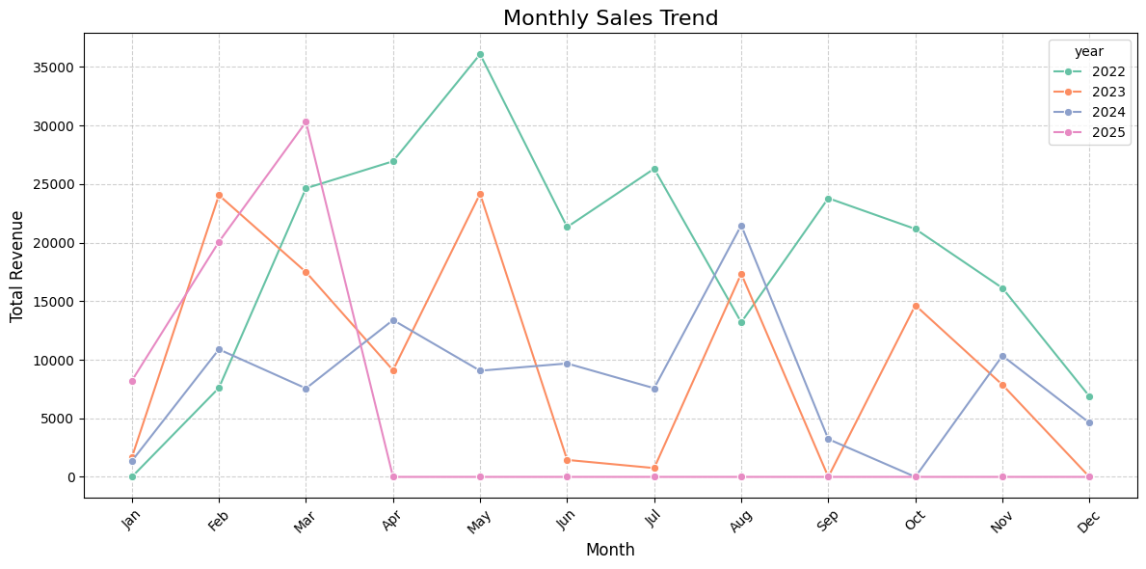
Monthly Sales Trend
Shows revenue trends by month and year.

Slide 3
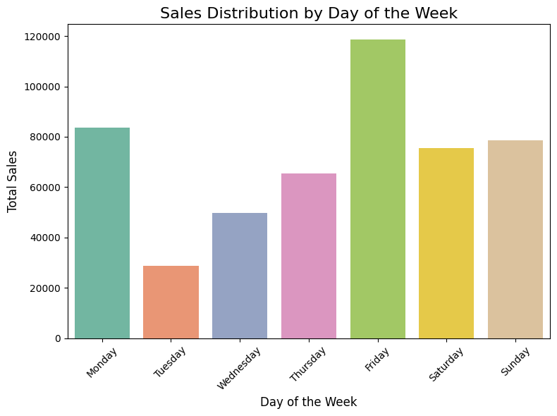
Sales by Day of Week
Distribution of sales volume by weekdays.

Slide 4
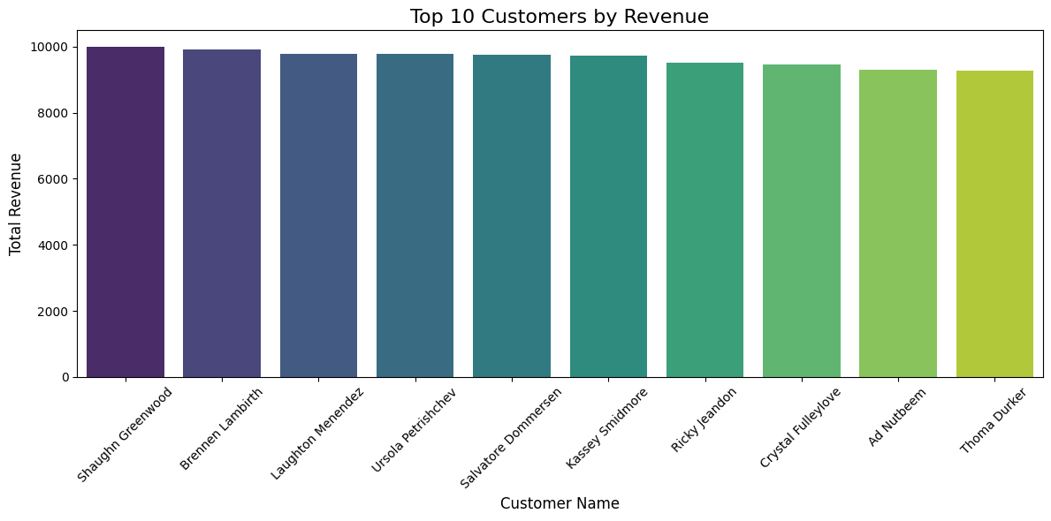
Top 10 Customers
Customers generating highest revenue.

Slide 5
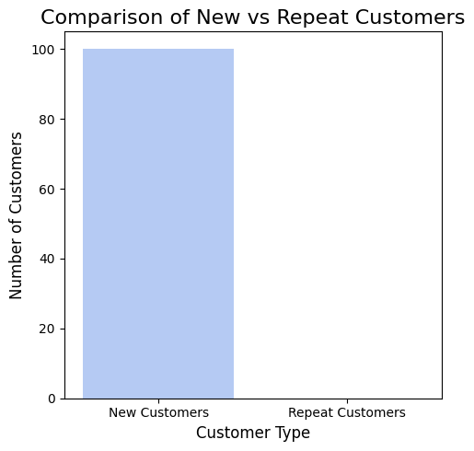
New vs Repeat Customers
Comparison of first-time vs returning buyers.

Slide 6
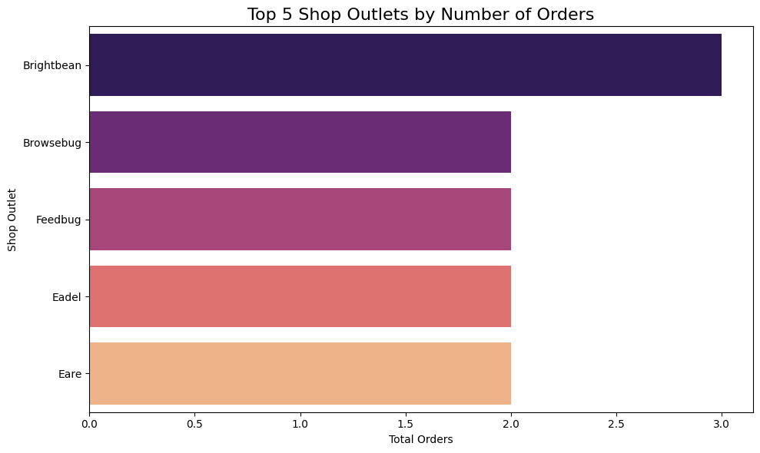
Most Active Locations
Outlets with the highest number of orders.

Slide 7
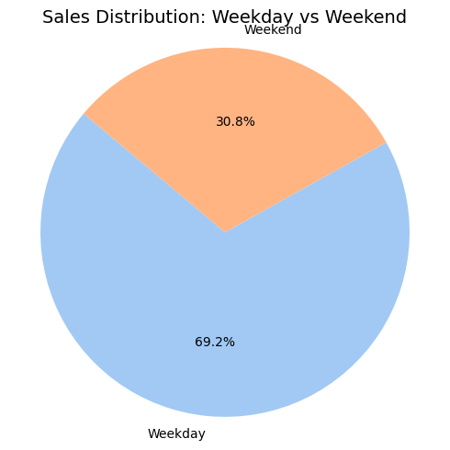
Weekday vs Weekend Sales
Weekend sales slightly higher — shown using a donut chart.

Slide 8
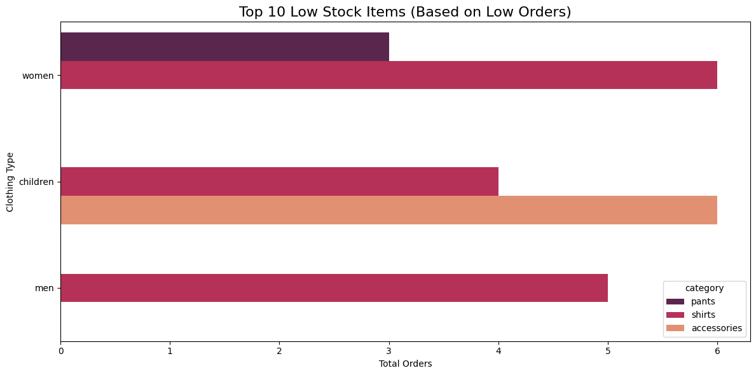
Low Stock Items
Items with the least number of orders (assumed low stock).

Slide 9
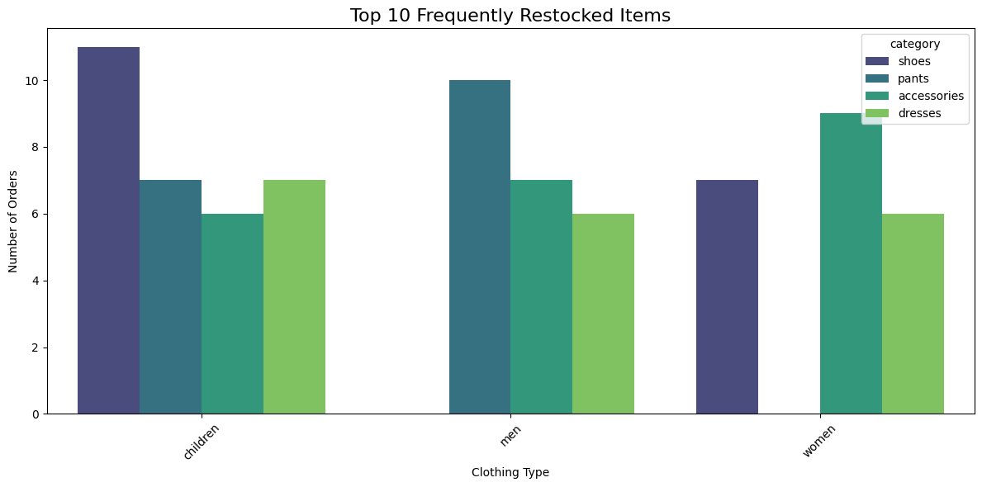
Frequently Restocked Items
High demand items ordered frequently.

Slide 10
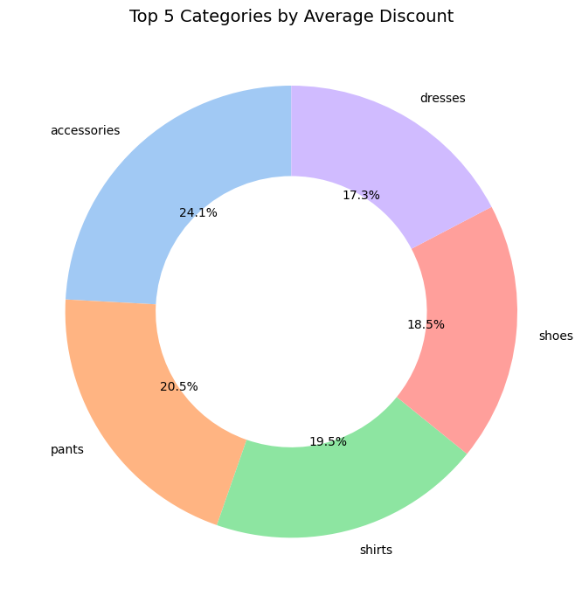
Average Discount by Category
Categories with highest average discounts shown in a donut chart.

