Slide 1
Exo-Planet
Detection
By: Ezra, Kieran, Edison, Aaron, Mira, and Darartu

Slide 2
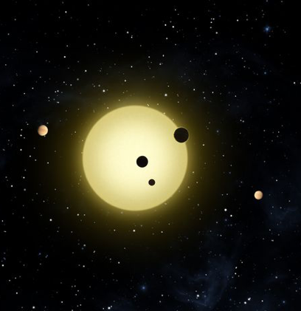
WHAT ARE EXOPLANETS?
Planets that orbit around other stars are called exoplanets

Slide 3
WHAT ARE WE TRYING TO ACCOMPLISH?
The purpose of our project is to use Machine Learning to accurately detect exoplanets
Notes:
The main reason is the size of data. There are billions of planets, making it impossible for humans to process them all.

Slide 4
WHAT IS TRANSIT PHOTOMETRY?
Notes:
Transit Photometry is one of the most widely used and most effective methods of discovering exoplanets so far. Transit Photometry measures the dips in starlight from distant stars when a planet’s orbit passes between the star and the telescope. Based on the size of the dip, we can also determine the exoplanet’s size and composition as well as their orbital period, the time it takes for them to complete an orbit.

Slide 5
PROBLEMS WITH TRANSIT PHOTOMETRY
Requires perfect alignment
Many false positives
Cannot measure mass
Notes:
Transit Photometry requires the planet’s orbit to be perfectly aligned with the astronomer’s line of sight, and only about 10% of planets with short orbital periods do so, and the number decreases for planets with longer orbital periods.
Transit Photometry also suffers from many false positives, although there are less if multiple exoplanets are detected around a star.
Finally, Transit Photometry cannot accurately measure the mass of a planet.
However, some of these problems can be solved by using Transit Photometry in conjunction with other methods, such as the Radial Velocity method. The Radial Velocity Method is a reliable way to find planets by measuring the amount of “wobble” that stars experience as a result of the gravitational force acting on them produced by planets.

Slide 6
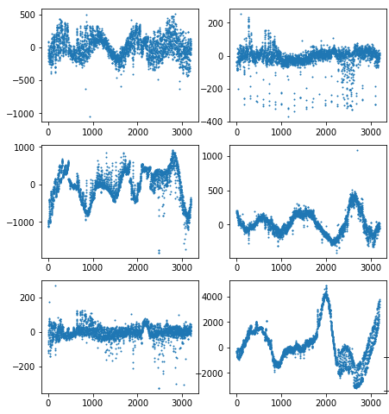
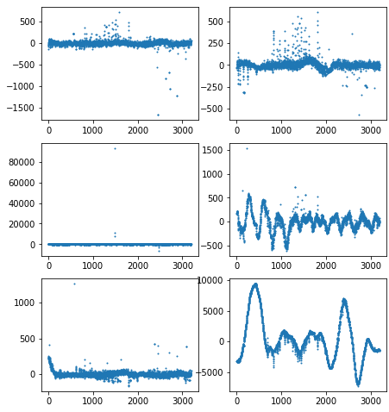
WHAT DOES OUR DATA LOOK LIKE?
Exoplanets Non-exoplanets
Notes:
As you can see, the brightness of the star in which the exoplanet is orbiting can be visualized using graphs that track how bright the star is after a certain amount of time. There are some differences you can see in the graphs between them. for example some of the exoplanets tend to have more consistent dips while the non exoplanets can be straight at times and less consistent though you can’t always count on that when trying to tell between them

Slide 7
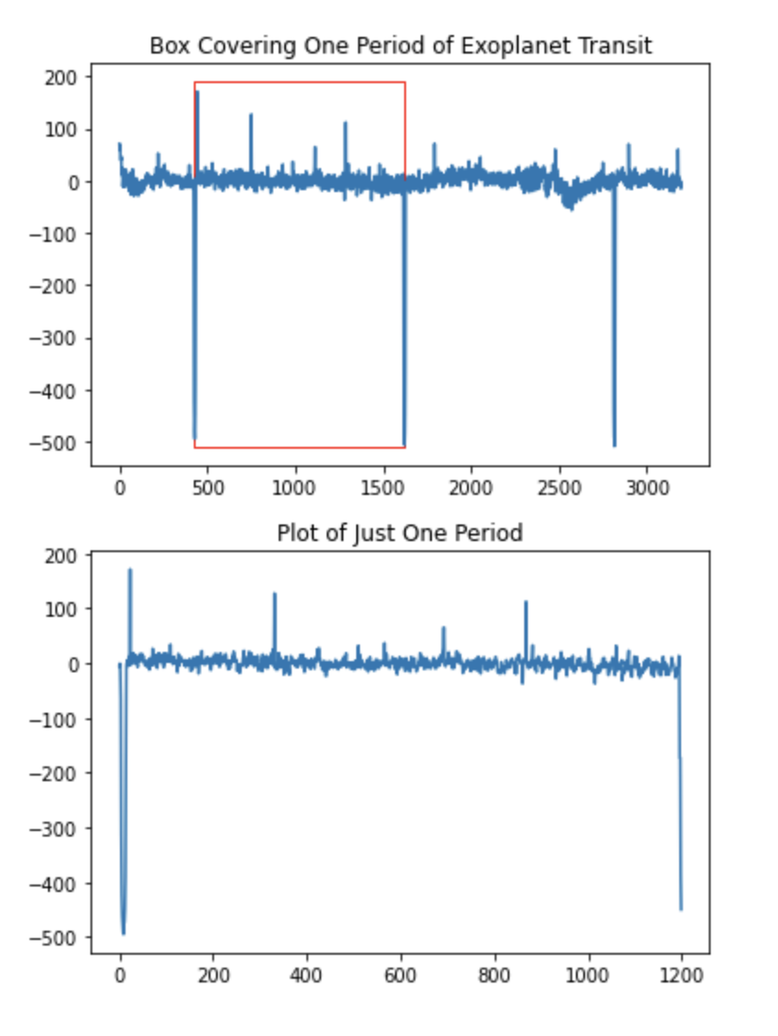
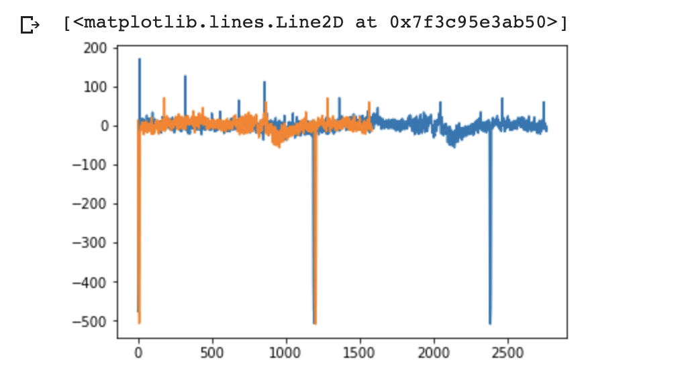
HOW CAN WE REPRESENT OUR DATA?
Notes:
Here we plotted a light curve which shows an exoplanet’s orbit around its star. In the graph on the right, we used the light curve folding method. After we created a period and layed it over the first we see if it matches to manually determine if it is an exoplanet.

Slide 8
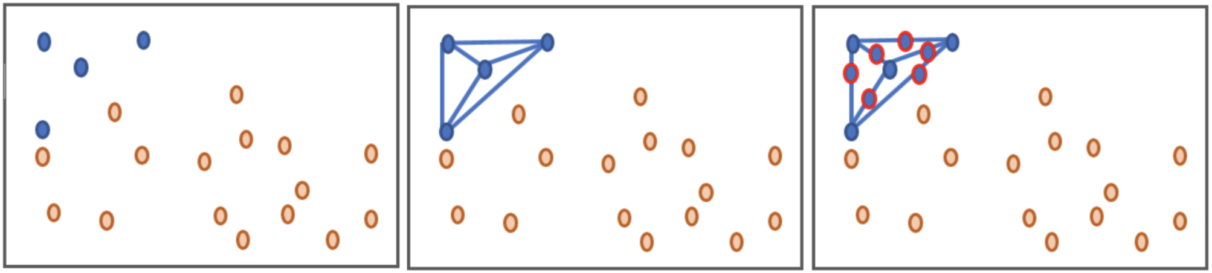
DATA AUGMENTATION
Off-balanced data set
More non-exoplanets then exoplanets
Augmented data set to increase the amount of Exoplanets
Now we can train models with a balanced data set
Notes:
As we went through our project we realised a major problem
Our data set was heavily imbalanced
This meant that our data would only be trained with extremely few versions of exoplanets and could be tested with even less exoplanets.
We fixed this by augmenting our data set.
We did this by adding data points in similar positions around other exoplanets to increase the amount of exoplanets.
Now we have a even split of non exoplanets and exoplanets.
So our models will be increasingly more accurate

Slide 9
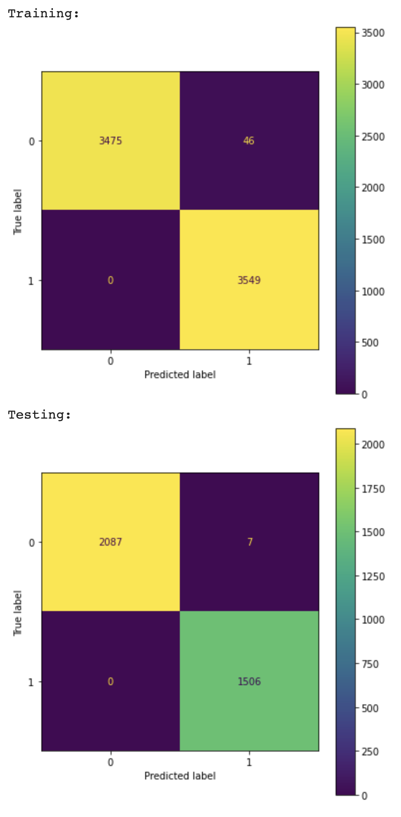
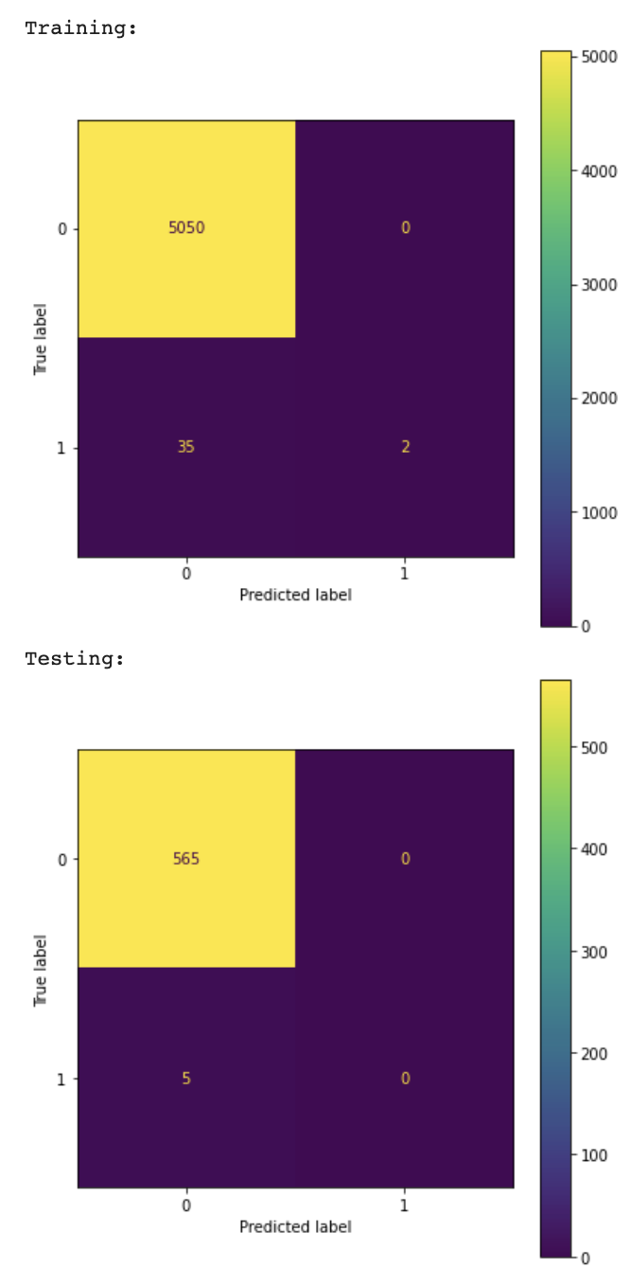
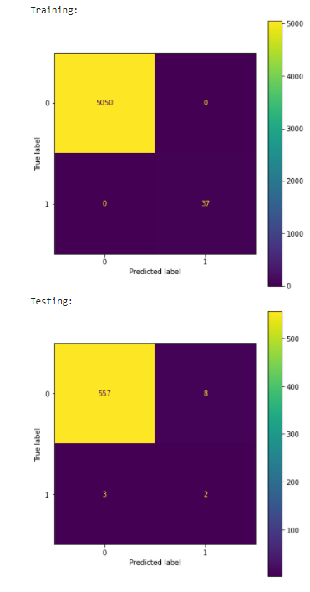
HOW ACCURATE ARE DIFFERENT MODELS?
MLP: KNN: Decision Tree:
Notes:
Now that we can look at the different models we can see that we trained 3.
MLP
KNN
Decision Tree Classifier
I will give everyone a second to look at the data, but although KNN and DT models were trained and tested with the non augmented dataset it proved to show how much of a difference it made to train it with one. As shown on the slides you can see a confusion matrix for each model. These represent the accuracy of the models by showing the numbers in each box, and the colors. Upon further investigation we could see that the MLP model did the best out of these while the DT and KNN models under performed.

Slide 10
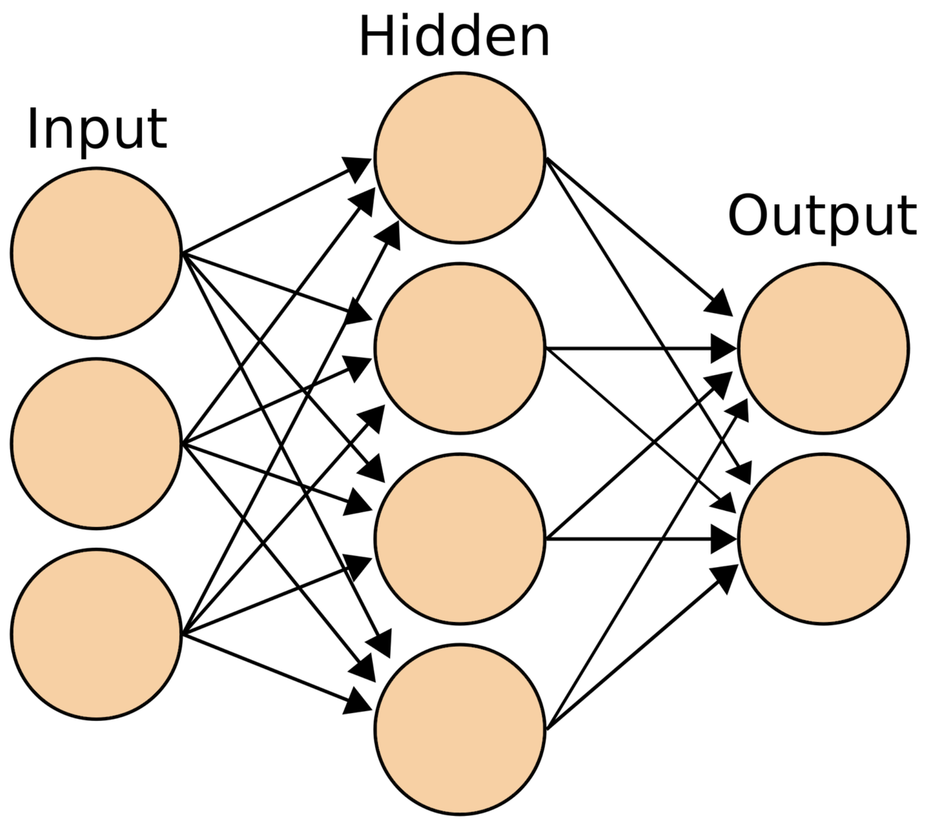
WHAT IS A NEURAL NETWORK?
Notes:
Neural networks are a model inspired by the brain that uses Inputs and hidden layers to reach an output, each circle is a neuron which has a specific value and every neuron in one column is connected to each neuron in the next column with the value of any neuron in a layer other than the input layer Is found by taking each neuron in the prior layer and multiplying Each one by a weight and than adding it all together, once you have all of the values for the second layer you continue this process until you get to the outputs and whichever neuron in the output layer has the highest value is the one that will end up being chosen, and using neural networks you can classify anything from what a picture is to whether or not something is an exoplanet

Slide 11
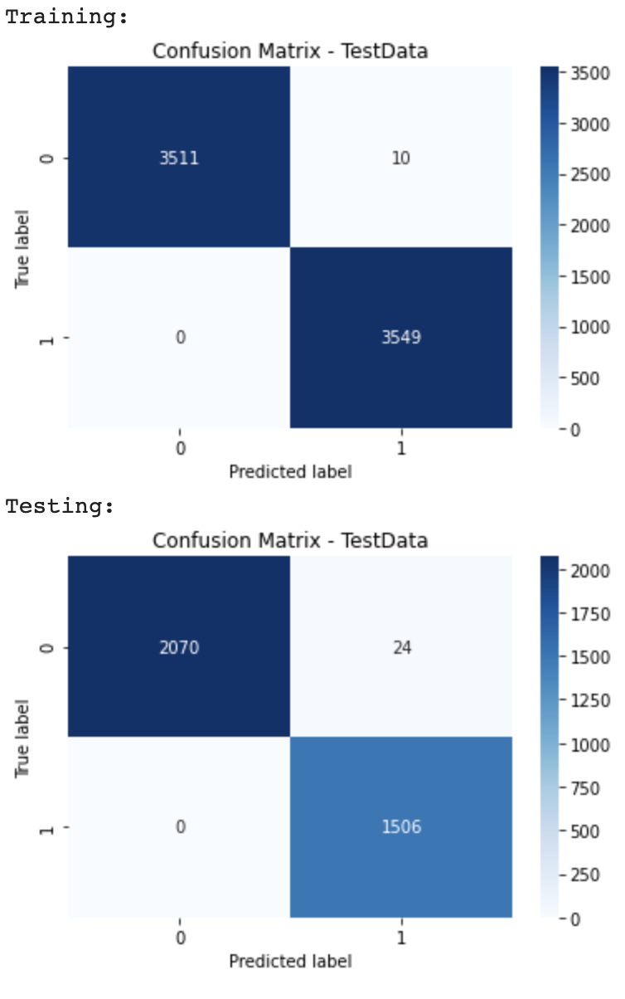
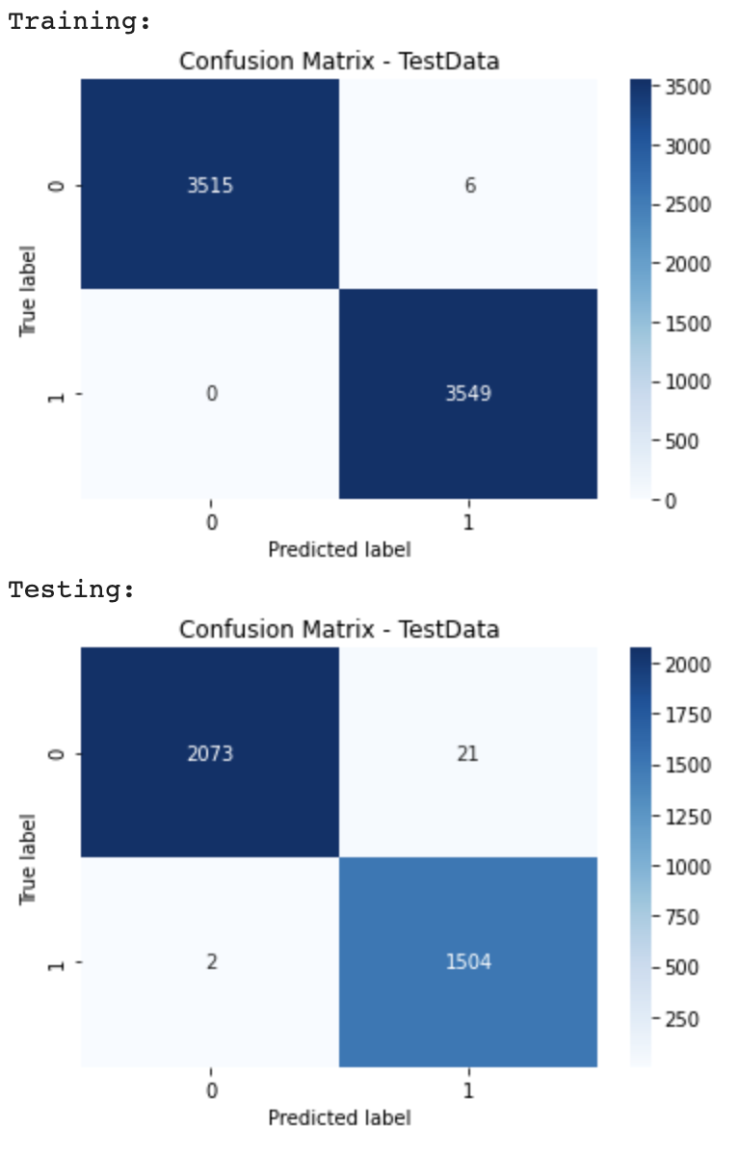
HOW CAN NEURAL NETWORKS HELP?
CNN: NN:
Notes:
Using neural networks we can get even more accurate results, and using convolutional neural networks will get even more accurate results as they are especially good with recognizing patterns

Slide 12
Discussion Question:
Why do we care about exoplanets?
Notes:
Can anyone tell me some reasons why we care about exoplanets? What could we learn from [them]? How can [they] benefit us? Please put your suggestions in the chat.

Slide 13
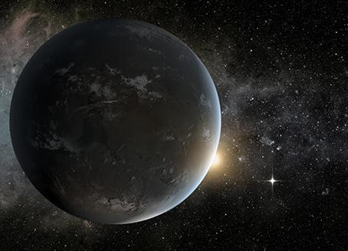
WHY DO WE CARE ABOUT EXOPLANETS?
Short Answer: Earth is eventually going to be absorbed by the Sun...
To look for other habitable planets
To look for life outside our solar system
Observing them allows us to learn more about the processes that create planets
Notes:
In the near to distant future, humanity might find itself in need of another planet to live on. And because the other planets in our solar system aren’t fit for humans, we need to search for others.
Exploring exoplanets raises the question of whether or not there is life on other planets. Who doesn’t like the idea of aliens? The discovery of another species is most definitely an exciting revelation, especially if that species is as intelligent - or more intelligent than - us humans.
Another reason why scientists in particular care about exoplanets is because it allows them to understand the processes that create planets. It could reveal new theories and laws that we haven’t learned before.

Slide 14
Thank you for participating!
Questions?
Notes:
We enjoyed making this presentation and we hope you enjoyed listening!
Does anyone have any questions?

