Slide 1


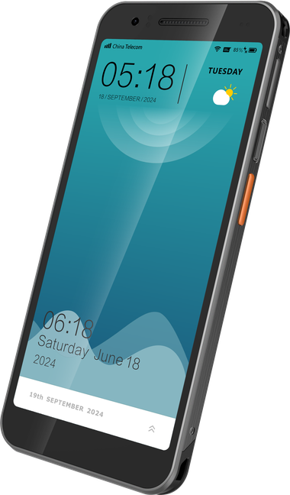
DT610 / FLAGSHIP PRODUCT
DT610
Lightweight RFID Mobile Computer
Barcode, UHF RFID and front-display NFC in one 222 g enterprise handheld.
01
Peak Performance
02
Built-in UHF RFID
Qualcomm QCM-6690, up to 2.9 GHz
Close-range verification, expandable with RFG91
6 TOPS of on-device AI provides power for smarter apps
and future business workflows. GMS/AER-qualified
platform, with UStage, OEMConfig and supported EMM
integrations.
Verify nearby tagged goods without a separate reader.
Pair DT610 with the optional RFG91 sled to extend RFID
read range to 15 m for larger inventory tasks.
03
Front-display NFC
04
Replaceable hot-swap battery
Customer-facing tap point for mobile checkout
Hot-swap power with smart battery management
Show the amount and accept a contactless tap on the
same side of the device. Front-display NFC supports
intuitive mPOS and SoftPOS workflows through approved
payment solutions.
Exchange a charged spare without shutting down the
handheld, keeping business apps available through the
shift. Smart battery management helps teams monitor
pack health and plan replacements.
222 g
12.9 mm
6″
DEVICE
WEIGHT
SLIM PROFILE
FHD+ DISPLAY
05
Modern wireless connectivity
06
Protection for everyday operations
5G, Wi-Fi 7 and Bluetooth 6.0
Standard: IP67 / 1.5 m; Pro: IP68 / 1.8 m
8 MP
16 MP
15
Keep frontline teams connected from the shop floor to the
field. Fast wireless links support live data, connected
peripherals and evolving business applications.
Use gloves or wet fingers for daily tasks. Choose DT610
Pro for stronger sealing and a 1.8 m drop-tested body
without an additional rugged boot.
FRONT
CAMERA
REAR CAMERA
ANDROID
VERSION
Fingerprint sensor in the power button.
Upgradeable to Android 19.
01 / 27

Slide 2

DT610 / APPLICATIONS & COMPETITIVE FIT
Workflows & competitive advantages
From mobile checkout to visual capture, parcel dimensioning and inventory counts.
Mobile checkout
Returns & replenishment
Front NFC + dedicated scanning
Integrated short-range UHF
Identify the item, show the amount and accept a
contactless tap through an approved SoftPOS
solution.
Verify nearby tagged goods, reconcile returns and
check local stock, with barcode capture available for
fallback.
AI Power
Inventory at scale
OPTION
AI Vision + optional 3D sensing
RFG91 sled, 15 m+ nominal range
Batch-identify barcoded products in one view; add a
3D structured-light clip to measure parcel volume for
shipping.
Add a dedicated reader for cycle counts, with a
stated 1,300+ tags/s maximum. Validate tags and
the counting process.
Where DT610 stands out
Exact models, published specifications, workflow-led selection
COMPARED WITH | DT610 ADVANTAGE TO DEMONSTRATE | SELECTION CONTEXT
Zebra EM45 RFID | Dedicated scan engine and hot-swap. 222 g versus 250 g by published device weights. | EM45 uses camera barcode scanning and a service-replaceable battery. Its larger display can suit some roles.
Bluebird X40 | Dedicated barcode capture and Wi-Fi 7. Compare repeated scanning and the complete working session. | X40 uses camera capture and Wi-Fi 6E. It is lighter at 199 g, with display and imaging strengths.
Zebra TC201 | Up to 2.9 GHz (FP4 option) in a 222 g device. Front-display NFC keeps the payment cue visible to the customer. | TC201: up to 2.0 GHz, 245 g. It also offers Wi-Fi 7, 5G and optional short- range UHF; compare the actual SKU and workflow.
02 / 27

Slide 3
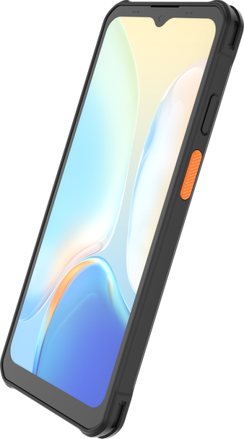
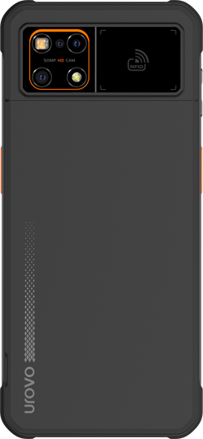
DT630 / ENTERPRISE SMARTPHONE
DT630
Enterprise Smartphone
A slim smartphone experience, with dedicated data capture for frontline work.
01
Power for business apps
02
Capture clear visual evidence
4 nm octa-core · 8/128 GB · NPU
50 MP rear camera · 4K video
Keep stock lookups, forms and communications
responsive. The dedicated NPU gives supported Edge AI
apps room to grow.
Document parcel condition in detail and link photos to
scanned IDs. Compatible OCR software can turn printed
labels or forms into task data.
03
Rear professional scanning
04
UHF without an extra reader
SE630 rear engine · 1D/2D · green LED
Impinj Gen2X · 50 tags/s
Aim directly at labels with the rear-mounted, laser-free
engine. A side trigger keeps repeated item checks fast
and natural.
Read groups of nearby tagged items without a bulky sled,
then reconcile returns, shelf stock or assets with business
records.
236 g
10.4 mm
6.6″
Protection for frontline work
Connect across the working day
05
06
DEVICE WEIGHT
SLIM PROFILE
FHD+ DISPLAY
IP68 · 1.5 m drop / 1.8 m with case
5G · Wi-Fi 6E · Bluetooth 5.4
500 nits
50 MP
15
Give teams a slim, pocketable handset that stands up to
dust, rain and routine drops across the store, warehouse
and field.
Move jobs and photo evidence over site Wi-Fi or field
cellular; dual-frequency GNSS supports delivery and
service location tasks.
BRIGHTNESS
REAR CAMERA
ANDROID
VERSION
UHF is optional.
Upgradable to Android 20.
03 / 27

Slide 4
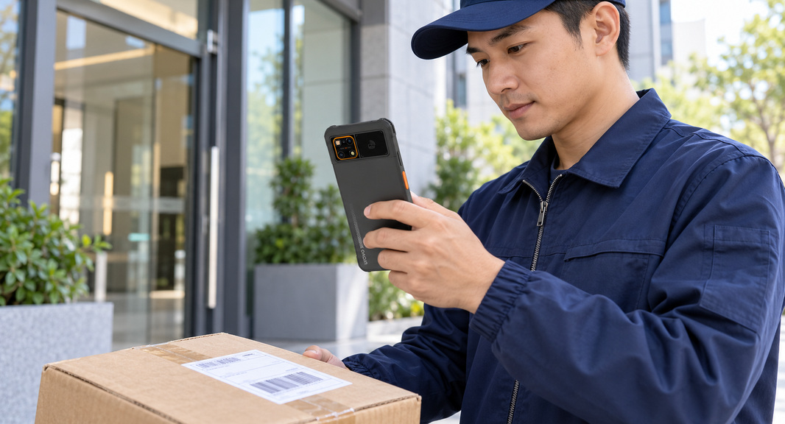
DT630 / APPLICATIONS & COMPETITIVE FIT
One device, from stockroom to doorstep
Scan the item. Capture the evidence. Complete the task where the work happens.
Retail & backroom
Parcel pickup & delivery
Dedicated barcode + optional UHF
Rear scanning + 50 MP imaging
Check prices, confirm returns and verify nearby
tagged stock, then update the inventory application.
Link the parcel ID to condition photos and delivery
records, reducing ambiguity when exceptions occur.
Field service & inspection
AI shelf auditing
6.6″ forms + 5G + L1/L5 GNSS
50 MP capture + compatible AI software
Review work orders, capture asset IDs and submit
inspection evidence without returning to a desk.
Capture a full shelf; AI software can flag gaps,
misplaced items and price-label mismatches against
the planogram.
Where DT630 stands out
Exact models, published specifications, workflow-led selection
COMPARED WITH | DT630 ADVANTAGE TO DEMONSTRATE | SELECTION CONTEXT
Samsung XCover7 / XCover7 Pro | Dedicated rear scanning and 8 GB RAM. More RAM than the referenced 6 GB Samsung variants. | Pro also has Wi-Fi 6E / BT 5.4. Compare the scanning workflow and each vendor’s lifecycle commitments.
Zebra EM45 (non-RFID) | Dedicated scanning; user-replaceable battery. Add optional built-in UHF on the specified DT630 version. | EM45 uses camera capture and a service-replaceable battery. Its display is larger at 6.7″.
Bluebird X40 | Dedicated scan engine in a thinner body. 10.4 vs 12 mm; larger 6.6″ vs 6.11″ display. | X40 is lighter at 199 g, with AMOLED, assisted camera scanning and warm- swap. Compare real tasks.
04 / 27

Slide 5
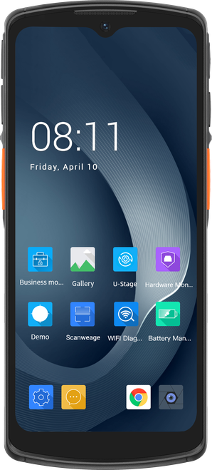
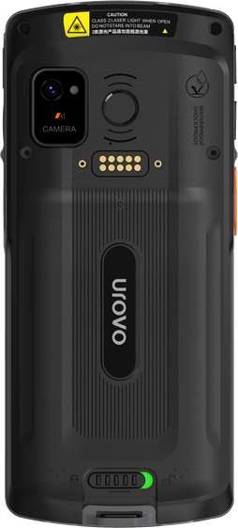
DT66 / PREMIUM 5G RUGGED MOBILE COMPUTER
DT66
5G Rugged Mobile Computer
A large workspace, professional capture and hot-swap power for demanding frontline shifts.
01
A platform for managed fleets
02
More room for the task
Android 15 · Qualcomm 2.4 GHz
6.5″ display · glove and wet-finger input
Run stock, delivery and service apps on the Android 15
version. UStage helps configure devices consistently;
optional fingerprint supports local unlocking.
Keep order lines, item details and exception forms
readable at the point of work, even when staff use gloves
or work around moisture.
03
Keep the session through a swap
04
Tap on the side the task needs
5000 mAh · documented hot-swap
Front-display and rear NFC · switchable
With a charged spare, the internal bridge keeps the
display, Wi-Fi and running apps powered during a timely
battery change.
Choose the NFC face in software for credential checks or
tag reading without forcing the operator to turn the whole
workflow around.
6.5″
5000
5G
Connected indoors and outside
Built for daily handling
05
06
LARGE
DISPLAY
mAh · HOT-SWAP
MOBILE DATA
5G · Wi-Fi 6E · Bluetooth 5.2
IP68 · 1.5 m drop · 400 × 1 m tumbles
IP68
10 m
15
Move work orders and stock updates across site Wi-Fi
and field cellular networks; connect compatible headsets
and printers by Bluetooth.
A sealed, rugged body handles dust, water exposure and
repeated knocks in receiving, warehouse and mobile
service work.
PROTECTION
OPTIONAL SCAN
RANGE
ANDROID
VERSION
Optional fingerprint sensor shown.
05 / 27

Slide 6

DT66 / APPLICATIONS & COMPETITIVE FIT
Ready for the floor. Connected in the field.
From replenishment and receiving to mobile service, keep the task on one handheld.
Retail & replenishment
Warehouse Receiving & Stocktaking
6.5″ workspace + professional scanning
IP68 + 5G / Wi-Fi 6E
Check prices and stock, confirm returns and follow
replenishment tasks while staying near the
customer.
Scan arrivals, verify quantities and pick against
orders. Professional capture and live data help keep
stock records accurate.
Delivery & field service
Shared fleets, successive shifts
5G + vehicle mount + 13 MP camera
Hot-swap + spare-pack charging + staging
Access routes or work orders, identify parcels or
assets, and attach condition photos to the job
record.
Keep a work session through a controlled battery
swap, then prepare consistent apps and devices for
the next team.
Where DT66 stands out
Exact models, published specifications, workflow-led selection
COMPARED WITH | DT66 ADVANTAGE TO DEMONSTRATE | SELECTION CONTEXT
Zebra TC27 | Larger 6.5″ workspace; 5000 mAh standard pack. TC27 publishes a 6″ display and 3800 mAh base battery. | TC27 also offers 5200 mAh. Compare the quoted battery, screen resolution and carried ergonomics.
Zebra TC101 | 6.5″ display, 5000 mAh base pack and dual-face NFC. TC101’s referenced base is 6″ / 3800 mAh. | TC101 is lighter and slimmer at 236 g / 12.5 mm, and offers a 5200 mAh extended pack. Compare the quoted SKU.
Honeywell CT37 | Larger touch workspace and a 5000 mAh pack. Demonstrate the complete form-and-scan task on the 6.5″ screen. | CT37 has a 6″ FHD+ screen, hot-swap and FlexRange options. Compare fit, resolution and software.
06 / 27

Slide 7
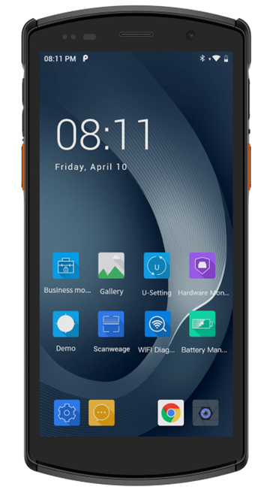
DT50S / UROVO BESTSELLING PDA
DT50S
Rugged Mobile Computer
Professional data capture and field performance for retail, logistics and manufacturing.
01
Choose the right capture engine
02
A clear workspace on the move
Standard · advanced-range · DPM options
5.7″ touch display · gloves and wet fingers
Match the optics to retail labels, suitable distant codes or
direct part marks. Capture paper and screen barcodes
with the engine selected for the job.
Review item details, picking lists and exception forms on
the same handheld. Glove and wet-finger input support
work around changing conditions.
03
Strong Field Performance
04
Protection backed by testing
Android 16 · 2.45 GHz octa-core · up to 8/128 GB
IP67 · 1.5 m drop · 400 × 1 m tumbles
Keep business apps and capture tools ready on one
device. Choose the RAM configuration for the app mix
and use UStage to standardize fleet setup.
A rugged body and documented handling tests suit
receiving, store operations and mobile work, helping
teams handle dust, water exposure and daily knocks.
5.7″
5000
IP67
Connected on site and on route
NFC for compatible credentials
05
06
TOUCH
DISPLAY
mAh ·
REPLACEABLE
SEALING
4G · dual-band Wi-Fi · Bluetooth 5.0
13.56 MHz · ISO 14443 / ISO 15693
8/128
13 MP
16
Update stock and work orders over site WLAN, then use
4G on delivery routes. Connect supported printers or
headsets and validate roaming on the site network.
Read compatible cards or tags for membership, asset or
access workflows. Pair the captured ID with the business
application and its permission rules.
GB RAM / ROM
· UP TO
REAR CAMERA
ANDROID
VERSION
Optional capacitive fingerprint unlocking.
DPM Scanner is optional.
07 / 27

Slide 8
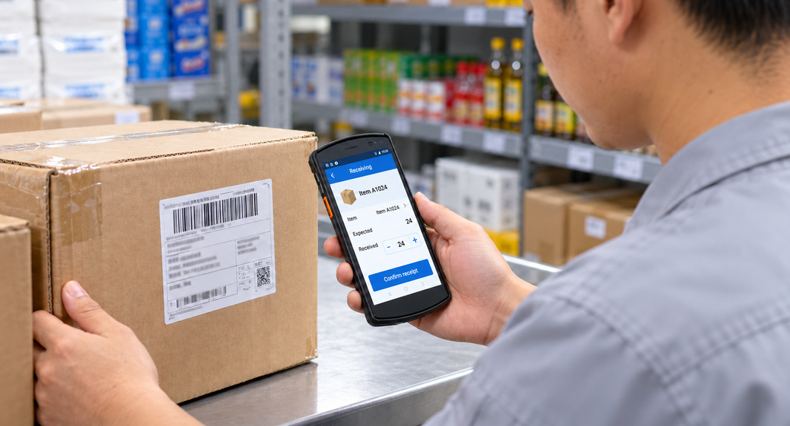
DT50S / UROVO BESTSELLING PDA
Retail, warehouse and production workflows
Select the scanner and memory around retail, logistics and production tasks.
Retail & stock checks
Receiving & shelf picking
Screen-barcode capture + 5.7″ touch UI
Advanced scan option: 6 cm–10 m
Check prices, confirm returns and read compatible
electronic vouchers, with item records updated in
the store app.
Use the qualified near/far engine for counter labels
and suitable distant shelf codes, reducing
repositioning.
Multitasking in the field
Manufacturing traceability
2.45 GHz octa-core + up to 8/128 GB
Dedicated high-density DPM option
Keep WMS, scanning, camera and push-to-talk
apps active for warehouse picking, parcel sorting
and airport baggage handling.
Capture validated direct part marks and associate
the part ID with an operation, inspection or
maintenance record.
Where DT50S fits best
Exact models, published specifications, workflow-led selection
COMPARED WITH | DT50S VALUE TO DEMONSTRATE | SELECTION CONTEXT
Honeywell EDA52 | Scanning choices and a larger standard battery. DT50S: 5.7″ / 5000 mAh; EDA52: 5.5″ / 4500 mAh. | Compare the quoted engine and memory. Battery capacity alone does not prove longer runtime.
Newland MT93 Pro Straight Shooter | Larger display and a thinner published body. 5.7″ / 13.6 mm versus 5.5″ / 15.9 mm. | The current Newland variant offers Wi-Fi 6E, eSIM and 6/128 GB. Compare the exact configuration.
Seuic CRUISE GeP | 5.7″ display in a thinner 13.6 mm body. GeP: 5.5″ / 14.4 mm; DT50S also offers optional DPM. | The supplied GeP configuration lists Wi-Fi 6E and IP68. Match the regional SKU and scanner to the task.
08 / 27

Slide 9

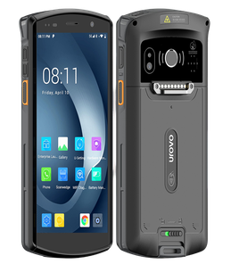
DT50 FAMILY / PLATFORM UPGRADE
DT50 Pro
The enhanced platform
Upgrade compute, connectivity and imaging while keeping the DT50 accessory ecosystem.
01
A newer platform for business apps
Android 16 (Upgradable to Android 21) · 6 nm Qualcomm Octa-Core 2.4GHz
Move to a newer OS and processor platform for supported business apps, without changing
the familiar DT50 form factor.
02
Wireless capacity for busy sites
Wi-Fi 6E 2×2 MU-MIMO · Bluetooth 5.3
Use compatible 6 GHz infrastructure for additional Wi-Fi capacity and connect supported
headsets or wearables on the newer Bluetooth platform.
03
More image resolution for evidence
16 MP PDAF rear camera · DT50S: 13 MP
Document damage, delivery exceptions and inspection details, then link the image to the
scanned item in the business app.
A16
6E
16 MP
04
More work from the same battery
ANDROID BASELINE
WI-FI · 2×2
REAR CAMERA
5000 mAh · 9.5 h → 14 h · ~50% longer runtime
A more efficient 6 nm platform replaces the 11 nm generation. The published ambient
comparison shows more working time per charge for warehouse and store tasks.
STORE EXCEPTION
01
Scan item
02
Photograph exception
03
Upload record
04
Resume the task
DT50S and DT50 Pro have the same form factor. All accessories are compatible.
09 / 27

Slide 10


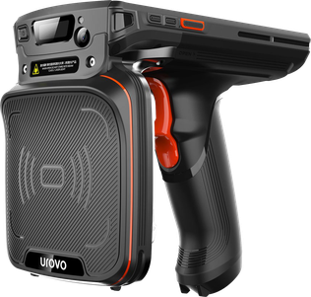
DT50 FAMILY / LONG-RANGE UHF RFID
DT50P
Long-range RFID inventory
Count tagged stock across warehouse aisles and fashion floors with one integrated reader.
WAREHOUSE · PALLET AND SHELF COUNT
FASHION RETAIL · RACK INVENTORY
THE RFID ADVANTAGE
One sweep. More inventory accounted for.
Impinj E710 · published 1,300+ tags/s*
Nominal read up to 20 m*
Integrated pistol grip
Capture many tagged items without aiming at each barcode, then compare EPCs with expected stock in the inventory app. Long reach helps staff cover high
shelves and dense apparel racks from the working aisle; tune the read zone to avoid adjacent stock.
BATCH INVENTORY
01
Select the count area
02
Sweep tagged stock
03
Reconcile EPCs
04
Resolve exceptions
DT50P Lite is 180 g lighter than DT50P, making extended handheld use more comfortable.
10 / 27

Slide 11
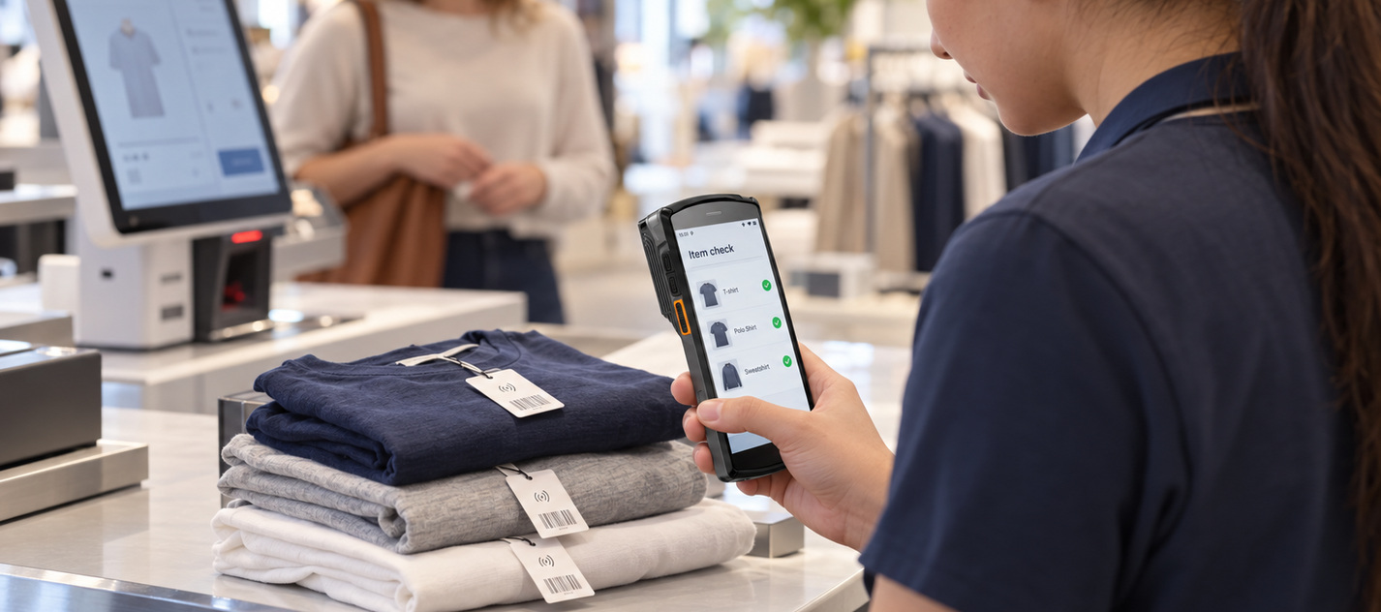

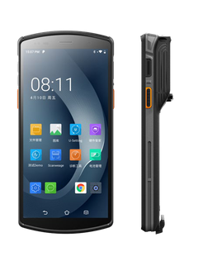
DT50 FAMILY / SHORT-RANGE UHF RFID
DT50D
RFID for nearby verification
Identify tagged items at the service point with an RFID reader built into the handheld.
SELF-CHECKOUT · EXCEPTION RECOVERY
SPORTS RETAIL · SERVICE DESK
THE RFID ADVANTAGE
Verify the item while serving the customer.
Integrated Impinj E310 · no separate pistol grip
UHF read/write + barcode fallback
Up to 1.5 m · 3 m option*
Read a nearby tag, match its EPC to the item record and resolve a return, stock query or missed self-checkout item in the connected app. The compact form
keeps RFID available at the counter; barcode capture covers missing or unreadable tags.
ASSISTED SERVICE
01
Receive the item
02
Read its tag
03
Confirm the record
04
Resolve the query
11 / 27

Slide 12
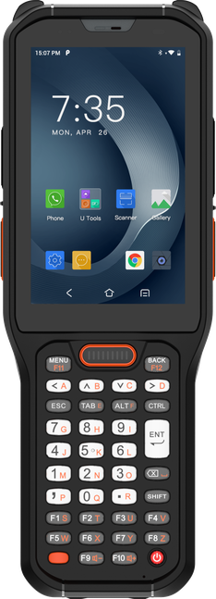
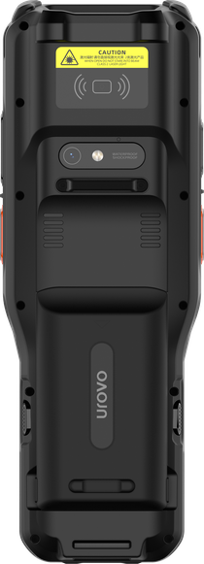
RT40S / WAREHOUSE & COLD-CHAIN MOBILE COMPUTER
RT40S
Keypad Warehouse Computer
Physical keys, extended-range capture and optional heated operation for warehouse teams.
01
Heated cold-chain option
02
Capture high-rack labels
−30°C option · heated screen & imager
Up to 15 m · extended-range option
Work in frozen storage with heaters for the screen and
scan window. Cold-chain configurations are available with
the 38- and 51-key layouts.
Read suitable rack and pallet labels from farther away to
reduce repositioning. Choose the engine around the label
size and actual working distance.
03
Physical keys for repeated work
04
Hot-swap between work cycles
29 / 38 / 51 keys · 4″ touch display
5200 mAh · replace without reboot
Enter quantities, bin codes and short IDs directly on
physical keys. Keep common WMS actions within reach
when gloves make touch input awkward.
Exchange a charged pack without restarting the terminal.
Spare batteries and multi-slot charging support handovers
across successive shifts.
4″
5200
IP68
Protection for warehouse handling
Stay connected across the site
05
06
TOUCH
DISPLAY
mAh · HOT-SWAP
PROTECTION
IP68 · 1.8 m drop rating
Wi-Fi 6 · 2×2 MU-MIMO · 4G
−30°C
15 m
13
A sealed, rugged body helps handle dust, water exposure
and daily knocks around racks and loading bays, with a
narrow 58 mm housing for carrying.
Update WMS tasks over site WLAN, with 802.11r roaming
on compatible networks. Use the regional 4G
configuration when work moves beyond Wi-Fi.
COLD-CHAIN
OPTION
MAX SCAN ·
OPTION
ANDROID
VERSION
Cold-chain option: 38- or 51-key models.
12 / 27

Slide 13

RT40S / APPLICATIONS & COMPETITIVE FIT
Warehouse workflows & competitive fit
Choose the keyboard, scan engine and temperature configuration around the actual job.
Frozen-storage picking
High-rack inventory
−30°C option + screen / imager heating
Extended-range scanning + physical keys
Follow picks with gloves on, scan cartons and
confirm quantities. Match the cold-chain unit and
battery to the temperature profile.
Read suitable elevated location and pallet labels,
enter counts and resolve exceptions from a stable
working position.
Receiving & dispatch
Manufacturing & asset checks
1D/2D capture + 13 MP camera + Wi-Fi 6
NFC read/write + barcode capture
Link carton IDs to received quantities and damage
photos, then update the WMS before putaway or
dispatch.
Identify compatible NFC-tagged tools or containers
and update records in a paired app, with barcode
capture for other items.
Where RT40S stands out
Temperature, input method and workflow drive the choice
COMPARED WITH | RT40S ADVANTAGE TO DEMONSTRATE | SELECTION CONTEXT
Zebra MC3400 / MC3450 | Optional heated −30°C operation and 51-key layout. RT40S lists IP68; Zebra lists IP65 / IP67. | Zebra offers Wi-Fi 6E and a 7000 mAh pack; MC3450 adds 5G. Compare the actual cold-room requirement.
Honeywell CK62 | IP68 and a dedicated cold-chain configuration. Screen and imager-window heating target frozen-storage work. | CK62 lists IP65 and −20°C minimum operation, with Wi-Fi 6E and selected 5G configurations.
Newland N7 Cachalot Pro II | IP68 sealing and a 51-key option. N7 Pro II lists IP65 and 29 / 38 / 47-key layouts. | N7 Pro II also has Android 13, hot-swap and near/far scanning. Demonstrate the full task on the quoted variants.
13 / 27

Slide 14
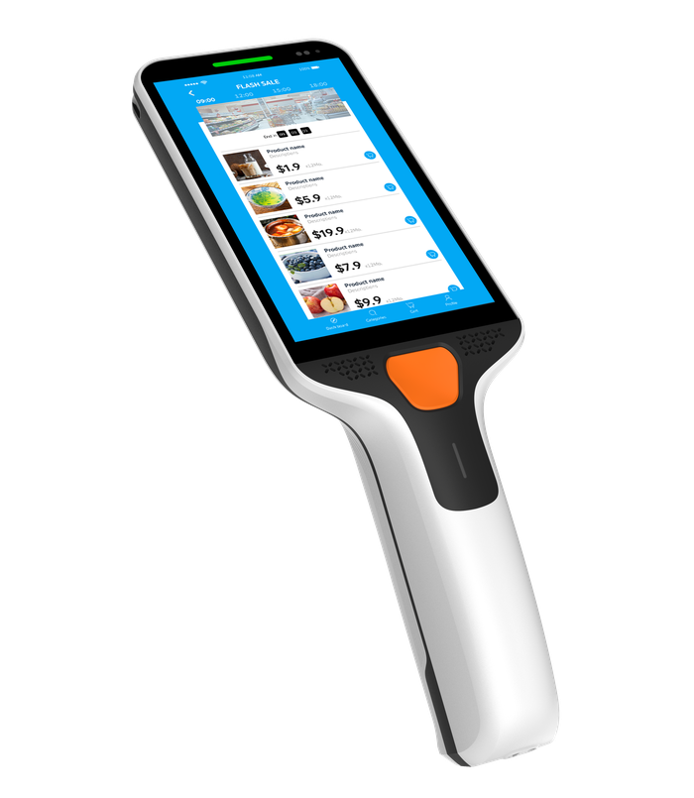
SP35 / PERSONAL SHOPPER
SP35
Personal Shopper
Self-scanning, front-facing NFC and optional indoor guidance in a dedicated shopping terminal.
01
A platform for evolving apps
02
One device for scan and pay
Q-6690 · 2.9 GHz · Android 15 → 20
Front-facing NFC · supported SoftPOS
Run shopping, guidance and payment apps on a capable
platform with a published Android upgrade target.
Identify members and offer contactless checkout on the
same device, using a supported payment application and
provider.
03
Durability for customer use
04
Help at the press of a button
IP65 · 1.5 m drop · 1000 × 0.5 m tumbles
Programmable PTT key · dual microphones
Keep a shared shopper-device pool ready for repeated
handling, everyday bumps, dust and water-jet exposure.
A shopper can request assistance with one press; the
connected service workflow can route staff to their
location.
DESIGNED FOR SELF-SHOPPING
05
Cart scanning without lifting
06
Guidance and device recovery
5″
2.9 GHz
IP65
Professional 1D/2D capture · cart-holder auto-scan
Optional UWB · indoor positioning
Scan items while the terminal sits in its cart holder.
Shoppers can handle goods naturally as the connected
app builds the basket.
Guide shoppers to products and locate misplaced
terminals, including up to 48 hours after power-off with a
deployed positioning solution.
TOUCH DISPLAY
CPU FREQUENCY
SEALING
6E
16 MP
15
WI-FI
REAR CAMERA
ANDROID
Upgradable to Android 20
UWB optional
14 / 27

Slide 15
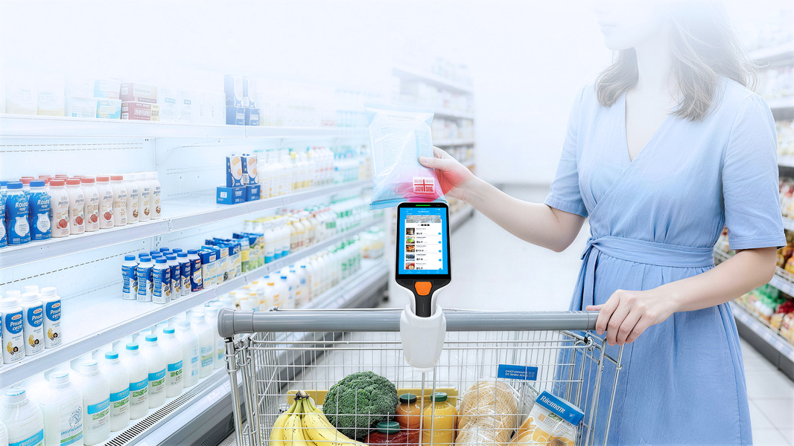
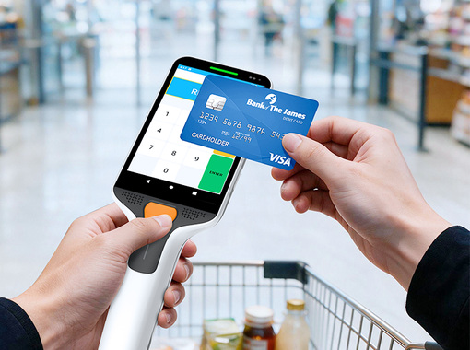
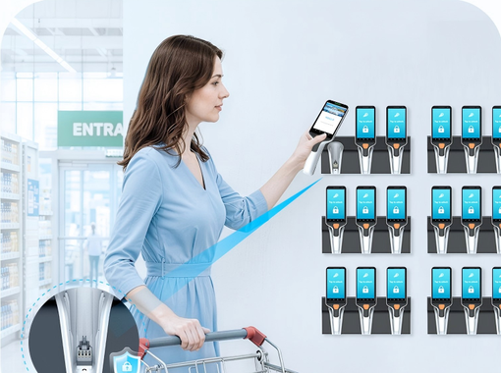
SP35 / THE IN-STORE SHOPPING JOURNEY
Self-shopping, from entry to checkout
Designed for supermarkets, membership clubs and department stores.
01
Collect and identify
02
Scan, check and find
Membership-card unlock + locking cradle
Cart auto-scan + optional UWB guidance
Release a device with a membership card. The retail
application can associate the shopping session with
the member, supporting controlled device issue.
Check prices and basket contents while shopping.
Optional indoor guidance helps find items; the side
key can request staff assistance.*
03
Complete contactless checkout
04
Return, lock and recharge
Front NFC + supported SoftPOS solution
Three-slot cradle + serviceable contacts
Finish an eligible shopping transaction on the same
handheld. Contactless payment can support self-
checkout or staff queue busting in the store.*
Return the terminal to a cradle that locks and
charges it. An open base reduces debris buildup;
modular pogo pins support local maintenance.*
Official SP35 illustration: auto-scan with the terminal in its shopping-cart holder.
Selected advantages versus Zebra
Matched to published configurations
ALTERNATIVE | SP35 DIFFERENCE | CUSTOMER VALUE
Zebra PS30 | 5″ vs 4.7″ screen; 4900 vs 3500 mAh battery. | More display area and 40% higher nominal battery capacity.*
Zebra PS20 | 5″ HD vs 4″ WVGA; Wi-Fi 6E vs 802.11ac. | A larger, higher-resolution UI and a newer WLAN platform.*
Tap on the front of the screen
Supported SoftPOS checkout*
Controlled collection and return
Locking three-slot charging cradle*
Also for store teams: click-and-collect picking, replenishment and returns, with UStage/UMS fleet tools.
15 / 27

Slide 16
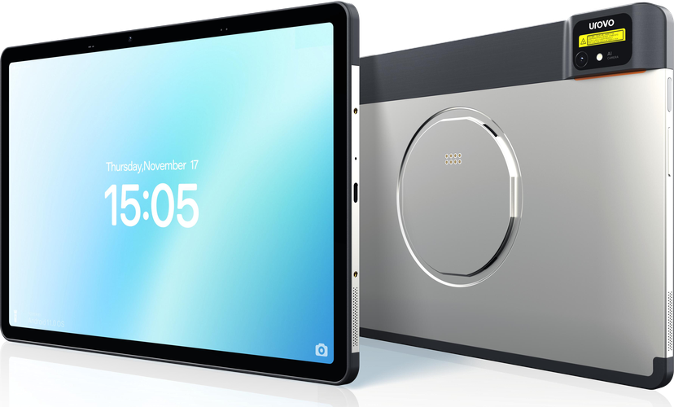
UPAD / SMART COMMERCIAL TABLET
UPad
Smart Commercial Tablet
An 11-inch workspace combining business data capture, supported payments and modular counter setups.
01
A platform for retail applications
02
Dedicated barcode capture
Android 16 · 4 nm octa-core platform
Integrated 1D/2D engine · FlexRange option
Run POS, stock and service apps on Android 16, with
room for demanding commercial workflows.
Scan products into the business app without carrying
a separate reader; match optics to the task.
03
Nearby RFID without a sled
04
Tap to pay on the display
Optional built-in UHF · up to 1.5 m
Front NFC · supported SoftPOS solutions
Read compatible nearby stock or asset tags, then
reconcile item IDs on the tablet’s larger screen.
Show the bill and accept supported contactless
payment on the same tablet, with the right provider.
QUICK-LOCK REAR INTERFACE
11″
542 g
IP54
05
Connected on site and on the move
06
Mobile and counter on one device
WUXGA DISPLAY
BODY WEIGHT
SEALING
Wi-Fi 6E · 4G · optional Wi-Fi HaLow
Magnetic Quick-Lock · modular accessories
450 nits
16 MP
16
Keep ordering and stock workflows connected on site
or in the field. Evaluate optional HaLow where the site
has compatible infrastructure.
Detach for mobile service and dock for counter work
with compatible accessories.
BRIGHTNESS
REAR CAMERA
ANDROID
Upgradable to Android 20
16 / 27

Slide 17

UPAD / APPLICATIONS & SAMSUNG COMPARISON
Counter service and mobile operations
One commercial tablet platform for cafés, retail floors and hospitality service points.
Café ordering and receipts
Tableside service and payment
UStation / printer-equipped UStation Max
Quick-Lock accessories + front NFC
Take an order on the cashier-facing screen. Choose
UStation Max where a printer-equipped counter
setup is required.
Carry the tablet to the table, review the order and
accept supported contactless payment, then return it
to its station.
Retail stock checks and returns
Hotel and fixed service points
Barcode engine + optional nearby UHF
11-inch interface + mounting options
Scan a product for stock or returns. With the UHF
option, read compatible nearby tags and reconcile
items in the retail app.
Use the larger interface for guest check-in or
assisted sales; a compatible mount can create a
fixed service point.
Two counter configurations
Where UPad fits versus Samsung
Specific published regional models
UStation
SAMSUNG REFERENCE | UPAD DIFFERENCE | BEST-FIT DISTINCTION
Galaxy Tab A11+ Wi-Fi | Integrated scanner + front NFC; optional UHF RFID. A11+ reference SKU: no NFC. | UPad for capture and payment workflows; A11+ is lighter for general tablet use.
Galaxy Tab Active5 Pro | 11″ vs 10.1″; 542 g vs 683 g. Dedicated barcode scan engine. | UPad for counter and mobile capture; Samsung for IP68, 5G and hot-swap needs.
Counter configuration
without a printer
UStation Max
Printer-equipped configuration
for receipt workflows
Quick-Lock supports switching between counter and mobile tasks.
Shared with Active5 Pro: front NFC and Wi-Fi 6E. Validate the complete solution.
17 / 27

Slide 18
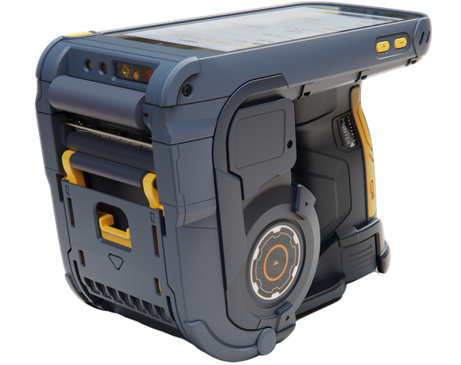
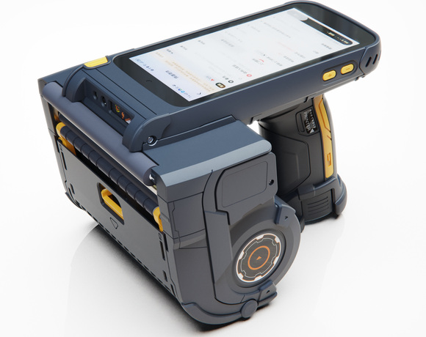
K388 PRO / MOBILE LABELING TERMINAL
K388 Pro
Mobile Labeling Terminal
Scan, process, print, peel and apply labels where the work happens — in two label-width formats.
01
Label where the work happens
02
Professional barcode capture
2″
4-in-1: scan · print · peel · apply
Integrated 1D/2D scan engine
Label beside the goods, reducing trips to a fixed
printer and loose-label handling.
Read product and screen codes into the labeling
workflow, with fewer separate devices to handle.
Compact
labeling format
Up to 48 mm
print width
03
Clear labels and reusable layouts
04
RFID encoding when required
Original 2-inch product render
203 dpi · CPCL / ZPL / TSPL
Optional UHF RFID tag writer
Print clear thermal labels and test existing command-
language layouts for reuse in the workflow.
Encode the tag and verify its EPC within the labeling
workflow, alongside printed content.
4″
Wide-label
format
05
Power continuity across shifts
06
Reload for the next labeling task
Hot-swap battery · four-slot battery charger
Quick-release magazine · gap / black mark
Up to 104 mm
print width
Keep the terminal powered during battery exchange;
prepare charged spares for the next session.
Load compatible media and calibrate positioning;
prepare rolls for the next labeling task.
Original 4-inch product render
RFID encoding is optional
18 / 27

Slide 19
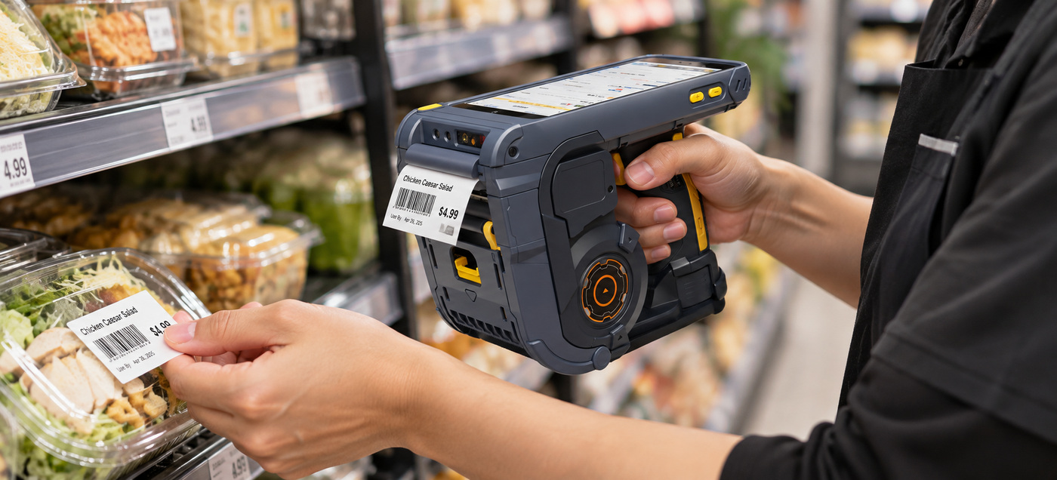

K388 PRO / ON-SITE LABELING SCENARIOS
Two label widths for work beside the goods
Keep item identification, label preparation and application together at the point of work.
2″ Retail relabeling
4″ Receiving and carton labeling
Damaged labels · RFID labels · approved markdowns · product re-ticketing
Wider carton labels · routing marks · dispatch identification
Replace a damaged product label or print an approved markdown at the shelf.
Keeping lookup, printing and application together reduces trips to a fixed print
station and helps avoid mixing labels between items.
At receiving or dispatch, print a wider carton or routing label beside the goods.
Review the order on-screen, use the correct wide layout and confirm the printed
barcode in the logistics app.
01
Scan source barcode
02
Review approved item data
01
Scan carton or order
02
Select the wide template
03
Print and peel
04
Apply to the correct item
03
Print the carton label
04
Apply and confirm
19 / 27

Slide 20
i9600 MINI / SMART MOBILE TERMINAL
i9600 Mini
Smart Mobile Terminal
A pocketable 6.7-inch handheld for store operations, with optional scanning and no onboard printer.
01
A current Android platform
02
Barcode capture on one device
Android 15 with GMS · Octa-core A75 2.0 GHz · 3 GB + 32 GB
Optional scan engine · 5 MP AF rear camera
Run store, product lookup and inventory apps on a current
Choose a professional scan engine where needed. The
Android platform with Google services.
rear camera supports code capture, with 16 MP available
as an option.
Built-in NFC
03
NFC built in
04
Replaceable power for mobile work
Integrated NFC · no external reader
5,000 mAh removable · 5 V / 2 A adaptor
Read compatible NFC tags and connect them to supported
Replace a depleted battery with a charged spare. Optional
membership, lookup or other business app workflows.
magnetic charging simplifies cable connection.
6.745″
298 g
17 mm
05
Connected on site and in the field
06
A compact body without a printer
DISPLAY · 720×1600
BODY WEIGHT
SLIM PROFILE
4G LTE · Wi-Fi ac · BT 5.0 · four GNSS systems
177 × 79.8 × 17 mm · 298 g · hand strap included
5,000
16 MP
15
Keep orders and stock checks connected. Dual SIM, two
Carry one handheld for store service and stock tasks, with
mAh
SAM slots and MicroSD are standard; eSIM is optional.
a printer-free body where receipts are produced
REMOVABLE
REAR CAMERA
ANDROID · WITH
elsewhere.
BATTERY
OPTIONAL
GMS
Non-financial configuration · no onboard printer · Android 15 with GMS
20
/ 27
Notes:
i9600 Mini Smart Mobile Terminal · non-financial configuration · source checks: November 2, 2026
Platform and source editionThe controlling source is the user-designated i9600 Mini Smart Mobile Terminal (EN)-SPEC-20260908 DOCX. Its table lists octa-core A75 2.0 GHz, Android 15 with GMS, 3 GB RAM + 32 GB ROM and a 6.745-inch 720×1600 display. No performance benchmark, future OS upgrade commitment or multi-app performance guarantee is inferred. The separate Smart MiniPOS specification is not used./Users/patrickxu/Downloads/debuglogger/i9600 Mini Smart Mobile Terminal (EN)-SPEC-20260908.docx
Barcode and camera configurationThe rear camera is 5 MP AF as standard and 16 MP AF as an option. The professional scan engine is optional. There is no front camera as standard; 2 MP FF and 16 MP AF front cameras are optional. Camera code capture follows the supplied customer copy and matching September Smart Mobile specification. Test the selected camera/app or scan engine on the actual labels; no decode-speed or accuracy result is claimed.
NFC and non-financial positioningThe original DOCX lists NFC. The matching September Smart Mobile specification describes built-in under-display NFC. The slide calls out built-in NFC without asserting payment certification or an exact antenna boundary. This source does not establish EMVCo, PCI or a supported SoftPOS payment solution for this configuration. Membership, tag identification and lookup scenarios require compatible tags and business software. No on-device bank-card acceptance is advertised.
Battery and chargingThe DOCX specifies a removable 3.85 V / 5,000 mAh lithium-polymer battery and a 5 V / 2 A adaptor. Nominal energy is 19.25 Wh (calculated as voltage × capacity). Removable does not mean hot-swappable: save work and follow the operating procedure before a battery exchange. The optional four-pin magnetic pogo interface and optional magnetic charging cable are listed separately. No charging-time, full-shift runtime or uninterrupted battery-swap claim is made.
Networks, location and card slotsStandard communications: FDD-LTE, TDD-LTE, WCDMA, GSM; Bluetooth 5.0; IEEE 802.11 a/b/g/n/ac at 2.4 and 5 GHz. Positioning lists GPS, A-GPS, BeiDou, GLONASS and Galileo; no positioning accuracy is asserted. Default slots: one Micro SIM + one Nano SIM + two SAM + one MicroSD. Optional slot configuration replaces the Micro SIM with eSIM while retaining Nano SIM, two SAM and MicroSD. Application, carrier and regional configuration compatibility must be checked.
Physical and environmental specification177 × 79.8 × 17 mm; 298 g; power button, volume +/- and custom key. Operating temperature 0–50°C; storage -20–70°C; 5–95% RH non-condensing. The source has no IP rating or drop rating. No weatherproof, industrial ruggedness or vehicle-mount compatibility is implied. The hand strap is standard and no onboard printer is specified. Printed receipts are an external workflow, not an included printer accessory.
Accessories and interfacesStandard accessory: hand strap. Optional accessories: Kensington security lock, screen protector and magnetic charging cable. Standard interfaces: USB Type-C USB 2.0 OTG and five-pin pogo. Optional interface: four-pin magnetic charging pogo. No charging dock, multi-slot cradle, scan handle, spare-battery sales kit or mounting accessory is added to the supplied accessory list. Prepare charging spares only where supplied for the project.
Official competitor sources and comparison scopeSUNMI L3 official Chinese datasheet, page 2: SUNMI OS 4.0 based on Android 14; 6.75-inch 720×1600 display; 4/64 GB or 6/128 GB; 175×79×15 mm; 282 g; IP68; 1.5 m concrete drop; -20–55°C operation. Its default card layout is one Nano SIM + MicroSD or two Nano SIM, with optional PSAM and eSIM. Its battery is 4.4 V / 5,000 mAh and hot-swap is optional in this sheet. Dual-sided NFC is qualified to the non-RFID version. The official website describes EMVCo PCD L1, SoftPOS, fingerprint and optional UHF capabilities. These are L3 strengths, not i9600 Mini features. The visible row compares OS and card-slot layouts; it does not assert that L3 lacks GMS.iMin Swift 1 Pro official product page: Android 13, GMS, 4/32 GB, 6.5-inch 720×1600 display, optional NFC, 4G, Wi-Fi ac and Bluetooth 5.0; base PDA weight 245 g; IP54 and 1 m drop. The page lists 168.3×79.3×17.2 mm; the official modular brochure lists a different base-body size, 77×162×11 mm, and optional scanner/printer modules. Dimensions are omitted from the comparison to avoid mixing revisions or configurations. Weight is for the base PDA; a scanner module adds weight. Both sources specify a 7.6 V / 2,500 mAh / 19 Wh battery, so the 5,000 mAh i9600 Mini is not presented as double the energy or runtime. GMS is shared. No matched price, TCO, CPU performance or certification superiority is claimed.The visible comparison lists i9600 Mini configurations in the middle column and the named competitor configurations in the right column. It is not an exhaustive specification matrix. Public sources and configurations can change; confirm the regional SKU before quoting.
Product artwork and scenario provenanceThe original product rendering is extracted unchanged from word/media/image3.png in the controlling DOCX. Transparent margins are clipped with CSS only; device proportions are preserved. The source artwork shows a front-camera appearance, which does not make a front camera standard. UROVO branding is reused from the existing series.The retail scene is generated with the built-in image_gen tool using that original rendering as the hardware reference. It is an illustrative stock-check workflow, not a customer deployment, a supplied business app, or evidence of payment certification. The final prompt and asset paths are retained in i9600_Mini_Sources.md beside this deck.
Web reference: products/i9600_Mini_Product_Presentation.html
https://cdn.sunmi.com/public/generalfile/mgt_import/9c0368888c3f4574a90d29277845f3df.pdf
https://imin.com/wp-content/uploads/2025/04/Swift-1-Pro.pdf
https://www.imin.com/product/swift-1-pro/

Slide 21
i9600 MINI / APPLICATIONS & COMPETITIVE FIT
Store operations, in hand
Stock checks, customer assistance and mobile service on one Android 15 handheld.
In-aisle orders and assistance
Stock checks and returns
Android 15 · 4G LTE · built-in NFC
Optional scan engine · camera decoding
Look up products, check prices and take orders
Capture an item ID for stock, replenishment or
beside the customer; read compatible membership
returns in the business app.
tags.
Field and delivery workflows
Fixed points and mobile shifts
4G LTE · GPS / BeiDou / GLONASS / Galileo
Removable battery · optional magnetic charging
Use route lookup, status updates and digital receipt
Prepare charged spares and connect charging at a
confirmation in compatible apps.
service point; produce printed receipts elsewhere.
Retail stock-check illustration
Accessories for everyday work
Where i9600 Mini fits
Published reference specifications
Standard
Hand strap
REFERENCE MODEL | I9600 MINI CONFIGURATION | COMPETITOR CONFIGURATION
SUNMI L3↗︎ | Android 15 with GMS Dual SIM + 2× SAM + MicroSD | Android 14 Dual SIM or SIM + MicroSD 1× PSAM optional
iMin Swift 1 Pro↗︎ | 6.745″ · Android 15 with GMS Built-in NFC · 298 g · 3 GB RAM | 6.5″ · Android 13 with GMS Optional NFC · 245 g · 4 GB RAM
Optional
Kensington security lock · screen protector
Magnetic charging cable
USB Type-C 2.0 OTG + 5-pin pogo standard.
4-pin magnetic charging pogo optional.
Both i9600 Mini and Swift 1 Pro specify GMS. Compare matched configurations.
NFC business workflows require compatible apps. Accessories and scan-engine configurations vary.
21
/ 27
Notes:
i9600 Mini Smart Mobile Terminal · non-financial configuration · source checks: November 2, 2026
Platform and source editionThe controlling source is the user-designated i9600 Mini Smart Mobile Terminal (EN)-SPEC-20260908 DOCX. Its table lists octa-core A75 2.0 GHz, Android 15 with GMS, 3 GB RAM + 32 GB ROM and a 6.745-inch 720×1600 display. No performance benchmark, future OS upgrade commitment or multi-app performance guarantee is inferred. The separate Smart MiniPOS specification is not used./Users/patrickxu/Downloads/debuglogger/i9600 Mini Smart Mobile Terminal (EN)-SPEC-20260908.docx
Barcode and camera configurationThe rear camera is 5 MP AF as standard and 16 MP AF as an option. The professional scan engine is optional. There is no front camera as standard; 2 MP FF and 16 MP AF front cameras are optional. Camera code capture follows the supplied customer copy and matching September Smart Mobile specification. Test the selected camera/app or scan engine on the actual labels; no decode-speed or accuracy result is claimed.
NFC and non-financial positioningThe original DOCX lists NFC. The matching September Smart Mobile specification describes built-in under-display NFC. The slide calls out built-in NFC without asserting payment certification or an exact antenna boundary. This source does not establish EMVCo, PCI or a supported SoftPOS payment solution for this configuration. Membership, tag identification and lookup scenarios require compatible tags and business software. No on-device bank-card acceptance is advertised.
Battery and chargingThe DOCX specifies a removable 3.85 V / 5,000 mAh lithium-polymer battery and a 5 V / 2 A adaptor. Nominal energy is 19.25 Wh (calculated as voltage × capacity). Removable does not mean hot-swappable: save work and follow the operating procedure before a battery exchange. The optional four-pin magnetic pogo interface and optional magnetic charging cable are listed separately. No charging-time, full-shift runtime or uninterrupted battery-swap claim is made.
Networks, location and card slotsStandard communications: FDD-LTE, TDD-LTE, WCDMA, GSM; Bluetooth 5.0; IEEE 802.11 a/b/g/n/ac at 2.4 and 5 GHz. Positioning lists GPS, A-GPS, BeiDou, GLONASS and Galileo; no positioning accuracy is asserted. Default slots: one Micro SIM + one Nano SIM + two SAM + one MicroSD. Optional slot configuration replaces the Micro SIM with eSIM while retaining Nano SIM, two SAM and MicroSD. Application, carrier and regional configuration compatibility must be checked.
Physical and environmental specification177 × 79.8 × 17 mm; 298 g; power button, volume +/- and custom key. Operating temperature 0–50°C; storage -20–70°C; 5–95% RH non-condensing. The source has no IP rating or drop rating. No weatherproof, industrial ruggedness or vehicle-mount compatibility is implied. The hand strap is standard and no onboard printer is specified. Printed receipts are an external workflow, not an included printer accessory.
Accessories and interfacesStandard accessory: hand strap. Optional accessories: Kensington security lock, screen protector and magnetic charging cable. Standard interfaces: USB Type-C USB 2.0 OTG and five-pin pogo. Optional interface: four-pin magnetic charging pogo. No charging dock, multi-slot cradle, scan handle, spare-battery sales kit or mounting accessory is added to the supplied accessory list. Prepare charging spares only where supplied for the project.
Official competitor sources and comparison scopeSUNMI L3 official Chinese datasheet, page 2: SUNMI OS 4.0 based on Android 14; 6.75-inch 720×1600 display; 4/64 GB or 6/128 GB; 175×79×15 mm; 282 g; IP68; 1.5 m concrete drop; -20–55°C operation. Its default card layout is one Nano SIM + MicroSD or two Nano SIM, with optional PSAM and eSIM. Its battery is 4.4 V / 5,000 mAh and hot-swap is optional in this sheet. Dual-sided NFC is qualified to the non-RFID version. The official website describes EMVCo PCD L1, SoftPOS, fingerprint and optional UHF capabilities. These are L3 strengths, not i9600 Mini features. The visible row compares OS and card-slot layouts; it does not assert that L3 lacks GMS.iMin Swift 1 Pro official product page: Android 13, GMS, 4/32 GB, 6.5-inch 720×1600 display, optional NFC, 4G, Wi-Fi ac and Bluetooth 5.0; base PDA weight 245 g; IP54 and 1 m drop. The page lists 168.3×79.3×17.2 mm; the official modular brochure lists a different base-body size, 77×162×11 mm, and optional scanner/printer modules. Dimensions are omitted from the comparison to avoid mixing revisions or configurations. Weight is for the base PDA; a scanner module adds weight. Both sources specify a 7.6 V / 2,500 mAh / 19 Wh battery, so the 5,000 mAh i9600 Mini is not presented as double the energy or runtime. GMS is shared. No matched price, TCO, CPU performance or certification superiority is claimed.The visible comparison lists i9600 Mini configurations in the middle column and the named competitor configurations in the right column. It is not an exhaustive specification matrix. Public sources and configurations can change; confirm the regional SKU before quoting.
Product artwork and scenario provenanceThe original product rendering is extracted unchanged from word/media/image3.png in the controlling DOCX. Transparent margins are clipped with CSS only; device proportions are preserved. The source artwork shows a front-camera appearance, which does not make a front camera standard. UROVO branding is reused from the existing series.The retail scene is generated with the built-in image_gen tool using that original rendering as the hardware reference. It is an illustrative stock-check workflow, not a customer deployment, a supplied business app, or evidence of payment certification. The final prompt and asset paths are retained in i9600_Mini_Sources.md beside this deck.
Web reference: products/i9600_Mini_Product_Presentation.html
https://cdn.sunmi.com/public/generalfile/mgt_import/9c0368888c3f4574a90d29277845f3df.pdf
https://imin.com/wp-content/uploads/2025/04/Swift-1-Pro.pdf
https://www.imin.com/product/swift-1-pro/

Slide 22
D81R SERIES / DESKTOP UHF RFID PRINTER
D81R Series
Desktop UHF RFID Printer
Print and encode UHF RFID labels in one pass — a 4-inch desktop platform in 203 dpi and 300 dpi.
01
Print and encode in one pass
02
Flexible on-metal label option
UHF read/write while printing · up to 4 in/s
Selected media up to 1.3 mm · optional
Write tag data as the label prints, keeping label
Match supported tags and ribbon for metal-asset labels
production and encoding in one desktop workflow.
as well as standard RFID label applications.
03
One-click RFID calibration
04
Read back and flag failed tags
Automatic power and position · reusable profiles
TID / EPC / TID+EPC · lock / unlock · VOID
PRINT + ENCODE IN ONE PASS
Calibrate a label type, then save its RFID settings for
Read tag data, apply supported password controls and
D812R
D813R
reuse on the same printer.
mark failed labels with configured retry handling.
203 dpi
300 dpi
104 mm
max. print width
108.4 mm
max. print width
05
Fits existing label workflows
06
Desktop media and finishing options
15 mm
1.3 mm
TSPL · ZPL · ZPL II · Windows / iOS / Android SDKs
300 m ribbon · USB standard · optional interfaces
SPECIFIED MIN. ON-PITCH TAG
ON-METAL OPTION · UP TO
Reuse supported label formats and integrate printing
Prepare longer ribbon runs; choose optional Ethernet,
4 in/s
300 m
with a PC or mobile app after compatibility testing.
Wi-Fi / Bluetooth, cutting or peeling for the task.
PRINT + ENCODE · UP TO
RIBBON LENGTH · UP TO
Both models: up to 4 in/s RFID print + encode. On-metal labels require the matching option and validated media.
22
/ 27
Notes:
D81R Series · D812R / D813R · source checks: November 2, 2026
Controlling sources and model selectionThe dedicated D81R Series(EN)-SPEC-20250114 specification (PDF modified September 24, 2026) and D81R Series(EN)-PB-2025 brochure control the hard specifications. D812R: 203 dpi, 104 mm maximum print width. D813R: 300 dpi, 108.4 mm maximum print width. Both share thermal transfer/direct thermal printing, 1,000 mm maximum print length, 500 MHz 32-bit processor, 8 MB RAM and 16 MB Flash, sensors and the listed interface options. The RAM subtype differs between the spec (PSRAM) and brochure (SDRAM), so no RAM subtype is advertised.The newer A3 user manual, revision dated September 24, 2026, correctly names D812R / D813R and lists print-only maxima of 200 / 150 mm/s. These are separate from RFID print-and-encode maxima, which are 4 in/s for both. Resolution supports choosing layouts with finer detail; no throughput benefit is asserted for D812R when both models are printing and encoding RFID labels./Users/patrickxu/patrick-agent/skills/urovo-product-expert/D81R Series/specs/default_202610081413/D81R Series(EN)-SPEC-20250114.pdf/Users/patrickxu/patrick-agent/skills/urovo-product-expert/D81R Series/brochure/default_202610081413/D81R Series(EN)-PB-2025.pdf/Users/patrickxu/Downloads/D81R-RFID系列-使用手册（英）261023.docx
Print and encode performance and pitchThe dedicated spec and brochure explicitly list maximum RFID speed 4 inch/s with printing and writing at the same time. This is a maximum, not a guaranteed rate for every tag, data length, verification, locking, retry or finishing mode. Print-only mode and read/write-before-printing modes are also documented. The in-one-pass feature does not establish that all jobs have zero backfeed under all conditions.The specification gives minimum on-pitch label length as 15 mm with an inconsistent parenthesis of 0.625 inches. 0.625 inches equals 15.875 mm, not 15 mm. The brochure and A3 manual also list 15 mm, so the slide retains the stated metric value and labels it as specified, but does not claim a verified pitch advantage over 15.9 mm or 16 mm competitor figures. Validate the delivered antenna/media setup on the target inlay.Protocol: ISO18000-6C / EPC Class 1 Gen2. The chip list is compatibility guidance, not a guarantee for every inlay geometry or region. No unlisted RF frequency or global certification coverage is inferred. The brochure's Impinj Connected badge is not treated as proof of a particular chipset or universal RFID compatibility.
On-metal media and source differencesThe dedicated spec lists 20–118 mm media width and 0.06–1.3 mm media thickness, with optional compatibility for flexible anti-metal tags no thicker than 1.3 mm. The brochure supports RFID tags, flexible anti-metal labels, jewelry adhesive labels and coated paper labels. Ordinary paper can be printed without implying that it contains a UHF chip.The A3 manual and shared printer table include a conflicting 1.5 mm anti-metal statement, while the A3 paper-thickness row still says up to 1.3 mm. The slide conservatively follows the dedicated spec at up to 1.3 mm with the matching option and validated media. The brochure says less than 1.3 mm on its cover. Exact borderline stock must be tested. No claim is made that all rigid tags fit, that all configurations include the anti-metal option, or that other RFID printers cannot handle anti-metal labels.Other source differences: D813R is 108.4 mm in the dedicated spec/brochure and 108 mm in the A3/shared table; maximum media width is 118 mm versus 120 mm; roll core is 25.4 mm versus a wider 25–76 mm accessory-table range. The deck uses dedicated-source values and avoids promising additional core adaptors.
Calibration and profile reuseOne-click or tool calibration obtains RFID read/write power and position. Saved RFID profiles can be reused for previously calibrated labels on the same printer. This does not establish that one profile transfers to all printers, all batches or different inlays without testing. Apply the documented calibration procedure before validating throughput.
Read-back and failed-tag handlingThe spec lists TID, EPC or TID+EPC reading, RFID password lock/unlock, failed-label marking and configurable rewrite/reprint handling. These are RFID functions; they do not establish optical verification of the printed barcode, automatic compatibility with every chip's lock state, tamper-proof records or a completed end-to-end audit system. No guarantee of zero failed labels is made.
Languages, software and integrationThe dedicated specification lists TSPL, EPL, ZPL and ZPL II. The brochure and shared printer configuration table list TSPL, ZPL and ZPL II; those shared three are shown in the presentation. The A3 manual/shared configuration table lists driver printing and Windows, iOS and Android secondary-development SDKs. The standard box includes a Windows labeling-software CD. Command emulation does not guarantee every existing template or RFID command works unchanged; test the customer format, tag data and selected app/driver combination.
Interfaces, accessories and finishingStandard interface: USB. Dedicated-spec options: Ethernet 10/100 Mbps, Bluetooth/Wi-Fi, and combined network configurations. The older spec lists 2.4 GHz Wi-Fi and Bluetooth 2.1 + 4.2; the newer A3 manual lists USB 2.0, Bluetooth SPP+BLE 4.2 and 2.4/5 GHz Wi-Fi options. The visible page therefore says Wi-Fi / Bluetooth without claiming an exact radio option for every unit.Standard pack: Windows labeling-software CD, quick start guide, USB cable, power cord, two 1-inch ribbon spindles for 300 m ribbon, and external universal switching power supply (24 V / 2.5 A / 60 W). Maximum ribbon length is 300 m, outside diameter 67 mm, 1-inch core; label roll outside diameter is 127 mm. Ribbon spindles do not mean that a 300 m ribbon roll is included.The shared Device and Accessories Guide, printer configuration sheet, explicitly lists optional full cutter and peeler for D812R and D813R. Their existence does not guarantee compatibility with maximum-thickness on-metal media or every RFID inlay; check the chosen stock, finishing method and order code. Display is not included. No undocumented ribbon saving, automatic cutter, industrial duty cycle, spare-parts interchangeability or price advantage is claimed./Users/patrickxu/patrick-agent/skills/urovo-product-expert/_shared/accessories/device-and-accessories-guide_202609182242/Device-and-Accessories-Guide-20260918.md — printer configuration sheet
Desktop competitors and matched configurationsZebra ZD621R official support and the manufacturer-authored ZD621R/ZD611R datasheet document 203 / 300 dpi configurations, a 4.3-inch colour touch display, USB and Ethernet, and both 300 m and 74 m ribbon support. D81R's 300 m ribbon is therefore a shared feature, not an exclusive advantage. Zebra's print-only maximum speed is not compared directly with D81R's 4 in/s RFID print-and-write figure. Different published Zebra datasheet revisions give different 300 dpi print widths; no Zebra print-width superiority claim is made.Zebra official ZD421/ZD621 user guide also lists 300 m and 74 m ribbon options. Manufacturer datasheet reference copy: Zebra ZD621 RFID datasheet.TSC official TH240/DH240 Series user manual, PDF pages 11 and 14 (printed pages 8 and 11): TH240T 203 dpi / 108 mm, TH340T 300 dpi / 105.7 mm. The thermal-transfer family supports 300 m ribbon. Its UHF RFID configuration supports selected on-metal tags up to 1.35 mm, tear-off mode only, with minimum label/tag pitch 15.9 mm. UHF is a selected RFID configuration, not standard on every TH240T/TH340T, and is not applicable to the RC ribbon-cartridge variant. The visible table labels these as RFID configurations and preserves the selected-tag and tear-off conditions.TSC is a direct desktop alternative with its own strengths, not an ordinary printer that cannot feed on-metal tags. SATO CL4NX Plus is an industrial-class reference and is omitted from this compact desktop comparison. No matched price, service cost, ROI, universal performance advantage or promise of a direct drop-in replacement is asserted.
Artwork and scenario provenanceThe original product rendering is decoded without retouching from page 1, image Im3.jp2, of the dedicated D81R specification; the extracted image is losslessly saved as PNG for browser support. Its proportions are preserved. UROVO branding and navigation follow the existing presentation series.The apparel-tagging scene is generated with the built-in image_gen tool using the extracted product artwork as the hardware reference. It illustrates a workflow, not a real deployment, supplied label stock or a certified inlay. Its generic printed UI/label is not a barcode-validation result. The prompt and final asset paths are retained in D81R_Sources.md beside this deck.
Web reference: products/D81R_Product_Presentation.html
https://fs.tscprinters.com/es/dl/3/8368
https://www.jarltech.com/sites/default/files/documents/product/datasheet/en/Zebra_ZD621_RFID_DataSheet_EN.pdf
https://www.zebra.com/content/dam/support-dam/en/documentation/unrestricted/guide/product/zd421-zd621-ug-en.pdf
https://www.zebra.com/us/en/support-downloads/printers/desktop/zd621.html

Slide 23
D81R SERIES / APPLICATIONS & COMPETITOR CONFIGURATIONS
RFID labels, ready for the next step
From apparel tagging and fine-detail labels to warehouse workflows and on-metal assets.
Retail apparel tagging
Jewelry and fine-detail labels
Print + encode · garment labels and tags
D813R · 300 dpi
Produce RFID item labels at a store or distribution
Choose the higher-resolution model for small text
centre, then link the item IDs to the retail system.
and fine barcode layouts on supported jewelry
labels.
Warehouse and logistics labels
On-metal asset tagging
One-pass UHF workflow · read-back support
Optional flexible anti-metal support · up to 1.3 mm
Print the visible label and encode the item identifier
Prepare validated tags for tools, IT equipment and
together for receiving, stock and shipping workflows.
metal containers with the matching media
configuration.
Apparel tagging illustration
Configure the desktop workflow
D81R and desktop alternatives
Published reference configurations
Included
USB cable · power cable and adaptor
REFERENCE MODEL | D81R CONFIGURATION | COMPETITOR CONFIGURATION
Zebra ZD621R↗︎ | USB standard · 300 m ribbon Feed button + status LEDs | USB + Ethernet · 300 m ribbon 4.3″ colour touch display
TSC TH240T / TH340T RFID↗︎ | D812R: 203 dpi · 104 mm D813R: 300 dpi · 108.4 mm On-metal option: up to 1.3 mm | TH240T: 203 dpi · 108 mm TH340T: 300 dpi · 105.7 mm Selected on-metal: up to 1.35 mm*
Ribbon spindles for 300 m rolls
Optional
Ethernet · Wi-Fi / Bluetooth
Full cutter · peeler
Check finishing-option compatibility with the selected RFID media.
Widths shown are maximum print widths. *TSC on-metal: selected tags, tear-off mode only.
RFID encoding performance depends on media and chip data. Compare the delivered configurations.
23
/ 27
Notes:
D81R Series · D812R / D813R · source checks: November 2, 2026
Controlling sources and model selectionThe dedicated D81R Series(EN)-SPEC-20250114 specification (PDF modified September 24, 2026) and D81R Series(EN)-PB-2025 brochure control the hard specifications. D812R: 203 dpi, 104 mm maximum print width. D813R: 300 dpi, 108.4 mm maximum print width. Both share thermal transfer/direct thermal printing, 1,000 mm maximum print length, 500 MHz 32-bit processor, 8 MB RAM and 16 MB Flash, sensors and the listed interface options. The RAM subtype differs between the spec (PSRAM) and brochure (SDRAM), so no RAM subtype is advertised.The newer A3 user manual, revision dated September 24, 2026, correctly names D812R / D813R and lists print-only maxima of 200 / 150 mm/s. These are separate from RFID print-and-encode maxima, which are 4 in/s for both. Resolution supports choosing layouts with finer detail; no throughput benefit is asserted for D812R when both models are printing and encoding RFID labels./Users/patrickxu/patrick-agent/skills/urovo-product-expert/D81R Series/specs/default_202610081413/D81R Series(EN)-SPEC-20250114.pdf/Users/patrickxu/patrick-agent/skills/urovo-product-expert/D81R Series/brochure/default_202610081413/D81R Series(EN)-PB-2025.pdf/Users/patrickxu/Downloads/D81R-RFID系列-使用手册（英）261023.docx
Print and encode performance and pitchThe dedicated spec and brochure explicitly list maximum RFID speed 4 inch/s with printing and writing at the same time. This is a maximum, not a guaranteed rate for every tag, data length, verification, locking, retry or finishing mode. Print-only mode and read/write-before-printing modes are also documented. The in-one-pass feature does not establish that all jobs have zero backfeed under all conditions.The specification gives minimum on-pitch label length as 15 mm with an inconsistent parenthesis of 0.625 inches. 0.625 inches equals 15.875 mm, not 15 mm. The brochure and A3 manual also list 15 mm, so the slide retains the stated metric value and labels it as specified, but does not claim a verified pitch advantage over 15.9 mm or 16 mm competitor figures. Validate the delivered antenna/media setup on the target inlay.Protocol: ISO18000-6C / EPC Class 1 Gen2. The chip list is compatibility guidance, not a guarantee for every inlay geometry or region. No unlisted RF frequency or global certification coverage is inferred. The brochure's Impinj Connected badge is not treated as proof of a particular chipset or universal RFID compatibility.
On-metal media and source differencesThe dedicated spec lists 20–118 mm media width and 0.06–1.3 mm media thickness, with optional compatibility for flexible anti-metal tags no thicker than 1.3 mm. The brochure supports RFID tags, flexible anti-metal labels, jewelry adhesive labels and coated paper labels. Ordinary paper can be printed without implying that it contains a UHF chip.The A3 manual and shared printer table include a conflicting 1.5 mm anti-metal statement, while the A3 paper-thickness row still says up to 1.3 mm. The slide conservatively follows the dedicated spec at up to 1.3 mm with the matching option and validated media. The brochure says less than 1.3 mm on its cover. Exact borderline stock must be tested. No claim is made that all rigid tags fit, that all configurations include the anti-metal option, or that other RFID printers cannot handle anti-metal labels.Other source differences: D813R is 108.4 mm in the dedicated spec/brochure and 108 mm in the A3/shared table; maximum media width is 118 mm versus 120 mm; roll core is 25.4 mm versus a wider 25–76 mm accessory-table range. The deck uses dedicated-source values and avoids promising additional core adaptors.
Calibration and profile reuseOne-click or tool calibration obtains RFID read/write power and position. Saved RFID profiles can be reused for previously calibrated labels on the same printer. This does not establish that one profile transfers to all printers, all batches or different inlays without testing. Apply the documented calibration procedure before validating throughput.
Read-back and failed-tag handlingThe spec lists TID, EPC or TID+EPC reading, RFID password lock/unlock, failed-label marking and configurable rewrite/reprint handling. These are RFID functions; they do not establish optical verification of the printed barcode, automatic compatibility with every chip's lock state, tamper-proof records or a completed end-to-end audit system. No guarantee of zero failed labels is made.
Languages, software and integrationThe dedicated specification lists TSPL, EPL, ZPL and ZPL II. The brochure and shared printer configuration table list TSPL, ZPL and ZPL II; those shared three are shown in the presentation. The A3 manual/shared configuration table lists driver printing and Windows, iOS and Android secondary-development SDKs. The standard box includes a Windows labeling-software CD. Command emulation does not guarantee every existing template or RFID command works unchanged; test the customer format, tag data and selected app/driver combination.
Interfaces, accessories and finishingStandard interface: USB. Dedicated-spec options: Ethernet 10/100 Mbps, Bluetooth/Wi-Fi, and combined network configurations. The older spec lists 2.4 GHz Wi-Fi and Bluetooth 2.1 + 4.2; the newer A3 manual lists USB 2.0, Bluetooth SPP+BLE 4.2 and 2.4/5 GHz Wi-Fi options. The visible page therefore says Wi-Fi / Bluetooth without claiming an exact radio option for every unit.Standard pack: Windows labeling-software CD, quick start guide, USB cable, power cord, two 1-inch ribbon spindles for 300 m ribbon, and external universal switching power supply (24 V / 2.5 A / 60 W). Maximum ribbon length is 300 m, outside diameter 67 mm, 1-inch core; label roll outside diameter is 127 mm. Ribbon spindles do not mean that a 300 m ribbon roll is included.The shared Device and Accessories Guide, printer configuration sheet, explicitly lists optional full cutter and peeler for D812R and D813R. Their existence does not guarantee compatibility with maximum-thickness on-metal media or every RFID inlay; check the chosen stock, finishing method and order code. Display is not included. No undocumented ribbon saving, automatic cutter, industrial duty cycle, spare-parts interchangeability or price advantage is claimed./Users/patrickxu/patrick-agent/skills/urovo-product-expert/_shared/accessories/device-and-accessories-guide_202609182242/Device-and-Accessories-Guide-20260918.md — printer configuration sheet
Desktop competitors and matched configurationsZebra ZD621R official support and the manufacturer-authored ZD621R/ZD611R datasheet document 203 / 300 dpi configurations, a 4.3-inch colour touch display, USB and Ethernet, and both 300 m and 74 m ribbon support. D81R's 300 m ribbon is therefore a shared feature, not an exclusive advantage. Zebra's print-only maximum speed is not compared directly with D81R's 4 in/s RFID print-and-write figure. Different published Zebra datasheet revisions give different 300 dpi print widths; no Zebra print-width superiority claim is made.Zebra official ZD421/ZD621 user guide also lists 300 m and 74 m ribbon options. Manufacturer datasheet reference copy: Zebra ZD621 RFID datasheet.TSC official TH240/DH240 Series user manual, PDF pages 11 and 14 (printed pages 8 and 11): TH240T 203 dpi / 108 mm, TH340T 300 dpi / 105.7 mm. The thermal-transfer family supports 300 m ribbon. Its UHF RFID configuration supports selected on-metal tags up to 1.35 mm, tear-off mode only, with minimum label/tag pitch 15.9 mm. UHF is a selected RFID configuration, not standard on every TH240T/TH340T, and is not applicable to the RC ribbon-cartridge variant. The visible table labels these as RFID configurations and preserves the selected-tag and tear-off conditions.TSC is a direct desktop alternative with its own strengths, not an ordinary printer that cannot feed on-metal tags. SATO CL4NX Plus is an industrial-class reference and is omitted from this compact desktop comparison. No matched price, service cost, ROI, universal performance advantage or promise of a direct drop-in replacement is asserted.
Artwork and scenario provenanceThe original product rendering is decoded without retouching from page 1, image Im3.jp2, of the dedicated D81R specification; the extracted image is losslessly saved as PNG for browser support. Its proportions are preserved. UROVO branding and navigation follow the existing presentation series.The apparel-tagging scene is generated with the built-in image_gen tool using the extracted product artwork as the hardware reference. It illustrates a workflow, not a real deployment, supplied label stock or a certified inlay. Its generic printed UI/label is not a barcode-validation result. The prompt and final asset paths are retained in D81R_Sources.md beside this deck.
Web reference: products/D81R_Product_Presentation.html
https://fs.tscprinters.com/es/dl/3/8368
https://www.jarltech.com/sites/default/files/documents/product/datasheet/en/Zebra_ZD621_RFID_DataSheet_EN.pdf
https://www.zebra.com/content/dam/support-dam/en/documentation/unrestricted/guide/product/zd421-zd621-ug-en.pdf
https://www.zebra.com/us/en/support-downloads/printers/desktop/zd621.html

Slide 24
GAINSCHA GS-2208D / 2-INCH DESKTOP LABEL PRINTER
GS-2208D
2-Inch Desktop Label Printer
Small-format coffee and order labels, printed on demand at the counter.
01
Drink labels, printed on demand
02
No ribbon to replace
203 dpi · up to 8 ips / 203.2 mm/s
Direct thermal printing · thermal label stock
Print the drink name, customisation and pickup ID from the
Create labels directly on compatible thermal paper, without
ordering app onto a small-format label.
adding an ink ribbon to the counter workflow.
03
A compact counter companion
04
Connect to store applications
129 mm body width · 1.3 kg
USB 2.0 + Ethernet · Wi-Fi / Bluetooth optional
Place label printing beside drink preparation or the pickup
Link the printer to the store system through the selected
counter, keeping the device close to the task.
interface and a tested application configuration.
DIRECT THERMAL · NO RIBBON
203 dpi
8 ips
54 mm
05
Reuse supported label formats
06
Prepare labels for quick application
PRINT RESOLUTION
PRINT SPEED · UP
MAX. PRINT
EPL / EPL 2 · ZPL / ZPL II · DPL · TSPL
127 mm roll OD · optional peeler
TO
WIDTH
Integrate through supported drivers or Windows / Android
Load a larger roll between changeovers and choose a
127 mm
1.3 kg
6
SDKs; validate existing templates and commands.
peeler when the workflow needs labels presented for
MAX. ROLL OUTER
BODY WEIGHT
COMMAND
application.
DIAMETER
EMULATIONS
GAINSCHA product reference · Direct thermal printing · Options depend on the supplied configuration.
24
/ 27
Notes:
GAINSCHA GS-2208D · 2-inch direct-thermal printer · source checks: November 2, 2026
Product identity and controlling sourceThe controlling source is the customer-supplied two-page PDF, 2 Inch Desktop Label Printer GS-2208D.pdf. Most text is outlined, so both pages were rendered and read visually. This deck covers GS-2208D only. It does not carry over GS-3205D's 300 dpi or 56 mm specifications and does not invent a UROVO model. UROVO branding identifies the presentation collection; the product is explicitly identified as GAINSCHA./Volumes/SSD1T/Downloads/debuglogger/2 Inch Desktop Label Printer GS-2208D.pdf
Resolution and speedGS-2208D: 8 dots/mm (203 dpi), direct thermal, maximum print speed 203.2 mm/s (8 ips), maximum print width 54 mm. Speed is a rated print maximum, not measured cups-per-minute or a guarantee for every barcode, driver, label size or network condition. The six emulations are EPL, EPL 2, ZPL, ZPL II, DPL and TSPL; this is a command list, not a claim of six universally interchangeable systems.
Thermal labels and cup applicationsDirect thermal printing uses compatible thermal media without a ribbon. The supplied PDF lists monochrome as standard, a dual-colour version as an option requiring dedicated dual-colour thermal paper, and a 127 mm maximum label roll outside diameter. It also lists wristband, retail and restaurant applications. This presentation focuses on coffee and small-format order labels; it does not claim medical certification, food-contact approval, waterproof output, cold-cup condensation resistance, adhesive suitability or linerless/cutter capability.Cup, ice, sugar and pickup data are produced by the connected ordering app and label template. The illustration's drink data is generic. Test adhesive/media performance on the actual hot/cold cup or packaging surface. QR or barcode printing does not itself establish scanning accuracy or an operational pickup system.
Physical specification and revision differencesThe supplied PDF lists 129 mm (W) × 165.3 mm (H) × 244.3 mm (D), 1.3 kg, ABS enclosure. Its 165.3 mm height controls over the customer AI draft's 163.5 mm. The manufacturer's current product page instead lists 1.35 kg; the visible metric retains the supplied edition's 1.3 kg. The PDF specifies operation 5–40°C and 25–85% RH non-condensing; storage -40–60°C, 10–90% RH. These are not weatherproofing or splash-resistance claims.The PDF lists FCC, CE, CCC, BIS and CB and RoHS/REACH/WEEE compliance. No regional certification is advertised as freshly verified for every configuration.
Supplied interfaces and configuration scopeThe supplied PDF lists USB 2.0 high-speed 480 Mbps and internal Ethernet 10/100 Mbps, with optional internal Bluetooth 4.0 and Wi-Fi. The current manufacturer page lists Bluetooth 4.2 while older manuals include economic/empower variants and USB Host. The visible slides say Bluetooth generically and do not promise USB Host on the supplied configuration.GAINSCHA GS-2208D official product page. Confirm delivered interfaces and regional availability when specifying a unit.
Formats and integrationThe supplied PDF lists EPL, EPL 2, ZPL, ZPL II, DPL and TSPL compatibility; Windows printer utility, Windows SDK and Android SDK; BarTender Windows drivers and label design software available via download. Firmware emulation is not a guarantee that every template, font, barcode or host application works unchanged. No iOS SDK, automatic app connection or current software licensing entitlement is inferred.
Included items and optional equipmentIncluded: Windows labeling-software CD, quick start guide, USB cable, power cord and external switching power supply. Power: input AC 100–240 V; output DC 24 V / 2.5 A / 60 W. Dealer option: peeler. User option: external roll mount. Internal Bluetooth and Wi-Fi are configuration options. Dual-colour printing is an optional version requiring matching dual-colour thermal stock, not a software-only toggle or standard capability. The source does not list a cutter or supplied label roll.
Luckin coffee reference and supplied footageThe customer states that the printer is used by Luckin coffee and supplied 1102-luckin.mov as the reference footage. Sampled frames show a Gainscha-branded printer printing a label and a coffee-store drink-preparation workflow. The exact model number, deployment scope and supplier relationship are not independently established by a readable model plate or a public case study. The video reference is therefore attributed in the playback dialog to customer-supplied footage, with no claim of official endorsement, all-store rollout or supply exclusivity.The original video is about 35.93 seconds, H.264/AAC, 2560×1440, with fixed black sidebars around a portrait picture. The web copy retains the complete sequence and audio, removes only the black sidebars (908×1440 crop at x=826), scales to 682×1080, and encodes H.264 in MP4 with the original AAC audio and fast-start metadata. There are no content cuts or speed changes. Source remains untouched./Volumes/SSD1T/Downloads/debuglogger/1102-luckin.mov../assets/gs2208d-luckin-demo.mp4
Two-inch desktop alternativesTSC DH220 official product family page and manufacturer datasheet: DH220 is direct thermal, 203 dpi, maximum 8 ips / 203 mm/s, 54 mm print width, and 127 mm roll outside diameter. These match the principal GS-2208D figures and are not presented as a speed advantage for GS-2208D. Other DH variants are not substituted silently.Zebra official ZD411 technical specification: 56 mm print width at 203 dpi, USB and USB Host, with Ethernet available as an option. The comparison selects the direct-thermal ZD411D configuration. Zebra's web manual and product/specification materials have differing speed wording, so no Zebra speed comparison is printed. Options, languages, management tools and application compatibility must be matched to the delivered SKU. ZD510-HC is omitted because its cartridge wristband focus is less direct for the coffee-label task.The visible table describes the reference models and GS-2208D separately. No price, lifecycle, TCO, clinical certification, universal barcode superiority or drop-in replacement advantage is inferred.
Original artwork and generated illustrationThe original product rendering is decoded from page 1, Im2.jp2, of the supplied PDF and losslessly saved as PNG. The generated café image uses it as the hardware reference. That image is an illustration, not a frame from the Luckin video, a documented customer installation or a supplied POS application. Its generic cup labels are not validated print samples. The prompt, original source and project asset paths are retained in GS2208D_Sources.md beside this deck.
Web reference: products/GS2208D_Product_Presentation.html
https://fs.tscprinters.com/system/files/tsc-auto-id-th-dh-series-en-20250930.pdf
https://gainscha.com.tw/Product-Center/Desktop-Barcode-Printer/Surpass-Series/2-Inch-Desktop-Label-Printer-GS-2208D
https://usca.tscprinters.com/en/products/dh-series-2-inch-high-precision-desktop-printers
https://www.zebra.com/content/dam/zebra_dam/en/tech-specs/zd411-tech-specs-en-us.pdf

Slide 25
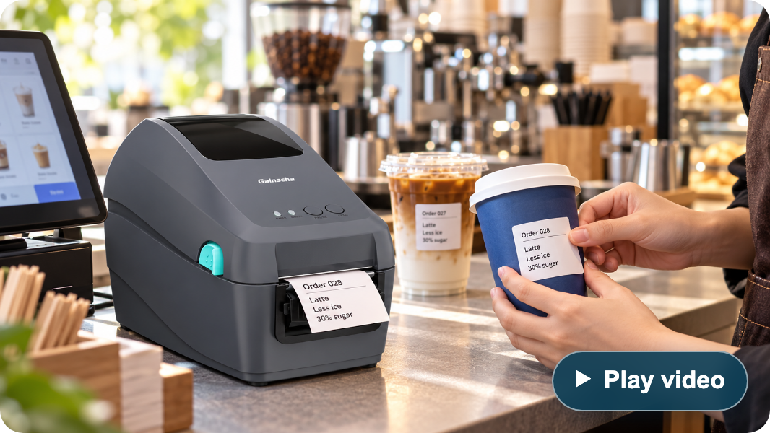
GS-2208D / COFFEE LABELS, ACCESSORIES & ALTERNATIVES
From order to labelled cup
Cup labels, pickup IDs and takeaway orders, prepared at the coffee counter.
Drink customisation labels
Pickup and order identification
Product name · ice level · sweetness
Order number · barcode / QR
Print the selected drink options on a cup label so the
Put the pickup identifier on the drink label and
preparation team can read the order beside the cup.
connect it to the ordering system’s collection
workflow.
Takeaway order labelling
Bakery and food labels
Cup labels · small-format bag labels
Product name · date · order ID
Apply the app-generated order label to cups or
Print small labels for pastries and packaged items
▶︎
Play video
takeaway packaging to help identify the prepared
from the store application.
order.
Café labelling illustration
Configure the counter setup
Two-inch desktop alternatives
Published reference configurations
Included
USB cable · power adaptor and cord
REFERENCE MODEL | GS-2208D CONFIGURATION | COMPETITOR CONFIGURATION
TSC DH220↗︎ | 203 dpi · up to 8 ips 54 mm print width · 127 mm roll OD | 203 dpi · up to 8 ips 54 mm print width · 127 mm roll OD
Zebra ZD411D↗︎ | 54 mm max. print width USB + Ethernet | 56 mm max. print width (203 dpi) USB + USB Host; Ethernet optional
Quick start guide · software CD
Optional
Peeler · external roll mount
Wi-Fi / Bluetooth · dual-colour version*
*Dual-colour printing requires dedicated dual-colour thermal paper.
Direct-thermal reference configurations. Options and command support vary.
Use label stock suited to the cup or packaging. Print layouts and order data come from the connected application.
25
/ 27
Notes:
GAINSCHA GS-2208D · 2-inch direct-thermal printer · source checks: November 2, 2026
Product identity and controlling sourceThe controlling source is the customer-supplied two-page PDF, 2 Inch Desktop Label Printer GS-2208D.pdf. Most text is outlined, so both pages were rendered and read visually. This deck covers GS-2208D only. It does not carry over GS-3205D's 300 dpi or 56 mm specifications and does not invent a UROVO model. UROVO branding identifies the presentation collection; the product is explicitly identified as GAINSCHA./Volumes/SSD1T/Downloads/debuglogger/2 Inch Desktop Label Printer GS-2208D.pdf
Resolution and speedGS-2208D: 8 dots/mm (203 dpi), direct thermal, maximum print speed 203.2 mm/s (8 ips), maximum print width 54 mm. Speed is a rated print maximum, not measured cups-per-minute or a guarantee for every barcode, driver, label size or network condition. The six emulations are EPL, EPL 2, ZPL, ZPL II, DPL and TSPL; this is a command list, not a claim of six universally interchangeable systems.
Thermal labels and cup applicationsDirect thermal printing uses compatible thermal media without a ribbon. The supplied PDF lists monochrome as standard, a dual-colour version as an option requiring dedicated dual-colour thermal paper, and a 127 mm maximum label roll outside diameter. It also lists wristband, retail and restaurant applications. This presentation focuses on coffee and small-format order labels; it does not claim medical certification, food-contact approval, waterproof output, cold-cup condensation resistance, adhesive suitability or linerless/cutter capability.Cup, ice, sugar and pickup data are produced by the connected ordering app and label template. The illustration's drink data is generic. Test adhesive/media performance on the actual hot/cold cup or packaging surface. QR or barcode printing does not itself establish scanning accuracy or an operational pickup system.
Physical specification and revision differencesThe supplied PDF lists 129 mm (W) × 165.3 mm (H) × 244.3 mm (D), 1.3 kg, ABS enclosure. Its 165.3 mm height controls over the customer AI draft's 163.5 mm. The manufacturer's current product page instead lists 1.35 kg; the visible metric retains the supplied edition's 1.3 kg. The PDF specifies operation 5–40°C and 25–85% RH non-condensing; storage -40–60°C, 10–90% RH. These are not weatherproofing or splash-resistance claims.The PDF lists FCC, CE, CCC, BIS and CB and RoHS/REACH/WEEE compliance. No regional certification is advertised as freshly verified for every configuration.
Supplied interfaces and configuration scopeThe supplied PDF lists USB 2.0 high-speed 480 Mbps and internal Ethernet 10/100 Mbps, with optional internal Bluetooth 4.0 and Wi-Fi. The current manufacturer page lists Bluetooth 4.2 while older manuals include economic/empower variants and USB Host. The visible slides say Bluetooth generically and do not promise USB Host on the supplied configuration.GAINSCHA GS-2208D official product page. Confirm delivered interfaces and regional availability when specifying a unit.
Formats and integrationThe supplied PDF lists EPL, EPL 2, ZPL, ZPL II, DPL and TSPL compatibility; Windows printer utility, Windows SDK and Android SDK; BarTender Windows drivers and label design software available via download. Firmware emulation is not a guarantee that every template, font, barcode or host application works unchanged. No iOS SDK, automatic app connection or current software licensing entitlement is inferred.
Included items and optional equipmentIncluded: Windows labeling-software CD, quick start guide, USB cable, power cord and external switching power supply. Power: input AC 100–240 V; output DC 24 V / 2.5 A / 60 W. Dealer option: peeler. User option: external roll mount. Internal Bluetooth and Wi-Fi are configuration options. Dual-colour printing is an optional version requiring matching dual-colour thermal stock, not a software-only toggle or standard capability. The source does not list a cutter or supplied label roll.
Luckin coffee reference and supplied footageThe customer states that the printer is used by Luckin coffee and supplied 1102-luckin.mov as the reference footage. Sampled frames show a Gainscha-branded printer printing a label and a coffee-store drink-preparation workflow. The exact model number, deployment scope and supplier relationship are not independently established by a readable model plate or a public case study. The video reference is therefore attributed in the playback dialog to customer-supplied footage, with no claim of official endorsement, all-store rollout or supply exclusivity.The original video is about 35.93 seconds, H.264/AAC, 2560×1440, with fixed black sidebars around a portrait picture. The web copy retains the complete sequence and audio, removes only the black sidebars (908×1440 crop at x=826), scales to 682×1080, and encodes H.264 in MP4 with the original AAC audio and fast-start metadata. There are no content cuts or speed changes. Source remains untouched./Volumes/SSD1T/Downloads/debuglogger/1102-luckin.mov../assets/gs2208d-luckin-demo.mp4
Two-inch desktop alternativesTSC DH220 official product family page and manufacturer datasheet: DH220 is direct thermal, 203 dpi, maximum 8 ips / 203 mm/s, 54 mm print width, and 127 mm roll outside diameter. These match the principal GS-2208D figures and are not presented as a speed advantage for GS-2208D. Other DH variants are not substituted silently.Zebra official ZD411 technical specification: 56 mm print width at 203 dpi, USB and USB Host, with Ethernet available as an option. The comparison selects the direct-thermal ZD411D configuration. Zebra's web manual and product/specification materials have differing speed wording, so no Zebra speed comparison is printed. Options, languages, management tools and application compatibility must be matched to the delivered SKU. ZD510-HC is omitted because its cartridge wristband focus is less direct for the coffee-label task.The visible table describes the reference models and GS-2208D separately. No price, lifecycle, TCO, clinical certification, universal barcode superiority or drop-in replacement advantage is inferred.
Original artwork and generated illustrationThe original product rendering is decoded from page 1, Im2.jp2, of the supplied PDF and losslessly saved as PNG. The generated café image uses it as the hardware reference. That image is an illustration, not a frame from the Luckin video, a documented customer installation or a supplied POS application. Its generic cup labels are not validated print samples. The prompt, original source and project asset paths are retained in GS2208D_Sources.md beside this deck.
Web reference: products/GS2208D_Product_Presentation.html
https://fs.tscprinters.com/system/files/tsc-auto-id-th-dh-series-en-20250930.pdf
https://gainscha.com.tw/Product-Center/Desktop-Barcode-Printer/Surpass-Series/2-Inch-Desktop-Label-Printer-GS-2208D
https://usca.tscprinters.com/en/products/dh-series-2-inch-high-precision-desktop-printers
https://www.zebra.com/content/dam/zebra_dam/en/tech-specs/zd411-tech-specs-en-us.pdf

Slide 26
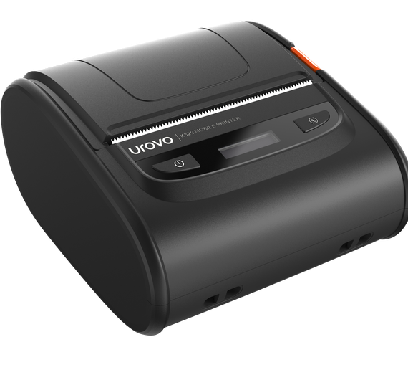
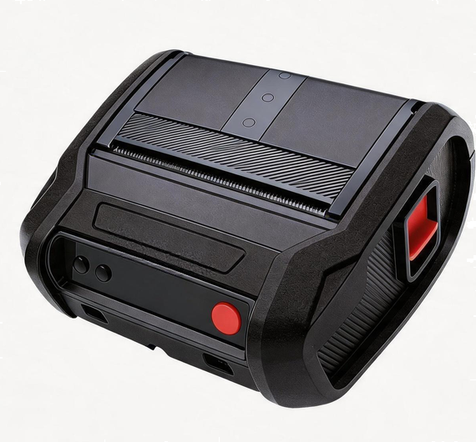
K329 + K389 / PORTABLE PRINTERS
Print where the work happens
Mobile labels and receipts — from the retail floor and delivery route to the warehouse and production line.
K329
K389
Everyday mobile printing
Rugged printing on the move
Get the next job moving
Built for demanding work
Up to 120 mm/s thermal printing for quick
receipts and replacement labels.
2 m drop-tested body · 390 g combines
handling protection with mobile use.
Pair and print beside the item
Swap power, keep working
Bluetooth + NFC quick pairing help connect
a compatible mobile device at the task.
3200 mAh hot-swap battery supports battery
exchange without powering down.
Ready for daily handling
Stay connected across the site
IP54 + 1.5 m drop rating add protection for
store work and delivery rounds.
Dual-band Wi-Fi + 802.11r support roaming
between compatible access points.
RETAIL · COURIER
WAREHOUSE · MANUFACTURING
AT THE SHELF / ON THE ROUTE
AT RECEIVING / ON THE LINE
Retail relabeling & courier collection
Warehouse & production labeling
Print an approved price or return label beside the goods, or issue a
receipt during parcel collection.
Print stock labels during put-away or batch and serial labels beside
production, reducing trips to a fixed printer.
26 / 27

Slide 27
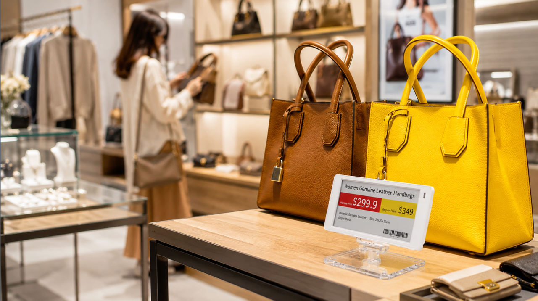
ESL / ELECTRONIC SHELF LABELS
ESL
Electronic Shelf Labels
Reusable e-paper labels for centrally managed prices and product information.
01
Four colors, clearer offers
02
Prices managed centrally
Black, white, red and yellow
Wireless updates via the ESL platform
Highlight promotions and key product
details in the same reusable display.
Publish approved changes to linked
labels, reducing manual paper
replacement.
03
Low power, less upkeep
04
Flexible content layouts
E-paper with coin-cell power
Custom templates, languages and codes
Coin-cell power avoids daily charging.
Battery monitoring helps plan
replacements.
Show item details, barcodes and QR
codes using layouts from the platform.
05
A light to find the item
06
Protection for store use
Configurable LED flashing
IP65, with optional IP68 on selected sizes
1.6″
2.1″
2.6″
4.2″
Guide staff to a product during picking
or replenishment with supported tags
and workflows.
Match the protection level and
temperature variant to the installation.
Compact shelf tags
Everyday pricing
More product detail
Promotions & offers
UROVO ecosystem: labels, matching base stations and cloud or local management, with APIs for business-system integration.
27 / 27

