Slide 1
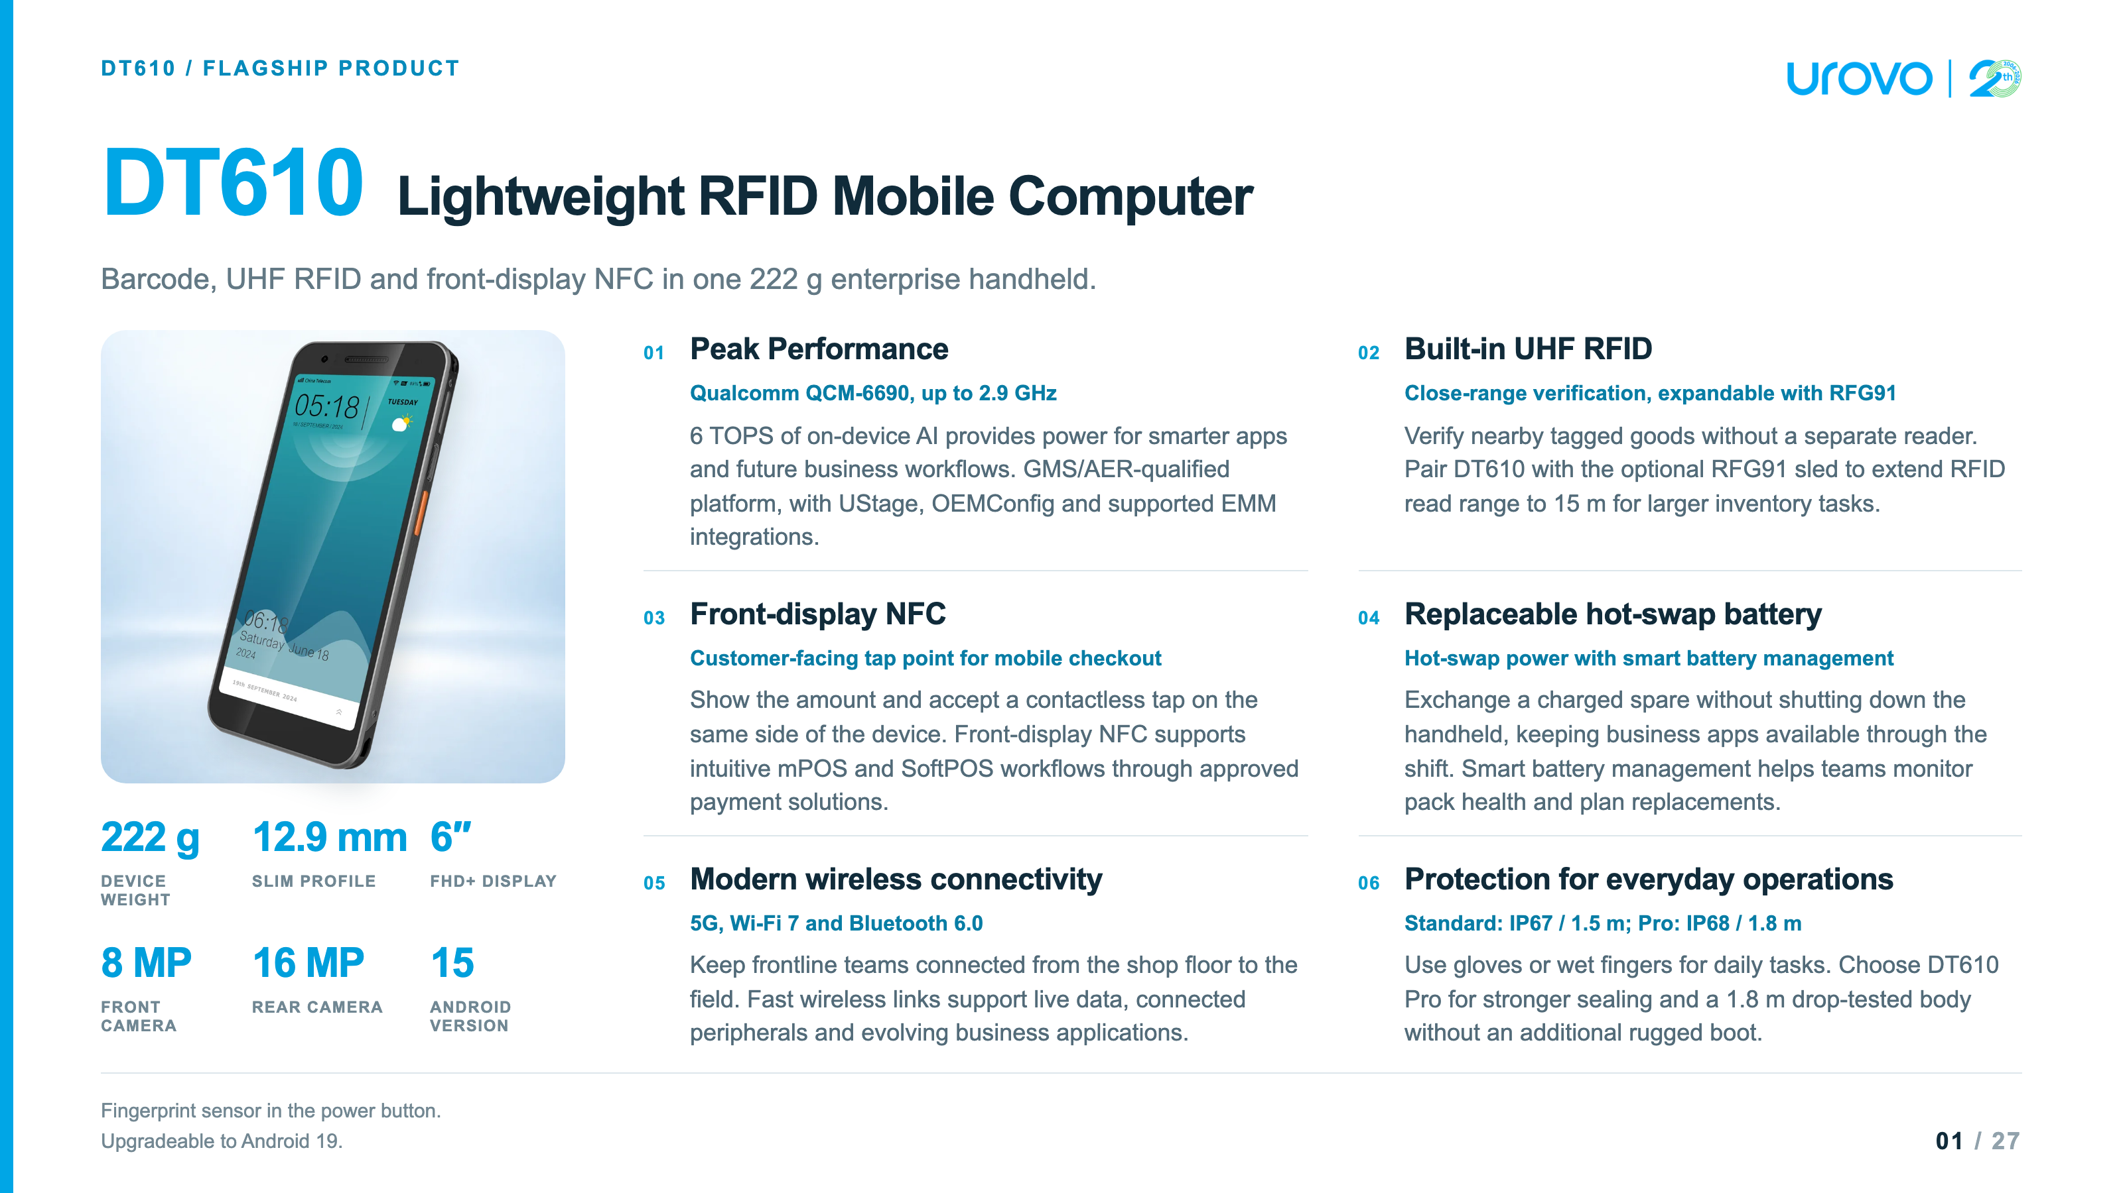

Slide 2
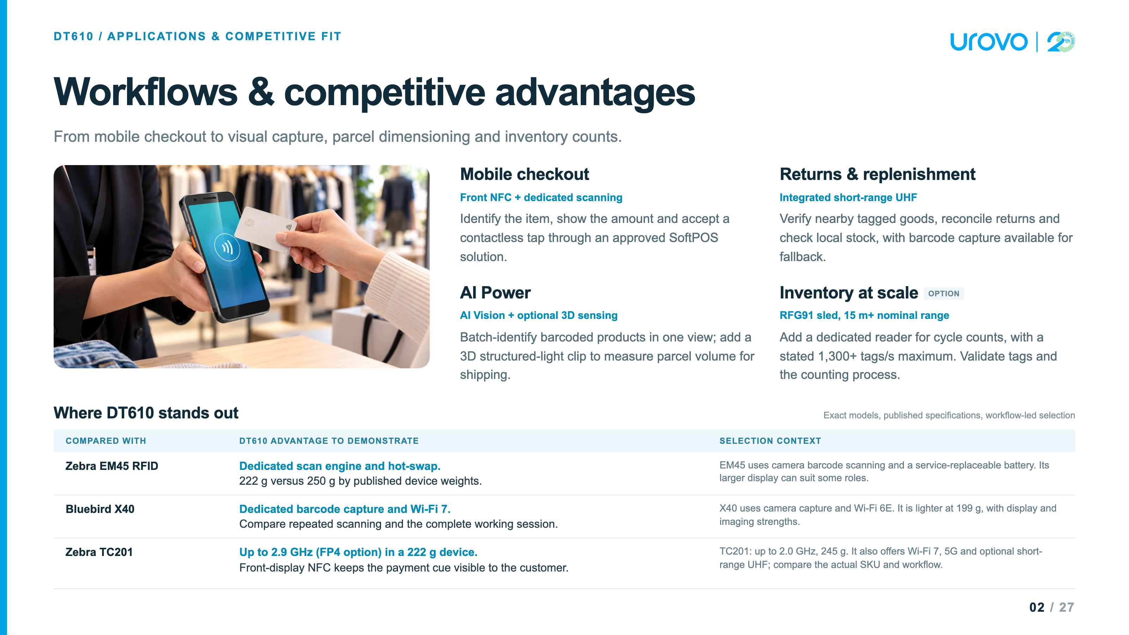

Slide 3
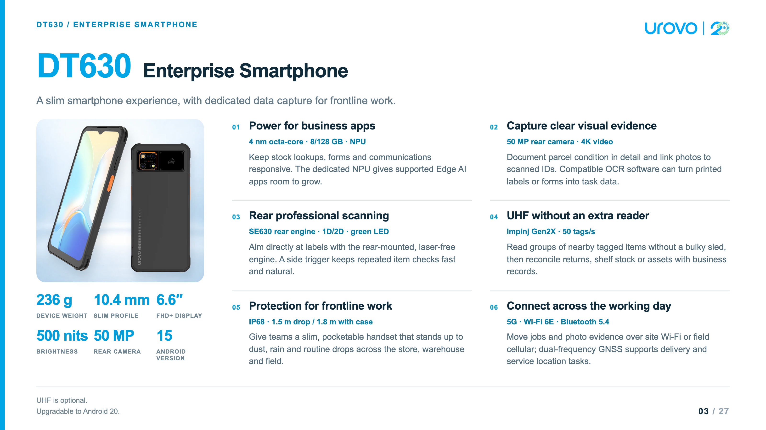

Slide 4
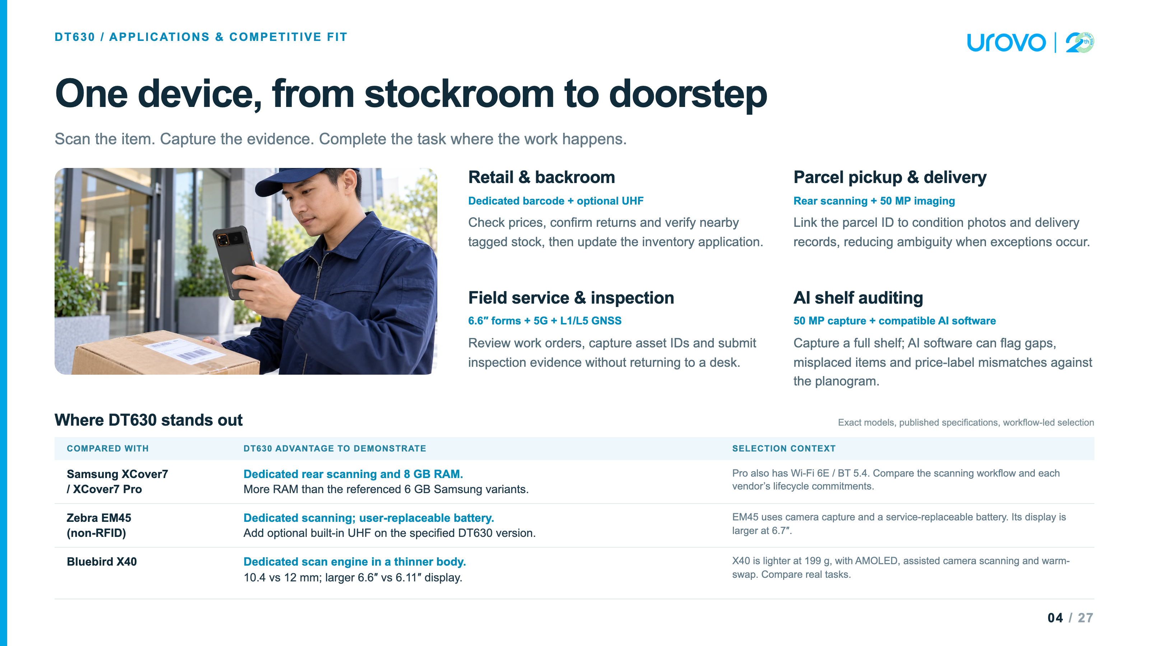

Slide 5
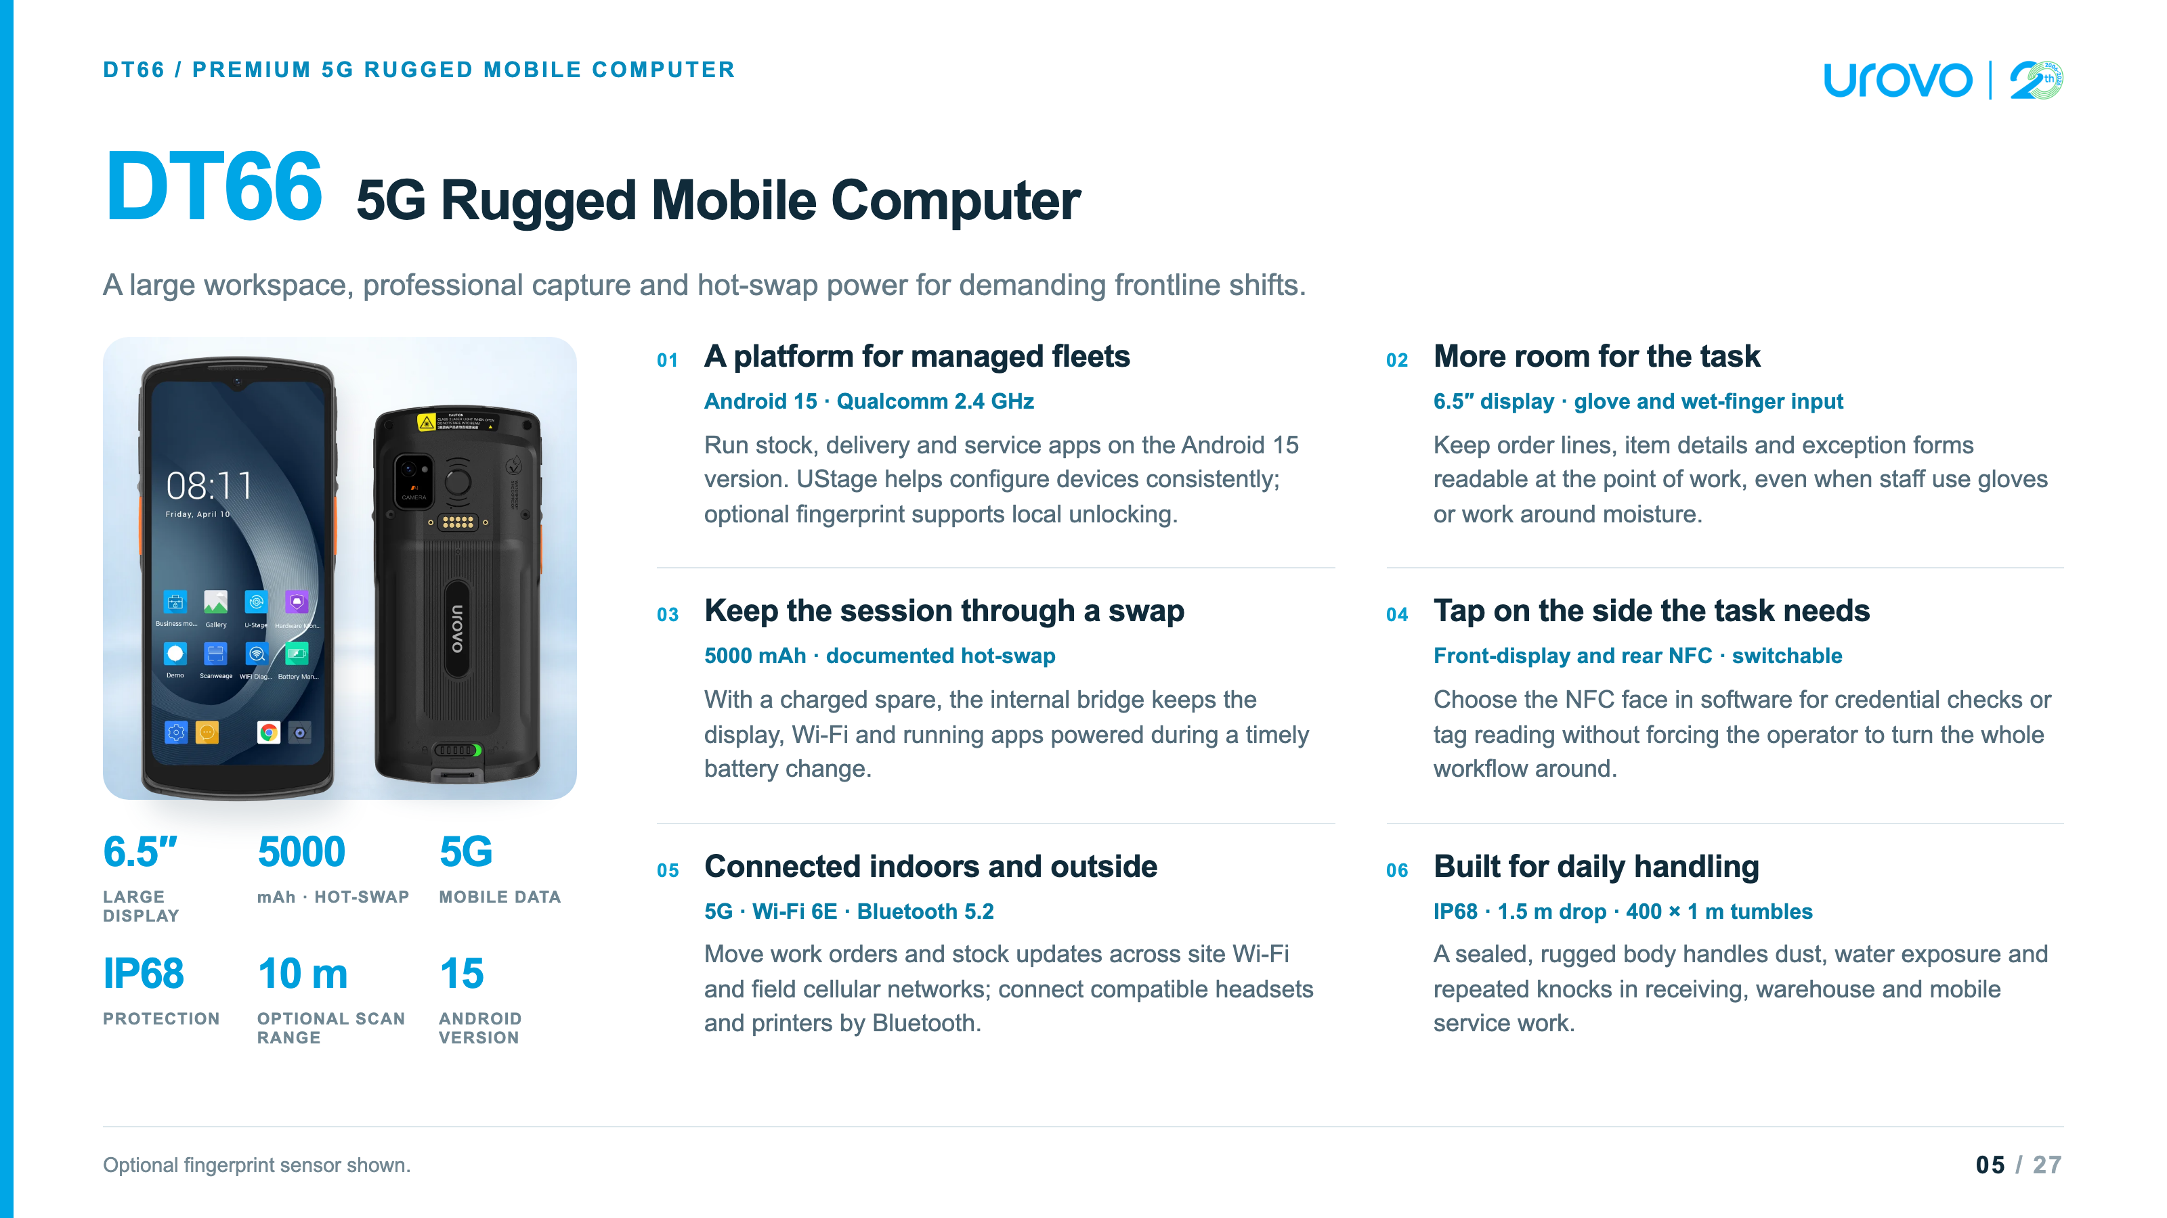

Slide 6
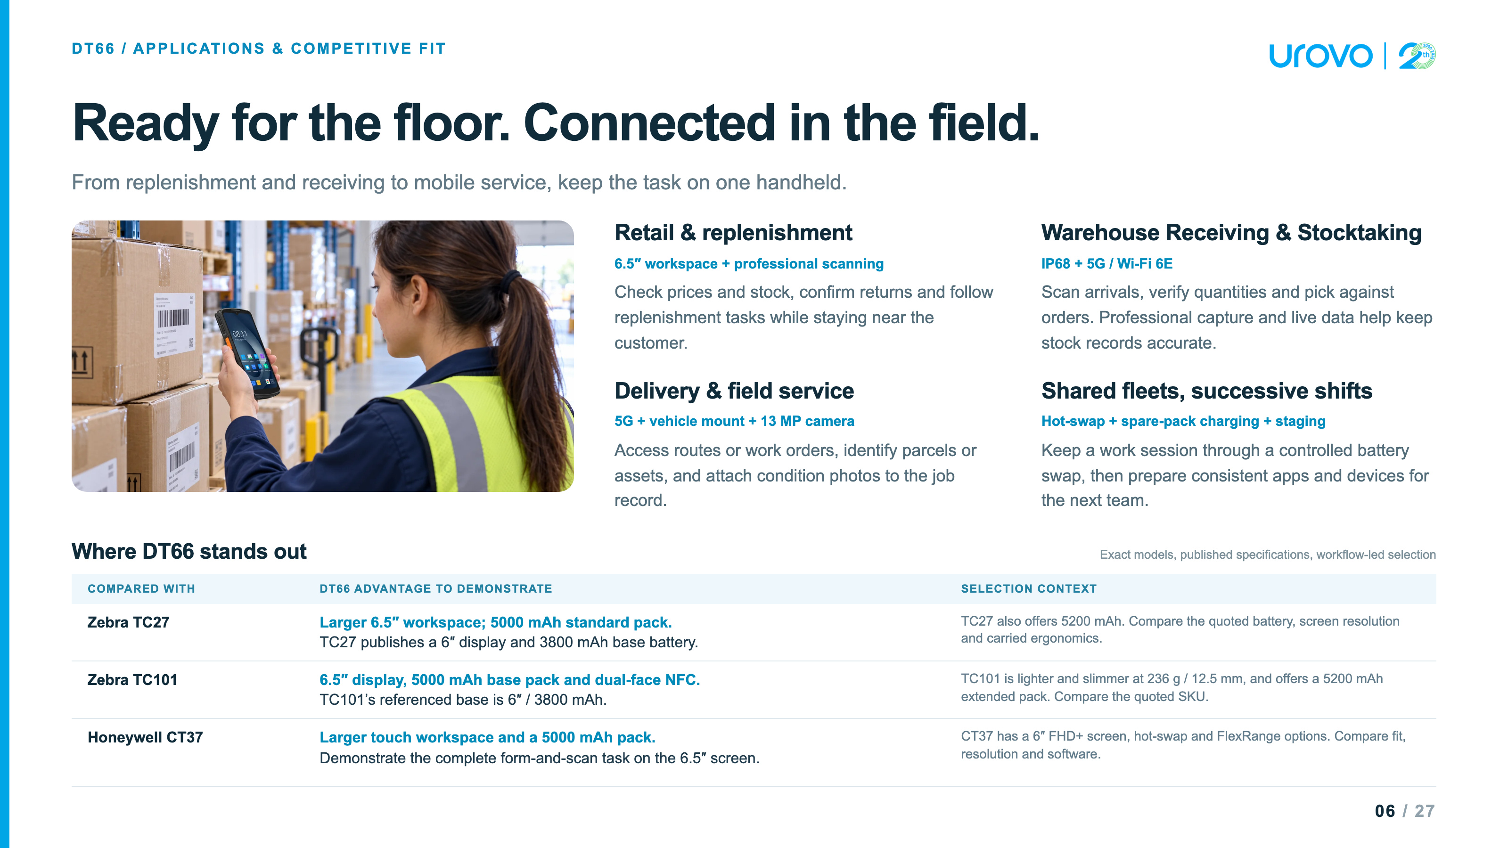

Slide 7
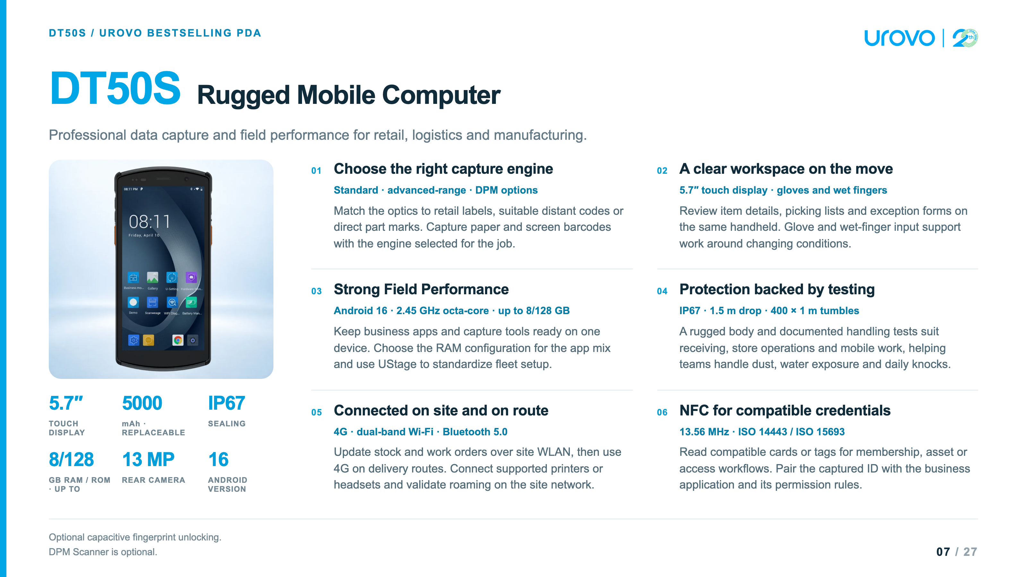

Slide 8
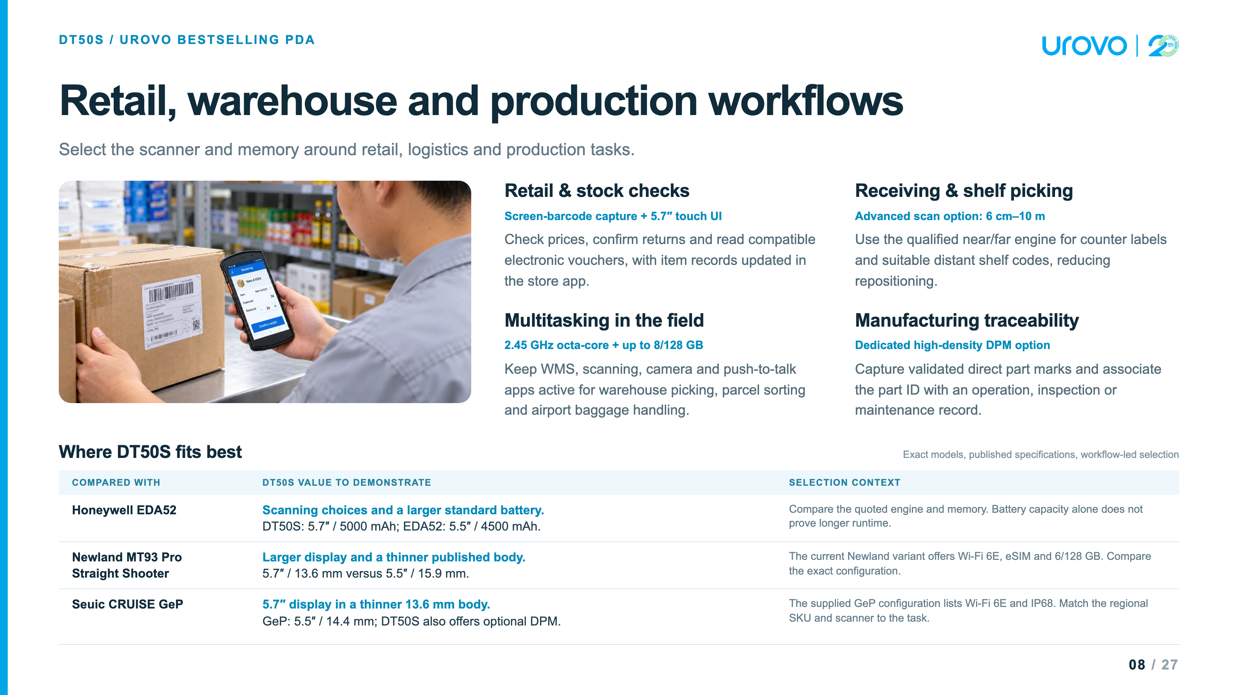

Slide 9
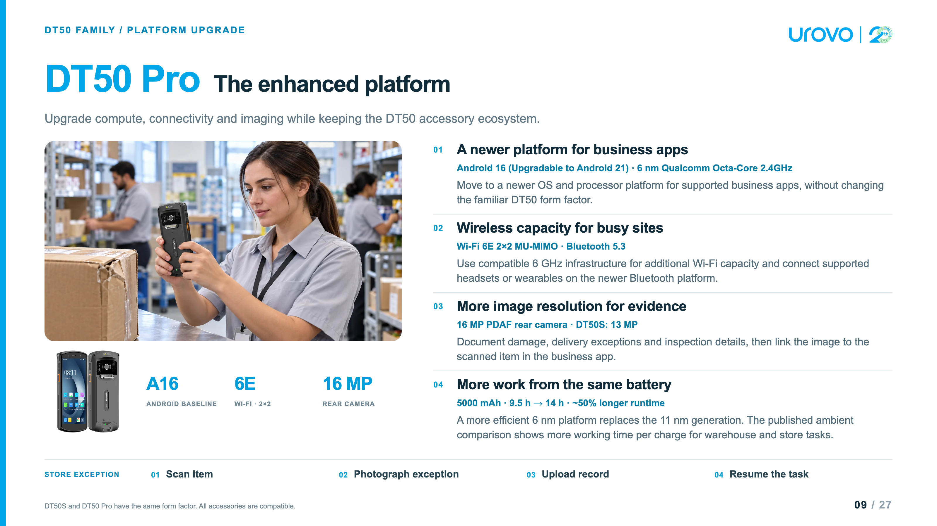

Slide 10
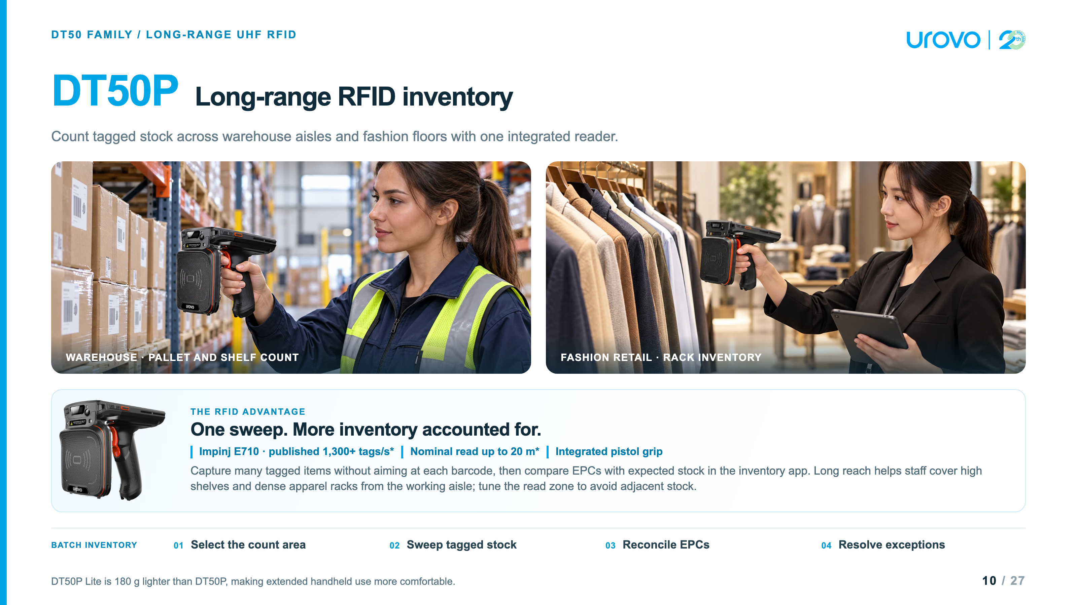

Slide 11
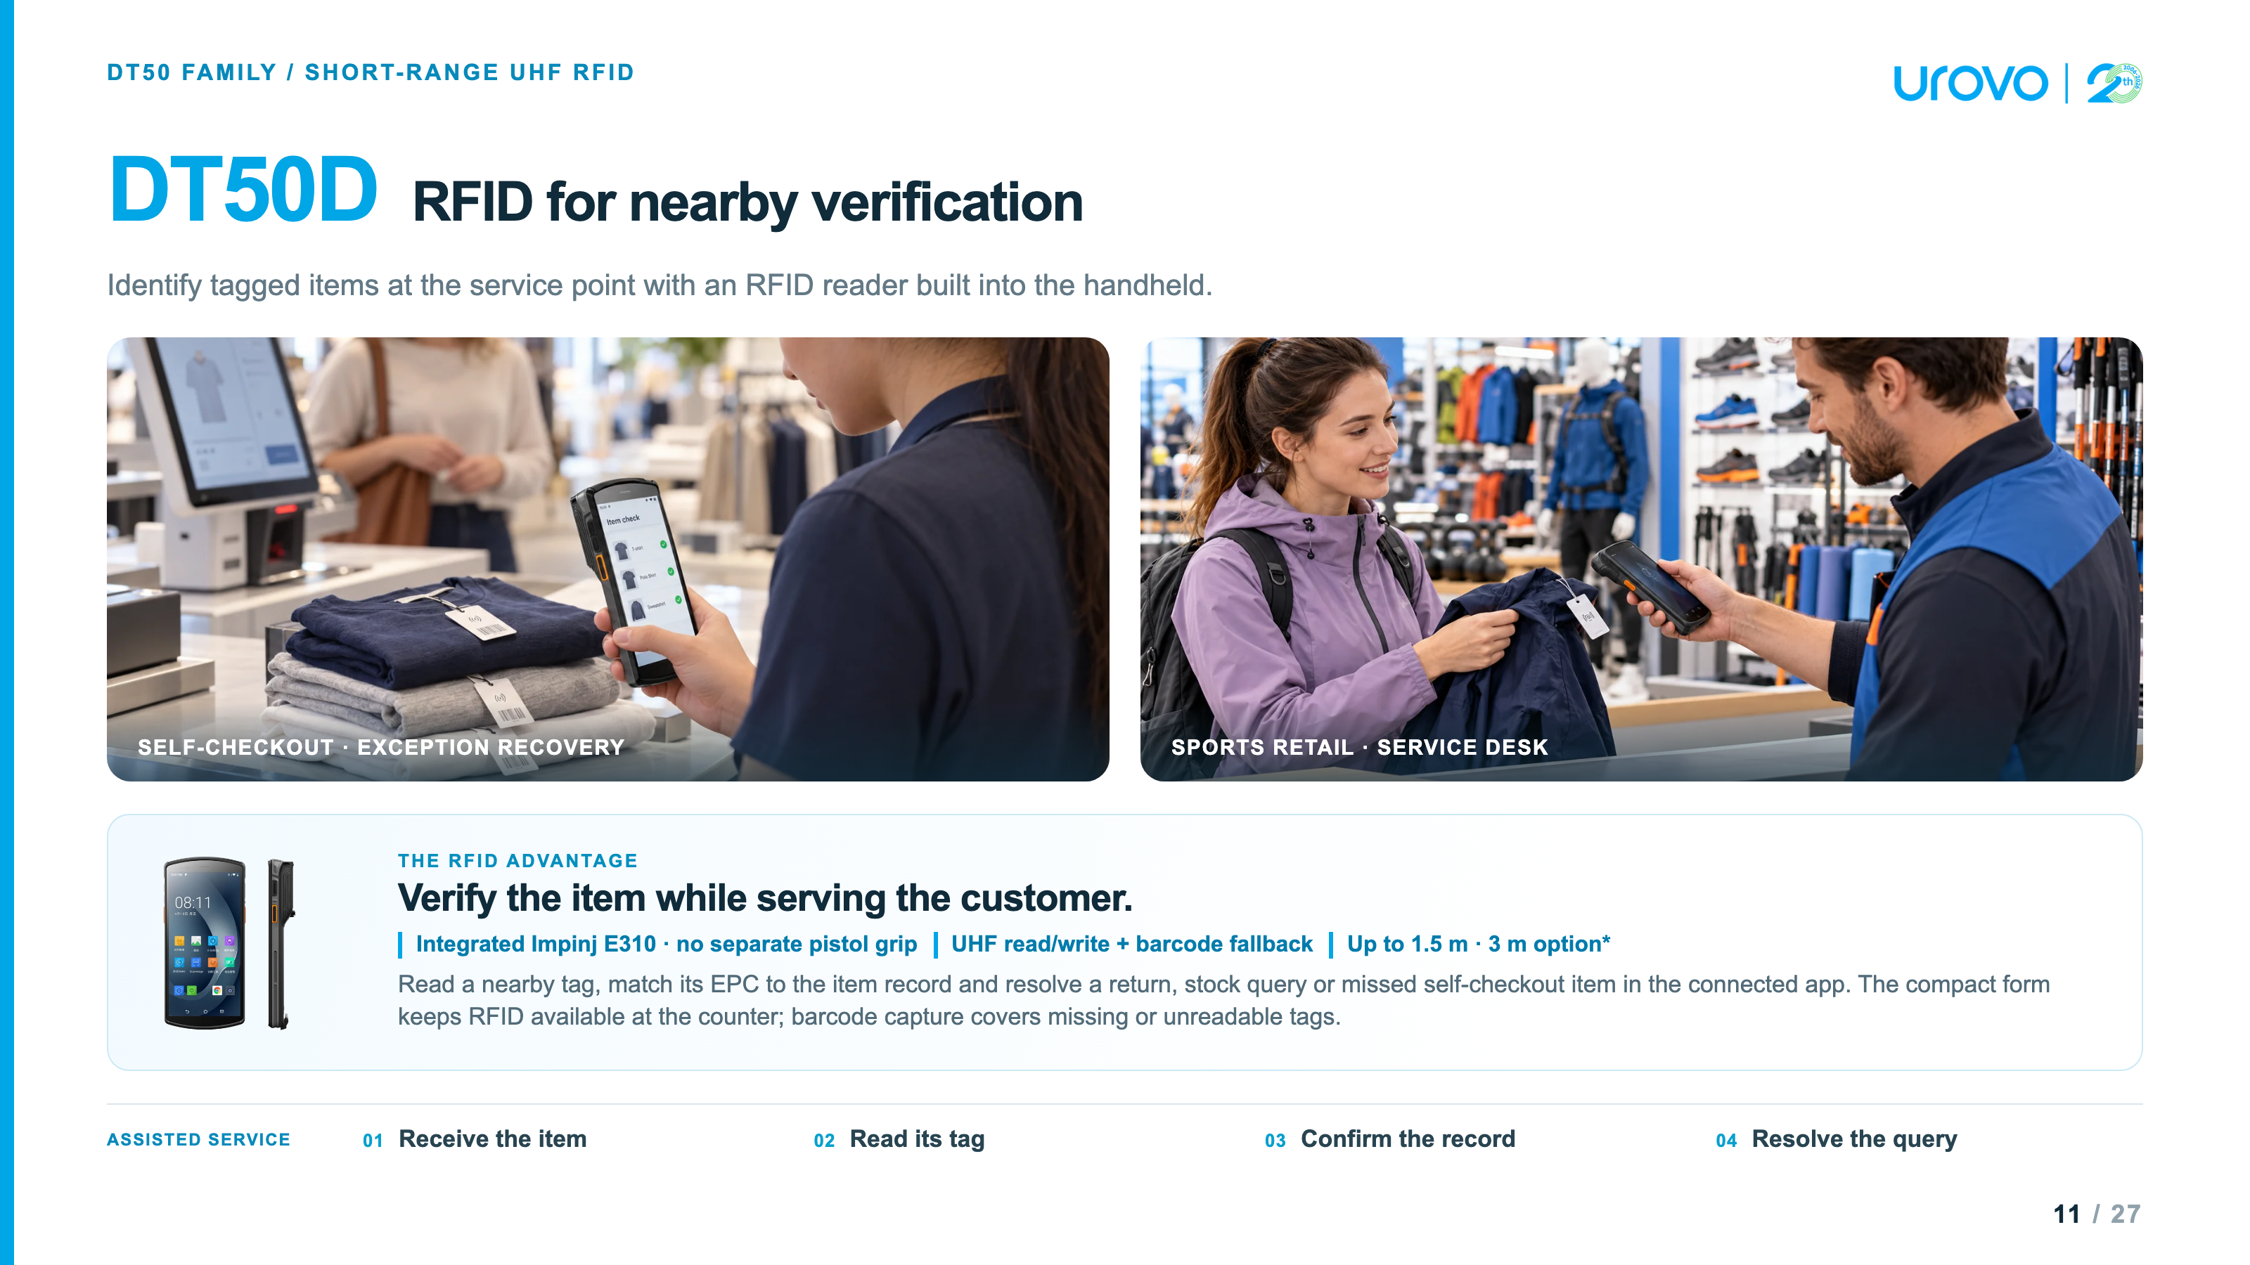

Slide 12
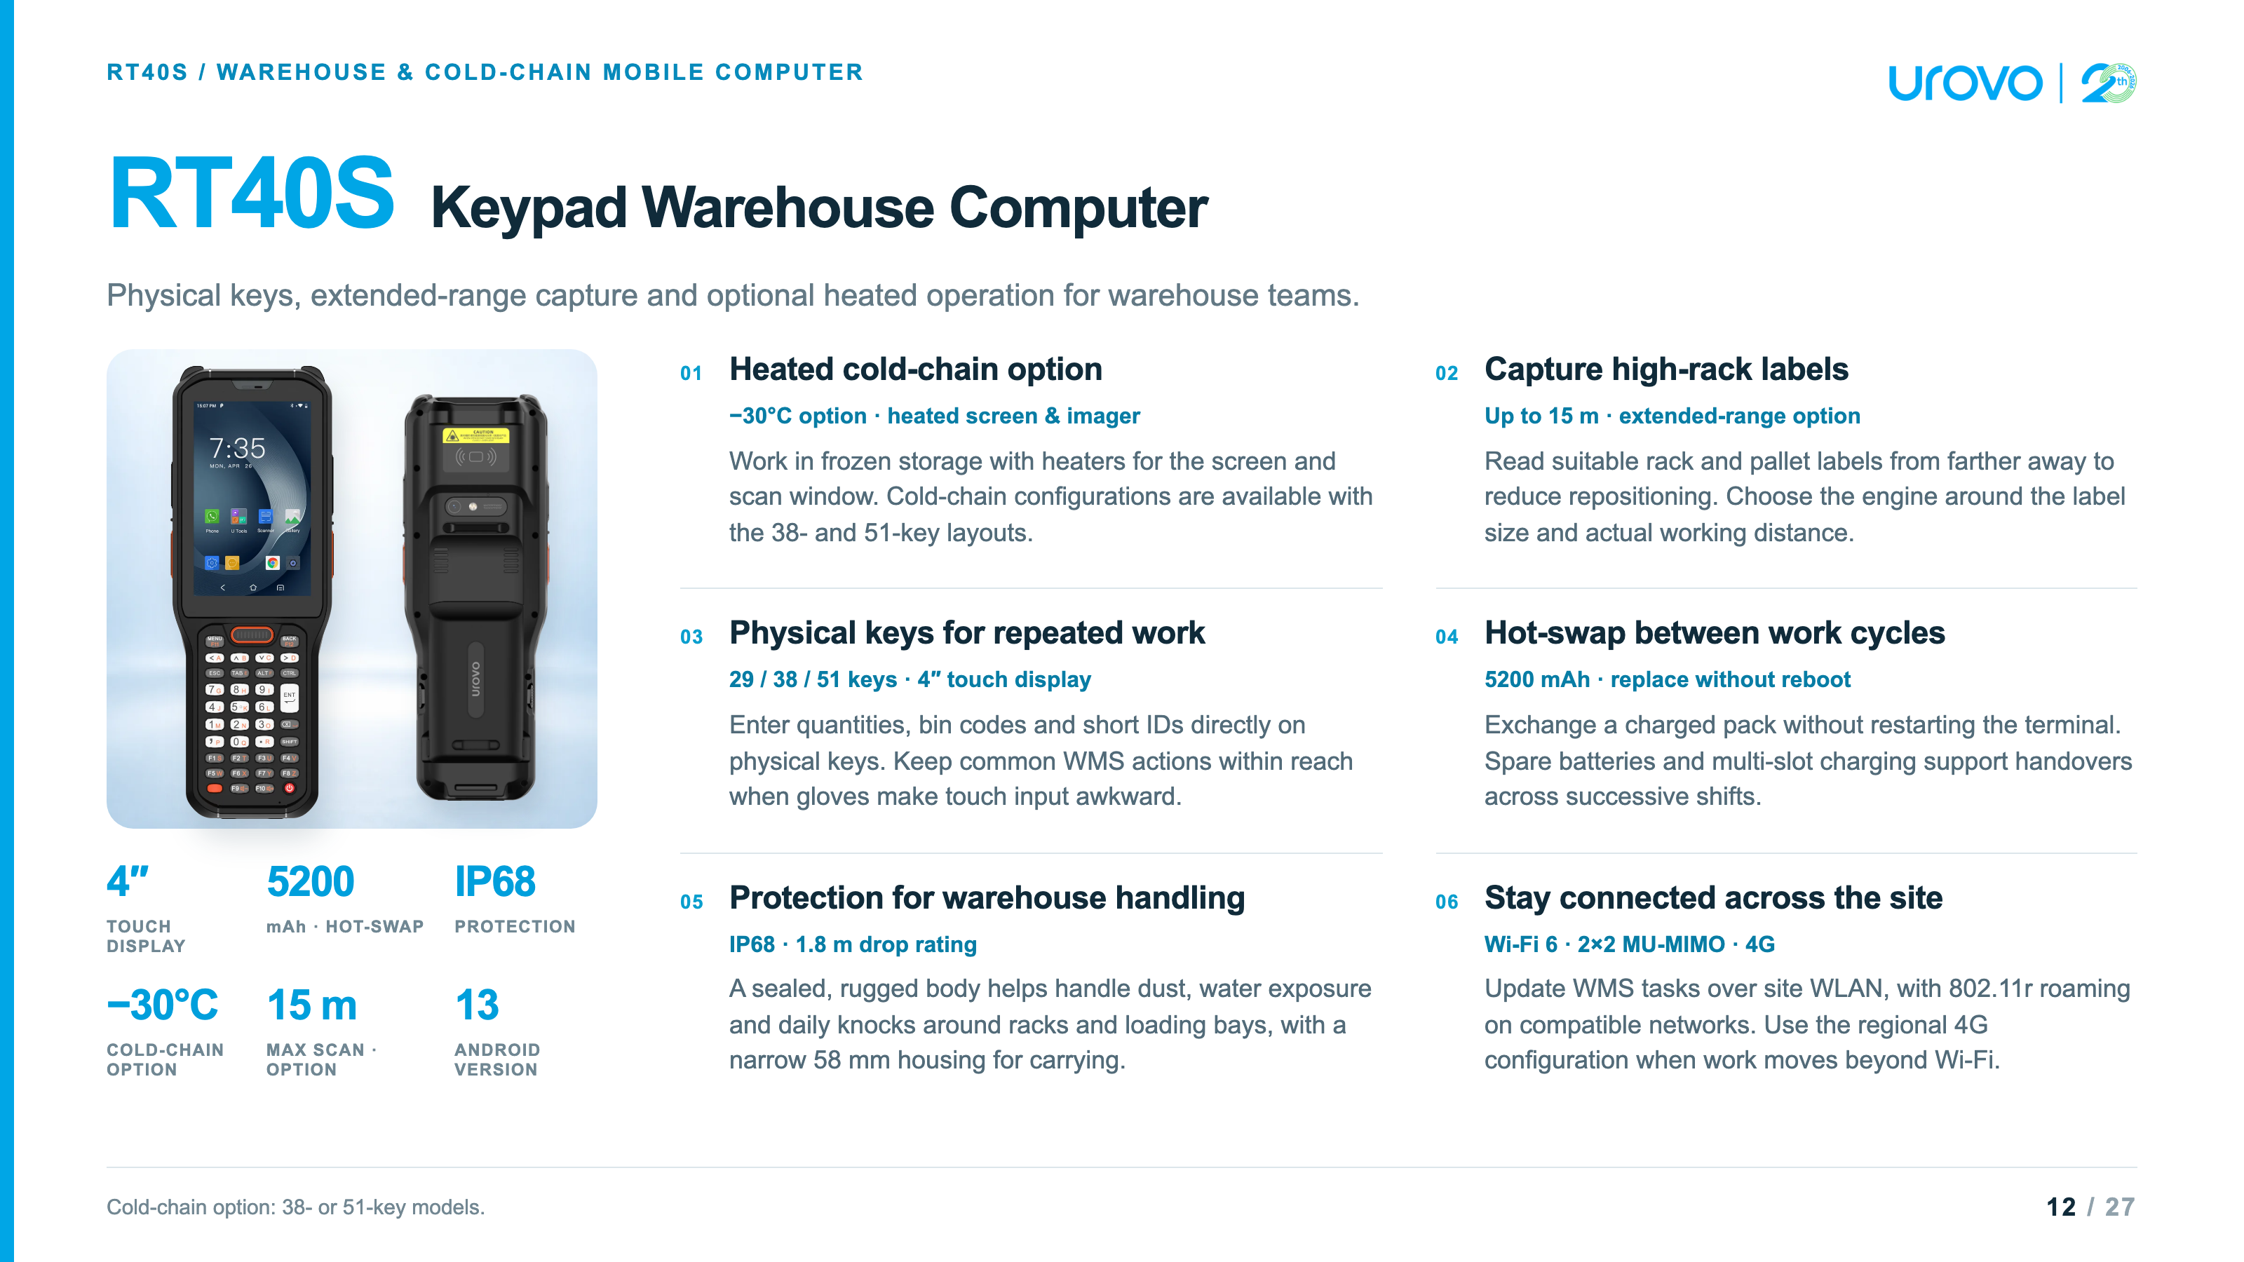

Slide 13
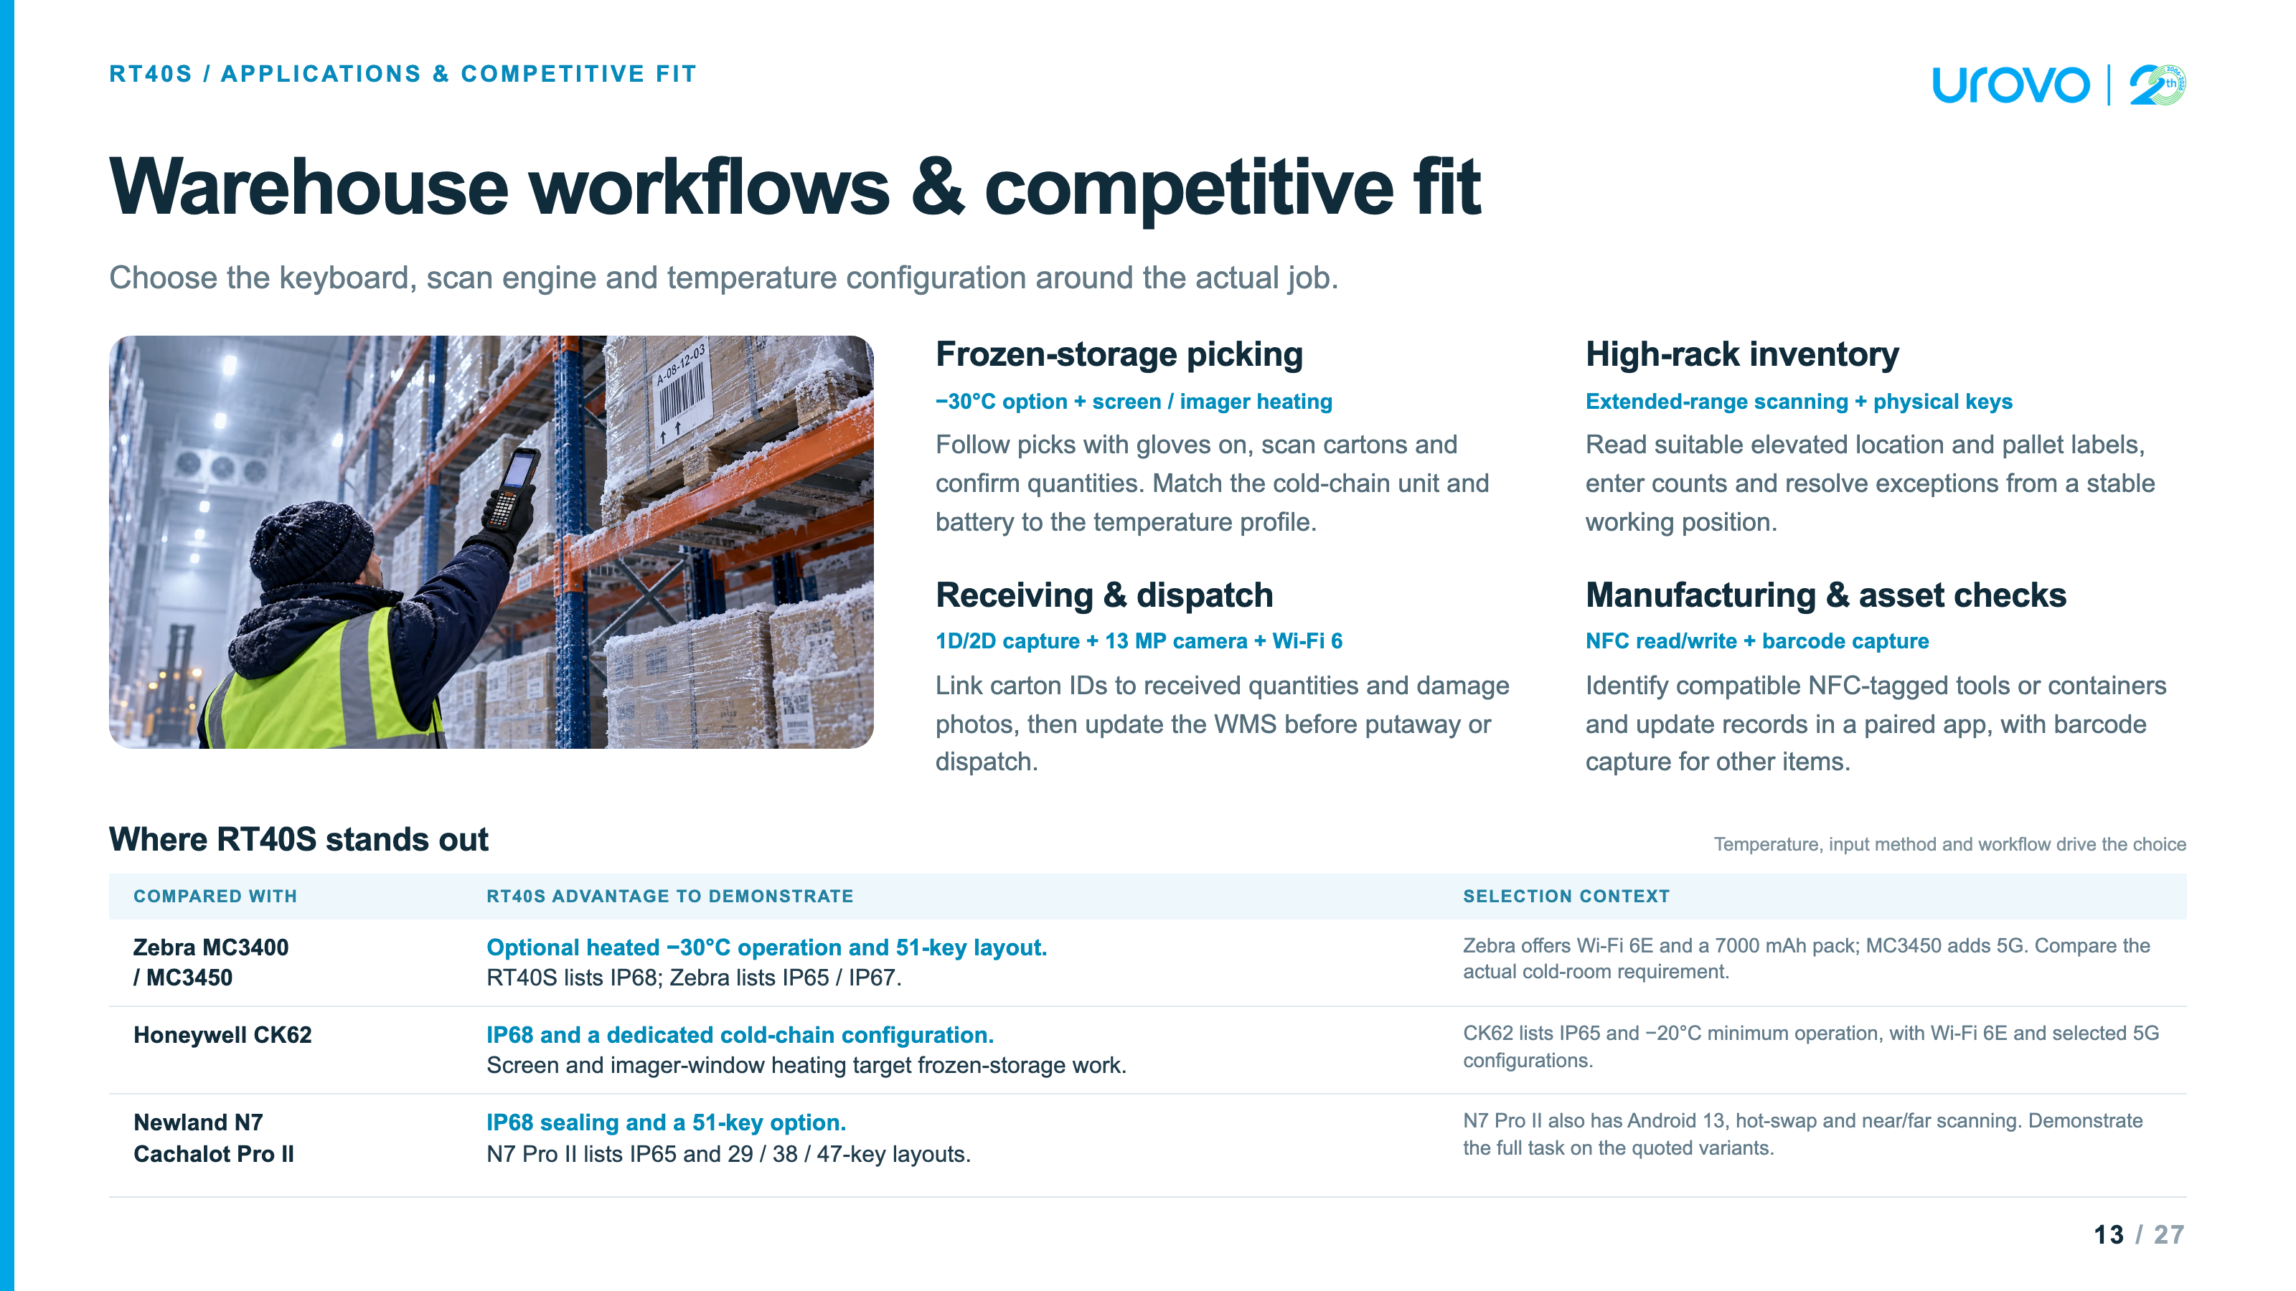

Slide 14
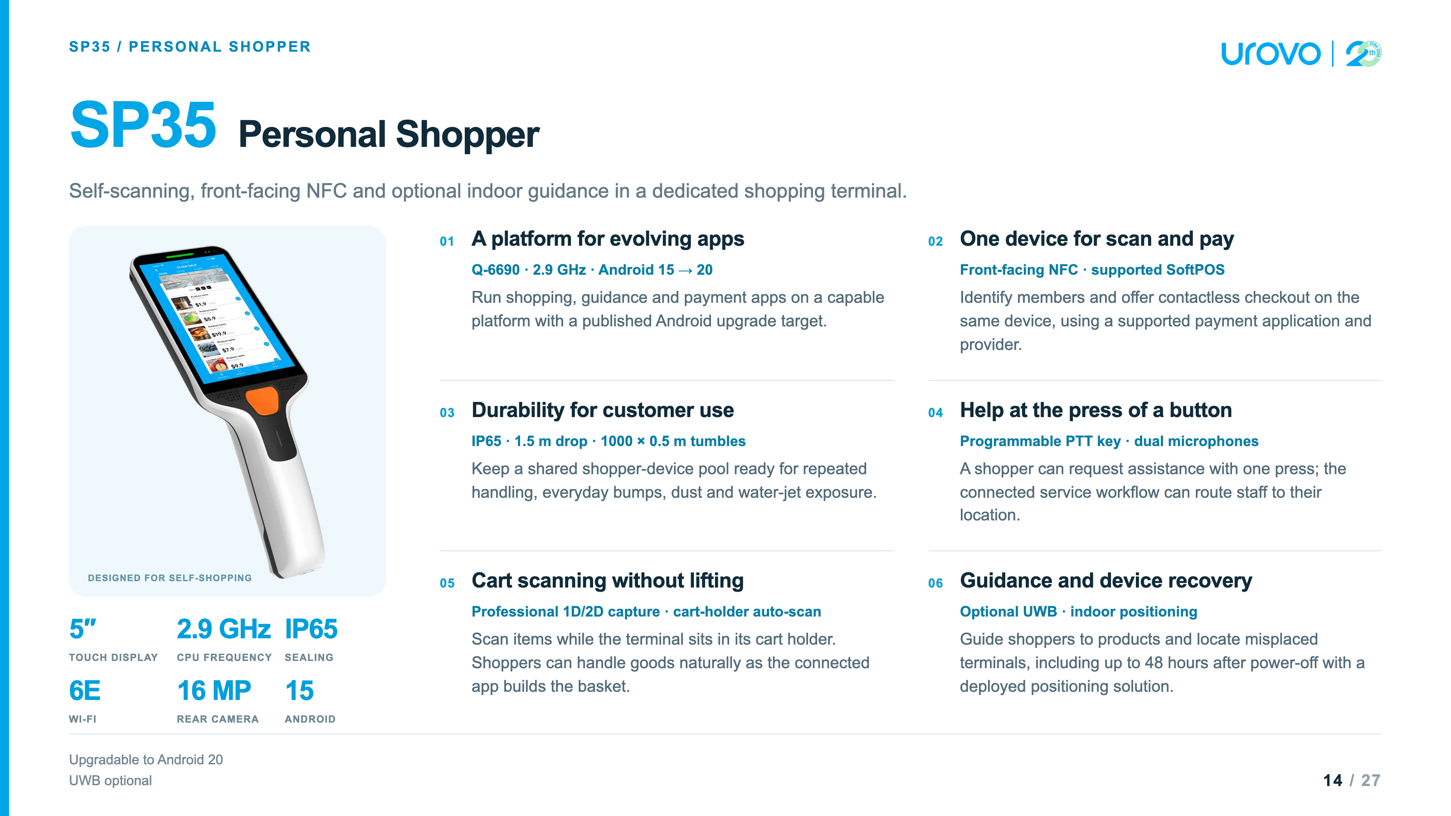

Slide 15
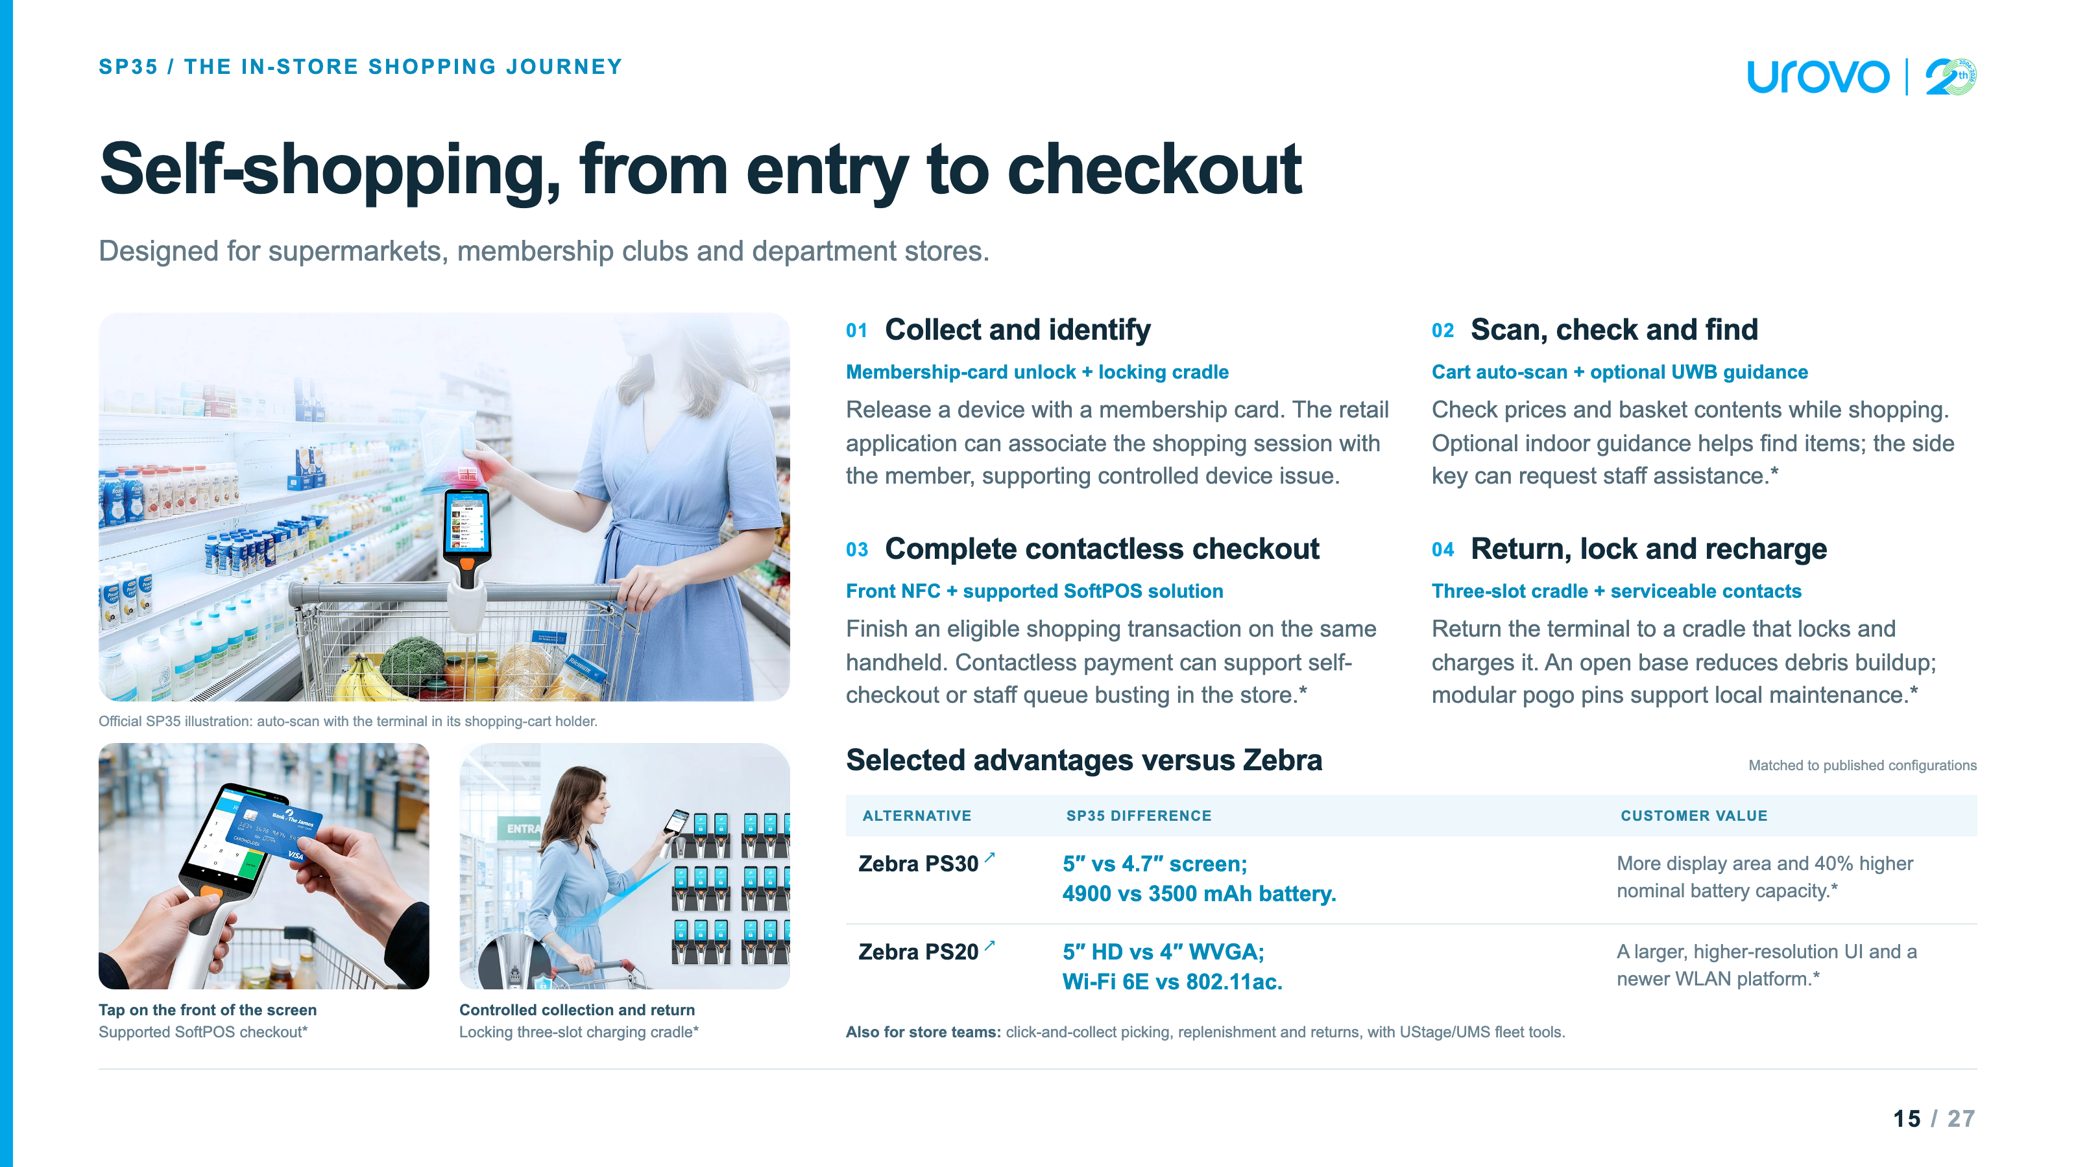

Slide 16
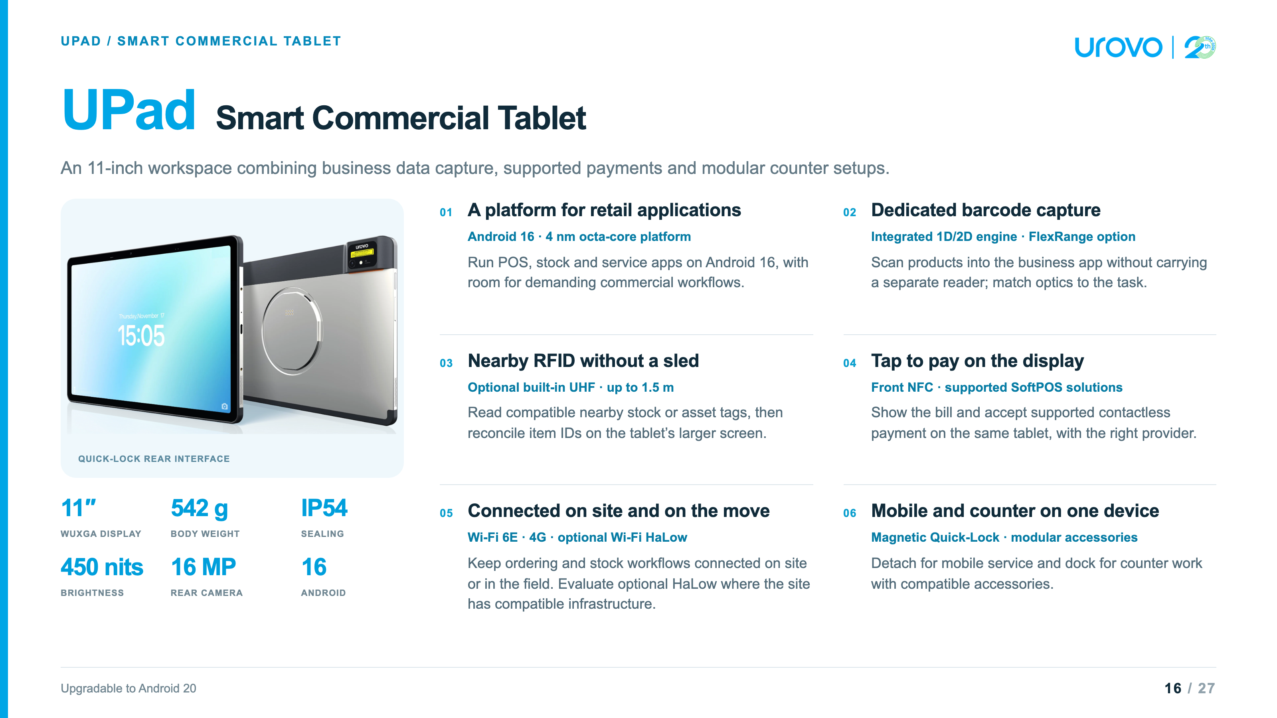

Slide 17
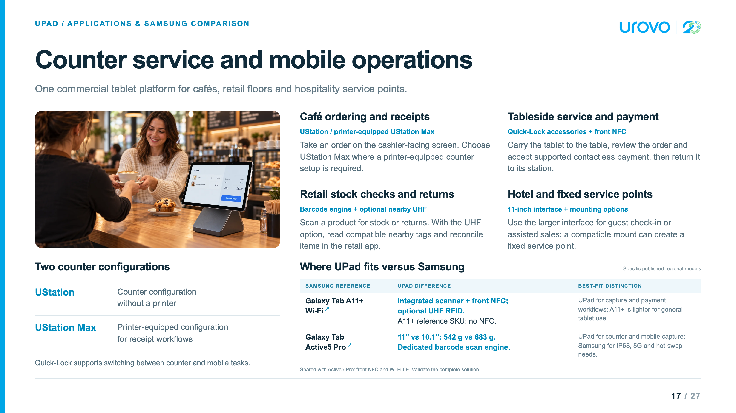

Slide 18
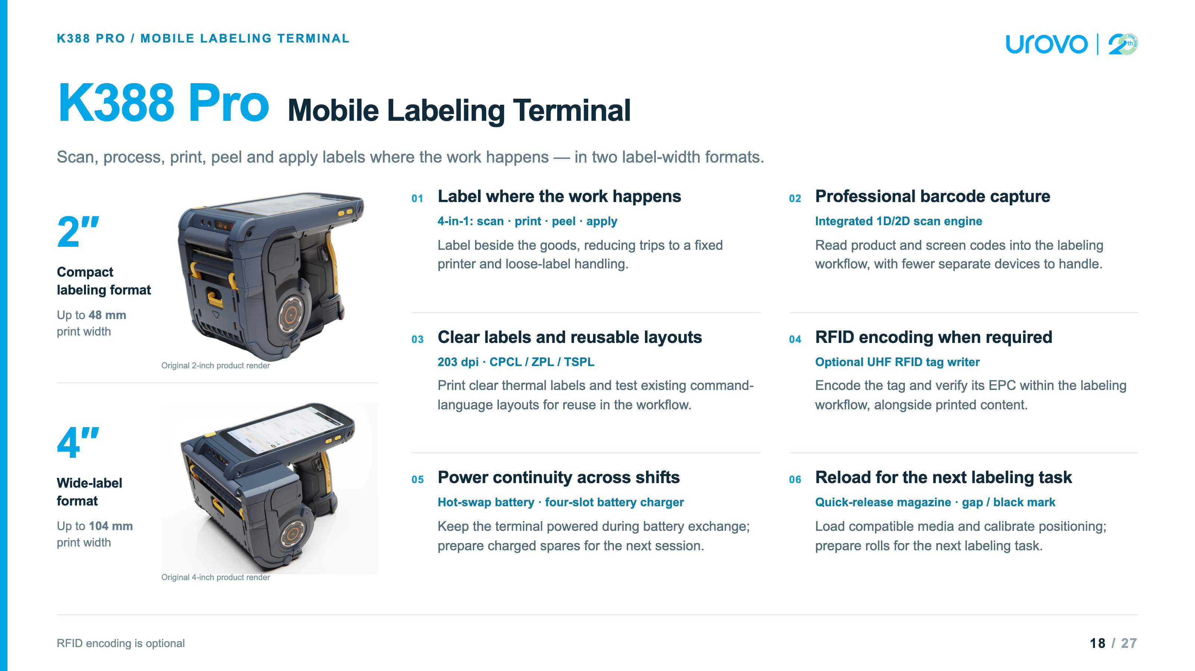

Slide 19


Slide 20
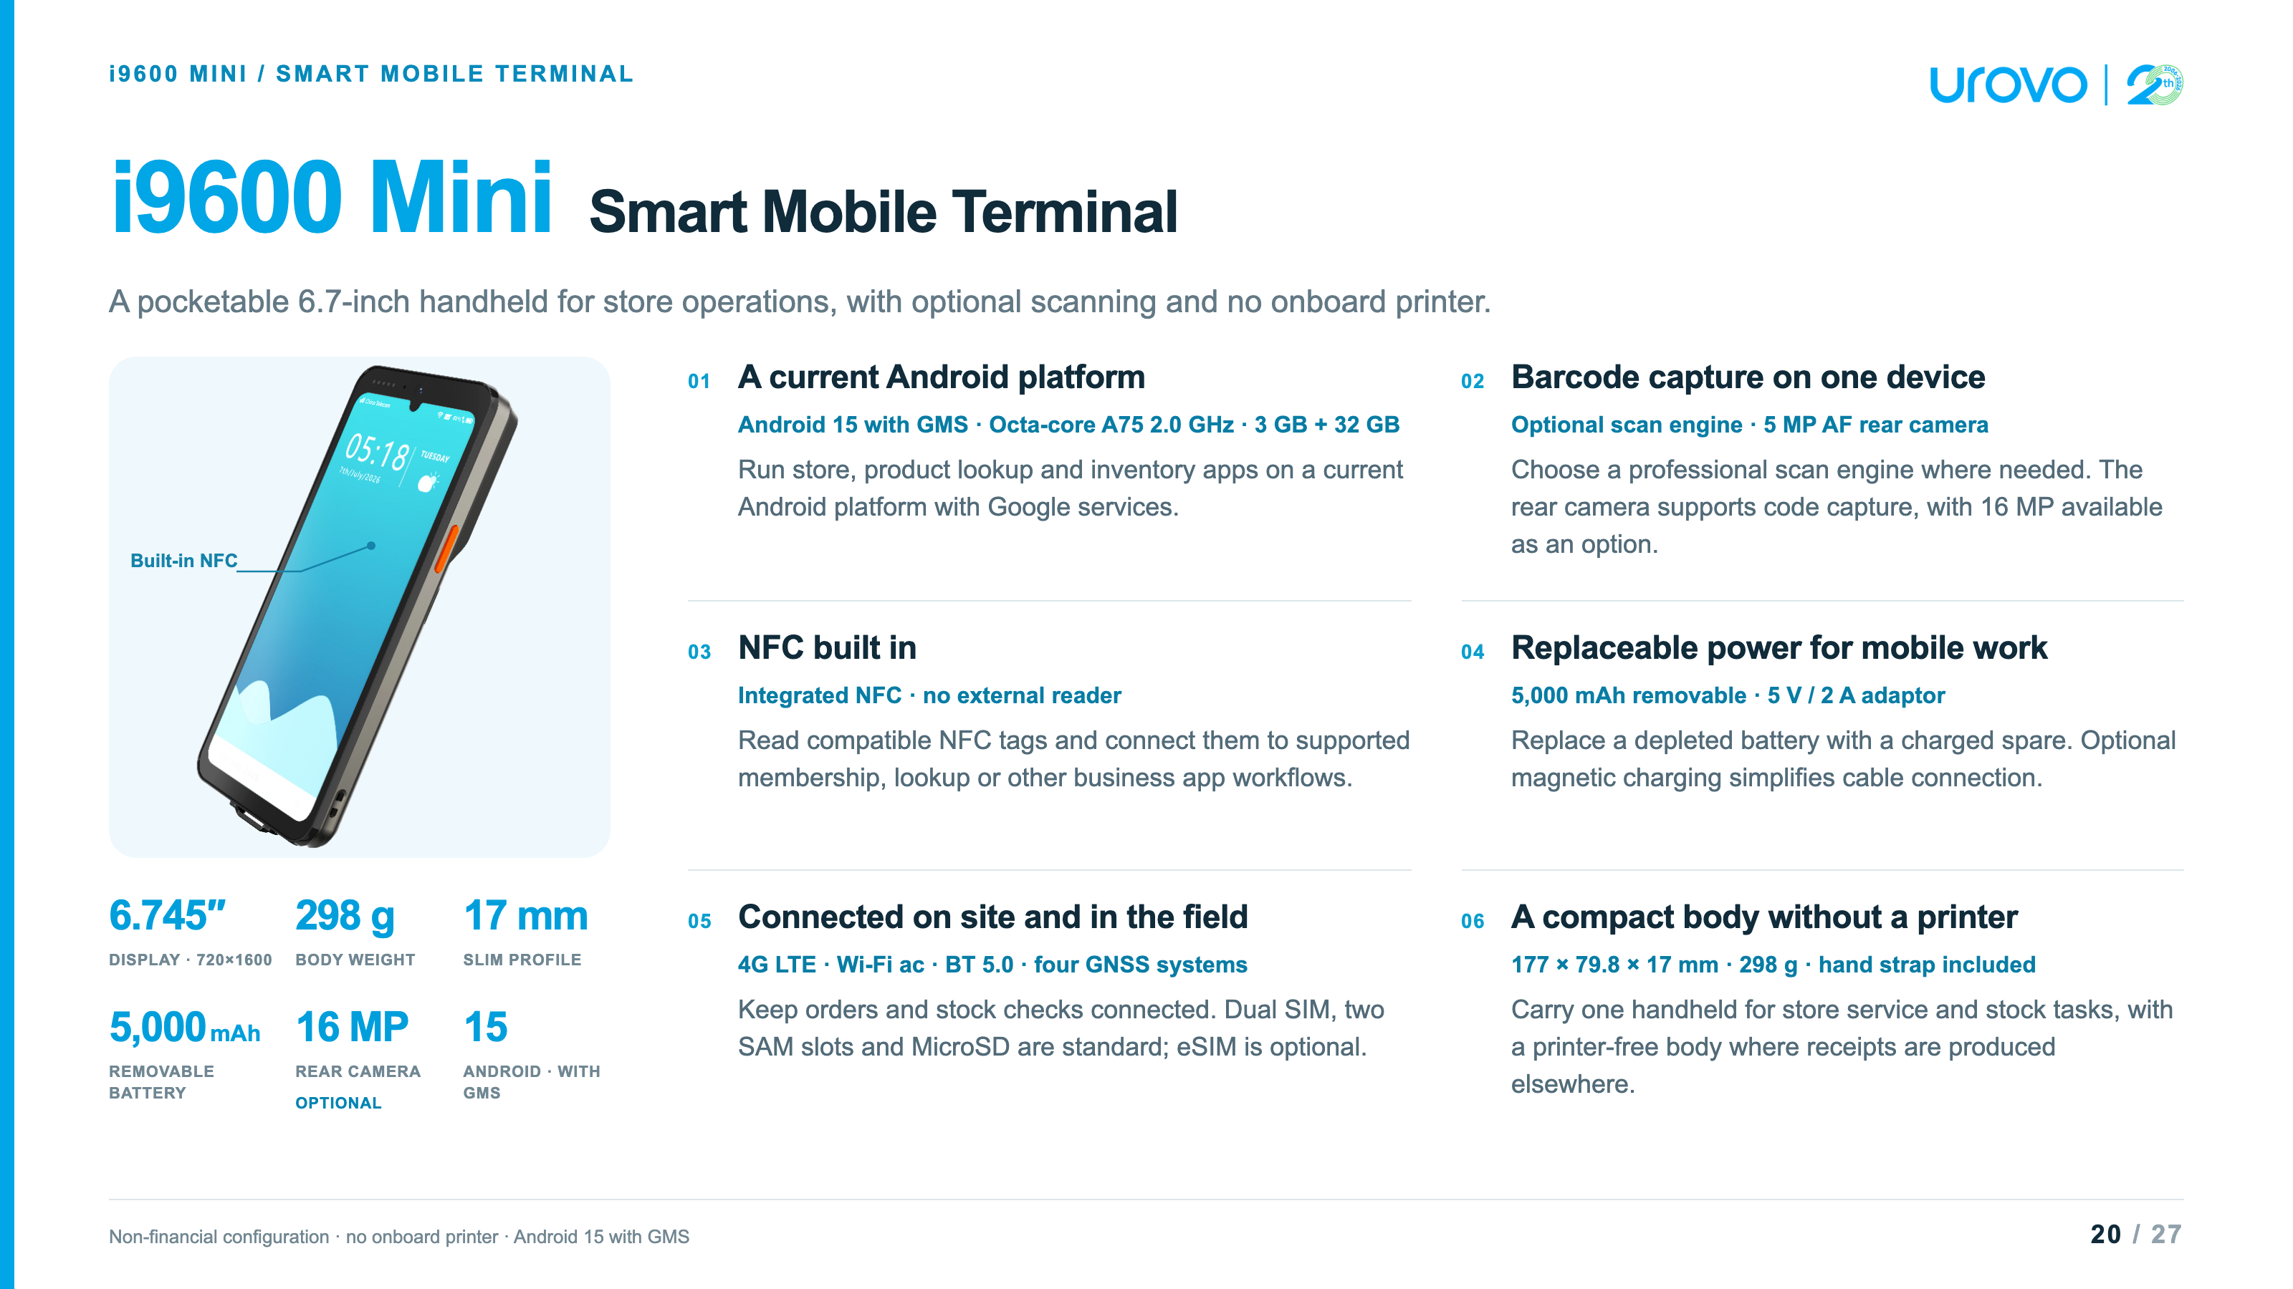
Notes:
i9600 Mini Smart Mobile Terminal · non-financial configuration · source checks: November 2, 2026
Platform and source editionThe controlling source is the user-designated i9600 Mini Smart Mobile Terminal (EN)-SPEC-20260908 DOCX. Its table lists octa-core A75 2.0 GHz, Android 15 with GMS, 3 GB RAM + 32 GB ROM and a 6.745-inch 720×1600 display. No performance benchmark, future OS upgrade commitment or multi-app performance guarantee is inferred. The separate Smart MiniPOS specification is not used./Users/patrickxu/Downloads/debuglogger/i9600 Mini Smart Mobile Terminal (EN)-SPEC-20260908.docx
Barcode and camera configurationThe rear camera is 5 MP AF as standard and 16 MP AF as an option. The professional scan engine is optional. There is no front camera as standard; 2 MP FF and 16 MP AF front cameras are optional. Camera code capture follows the supplied customer copy and matching September Smart Mobile specification. Test the selected camera/app or scan engine on the actual labels; no decode-speed or accuracy result is claimed.
NFC and non-financial positioningThe original DOCX lists NFC. The matching September Smart Mobile specification describes built-in under-display NFC. The slide calls out built-in NFC without asserting payment certification or an exact antenna boundary. This source does not establish EMVCo, PCI or a supported SoftPOS payment solution for this configuration. Membership, tag identification and lookup scenarios require compatible tags and business software. No on-device bank-card acceptance is advertised.
Battery and chargingThe DOCX specifies a removable 3.85 V / 5,000 mAh lithium-polymer battery and a 5 V / 2 A adaptor. Nominal energy is 19.25 Wh (calculated as voltage × capacity). Removable does not mean hot-swappable: save work and follow the operating procedure before a battery exchange. The optional four-pin magnetic pogo interface and optional magnetic charging cable are listed separately. No charging-time, full-shift runtime or uninterrupted battery-swap claim is made.
Networks, location and card slotsStandard communications: FDD-LTE, TDD-LTE, WCDMA, GSM; Bluetooth 5.0; IEEE 802.11 a/b/g/n/ac at 2.4 and 5 GHz. Positioning lists GPS, A-GPS, BeiDou, GLONASS and Galileo; no positioning accuracy is asserted. Default slots: one Micro SIM + one Nano SIM + two SAM + one MicroSD. Optional slot configuration replaces the Micro SIM with eSIM while retaining Nano SIM, two SAM and MicroSD. Application, carrier and regional configuration compatibility must be checked.
Physical and environmental specification177 × 79.8 × 17 mm; 298 g; power button, volume +/- and custom key. Operating temperature 0–50°C; storage -20–70°C; 5–95% RH non-condensing. The source has no IP rating or drop rating. No weatherproof, industrial ruggedness or vehicle-mount compatibility is implied. The hand strap is standard and no onboard printer is specified. Printed receipts are an external workflow, not an included printer accessory.
Accessories and interfacesStandard accessory: hand strap. Optional accessories: Kensington security lock, screen protector and magnetic charging cable. Standard interfaces: USB Type-C USB 2.0 OTG and five-pin pogo. Optional interface: four-pin magnetic charging pogo. No charging dock, multi-slot cradle, scan handle, spare-battery sales kit or mounting accessory is added to the supplied accessory list. Prepare charging spares only where supplied for the project.
Official competitor sources and comparison scopeSUNMI L3 official Chinese datasheet, page 2: SUNMI OS 4.0 based on Android 14; 6.75-inch 720×1600 display; 4/64 GB or 6/128 GB; 175×79×15 mm; 282 g; IP68; 1.5 m concrete drop; -20–55°C operation. Its default card layout is one Nano SIM + MicroSD or two Nano SIM, with optional PSAM and eSIM. Its battery is 4.4 V / 5,000 mAh and hot-swap is optional in this sheet. Dual-sided NFC is qualified to the non-RFID version. The official website describes EMVCo PCD L1, SoftPOS, fingerprint and optional UHF capabilities. These are L3 strengths, not i9600 Mini features. The visible row compares OS and card-slot layouts; it does not assert that L3 lacks GMS.iMin Swift 1 Pro official product page: Android 13, GMS, 4/32 GB, 6.5-inch 720×1600 display, optional NFC, 4G, Wi-Fi ac and Bluetooth 5.0; base PDA weight 245 g; IP54 and 1 m drop. The page lists 168.3×79.3×17.2 mm; the official modular brochure lists a different base-body size, 77×162×11 mm, and optional scanner/printer modules. Dimensions are omitted from the comparison to avoid mixing revisions or configurations. Weight is for the base PDA; a scanner module adds weight. Both sources specify a 7.6 V / 2,500 mAh / 19 Wh battery, so the 5,000 mAh i9600 Mini is not presented as double the energy or runtime. GMS is shared. No matched price, TCO, CPU performance or certification superiority is claimed.The visible comparison lists i9600 Mini configurations in the middle column and the named competitor configurations in the right column. It is not an exhaustive specification matrix. Public sources and configurations can change; confirm the regional SKU before quoting.
Product artwork and scenario provenanceThe original product rendering is extracted unchanged from word/media/image3.png in the controlling DOCX. Transparent margins are clipped with CSS only; device proportions are preserved. The source artwork shows a front-camera appearance, which does not make a front camera standard. UROVO branding is reused from the existing series.The retail scene is generated with the built-in image_gen tool using that original rendering as the hardware reference. It is an illustrative stock-check workflow, not a customer deployment, a supplied business app, or evidence of payment certification. The final prompt and asset paths are retained in i9600_Mini_Sources.md beside this deck.
Web reference: products/i9600_Mini_Product_Presentation.html
https://cdn.sunmi.com/public/generalfile/mgt_import/9c0368888c3f4574a90d29277845f3df.pdf
https://imin.com/wp-content/uploads/2025/04/Swift-1-Pro.pdf
https://www.imin.com/product/swift-1-pro/

Slide 21
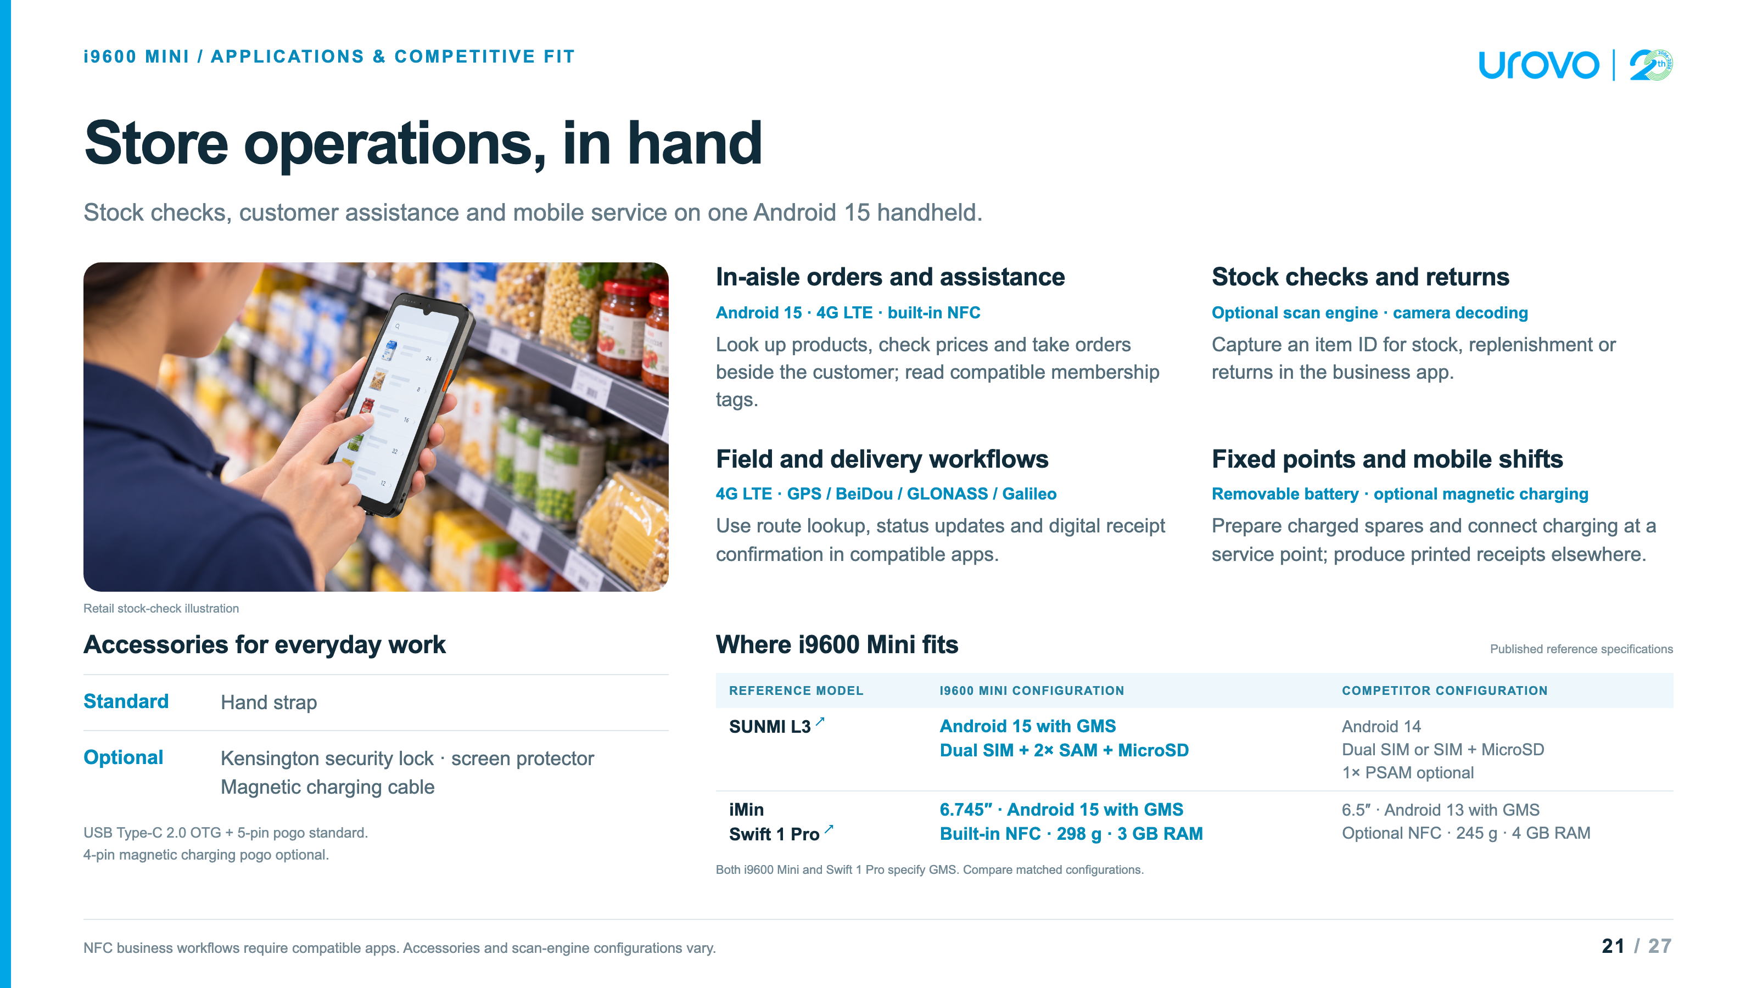
Notes:
i9600 Mini Smart Mobile Terminal · non-financial configuration · source checks: November 2, 2026
Platform and source editionThe controlling source is the user-designated i9600 Mini Smart Mobile Terminal (EN)-SPEC-20260908 DOCX. Its table lists octa-core A75 2.0 GHz, Android 15 with GMS, 3 GB RAM + 32 GB ROM and a 6.745-inch 720×1600 display. No performance benchmark, future OS upgrade commitment or multi-app performance guarantee is inferred. The separate Smart MiniPOS specification is not used./Users/patrickxu/Downloads/debuglogger/i9600 Mini Smart Mobile Terminal (EN)-SPEC-20260908.docx
Barcode and camera configurationThe rear camera is 5 MP AF as standard and 16 MP AF as an option. The professional scan engine is optional. There is no front camera as standard; 2 MP FF and 16 MP AF front cameras are optional. Camera code capture follows the supplied customer copy and matching September Smart Mobile specification. Test the selected camera/app or scan engine on the actual labels; no decode-speed or accuracy result is claimed.
NFC and non-financial positioningThe original DOCX lists NFC. The matching September Smart Mobile specification describes built-in under-display NFC. The slide calls out built-in NFC without asserting payment certification or an exact antenna boundary. This source does not establish EMVCo, PCI or a supported SoftPOS payment solution for this configuration. Membership, tag identification and lookup scenarios require compatible tags and business software. No on-device bank-card acceptance is advertised.
Battery and chargingThe DOCX specifies a removable 3.85 V / 5,000 mAh lithium-polymer battery and a 5 V / 2 A adaptor. Nominal energy is 19.25 Wh (calculated as voltage × capacity). Removable does not mean hot-swappable: save work and follow the operating procedure before a battery exchange. The optional four-pin magnetic pogo interface and optional magnetic charging cable are listed separately. No charging-time, full-shift runtime or uninterrupted battery-swap claim is made.
Networks, location and card slotsStandard communications: FDD-LTE, TDD-LTE, WCDMA, GSM; Bluetooth 5.0; IEEE 802.11 a/b/g/n/ac at 2.4 and 5 GHz. Positioning lists GPS, A-GPS, BeiDou, GLONASS and Galileo; no positioning accuracy is asserted. Default slots: one Micro SIM + one Nano SIM + two SAM + one MicroSD. Optional slot configuration replaces the Micro SIM with eSIM while retaining Nano SIM, two SAM and MicroSD. Application, carrier and regional configuration compatibility must be checked.
Physical and environmental specification177 × 79.8 × 17 mm; 298 g; power button, volume +/- and custom key. Operating temperature 0–50°C; storage -20–70°C; 5–95% RH non-condensing. The source has no IP rating or drop rating. No weatherproof, industrial ruggedness or vehicle-mount compatibility is implied. The hand strap is standard and no onboard printer is specified. Printed receipts are an external workflow, not an included printer accessory.
Accessories and interfacesStandard accessory: hand strap. Optional accessories: Kensington security lock, screen protector and magnetic charging cable. Standard interfaces: USB Type-C USB 2.0 OTG and five-pin pogo. Optional interface: four-pin magnetic charging pogo. No charging dock, multi-slot cradle, scan handle, spare-battery sales kit or mounting accessory is added to the supplied accessory list. Prepare charging spares only where supplied for the project.
Official competitor sources and comparison scopeSUNMI L3 official Chinese datasheet, page 2: SUNMI OS 4.0 based on Android 14; 6.75-inch 720×1600 display; 4/64 GB or 6/128 GB; 175×79×15 mm; 282 g; IP68; 1.5 m concrete drop; -20–55°C operation. Its default card layout is one Nano SIM + MicroSD or two Nano SIM, with optional PSAM and eSIM. Its battery is 4.4 V / 5,000 mAh and hot-swap is optional in this sheet. Dual-sided NFC is qualified to the non-RFID version. The official website describes EMVCo PCD L1, SoftPOS, fingerprint and optional UHF capabilities. These are L3 strengths, not i9600 Mini features. The visible row compares OS and card-slot layouts; it does not assert that L3 lacks GMS.iMin Swift 1 Pro official product page: Android 13, GMS, 4/32 GB, 6.5-inch 720×1600 display, optional NFC, 4G, Wi-Fi ac and Bluetooth 5.0; base PDA weight 245 g; IP54 and 1 m drop. The page lists 168.3×79.3×17.2 mm; the official modular brochure lists a different base-body size, 77×162×11 mm, and optional scanner/printer modules. Dimensions are omitted from the comparison to avoid mixing revisions or configurations. Weight is for the base PDA; a scanner module adds weight. Both sources specify a 7.6 V / 2,500 mAh / 19 Wh battery, so the 5,000 mAh i9600 Mini is not presented as double the energy or runtime. GMS is shared. No matched price, TCO, CPU performance or certification superiority is claimed.The visible comparison lists i9600 Mini configurations in the middle column and the named competitor configurations in the right column. It is not an exhaustive specification matrix. Public sources and configurations can change; confirm the regional SKU before quoting.
Product artwork and scenario provenanceThe original product rendering is extracted unchanged from word/media/image3.png in the controlling DOCX. Transparent margins are clipped with CSS only; device proportions are preserved. The source artwork shows a front-camera appearance, which does not make a front camera standard. UROVO branding is reused from the existing series.The retail scene is generated with the built-in image_gen tool using that original rendering as the hardware reference. It is an illustrative stock-check workflow, not a customer deployment, a supplied business app, or evidence of payment certification. The final prompt and asset paths are retained in i9600_Mini_Sources.md beside this deck.
Web reference: products/i9600_Mini_Product_Presentation.html
https://cdn.sunmi.com/public/generalfile/mgt_import/9c0368888c3f4574a90d29277845f3df.pdf
https://imin.com/wp-content/uploads/2025/04/Swift-1-Pro.pdf
https://www.imin.com/product/swift-1-pro/

Slide 22
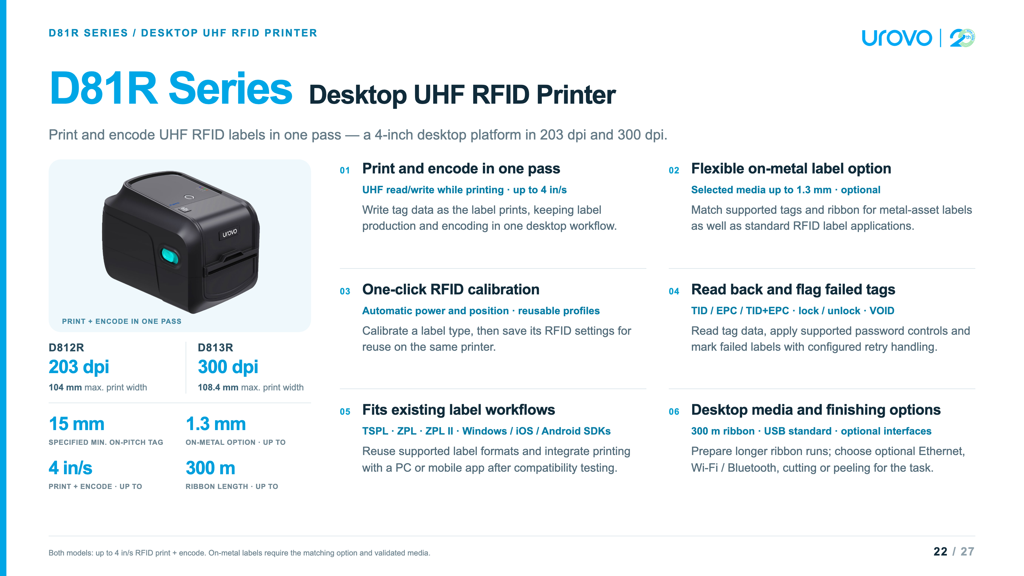
Notes:
D81R Series · D812R / D813R · source checks: November 2, 2026
Controlling sources and model selectionThe dedicated D81R Series(EN)-SPEC-20250114 specification (PDF modified September 24, 2026) and D81R Series(EN)-PB-2025 brochure control the hard specifications. D812R: 203 dpi, 104 mm maximum print width. D813R: 300 dpi, 108.4 mm maximum print width. Both share thermal transfer/direct thermal printing, 1,000 mm maximum print length, 500 MHz 32-bit processor, 8 MB RAM and 16 MB Flash, sensors and the listed interface options. The RAM subtype differs between the spec (PSRAM) and brochure (SDRAM), so no RAM subtype is advertised.The newer A3 user manual, revision dated September 24, 2026, correctly names D812R / D813R and lists print-only maxima of 200 / 150 mm/s. These are separate from RFID print-and-encode maxima, which are 4 in/s for both. Resolution supports choosing layouts with finer detail; no throughput benefit is asserted for D812R when both models are printing and encoding RFID labels./Users/patrickxu/patrick-agent/skills/urovo-product-expert/D81R Series/specs/default_202610081413/D81R Series(EN)-SPEC-20250114.pdf/Users/patrickxu/patrick-agent/skills/urovo-product-expert/D81R Series/brochure/default_202610081413/D81R Series(EN)-PB-2025.pdf/Users/patrickxu/Downloads/D81R-RFID系列-使用手册（英）261023.docx
Print and encode performance and pitchThe dedicated spec and brochure explicitly list maximum RFID speed 4 inch/s with printing and writing at the same time. This is a maximum, not a guaranteed rate for every tag, data length, verification, locking, retry or finishing mode. Print-only mode and read/write-before-printing modes are also documented. The in-one-pass feature does not establish that all jobs have zero backfeed under all conditions.The specification gives minimum on-pitch label length as 15 mm with an inconsistent parenthesis of 0.625 inches. 0.625 inches equals 15.875 mm, not 15 mm. The brochure and A3 manual also list 15 mm, so the slide retains the stated metric value and labels it as specified, but does not claim a verified pitch advantage over 15.9 mm or 16 mm competitor figures. Validate the delivered antenna/media setup on the target inlay.Protocol: ISO18000-6C / EPC Class 1 Gen2. The chip list is compatibility guidance, not a guarantee for every inlay geometry or region. No unlisted RF frequency or global certification coverage is inferred. The brochure's Impinj Connected badge is not treated as proof of a particular chipset or universal RFID compatibility.
On-metal media and source differencesThe dedicated spec lists 20–118 mm media width and 0.06–1.3 mm media thickness, with optional compatibility for flexible anti-metal tags no thicker than 1.3 mm. The brochure supports RFID tags, flexible anti-metal labels, jewelry adhesive labels and coated paper labels. Ordinary paper can be printed without implying that it contains a UHF chip.The A3 manual and shared printer table include a conflicting 1.5 mm anti-metal statement, while the A3 paper-thickness row still says up to 1.3 mm. The slide conservatively follows the dedicated spec at up to 1.3 mm with the matching option and validated media. The brochure says less than 1.3 mm on its cover. Exact borderline stock must be tested. No claim is made that all rigid tags fit, that all configurations include the anti-metal option, or that other RFID printers cannot handle anti-metal labels.Other source differences: D813R is 108.4 mm in the dedicated spec/brochure and 108 mm in the A3/shared table; maximum media width is 118 mm versus 120 mm; roll core is 25.4 mm versus a wider 25–76 mm accessory-table range. The deck uses dedicated-source values and avoids promising additional core adaptors.
Calibration and profile reuseOne-click or tool calibration obtains RFID read/write power and position. Saved RFID profiles can be reused for previously calibrated labels on the same printer. This does not establish that one profile transfers to all printers, all batches or different inlays without testing. Apply the documented calibration procedure before validating throughput.
Read-back and failed-tag handlingThe spec lists TID, EPC or TID+EPC reading, RFID password lock/unlock, failed-label marking and configurable rewrite/reprint handling. These are RFID functions; they do not establish optical verification of the printed barcode, automatic compatibility with every chip's lock state, tamper-proof records or a completed end-to-end audit system. No guarantee of zero failed labels is made.
Languages, software and integrationThe dedicated specification lists TSPL, EPL, ZPL and ZPL II. The brochure and shared printer configuration table list TSPL, ZPL and ZPL II; those shared three are shown in the presentation. The A3 manual/shared configuration table lists driver printing and Windows, iOS and Android secondary-development SDKs. The standard box includes a Windows labeling-software CD. Command emulation does not guarantee every existing template or RFID command works unchanged; test the customer format, tag data and selected app/driver combination.
Interfaces, accessories and finishingStandard interface: USB. Dedicated-spec options: Ethernet 10/100 Mbps, Bluetooth/Wi-Fi, and combined network configurations. The older spec lists 2.4 GHz Wi-Fi and Bluetooth 2.1 + 4.2; the newer A3 manual lists USB 2.0, Bluetooth SPP+BLE 4.2 and 2.4/5 GHz Wi-Fi options. The visible page therefore says Wi-Fi / Bluetooth without claiming an exact radio option for every unit.Standard pack: Windows labeling-software CD, quick start guide, USB cable, power cord, two 1-inch ribbon spindles for 300 m ribbon, and external universal switching power supply (24 V / 2.5 A / 60 W). Maximum ribbon length is 300 m, outside diameter 67 mm, 1-inch core; label roll outside diameter is 127 mm. Ribbon spindles do not mean that a 300 m ribbon roll is included.The shared Device and Accessories Guide, printer configuration sheet, explicitly lists optional full cutter and peeler for D812R and D813R. Their existence does not guarantee compatibility with maximum-thickness on-metal media or every RFID inlay; check the chosen stock, finishing method and order code. Display is not included. No undocumented ribbon saving, automatic cutter, industrial duty cycle, spare-parts interchangeability or price advantage is claimed./Users/patrickxu/patrick-agent/skills/urovo-product-expert/_shared/accessories/device-and-accessories-guide_202609182242/Device-and-Accessories-Guide-20260918.md — printer configuration sheet
Desktop competitors and matched configurationsZebra ZD621R official support and the manufacturer-authored ZD621R/ZD611R datasheet document 203 / 300 dpi configurations, a 4.3-inch colour touch display, USB and Ethernet, and both 300 m and 74 m ribbon support. D81R's 300 m ribbon is therefore a shared feature, not an exclusive advantage. Zebra's print-only maximum speed is not compared directly with D81R's 4 in/s RFID print-and-write figure. Different published Zebra datasheet revisions give different 300 dpi print widths; no Zebra print-width superiority claim is made.Zebra official ZD421/ZD621 user guide also lists 300 m and 74 m ribbon options. Manufacturer datasheet reference copy: Zebra ZD621 RFID datasheet.TSC official TH240/DH240 Series user manual, PDF pages 11 and 14 (printed pages 8 and 11): TH240T 203 dpi / 108 mm, TH340T 300 dpi / 105.7 mm. The thermal-transfer family supports 300 m ribbon. Its UHF RFID configuration supports selected on-metal tags up to 1.35 mm, tear-off mode only, with minimum label/tag pitch 15.9 mm. UHF is a selected RFID configuration, not standard on every TH240T/TH340T, and is not applicable to the RC ribbon-cartridge variant. The visible table labels these as RFID configurations and preserves the selected-tag and tear-off conditions.TSC is a direct desktop alternative with its own strengths, not an ordinary printer that cannot feed on-metal tags. SATO CL4NX Plus is an industrial-class reference and is omitted from this compact desktop comparison. No matched price, service cost, ROI, universal performance advantage or promise of a direct drop-in replacement is asserted.
Artwork and scenario provenanceThe original product rendering is decoded without retouching from page 1, image Im3.jp2, of the dedicated D81R specification; the extracted image is losslessly saved as PNG for browser support. Its proportions are preserved. UROVO branding and navigation follow the existing presentation series.The apparel-tagging scene is generated with the built-in image_gen tool using the extracted product artwork as the hardware reference. It illustrates a workflow, not a real deployment, supplied label stock or a certified inlay. Its generic printed UI/label is not a barcode-validation result. The prompt and final asset paths are retained in D81R_Sources.md beside this deck.
Web reference: products/D81R_Product_Presentation.html
https://fs.tscprinters.com/es/dl/3/8368
https://www.jarltech.com/sites/default/files/documents/product/datasheet/en/Zebra_ZD621_RFID_DataSheet_EN.pdf
https://www.zebra.com/content/dam/support-dam/en/documentation/unrestricted/guide/product/zd421-zd621-ug-en.pdf
https://www.zebra.com/us/en/support-downloads/printers/desktop/zd621.html

Slide 23
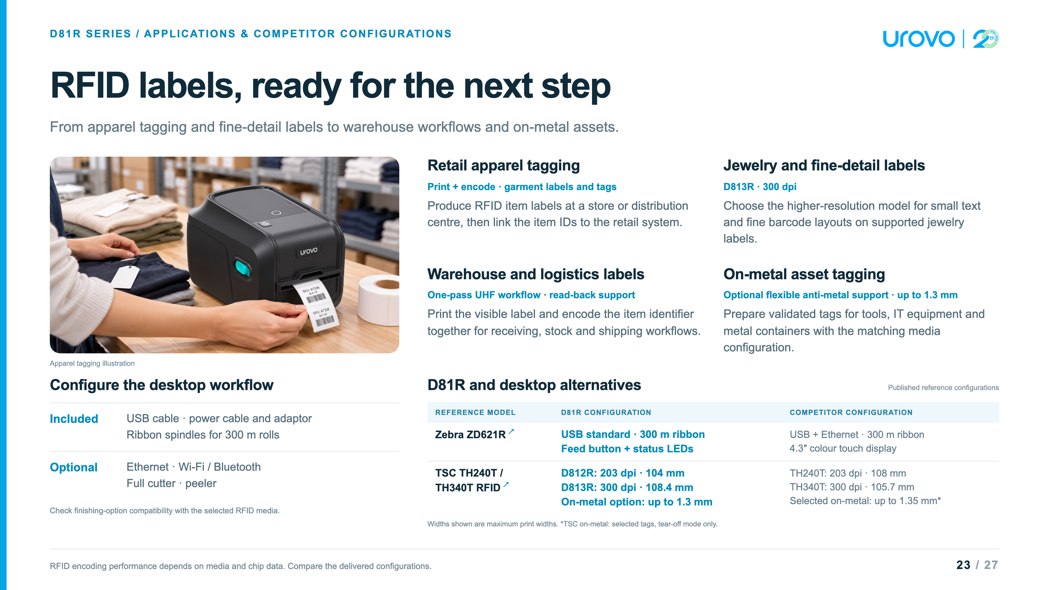
Notes:
D81R Series · D812R / D813R · source checks: November 2, 2026
Controlling sources and model selectionThe dedicated D81R Series(EN)-SPEC-20250114 specification (PDF modified September 24, 2026) and D81R Series(EN)-PB-2025 brochure control the hard specifications. D812R: 203 dpi, 104 mm maximum print width. D813R: 300 dpi, 108.4 mm maximum print width. Both share thermal transfer/direct thermal printing, 1,000 mm maximum print length, 500 MHz 32-bit processor, 8 MB RAM and 16 MB Flash, sensors and the listed interface options. The RAM subtype differs between the spec (PSRAM) and brochure (SDRAM), so no RAM subtype is advertised.The newer A3 user manual, revision dated September 24, 2026, correctly names D812R / D813R and lists print-only maxima of 200 / 150 mm/s. These are separate from RFID print-and-encode maxima, which are 4 in/s for both. Resolution supports choosing layouts with finer detail; no throughput benefit is asserted for D812R when both models are printing and encoding RFID labels./Users/patrickxu/patrick-agent/skills/urovo-product-expert/D81R Series/specs/default_202610081413/D81R Series(EN)-SPEC-20250114.pdf/Users/patrickxu/patrick-agent/skills/urovo-product-expert/D81R Series/brochure/default_202610081413/D81R Series(EN)-PB-2025.pdf/Users/patrickxu/Downloads/D81R-RFID系列-使用手册（英）261023.docx
Print and encode performance and pitchThe dedicated spec and brochure explicitly list maximum RFID speed 4 inch/s with printing and writing at the same time. This is a maximum, not a guaranteed rate for every tag, data length, verification, locking, retry or finishing mode. Print-only mode and read/write-before-printing modes are also documented. The in-one-pass feature does not establish that all jobs have zero backfeed under all conditions.The specification gives minimum on-pitch label length as 15 mm with an inconsistent parenthesis of 0.625 inches. 0.625 inches equals 15.875 mm, not 15 mm. The brochure and A3 manual also list 15 mm, so the slide retains the stated metric value and labels it as specified, but does not claim a verified pitch advantage over 15.9 mm or 16 mm competitor figures. Validate the delivered antenna/media setup on the target inlay.Protocol: ISO18000-6C / EPC Class 1 Gen2. The chip list is compatibility guidance, not a guarantee for every inlay geometry or region. No unlisted RF frequency or global certification coverage is inferred. The brochure's Impinj Connected badge is not treated as proof of a particular chipset or universal RFID compatibility.
On-metal media and source differencesThe dedicated spec lists 20–118 mm media width and 0.06–1.3 mm media thickness, with optional compatibility for flexible anti-metal tags no thicker than 1.3 mm. The brochure supports RFID tags, flexible anti-metal labels, jewelry adhesive labels and coated paper labels. Ordinary paper can be printed without implying that it contains a UHF chip.The A3 manual and shared printer table include a conflicting 1.5 mm anti-metal statement, while the A3 paper-thickness row still says up to 1.3 mm. The slide conservatively follows the dedicated spec at up to 1.3 mm with the matching option and validated media. The brochure says less than 1.3 mm on its cover. Exact borderline stock must be tested. No claim is made that all rigid tags fit, that all configurations include the anti-metal option, or that other RFID printers cannot handle anti-metal labels.Other source differences: D813R is 108.4 mm in the dedicated spec/brochure and 108 mm in the A3/shared table; maximum media width is 118 mm versus 120 mm; roll core is 25.4 mm versus a wider 25–76 mm accessory-table range. The deck uses dedicated-source values and avoids promising additional core adaptors.
Calibration and profile reuseOne-click or tool calibration obtains RFID read/write power and position. Saved RFID profiles can be reused for previously calibrated labels on the same printer. This does not establish that one profile transfers to all printers, all batches or different inlays without testing. Apply the documented calibration procedure before validating throughput.
Read-back and failed-tag handlingThe spec lists TID, EPC or TID+EPC reading, RFID password lock/unlock, failed-label marking and configurable rewrite/reprint handling. These are RFID functions; they do not establish optical verification of the printed barcode, automatic compatibility with every chip's lock state, tamper-proof records or a completed end-to-end audit system. No guarantee of zero failed labels is made.
Languages, software and integrationThe dedicated specification lists TSPL, EPL, ZPL and ZPL II. The brochure and shared printer configuration table list TSPL, ZPL and ZPL II; those shared three are shown in the presentation. The A3 manual/shared configuration table lists driver printing and Windows, iOS and Android secondary-development SDKs. The standard box includes a Windows labeling-software CD. Command emulation does not guarantee every existing template or RFID command works unchanged; test the customer format, tag data and selected app/driver combination.
Interfaces, accessories and finishingStandard interface: USB. Dedicated-spec options: Ethernet 10/100 Mbps, Bluetooth/Wi-Fi, and combined network configurations. The older spec lists 2.4 GHz Wi-Fi and Bluetooth 2.1 + 4.2; the newer A3 manual lists USB 2.0, Bluetooth SPP+BLE 4.2 and 2.4/5 GHz Wi-Fi options. The visible page therefore says Wi-Fi / Bluetooth without claiming an exact radio option for every unit.Standard pack: Windows labeling-software CD, quick start guide, USB cable, power cord, two 1-inch ribbon spindles for 300 m ribbon, and external universal switching power supply (24 V / 2.5 A / 60 W). Maximum ribbon length is 300 m, outside diameter 67 mm, 1-inch core; label roll outside diameter is 127 mm. Ribbon spindles do not mean that a 300 m ribbon roll is included.The shared Device and Accessories Guide, printer configuration sheet, explicitly lists optional full cutter and peeler for D812R and D813R. Their existence does not guarantee compatibility with maximum-thickness on-metal media or every RFID inlay; check the chosen stock, finishing method and order code. Display is not included. No undocumented ribbon saving, automatic cutter, industrial duty cycle, spare-parts interchangeability or price advantage is claimed./Users/patrickxu/patrick-agent/skills/urovo-product-expert/_shared/accessories/device-and-accessories-guide_202609182242/Device-and-Accessories-Guide-20260918.md — printer configuration sheet
Desktop competitors and matched configurationsZebra ZD621R official support and the manufacturer-authored ZD621R/ZD611R datasheet document 203 / 300 dpi configurations, a 4.3-inch colour touch display, USB and Ethernet, and both 300 m and 74 m ribbon support. D81R's 300 m ribbon is therefore a shared feature, not an exclusive advantage. Zebra's print-only maximum speed is not compared directly with D81R's 4 in/s RFID print-and-write figure. Different published Zebra datasheet revisions give different 300 dpi print widths; no Zebra print-width superiority claim is made.Zebra official ZD421/ZD621 user guide also lists 300 m and 74 m ribbon options. Manufacturer datasheet reference copy: Zebra ZD621 RFID datasheet.TSC official TH240/DH240 Series user manual, PDF pages 11 and 14 (printed pages 8 and 11): TH240T 203 dpi / 108 mm, TH340T 300 dpi / 105.7 mm. The thermal-transfer family supports 300 m ribbon. Its UHF RFID configuration supports selected on-metal tags up to 1.35 mm, tear-off mode only, with minimum label/tag pitch 15.9 mm. UHF is a selected RFID configuration, not standard on every TH240T/TH340T, and is not applicable to the RC ribbon-cartridge variant. The visible table labels these as RFID configurations and preserves the selected-tag and tear-off conditions.TSC is a direct desktop alternative with its own strengths, not an ordinary printer that cannot feed on-metal tags. SATO CL4NX Plus is an industrial-class reference and is omitted from this compact desktop comparison. No matched price, service cost, ROI, universal performance advantage or promise of a direct drop-in replacement is asserted.
Artwork and scenario provenanceThe original product rendering is decoded without retouching from page 1, image Im3.jp2, of the dedicated D81R specification; the extracted image is losslessly saved as PNG for browser support. Its proportions are preserved. UROVO branding and navigation follow the existing presentation series.The apparel-tagging scene is generated with the built-in image_gen tool using the extracted product artwork as the hardware reference. It illustrates a workflow, not a real deployment, supplied label stock or a certified inlay. Its generic printed UI/label is not a barcode-validation result. The prompt and final asset paths are retained in D81R_Sources.md beside this deck.
Web reference: products/D81R_Product_Presentation.html
https://fs.tscprinters.com/es/dl/3/8368
https://www.jarltech.com/sites/default/files/documents/product/datasheet/en/Zebra_ZD621_RFID_DataSheet_EN.pdf
https://www.zebra.com/content/dam/support-dam/en/documentation/unrestricted/guide/product/zd421-zd621-ug-en.pdf
https://www.zebra.com/us/en/support-downloads/printers/desktop/zd621.html

Slide 24
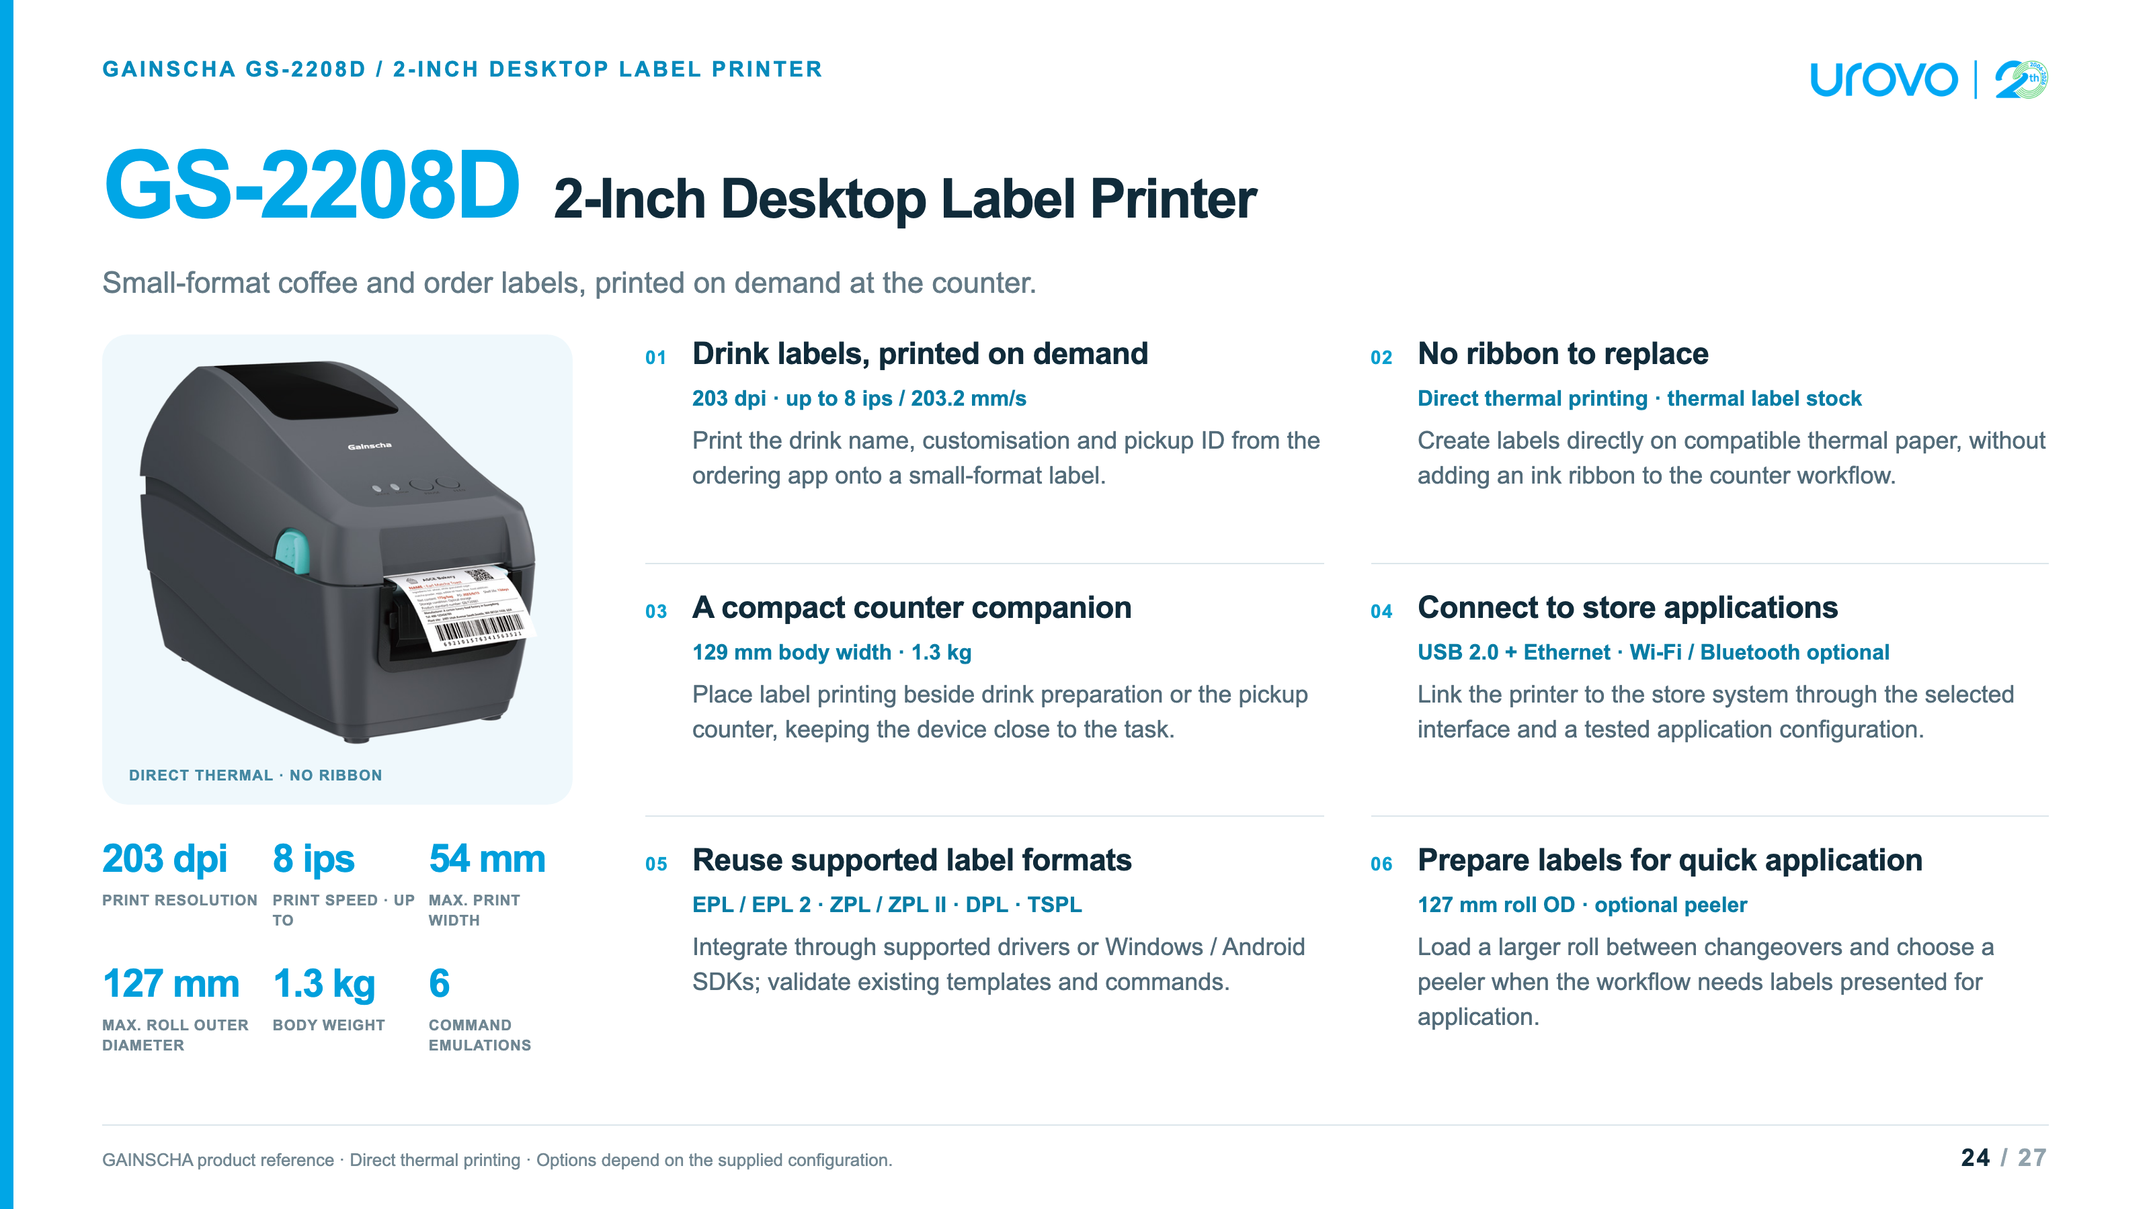
Notes:
GAINSCHA GS-2208D · 2-inch direct-thermal printer · source checks: November 2, 2026
Product identity and controlling sourceThe controlling source is the customer-supplied two-page PDF, 2 Inch Desktop Label Printer GS-2208D.pdf. Most text is outlined, so both pages were rendered and read visually. This deck covers GS-2208D only. It does not carry over GS-3205D's 300 dpi or 56 mm specifications and does not invent a UROVO model. UROVO branding identifies the presentation collection; the product is explicitly identified as GAINSCHA./Volumes/SSD1T/Downloads/debuglogger/2 Inch Desktop Label Printer GS-2208D.pdf
Resolution and speedGS-2208D: 8 dots/mm (203 dpi), direct thermal, maximum print speed 203.2 mm/s (8 ips), maximum print width 54 mm. Speed is a rated print maximum, not measured cups-per-minute or a guarantee for every barcode, driver, label size or network condition. The six emulations are EPL, EPL 2, ZPL, ZPL II, DPL and TSPL; this is a command list, not a claim of six universally interchangeable systems.
Thermal labels and cup applicationsDirect thermal printing uses compatible thermal media without a ribbon. The supplied PDF lists monochrome as standard, a dual-colour version as an option requiring dedicated dual-colour thermal paper, and a 127 mm maximum label roll outside diameter. It also lists wristband, retail and restaurant applications. This presentation focuses on coffee and small-format order labels; it does not claim medical certification, food-contact approval, waterproof output, cold-cup condensation resistance, adhesive suitability or linerless/cutter capability.Cup, ice, sugar and pickup data are produced by the connected ordering app and label template. The illustration's drink data is generic. Test adhesive/media performance on the actual hot/cold cup or packaging surface. QR or barcode printing does not itself establish scanning accuracy or an operational pickup system.
Physical specification and revision differencesThe supplied PDF lists 129 mm (W) × 165.3 mm (H) × 244.3 mm (D), 1.3 kg, ABS enclosure. Its 165.3 mm height controls over the customer AI draft's 163.5 mm. The manufacturer's current product page instead lists 1.35 kg; the visible metric retains the supplied edition's 1.3 kg. The PDF specifies operation 5–40°C and 25–85% RH non-condensing; storage -40–60°C, 10–90% RH. These are not weatherproofing or splash-resistance claims.The PDF lists FCC, CE, CCC, BIS and CB and RoHS/REACH/WEEE compliance. No regional certification is advertised as freshly verified for every configuration.
Supplied interfaces and configuration scopeThe supplied PDF lists USB 2.0 high-speed 480 Mbps and internal Ethernet 10/100 Mbps, with optional internal Bluetooth 4.0 and Wi-Fi. The current manufacturer page lists Bluetooth 4.2 while older manuals include economic/empower variants and USB Host. The visible slides say Bluetooth generically and do not promise USB Host on the supplied configuration.GAINSCHA GS-2208D official product page. Confirm delivered interfaces and regional availability when specifying a unit.
Formats and integrationThe supplied PDF lists EPL, EPL 2, ZPL, ZPL II, DPL and TSPL compatibility; Windows printer utility, Windows SDK and Android SDK; BarTender Windows drivers and label design software available via download. Firmware emulation is not a guarantee that every template, font, barcode or host application works unchanged. No iOS SDK, automatic app connection or current software licensing entitlement is inferred.
Included items and optional equipmentIncluded: Windows labeling-software CD, quick start guide, USB cable, power cord and external switching power supply. Power: input AC 100–240 V; output DC 24 V / 2.5 A / 60 W. Dealer option: peeler. User option: external roll mount. Internal Bluetooth and Wi-Fi are configuration options. Dual-colour printing is an optional version requiring matching dual-colour thermal stock, not a software-only toggle or standard capability. The source does not list a cutter or supplied label roll.
Luckin coffee reference and supplied footageThe customer states that the printer is used by Luckin coffee and supplied 1102-luckin.mov as the reference footage. Sampled frames show a Gainscha-branded printer printing a label and a coffee-store drink-preparation workflow. The exact model number, deployment scope and supplier relationship are not independently established by a readable model plate or a public case study. The video reference is therefore attributed in the playback dialog to customer-supplied footage, with no claim of official endorsement, all-store rollout or supply exclusivity.The original video is about 35.93 seconds, H.264/AAC, 2560×1440, with fixed black sidebars around a portrait picture. The web copy retains the complete sequence and audio, removes only the black sidebars (908×1440 crop at x=826), scales to 682×1080, and encodes H.264 in MP4 with the original AAC audio and fast-start metadata. There are no content cuts or speed changes. Source remains untouched./Volumes/SSD1T/Downloads/debuglogger/1102-luckin.mov../assets/gs2208d-luckin-demo.mp4
Two-inch desktop alternativesTSC DH220 official product family page and manufacturer datasheet: DH220 is direct thermal, 203 dpi, maximum 8 ips / 203 mm/s, 54 mm print width, and 127 mm roll outside diameter. These match the principal GS-2208D figures and are not presented as a speed advantage for GS-2208D. Other DH variants are not substituted silently.Zebra official ZD411 technical specification: 56 mm print width at 203 dpi, USB and USB Host, with Ethernet available as an option. The comparison selects the direct-thermal ZD411D configuration. Zebra's web manual and product/specification materials have differing speed wording, so no Zebra speed comparison is printed. Options, languages, management tools and application compatibility must be matched to the delivered SKU. ZD510-HC is omitted because its cartridge wristband focus is less direct for the coffee-label task.The visible table describes the reference models and GS-2208D separately. No price, lifecycle, TCO, clinical certification, universal barcode superiority or drop-in replacement advantage is inferred.
Original artwork and generated illustrationThe original product rendering is decoded from page 1, Im2.jp2, of the supplied PDF and losslessly saved as PNG. The generated café image uses it as the hardware reference. That image is an illustration, not a frame from the Luckin video, a documented customer installation or a supplied POS application. Its generic cup labels are not validated print samples. The prompt, original source and project asset paths are retained in GS2208D_Sources.md beside this deck.
Web reference: products/GS2208D_Product_Presentation.html
https://fs.tscprinters.com/system/files/tsc-auto-id-th-dh-series-en-20250930.pdf
https://gainscha.com.tw/Product-Center/Desktop-Barcode-Printer/Surpass-Series/2-Inch-Desktop-Label-Printer-GS-2208D
https://usca.tscprinters.com/en/products/dh-series-2-inch-high-precision-desktop-printers
https://www.zebra.com/content/dam/zebra_dam/en/tech-specs/zd411-tech-specs-en-us.pdf

Slide 25
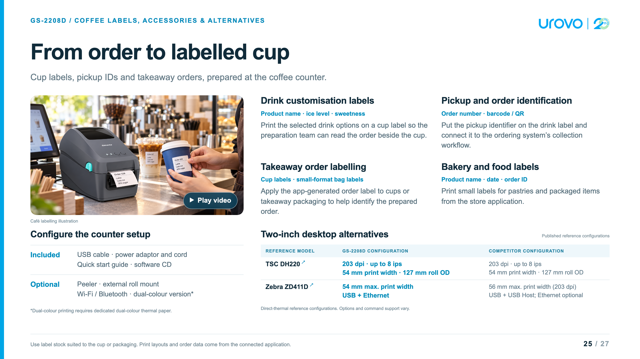
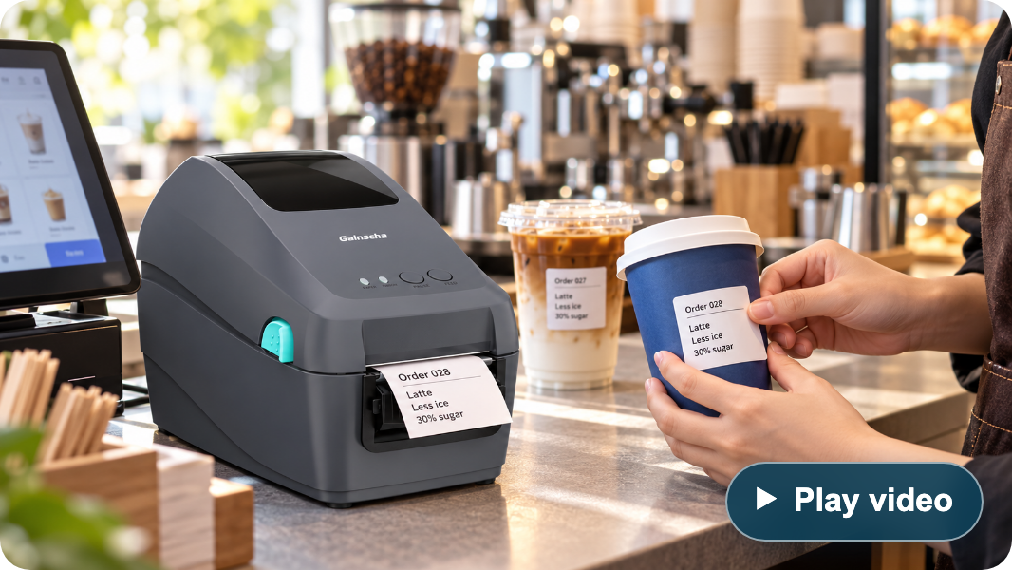
Notes:
GAINSCHA GS-2208D · 2-inch direct-thermal printer · source checks: November 2, 2026
Product identity and controlling sourceThe controlling source is the customer-supplied two-page PDF, 2 Inch Desktop Label Printer GS-2208D.pdf. Most text is outlined, so both pages were rendered and read visually. This deck covers GS-2208D only. It does not carry over GS-3205D's 300 dpi or 56 mm specifications and does not invent a UROVO model. UROVO branding identifies the presentation collection; the product is explicitly identified as GAINSCHA./Volumes/SSD1T/Downloads/debuglogger/2 Inch Desktop Label Printer GS-2208D.pdf
Resolution and speedGS-2208D: 8 dots/mm (203 dpi), direct thermal, maximum print speed 203.2 mm/s (8 ips), maximum print width 54 mm. Speed is a rated print maximum, not measured cups-per-minute or a guarantee for every barcode, driver, label size or network condition. The six emulations are EPL, EPL 2, ZPL, ZPL II, DPL and TSPL; this is a command list, not a claim of six universally interchangeable systems.
Thermal labels and cup applicationsDirect thermal printing uses compatible thermal media without a ribbon. The supplied PDF lists monochrome as standard, a dual-colour version as an option requiring dedicated dual-colour thermal paper, and a 127 mm maximum label roll outside diameter. It also lists wristband, retail and restaurant applications. This presentation focuses on coffee and small-format order labels; it does not claim medical certification, food-contact approval, waterproof output, cold-cup condensation resistance, adhesive suitability or linerless/cutter capability.Cup, ice, sugar and pickup data are produced by the connected ordering app and label template. The illustration's drink data is generic. Test adhesive/media performance on the actual hot/cold cup or packaging surface. QR or barcode printing does not itself establish scanning accuracy or an operational pickup system.
Physical specification and revision differencesThe supplied PDF lists 129 mm (W) × 165.3 mm (H) × 244.3 mm (D), 1.3 kg, ABS enclosure. Its 165.3 mm height controls over the customer AI draft's 163.5 mm. The manufacturer's current product page instead lists 1.35 kg; the visible metric retains the supplied edition's 1.3 kg. The PDF specifies operation 5–40°C and 25–85% RH non-condensing; storage -40–60°C, 10–90% RH. These are not weatherproofing or splash-resistance claims.The PDF lists FCC, CE, CCC, BIS and CB and RoHS/REACH/WEEE compliance. No regional certification is advertised as freshly verified for every configuration.
Supplied interfaces and configuration scopeThe supplied PDF lists USB 2.0 high-speed 480 Mbps and internal Ethernet 10/100 Mbps, with optional internal Bluetooth 4.0 and Wi-Fi. The current manufacturer page lists Bluetooth 4.2 while older manuals include economic/empower variants and USB Host. The visible slides say Bluetooth generically and do not promise USB Host on the supplied configuration.GAINSCHA GS-2208D official product page. Confirm delivered interfaces and regional availability when specifying a unit.
Formats and integrationThe supplied PDF lists EPL, EPL 2, ZPL, ZPL II, DPL and TSPL compatibility; Windows printer utility, Windows SDK and Android SDK; BarTender Windows drivers and label design software available via download. Firmware emulation is not a guarantee that every template, font, barcode or host application works unchanged. No iOS SDK, automatic app connection or current software licensing entitlement is inferred.
Included items and optional equipmentIncluded: Windows labeling-software CD, quick start guide, USB cable, power cord and external switching power supply. Power: input AC 100–240 V; output DC 24 V / 2.5 A / 60 W. Dealer option: peeler. User option: external roll mount. Internal Bluetooth and Wi-Fi are configuration options. Dual-colour printing is an optional version requiring matching dual-colour thermal stock, not a software-only toggle or standard capability. The source does not list a cutter or supplied label roll.
Luckin coffee reference and supplied footageThe customer states that the printer is used by Luckin coffee and supplied 1102-luckin.mov as the reference footage. Sampled frames show a Gainscha-branded printer printing a label and a coffee-store drink-preparation workflow. The exact model number, deployment scope and supplier relationship are not independently established by a readable model plate or a public case study. The video reference is therefore attributed in the playback dialog to customer-supplied footage, with no claim of official endorsement, all-store rollout or supply exclusivity.The original video is about 35.93 seconds, H.264/AAC, 2560×1440, with fixed black sidebars around a portrait picture. The web copy retains the complete sequence and audio, removes only the black sidebars (908×1440 crop at x=826), scales to 682×1080, and encodes H.264 in MP4 with the original AAC audio and fast-start metadata. There are no content cuts or speed changes. Source remains untouched./Volumes/SSD1T/Downloads/debuglogger/1102-luckin.mov../assets/gs2208d-luckin-demo.mp4
Two-inch desktop alternativesTSC DH220 official product family page and manufacturer datasheet: DH220 is direct thermal, 203 dpi, maximum 8 ips / 203 mm/s, 54 mm print width, and 127 mm roll outside diameter. These match the principal GS-2208D figures and are not presented as a speed advantage for GS-2208D. Other DH variants are not substituted silently.Zebra official ZD411 technical specification: 56 mm print width at 203 dpi, USB and USB Host, with Ethernet available as an option. The comparison selects the direct-thermal ZD411D configuration. Zebra's web manual and product/specification materials have differing speed wording, so no Zebra speed comparison is printed. Options, languages, management tools and application compatibility must be matched to the delivered SKU. ZD510-HC is omitted because its cartridge wristband focus is less direct for the coffee-label task.The visible table describes the reference models and GS-2208D separately. No price, lifecycle, TCO, clinical certification, universal barcode superiority or drop-in replacement advantage is inferred.
Original artwork and generated illustrationThe original product rendering is decoded from page 1, Im2.jp2, of the supplied PDF and losslessly saved as PNG. The generated café image uses it as the hardware reference. That image is an illustration, not a frame from the Luckin video, a documented customer installation or a supplied POS application. Its generic cup labels are not validated print samples. The prompt, original source and project asset paths are retained in GS2208D_Sources.md beside this deck.
Web reference: products/GS2208D_Product_Presentation.html
https://fs.tscprinters.com/system/files/tsc-auto-id-th-dh-series-en-20250930.pdf
https://gainscha.com.tw/Product-Center/Desktop-Barcode-Printer/Surpass-Series/2-Inch-Desktop-Label-Printer-GS-2208D
https://usca.tscprinters.com/en/products/dh-series-2-inch-high-precision-desktop-printers
https://www.zebra.com/content/dam/zebra_dam/en/tech-specs/zd411-tech-specs-en-us.pdf

Slide 26
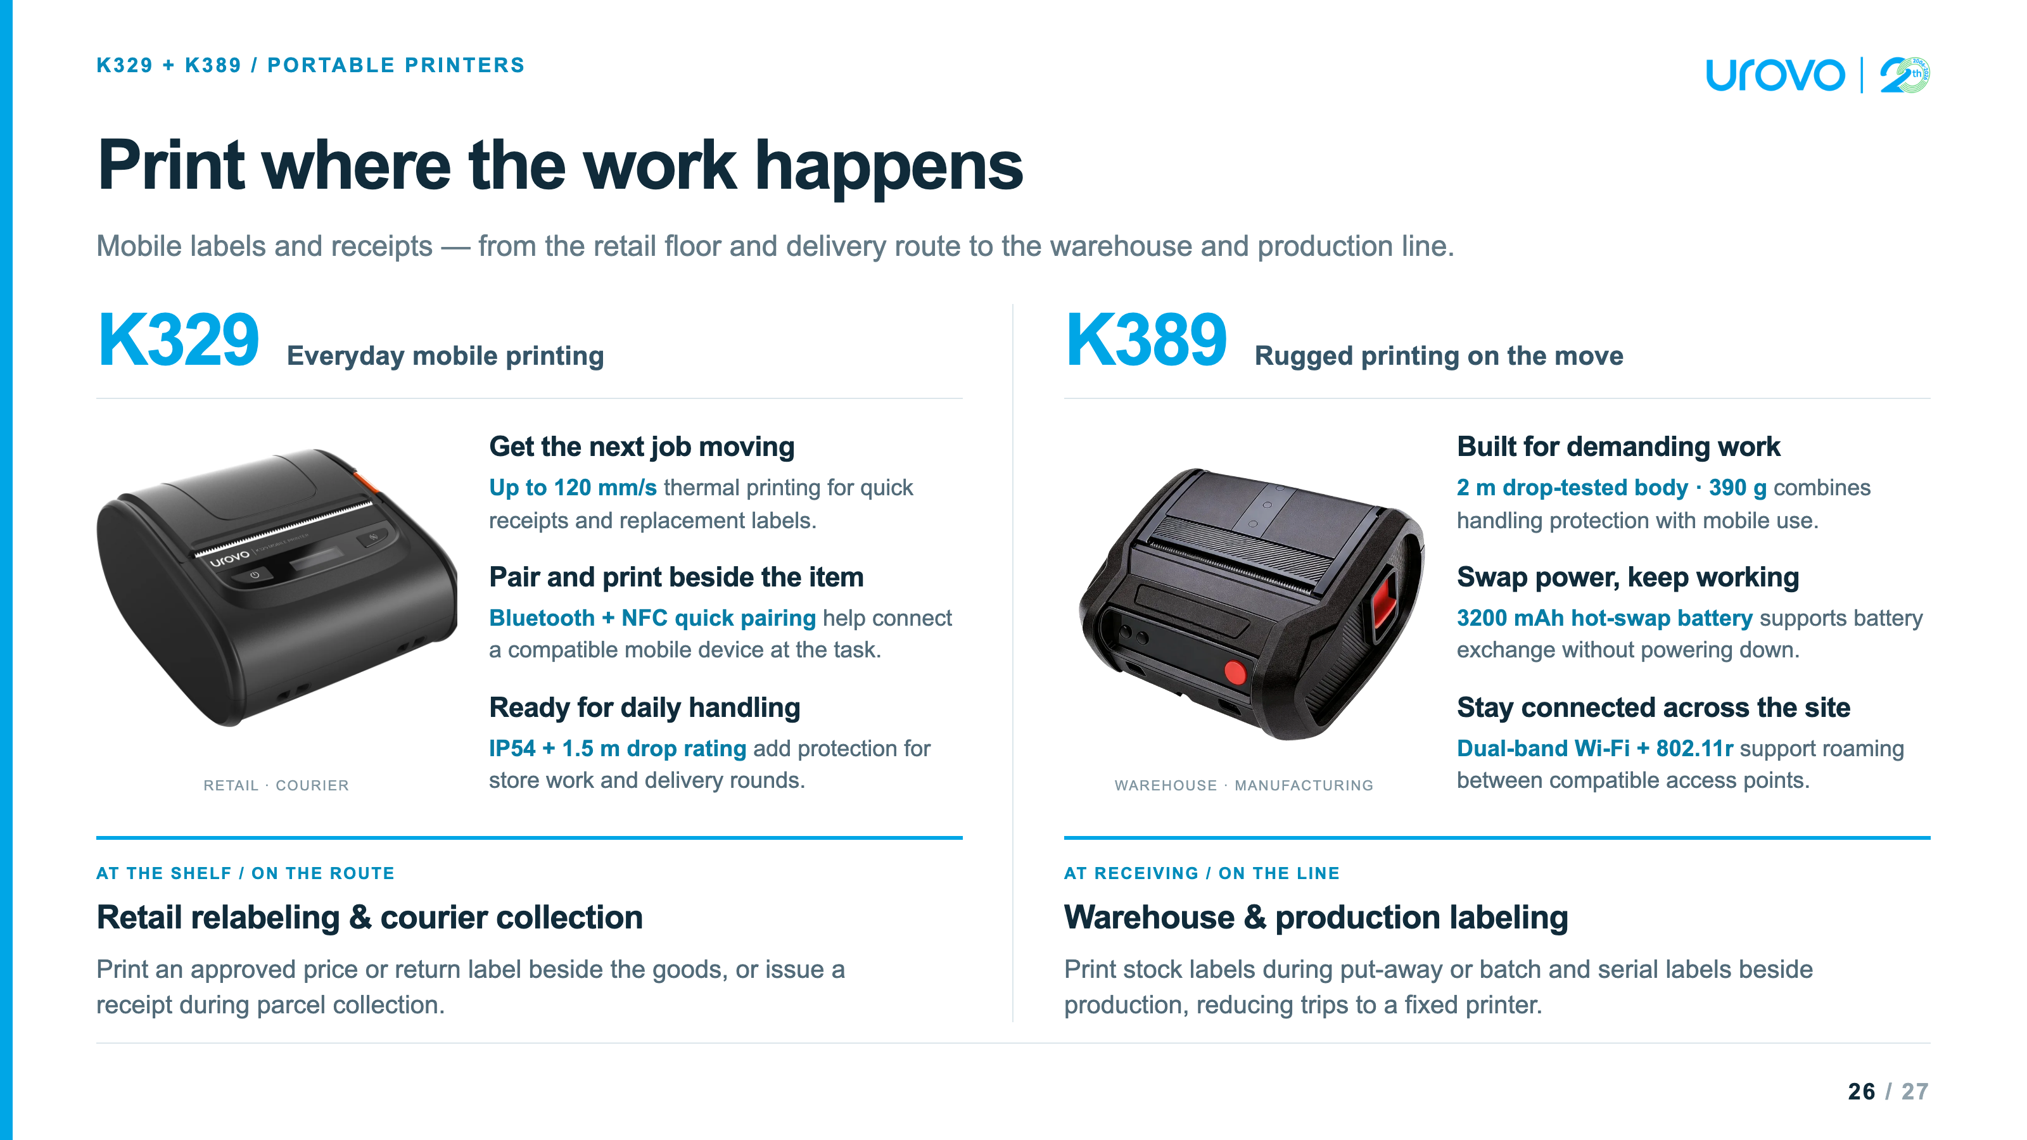

Slide 27


