Slide 1
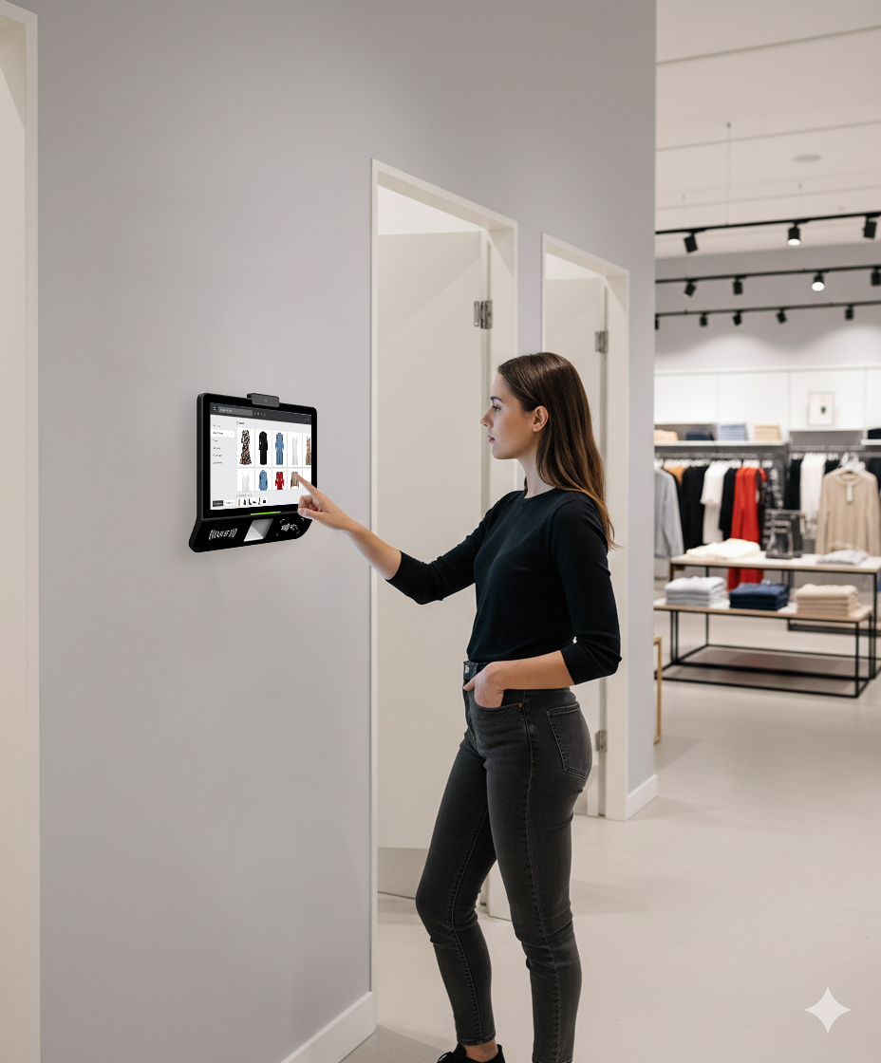

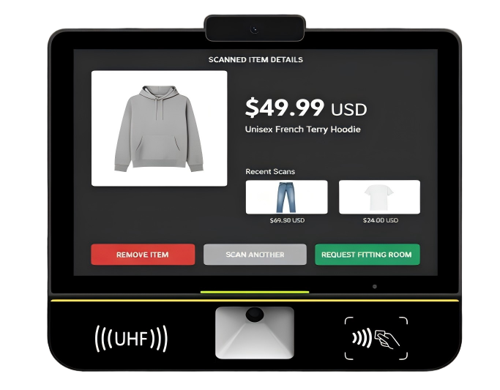
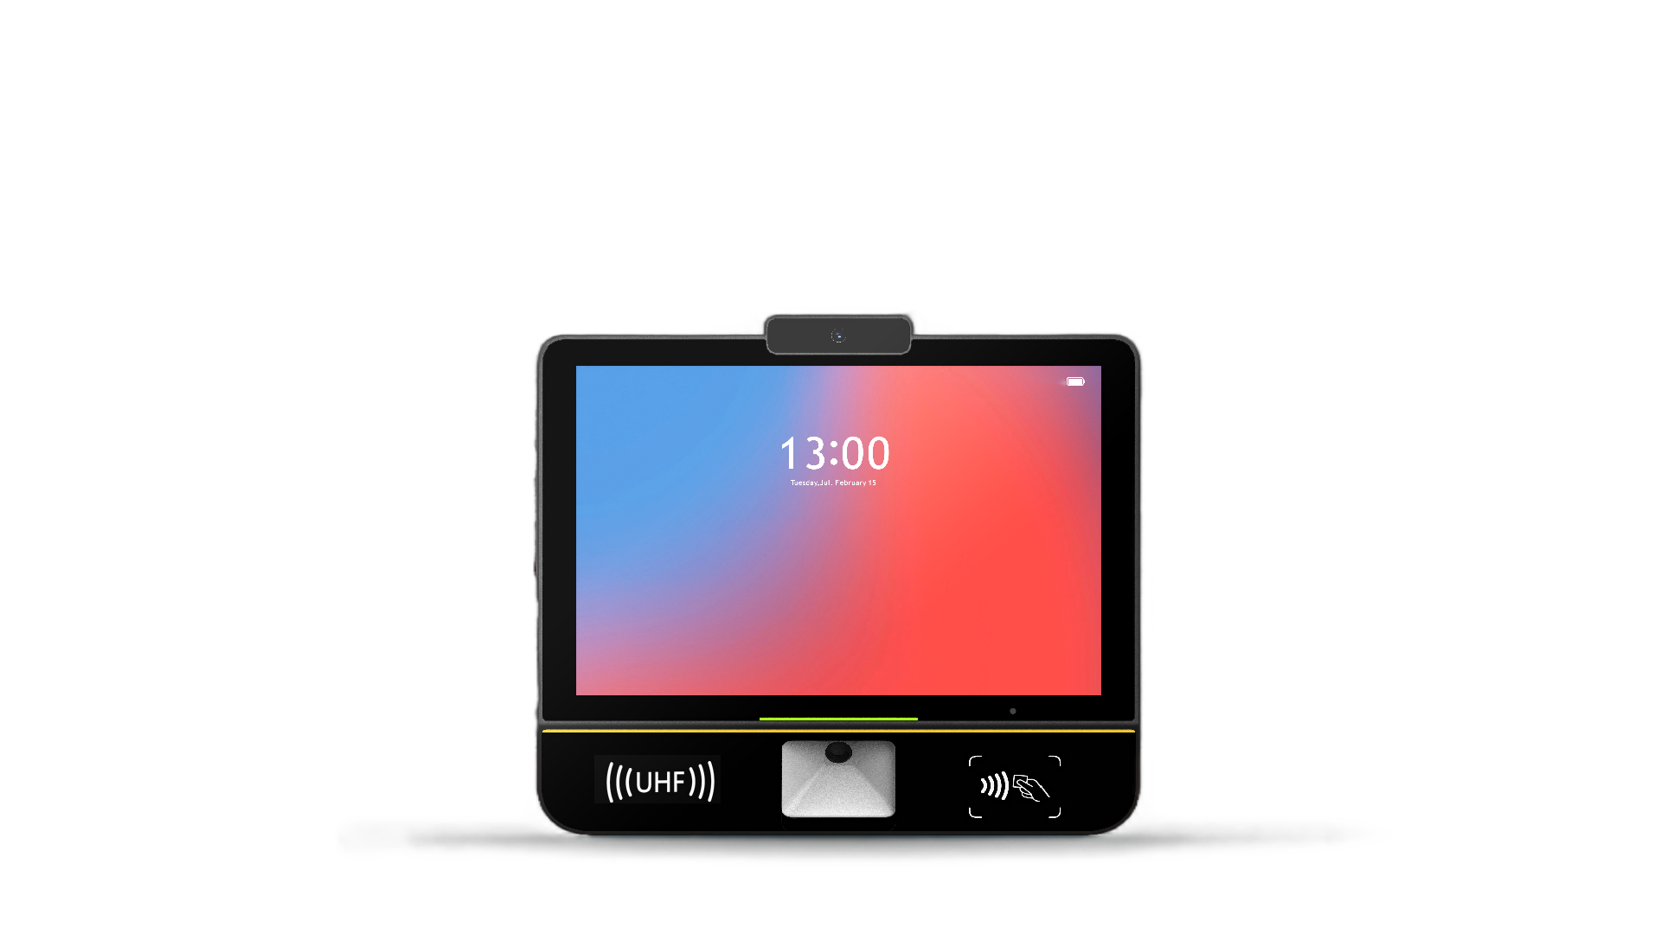
U100
Price Checker
Slim Design
10.1’’display with less than half the thickness of a traditional price checker yet fully functional with a 30-degree scanning angle
Powerful Platform
Powered by the Android 13 O.S and a Quad-core A53 2.0GHz processor, alongside with 3GB RAM and 32GB ROM of ample memory
Proximity Sensing Wake-up
Microwave radar and 8MP autofocus camera enables presence detection and
facial recognition that can automatically wakes the display
Easy Deployment
Compatible with quick-hitch bracket and standard VESA mounts, supporting both wall-mounted and desktop installation. LAN with optional PoE, USB, and serial interfaces, enable seamless integration with existing systems and peripherals
Multi-Method Data Capture
Provided by an integrated scanner and an optional RFID. Build-in NFC enables quick recognition of various card types
UHF RFID Module Optional

Slide 2

















U100 Price Checker
Specifications
Processor
O.S.
Memory
Display
Touch Screen
Quad-core A53 2.0GHz
Android 13
RAM: 3GB ROM: 32GB
10.1”
800x1280
Ultra sensitive capacitive touch panel
Interface
Scanning
Camera
Sensors
Audio
1x DC Jack Power
1x USB Type-C Debug
1x RJ45 LAN (PoE optional)
2x USB Type-A HOST
1x RS232 RJ11
Built-in scanner
Supporting 1D/2D barcode reading
8MP AF camera
Presence Sensor
Speaker(3W), MIC
Adaptor
Buttons
Slots
UHF RFID
NFC
12V/2A
PWR button
1 MicroSD and 2 SAM
Short-range UHF （Optional）
Built-in NFC
Communication
Environmental
4G/3G/2G: N/A
Bluetooth：BT 5.0
Wi-Fi：IEEE 802.11 a/b/g/n/ac 2.4GHz/5GHz
Operating: -10℃~55℃
Storage: -20℃～70℃
Humidity: 5%RH～95%RH (No condensation)
UROVO PTE. LIMITED
Website: en.urovo.com
Email: urovo@urovo.com
Address: 1 Raffles Place, #21-01 One Raffles Place Tower 1,
Singapore 048616
Urovo Europe
Website: europe.urovo.com
Email: sales-europe@urovo-emea.com
Address: de Maas 9, 5684PL, Best, the Netherlands
*This page is subject to change
without prior notice
Urovo North America
Website: us.urovo.com
Email: urovo@urovo.com
Address: 1990 Main Street, Suite 750, Sarasota,
Florida 34236

