Slide 1
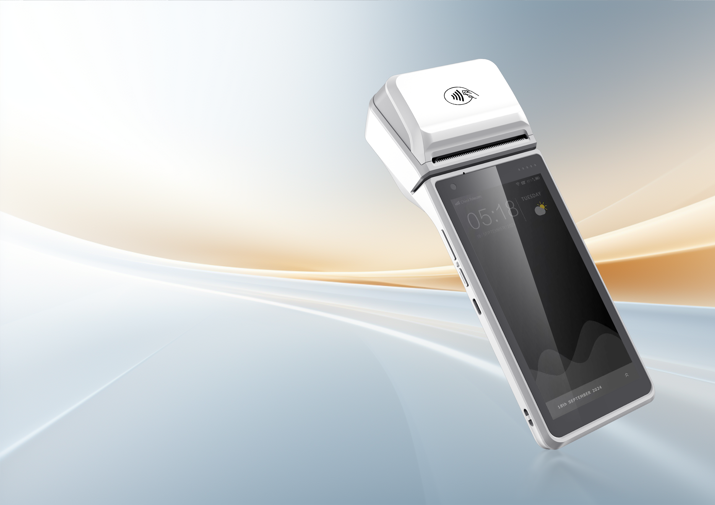

i9200
Smart POS Payment Terminal
Slim and Lightweight Design
Designed for portability and ease of use, with a sleek, lightweight body that ensures on-the-go convenience.
High-Performance for Smoother Operation
Powered by Android 13 and a 2.0 GHz Quad-Core CPU, it delivers fast, efficient performance for seamless multitasking.
5.5-Inch Large Screen
Experience a clear and expansive view with the 5.5-inch display, perfect for effortless operation and efficient interaction.
High-Speed Printing
Delivers rapid print speeds of 80mm/s, ensuring fast and reliable printing to boost workflow efficiency.
Optional Professional Scan Engine
Provides the flexibility of an optional scan engine, enabling enhanced barcode scanning capabilities.
All-in-One Payment
Supports a full range of payment methods, including magnetic stripe cards, IC cards, NFC, and QR codes.

Slide 2



















i9200 Smart POS Payment Terminal
Specifications
Processor
O.S.
Memory
Display
Quad-core A53 2.0GHz
Octa-core A53 2.0GHz (optional)
Android 13
RAM: 2GB ROM: 16GB
RAM: 3GB ROM: 32GB (optional)
Micro SD / TFx1, Up to 128 GB
5.5”Display
720×1440
Button
Audio
Battery
Adaptor
PWR button,
Vol+/- button
Speaker(1W), Buzzer,
No MIC (optional)
Removable li-polymer battery,
3.85V / 5000mAh
5V / 2A
Camera
Slot
Positioning
Interfaces
No front camera (2MP FF optional)
Rear 5MP AF (16MP AF optional)
Option 1:
1 Micro SIM1 + 1 Nano SIM2 + 1 SAM1 + 1 SAM2 + 1 MicroSD;
Option 2:
1 e-SIM + 1 Nano SIM2 + 1 SAM1 + 1 SAM2 + 1 MicroSD
GPS、A-GPS、
BEIDOU、GLONASS、
Galileo
1 x Type-C USB OTG
Pogopin (5pin)
Network Connection
Payment
Notification LED
Environment
FDD-LTE，TDD-LTE，WCDMA，GSM
Bluetooth：BT 5.0
Wi-Fi: 2.4 GHz / 5 GHz,
IEEE 802.11 a/b/g/n/ac
Magnetic stripe card
IC Card
Contactless Card
Contactless Notification LED,
Blue / Yellow / Green / Red
Power LED
Operating: 0°c~50°c
Storage: -20°C~70°C
Humidity: 5%RH~95%RH
(No condensation)
Dimensions
Certification
Thermal Printer
Scanning
L x W x H (mm): 213.6*79*48.8mm (18.5mm thinnest)
Weight (g): 363g
PCI PTS 6.x, EMV L1&L2, EMV Contactless L1, MasterCard Contactless, Visa PayWave etc.
Media roll size: 40mm
Media width: 58mm printing paper
Resolution: 203dpi (8dot/mm)
Print speed: 80mm/s
Support 1D/2D barcode printing
Camera decoding, supporting barcode and payment QR code;
Optional scan engine
*This page is subject to change
without prior notice
UROVO PTE. LIMITED
Website: en.urovo.com
Email: urovo@urovo.com
Address: 1 Raffles Place, #21-01 One Raffles Place Tower 1,
Singapore 048616
Urovo Europe
Website: europe.urovo.com
Email: sales-europe@urovo-emea.com
Address: de Maas 9, 5684PL, Best, the Netherlands
Urovo North America
Website: us.urovo.com
Email: urovo@urovo.com
Address: 1990 Main Street, Suite 750, Sarasota,
Florida 34236

