Slide 1

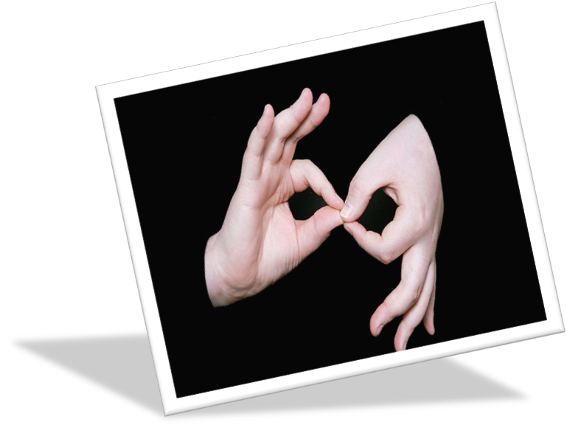

Slide 2
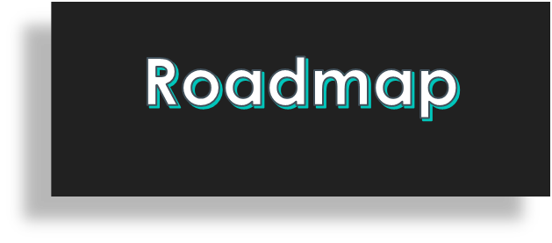
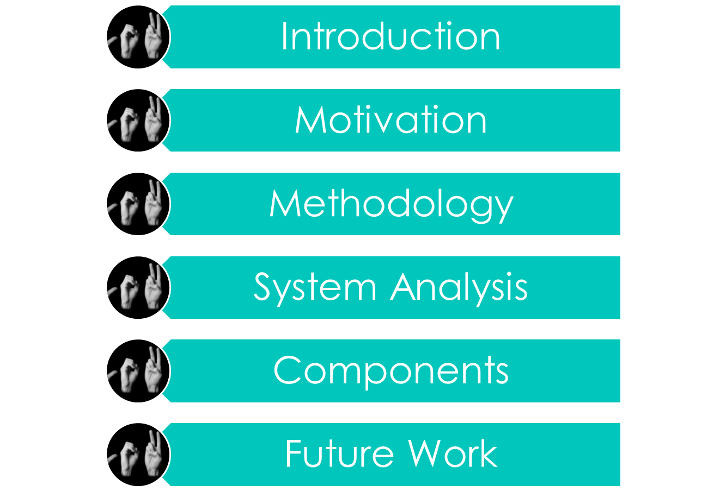

Slide 3
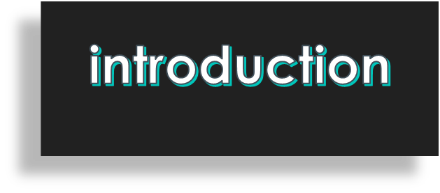
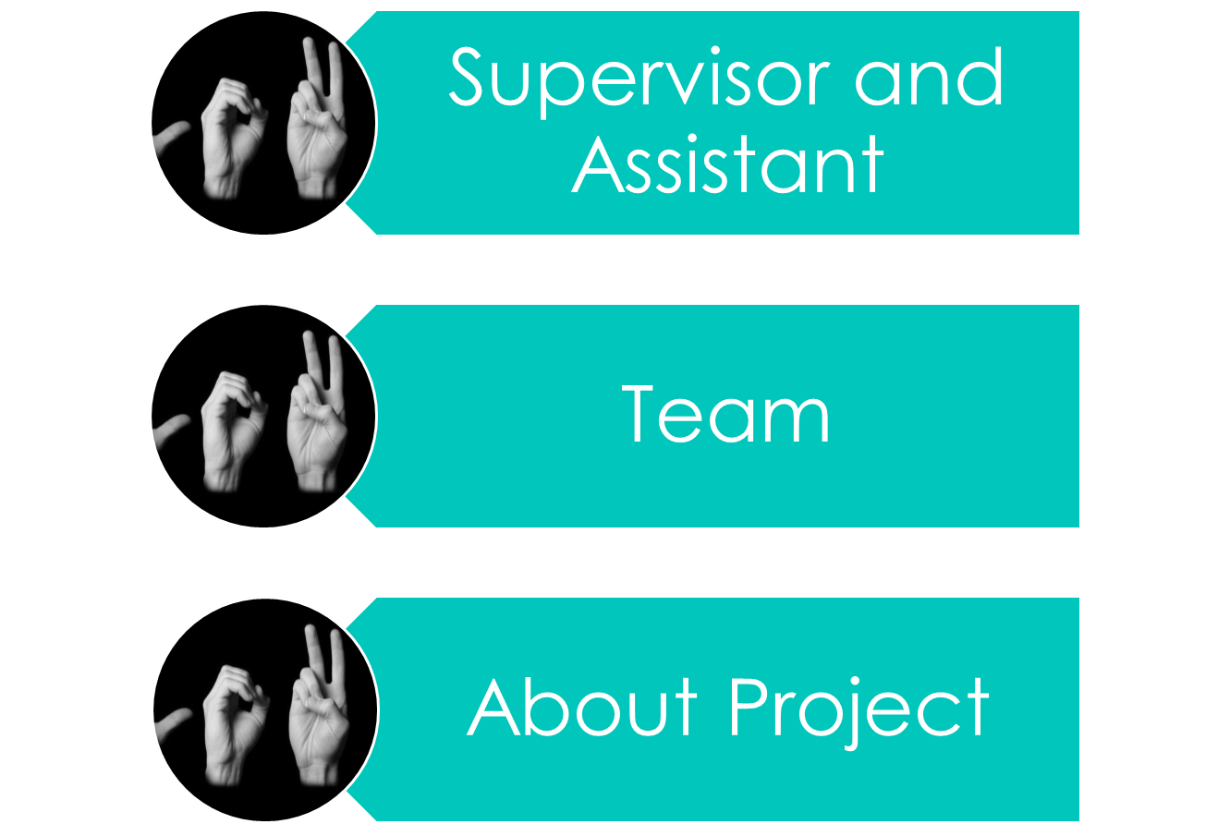

Slide 4
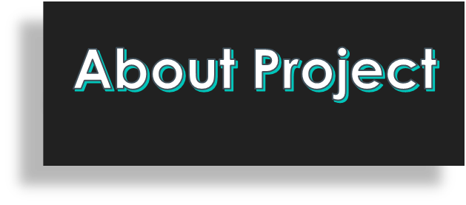
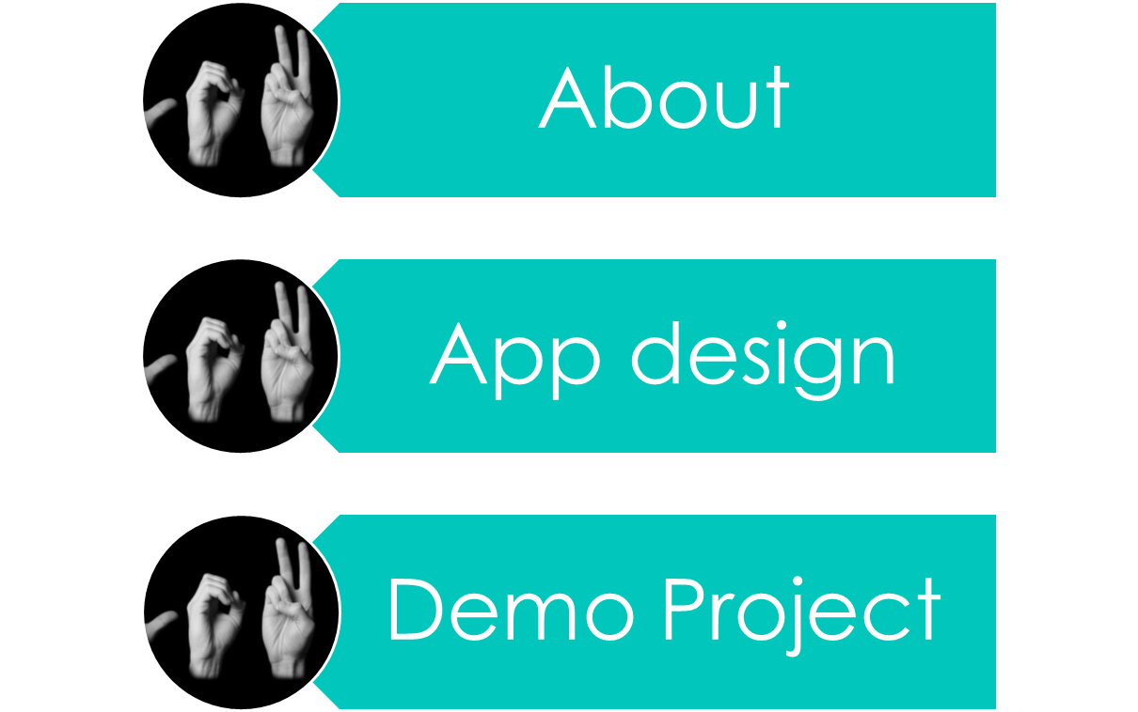

Slide 5
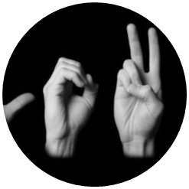

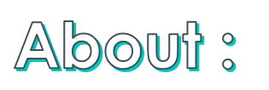
It’s a simple project converts 26 letters of sign language into text that is displayed on a smartphone
the glove is designed to help deaf-mute people send messages to those who do not understand sign language.
Sign language is the only available form of communication between deaf and dumb people Because learning written languages can be difficult without being able to understand the sounds that go with certain words.

Slide 6
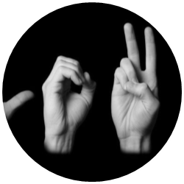
the innovative device consists of glove equipped with nine sensors on the joints of the fingers.
The sensors expand when the user bends his fingers; Which leads to the production of an electrical signal that is processed by the program to know the meaning of the movement.
Motion sensors are also installed on the bottom of the gloves to record the movement and static of the hand, allowing the ability to distinguish between certain letters and sending information from the gloves via Bluetooth to an application on a smartphone to display a translated version of the message.

Slide 7
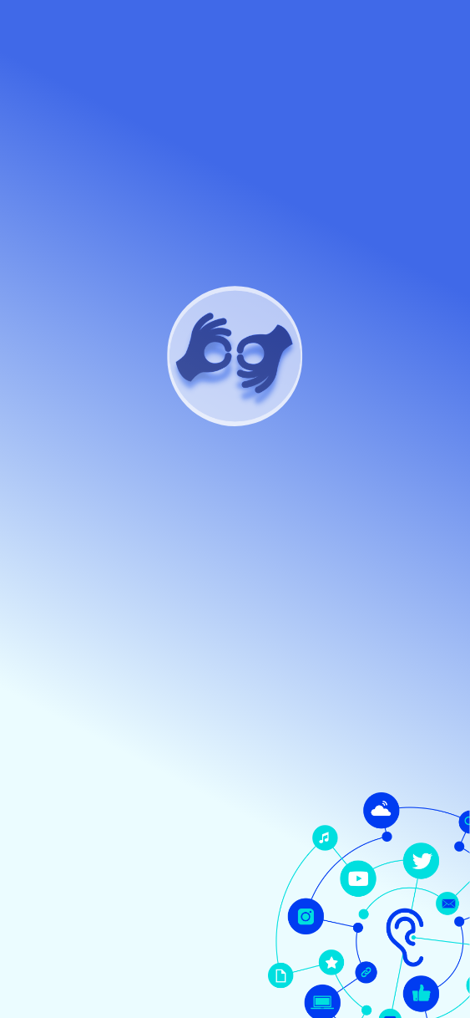
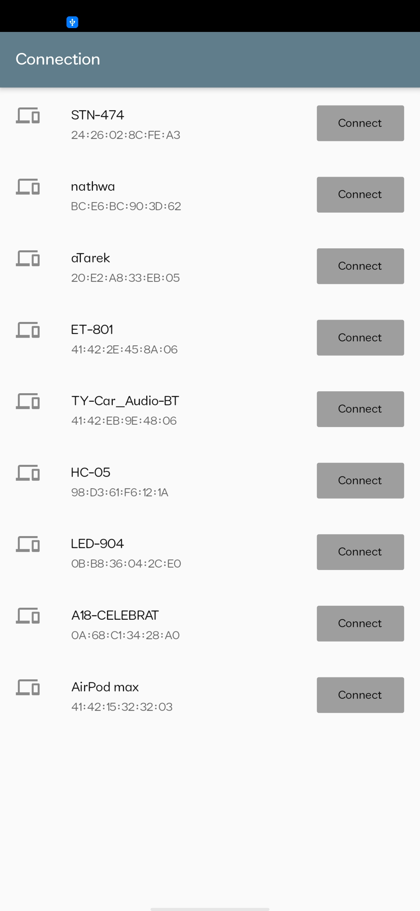
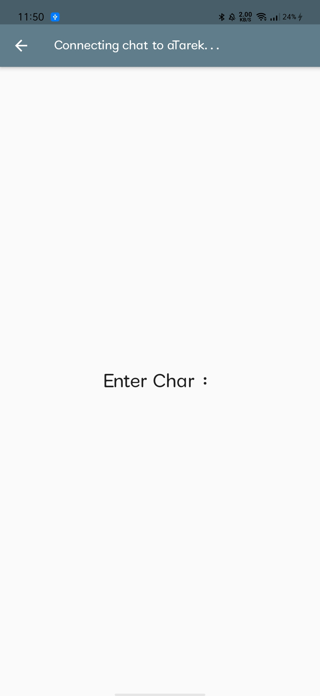
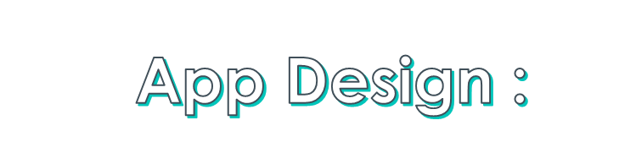
First One:
Splash Screen
Bluetooth Connection
Display Screen

Slide 8
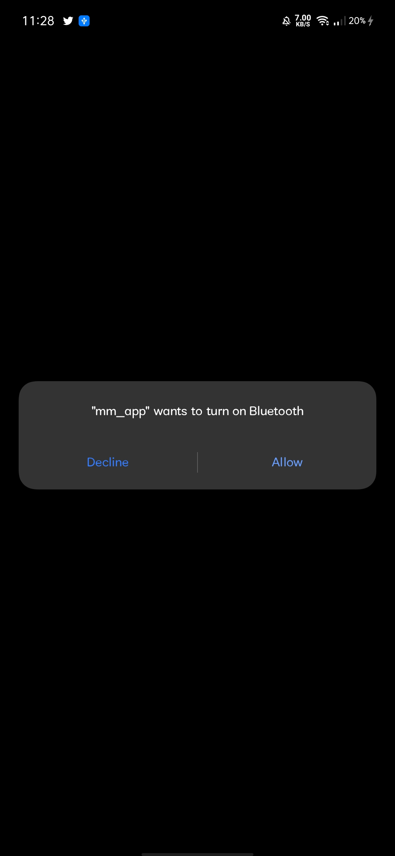
Second One:
Splash Screen
Bluetooth Connection
Display Screen

Slide 9
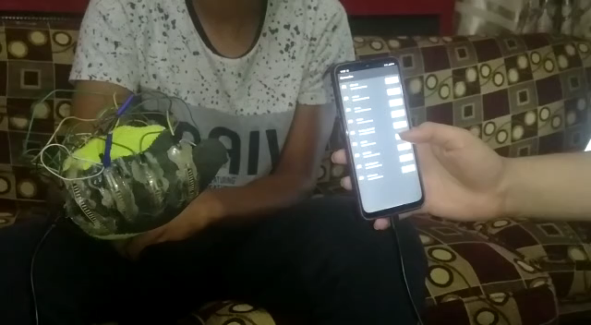
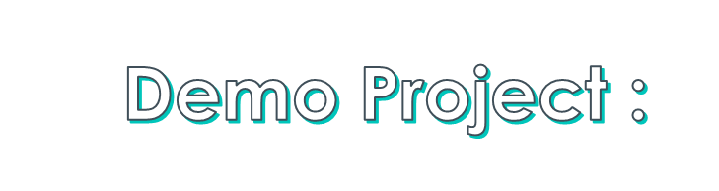

Slide 10
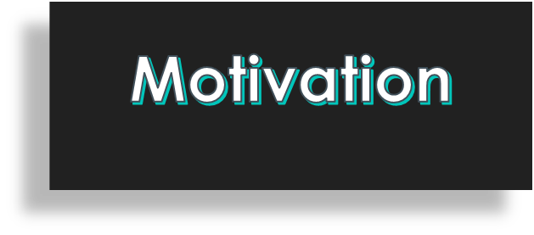




Slide 11
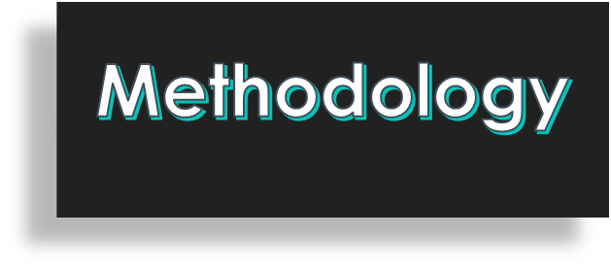
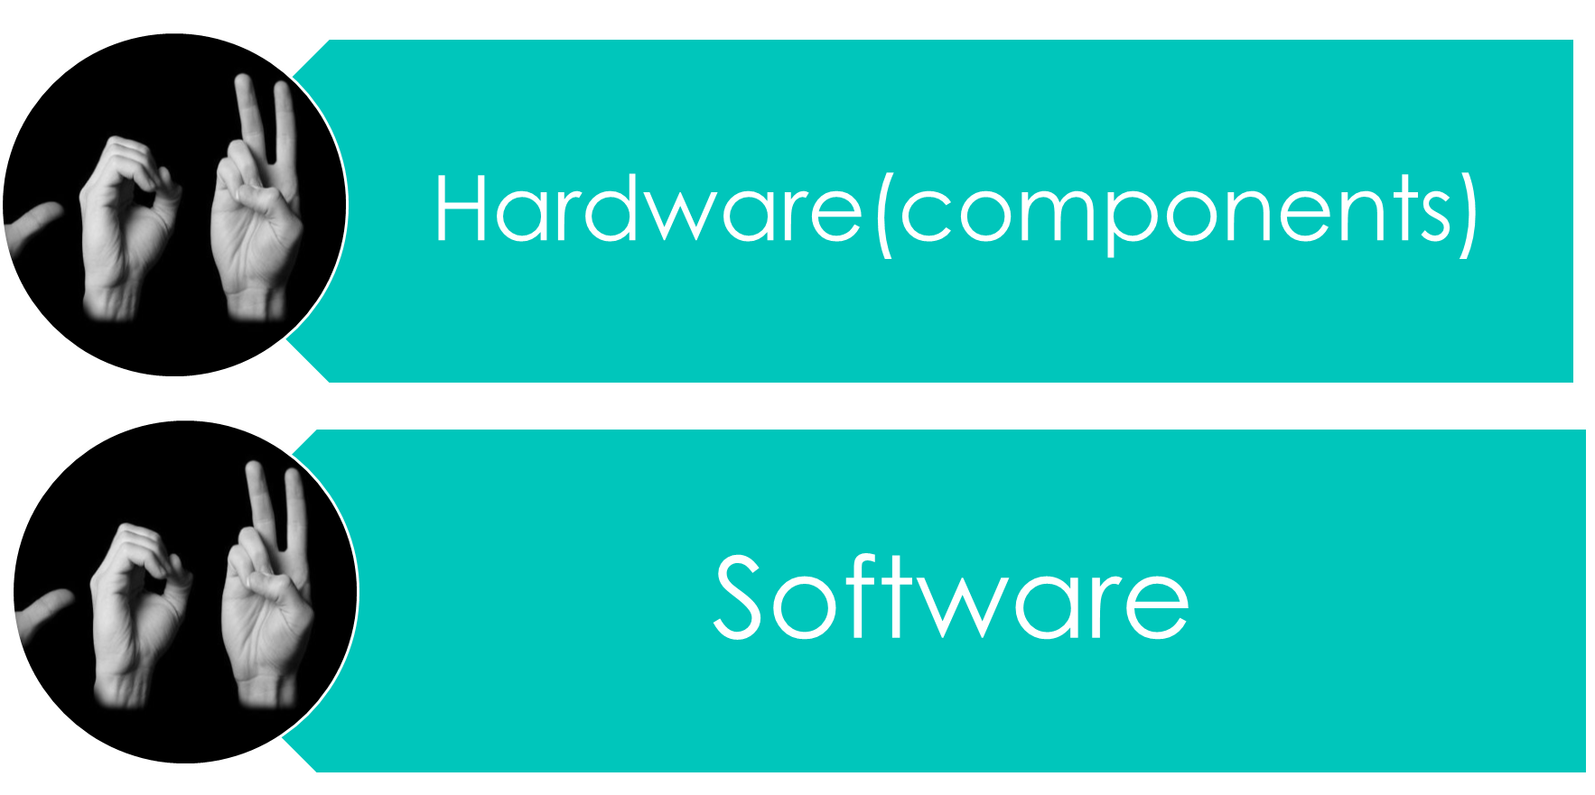

Slide 12
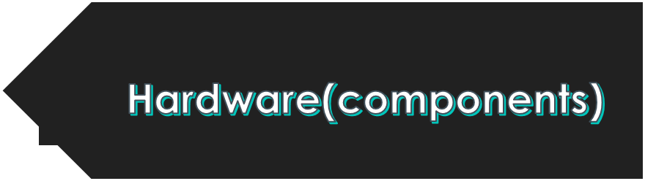
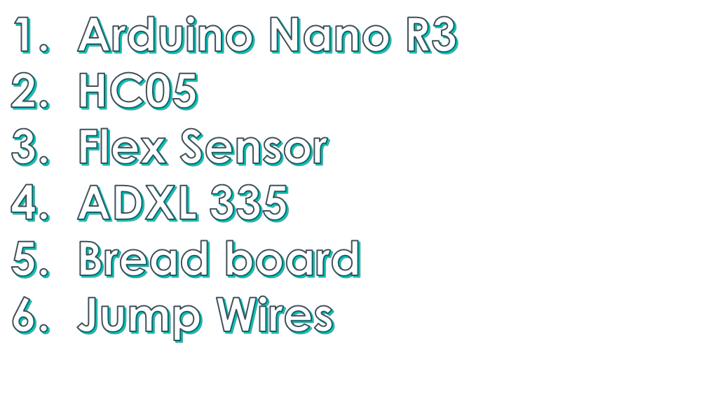

Slide 13
The Arduino Nano is one of the smallest and yet most exciting breadboard-friendly boards available on the market today .
HC-05 Bluetooth Module is an easy to use Bluetooth SPP (Serial Port Protocol) module, designed for transparent wireless serial connection setup

Slide 14
flex sensor or bend sensor is a sensor that measures the amount of deflection or bending .
The ADXL335 is a small, thin, low power, complete 3-axis accelerometer with signal conditioned voltage outputs. The product measures acceleration with a minimum full-scale range of ±3 g .

Slide 15
breadboard is used to build and test circuits quickly before finalizing any circuit design. The breadboard has many holes into which circuit components like ICs and resistors can be inserted .

Slide 16
is an electrical wire or group of them in a cable, with a connector or pin at each end (or sometimes without them – simply "tinned") which is normally used to interconnect the components of a breadboard or other prototype .

Slide 17


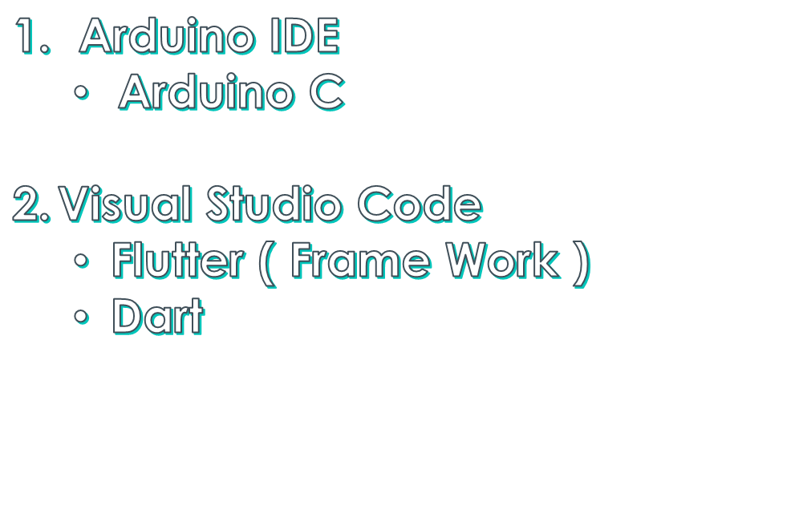

Slide 18


The Arduino Integrated Development Environment (IDE) is a cross-platform application (for Windows, macOS, Linux) that is written in functions from C and C++. It is used to write and upload programs to Arduino compatible boards, but also, with the help of third-party cores, other vendor development boards .

Slide 19
Is a streamlined code editor with support for development operations like debugging, task running, and version control.
Flutter is a free and open-source mobile UI framework created by Google and released in May 2017.

Slide 20

Dart is a client-optimized language for developing fast apps on any platform. Its goal is to offer the most productive programming language for multi-platform development, paired with a flexible execution runtime platform for app frameworks .

Slide 21
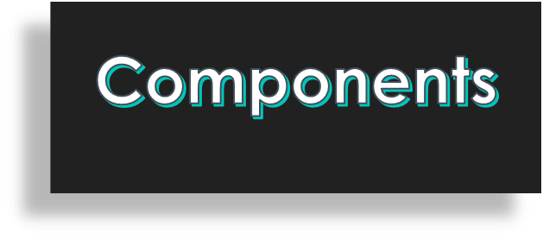
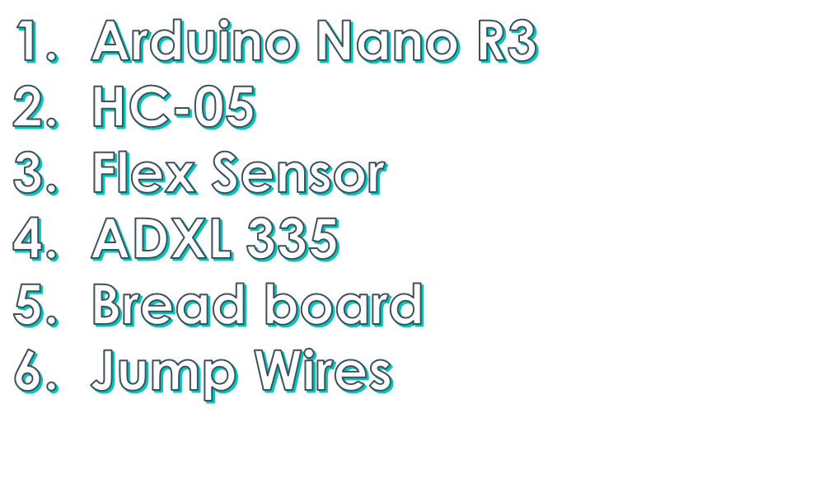

Slide 22
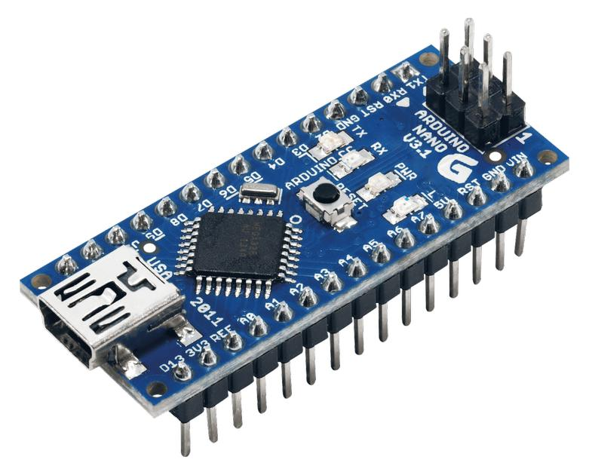


Slide 23
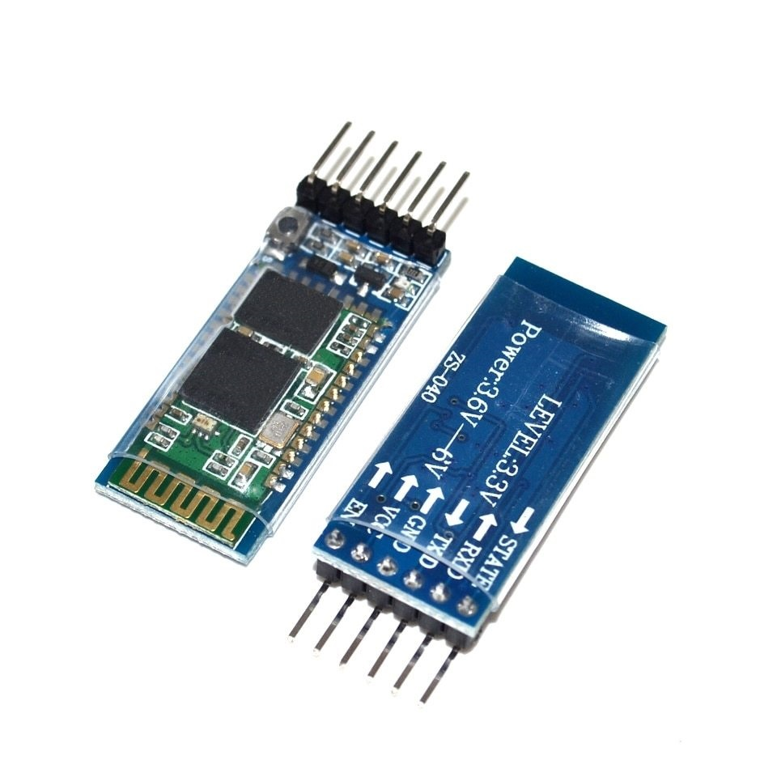


Slide 24
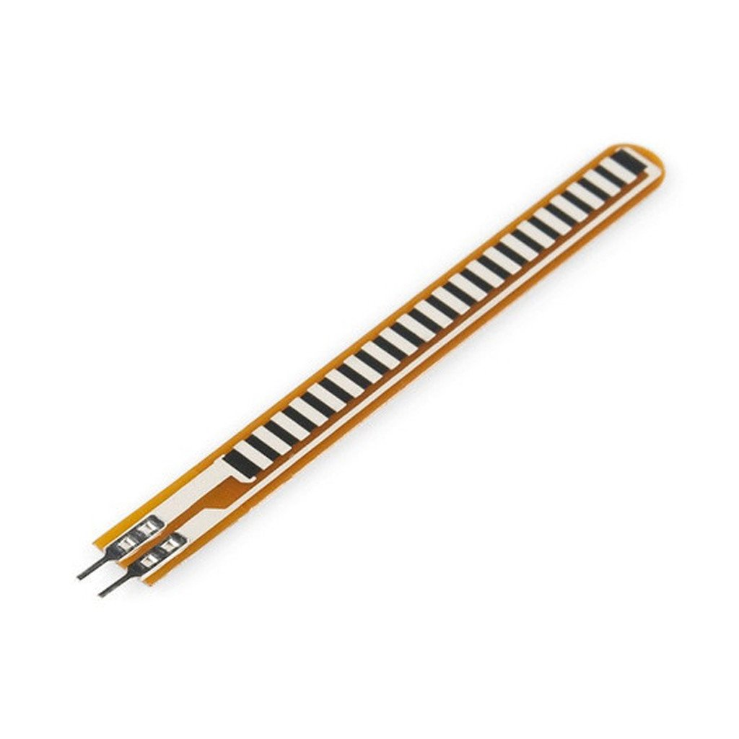


Slide 25
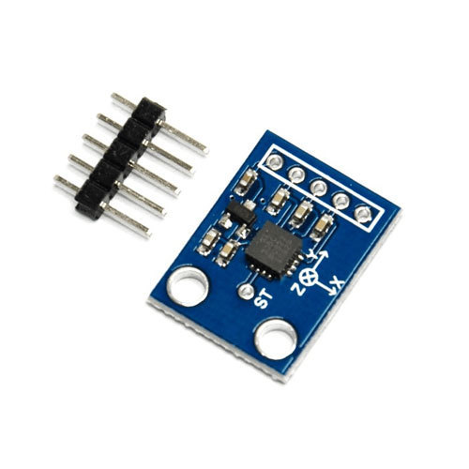


Slide 26
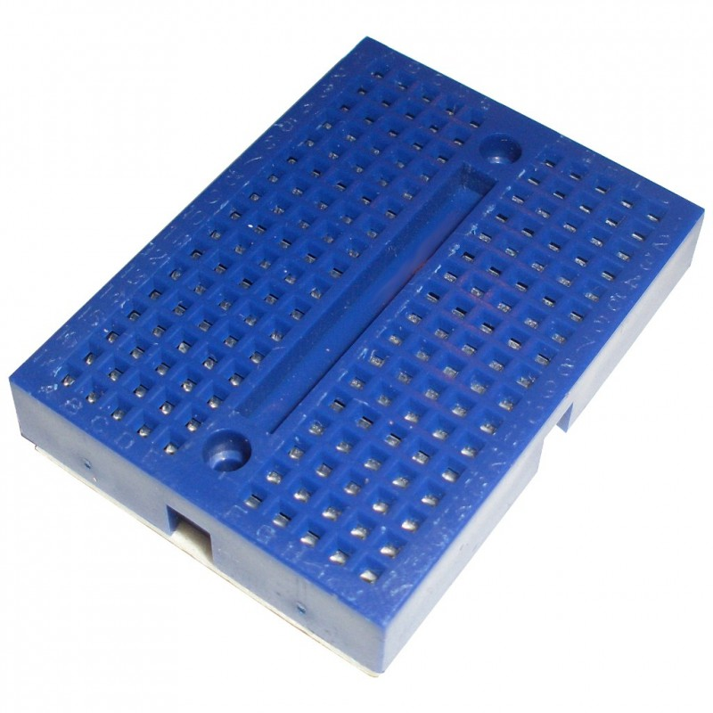


Slide 27
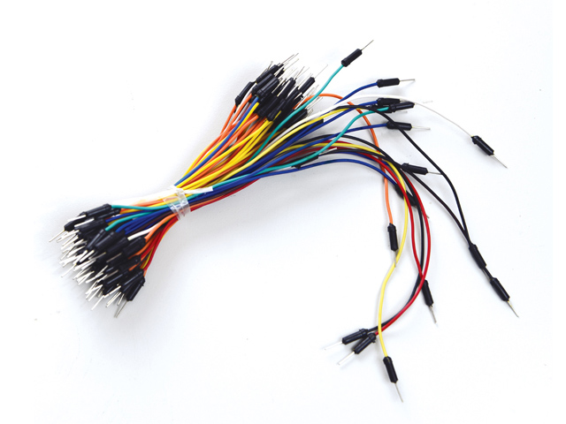


Slide 28
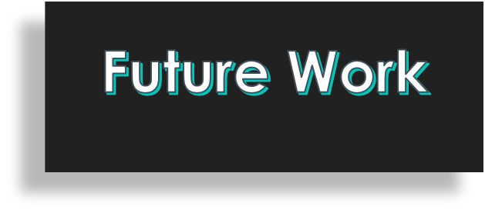
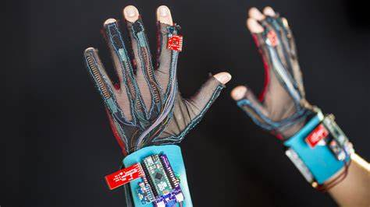
One common misconception is that “sign language” is a single language. In fact, there are many different sign languages around the world. For example, ASL and BSL are quite different to each other, much more so that American English and British English. In fact, the two sign languages only have 33% of signs in common.

Slide 29
