Slide 1
Cash Business Management
FNB Smart Box Project - Architecture Overview
HPS Team - 03/08/2022

Slide 2
Functional & Technical Requirements

Slide 3


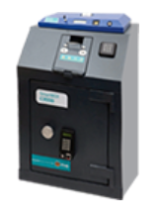
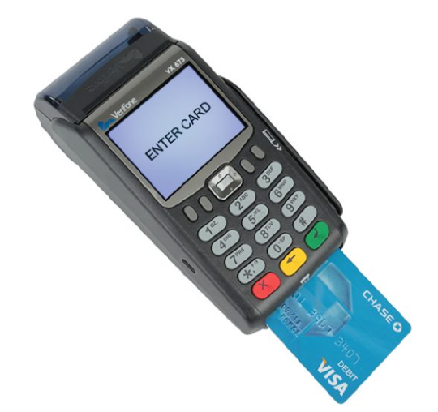
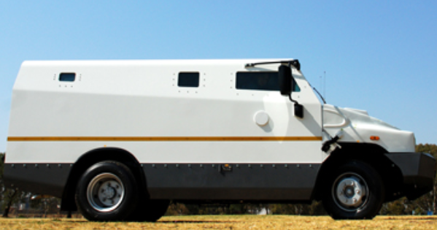
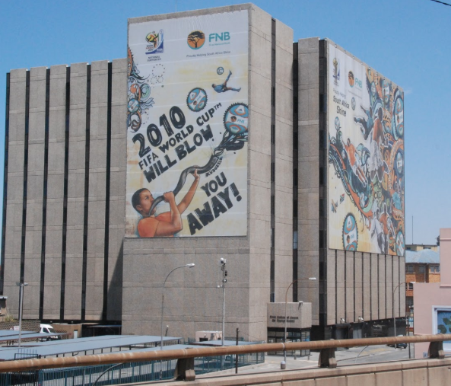
Business Flow
Entities & Events
Cash Terminal:
Entity
Merchant
Cash Dropping:
Event
POS Outlet
Cash Outlet
Terminal POS
Cash Terminal
Cash Dropping
Cash Removal
C.I.T
Cash Centre
Cash Transport
Cash Counting

Slide 4

Cash Management – Scope Overview
PowerCARD scope
OK
FNB Systems
No further actions
REST
Integrity checks
Business checks
Message format
Merchant exists
Duplicate message
Device not mapped
OK
Removal amount = Sum (drop amount)
Count amount= Sum( drop amount)
…
WS
Case creation
Case creation
Create financial adjustment (if any)
NOK
NOK

Slide 5
Messages & Format
Types of messages
Drop message
Removal message
Verification message
Demand message
Protocol
REST over HTTP
SSL
Message content
Status
Sequence number (message sequence number)
Merchant number
Outlet number
Bag number
Container type (notes or coins)
Amount
Notes amount
Coins amount
Message date and time
Denomination 1 to 11 (number of each note and coins contained in the message)

Slide 6
Application Requirements
Cash Management Application should
Do the settlement based on 5 options (on drop, on removal, on demand, pre-determined time, on count)
Show the funds immediately to the merchant
Do the treatment in a real-time manner or quasi real-time (30 seconds maximum)
Webservices that will be exposed
Can be called externally from FNB
Retries are managed at FNB side

Slide 7
Non-Functional Requirement
Cash Management Architecture should
Handle huge volumes of events
Be scalable
Be resilient
Handle back pressure
Be Cloud-native
All communications between components should be encrypted
Centralize logs
Monitor messages & metrics
Use Microservices
…

Slide 8
Architecture Overview

Slide 9








Architecture & Technology Stack
PowerCARD V3.5
PowerCARD Cash Management
3rd party
Typescript
Javascript
PrimeNG
NgRX
Web Server
IHM
HTML 5
Angular GUI
3rd party
systems
Web Services (WAR)
Java
Spring
Apache CXF
Application Server
Business
& APIs
Micro
services
REST APIs
Controls &
Business
Kubernetes
Docker
Java
SpringBoot
EFK
Kafka / Pulsar
Kubernetes
Controls &
Business access
Java / JEE
Spring
Jersey (JAX-RS)
Hibernate
Audit & Logs
Metrics
Business
& DAO
Business Rules (Stored procedures)
Oracle
DataGuard
PL/SQL
DB Server
Business
& Data
OR
Data

Slide 10


Microservices – Typology definition
Typology
Event handler
Centralize authorization workflow for monitoring and maintenance Orchestrate and schedule all the services. Handle authorization flow & lifecycle, decide workflow steps using Kafka/Pulsar topics.
OR
Biz. service
Split business driven development and maintenance operation (DDD) Business service that can describe business rules
Message broker
Channel
Abstract external systems specifications (protocol, I/O constraints…) Connect PowerCARD with external protocols, REST service

Slide 11

Architecture - Components
Queue
VODS
PowerCARD Cash Management
PowerCARD
Data API
Posting Service
Posting Cash Merchant Transfer
…
Oracle
D1
D2
To
Publish
Publish Service
Publish event
Post in Queue
To VODS
REST API
Message Broker
Cash Web Service
ERROR
Integrity checks
Format check
Merchant exists
Duplications
…
D
R
C
Event handler
Orchestration
Non blocking event loop
Scalable and fault tolerant
D1 : Drop message n°1
Cash Service
Oracle
D2 : Drop message n°2
D : Demand message
Cash Business Checks Run batch cash
Create case & adjustement
…
R : Removal message
C : Count message
All services are either Kafka producers and consumers
11

Slide 12
Architecture - Flow
1
Message received on WS, do integrity checks. Return error if not correct
2
If OK, send a message to broker with a type (D1, D, R, C..) and a status
PowerCARD Cash Management
If message is D1 or D2, post cash using Data API and send the message to broker with « To publish » status, depending on the settlement option
PowerCARD
Data API
Posting Service
Post Cash
3
Oracle
4
« Publish service » get the event to publish
3
5
Post event to external queue (custom external integration)
1
2
4
Cash Web Service
Publish Service
If message is D, R or C or D2, run the « batch » with business checks.
Create case & adjustment if NOK.
Event handler
6
Integrity checks
Publish event
6
5
Cash Service
Queue
NB : Event Handler is responsible for organizing the flow of events depending on a workflow.
Possible to add new steps with new microservices if needed (extensibility).
Oracle
Cash Business Checks
VODS
All messages pass through Event Handler Microservice
12

Slide 13


Infrastructure Deployment
Kubernetes
Kafka / Pulsar Cluster
EFK: Logging, metrics
- Deployments Policies
- Node scalability
policies
Spring boot Microservices
Oracle 3.5 DB
Active
instance
DataGuard
Passive
Instance

Slide 14
Thank you

