Slide 1
SMART CALL MONITOR
AI-Powered Call-Center Quality Monitoring & Live Agent Coaching
“Every conversation becomes actionable intelligence.”
🔒 100% LOCAL AI PIPELINE
Arab Academy for Science, Technology & Maritime Transport · Graduation Project · 2026
Team: ______________________ Supervisor: ______________________
Notes:
Title. One line: SCM listens to calls live, coaches the agent in real time, and writes a full QA report automatically — and the AI runs entirely on our own machine. Replace the team/supervisor placeholders.

Slide 2
THE PROBLEM
Quality assurance is broken
1
Manual & slow
A supervisor listens to calls by hand, long after they end.
2
~1% coverage
Only a tiny random sample of calls is ever reviewed.
3
Subjective
Two reviewers score the same call differently.
Feedback too late
1 in 100 calls is reviewed
4
By the time an issue is found, the customer is already gone.
Smart Call Monitor
1
Notes:
Open emotionally: the call center IS the brand; one bad call loses a customer. But companies barely know what's said on their calls. Manual QA reviews ~1 in 100, is slow, subjective, and too late.

Slide 3
WHY IT MATTERS
Every call matters — and no one is listening
1
2
3
The call center is the brand
Agents need help in the moment
Data shouldn't leave the company
One conversation can win or lose a customer for life — quality can't be left to chance.
Coaching after the fact is too late. The right nudge must arrive during the call.
Customer conversations are sensitive. Sending them to a third-party cloud is a real risk.
Millions of calls happen every day. What if every one could be understood — instantly, privately?
Smart Call Monitor
2
Notes:
Three needs the product answers: visibility into every call, in-the-moment help for agents, and privacy. The third sets up the Local-AI differentiator.

Slide 4
THE SOLUTION
Introducing Smart Call Monitor
Listens
Coaches live
Reports instantly
Transcribes the call live, speaker by speaker.
Turn-by-turn AI suggestions while the agent is on the line.
A full QA report written automatically the moment the call ends.
Call
→
Understand
→
Coach
→
Report
Every call — not one in a hundred. All of them.
Smart Call Monitor
3
Notes:
SCM does three things: live transcription, live coaching, and an automatic post-call report. Emphasize 'all calls, automatically' vs the 1% manual sample.

Slide 5
TRANSFORMATION
From hours of manual review to seconds
BEFORE — Traditional QA
AFTER — Smart Call Monitor
Agent finishes the call
Call ends
↓
Manager manually listens
↓
AI transcribes
↓
Hours of work
↓
AI analyzes
↓
Human errors
↓
Structured report
↓
Inconsistent evaluation
↓
Dashboard updates
↓
Late feedback
↓
Manager gets insights instantly
Hours → Seconds
Smart Call Monitor
4
Notes:
Side-by-side: the old manual loop (slow, error-prone, late) vs the SCM loop (automatic, instant, consistent). Land on 'Hours -> Seconds'.

Slide 6
KEY DIFFERENTIATOR
Why Local AI? Privacy by default
CLOUD AI
LOCAL AI 🔒 inside your company
Customer audio
Customer audio
↓
↓
Internet
Our server
↓
↓
Speech-to-Text
Cloud API
↓
↓
Local LLM
Third-party server
↓
Dashboard
Problems: privacy risk · API costs · internet dependency · latency
Benefits: complete privacy · zero API cost · offline · enterprise security
0 bytes to the cloud — data never leaves the building
Smart Call Monitor
5
Notes:
Centerpiece. Honest framing: by DEFAULT the whole pipeline runs locally; cloud providers are optional, off by default, with automatic fallback. Do not claim 'never cloud'. Mention banks/hospitals/government as the killer use case.

Slide 7
SYSTEM ARCHITECTURE
One pipeline, end to end — in real time
🔒 On-premise — nothing leaves the machine
Audio
→
Speech-to-Text
→
Local LLM
→
Structured JSON
→
Backend
→
Dashboards
Discord / live call
faster-whisper (local)
LM Studio
18 fields
Node + Supabase
role-based
Live transcript + coaching stream to the dashboard over WebSocket; the backend persists everything to Supabase and pushes realtime updates.
Local / on-premise
AI output
Infrastructure
Smart Call Monitor
6
Notes:
Walk left to right: audio in, speech to text locally, local LLM understands it, returns structured JSON, backend stores it, dashboards display it. The dashed box stresses STT + LLM run on-premise.

Slide 8
TECHNOLOGY STACK
Simple, robust, local-first
Frontend
Backend
Data & Auth
AI Layer
HTML, CSS, JavaScript
Role dashboards (RTL Arabic)
Chart.js, WebSocket, SSE
Node.js + Express
Modular by role
Helmet, rate limiting, audit
Supabase PostgreSQL
Supabase Auth + JWT
Supabase Realtime
LM Studio — local LLM
faster-whisper (local STT)
Structured JSON output
The AI layer is the differentiator — it runs on our own hardware.
Smart Call Monitor
7
Notes:
Keep it executive-level. Four pillars; the AI column (local LLM + local Whisper) is the star.

Slide 9
BACKEND ARCHITECTURE
Built like production software
Client
→
Helmet / CORS / Rate-limit
→
Authenticate + Authorize
→
Route
→
Service
→
Repository
→
Supabase
Request path — every call is secured, validated, and logged
Role modules
Cross-cutting
auth
admin
manager
supervisor
Centralized error handling (ApiError)
Request logging + audit trail
Layered: routes → services → repositories
agent
events
live
Smart Call Monitor
8
Notes:
Each request flows through security middleware, auth, then the layered route/service/repository stack. The system is modular by role and fully audited.

Slide 10
DATABASE DESIGN
Relational schema on Supabase PostgreSQL
users
customers
user_id (PK)
role, parent_id
customer_id (PK)
name, phone
calls
audit_logs
call_id (PK)
sentiment, analysis
user_id (FK)
action, details
transcripts
performance_scores
suggestions
call_id (FK)
speaker, text
call_id (FK)
6 scores 0–100
call_id (FK)
suggest_text
7 tables · UUID keys · foreign keys & CHECK constraints · indexes · self-referencing org hierarchy (users.parent_id) · Supabase Realtime on live tables
Smart Call Monitor
9
Notes:
calls is the hub. People (users, customers) link to calls; call data (transcripts, scores, suggestions) hangs off calls; audit_logs tracks users. Mention RLS on audit_logs and the self-referencing hierarchy.

Slide 11
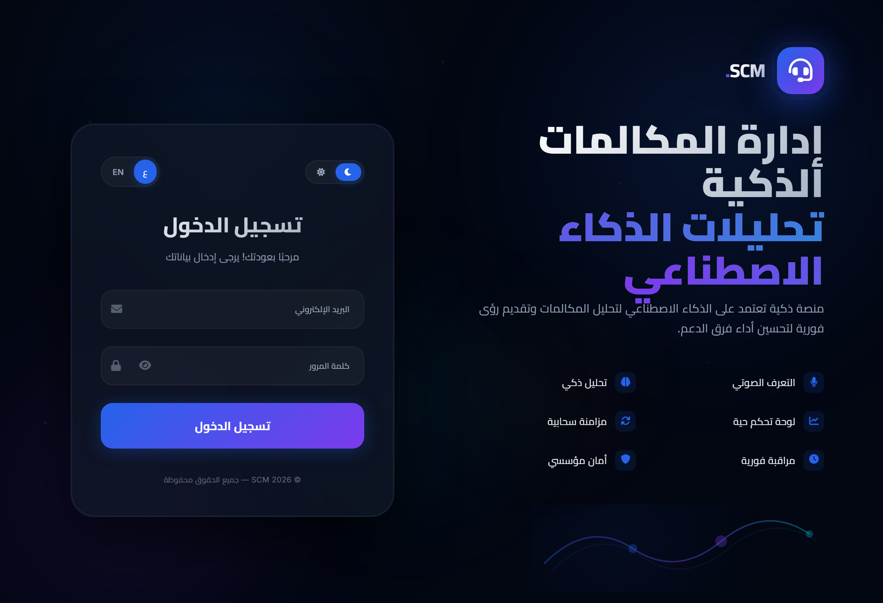
AUTHENTICATION & SECURITY
Least-privilege access, end to end
Login
→
JWT issued
→
Authenticate
→
Authorize (role)
→
Access
Access control
Admin
Manager
Supervisor
Agent
JWT verified on every request; authorize by role
Row-Level Security on audit_logs
Immutable audit trail + Helmet security headers
Password hashing; agents touch only their own calls
Real login — Supabase Auth + role-based redirect
Smart Call Monitor
10
Notes:
A token acts like a keycard: issued at login, checked on every request, and gated by role. Sensitive tables use RLS; every important action is logged.

Slide 12
AUDIO PROCESSING & SPEECH-TO-TEXT
Messy real-world audio → reliable Arabic text
48kHz stereo
→
16kHz mono
→
Speaker turns
→
Whisper
raw capture
resample + clean
silence split
transcribe
Hybrid transcription
Speaker diarization
Fast 'small' model for the live transcript
Accurate 'turbo' model re-runs the whole call for the report
Hallucination filter + voice-activity / silence gating
Separates who said what
Auto-labels Agent vs Customer from domain cue-words
Cleaner text → more accurate analysis
16 kHz · mono
int8 on CPU
VAD
beam 1 → 5
hotwords
Smart Call Monitor
11
Notes:
Two ideas: (1) hybrid — fast model live, accurate model for the report; (2) diarization labels Agent vs Customer. Both run locally.

Slide 13
LOCAL LLM ANALYSIS
Prompt engineering & guaranteed structured output
How the analysis works
Structured output — 18 fields
Model: arabic-orpo-llama-3-8b-instruct in LM Studio (local, OpenAI-compatible API)
Prompt = role + few-shot examples + strict rules + JSON schema
JSON-Schema mode → guaranteed valid JSON every time
Resilient fallback parser (fixes Arabic commas, trailing commas)
Sentiment constrained to 4 values; scores constrained 0–10
{
"call_summary": "...",
"customer_sentiment": "غاضب|محبط|محايد|سعيد",
"problem_solved": "نعم|لا|جزئياً",
"agent_performance_score": 0-10,
"empathy_score": 0-10,
"communication_score": 0-10,
"strengths": [ ... ],
"weaknesses": [ ... ],
"recommended_actions": [ ... ],
"critical_moments": [ ... ],
"next_steps": [ ... ]
}
Smart Call Monitor
12
Notes:
The hardest part with a small local model is reliable output. We force valid JSON via JSON-Schema mode plus a forgiving parser. Output is 18 structured fields per call.

Slide 14
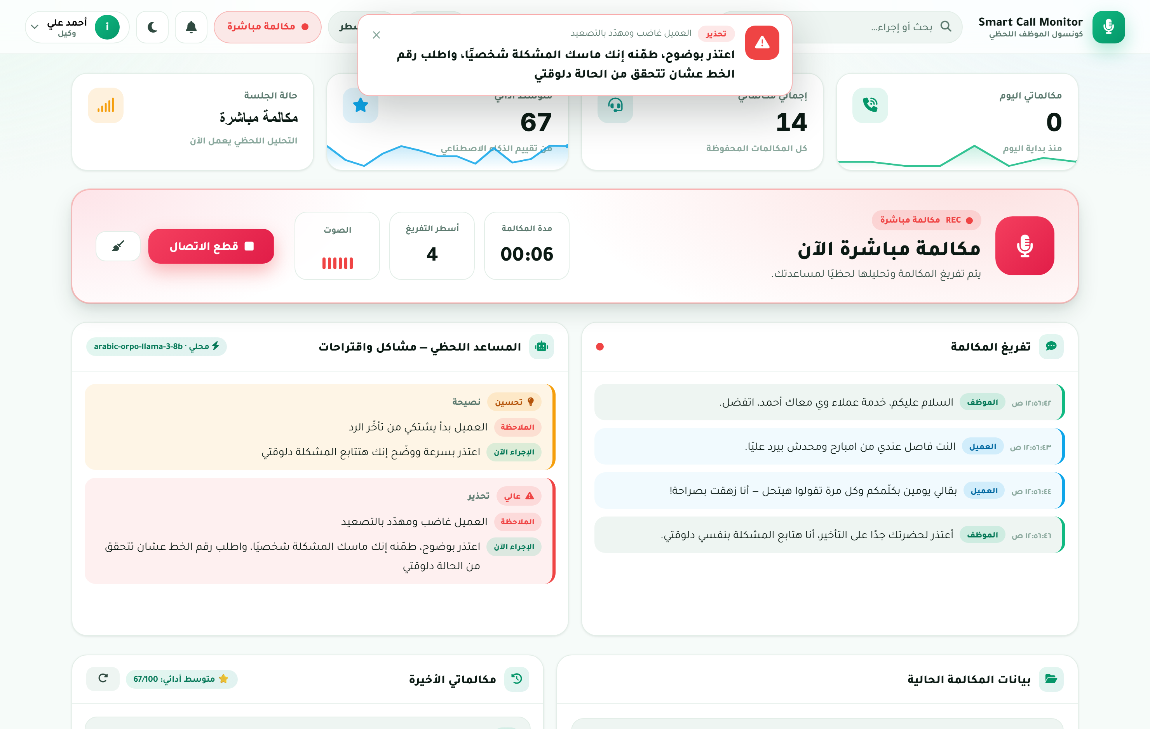
LIVE AGENT COACHING
Real-time help, turn by turn
Warning · تحذير
Risk / mistake — act now
Advice · نصيحة
A possible improvement
Guidance · توجيه
A concrete next step
How it works
After each turn: does the agent need help now?
Anger detection is top priority
Real agent console — the coaching alert fires the moment the customer escalates
Smart Call Monitor
13
Notes:
Three coaching types. The WOW is anger detection: the system surfaces a calming suggested response the instant the customer escalates. Show the real coach-alert here.

Slide 15
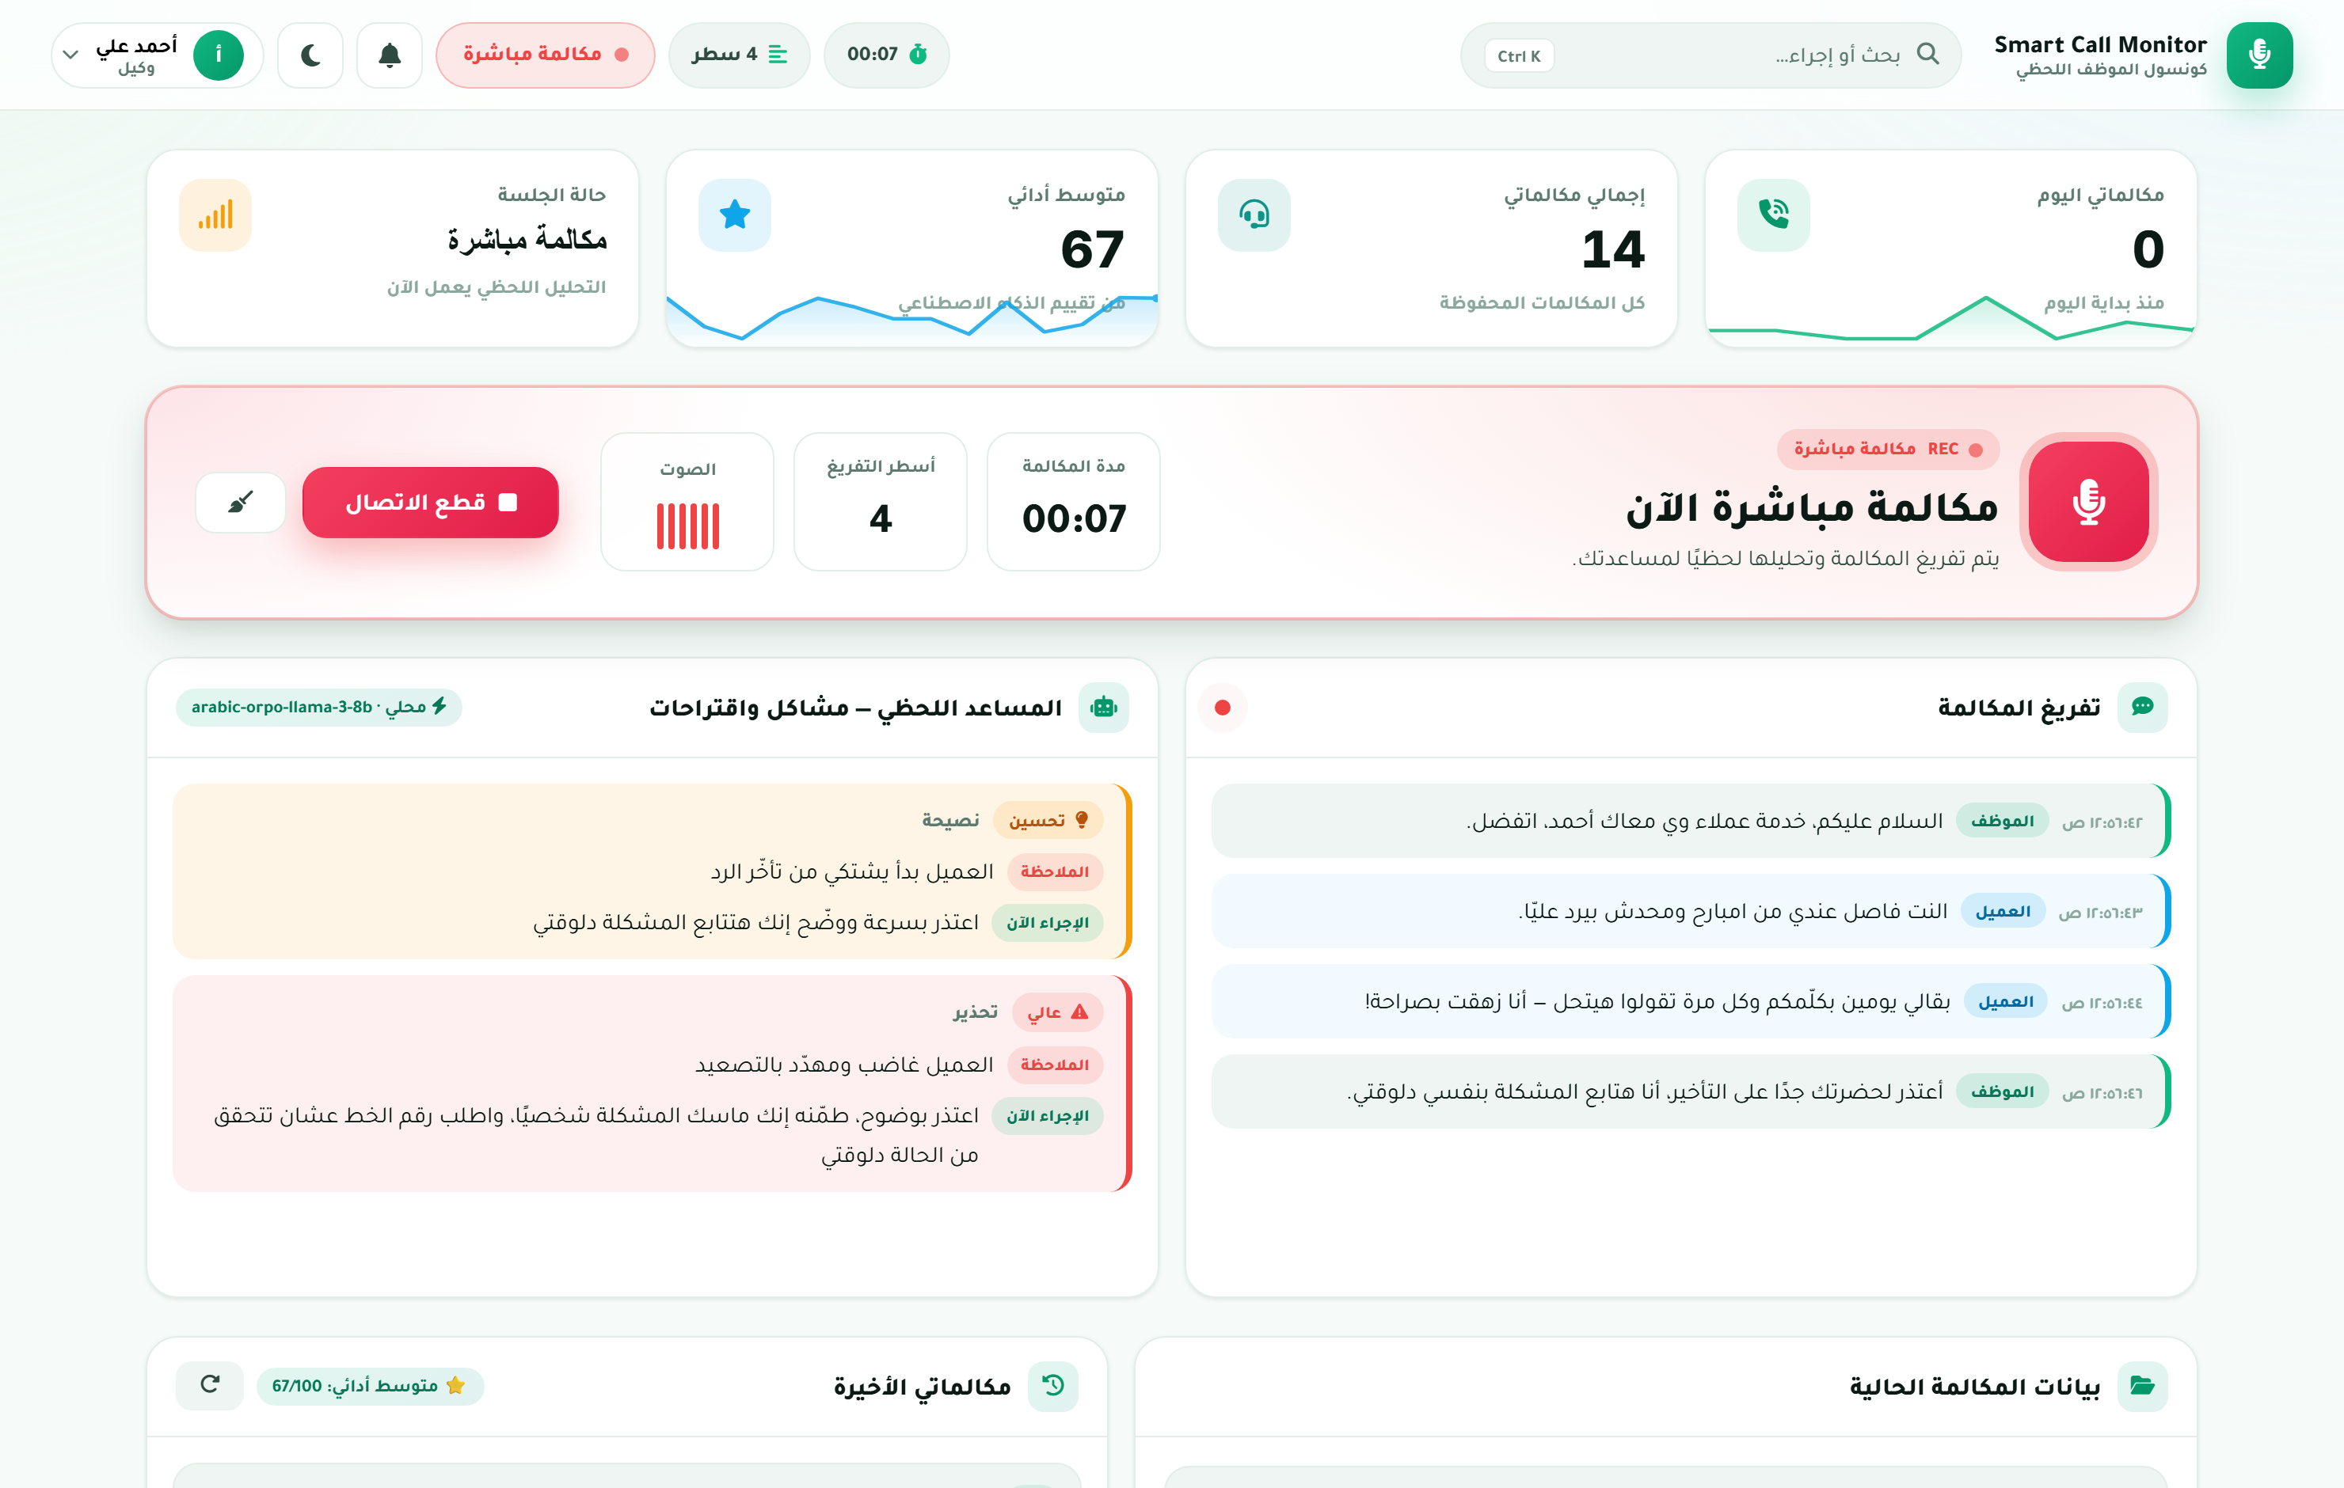
DEMO · AGENT CONSOLE
Live transcription + AI coaching
On screen
Call-hero: offline → ready → LIVE → ended
Live transcript (Agent/Customer)
AI assistant: issues & actions
Live engine badge
System logs
Save call + customer + PDF
Live: speaker-separated transcript + AI assistant (issues & actions) + on-premise engine badge
Smart Call Monitor
14
Notes:
This is the real agent console. Narrate the live transcript filling and the AI assistant panel. Capture from the running app per the production package.

Slide 16
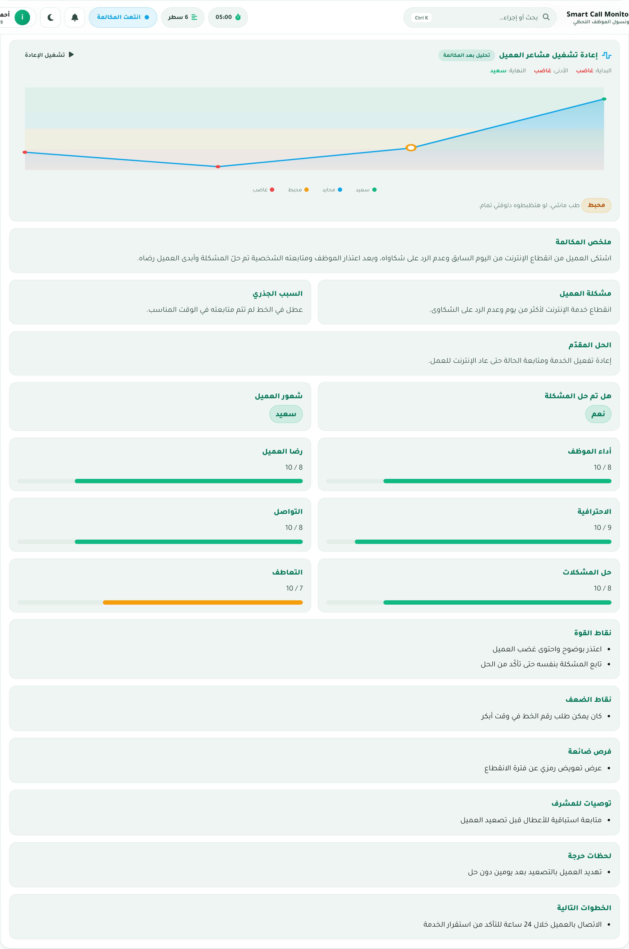
POST-CALL AI REPORT
A full QA evaluation — written automatically
What the report contains
Summary · customer issue · root cause · resolution · sentiment · problem-solved — plus six performance scores and action lists (strengths, weaknesses, recommendations, next steps).
Agent performance
8/10
Customer satisfaction
8/10
Professionalism
9/10
Communication
8/10
Problem solving
8/10
Empathy
7/10
Real report (Sentiment Replay on top)
Smart Call Monitor
15
Notes:
The report writes itself in seconds: 18 fields incl. six 0-10 scores, sentiment, and recommendations. Scores shown are illustrative; capture a real report consistent with your demo call.

Slide 17
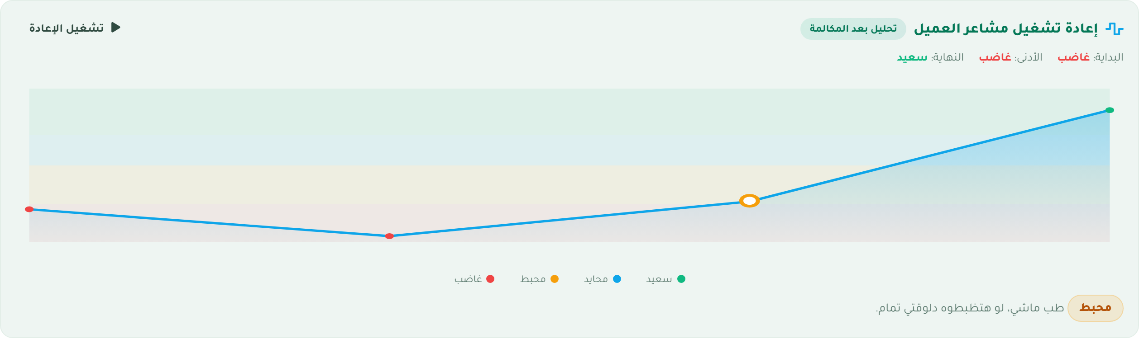
NEW FEATURE
Sentiment Timeline Replay (post-call)
Real component inside the report — auto-plays the customer's emotional arc, anchored to the AI's final sentiment
Post-call analysis — not live. Built into agent.js → renderReport: reconstructs the customer's arc from the transcript (Egyptian-Arabic emotion markers) and anchors the endpoint to the report's customer_sentiment. Fully guarded; uses a model-provided timeline if present.
Smart Call Monitor
16
Notes:
New feature we built. Be precise: it is POST-CALL (not a live meter). It reconstructs the customer's arc from the transcript and anchors the endpoint to the report's customer_sentiment. The chart shows a sample arc; the real component animates inside the report.

Slide 18
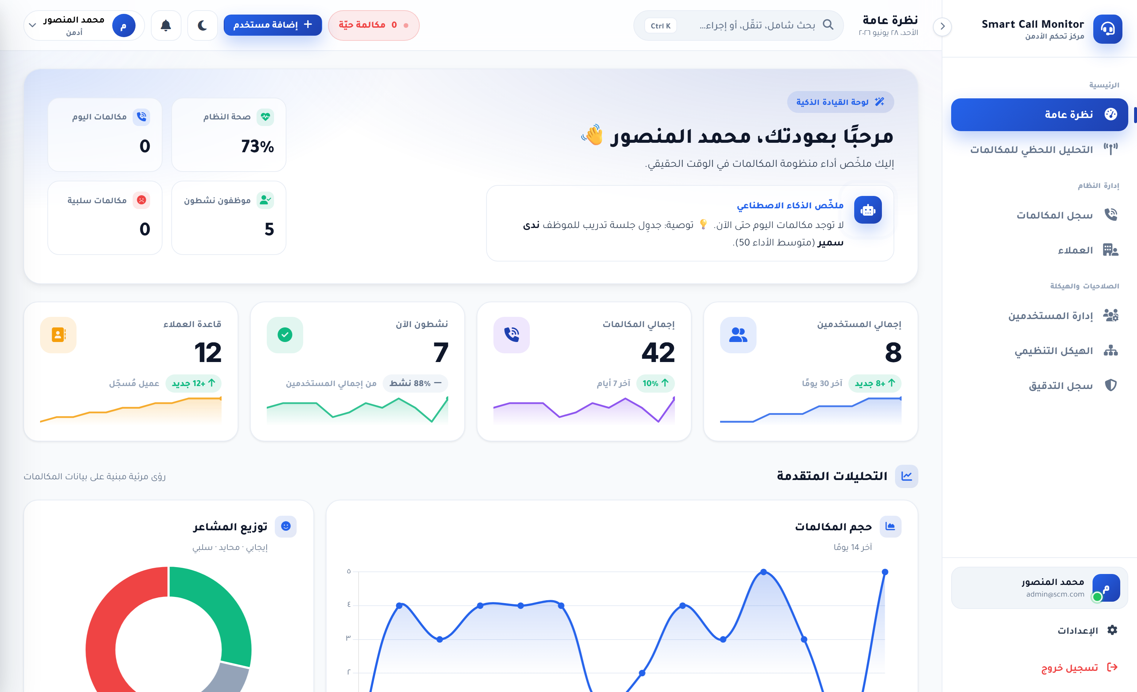
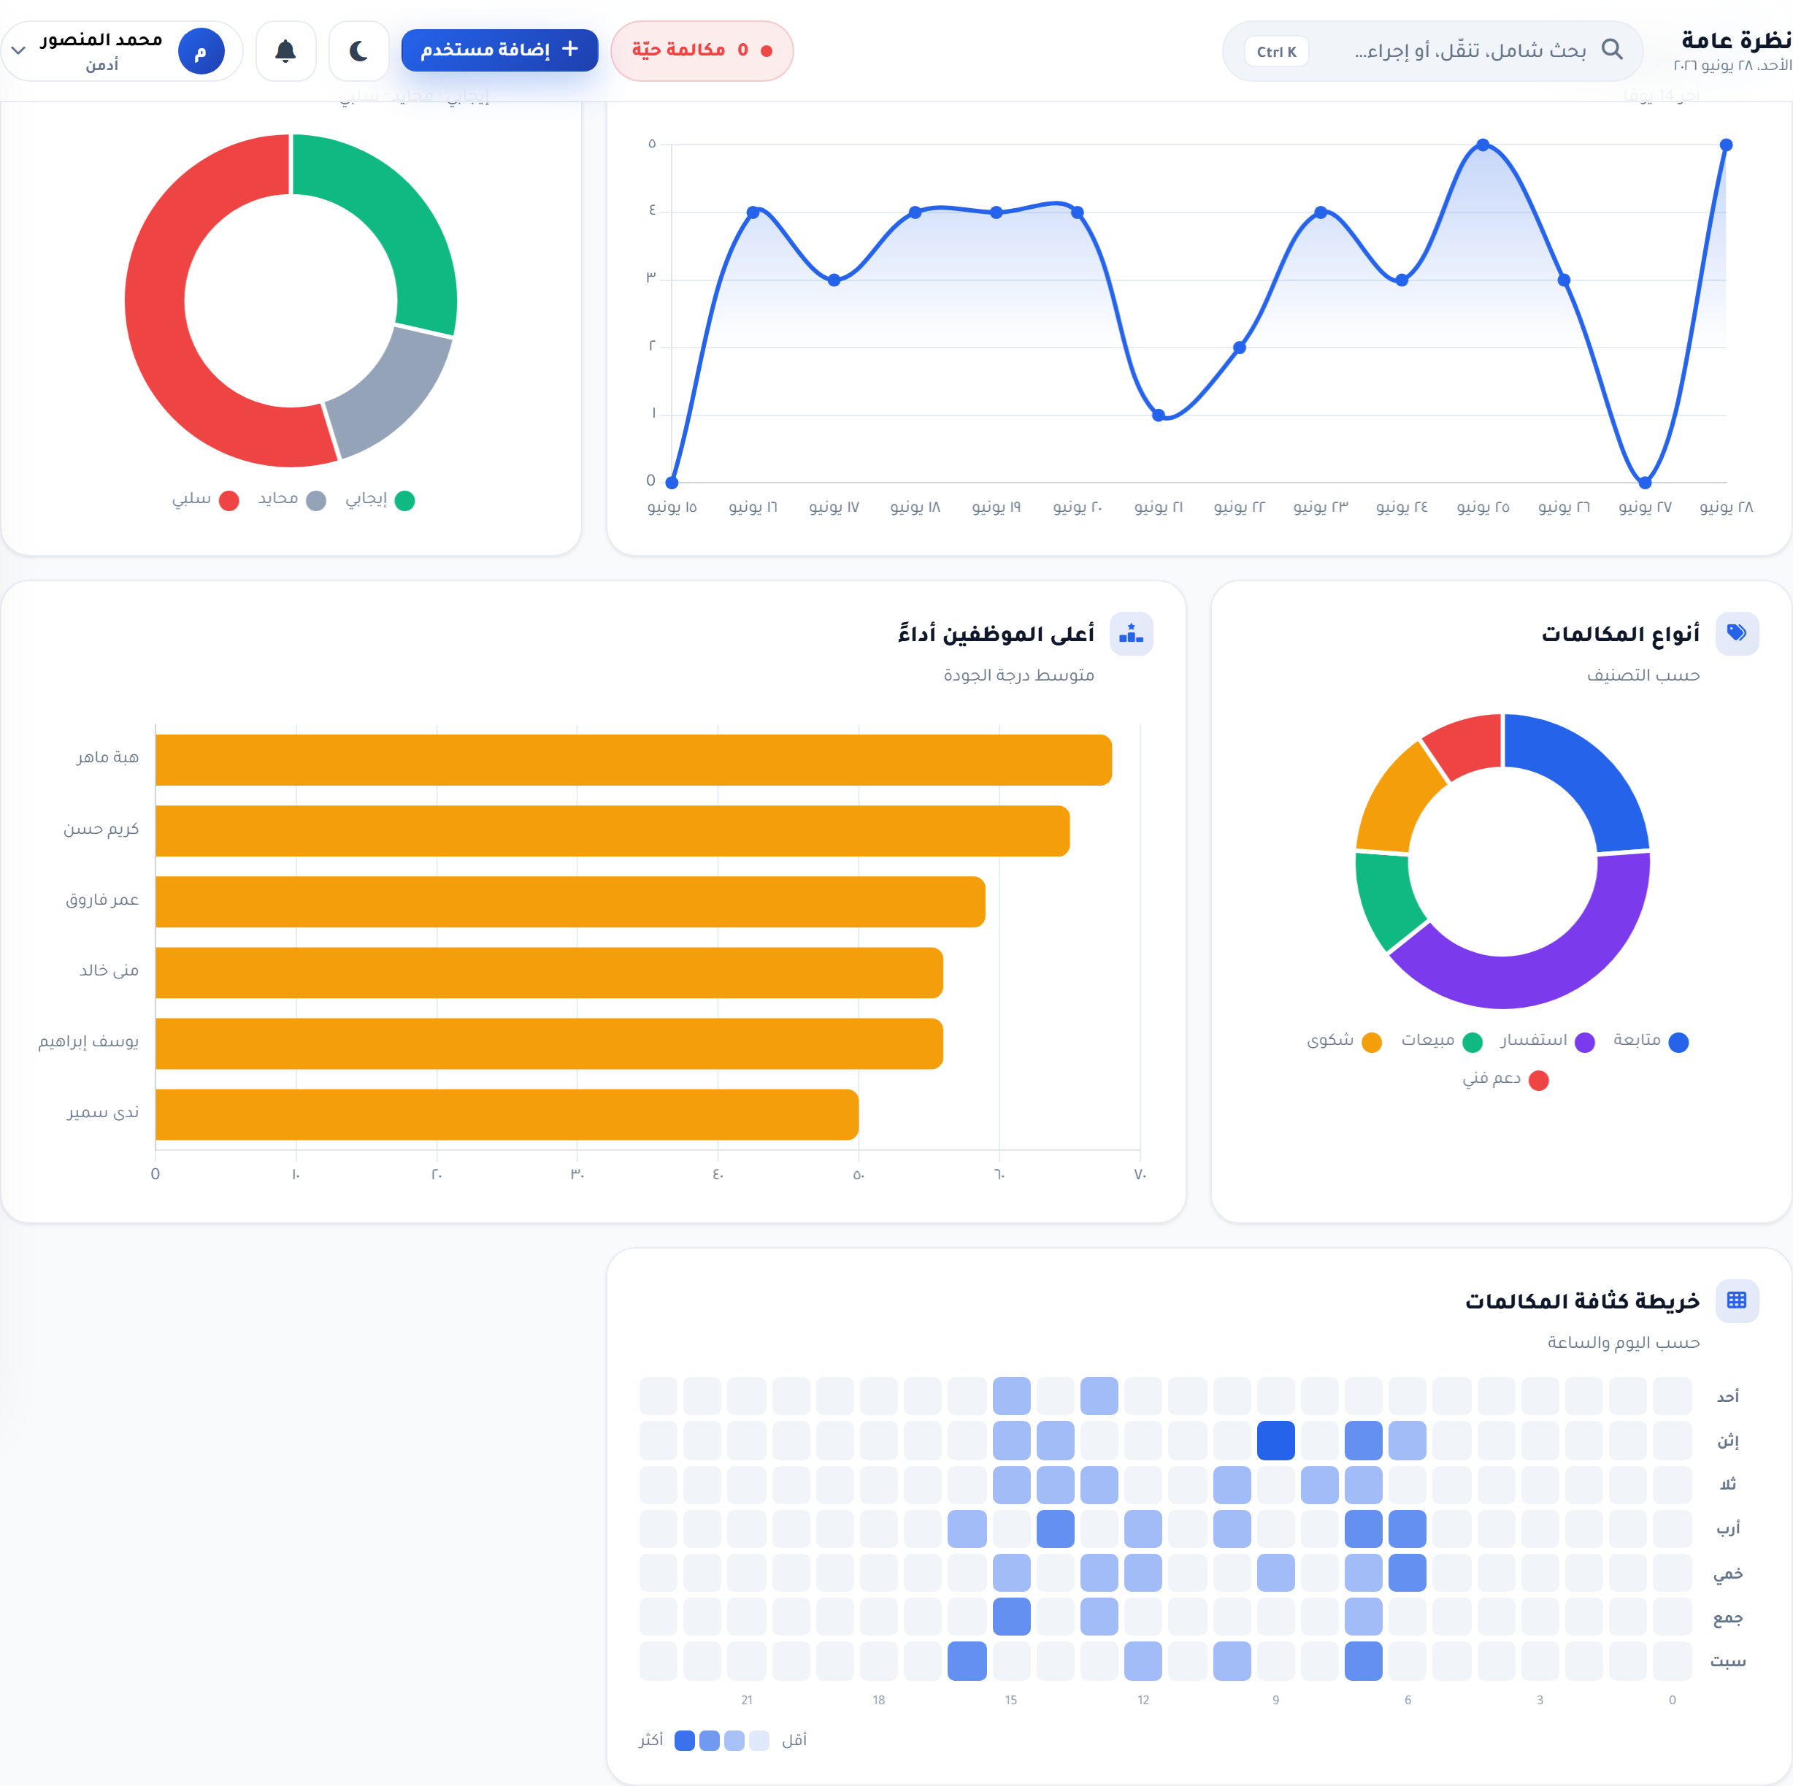
DEMO · ADMIN
Management cockpit & analytics
Live KPIs
Sentiment
Agent ranking
Heatmap
Search & filter
PDF export
7 admin views
Smart Call Monitor
17
Notes:
Management sees the whole operation live: KPIs, charts (call volume, sentiment, types, agent ranking, heatmap), searchable call history, drill-down detail, and PDF export. Charts here use sample data; capture real ones.

Slide 19
BUSINESS VALUE
Who it's for
Telecom
Banks 🔒
Hospitals 🔒
Insurance 🔒
Millions of support calls; reduce churn
Compliance-sensitive; data stays in-house
Patient privacy stays on-premise
Claims & disputes, auditable QA
🔒 = privacy-regulated.
The more sensitive the data, the more local AI matters.
Government 🔒
Support / BPO
E-commerce
Data sovereignty — stays in-country
Consistency & training at scale
Orders & returns; peak-season volume
Smart Call Monitor
18
Notes:
Any call-heavy business benefits; regulated industries (banks, hospitals, insurance, government) are the best fit because the AI stays on-premise.

Slide 20
THE IMPACT
From sampling quality to knowing it
Manual QA
With Smart Call Monitor
~500
Seconds
hours to review 1,000 calls
per automatic report
1% reviewed · delayed · inconsistent
100% reviewed · instant · consistent · lower cost
1% sampled → 100% understood
Figures are illustrative (assumes ~30 min per manual review).
Smart Call Monitor
19
Notes:
Make the contrast concrete but mark numbers as illustrative. The headline is coverage: 1% sampled becomes 100% understood.

Slide 21
ENGINEERING
Challenges → Solutions
Challenge: End-to-end-encrypted live audio
Challenge: Corrupted audio packets
Solution: Decrypt each packet via the live session
Solution: Emit a silence frame & skip — keep the call alive
Challenge: AI hallucinations on silence
Challenge: Invalid JSON from a small model
Solution: Voice-activity gating + phantom-phrase filter
Solution: JSON-Schema output + resilient parser
Challenge: Egyptian-Arabic accuracy
Challenge: Latency vs accuracy
Solution: Curated hotwords + hybrid fast/accurate STT
Solution: Fast model live, accurate model for the report
Smart Call Monitor
20
Notes:
These are real problems from the codebase and great Q&A fodder: E2EE decryption, packet resilience, hallucination filtering, guaranteed JSON, Arabic accuracy, latency vs accuracy.

Slide 22
ROADMAP
Future work
1
2
3
4
5
→
→
→
→
Egyptian-Arabic STT model
GPU for higher accuracy
Supervisor live-assist
Telephony / SIP integration
Trends & gamification
The foundation is built to grow — and even our future stays local.
Smart Call Monitor
21
Notes:
Frame as ambition, not gaps. Tie back to identity: even the roadmap keeps the AI local.

Slide 23
SMART CALL MONITOR
“Every conversation becomes actionable intelligence.”
🔒 Local-first · Privacy by default
Questions & Discussion
Arab Academy for Science, Technology & Maritime Transport · Graduation Project · 2026
22
Notes:
Close on the tagline + local-first badge. Invite questions. (Per your preference we avoid a bare 'Thank you' card.)

