Slide 1
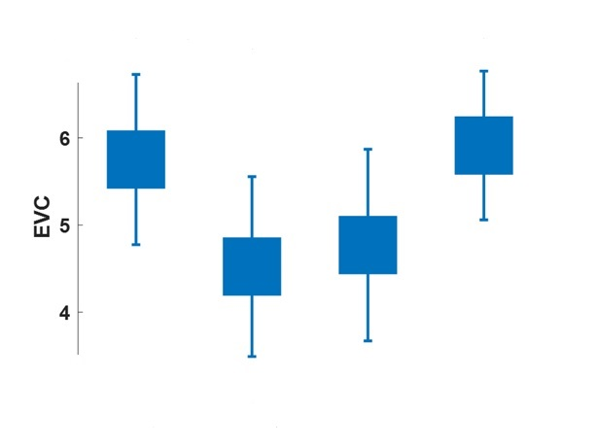

*
*
×${10}^{−3}$
*
Occipital
Frontal
Parietal
Temporal
*
*

