Slide 1
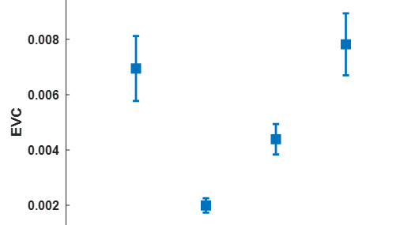
*
*
*
Occipital
Frontal
Parietal
Temporal
*
*

