Slide 1
Team-10 Automated Essay Scoring for IELTS Written Part Essays Lukas Müller, Finn Ferchau, Sascha Stelzl

Slide 2
Introduction
Project Focus: Automatic evaluation of IELTS Writing Task 2 essays.
Primary Goals:
Predict essay scores, based on the prompt and the essay.
Categorize essays based on their prompts.

Slide 3
Motivation
Core Objective: Automatically score IELTS essays and categorize them by prompt.
Driving Force: Provide students with preliminary feedback on their essays.
Target User: Students preparing for the IELTS exam.
Key Questions:
"How good is my essay?"
"Does my essay align with others that address the same prompt?"

Slide 4
Dataset
Source: HuggingFace: IELTS Writing Task 2 Evaluation
Content: Essay prompts and corresponding essay responses.
Evaluation Scores:
Coherence and Cohesion
Lexical Resource
Grammatical Range and Accuracy
Overall Band Score
Dataset Size: ~ 9,000 rows

Slide 5
Methodology – Overall Workflow
Data Cleaning: Preprocessing the raw essay data.
Statistical Analysis: Exploratory data analysis for insights.
Baseline Model Training:
Linear Regression
Logistic Regression
SVM
BERT Model Training: Fine-tuning a BERT-based transformer model.
Clustering Implementation: Grouping similar essays.

Slide 6
Methodology – Machine Learning Models
Automated Essay Scoring (AES):
Baselines: Linear Regression, Logistic Regression, Support Vector Machines (SVM).
Transformer-based: BERT (regression or classification).
Essay Clustering:
K-Means Clustering
Hierarchical Clustering

Slide 7
Preproccesing – Key Data Preparation Steps
Extracting detailed scoring components (e.g., "task achievement", "coherence and cohesion", "lexical resource", "grammatical range and accuracy", and "overall band score") from the evalution column
Cleaning text columns (prompt, essay, and various description fields) by removing newlines, carriage returns, and multiple spaces

Slide 8
Preproccesing – Data Filtering
Essays are filtered to a maximum token length (e.g., 512 tokens using a RoBERTa tokenizer) to meet model input requirements. This step reduces the training dataset from 9717 to 9605 rows and the test dataset from 486 to 481 rows.
Essays with overall band scores outside the range of 4.0 to 8.5 are removed. This further refines the training data from 9605 to 9048 rows and the test data from 481 to 454 rows, focusing on the most relevant score distribution.

Slide 9
Statistical Analysis 1 - Essay Length vs Band Score
Research Question: Is there a correlation between essay length and overall band scores?
Key Findings:
Weak but significant positive correlation (r = 0.286, p = 7.82e-170)
Longer essays tend to receive slightly higher scores
Relationship is statistically significant but not strong enough to be the primary scoring factor

Slide 10
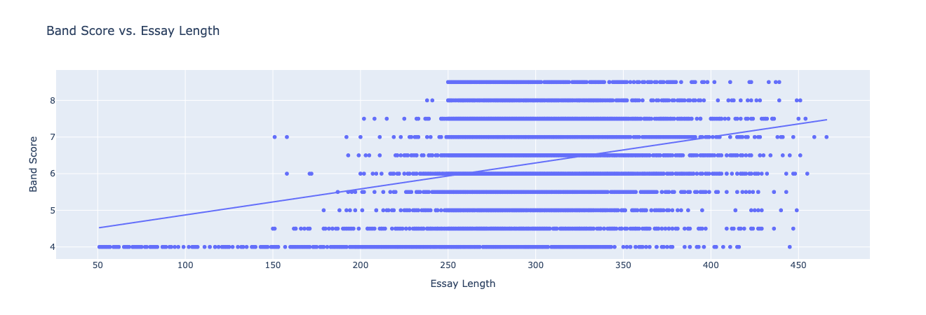
Statistical Analysis 1 - Essay Length vs Band Score

Slide 11
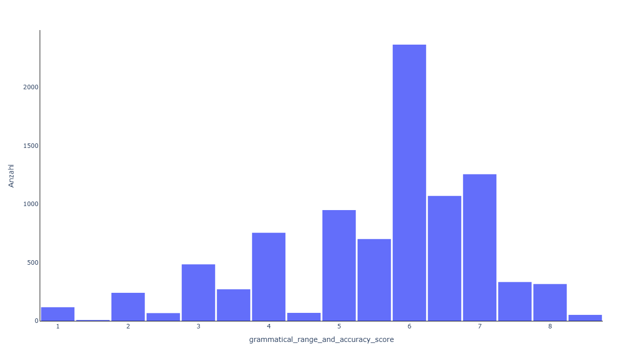
Statistical Analysis 2 – Vocabulary diversity vs Score
Grammatical range and accuracy score
Notes:
Verteilung der einzelnen Scores sehr unbalanciert, auch werte von 1 bis 4 und 9 vorhanden
Lexical resource score: time children, life, example, job zu example government, individual, instance
Coherence and cohesion score: von children time zu example instance government
Task Achievement: von time life children esample zu government individual instance/example
Können aufgrund der verschiedenen Vokabelgrößen

Slide 12
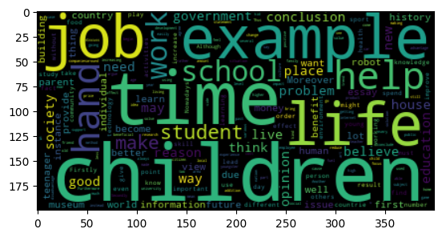
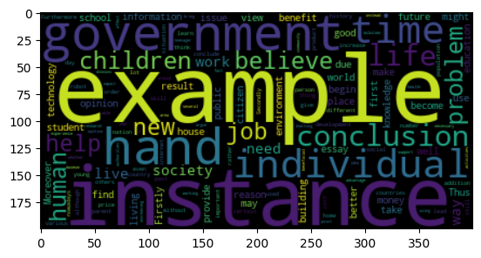
Statistical Analysis 2 – Vocabulary diversity vs Score
Grammatical range and accuracy score
Score 4
Score 8,5
Notes:
Verteilung der einzelnen Scores sehr unbalanciert, auch werte von 1 bis 4 und 9 vorhanden
Lexical resource score: time children, life, example, job zu example government, individual, instance
Coherence and cohesion score: von children time zu example instance government
Task Achievement: von time life children esample zu government individual instance/example
Können aufgrund der verschiedenen Vokabelgrößen

Slide 13
Prompt Binning – Clustering Essay Prompts
Objective: Group similar essay prompts for further statistical analysis
Dataset Overview:
2,386 unique prompts from 9,048 essays
Used Jina Embeddings V3 for semantic representation
K-Means Results (Optimal Method):
30 balanced clusters with good distribution
Average cluster size: 79.5 prompts (range: 39-166)
Coefficient of variation: 0.398 (reasonably balanced)
Gini coefficient: 0.214 (low inequality)

Slide 14
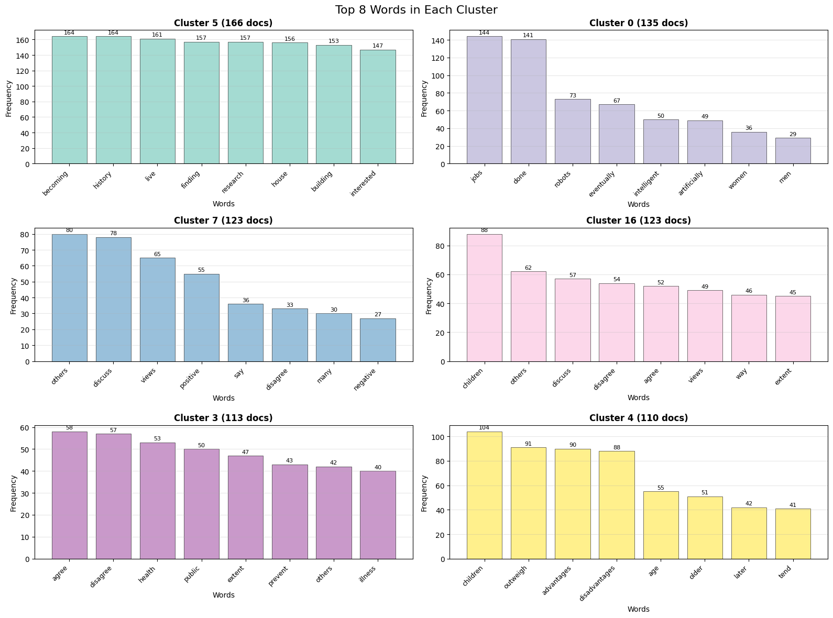

Slide 15
Statistical Analysis 3 – Distinctive Words per Prompt
Research Question: Are certain words used more frequently in essays for specific prompts than others?
Methodology:
Cluster-based analysis using prompt clusters
Distinctiveness score: Ratio of word frequency in cluster vs. all clusters
Text preprocessing: Tokenization, stopword removal, lowercase conversion
Key Findings:
Strong thematic vocabulary patterns emerge across different prompt types
Words show high distinctiveness scores (up to 80+ for highly specific terms)
Clear semantic clustering reflects prompt topics

Slide 16
Statistical Analysis 3 - Results & Examples
Top Distinctive Words by Theme:
Cluster | Theme | Top Distinctive Words | Score Range
29 | Job Interviews | recruiter, interviewer, interviews | 70-80
1 | Education/Literacy | prisoners, illiterate, literacy | 30-46
3 | Health/Food | pizzas, fatty, nutritious, diet | 18-24
9 | Technology/Social Media | whatsapp, apps, instantly, cyber | 17-40
18 | Climate Change | melt, glaciers, climate, temperature | 20-28

Slide 17
Statistical Analysis 4 - Scoring Category Difficulty
Research Question: Do students of different levels find different aspects of writing an essay easier than others? How does the distribution of scoring categories differ for different final grades?
Key Findings:
Grammar & Accuracy: The Universal Challenge
Most challenging component across all band levels (4.0-8.0)
Consistently 0.38-1.08 points below overall band score
Task Achievement: The Consistent Strength
Least challenging component for most band levels
Students generally understand and address essay requirements well

Slide 18
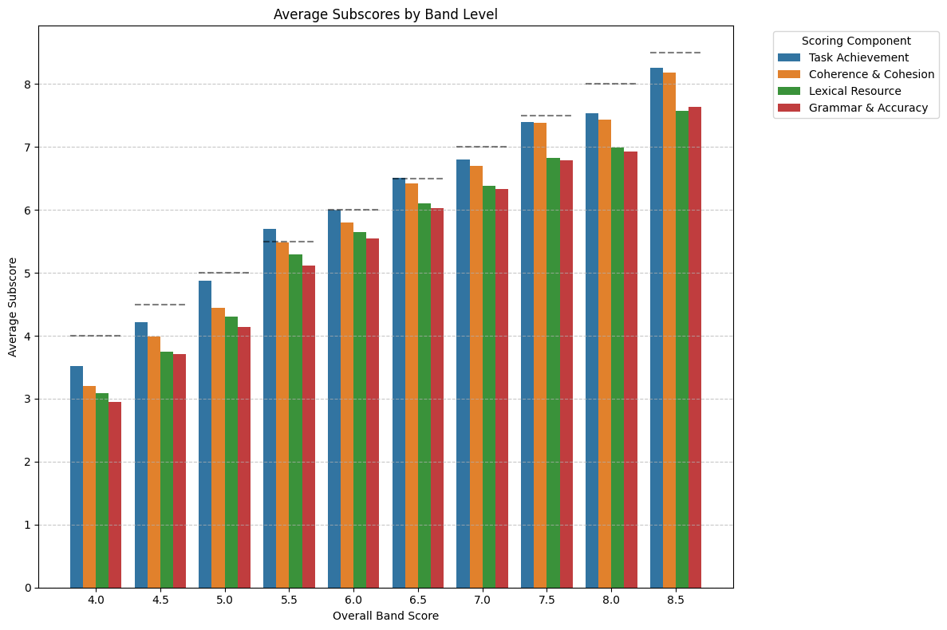
Statistical Analysis 4 - Scoring Category Difficulty

Slide 19
Statistical Analysis 5 – Question Difficulty Analysis
Research Question: Are some essay question types easier to answer than others?
Method: Analyse the mean overall band score per prompt cluster
Key Findings:
Average band scores range from 6.04 to 6.46 across clusters
0.42 point difference between easiest and hardest topics
Clear difficulty patterns emerge by topic theme

Slide 20
Statistical Analysis 5 – Easiest vs. Hardest Questions
Easiest Question Types:
Most Difficult Question Types:
Rank | Cluster | Topic Theme | Avg Score
1 | 28 | Space exploration funding | 6.46
2 | 17 | News/media topics | 6.41
3 | 8 | Transportation/fuel issues | 6.39
Rank | Cluster | Topic Theme | Avg Score
28 | 16 | Sports/teamwork | 6.09
29 | 14 | Technology/robotics | 6.11
30 | 19 | Museums (education vs. entertainment) | 6.04

Slide 21
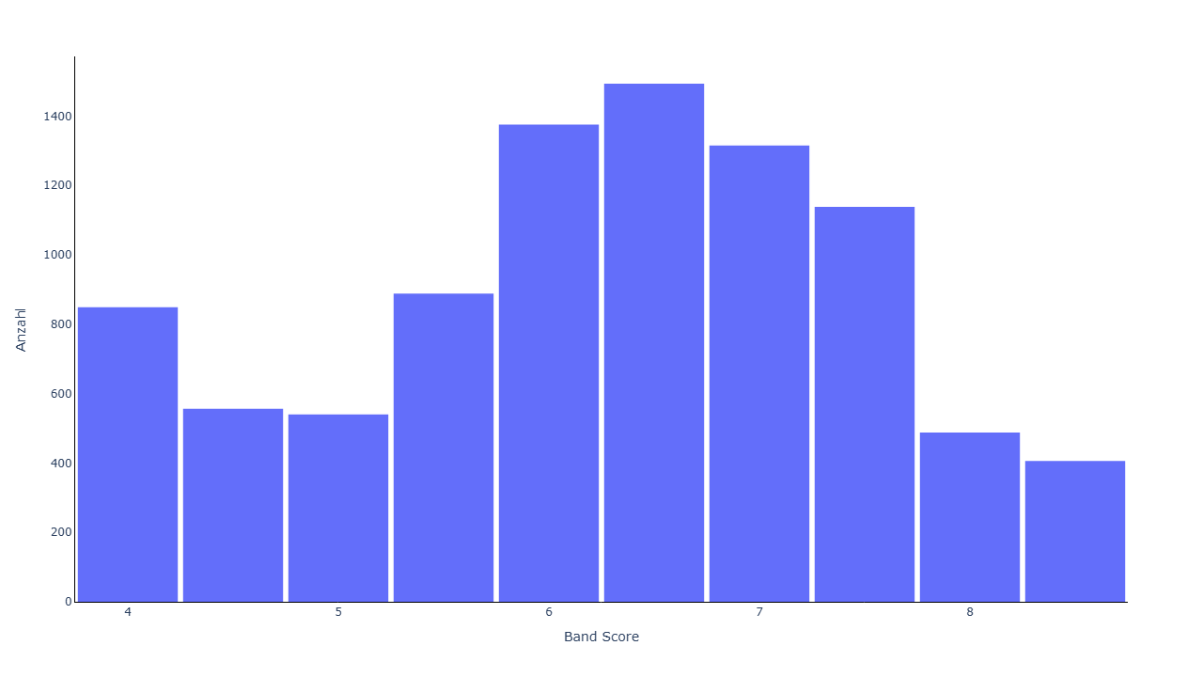
Statistical Analysis 6 – Specific words vs band score
Overall band score

Slide 22
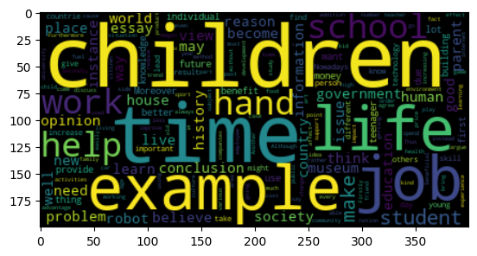
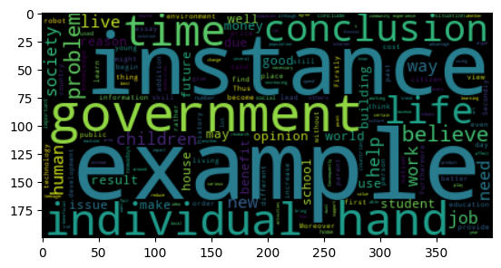
Statistical Analysis 6 – Specific words vs band score
Score 4
Score 8,5
Notes:
Wortfrequenzen werden balancierter
Ähnlich wie bei den kategorialen scores

Slide 23
Baseline Models – Linear Reg. Implementation
Model Setup:
Model: Ridge Linear Regression (alpha=1.0)
TF-IDF features from prompts + essays (n-grams 1-3)
Random oversampling to address class imbalance
Multi-class classification: Band scores 8-17 (transformed from 4.0-8.5)
Final Performance Results:
R² Score: 66.5%
Classification Accuracy: 53.3%

Slide 24
Baseline Models – Logistic Reg. Implemenation
Model Setup:
Model: Logistic Regression classifier (multi_class="multinomial", solver="lbfgs", C=1)
TF-IDF features from prompts + essays (n-grams 1-3)
Random oversampling to address class imbalance
Multi-class classification: Band scores 8-17 (transformed from 4.0-8.5)
Final Performance Results:
Test Accuracy: 59.91%
Significant improvement: Slightly outperformed the linear regression approach in classification tasks, but the model struggles with lower support classes.

Slide 25
Baseline Models – SVM Implementation
Model Setup:
Support Vector Machine with RBF kernel (C=1)
TF-IDF features from prompts + essays (n-grams 1-3)
Random oversampling to address class imbalance
Multi-class classification: Band scores 8-17 (transformed from 4.0-8.5)
Final Performance Results:
Test Accuracy: 59.47%

Slide 26
Baseline Models – KNN Implementation
Model Setup:
KNN with n=1
TF-IDF features from essays (n-grams 1-3)
SMOTE oversampling to address class imbalance
PCA n_components = 512
Multi-class classification: Band scores*10 (40 - 85)
Final Performance Results:
Test Accuracy: 65,0%

Slide 27
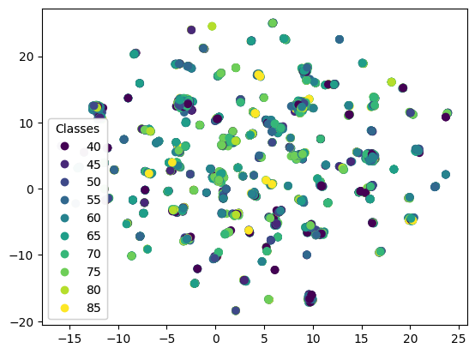
Baseline Models – KNN Implementation
UMAP – Uniform Manifold approximation und Projection
Score classes partially overlap significantly.
Notes:
Cluster, Muster oder Ähnlichkeiten sichtbar zu machen.
Struktur der Daten (lokale Nachbarschaften) in der niedrigen Dimension so gut wie möglich zu erhalten.

Slide 28
BERT Models – Single BERT Model Approaches
Model Architecture:
BERT-base-cased encoder with linear prediction head
Input: Concatenated prompt + essay (max 512 tokens)
Oversampling applied to balance class distribution (0-9 range)

Slide 29
BERT Models – Single BERT Model Approaches
Model Variations Tested:
Approach | Representation | Accuracy
Classification | Pooled hidden states | 27.75%
Classification | CLS token | 32.60%
Regression | CLS token | 57.50%
Key Technical Findings:
Regression > Classification: Treating scoring as regression problem yielded better results
CLS token > Pooling: [CLS] token representation outperformed pooled hidden states
Learning rate scheduling with warmup crucial for stable training

Slide 30
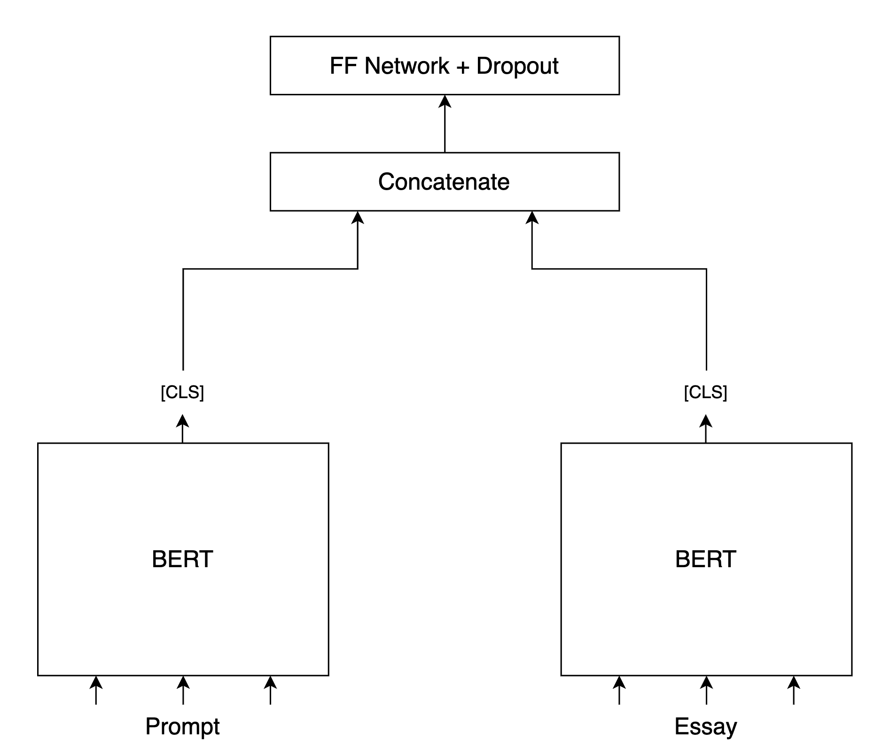
BERT Models – Dual BERT Encoder + Concatenation
Architecture Overview:
Two separate BERT encoders: One for prompts, one for essays
CLS token concatenation: Combines prompt and essay embeddings via concatenation
Prediction head: Two-layer MLP (1536→512→1) with ReLU and dropout
Performance:
61.23% Accuracy

Slide 31
BERT Models – Dual BERT Encoder + Cross-Attention
Architecture Enhancement:
Bidirectional cross-attention: Prompt attends to essay & essay attends to prompt
Multi-head attention: 8 attention heads for interaction modeling
Layer normalization: Applied to concatenated attended representations
Optimized hyperparameters: Learning rate 7e-5, hidden dim 1024, dropout 0.15
Performance Results:
Classification Accuracy: 81.0%

Slide 32
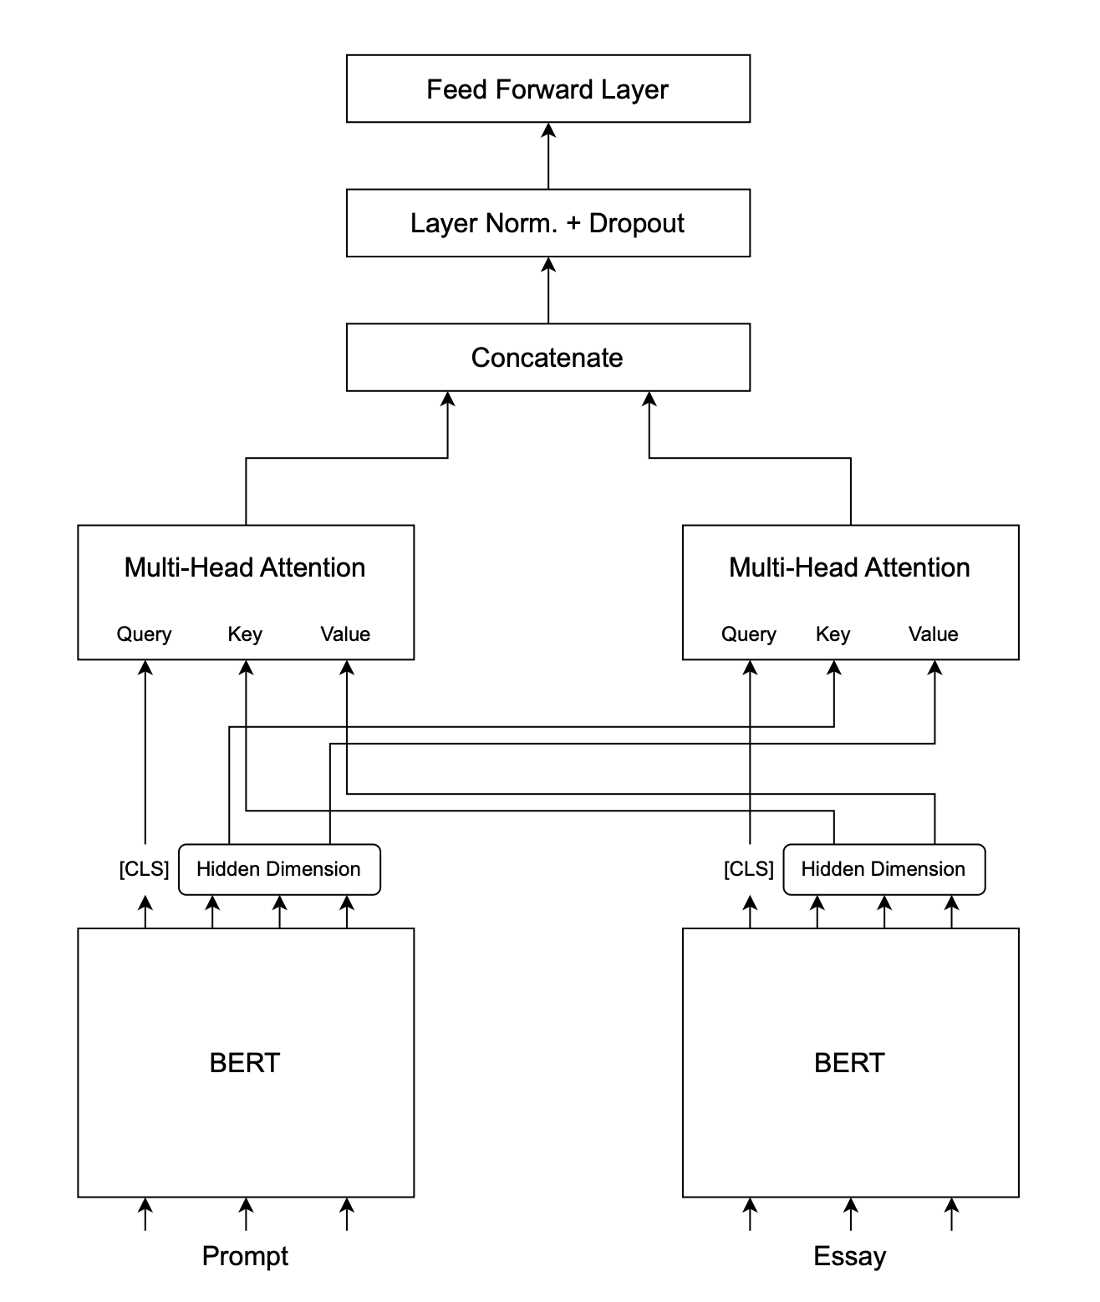
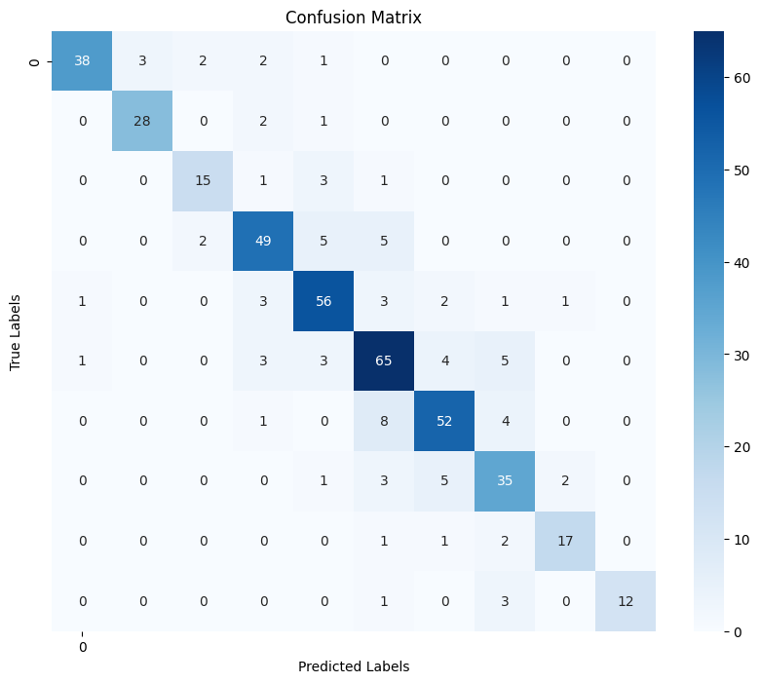

Slide 33
BERT Models – EuroBERT
Architecture Enhancement:
Larger Context Window: Prompt and Essays can be concatenated by a single [SEP]-Tag
Performance Results:
Classification Accuracy: 46.26%
Macro Average F1-Score: 48.1%
Weighted Average Precision/Recall: 49%

Slide 34
Clustering Analysis – Clustering based on the prompts
Model Setup:
k-means n = 30 (clustered prompts) und n = 10 (Scores)
TF-IDF features from essays (n-grams 1-3) / Jina Embeddings V3
Random/SMOTE oversampling to address class imbalance
PCA n_components = 35- 80
Multi-class classification: Band scores*10 (40 - 85)/ prompt cluster (0-29)
Final Performance Results:
Test Accuracy: 78,6% (prompt cluster)
For scores, the accuracy was never above 16%.

Slide 35
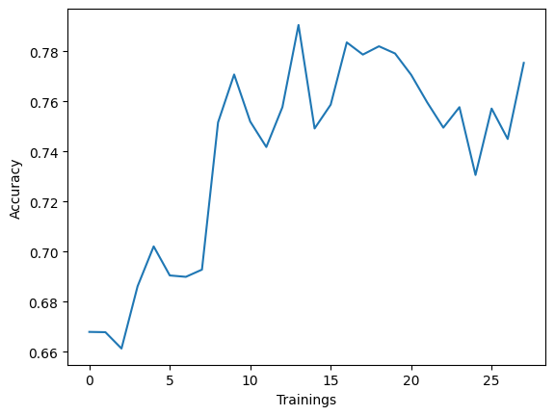
Clustering Analysis – Clustering based on the prompts
Four trainings for each dimension
Dimensions = [5, 10, 20, 35, 50, 65, 80]
Best Accuracy between 35-80
Notes:
Random Oversampling
Embedding model

Slide 36
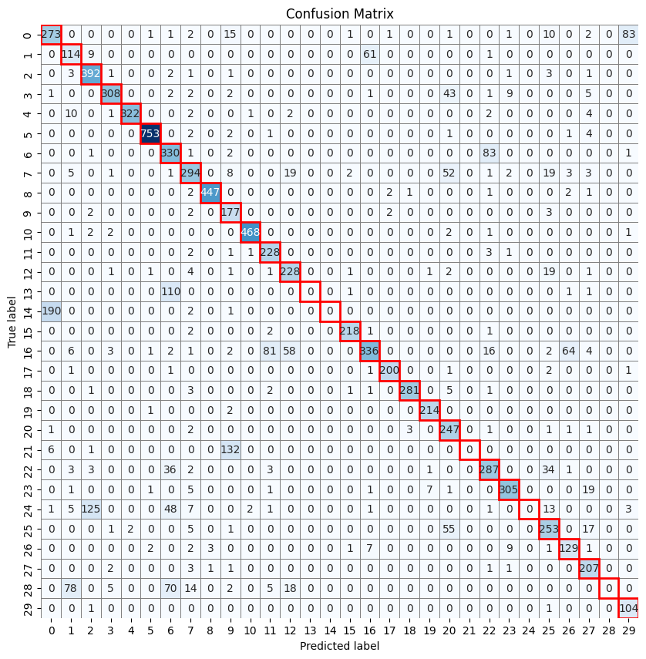
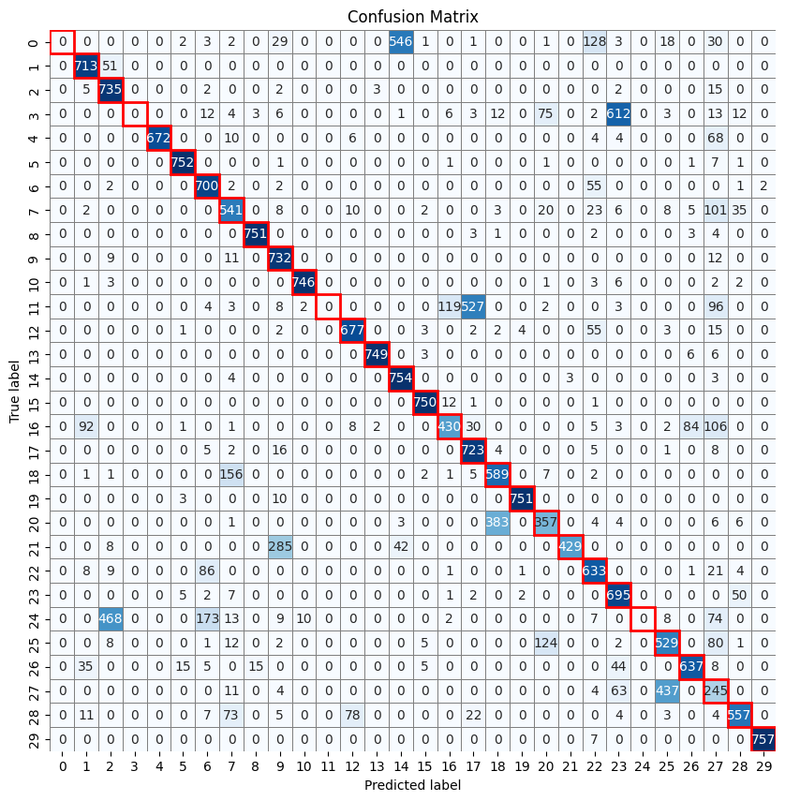
PCA
Random Oversampling
Notes:
Random Oversampling
Embedding model
Raw daten 61%
TF-IDF auch über 60%

Slide 37
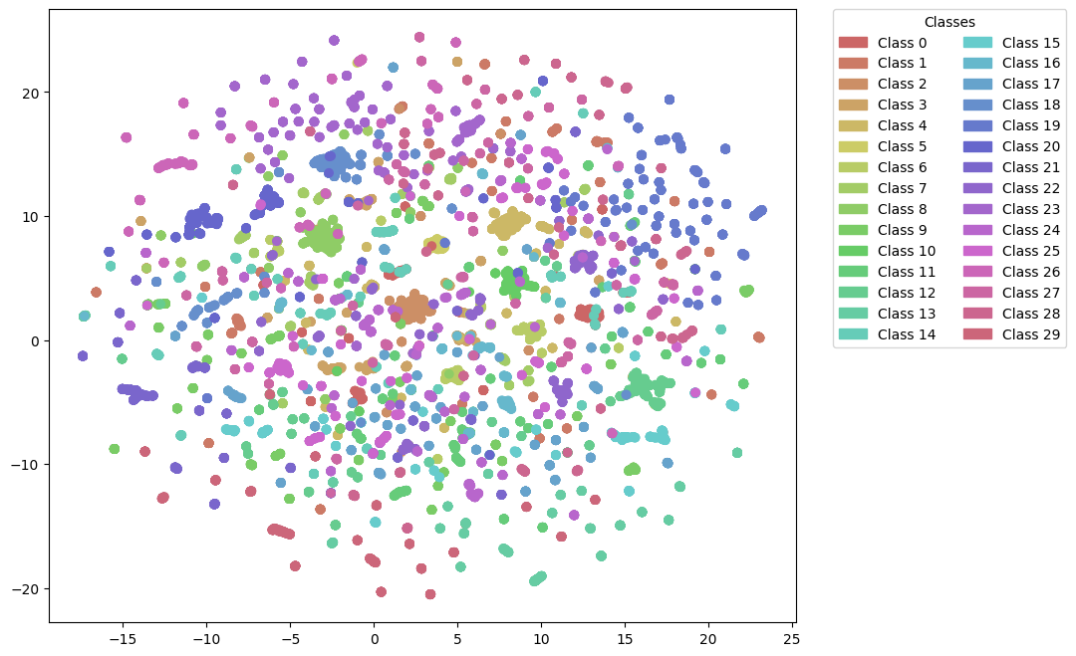
Umap

Slide 38
Questions?

