Slide 1

Metaverse

Slide 2
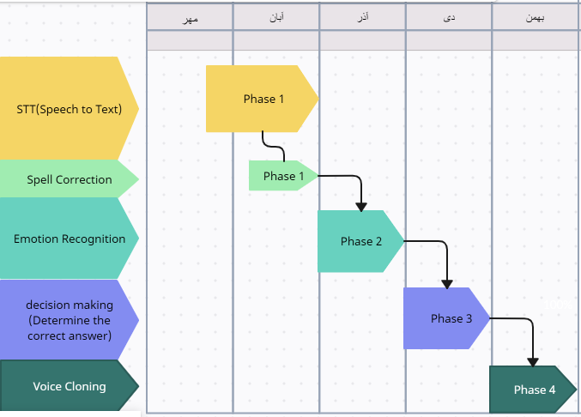
فرآیند و مراحل انجام پروژه(حالت اول)

Slide 3
Project roadmap
1403
مهر
آبان
آذر
دی
بهمن
Faster STT model
STT
&
Spell Correction
STT & Spell Correction
Correct results (lower WER & CER)
Emotion Detection from Voice
Emotion Detection
Emotion Detection
Emotion Detection from text
LM Powered Answer
LM
Powered Answer
Build Customized Dataset
Model Training
Text to Speech
& Integration
Models Integration
TTS &
Integration
More speed
Less size on Disk and RAM usage

Slide 4
پیشبرد مراحل پروژه:
Whisper wer29%
Speech To Text (STT)
SYSTRAN wer29% & speed 3x whisper
SpeechRecognition(very slow)
Persian
Emotion Detection
Bektash (from text)
SA text emotion (from text)
Hubert-base-model (from Audio): Slower & more accurate
Persian
Spell correction
Parsivar Spell check

Slide 5


پیشبرد مراحل پروژه:
Voice Cloning(VC)
Train Demucs model on Zinouri Audios
Piper: Fast/ high Quality
Microsoft: Fastest /medium Quality
Text To Speech (TTS)
Facebook: very slow, less Quality
Kamtera: very slow, less Quality
Alister: less Quality

