Slide 1
Architecture 1001:
x86-64 Assembly
Intel Registers
Xeno Kovah – 2021
xeno@darkmentor.com

Slide 2

All materials is licensed under a Creative Commons “Share Alike” license.
http://creativecommons.org/licenses/by-sa/4.0/
Attribution condition: You must indicate that derivative work
"Is derived from Xeno Kovah's 'Architecture 1001: x86-64 Assembly’ class, available at https://ost.fyi"
Notes:
Attribution condition: You must indicate that derivative work
"Is derived from Xeno Kovah's 'Architecture 1001: x86-64 Assembly’ class, available at https://ost.fyi"

Slide 3
Architecture - Registers
Registers are small memory storage areas built into the processor (still volatile memory)
Intel has 16 “general purpose” registers + the instruction pointer which points at the next instruction to execute
  But 2 of the 16 are not that general
On x86-32, registers are 32 bits wide
On x86-64, registers are 64 bits wide
Book Chapter 5

Slide 4
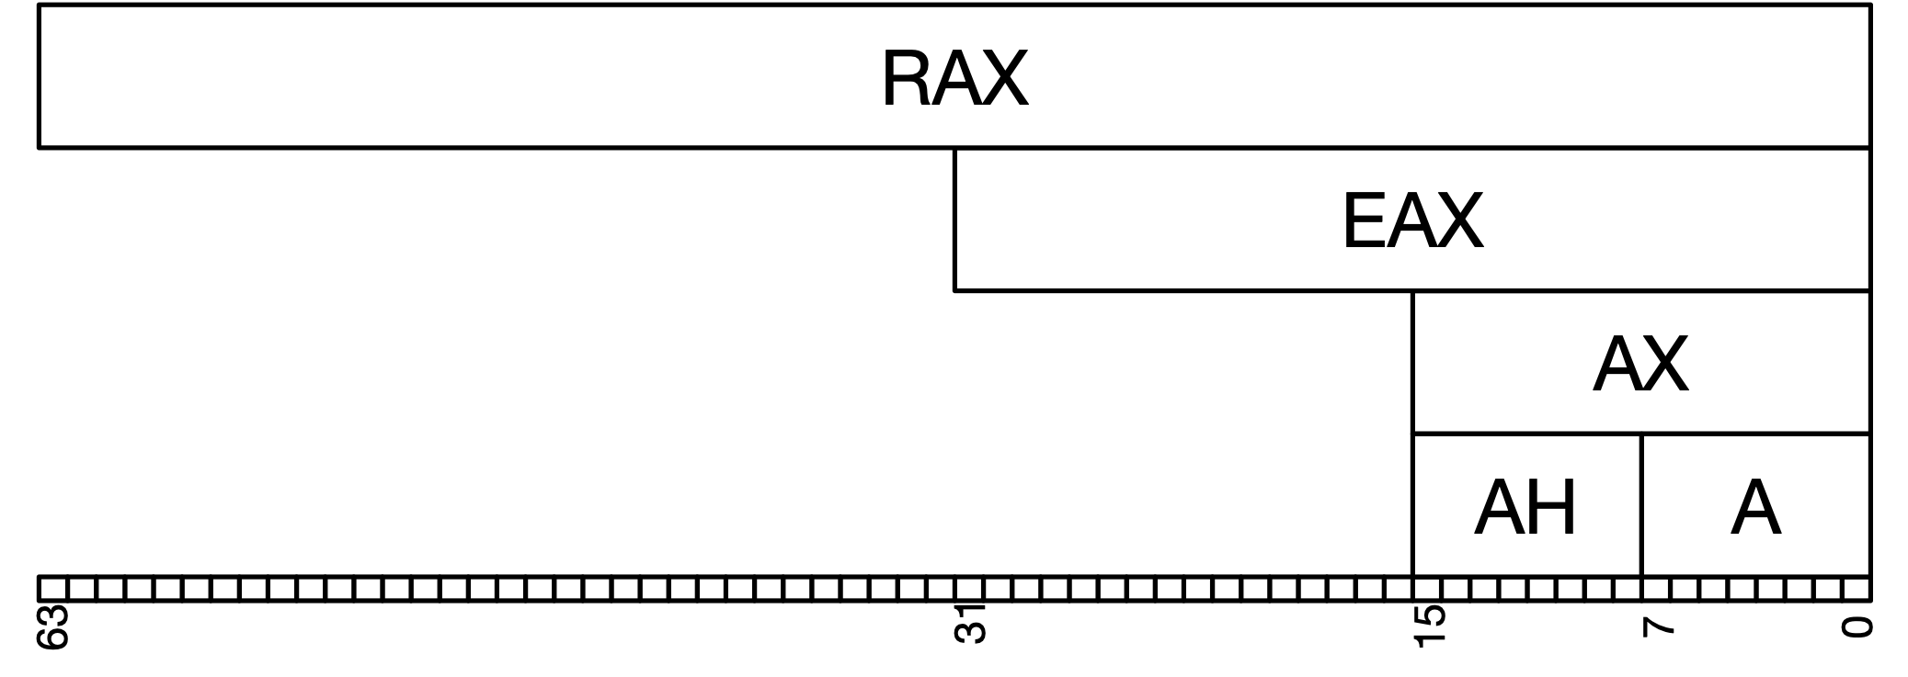

Intel Register Evolution
8-bit 8008

Slide 5
Intel Register Evolution
16-bit 8086
A eXtended
A High
A Low

Slide 6
Intel Register Evolution
32-bit 80386
Extended AX

Slide 7
Intel Register Evolution
64-bit AMD Opteron / Intel Pentium 4

Slide 8

Intel Register Evolution
64-bit AMD Opteron / Intel Pentium 4
Really-wide AX
Or just
Register 0
R0-D(ouble)Word
R0-Word
R0-Byte

Slide 9
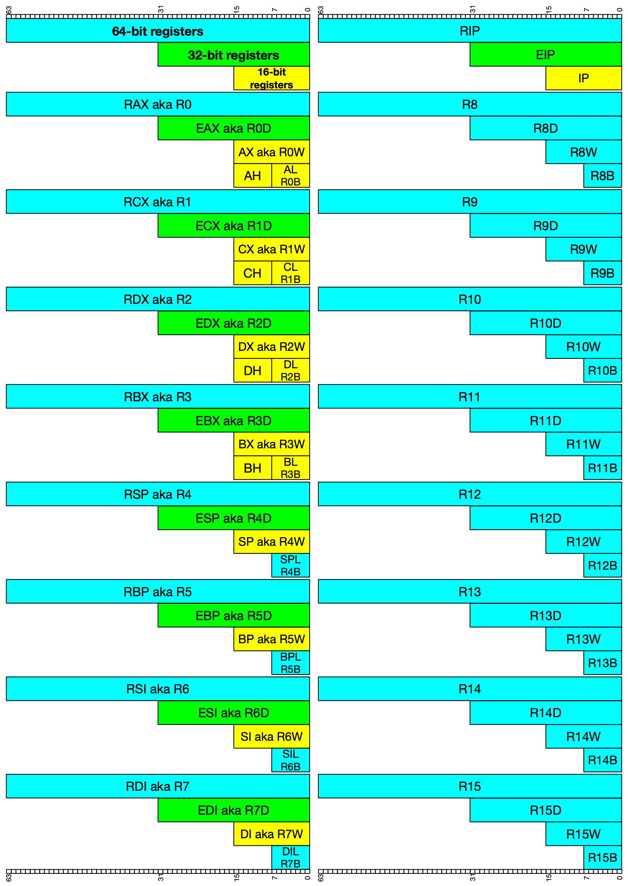

Slide 10
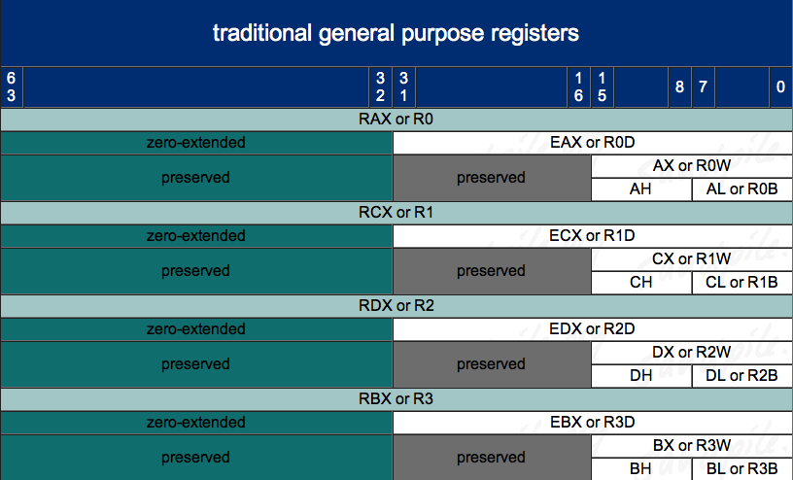
Architecture - Registers – 8/16/32/64 bit addressing 1
http://www.sandpile.org/x86/gpr.htm

Slide 11
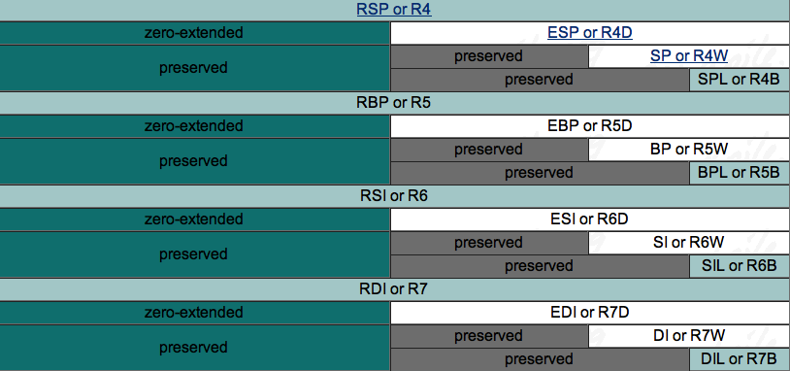
Architecture - Registers – 8/16/32/64 bit addressing 2
(note: we didn’t previously have low-byte access to *SP, *BP, *SI, or *DI!)
http://www.sandpile.org/x86/gpr.htm

Slide 12
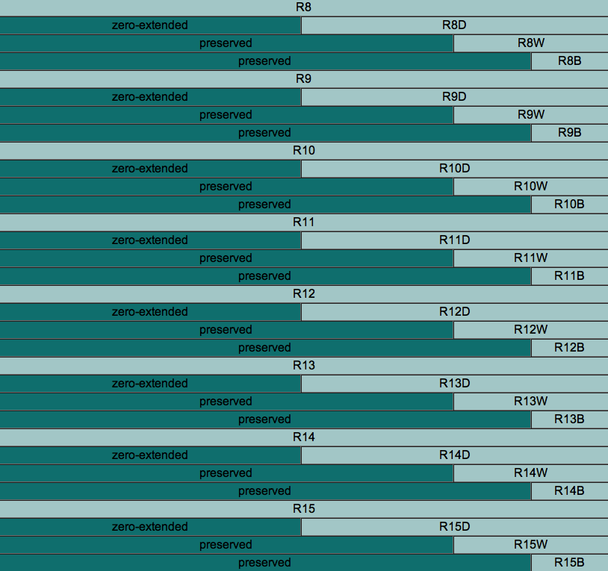
Architecture - Registers – 8/16/32/64 bit addressing 3
http://www.sandpile.org/x86/gpr.htm
Notes:
note to scornwell: maybe a simple game here like:
“DIL is the 8 least-significant-bit access for which 64 bit register?” (RDI)
“What is the word-sized access register for R14 called?” (R14W)
“What is the 16 bit access for R14 called?” (R14W)

Slide 13
Intel Register Conventions 1
These are Intel’s suggestions to compiler developers (and assembly handcoders). Registers don’t have to be used these ways, but if you see them being used like this, you’ll know why. But I simplified some descriptions. I also color coded as GREEN for the ones which we will actually see in this class (as opposed to future ones), and RED for not.
RAX - Stores function return values
RBX - Base pointer to the data section
RCX - Counter for string and loop operations
RDX - I/O pointer
Intel Arch v1 Section 3.4.1 - General-Purpose Registers, page 3-11
Also MS’s conventions: https://docs.microsoft.com/en-us/cpp/build/x64-software-conventions?view=msvc-160

Slide 14
Intel Register Conventions 2
RSI - Source index pointer for string operations
RDI - Destination index pointer for string operations
RSP - Stack (top) pointer
RBP - Stack frame base pointer
RIP - Pointer to next instruction to execute (“instruction pointer”)

