Slide 1
Architecture 1001:
x86-64 Assembly
SingleLocalVariable.c
Xeno Kovah – 2021
xeno@darkmentor.com

Slide 2

All materials is licensed under a Creative Commons “Share Alike” license.
http://creativecommons.org/licenses/by-sa/4.0/
Attribution condition: You must indicate that derivative work
"Is derived from Xeno Kovah's 'Architecture 1001: x86-64 Assembly’ class, available at https://ost.fyi"
Notes:
Attribution condition: You must indicate that derivative work
"Is derived from Xeno Kovah's 'Architecture 1001: x86-64 Assembly’ class, available at https://ost.fyi"

Slide 3
SingleLocalVariable.c
Adding a single local variable
int func(){
int i = 0x5ca1ab1e;
return i;
}
int main(){
return func();
}
func:
0000000140001000 sub rsp,18h
0000000140001004 mov dword ptr [rsp],5CA1AB1Eh
000000014000100B mov eax,dword ptr [rsp]
000000014000100E add rsp,18h
0000000140001012 ret
main:
0000000140001020 sub rsp,28h
0000000140001024 call func (0140001000h)
0000000140001029 add rsp,28h
000000014000102D ret

Slide 4
Right click on the next project and select "Set as StartUp Project" as you move between class examples to make them launch when you run the debugger. Its text will go bold after.

Slide 5
SingleLocalVariable.c Stack
If we step through line 0000000140001004 in func(), the stack looks like this:
00000000`0014FE08
00000000`0014FE00
00000000`0014FDF8
00000000`0014FDF0
00000000`0014FDE8
00000000`0014FDE0
00000000`0014FDD8
00000000`0014FDD0
00000000`0014FDC8
00000000`0014FDC0

Slide 6

👁
STOP
&&
STEP THROUGH
THE ASSEMBLY
&&
DRAW A STACK DIAGRAM!

Slide 7
SingleLocalVariable.c Stack
If we step through line 0000000140001004 in func(), the stack looks like this:
00000000`0014FE08 | return address = 00000001`40001349
00000000`0014FE00 | undef
00000000`0014FDF8 | undef
00000000`0014FDF0 | undef
00000000`0014FDE8 | undef
00000000`0014FDE0 | undef
00000000`0014FDD8 | return address = 00000001`40001029
00000000`0014FDD0 | undef
00000000`0014FDC8 | undef
00000000`0014FDC0 | undef`5CA1AB1E
main()
frame
Because the asm only wrote a “dword ptr” (4 bytes) worth of memory at this location, so the top 4 bytes are untouched and thus undefined
func()
frame

Slide 8
A Little Bit About r/mX Forms
That I Skipped
In Intel Syntax, for r/mX memory descriptions, it will use things like "qword ptr", "dword ptr", or "word ptr" to indicate the size of the data being operated on (8, 4, and 2 bytes respectively)
mov qword ptr [rsp+10h],rax
mov dword ptr [rsp],5CA1AB1Eh
mov word ptr [rsp],ax

Slide 9
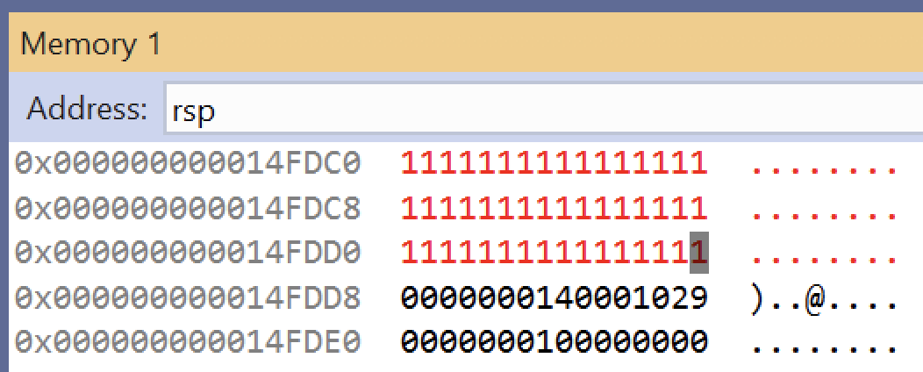
An Easy Way to See What Memory Changes
You can click into the VS memory window and edit memory to initialize uninitialized memory, and then see what actually changes

Slide 10
SingleLocalVariable.c Takeaways
Local variables lead to an allocation of space on the stack, within the function where the variable is scoped to
In VS there is an over-allocation of space for local variables
  0x18 reserved for only 0x4 (int) worth of data
int func(){
int i = 0x5ca1ab1e;
return i;
}
int main(){
return func();
}
func:
0000000140001000 sub rsp,18h
0000000140001004 mov dword ptr [rsp],5CA1AB1Eh
000000014000100B mov eax,dword ptr [rsp]
000000014000100E add rsp,18h
0000000140001012 ret
main:
0000000140001020 sub rsp,28h
0000000140001024 call func (0140001000h)
0000000140001029 add rsp,28h
000000014000102D ret

Slide 11
Mystery Listery
Why do the GCC/Clang HelloWorlds have balanced Push/Pop instructions but Visual Studio doesn’t?
What’s up with the sub/add 0x28 in main()?
Why is VS over-allocating space for a single local variable?

Slide 12
Simple Stack Diagram 3
stack bottom
“return address” to return
from main() to invoke_main()
#include <stdio.h>
int bar(int y){
int a = 3*y;
printf("bar returned %d", a);
return a;
}
int foo(int x){
int b = 5*x;
printf("foo passed %d", b);
return bar(b);
}
int main(){
int c = foo(7);
printf("main passed %d", c);
}
main()
frame
int c
“return address” to return
from foo() to main()
int b
foo()
frame
“return address” to return
from bar() to foo()
int a
bar()
frame
stack top

