Slide 1
Architecture 1001:
x86-64 Assembly
Calling Conventions
Xeno Kovah – 2021
xeno@darkmentor.com

Slide 2

All materials is licensed under a Creative Commons “Share Alike” license.
http://creativecommons.org/licenses/by-sa/4.0/
Attribution condition: You must indicate that derivative work
"Is derived from Xeno Kovah's 'Architecture 1001: x86-64 Assembly’ class, available at https://ost.fyi"
Notes:
Attribution condition: You must indicate that derivative work
"Is derived from Xeno Kovah's 'Architecture 1001: x86-64 Assembly’ class, available at https://ost.fyi"

Slide 3




Yello?
Calling Conventions
Ahoy-hoy!
2 elements of importance:
  Register conventions for which registers "belong" to the caller vs. callee
  Parameter-passing conventions
Both are compiler-dependent
Yeobeoseyo!
Einstein!

Slide 4
Calling Conventions 2
We're just talking about the MS "x64" ABI and System V "x86-64" ABI in the this section
More examples at
  http://en.wikipedia.org/wiki/X86_calling_conventions
"ABI" = Application Binary Interface. Standard of how executables are supposed to work on an architecture
  https://raw.githubusercontent.com/wiki/hjl-tools/x86-psABI/x86-64-psABI-1.0.pdf
https://docs.microsoft.com/en-us/cpp/build/x64-software-conventions?view=msvc-160

Slide 5
Register Conventions:
Caller-save registers
Also called “volatile” registers by MS
  I.e. the caller should assume they will be changed by the callee
Registers "belong" to the callee.
So the caller is in charge of saving the value before a call to a subroutine, and restoring the value after the call returns
VisualStudio: RAX, RCX, RDX, R8, R9, R10, R11
GCC: RAX, RDI, RSI, RDX, RCX, R8, R9, R10, R11

Slide 6
Register Conventions:
Callee-save registers
Also called “non-volatile” registers by MS
  I.e. the caller should assume they will not be changed by the callee
Registers "belong" to the caller
If the callee needs to use more registers than are saved by the caller, the callee is responsible for making sure the values are stored/restored, so it doesn't break things for the caller
VisualStudio: RBX, RBP, RDI, RSI, R12-R15
GCC: RBX, RBP, R12-R15

Slide 7

Register Conventions:
Balance
Both caller and callee are responsible for balancing any register saves they perform (add to the stack), with restores (removal from the stack)
Caller will typically save registers right before the call and restore right after the call
Callee will typically save registers at the beginning of the function and restore at the end of the function

Slide 8
VS vs. GCC et al.
Caller vs. Callee-save Regs
VS Caller-saved | RAX |  | RCX | RDX |  |  |  | R8-11
VS Callee-saved |  | RBX |  |  | RSI | RDI | RBP |  | R12-15
System V (GCC et al.) Caller-saved | RAX |  | RCX | RDX | RSI | RDI |  | R8-11
System V (GCC et al.) Callee-saved |  | RBX |  |  |  |  | RBP |  | R12-15

Slide 9
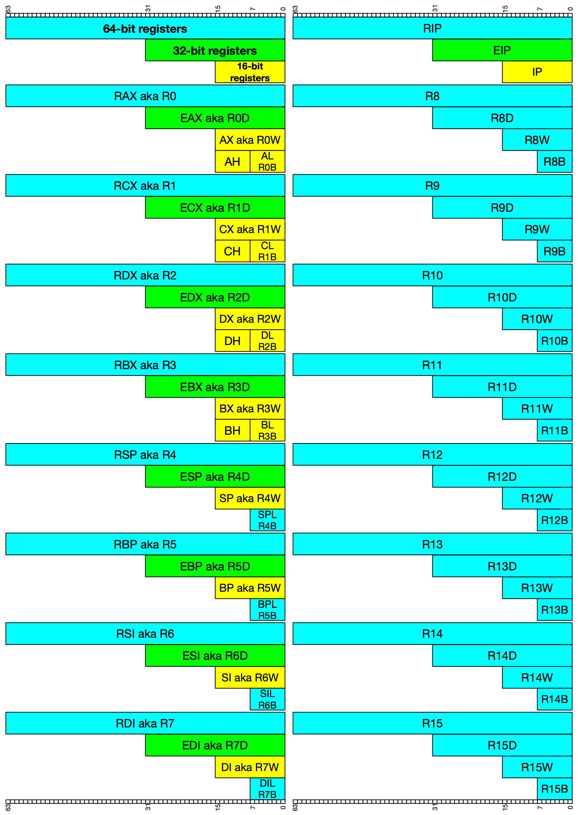
🗣
VS Caller-save
👤
📱
🗣
🗣
📱
VS Callee-save
📱
GCC/Clang
Caller-save
📱
🗣
🗣
📱
📲
GCC/Clang
Callee-save
📱
🗣
🗣
📱
📲
👤
🗣
📱
👤
📲
📲
👤
👤
📲
📱
👤
👤
📲
📱
👤
👤
📲

Slide 10


Slide 11
Parameter-passing Conventions: Common
x86-64 compilers use a subset of the caller-save registers to pass parameters into and out of functions
RAX or RDX:RAX passes out the return value
  RAX holds anything 64 bits or smaller
  RDX:RAX can be used to return 128 bit values

Slide 12
Parameter Conventions:
Microsoft “x64” ABI
First 4 parameters (from left to right) are put into RCX, RDX, R8, R9 respectively
Remaining parameters “pushed” onto the stack so that the left-most parameter is at the lowest address
  Typically "mov" is used instead of "push" though
RCX
RDX
R8
R9
"pushed"
int func(int a, int b, int c, int d, int e){
int i = a+b-c+d-e;
return i;
}
int main(){
return func(0x11,0x22,0x33,0x44,0x55);
}
Notes:
Colon notation means the full value is represented by the concatenation of the two values.
If rdx = 0x11112222 and eax = 0x33334444, then rdx:eax is the quadword 0x1111222233334444

Slide 13
Parameter Conventions:
System V “x86-64” ABI (GCC et al.)
First 6 parameters (from left to right) are put into RDI, RSI, RDX, RCX, R8, R9 respectively
Remaining parameters “pushed” onto the stack so that the left-most parameter is at the lowest address
  Typically "mov" is used instead of "push" though
RDI
RSI
RDX
RCX
R8
int func(int a, int b, int c, int d, int e){
int i = a+b-c+d-e;
return i;
}
int main(){
return func(0x11,0x22,0x33,0x44,0x55);
}
Book page 111
Notes:
http://24.media.tumblr.com/tumblr_m9p96hnQVc1qgy3iwo1_500.gif
TODO: calling convention identification reinforcement goes here, or at end of deck, or after we’ve seen some asm?
Give students an example randomized C call, and the equivalent templated, randomized, x86 code and ask them to pick which calling convention it uses

Slide 14
VS vs. GCC et al.
Function Parameter Order
VS Caller-saved | RAX |  | RCX (1) | RDX (2) |  |  |  | R8 (3) | R9 (4) | R10-11
VS Callee-saved |  | RBX |  |  | RSI | RDI | RBP |  |  |  | R12-15
System V (GCC et al.) Caller-saved | RAX |  | RCX (4) | RDX (3) | RSI (2) | RDI (1) |  | R8 (5) | R9 (6) | R10-11
System V (GCC et al.) Callee-saved |  | RBX |  |  |  |  | RBP |  |  |  | R12-15

Slide 15
VS arguments
1️⃣
2️⃣
3️⃣
4️⃣
3️⃣
⑤
④
1️⃣
4️⃣
⑥
③
2️⃣
System V
arguments
①
②
③
④
⑤
⑥
②
①

