Slide 1
Architecture 1001:
x86-64 Assembly
IfExample2.c
Xeno Kovah – 2021
xeno@darkmentor.com

Slide 2

All materials is licensed under a Creative Commons “Share Alike” license.
http://creativecommons.org/licenses/by-sa/4.0/
Attribution condition: You must indicate that derivative work
"Is derived from Xeno Kovah's 'Architecture 1001: x86-64 Assembly’ class, available at https://ost.fyi"
Notes:
Attribution condition: You must indicate that derivative work
"Is derived from Xeno Kovah's 'Architecture 1001: x86-64 Assembly’ class, available at https://ost.fyi"

Slide 3
IfExample2.c
int main() {
unsigned int a = -1, b = 2;
if (a == b) {
return 1;
}
if (a > b) {
return 2;
}
if (a < b) {
return 3;
}
return 0xdefea7ed;
}
main:
0000000140001000 sub rsp,18h
0000000140001004 mov dword ptr [rsp+4],0FFFFFFFFh
000000014000100C mov dword ptr [rsp],2
0000000140001013 mov eax,dword ptr [rsp]
0000000140001016 cmp dword ptr [rsp+4],eax
000000014000101A jne 0000000140001023
000000014000101C mov eax,1
0000000140001021 jmp 0000000140001048
0000000140001023 mov eax,dword ptr [rsp]
0000000140001026 cmp dword ptr [rsp+4],eax
000000014000102A jbe 0000000140001033
000000014000102C mov eax,2
0000000140001031 jmp 0000000140001048
0000000140001033 mov eax,dword ptr [rsp]
0000000140001036 cmp dword ptr [rsp+4],eax
000000014000103A jae 0000000140001043
000000014000103C mov eax,3
0000000140001041 jmp 0000000140001048
0000000140001043 mov eax,0DEFEA7EDh
0000000140001048 add rsp,18h
000000014000104C ret
Jcc

Slide 4
Some Notable Jcc Instructions 3
Mnemonic translations
B = below, unsigned notion
A = above, unsigned notion
N = Not (like “Not less than:” JNL)
G = greater than, signed notion
L = less than, signed notion
E = Equal (same a Z, zero flag set)

Slide 5
Inference…
There are different conditions for unsigned (above) vs. signed (greater than)…
Which leads to different assembly instructions for unsigned (JA) vs. signed (JG) comparisons…
Which implies the compiler emits different code depending on whether the programmer declared variables as unsigned vs. signed…
Which a reverse engineer / decompiler can use to infer whether variables are likely unsigned or signed

Slide 6
Less Obvious
It turns out that for instructions that set status flags (e.g. arithmetic operations), the hardware just does the operation and sets flags as if the operands were both unsigned and signed
Basically the hardware doesn’t know or care about whether the humans are currently interpreting the bits as signed or unsigned. That’s the compiler’s problem to sort out.
The compiler must emit instructions which treat the bits as signed or unsigned based on what’s specified in the high level language

Slide 7
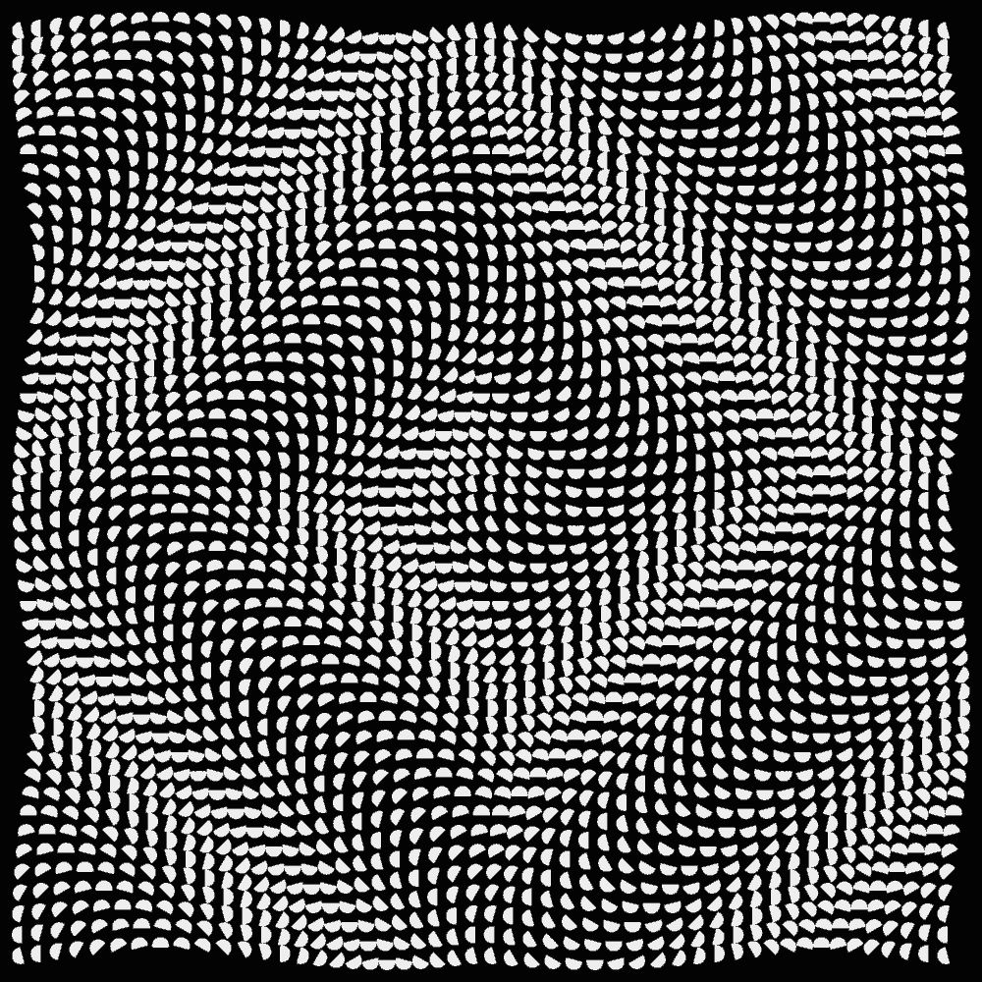
👁
STOP
&&
STEP THROUGH
THE ASSEMBLY
&&
CHECK YOUR UNDERSTANDING

