Slide 1
Architecture 1001:
x86-64 Assembly
ShiftExample3Signed.c
Xeno Kovah – 2021
xeno@darkmentor.com

Slide 2

All materials is licensed under a Creative Commons “Share Alike” license.
http://creativecommons.org/licenses/by-sa/4.0/
Attribution condition: You must indicate that derivative work
"Is derived from Xeno Kovah's 'Architecture 1001: x86-64 Assembly’ class, available at https://ost.fyi"
Notes:
Attribution condition: You must indicate that derivative work
"Is derived from Xeno Kovah's 'Architecture 1001: x86-64 Assembly’ class, available at https://ost.fyi"

Slide 3
That’s the power of love sign!
#include <stdlib.h>
int main(int argc, char **argv)
{
unsigned int a, b, c;
a = atoi(argv[0]);
b = a * 8;
c = b / 16;
return c;
}
#include <stdlib.h>
int main(int argc, char **argv)
{
int a, b, c;
a = atoi(argv[0]);
b = a * 8;
c = b / 16;
return c;
}
"The power of sign, is a curious thing!
Make one man weep, make another man sing!"
It's about integer overflow vulnerabilities! :D
Notes:
http://4.bp.blogspot.com/-FAaWCtna3mw/Tc69R-mPbFI/AAAAAAAABxA/Nriylz_dc20/s1600/hlhlfr.jpeg

Slide 4
ShiftExample3Signed.c
Note: Compiled with /O2 “Maximize Speed”, to clear away a bit of cruft
#include <stdlib.h>
int main(int argc, char **argv)
{
int a, b, c;
a = atoi(argv[1]);
b = a * 8;
c = b / 16;
return c;
}
main:
0000000140001000 sub rsp,28h
0000000140001004 mov rcx,qword ptr [rdx]
0000000140001007 call qword ptr [0000000140004178h]
000000014000100D shl eax,3
0000000140001010 cdq
0000000140001011 and edx,0Fh
0000000140001014 add eax,edx
0000000140001016 sar eax,4
0000000140001019 add rsp,28h
000000014000101D ret

Slide 5
main:
0000000140001010 sub rsp,28h
0000000140001014 mov rcx,qword ptr [rdx]
0000000140001017 call qword ptr [40008368h]
000000014000101D shl eax,3
0000000140001020 shr eax,4
0000000140001023 add rsp,28h
0000000140001027 ret
Vs
main:
0000000140001010 sub rsp,28h
0000000140001014 mov rcx,qword ptr [rdx]
0000000140001017 call qword ptr [40008368h]
000000014000101D shl eax,3
0000000140001020 cdq
0000000140001021 and edx,0Fh
0000000140001024 add eax,edx
0000000140001026 sar eax,4
0000000140001029 add rsp,28h
000000014000102D ret
Changed
CDQ is added as an VS-ism. It’s necessary for the math to work out, but I feel like I’ve only run into it once ever in the wild. So I don’t consider it that important for beginners to know and I’m skipping it. But you can feel free to come back and read this code once we’ve gone through the RTFM section.

Slide 6
25
SAR - Shift Arithmetic Right
Can be explicitly used with the C “>>” operator, if operands are signed
First operand (source and destination) is an r/mX
Second operand is either cl (lowest byte of ecx), or a 1 byte immediate. The 2nd operand is the number of places to shift
It divides the register by 2 for each place the value is shifted. More efficient than a divide instruction
Each bit shifted off the right side is placed in CF
sar bl, 2
shr bl, 2
 | 10110011b (bl - 0xB3)
result | 11101100b (bl - 0xEC)
 | 10110011b (bl - 0xB3)
result | 00101100b (bl - 0x2C)
!=
mov cl, 2; sar bl, cl
mov cl, 2; shr bl, cl
 | 00110011b (bl - 0x33)
result | 00001100b (bl - 0x0C)
 | 00110011b (bl - 0x33)
result | 00001100b (bl - 0x0C)
==

Slide 7
26
SAL - Shift Arithmetic Left
Actually behaves exactly the same as SHL!
First operand (source and destination) is an r/mX
Second operand is either cl (lowest byte of rcx), or a 1 byte immediate. The 2nd operand is the number of places to shift
It multiplies the register by 2 for each place the value is shifted. More efficient than a multiply instruction
Each bit shifted off the left side is placed in CF
sal bl, 2
shl bl, 2
 | 10110011b (bl - 0xB3)
result | 11001100b (bl - 0xCC)
 | 10110011b (bl - 0xB3)
result | 11001100b (bl - 0xCC)
==
mov cl, 2; sal bl, cl
mov cl, 2; shl bl, cl
 | 00110011b (bl - 0x33)
result | 11001100b (bl - 0xCC)
 | 00110011b (bl - 0x33)
result | 11001100b (bl - 0xCC)
==

Slide 8
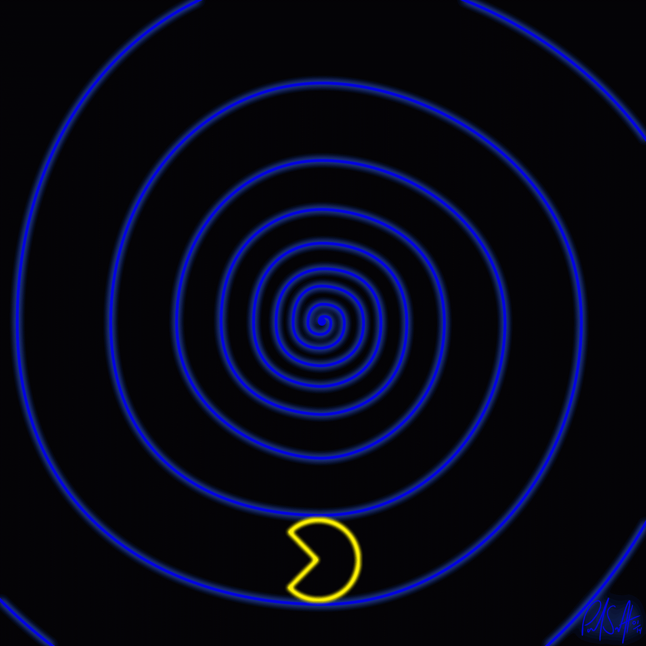
👁
STOP
&&
STEP THROUGH
THE ASSEMBLY
&&
CHECK YOUR UNDERSTANDING

Slide 9
ShiftExample3Signed.c Takeaways
Compilers still prefer shifts for mul/div over powers of 2
But when the operands are signed rather than unsigned, it must use different instructions, and potentially do more work to deal with a signed multiply
CDQ isn’t super important for beginners to know, left as an exercise for the reader to RTFM for later ;)
#include <stdlib.h>
int main(int argc, char **argv)
{
int a, b, c;
a = atoi(argv[1]);
b = a * 8;
c = b / 16;
return c;
}
main:
0000000140001010 sub rsp,28h
0000000140001014 mov rcx,qword ptr [rdx]
0000000140001017 call qword ptr [40008368h]
000000014000101D shl eax,3
0000000140001020 cdq
0000000140001021 and edx,0Fh
0000000140001024 add eax,edx
0000000140001026 sar eax,4
0000000140001029 add rsp,28h
000000014000102D ret

Slide 10
Instructions we now know (26)
NOP
PUSH/POP
CALL/RET
MOV
ADD/SUB
IMUL
MOVZX/MOVSX
LEA
JMP/Jcc (family)
CMP/TEST
AND/OR/XOR/NOT
INC/DEC
SHR/SHL/SAR/SAL

Slide 11

20
10
14
5
21
7
16
17
8
13
6
18
imul
9
14
movsx
11
not
19
shl
23
shr
14
24
2
sal
25
sar
26
15
3
4
12
1
22

