Slide 1
Architecture 1001:
x86-64 Assembly
MulDivExample.c
Xeno Kovah – 2021
xeno@darkmentor.com

Slide 2

All materials is licensed under a Creative Commons “Share Alike” license.
http://creativecommons.org/licenses/by-sa/4.0/
Attribution condition: You must indicate that derivative work
"Is derived from Xeno Kovah's 'Architecture 1001: x86-64 Assembly’ class, available at https://ost.fyi"
Notes:
Attribution condition: You must indicate that derivative work
"Is derived from Xeno Kovah's 'Architecture 1001: x86-64 Assembly’ class, available at https://ost.fyi"

Slide 3
MulDivExample.c
#define uint64 unsigned long long
uint64 main(){
uint64 a = 0xdefec7ed;
a *= 0xde7ec7ab1e;
a /= 0x2bad505ad;
return a;
}
main:
0000000140001000 sub rsp,18h
0000000140001004 mov eax,0DEFEC7EDh
0000000140001009 mov qword ptr [rsp],rax
000000014000100D mov rax,0DE7EC7AB1Eh
0000000140001017 mov rcx,qword ptr [rsp]
000000014000101B imul rcx,rax
000000014000101F mov rax,rcx
0000000140001022 mov qword ptr [rsp],rax
0000000140001026 xor edx,edx
0000000140001028 mov rax,qword ptr [rsp]
000000014000102C mov rcx,2BAD505ADh
0000000140001036 div rax,rcx
0000000140001039 mov qword ptr [rsp],rax
000000014000103D mov rax,qword ptr [rsp]
0000000140001041 add rsp,18h
0000000140001045 ret
Notes:
We already saw that when a C operand is a power of 2, it uses shifts instead of multiplies/divides, but this shows that in other cases, it uses multiply or divide instructions.

Slide 4
27
DIV - Unsigned Divide
Three forms
  Unsigned divide ax by r/m8, al = quotient, ah = remainder
  Unsigned divide edx:eax by r/m32, eax = quotient, edx = remainder
  Unsigned divide rdx:rax by r/m64, rax = quotient, rdx = remainder
If dividend is 32/64bits, edx/rdx will just be set to 0 by the compiler before the instruction (as occurred in the MulDivExample.c code)
If the divisor is 0, a divide by zero exception is raised.
ax | r/m8(cl)
0x8 | 0x3
rdx | rax | r/mX(rcx)
0x0 | 0x8 | 0x5
initial
operation
div ax, cl
div rax, rcx
ah | al
0x2 | 0x2
rdx | rax | r/mX(rcx)
0x3 | 0x1 | 0x5
result
Book page 69
Notes:
Note that there’s no form which takes an immediate.

Slide 5
28
IDIV - Signed Divide
If you were to then change MulDivExample to signed, you would see the IDIV instruction appear
Three forms
  Signed divide ax by r/m8, al = quotient, ah = remainder
  Signed divide edx:eax by r/mX, eax = quotient, edx = remainder
  Signed divide rdx:rax by r/m64, rax = quotient, rdx = remainder
If dividend is 32/64bits, edx/rdx will just be set to 0 by the compiler before the instruction
If the divisor is 0, a divide by zero exception is raised.
ax | r/m8(cl)
0xFE | 0x2
rdx | rax | r/mX(rcx)
0x0 | 0x57e11a | 0xb01d
initial
operation
div ax, cl
div rax, rcx
ah | al
0x0 | 0xFF
rdx | rax | r/mX(rcx)
0x82B7 | 0x7F | 0x3
result
Book page 69
Notes:
Note that there’s no form which takes an immediate.

Slide 6
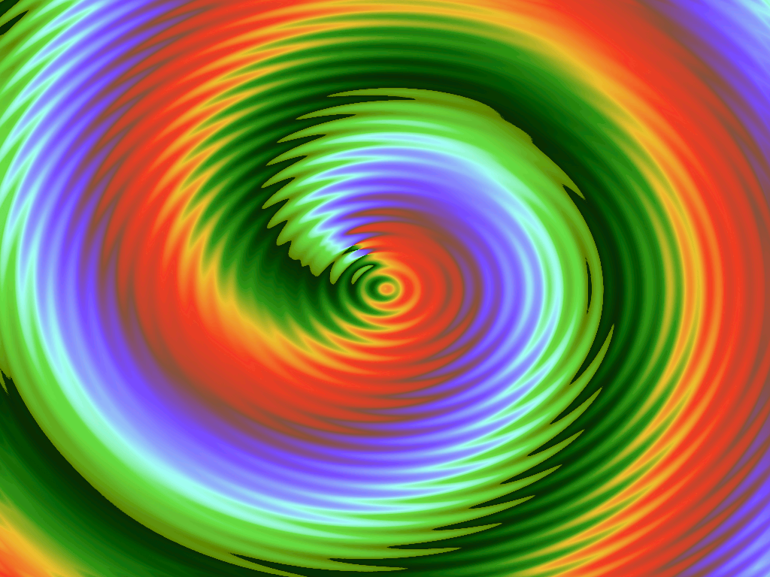
👁
STOP
&&
STEP THROUGH
THE ASSEMBLY
&&
CHECK YOUR UNDERSTANDING

Slide 7
MulDivExample.c Takeaways
When a multiply or divide is not by a power of 2, compilers will use normal multiply/divide instructions
VS compiler prefers IMUL over MUL (unsigned multiply)
#define uint64 unsigned long long
uint64 main(){
uint64 a = 0xdefec7ed;
a *= 0xde7ec7ab1e;
a /= 0x2bad505ad;
return a;
}
main:
0000000140001000 sub rsp,18h
0000000140001004 mov eax,0DEFEC7EDh
0000000140001009 mov qword ptr [rsp],rax
000000014000100D mov rax,0DE7EC7AB1Eh
0000000140001017 mov rcx,qword ptr [rsp]
000000014000101B imul rcx,rax
000000014000101F mov rax,rcx
0000000140001022 mov qword ptr [rsp],rax
0000000140001026 xor edx,edx
0000000140001028 mov rax,qword ptr [rsp]
000000014000102C mov rcx,2BAD505ADh
0000000140001036 div rax,rcx
0000000140001039 mov qword ptr [rsp],rax
000000014000103D mov rax,qword ptr [rsp]
0000000140001041 add rsp,18h
0000000140001045 ret
Notes:
We already saw that when a C operand is a power of 2, it uses shifts instead of multiplies/divides, but this shows that in other cases, it uses multiply or divide instructions.

Slide 8
Instructions we now know (28)
NOP
PUSH/POP
CALL/RET
MOV
ADD/SUB
IMUL
MOVZX/MOVSX
LEA
JMP/Jcc (family)
CMP/TEST
AND/OR/XOR/NOT
INC/DEC
SHR/SHL/SAR/SAL
DIV/IDIV

Slide 9

20
10
14
5
21
7
16
17
8
13
6
18
imul
9
14
movsx
11
not
19
shl
23
shr
14
24
2
sal
25
sar
26
15
div
27
3
idiv
4
28
12
1
22

