Slide 1
Architecture 1001:
x86-64 Assembly
ThereWillBe0xb100d.c
Xeno Kovah – 2021
xeno@darkmentor.com

Slide 2

All materials is licensed under a Creative Commons “Share Alike” license.
http://creativecommons.org/licenses/by-sa/4.0/
Attribution condition: You must indicate that derivative work
"Is derived from Xeno Kovah's 'Architecture 1001: x86-64 Assembly’ class, available at https://ost.fyi"
Notes:
Attribution condition: You must indicate that derivative work
"Is derived from Xeno Kovah's 'Architecture 1001: x86-64 Assembly’ class, available at https://ost.fyi"

Slide 3

OST PRESENTS
CC
CC
CC
CC
CC
CC
CC
CC
CC
CC
CC
CC
CC
CC
CC
CC
CC
CC
CC
CC
CC
CC

Slide 4
ThereWillBe0xb100d.c
int main(){
char buf[40];
buf[39] = 42;
return 0xb100d;
}

Slide 5
ThereWillBe0xb100d.c
main:
0000000140001010 push rdi
0000000140001012 sub rsp,60h
0000000140001016 mov rdi,rsp
0000000140001019 mov ecx,18h
000000014000101E mov eax,0CCCCCCCCh
0000000140001023 rep stos dword ptr [rdi]
0000000140001025 mov eax,1
000000014000102A imul rax,rax,27h
000000014000102E mov byte ptr [rsp+rax+28h],2Ah
0000000140001033 mov eax,0xb100d
0000000140001038 mov edi,eax
000000014000103A mov rcx,rsp
000000014000103D lea rdx,[__xi_z+1A0h (0140006910h)]
0000000140001044 call _RTC_CheckStackVars (01400010B0h)
0000000140001049 mov eax,edi
000000014000104B add rsp,60h
000000014000104F pop rdi
0000000140001050 ret

Slide 6
rep stos setup
0000000140001016 mov rdi,rsp
Set rdi - the destination
0000000140001019 mov ecx,18h
Set ecx - the count
000000014000101E mov eax,0CCCCCCCCh
Set eax - the value
0000000140001023 rep stos dword ptr [rdi]
Start the repeated store
So what’s this going to do? Store 0x18 copies of the dword 0xCCCCCCCC starting at rsp
And that just happens to be 0x60 bytes of 0xCC, the entire "sub rsp, 0x60"-reserved stack space!

Slide 7

👁
STOP
&&
STEP THROUGH
THE ASSEMBLY
&&
DRAW A STACK DIAGRAM

Slide 8
ThereWillBe0xb100d.c
int main(){
char buf[40];
buf[41] = 42;
return 0xb100d;
}
Try writing outside the
bounds of the buffer

Slide 9
👁
PAUSE
&&
RUN THE CODE
&&
SEE WHAT HAPPENS

Slide 10
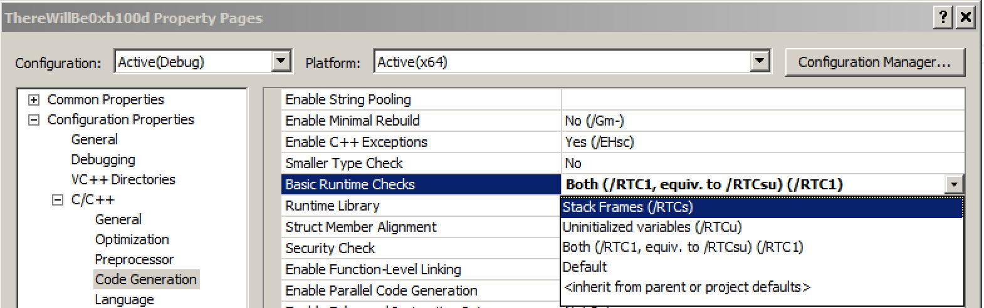
Q: Where does the rep stos come from in this example?
A: Compiler-auto-generated code. From the stack frames runtime check option. This is enabled by default in the debug build. Disabling this option removes the compiler-generated code.

Slide 11
More straightforward without the runtime check
main:
0000000140001010 sub rsp,38h
0000000140001014 mov eax,1
0000000140001019 imul rax,rax,27h
000000014000101D mov byte ptr [rsp+rax],2Ah
0000000140001021 mov eax,0B100Dh
0000000140001026 add rsp,38h
000000014000102A ret
Notes:
But still not entirely clear :)

