Slide 1
Architecture 1001:
x86-64 Assembly
JourneyToTheCenterOfMemcpy.c
Xeno Kovah – 2021
xeno@darkmentor.com

Slide 2

All materials is licensed under a Creative Commons “Share Alike” license.
http://creativecommons.org/licenses/by-sa/4.0/
Attribution condition: You must indicate that derivative work
"Is derived from Xeno Kovah's 'Architecture 1001: x86-64 Assembly’ class, available at https://ost.fyi"
Notes:
Attribution condition: You must indicate that derivative work
"Is derived from Xeno Kovah's 'Architecture 1001: x86-64 Assembly’ class, available at https://ost.fyi"

Slide 3
OST PRESENTS
MEMCPY()

Slide 4
JourneyToTheCenterOfMemcpy.c
#include <stdio.h>
#pragma pack(1)
typedef struct mystruct{
int var1;
char var2[4];
} mystruct_t;
#pragma
#define uint64 unsigned long long
uint64 main(){
mystruct_t a, b;
a.var1 = 0xFF;
memcpy(&b, &a, sizeof(mystruct_t));
return 0xAce0fBa5e;
}
sub rsp,48h
mov dword ptr [a],0FFh
mov r8d,8
lea rdx,[a]
lea rcx,[b]
call memcpy (0140002E62h)
mov rax,0ACE0FBA5Eh
add rsp,48h
ret
STEP INTO!
STEP INTO THE UNKNOWN!

Slide 5

Find REP MOVS!
memcpy

Slide 6
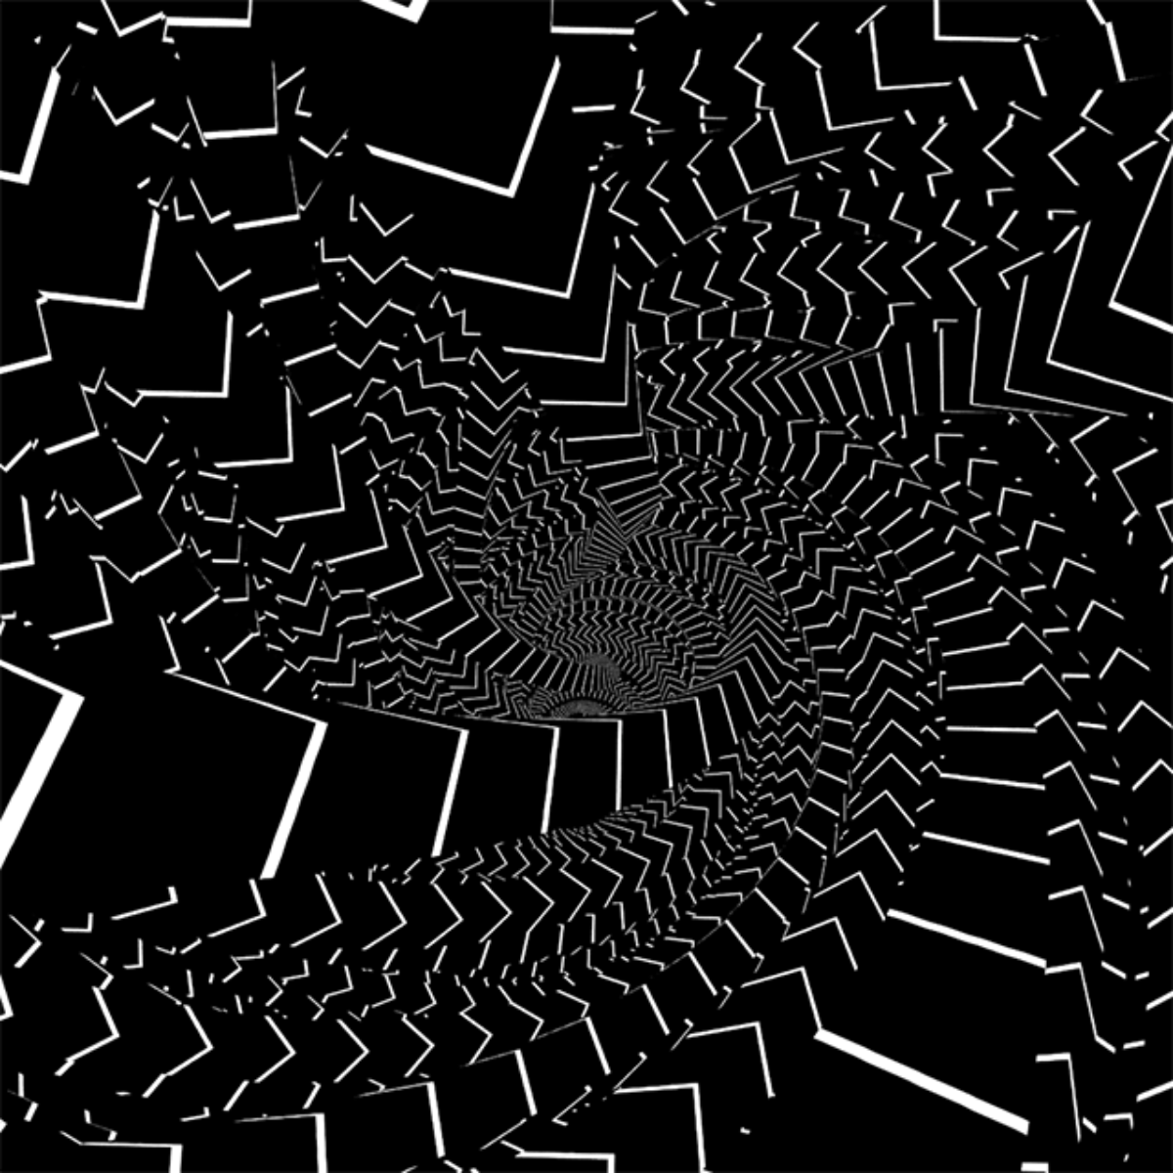
👁
STOP
&&
STEP THROUGH
THE MEMCPY ASSEMBLY
&&
FIND REP MOVS
&&
WRITE DOWN PSEUDOCODE
FOR THE PATH THAT LEADS TO IT

Slide 7
We'll Do It Live!

Slide 8
REP MOVS
Repeat Move Data String to String
30
MOVS is one of number of instructions that can have the “rep” prefix added to it, which repeat a single instruction multiple times.
  MOVS is actually its own instruction which can be called without the REP instruction prefix
All rep operations use *cx register as a “counter” to determine how many times to loop through the instruction. Each time it executes, it decrements *cx. Once *cx == 0, it continues to the next instruction
Book page 101-102

Slide 9
REP MOVS 2
Repeat Move Data String to String
30
REP MOVS stores 1, 2, 4, or 8 bytes at a time
Either fill 1 byte from [si] to [di] with or fill 1/2/4/8 bytes at a time from [*si] to [*di]
Moves the *di and *si registers forward 1/2/4/8 at a time, so that the repeated store operation is storing into consecutive locations.
So there are 3 pieces which must happen before the actual rep movs occurs:
  Set *si to the start source
  Set *di to the start destination
  Set *cx to the number of times to store
Book page 101-102

Slide 10
REP MOVS 3
Repeat Move Data String to String
30
Note: Unlike MOV, MOVS can move memory to memory…but only between [*si] and [*di]
A lot of people don’t pay attention to the fact that it’s REP MOVS, not REP MOV (even though you may say it like “rep-move”)
Book page 101-102

Slide 11
VS vs. GCC et al.
Caller vs. Callee-save Regs
VS Caller-saved | RAX |  | RCX | RDX |  |  |  | R8-11
VS Callee-saved |  | RBX |  |  | RSI | RDI | RBP |  | R12-15
System V (GCC et al.) Caller-saved | RAX |  | RCX | RDX | RSI | RDI |  | R8-11
System V (GCC et al.) Callee-saved |  | RBX |  |  |  |  | RBP |  | R12-15

Slide 12
High level pseudo-code approximation
(how interesting…it’s like I went in reverse of the normal software engineering process…)
memcpy(void * dst, void * src, unsigned int len){
if(len <= 0x10)
goto 00007FFB76491350 // 2x MOV
if(len <= 0x20)
goto 00007FFB76491330 // AHHHH! MOVUPS! IDEKWTFBBQ!
else {
if(src >= dst)
goto 00007FFB76491314
else { // if (src < len)
if(dst < (src+dst)) // if (src < dst < (src + len)
goto 00007FFB764915F0
}
if (len < 0x80){
goto 00007FFB76491530 // AHHHH! MOVUPS! IDEKWTFBBQ!
}
else{
if( ((*(char *)(7FFB764B43BCh)) & 0x2) == 0) // ?!
goto 00007FFB76491480 // not taken ¯\_(ツ)_/¯
else
goto 00007FFB764912D0 // HERE BE REP MOVS!
}
}

Slide 13
High level pseudo-code approximation
(how interesting…it’s like I went in reverse of the normal software engineering process…)
memcpy(void * dst, void * src, unsigned int len){
if(len <= 0x10)
goto 00007FFB76491350 // 2x MOV
if(len <= 0x20)
goto 00007FFB76491330 // AHHHH! MOVUPS! IDEKWTFBBQ!
if (src < dst)
if(dst < (src+len)) // Uh oh, overlap!
goto 00007FFB764915F0 // not taken
}
if (len < 0x80){
goto 00007FFB76491530 // AHHHH! MOVUPS! IDEKWTFBBQ!
}
else{
if( ((*(char *)(7FFB764B43BCh)) & 0x2) == 0) // ?!
goto 00007FFB76491480 // not taken ¯\_(ツ)_/¯
else
goto 00007FFB764912D0 // HERE BE REP MOVS!
}
...
}

Slide 14
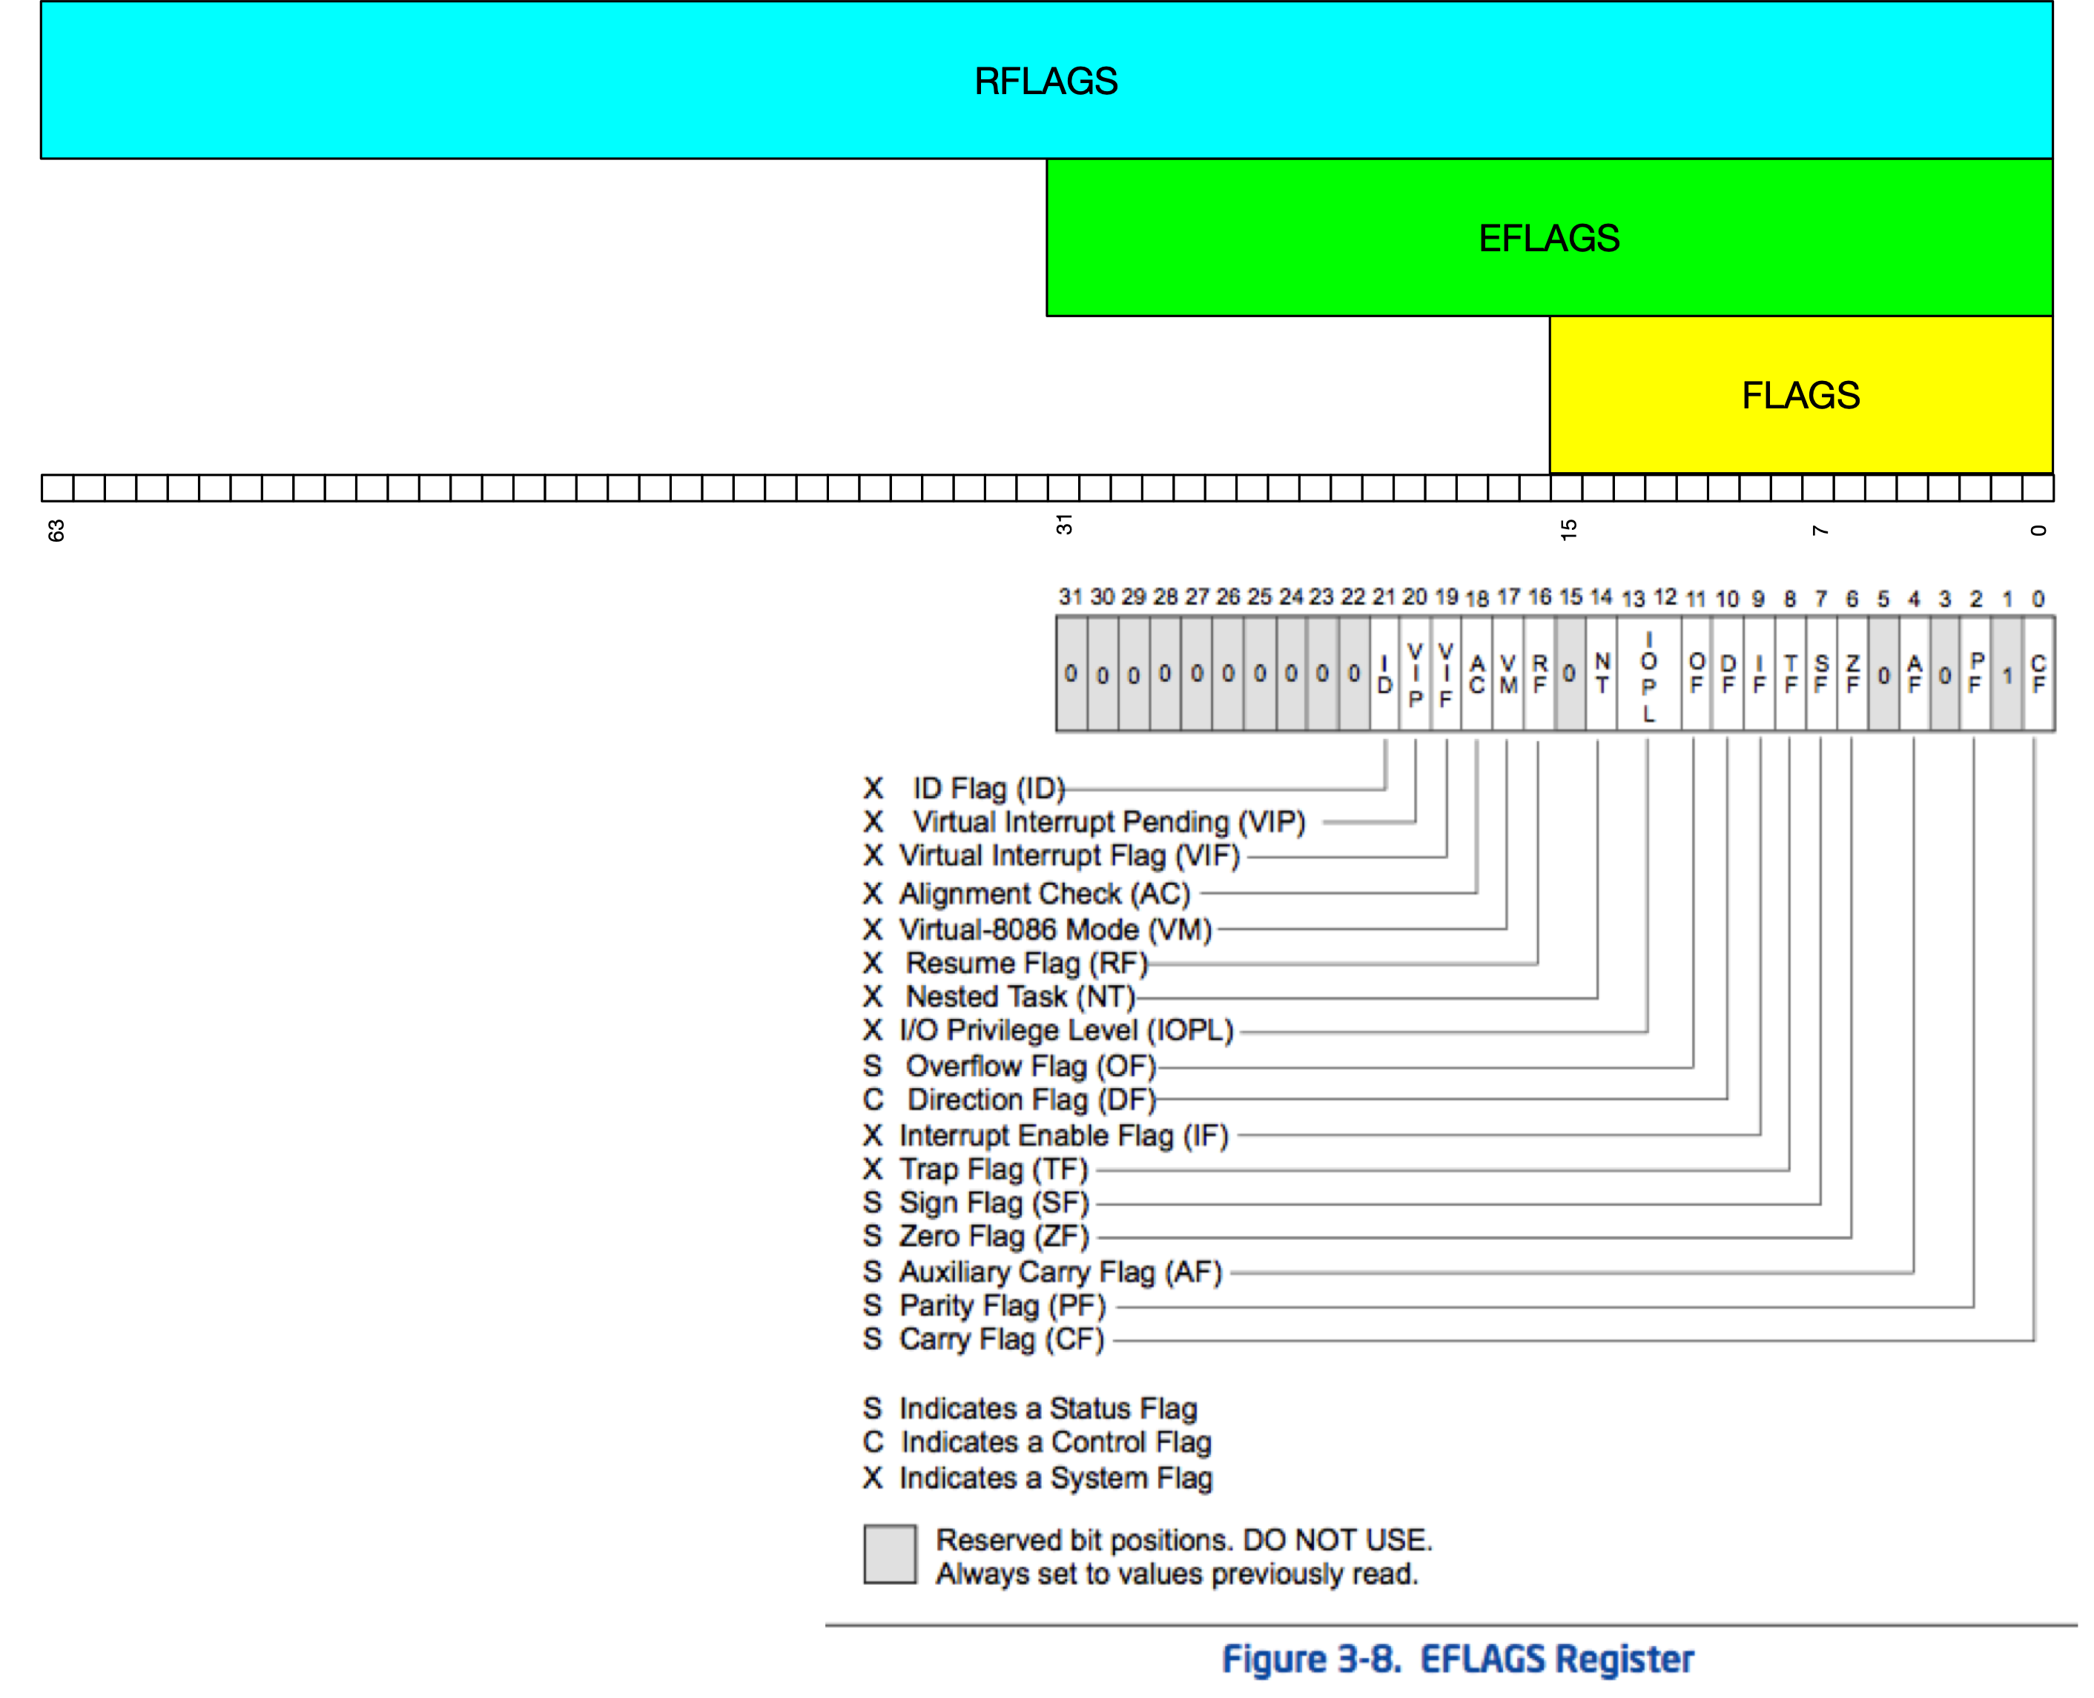
This Class
O
F
D
F
S
F
Z
F
A
F
P
F
C
F

Slide 15
Instructions we now know (30)
NOP
PUSH/POP
CALL/RET
MOV
ADD/SUB
IMUL
MOVZX/MOVSX
LEA
JMP/Jcc (family)
CMP/TEST
AND/OR/XOR/NOT
INC/DEC
SHR/SHL/SAR/SAL
DIV/IDIV
REP STOS
REP MOVS

Slide 16

20
10
14
5
21
7
16
17
8
13
6
18
imul
9
14
movsx
11
not
19
shl
23
shr
14
24
2
sal
25
sar
26
15
div
27
3
idiv
4
28
rep stos
12
29
1
22
rep movs
30

