Slide 1
Architecture 1001:
x86-64 Assembly
READ THE FUN MANUAL!
Xeno Kovah – 2021
xeno@darkmentor.com

Slide 2

All materials is licensed under a Creative Commons “Share Alike” license.
http://creativecommons.org/licenses/by-sa/4.0/
Attribution condition: You must indicate that derivative work
"Is derived from Xeno Kovah's 'Architecture 1001: x86-64 Assembly’ class, available at https://ost.fyi"
Notes:
Attribution condition: You must indicate that derivative work
"Is derived from Xeno Kovah's 'Architecture 1001: x86-64 Assembly’ class, available at https://ost.fyi"

Slide 3


Slide 4
Guess what?
I have repeatedly misled you!
Simplification is misleading
Time to learn the fascinating truth…
Time to RTFM!

Slide 5
Read The Fun Manuals
http://www.intel.com/products/processor/manuals/
Vol.1 is a summary of life, the universe, and everything about x86
Vol. 2a-d explains all the instructions
Vol. 3a-d are all the gory details for all the extra stuff they’ve added in over the years (MultiMedia eXtentions - MMX, Virtual Machine eXtentions - VMX, virtual memory, 16/64 bit modes, system management mode, etc)
Reminder to use the pre-downloaded Nov 2020 version of the manual which we've been using as the standardized reference throughout this class, so we’re all looking at the same information
We’re primarily looking at Vol. 2 in this class
Notes:
Googling is fine to start with, but eventually you need to learn to read the manuals to get the details from the authoritative source

Slide 6
Interpreting the Instruction Reference Pages
The correct way to interpret these pages is given in the Intel Manual 2a, Sections 2.1 & 2.2
I will give yet another simplification for now, and have a deeper dive be optional material
Moral of the story is that you have to RTFM to RTFM ;)

Slide 7
AND - Bitwise AND
C binary operator "&" (not &&, that's logical AND)
Destination operand can be r/mX or register
Source operand can be r/mX or register or immediate (No source and destination as r/mXs)
What
I Said:
and al, bl
and al, 0x42
 | 00110011b (al - 0x33)
AND | 01010101b (bl - 0x55)
result | 00010001b (al - 0x11)
 | 00110011b (al - 0x33)
AND | 01000010b (imm - 0x42)
result | 00000010b (al - 0x02)
Book page 75

Slide 8
What
The
Manual
Says
:O

Slide 9
Opcode Column
Represents the literal byte value(s) which correspond to the given instruction
In this case, if you were to see a 0x24 followed by a byte, or 0x25 followed by 4 bytes, you would know they were specific forms of the AND instruction
For more detail, see Intel Vol. 2a section 3.1.1.1
“Opcode Column in the Instruction Summary Table (Instructions without VEX Prefix)”

Slide 10
If it was 0x25, how would you know whether it should be followed by 2 bytes (imm16) or 4 bytes (imm32)?
The length of the operand depends on if the processor is in 16-bit, 32-bit, or 64-bit mode
Each mode has a default operand size (i.e. the size of the value)
Notes:
There are many instructions which are “overloaded” with equivalent 16 bit and 32 bit versions shown in the manual.

Slide 11
For 64-bit mode, the default operand size is 32-bits for most instructions and the default address size is 64-bits
This means the default interpretation will usually be the ones with the r/m32, r32, imm32, or in this case a specific register like EAX, unless explicitly overridden with special instruction prefixes
These are talked about later in optional material
Notes:
There are many instructions which are “overloaded” with equivalent 16 bit and 32 bit versions shown in the manual.

Slide 12
Instruction Column
The human-readable mnemonic which is used to represent the instruction.
This will frequently contain special encodings such as the “r/mX format” which I’ve previously discussed
For more detail, see Intel Vol. 2a section 3.1.1.3
“Instruction Column in the Opcode Summary Table”

Slide 13
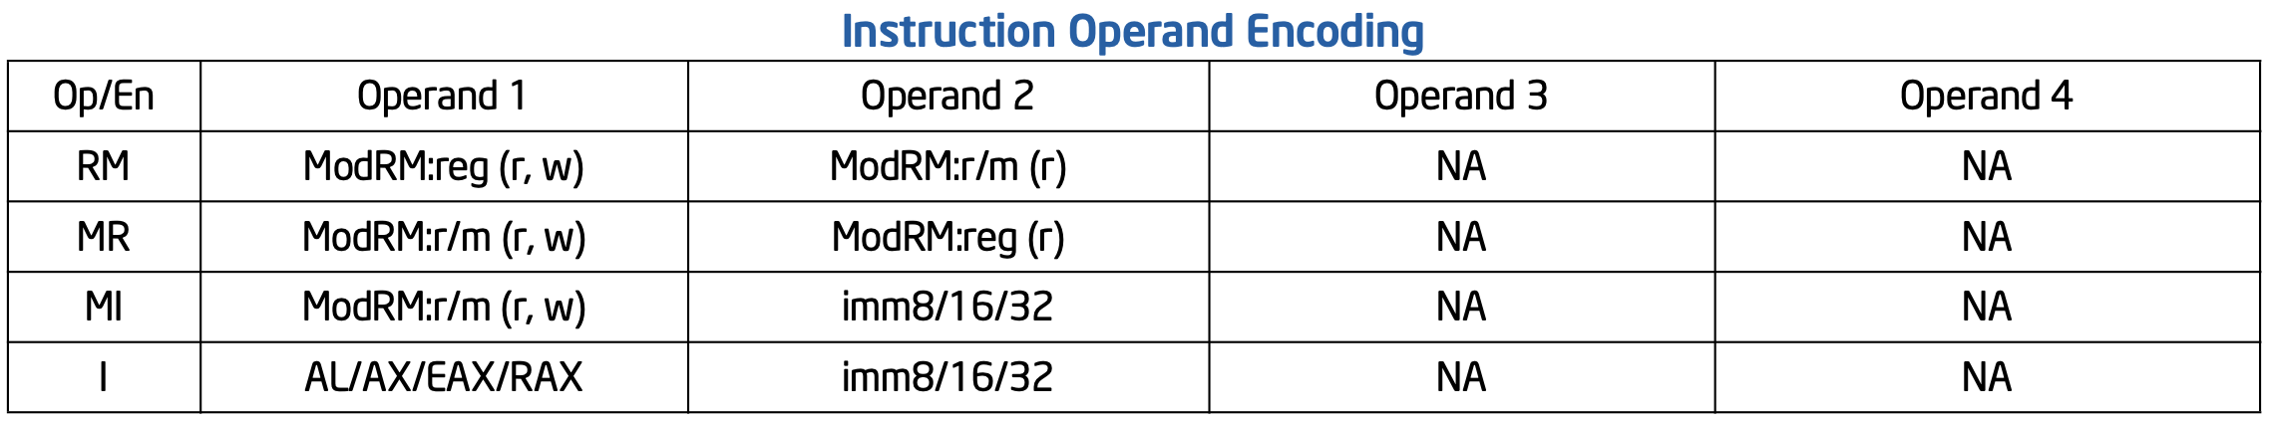
"Operand Encoding" Column
Indicates what forms the operands can take
For more detail, see Intel Vol. 2a section 3.1.1.4
“Operand Encoding Column in the Instruction Summary Table”

Slide 14
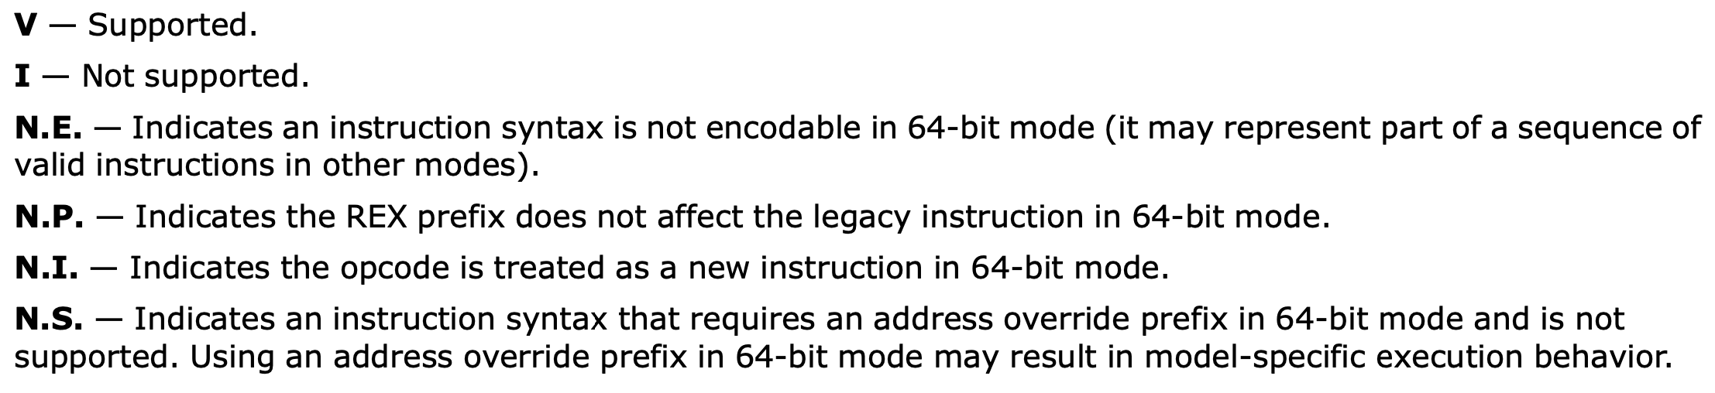
64bit Column
Whether or not the opcode is valid in 64 bit mode
Should say "Valid" and "Invalid"
For more detail, see Intel Vol. 2a section 3.1.1.5
“64/32-bit Mode Column in the Instruction Summary Table”

Slide 15
Compatibility/Legacy Mode Column
Whether or not the opcode is valid in 32/16 bit code
Should say "Valid" and "Invalid"
For more detail, see Intel Vol. 2a section 3.1.1.5
“64/32-bit Mode Column in the Instruction Summary Table”

Slide 16
Description Column
Simple description of the action performed by the instruction
Typically this just conveys the flavor of the instruction, but the majority of the details are in the main description text
See Intel Vol. 2a section 3.1.1.7
“Description Column in the Instruction Summary Table”

Slide 18
Further AND variations
Looking at some other forms, we now see those “r/mX” things I told you about
The main thing you need to know is that any time you see a r/mX, it can be either a register or memory value.
Looking at the opcode column, we can infer that /r is probably a register placeholder, but what is the REX or REX.W?
As mentioned before, the in-depth understanding of the opcode column is in optional material

Slide 19
Which Description Is Buggy?

Slide 20
Which Description Is Buggy?
Bugs!🐞🐜🐛
The point of the "REX variants, is to allow 64 bit code to access 64-bit only byte registers like SPL, BPL, SIL, DIL, and R8L-R15L
Notes:
Switch to ODA to show example encoding. E.g. "20 C0" and then "40 20 C0" to show they're the same. And then "40 20 C4" through C5 followed by "41 20 C0" through CF (for r8l-

Slide 21
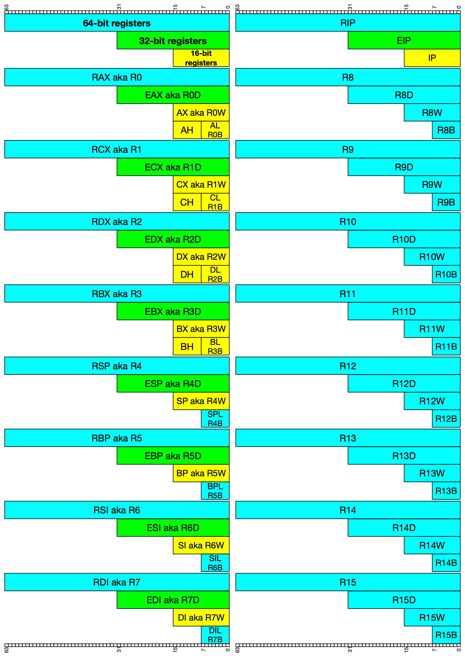

Slide 22
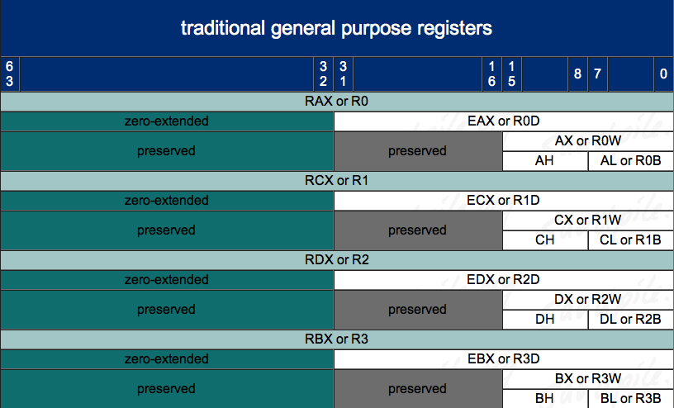
Architecture - Registers – 8/16/32/64 bit addressing 1
http://www.sandpile.org/x86/gpr.htm

Slide 23
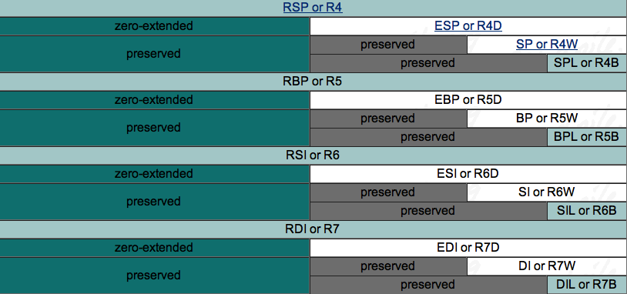
Architecture - Registers – 8/16/32/64 bit addressing 2
(note: we didn’t previously have low-byte access to *SP, *BP, *SI, or *DI!)
http://www.sandpile.org/x86/gpr.htm

Slide 24
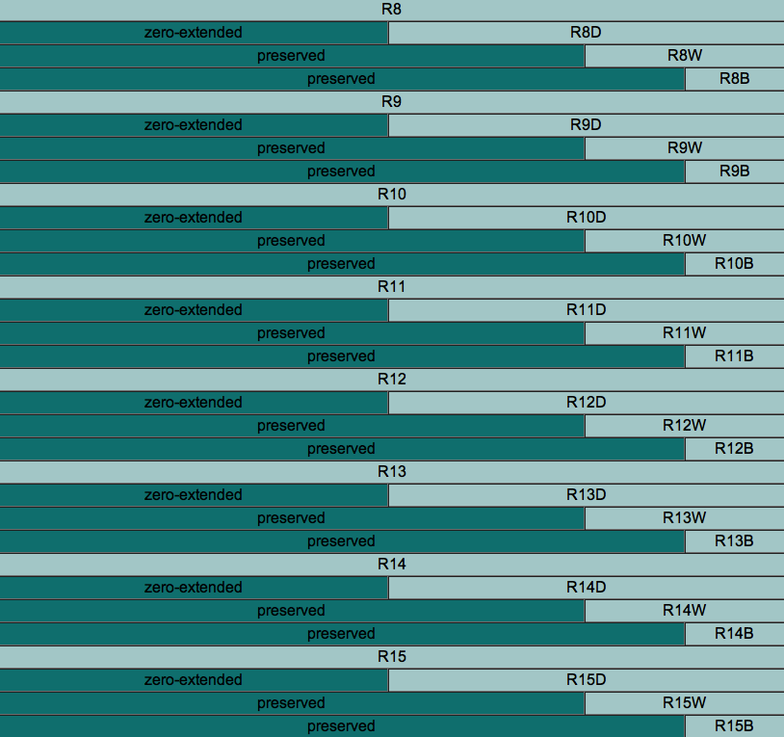
Architecture - Registers – 8/16/32/64 bit addressing 3
http://www.sandpile.org/x86/gpr.htm
Notes:
note to scornwell: maybe a simple game here like:
“DIL is the 8 least-significant-bit access for which 64 bit register?” (RDI)
“What is the word-sized access register for R14 called?” (R14W)
“What is the 16 bit access for R14 called?” (R14W)

Slide 25
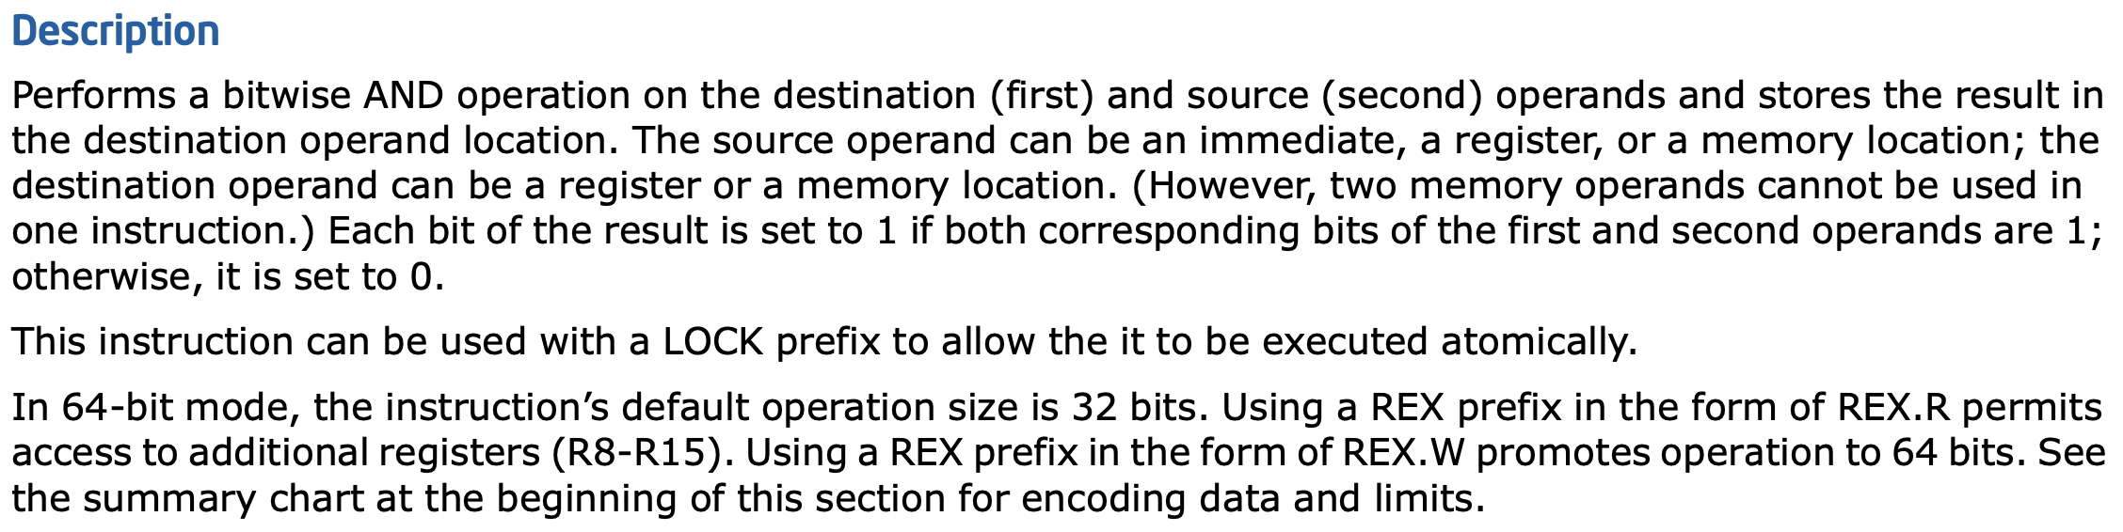
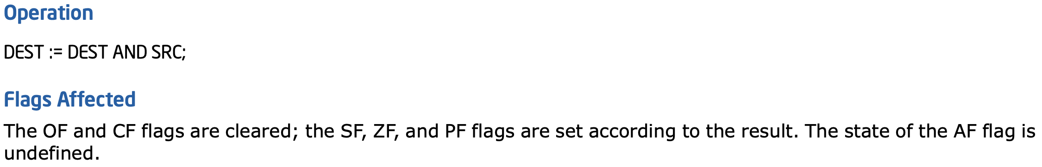
AND Details

Slide 26

MOAR EXAMPLES!
MORE!

Slide 27
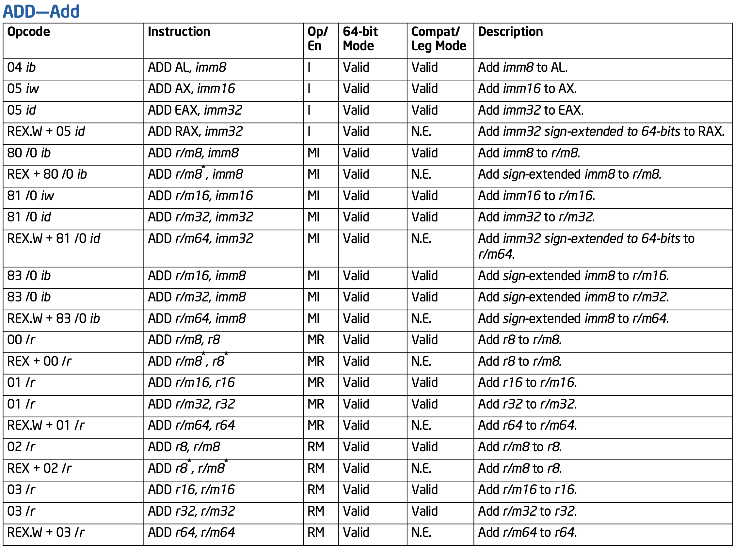

Slide 28
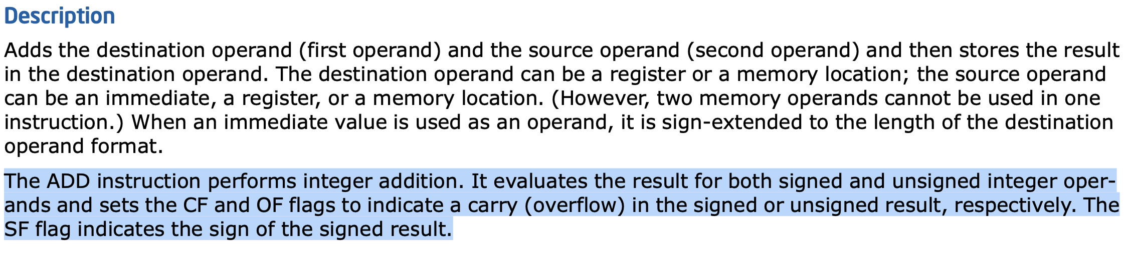
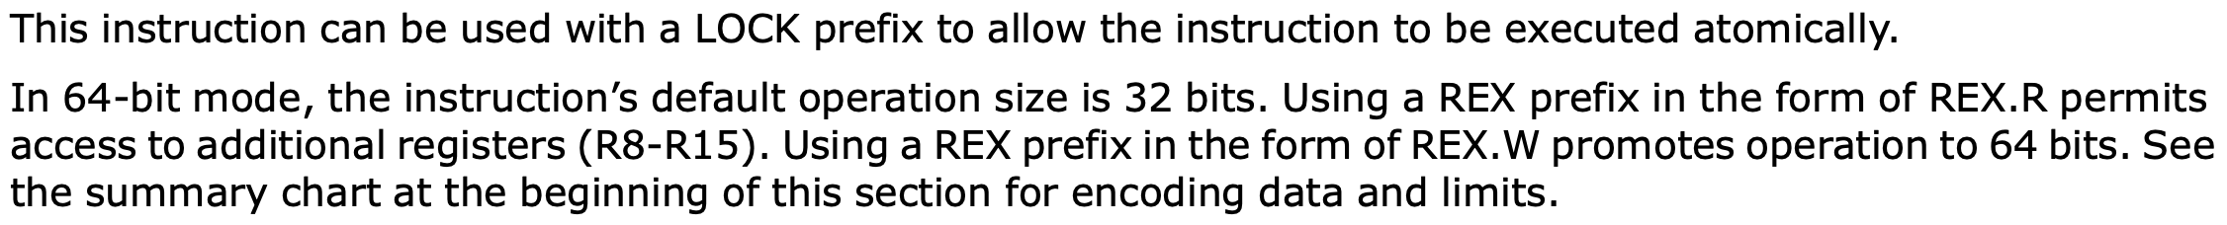
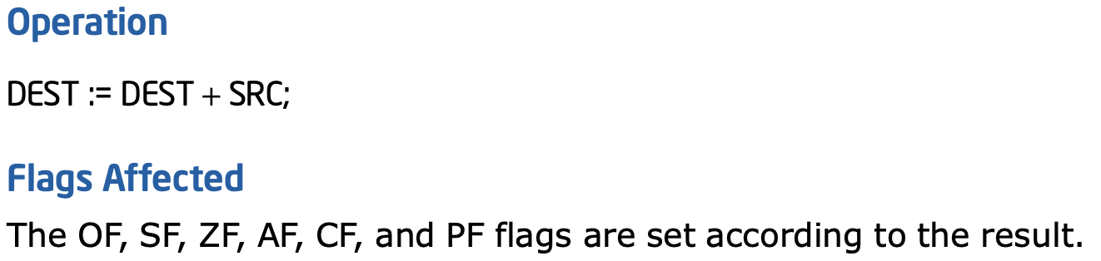
ADD Details

Slide 29
Less Obvious
It turns out that for instructions that set status flags (e.g. arithmetic operations), the hardware just does the operation and sets flags as if the operands were both unsigned and signed
Basically the hardware doesn’t know or care about whether the humans are currently interpreting the bits as signed or unsigned. That’s the compiler’s problem to sort out.
The compiler must emit instructions which treat the bits as signed or unsigned based on what’s specified in the high level language

Slide 30
MOAR EXAMPLES!
MORE!

Slide 31
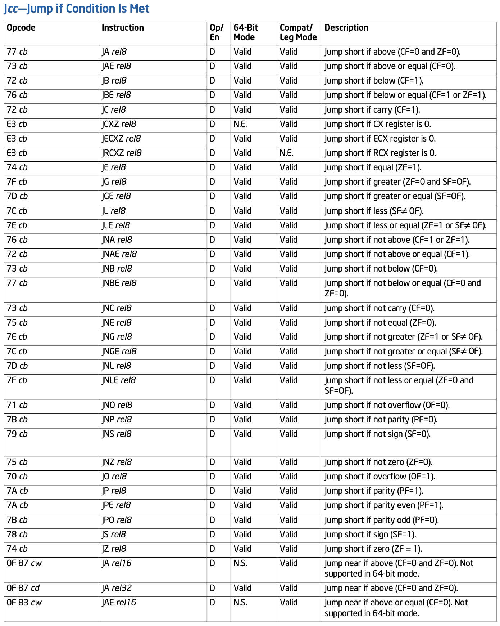

Slide 32
Jcc Revisited
If you look closely, you will see that there are multiple mnemonics for the same opcodes. The opcodes prove they're the same instructions
Which mnemonic is displayed is disassembler-dependent

Slide 33
Jcc Revisited
A "short" control flow displacement is always specified by a signed 8-bit number
A "near" control flow displacement could be a signed 16-bit (except when running in 64-bit mode) or signed 32-bit number

Slide 34
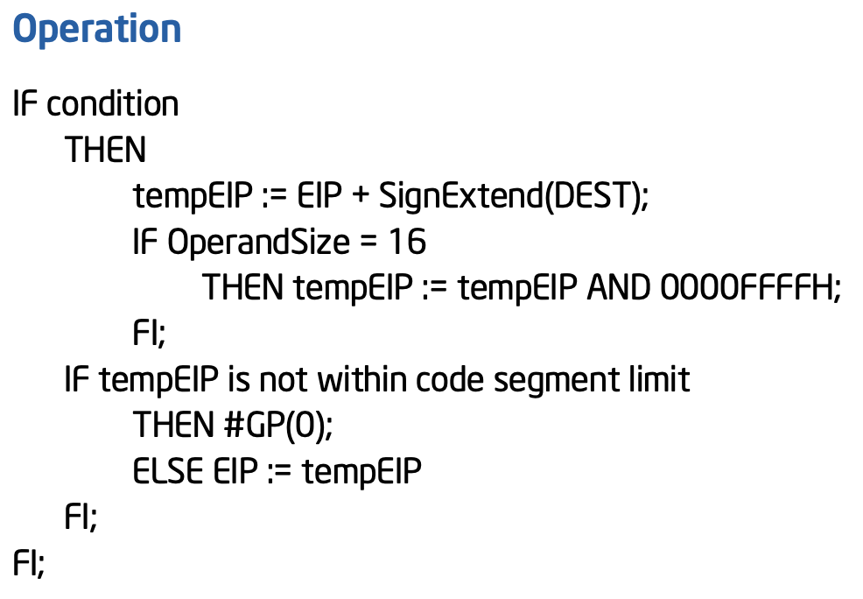
Jcc Revisited
The "Operation" section is now a little more complicated w/ its own conditional control flow pseudocode!
This probably should be updated to have a "IF 64-bit Mode" like JMP does...

Slide 35
MOAR EXAMPLES!
MORE!

Slide 36
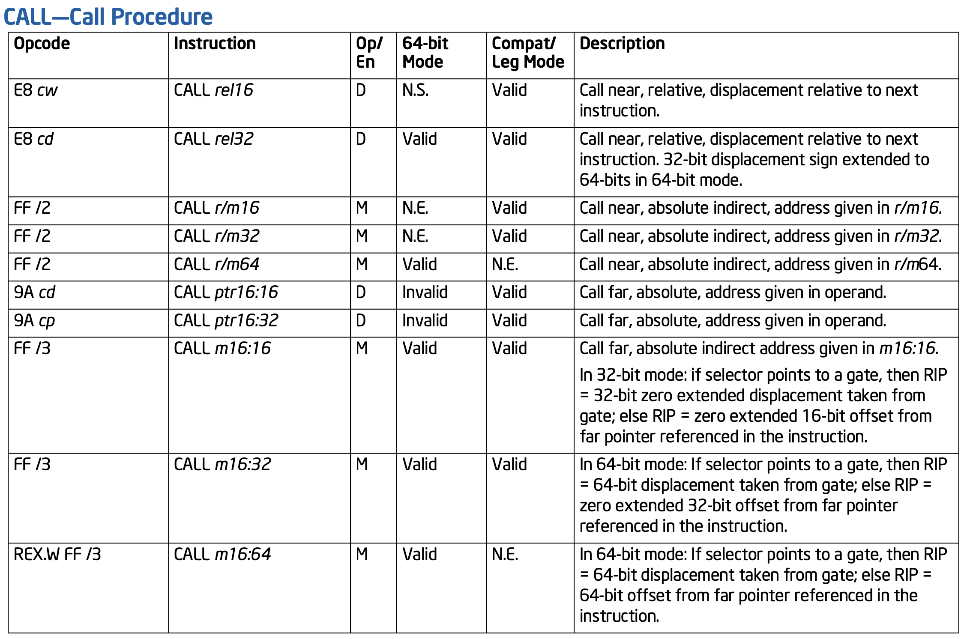

Slide 37
There's no "call short"
"Absolute indirect" form calculates an absolute address, using either just an address in a register, or an address calculated with the r/m64 "base + index*scale + displacement" form

Slide 38
"Far" control flow transfer involves the specification of a "segment selector". We learn about those in Arch2001

Slide 39
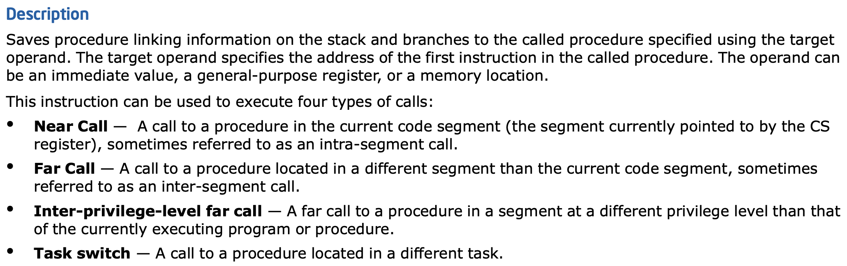
That's all Arch2001 stuff!

Slide 40
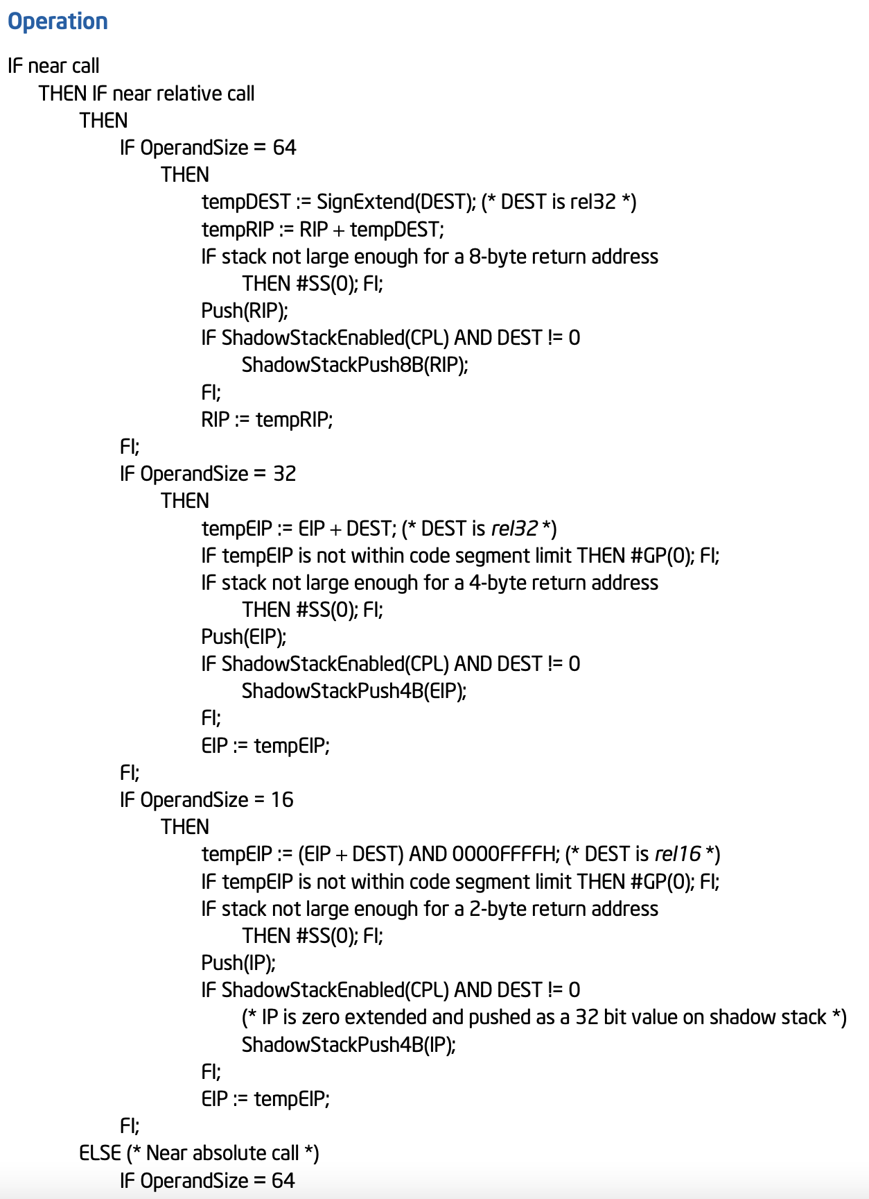
Because of the implications of the different distance variants, privilege transitions, different execution modes, CET, and, the pseudocode for the call instruction is about 9.75 pages long!

Slide 41
MOAR EXAMPLES!
MORE!

Slide 42
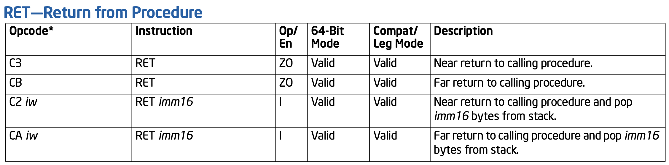
RET supports both "near" & "far" control flow transfer. But you'll almost only ever see the near return (0xC3)
This also shows that second form of RET I mentioned where it can also add some number of bytes to the stack pointer
About 10 pages of Operation pseudocode here too :-/

Slide 43
MOAR EXAMPLES!
MORE!

Slide 44
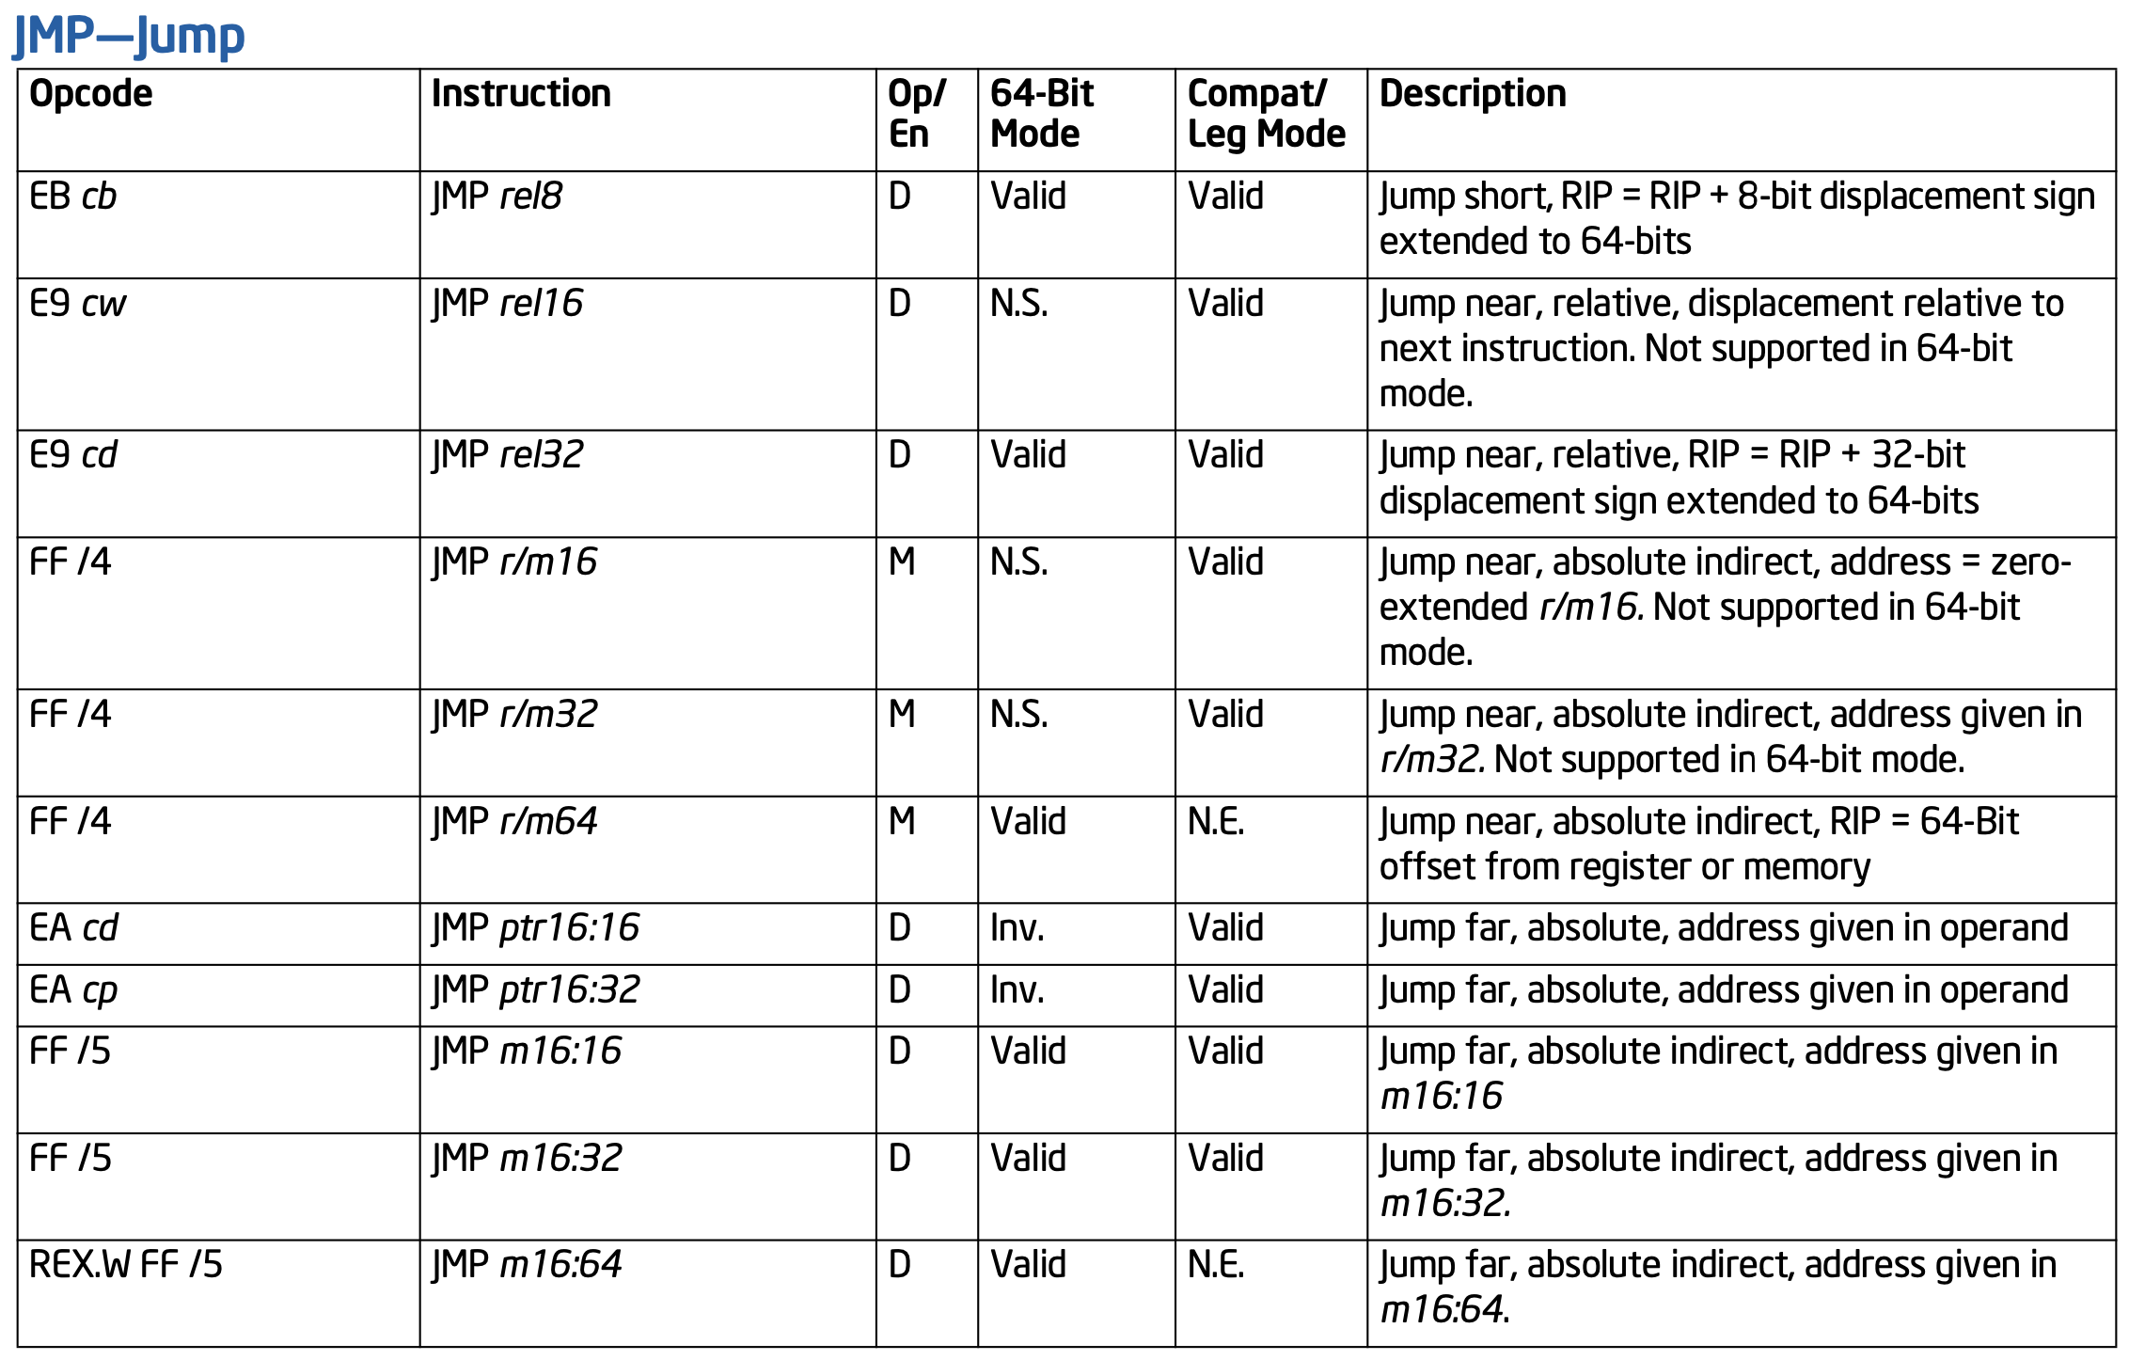
The typical 8/16/32 byte relative displacements as well as absolute indirect
~5 pages of pseudocode. It's almost like control flow transfer is hard!

Slide 45
Also supports the far displacement we don't know about yet

Slide 46
MOAR EXAMPLES!
MORE!

Slide 47
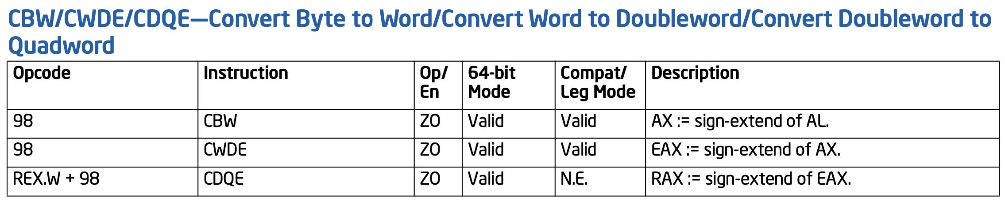
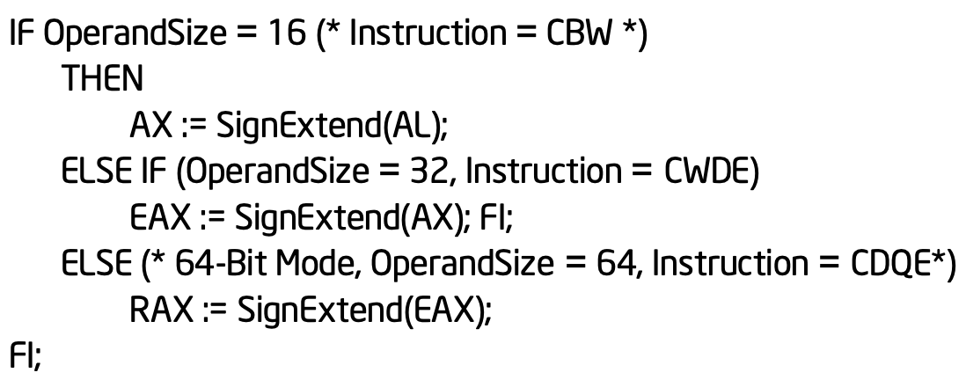
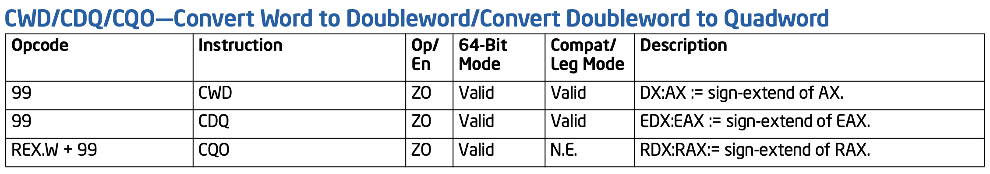
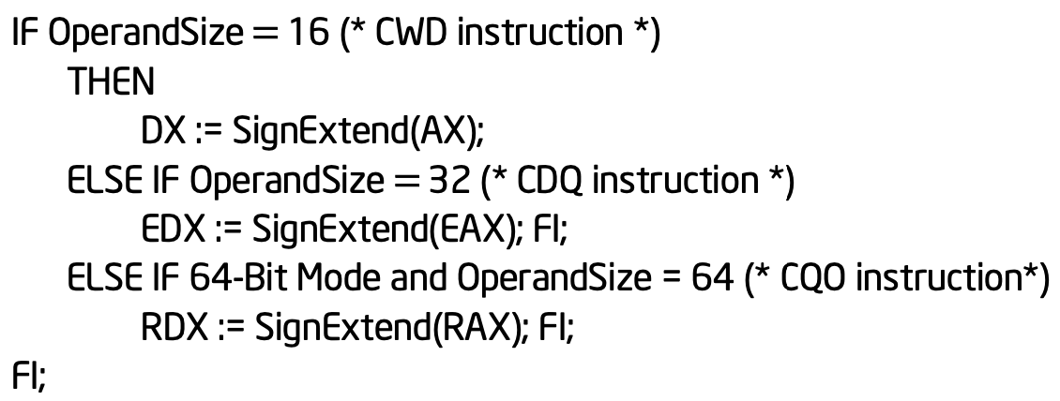

Slide 48

Ok. That's enough for now

Slide 49
MiniExercise:
Go change the MulDivExample.c to use a signed "long long" variable instead of "unsigned long long"
Who doth appear, and why?
Read and understand the code

Slide 50
Exercise:
How do these instructions behave when using 16 or 32 bit values?

Slide 51
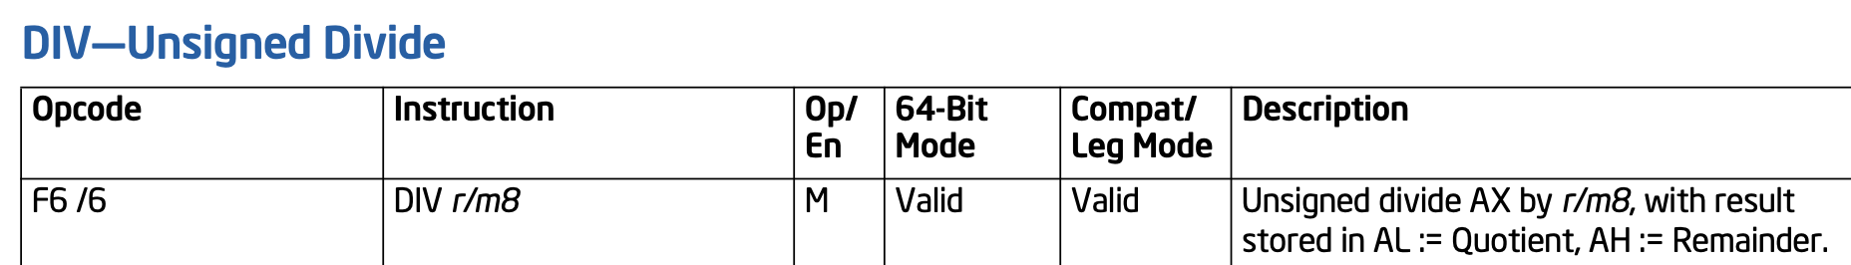
Exercise:
What happens if you divide a large 16 bit value by 1?
That doesn't seem like it will fit into AL...

