Slide 1
Architecture 1001:
x86-64 Assembly
Writing Assembly: GCC
Xeno Kovah – 2021
xeno@darkmentor.com

Slide 2

All materials is licensed under a Creative Commons “Share Alike” license.
http://creativecommons.org/licenses/by-sa/4.0/
Attribution condition: You must indicate that derivative work
"Is derived from Xeno Kovah's 'Architecture 1001: x86-64 Assembly’ class, available at https://ost.fyi"
Notes:
Attribution condition: You must indicate that derivative work
"Is derived from Xeno Kovah's 'Architecture 1001: x86-64 Assembly’ class, available at https://ost.fyi"

Slide 3
VisualStudio Intrinsics
A subset of assembly instructions can be inserted into C code by using VS compiler intrinsics
These look like C functions calls, but the compiler substitutes them with literal assembly instructions
Examples:
__stosX (rep stos)
__movsX (rep movs)
_rotrX (ror)
Many more (mostly relevant to Arch2001):
  http://msdn.microsoft.com/en-us/library/hh977022.aspx

Slide 4
VisualStudio Assembly
Visual Studio supports inline assembler for 32-bit code, but not x86-64
Hand-written assembly must be written in MASM (Microsoft Assembler syntax) in a separate .asm file, with exported function names, and then called from your C code and linked to by the linker
How to create a basic project is shown on the site, but one has been provided already in the "scratchpad_asm" project

Slide 5
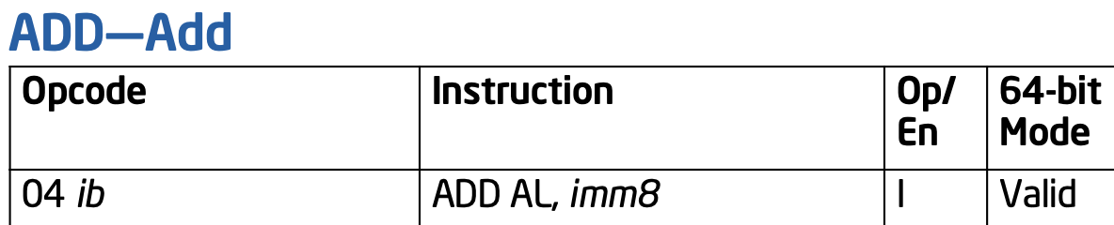
Writing Bytes to Get Asm
You can emit bytes directly in the instruction stream in MASM by just writing "db XXh" and then the byte you want to emit. E.g.
  db 04h
  db 01h
  Or
  db 04h, 01h
Would create the instruction "add al, 1"

Slide 6
Writing Bytes to Get Asm 2
Writing instructions via raw bytes can be used to test your understanding of instruction encoding as specified in the manual
  Also sometimes useful if you can't find the correct syntax for the specific assembler you're using, but you know exactly what instruction you want
Just put it into scratchpad_asm, run it in the debugger, and then confirm what you expect happens after you step past the instruction

Slide 7
Misc MASM Syntax Issue
MASM doesn't like immediates that start with an alphabet character. They must be preceded by a zero
  "mov rax, E09966C1A977E177h" yields a compile error
  "mov rax, 0E09966C1A977E177h" is OK
This also applies to raw bytes
  "DB C3h" errors out
  "DB 0C3h" is OK

Slide 9
Lab: Create a Project With MASM
This will show how to get Visual Studio to play nice with MASM files

Slide 10
Lab: RTFM && WTFI!
Read The Fun Manual and Write The Fun Instructions!
Write raw bytes to create the following assembly sequence:
  mov eax, 0xAABBCCDD
  sahf ; What's that? IDK, RTFM!
  jz mylabel
  and eax, 0x31337
  mylabel:
  ret

