Slide 1
Architecture 1001:
x86-64 Assembly
About this class
Xeno Kovah – 2021
xeno@darkmentor.com

Slide 2

All materials is licensed under a Creative Commons “Share Alike” license.
http://creativecommons.org/licenses/by-sa/4.0/
Attribution condition: You must indicate that derivative work
"Is derived from Xeno Kovah's 'Architecture 1001: x86-64 Assembly’ class, available at https://ost.fyi"
Notes:
Attribution condition: You must indicate that derivative work
"Is derived from Xeno Kovah's 'Architecture 1001: x86-64 Assembly’ class, available at https://ost.fyi"

Slide 3
When you’re “done” with this class…you’re not done.
You’ve just begun.
I want peers who can do what I can do, and ultimately exceed me
Mastery requires spending significant time outside of class honing your skills
Notes:
Alright, before we start this class in earnest, I want to set the stage by way of my motivation for why I’m teaching this class. What it really comes down to is that I want peers who know what I know, can do what I can do, and can ultimately exceed me. I want more cool kids doing cool work that I can watch a presentation of and say “that’s cool!”
But I’ve obviously got a bit of a head start on you if you’re going to exceed me, yes? Which is why you need to understand that while I want to help get you to my level ASAP, that’s not going to happen if you just watch this class and then call it a day. Mastery of these skills will require spending significant time outside of class honing your skills. Like, hundreds to thousands of hours. Obviously that’s why your best option is to get a job which lets you get paid to keep honing your skills. That’s how I got my thousands of hours in after all.
So anyway, I just wanted you to know before you’re more than 1 slide into this class, that these videos are not the end, they’re just the beginning. I have high expectations of the students who start down our learning paths, and I hope that you’ll rise to meet them.

Slide 4
About the Class
The intent of this class is to expose you to the most commonly generated assembly instructions, and the most frequently dealt with architecture hardware.
  64 bit instructions/hardware
  Implementation of a Stack
  Common debugging/disassembling tools
Many things will therefore be intentionally left out or deferred to later classes.
  Floating point/vector instructions/hardware
  16 bit instructions/hardware
  Complicated or rare instructions
  Instruction pipeline, alternate modes of operation, hardware virtualization, etc (see other classes for those)
Notes:
Alright, so what are we going to learn in this class? The main thing is that I want you to learn above the most common assembly, registers, how the stack works, and what kind of tools you need in order to keep learning after class.
This means that I’m explicitly leaving out less common things like floating point instructions and registers, complicated and rare instructions, and many other things which will instead show up in more advanced classes.

Slide 5
About the Class 2
The hope is that the material covered will be provide the required background to delve deeper into areas which may have seemed daunting previously.
Because I can’t anticipate the needs of all job classes, if there are specific areas which you think would be useful to certain job types, let me know. The focus areas are currently primarily influenced by my security background, but I would like to make the class as widely applicable as possible.

Slide 6
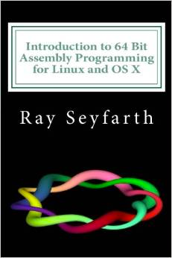
Optional Book (64 bit)
“Introduction to 64 Bit Assembly Programming for Linux and OS X: Third Edition” by Ray Seyfarth
Optional book for the class, to give you alternative explanations to my own
When you see “Book” page references in the bottom of slides, it is referring to this book.
Notes:
FYI there’s an optional book for the class. There’s no strong need for it, in that you can always just google around if something’s not clear to you, but I wanted there to be a consistent single-author alternative explanation to mine, incase you wanted it.

Slide 7
Miss Alaineous
It’s called x86 because of the progression of Intel chips from 8086, 80186, 80286, etc.
Originally 16-bit architecture. Later evolved to 32 and 64-bit, but kept the backwards compatibility. The hardware actually starts up in 16 bit before software transitions it to 32 or 64 bit operation.
Notes:
OK, a few quick miscellaneous points:
The name x86 comes from the fact that Intel’s first chip to use this instruction set had a model number of 8086. Then they came out with the 80186, 80286 and so forth.
The 8086 was a 16-bit architecture, which means it had 16-bit registers, a 16-bit memory space, etc. Later on when Intel expanded it to 32 bit and then later 64 bit, they always kept the backwards compatibility. So in reality when most hardware first powers on, it is actually running in 16 bit mode. Which we’ll talk about more in a future advanced architecture class.

Slide 8
Miss Alaineous 2
Intel originally wanted to break from x86 when moving to 64 bit. This was IA64 (Intel Architecture 64 bit) aka Itanium. However, AMD decided to extend x86 to 64 bits itself, leading to the AMD64 architecture. When Itanium had very slow adoption, Intel decided to bite the bullet and license the 64 bit extensions from AMD.
In the Intel manuals you will see the 64 bit extensions referred to as IA32e or EMT64 or Intel 64 (but never IA64. Again, that's Itanium, a completely different architecture).
Notes:
Now when Intel originally was going to move from 32 bit to 64 bit, they were actually going to make a whole new architecture with all new instructions. This was known as Itanium, or IA64. But in parallel AMD decided to just extend 32 bit x86 to 64 bits in a fairly straightforward way. In the end Itanium didn’t really get widespread adoption, and Intel was forced to backpedal and license the 64 bit extensions from AMD.
In the Intel manuals this has a bunch of different names like IA32e, EMT64, and Intel 64.

Slide 9
Miss Alaineous 3
You might sometimes see it called amd64 or x64 by MS or some linux distributions
In this class we're going to go with x86-64
Notes:
Other names you might seen in Linux distributions or from Microsoft are amd64 or x64. But in this class we’re going to call it x86-64.

Slide 10
Where is x86-64 used?
More powerful (but thus power-hungry) systems such as PCs, servers, and even super-computers
  Minimal adoption on phones or embedded systems. Intel does have the entire Atom line of lower-power chips targeted towards embedded systems though (and they’re starting to focus more on performance per Watt, which is where ARM has always been better)
Notes:
So where is x86-64 used? Well you probably know that it’s mostly used in applications which need high computational power, such as PCs, servers, and even super-computers. With very high probability, the machine you’re watching this class on is an x86-64 machine. But the ARM-based systems, like Microsoft Surface or Apple’s M1 Macs - which I helped design the SecureBoot system for - are coming to give Intel a run for it’s money in the PC space.
Intel has some chips which are more focused on power-constrained devices, like embedded systems, but they make up a tiny fraction of Intel’s chip volume.

Slide 11
What you’re going to learn:
#include <stdio.h>
int main(){
  printf(“Hello World!\n”);
  return 0x1234;
}
Notes:
So what are you going to learn in this class? Well, we’re going to be learning assembly by looking at simple C programs and seeing how the compiler outputs the equivalent assembly. So for instance you’ll learn that this simple Hello World program…

Slide 12
Is the same as…
0000000140001000 sub rsp,28h
0000000140001004 lea rcx,[__NULL_IMPORT_DESCRIPTOR+15C0h (0140006000h)]
000000014000100B call printf (0140001080h)
0000000140001010 mov eax,1234h
0000000140001015 add rsp,28h
0000000140001019 ret
Windows Visual Studio 2019 Community
/GS (buffer overflow protection) option turned off
Disassembled with Visual C++
Notes:
Is the same as this assembly when compiled from within Windows Visual Studio, and disassembled from within Visual Studio.

Slide 13
which could be viewed as…
main invoke_main:1400013f4(c)
140001000 48 83 ec 28 SUB RSP,0x28
140001004 48 8d 0d LEA _Argc,[.data] = "Hello World!\n"
f5 4f 00 00
14000100b e8 70 00 CALL printf int printf(char * _Format, ...)
00 00
140001010 b8 34 12 MOV EAX,0x1234
00 00
140001015 48 83 c4 28 ADD RSP,0x28
140001019 c3 RET
Windows Visual Studio 2019 Community
/GS (buffer overflow protection) option turned off
Disassembled with Ghidra 9.2
Notes:
Which could look like this, if you happened to disassemble the same program with a different disassembler like Ghidra.

Slide 14
which is equivalent to…
0000000000001149 <main>:
1149: f3 0f 1e fa endbr64
114d: 55 push %rbp
114e: 48 89 e5 mov %rsp,%rbp
1151: 48 8d 3d ac 0e 00 00 lea 0xeac(%rip),%rdi
1158: e8 f3 fe ff ff callq 1050 <puts@plt>
115d: b8 34 12 00 00 mov $0x1234,%eax
1162: 5d pop %rbp
1163: c3 retq
1164: 66 2e 0f 1f 84 00 00 nopw %cs:0x0(%rax,%rax,1)
116b: 00 00 00
116e: 66 90 xchg %ax,%ax
Ubuntu 20.04, GCC 9.3.0
Disassembled with “objdump -d”
Notes:
We’ll also learn that the same Hello World can look different when compiled by a different compiler like GCC on Ubuntu Linux.

Slide 15
which is equivalent to…
_main:
0000000100003f50 pushq %rbp
0000000100003f51 movq %rsp, %rbp
0000000100003f54 subq $0x10, %rsp
0000000100003f58 movl $0x0, -0x4(%rbp)
0000000100003f5f leaq 0x38(%rip), %rdi ## literal pool for: "Hello World!\n"
0000000100003f66 movb $0x0, %al
0000000100003f68 callq 0x100003f7e ## symbol stub for: _printf
0000000100003f6d movl $0x1234, %ecx ## imm = 0x1234
0000000100003f72 movl %eax, -0x8(%rbp)
0000000100003f75 movl %ecx, %eax
0000000100003f77 addq $0x10, %rsp
0000000100003f7b popq %rbp
0000000100003f7c retq
macOS 11.2, Apple clang version 12.0.0 (clang-1200.0.32.29)
Disassembled from command line with “otool -tV”
Notes:
Or when compiled by Clang on macOS 11.

Slide 16
But it all boils down to…
.text:0000000140001000 sub rsp, 28h
.text:0000000140001004 lea rcx, Format ; "Hello World!\n"
.text:000000014000100B call printf
.text:0000000140001010 mov eax, 1234h
.text:0000000140001015 add rsp, 28h
.text:0000000140001019 retn
Windows Visual Studio 2019 Community, /GS option turned off
Disassembled with IDA Freeware 7 (with some omissions for fitting on screen)
Notes:
But at the end of the day the simplest version remains this 6-instruction version, here shown disassembled by yet another disassembler, IDA. We can see the basic outline of what’s going on here. We see something referencing the string “Hello World”, we see a call to the printf() function. And we see the number hex 1234 which is what this version of Hello World returned at the end. The rest of the assembly, well we’ve got no idea yet what’s going on there.

Slide 17

Take Heart!
By one measure, only 14 assembly instructions account for 90% of code!
  http://www.blackhat.com/presentations/bh-usa-06/BH-US-06-Bilar.pdf
You’ve already seen 10 common instructions, just in the hello world variations! (And 2 special security instructions we’ll talk about later.)
I think that knowing about 20-30 (not counting variations) is good enough that you will have the check the manual very infrequently
Notes:
But take heart! By one measure, only 14 assembly instructions account for 90% of code! And you’ve already seen 10 common instructions just in the different versions of Hello World that different compilers generate!
My personal experience is that if you know about 30 instructions, you will be able to read most code, and only need to hit up the manual very infrequently.

Slide 18

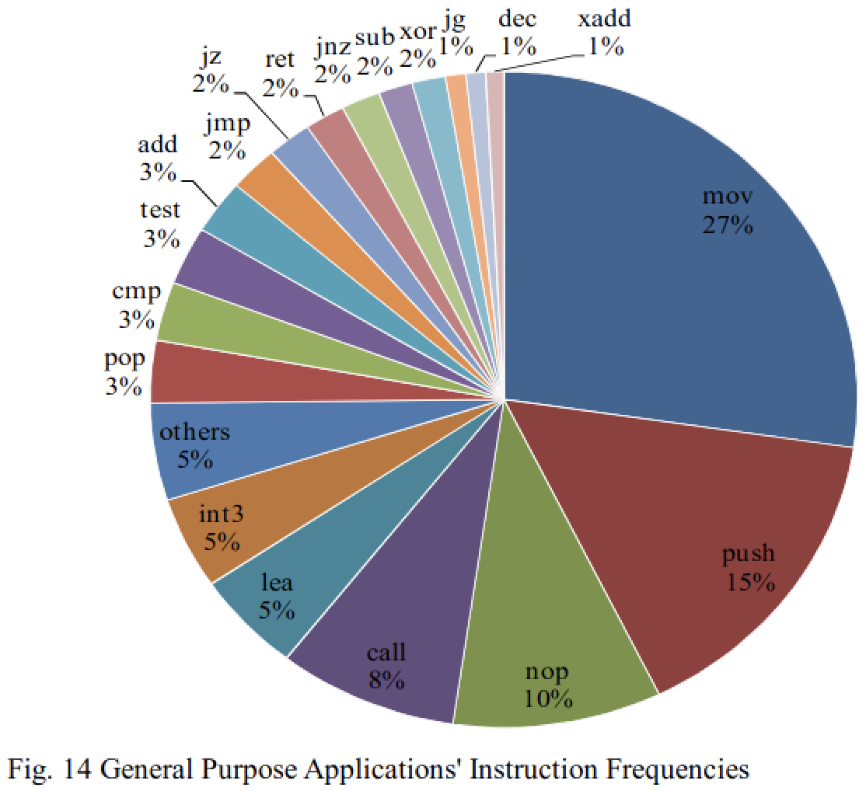
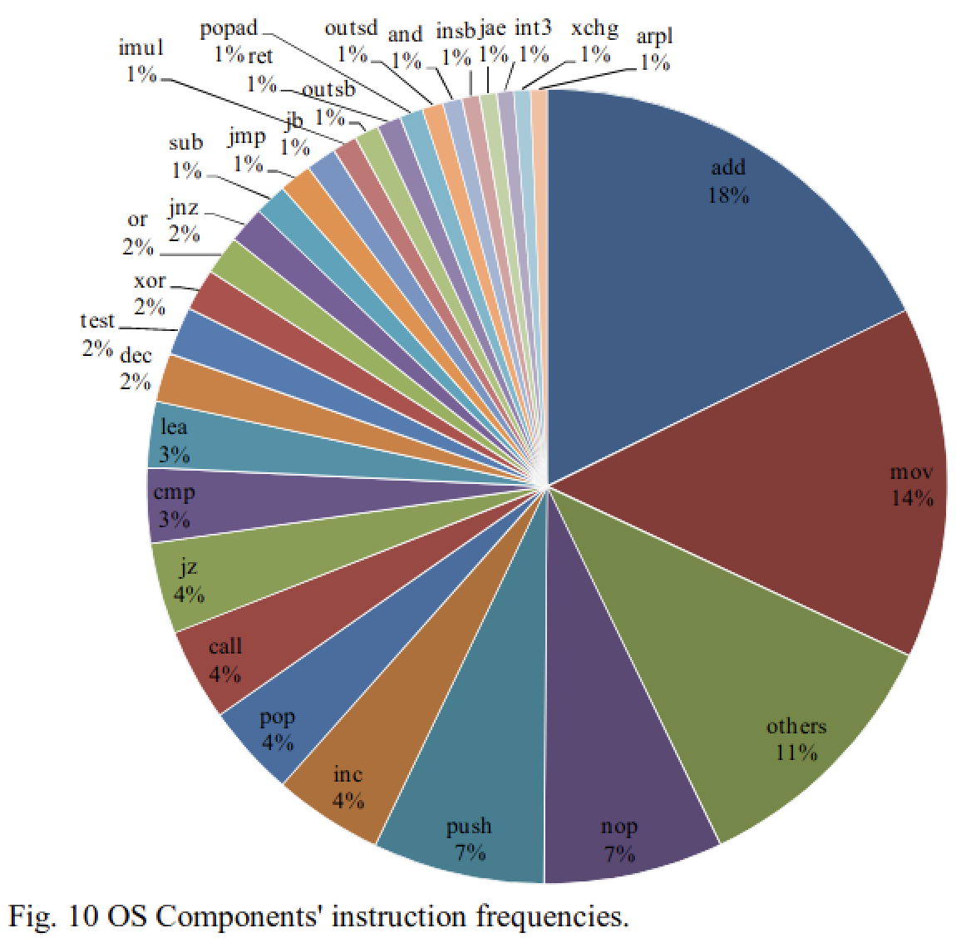
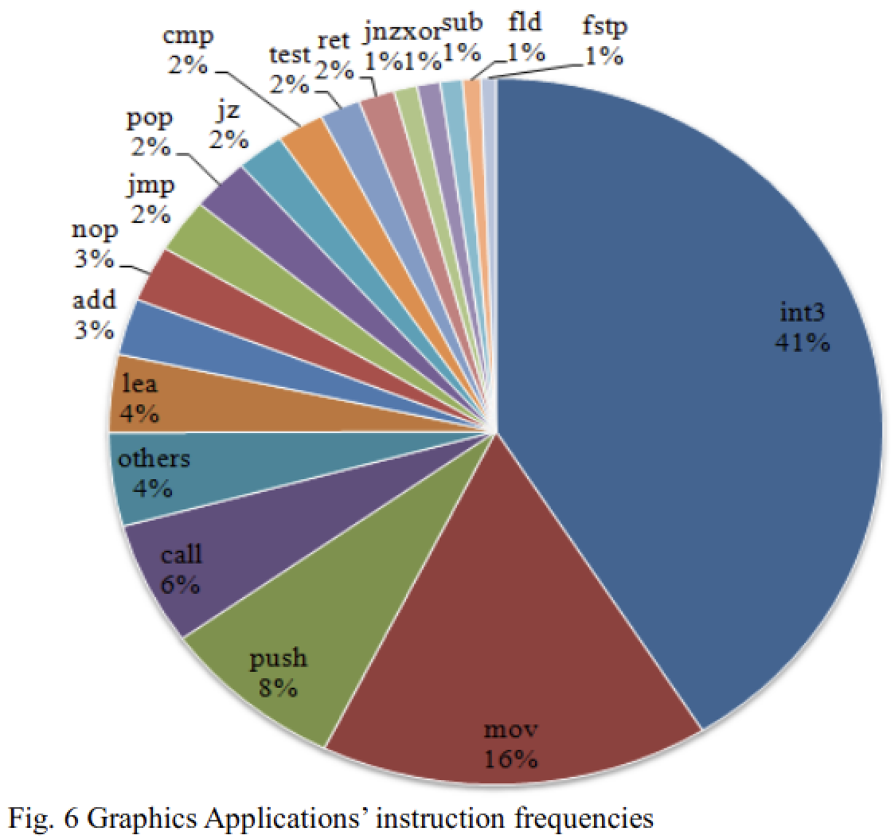
Take Heart!
Check out this newer reference!
  https://citeseerx.ist.psu.edu/viewdoc/download?doi=10.1.1.407.5071&rep=rep1&type=pdf
Notes:
And since that BlackHat reference from 2006 might seem like it’s getting a bit stale, here’s a newer reference from 2011 which also showed that you really don’t need to know that many instructions to know most of the code used in common application types!
<click>
For instance, we will see literally every assembly instruction, and more, which is cited in this frequency breakdown of a web browser’s instructions!

Slide 19
Outcomes
By the end of this class you should…
  Know the x86-64 general purpose registers, and their 32 and 16 bit sub-register names
  Understand how data like local variables or return addresses are stored on the stack
  Understand function calling conventions
  Be comfortable writing C code in an IDE (like Visual Studio) and reading and stepping through the disassembly (so you can find new instructions)
  Be able to read assembly well enough to determine the expected inputs to influence the control flow for an opaque binary (the infamous “Binary Bomb lab”)
Notes:
Alright, so what’s the final outcome going to be from this class?
By the end I expect that you should know all the x86-64 general purpose registers, and the older 32 and 16 bit register names, which can still be accessed by 64 bit code.
<just read the rest of the slide>
Alright, well I think that’s quite enough of my face for now. I’m going to go ahead and disappear from a good chunk of the future videos, because <lean towards camera> it’s very annoying to have to keep talking into the camera, making virtual eye contact, while not looking down at my slides. But don’t worry, I’ll *pop* back in from time to time when I want to use my phase for *emphasis* <make funny face> ;)

