Slide 1
Architecture 1001:
x86-64 Assembly
The Stack
Xeno Kovah – 2021
xeno@darkmentor.com

Slide 2

All materials is licensed under a Creative Commons “Share Alike” license.
http://creativecommons.org/licenses/by-sa/4.0/
Attribution condition: You must indicate that derivative work
"Is derived from Xeno Kovah's 'Architecture 1001: x86-64 Assembly’ class, available at https://ost.fyi"
Notes:
Attribution condition: You must indicate that derivative work
"Is derived from Xeno Kovah's 'Architecture 1001: x86-64 Assembly’ class, available at https://ost.fyi"

Slide 3

The Stack
A stack is a Last-In-First-Out (LIFO) data structure where data is "pushed" on to the top of the stack and "popped" off the top
The stack is a conceptual area of main memory (RAM) which is designated by the OS when a program is started
  Different OSes start it at different addresses by their own convention, or if they’re using address space layout randomization (ASLR)
Book page 107

Slide 4
The Stack 2
By convention the stack grows toward lower memory addresses. Adding something to the stack means the top of the stack is now at a lower memory address
High Addresses
Process Memory
Grows Down
Stack
Grows Up
Heap
Code
Global Data
Book page 107
Low Addresses

Slide 5
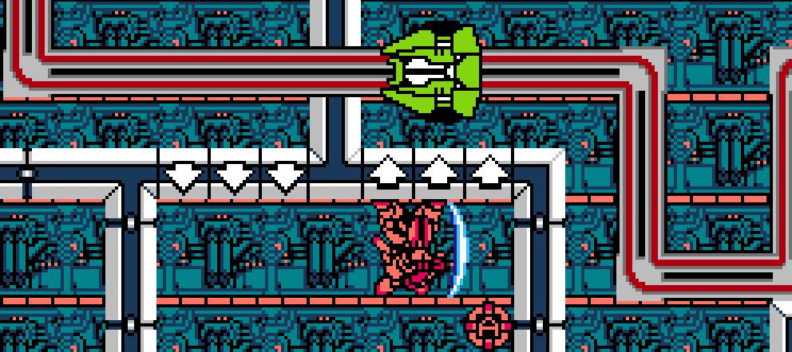
The stack grows down towards low addresses!
This message brought to you by M-308 Gunner from MetalStorm!
Notes:
http://satoshimatrix.files.wordpress.com/2011/08/metal-storm-u-0009.png
http://2.bp.blogspot.com/_OcRaBrP1awY/SAelZhj61tI/AAAAAAAAATw/NudzjUumtRk/s400/luncheon_plates_stacks_DSCN4744.JPG

Slide 6

The enemy’s plate is down!
Notes:
http://satoshimatrix.files.wordpress.com/2011/08/metal-storm-u-0009.png
http://2.bp.blogspot.com/_OcRaBrP1awY/SAelZhj61tI/AAAAAAAAATw/NudzjUumtRk/s400/luncheon_plates_stacks_DSCN4744.JPG

Slide 7

Everything you know is wrong!
Black is white, up is down, and short is long!
Notes:
http://satoshimatrix.files.wordpress.com/2011/08/metal-storm-u-0009.png
http://2.bp.blogspot.com/_OcRaBrP1awY/SAelZhj61tI/AAAAAAAAATw/NudzjUumtRk/s400/luncheon_plates_stacks_DSCN4744.JPG

Slide 8
The Stack 3
RSP points to the top of the stack - the lowest address which is being used
  While data will exist at addresses beyond the top of the stack, it is considered undefined
Book page 107

Slide 9
The Stack 4
What can you find on the stack?
  "Return addresses" so a called function can return back to the function that called it
  Local variables
  Sometimes used to pass arguments between functions
  Save space for registers so functions can share registers without smashing the value for each other
  Save space for registers when the compiler has to juggle too many in a function
  Dynamically allocated memory via alloca()
Book page 107

Slide 10
Simple Stack Diagram
stack bottom
#include <stdio.h>
int bar(int y){
int a = 3*y;
printf("bar returned %d", a);
return a;
}
int foo(int x){
int b = 5*x;
printf("foo passed %d", b);
return bar(b);
}
int main(){
int c = foo(7);
printf("main passed %d", c);
}
main()
frame
foo()
frame
bar()
frame
stack top
Book page 113

