Slide 1
Architecture 1001:
x86-64 Assembly
Push / Pop
Xeno Kovah – 2021
xeno@darkmentor.com

Slide 2

All materials is licensed under a Creative Commons “Share Alike” license.
http://creativecommons.org/licenses/by-sa/4.0/
Attribution condition: You must indicate that derivative work
"Is derived from Xeno Kovah's 'Architecture 1001: x86-64 Assembly’ class, available at https://ost.fyi"
Notes:
Attribution condition: You must indicate that derivative work
"Is derived from Xeno Kovah's 'Architecture 1001: x86-64 Assembly’ class, available at https://ost.fyi"

Slide 3
As seen in Hello.c! (on macOS)
_main:
0000000100003f50 pushq %rbp
0000000100003f51 movq %rsp, %rbp
0000000100003f54 subq $0x10, %rsp
0000000100003f58 movl $0x0, -0x4(%rbp)
0000000100003f5f leaq 0x38(%rip), %rdi
0000000100003f66 movb $0x0, %al
0000000100003f68 callq 0x100003f7e ##_printf
0000000100003f6d movl $0x1234, %ecx
0000000100003f72 movl %eax, -0x8(%rbp)
0000000100003f75 movl %ecx, %eax
0000000100003f77 addq $0x10, %rsp
0000000100003f7b popq %rbp
0000000100003f7c retq
macOS 11.2, Apple clang version 12.0.0 (clang-1200.0.32.29)
Disassembled from command line with “otool -tV”
Notes:
Or when compiled by Clang on macOS 11.

Slide 4
As seen in Hello.c! (on Linux)
0000000000001149 <main>:
1149: endbr64
114d: push %rbp
114e: mov %rsp,%rbp
1151: lea 0xeac(%rip),%rdi
1158: callq 1050 <puts@plt>
115d: mov $0x1234,%eax
1162: pop %rbp
1163: retq
1164: nopw %cs:0x0(%rax,%rax,1)
116e: xchg %ax,%ax
Ubuntu 20.04, GCC 9.3.0
Disassembled with “objdump -d”
Notes:
We’ll also learn that the same Hello World can look different when compiled by a different compiler like GCC on Ubuntu Linux.

Slide 5
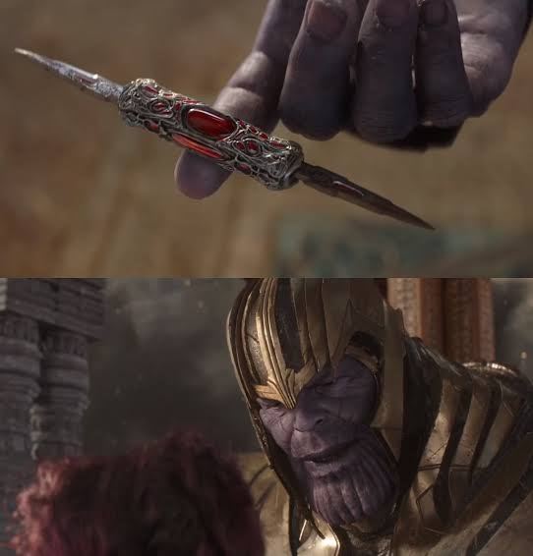
PUSH
POP
PERFECTLY BALANCED
AS ALL THINGS SHOULD BE

Slide 6
Is the same as…
0000000140001000 sub rsp,28h
0000000140001004 lea rcx,[__NULL_IMPORT_DESCRIPTOR+15C0h (0140006000h)]
000000014000100B call printf (0140001080h)
0000000140001010 mov eax,1234h
0000000140001015 add rsp,28h
0000000140001019 ret
Windows Visual Studio 2019 Community
/GS (buffer overflow protection) option turned off
Disassembled with Visual C++
Notes:
Is the same as this assembly when compiled from within Windows Visual Studio, and disassembled from within Visual Studio.

Slide 7
Mystery Listery
Why do the GCC/Clang HelloWorlds have balanced Push/Pop instructions but Visual Studio doesn’t?

Slide 8
PUSH
Push quadword onto the stack
2
The push instruction automatically decrements the stack pointer, RSP, by 8
In 64-bit execution mode, operand can be
  The value in a 64-bit register
  A 64-bit value from memory, as given in "r/mX" form talked about next
Book page 107
Notes:
Will always be a QWORD because we will be running the processor in 64bit mode, and the instruction for a 16 bit push is the same as the one for a 32bit push is the same as the one for a 64 bit push. The processor just interprets the size based on the mode it is currently running in (or more accurately the segment, but that’s a story for Intermediate x86-64 ;))

Slide 9
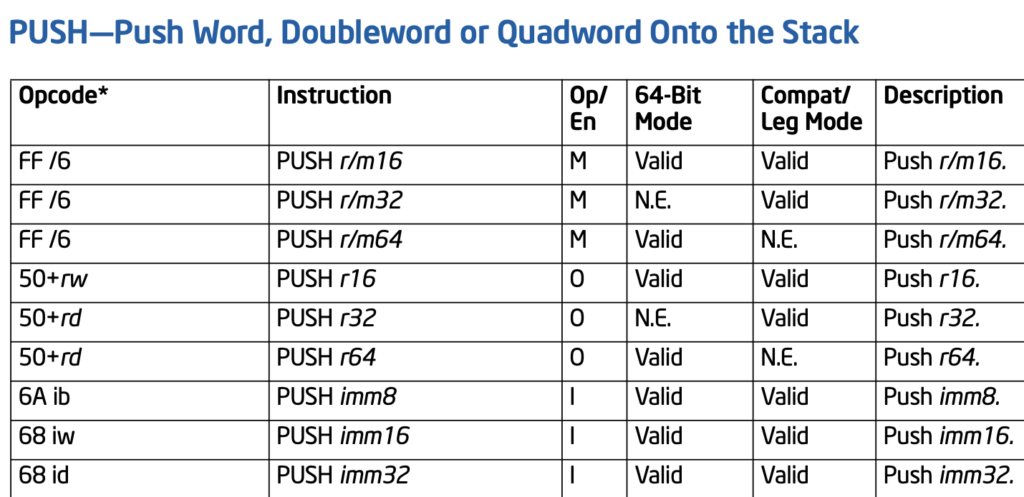
“r/mX” Addressing Forms 1
“r/mX” is a term I made up to refer to anywhere you see “r/m8”, “r/m16”, “r/m32”, or “r/m64” in the Intel manual
Book page 123

Slide 10
“r/mX” Addressing Forms 2
In Intel syntax, most of the time square brackets [] means to treat the value within as a memory address, and fetch the value at that address (like dereferencing a pointer)
An “r/mX” can take 4 forms:
  Register → rbx
  Memory, base-only → [rbx]
  Memory, base+index*scale → [rbx+rcx*X]
    For X = 1, 2, 4, or 8
  Memory, base+index*scale+displacement → [rbx+rcx*X+Y]
    For Y of 1 byte (0-2^8) or 4 bytes (0-2^32)
Book page 123

Slide 11
“r/mX” Addressing Forms 3
[base + index*scale + displacement]
  Has natural applicability to multi-dimensional array indexing, arrays of structs, etc
So when I say in the future instructions support access to memory, I mean memory as encoded in an “r/mX” form
And when I say “r/mX”, I mean something that could be as simple as a single register, or as complicated as a memory address calculation in that form
Book page 123

Slide 12
“r/mX” Addressing Example
push register
push rbx
push memory
push [rbx]
push [rbx+rcx*4]
push [rbx+rcx*8+0x20]
Note: there’s nothing special about the particular registers I chose above.
Any could be substituted with any other general purpose registers
Book page 123

Slide 13
Note about the ` address convention
When writing 64 bit numbers, it can be easy to lose track of whether you have the right number of digits
WinDbg (which we don’t use in this class, but do in future architecture classes) allows you to write 64 bit numbers with a ` between the two 32 bit halves.
I think this is helpful to see when a number is > 32 bit or not (because there will be some non-zero value on the left side of the `)
So in this class I’ll often write 64 bit numbers like 0x12345678`12345678.
But keep in mind that the only tool which probably supports you entering them like that is WinDbg

Slide 14

push RAX
Registers Before
Registers After
RAX | 00000000`00000003
RSP | 00000000`0014FE08
RAX | 00000000`00000003
RSP | 00000000`0014FE00
Stack Before
Stack After
00000000`0014FE10 | 00000000` 00000001
00000000`0014FE08 | 00000000` 00000002
00000000`0014FE00 | undef
00000000`0014FDF8 | undef
00000000` 00000001
00000000` 00000002
00000000` 00000003
undef
RSP
RSP

Slide 15
POP
Pop a value from the stack
3
In 64-bit execution mode, operand can be
  A 64-bit register
  A 64-bit memory address, as given in "r/mX" form
Increments RSP by 0x8
Book page 108

Slide 16
pop RAX
Registers Before
Registers After
RAX | 00000000`00005007
RSP | 00000000`0014FE00
RAX | 00000000`00000003
RSP | 00000000`0014FE08
Stack Before
Stack After
00000000`0014FE10 | 00000000` 00000001
00000000`0014FE08 | 00000000` 00000002
00000000`0014FE00 | 00000000` 00000003
00000000`0014FDF8 | undef
00000000` 00000001
00000000` 00000002
undef
undef
RSP
RSP

Slide 17
Push/Pop 32-bit Throwback
If you are executing in 32-bit mode, push/pop will add/remove values 32 bits at a time, rather than 64 bits, and thus they decrement/increment ESP by 4 rather than 8 at a time
Likewise, if you’re in 16-bit mode, they push/pop 16-bit values, and decrement/increment SP by 2 at a time

Slide 18
Instructions we now know (3)
NOP
PUSH/POP

Slide 19

2
3
1

