Slide 1
Architecture 1001:
x86-64 Assembly
32-bit Calling Conventions
Xeno Kovah – 2021
xeno@darkmentor.com

Slide 2

All materials is licensed under a Creative Commons “Share Alike” license.
http://creativecommons.org/licenses/by-sa/4.0/
Attribution condition: You must indicate that derivative work
"Is derived from Xeno Kovah's 'Architecture 1001: x86-64 Assembly’ class, available at https://ost.fyi"
Notes:
Attribution condition: You must indicate that derivative work
"Is derived from Xeno Kovah's 'Architecture 1001: x86-64 Assembly’ class, available at https://ost.fyi"

Slide 3
32-bit Stack Calling Conventions throwback 1
In 32 bit code, there are many more calling conventions in use
  “cdecl” (default for most C code)
    Caller cleans up the stack
  “stdcall” (for Windows' Win32 APIs)
    Callee cleans up the stack
Function parameters are pushed onto stack from right to left
  leftmost parameter (the first function parameter) ends up at the lowest address
https://docs.microsoft.com/en-us/cpp/cpp/cdecl?view=msvc-160
https://docs.microsoft.com/en-us/cpp/cpp/stdcall?view=msvc-160

Slide 4
32-bit TooManyParameters.c
//Change uint64 to int
int func(int a, int b, int c, int d, int e){
int i = a+b-c+d-e;
return i;
}
int main(){
return func(0x11,0x22,0x33,0x44,0x55);
}
Step 1: Set config to "Win32" instead of "x64" in VS
Step 2: Start debugger
Step 3: Set memory window to esp instead of rsp and 4 bytes at a time

Slide 5
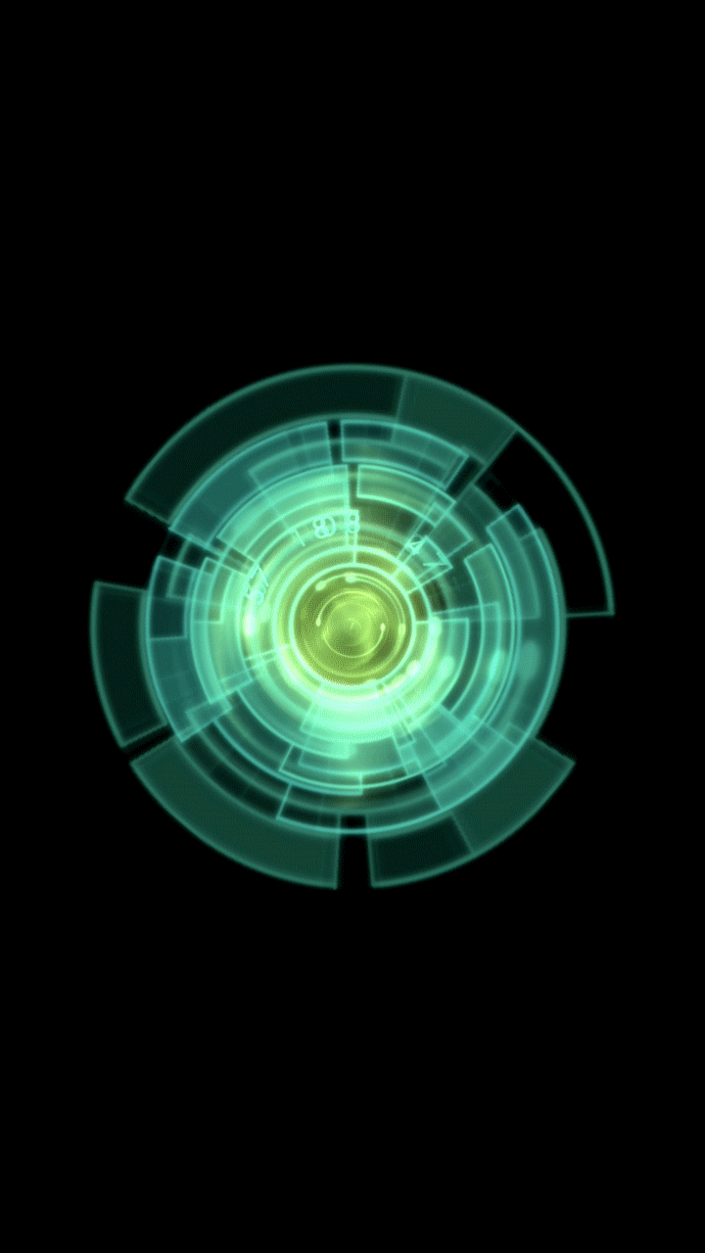
👁
STOP
&&
STEP THROUGH
THE ASSEMBLY
&&
DRAW A STACK DIAGRAM!

Slide 6

32-bit TooManyParameters.c
return address = 00000000`004013c3
saved previous ebp = 0019ff04
arg5 = e = 0x55
arg4 = d = 0x44
arg3 = c = 0x33
arg2 = b = 0x22
arg1 = a = 0x11
return address = 00000000`00401032
saved previous ebp = 0019fee4
undef`ffffffef
//Change uint64 to int
int func(int a, int b, int c, int d, int e){
int i = a+b-c+d-e;
return i;
}
int main(){
return func(0x11,0x22,0x33,0x44,0x55);
}
Not Microsoft stack “Shadow Space”, just the normal calling convention!
No alignment attempts
==
no padding

Slide 7
32-bit TooManyParameters.c 2
return address = 00000000`004013c3
saved previous ebp = 0019ff04
arg5 = e = 0x55
arg4 = d = 0x44
arg3 = c = 0x33
arg2 = b = 0x22
arg1 = a = 0x11
return address = 00000000`00401032
saved previous ebp = 0019fee4
undef`ffffffef
//Change uint64 to int
int func(int a, int b, int c, int d, int e){
int i = a+b-c+d-e;
return i;
}
int main(){
return func(0x11,0x22,0x33,0x44,0x55);
}
main:
push ebp
mov ebp,esp
push 55h
push 44h
push 33h
push 22h
push 11h
call 00401000
add esp,14h
pop ebp
ret
func:
push ebp
mov ebp,esp
push ecx
mov eax,dword ptr [ebp+8]
add eax,dword ptr [ebp+0Ch]
sub eax,dword ptr [ebp+10h]
add eax,dword ptr [ebp+14h]
sub eax,dword ptr [ebp+18h]
mov dword ptr [ebp-4],eax
mov eax,dword ptr [ebp-4]
mov esp,ebp
pop ebp
ret
In 32 bit code when you see a bunch of pushes in front of a call, that usually makes it pretty clear what the arguments to the function are

Slide 8
32-bit TooManyParameters.c 2
return address = 00000000`004013c3
saved previous ebp = 0019ff04
arg5 = e = 0x55
arg4 = d = 0x44
arg3 = c = 0x33
arg2 = b = 0x22
arg1 = a = 0x11
return address = 00000000`00401032
saved previous ebp = 0019fee4
undef`ffffffef
//Change uint64 to int
int func(int a, int b, int c, int d, int e){
int i = a+b-c+d-e;
return i;
}
int main(){
return func(0x11,0x22,0x33,0x44,0x55);
}
main:
push ebp
mov ebp,esp
push 55h
push 44h
push 33h
push 22h
push 11h
call 00401000
add esp,14h
pop ebp
ret
func:
push ebp
mov ebp,esp
push ecx
mov eax,dword ptr [ebp+8]
add eax,dword ptr [ebp+0Ch]
sub eax,dword ptr [ebp+10h]
add eax,dword ptr [ebp+14h]
sub eax,dword ptr [ebp+18h]
mov dword ptr [ebp-4],eax
mov eax,dword ptr [ebp-4]
mov esp,ebp
pop ebp
ret
Not a callee-save! It's a VS-ism for allocating a single int worth of space for a local variable!

Slide 9
32-bit VS vs. GCC et al.
Caller vs. Callee-save Regs
VS Caller-saved | EAX |  | ECX | EDX
VS Callee-saved |  | EBX |  |  | ESI | EDI | EBP
System V (GCC et al.) Caller-saved | EAX |  | ECX | EDX | ESI | EDI
System V (GCC et al.) Callee-saved |  | EBX |  |  |  |  | EBP

Slide 10
32-bit Stack Calling Conventions throwback 2
Both cdecl and stdcall conventions perform explicit stack frame linkage
Each time you enter a new function, the old ebp ("stack frame base pointer" by Intel convention) gets pushed onto the stack, and the new esp (top-of-the stack pointer, which now points at the copy of ebp), gets moved into ebp
https://docs.microsoft.com/en-us/cpp/cpp/cdecl?view=msvc-160
https://docs.microsoft.com/en-us/cpp/cpp/stdcall?view=msvc-160

Slide 11
Changing to 32 bit compilation
Assembly changes from this:
int func(){
return 0xbeef;
}
int main(){
func();
return 0xf00d;
}
func:
0000000140001000 mov eax,0BEEFh
0000000140001005 ret
main:
0000000140001010 sub rsp,28h
0000000140001014 call func (0140001000h)
0000000140001019 mov eax,0F00Dh
000000014000101E add rsp,28h
0000000140001022 ret

Slide 12
Changing to 32 bit compilation
To this:
int func(){
return 0xbeef;
}
int main(){
func();
return 0xf00d;
}
func:
00401000 push ebp
00401001 mov ebp,esp
00401003 mov eax,0BEEFh
00401008 pop ebp
00401009 ret
main:
00401010 push ebp
00401011 mov ebp,esp
00401013 call func (0401000h)
00401018 mov eax,0F00Dh
0040101D pop ebp
0040101E ret

Slide 13
32-bit Stack Frame Diagram
ebp
stack bottom
int func(){
return 0xbeef;
}
int main(){
func();
return 0xf00d;
}
esp
“return address” main() to invoke_main()
“Saved ebp”
main()
frame
“return address” func() to main()
“Saved ebp”
func:
00401000 push ebp
00401001 mov ebp,esp
00401003 mov eax,0BEEFh
00401008 pop ebp
00401009 ret
main:
00401010 push ebp
00401011 mov ebp,esp
00401013 call func (0401000h)
00401018 mov eax,0F00Dh
0040101D pop ebp
0040101E ret
func()
frame
stack top
Animated slide, don't let the esp location fool you, it moves!

Slide 14
32-bit Simple Stack Diagram 4
ebp
stack bottom
esp
“return address” main() to invoke_main()
#include <stdio.h>
int bar(int y){
int a = 3*y;
printf("bar returned %d", a);
return a;
}
int foo(int x){
int b = 5*x;
printf("foo passed %d", b);
return bar(b);
}
int main(){
int c = foo(7);
printf("main passed %d", c);
}
“Saved ebp”
int c
main()
frame
Function arguments (x=7)
“return address” foo() to main()
“Saved ebp”
int b
foo()
frame
Function arguments (y=b)
“return address” bar() to foo()
“Saved ebp”
int a
bar()
frame
stack top

Slide 15
32-bit Maximum Stack Diagram
ebp
stack bottom
esp
“return address” from main() to whoever called main()
“Saved ebp”
local variables (if any)
main()
frame
Callee-save regs (if any)
Caller-save regs (if any)
Function arguments (if any)
“return address” foo() to main()
“Saved ebp”
local variables (if any)
foo()
frame
Callee-save regs (if any)
Caller-save regs (if any)
Function arguments (if any)
“return address” bar() to foo()
“Saved ebp”
local variables (if any)
Callee-save regs (if any)
bar()
frame
stack top

Slide 16
Quiz: How can you tell if a register's being used as a callee-save reg?
A: it's saved at the beginning of a function and restored at the end
Quiz: How can you tell if a register's being used as a caller-save reg?
A: It's being saved before a call, and restored after

Slide 17
32-bit Stack Calling Conventions throwback 3
Function parameters tend to get referenced as "ebp+offset"
Local variables tend to get referenced as "ebp-offset"
  Although gcc sometimes references as esp+offset

Slide 18
32-bit Maximum Stack Diagram 2
stack bottom
“return address” from main() to whoever called main()
“Saved ebp”
local variables (if any)
main()
frame
Callee-save regs (if any)
Caller-save regs (if any)
Function arguments (if any)
“return address” foo() to main()
“Saved ebp”
local variables (if any)
foo()
frame
Callee-save regs (if any)
Caller-save regs (if any)
Function arguments @ [ebp + ...]
Function arguments (if any)
“return address” bar() to foo()
ebp
“Saved ebp”
Local variables @ [ebp - ...] (or [esp + ...])
local variables (if any)
esp
Callee-save regs (if any)
bar()
frame
stack top

Slide 20
32-bit Stack Calling Conventions throwback 4
MS also supports other conventions such as "fastcall" which passes first 2 params in EDX, ECX, and then the rest on the stack
  It's like a more limited version of the x86-64 calling convention
No use of stack frames (since that's extra overhead, which would make it less fast!)
https://docs.microsoft.com/en-us/cpp/cpp/fastcall?view=msvc-160

Slide 21
32-bit VS vs. GCC et al.
Caller vs. Callee-save Regs
VS Caller-saved | EAX |  | ECX (1) fastcall | EDX (2) fastcall
VS Callee-saved |  | EBX |  |  | ESI | EDI | EBP
System V (GCC et al.) Caller-saved | EAX |  | ECX | EDX | ESI | EDI
System V (GCC et al.) Callee-saved |  | EBX |  |  |  |  | EBP

Slide 23
32-bit Stack Calling Conventions throwback 4
TODO: thiscall
https://docs.microsoft.com/en-us/cpp/cpp/thiscall?view=msvc-160

