Slide 1
Architecture 1001:
x86-64 Assembly
IfExample.c
Xeno Kovah – 2021
xeno@darkmentor.com

Slide 2

All materials is licensed under a Creative Commons “Share Alike” license.
http://creativecommons.org/licenses/by-sa/4.0/
Attribution condition: You must indicate that derivative work
"Is derived from Xeno Kovah's 'Architecture 1001: x86-64 Assembly’ class, available at https://ost.fyi"
Notes:
Attribution condition: You must indicate that derivative work
"Is derived from Xeno Kovah's 'Architecture 1001: x86-64 Assembly’ class, available at https://ost.fyi"

Slide 3
IfExample.c
main:
0000000140001000 sub rsp,18h
0000000140001004 mov dword ptr [rsp+4],0FFFFFFFFh
000000014000100C mov dword ptr [rsp],2
0000000140001013 mov eax,dword ptr [rsp]
0000000140001016 cmp dword ptr [rsp+4],eax
000000014000101A jne 0000000140001023
000000014000101C mov eax,1
0000000140001021 jmp 0000000140001048
0000000140001023 mov eax,dword ptr [rsp]
0000000140001026 cmp dword ptr [rsp+4],eax
000000014000102A jle 0000000140001033
000000014000102C mov eax,2
0000000140001031 jmp 0000000140001048
0000000140001033 mov eax,dword ptr [rsp]
0000000140001036 cmp dword ptr [rsp+4],eax
000000014000103A jge 0000000140001043
000000014000103C mov eax,3
0000000140001041 jmp 0000000140001048
0000000140001043 mov eax,0DEFEA7h
0000000140001048 add rsp,18h
000000014000104C ret
int main(){
int a = -1, b = 2;
if(a == b){
return 1;
}
if(a > b){
return 2;
}
if(a < b){
return 3;
}
return 0xdefea7;
}
Jcc

Slide 4
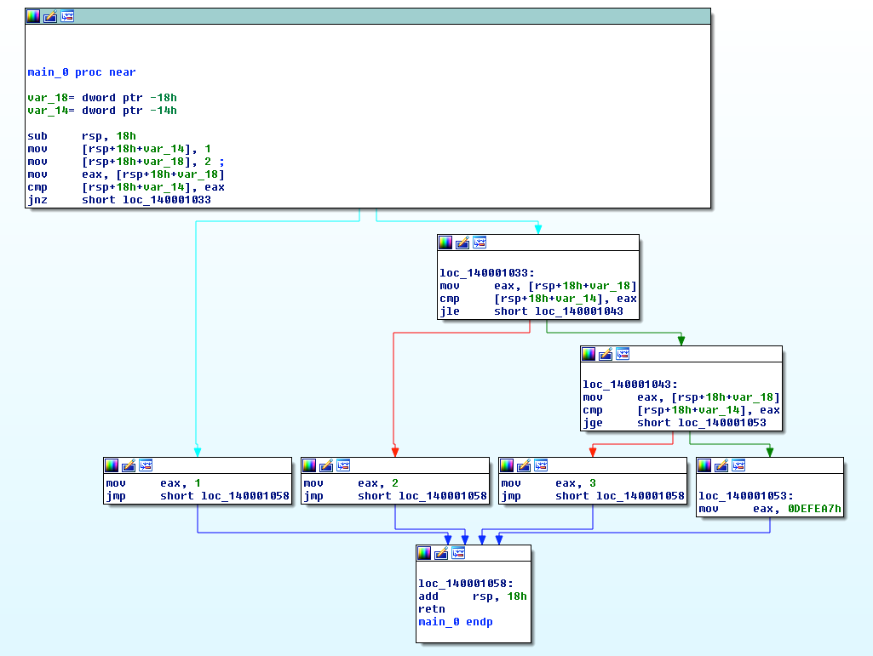
Ghost of Xmas Future:
Tools you won’t get to use today
generate a Control Flow Graph (CFG)
which looks much nicer.
Not that that helps you. Just sayin’ :)

Slide 5
"14"
Jcc - Jump If Condition Is Met
If a condition is true, the jump is taken. Otherwise it proceeds to the next instruction
There are more than 4 pages of conditional jump types! Luckily a bunch of them are synonyms for each other.
JNE == JNZ (Jump if not equal, Jump if not zero, both check if the Zero Flag (ZF) == 0)
Book page 93

Slide 6

"14"
Jcc - Jump If Condition Is Met
If a condition is true, the jump is taken. Otherwise it proceeds to the next instruction
There are more than 4 pages of conditional jump types! Luckily a bunch of them are synonyms for each other.
JNE == JNZ (Jump if not equal, Jump if not zero, both check if the Zero Flag (ZF) == 0)
Book page 93

Slide 7
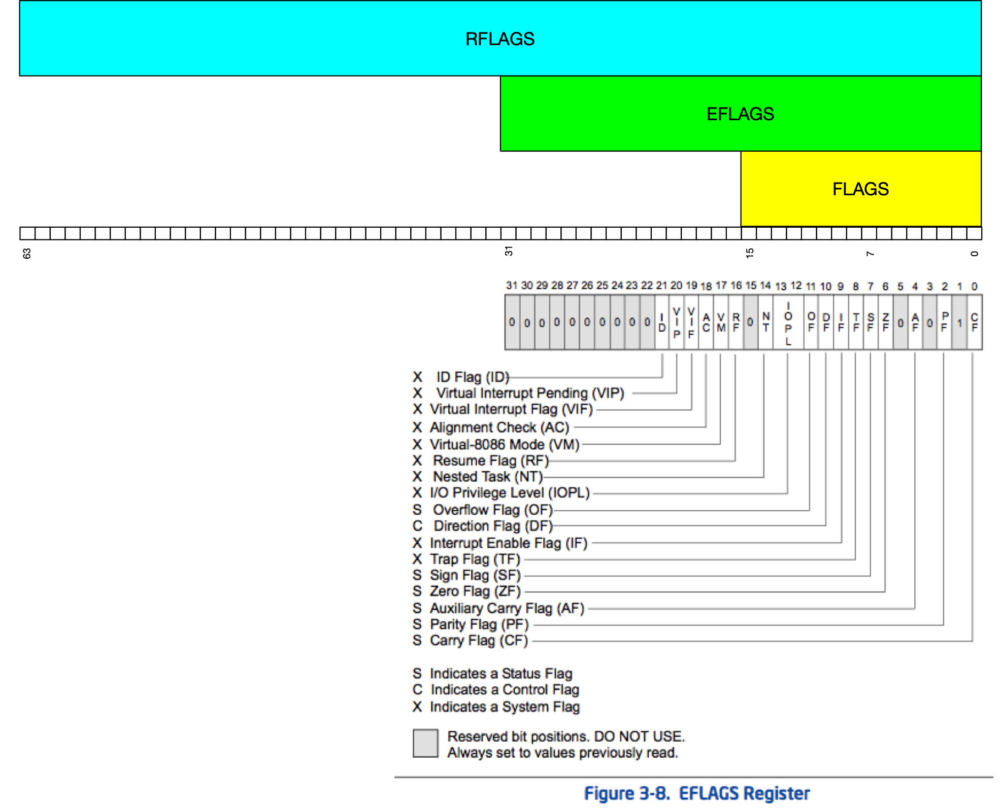
Architecture - RFLAGS
“In 64-bit mode, EFLAGS is extended to 64 bits and called RFLAGS. The upper 32 bits of RFLAGS register is reserved. The lower 32 bits of RFLAGS is the same as EFLAGS.”
Intel Vol 1 Sec 3.4.3.4 - page 3-18 - Jan 2020 manuals

Slide 8
Architecture - RFLAGS
RFLAGS register holds many single bit flags. Will only ask you to remember the following for now:
  Zero Flag (ZF) - Set if the result of some instruction is zero; cleared otherwise.
  Sign Flag (SF) - Set equal to the most-significant bit of the result, which is the sign bit of a signed integer. (0 indicates a positive value and 1 indicates a negative value.)
Other flags will be optional material

Slide 9


Slide 10
This Class
O
F
S
F
Z
F
A
F
P
F
C
F

Slide 11
This Class
ID
RF
I
O
P
L
IF
TF
Future Class

Slide 12
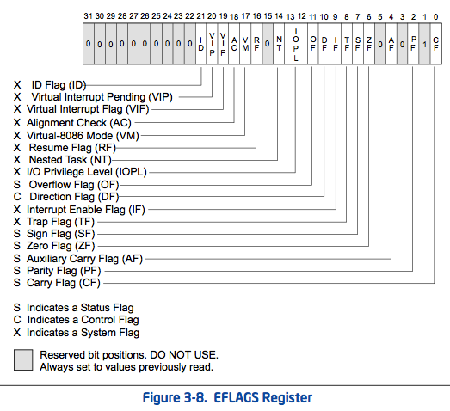
= Intro x86-64
= Intermediate x86-64
Z
F
I
D
R
F
O
F
D
F
I
F
T
F
S
F
A
F
P
F
C
F
I
O
P
L
Intel Vol 1 Sec 3.4.3.1 - page 3-21 - May 2012 manuals

Slide 13
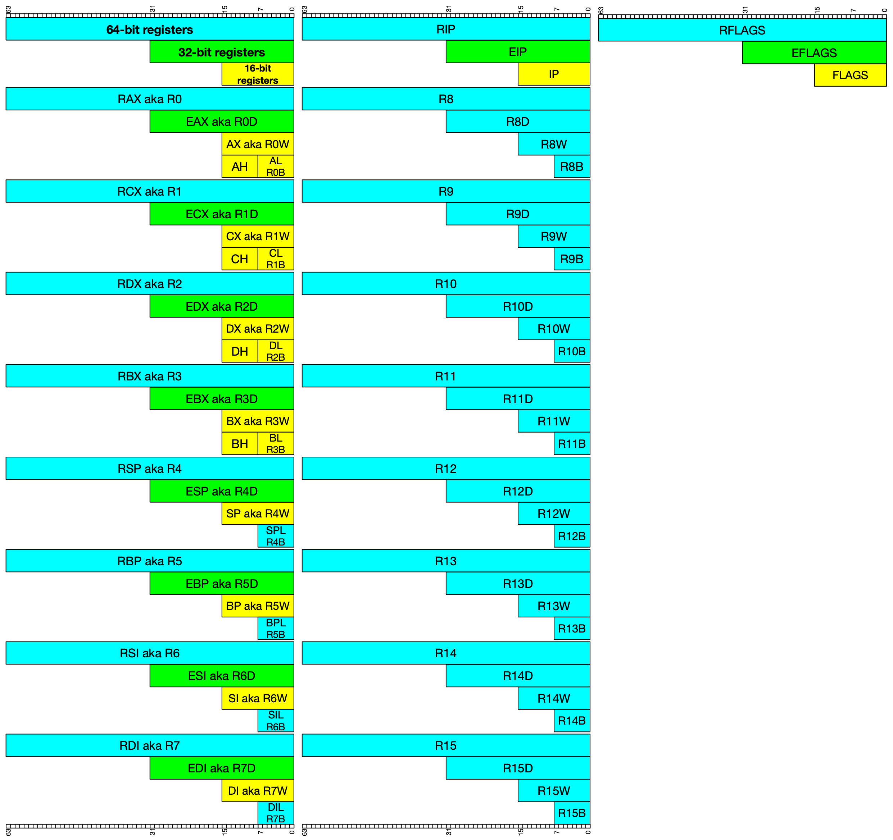

Slide 14
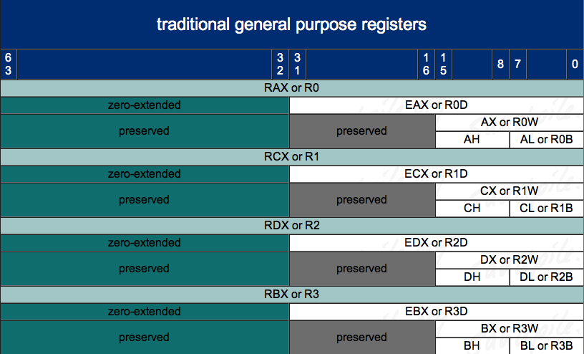
Architecture - Registers – 8/16/32/64 bit addressing 1
http://www.sandpile.org/x86/gpr.htm

Slide 15
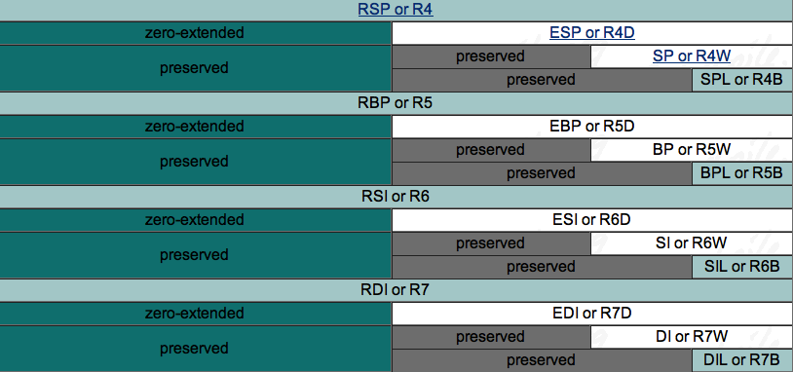
Architecture - Registers – 8/16/32/64 bit addressing 2
(note: we didn’t previously have low-byte access to *SP, *BP, *SI, or *DI!)
http://www.sandpile.org/x86/gpr.htm

Slide 16
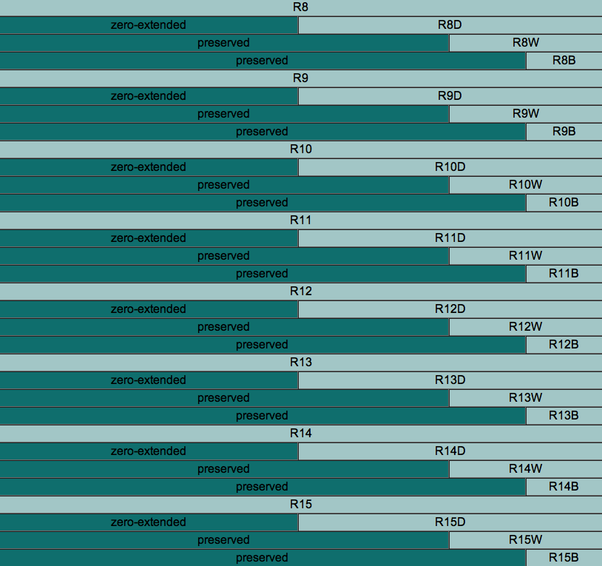
Architecture - Registers – 8/16/32/64 bit addressing 3
http://www.sandpile.org/x86/gpr.htm
Notes:
note to scornwell: maybe a simple game here like:
“DIL is the 8 least-significant-bit access for which 64 bit register?” (RDI)
“What is the word-sized access register for R14 called?” (R14W)
“What is the 16 bit access for R14 called?” (R14W)

Slide 17
Some Notable Jcc Instructions
JZ/JE: if ZF == 1
JNZ/JNE: if ZF == 0
JLE/JNG : if ZF == 1 or SF != OF
JGE/JNL : if SF == OF
JBE/JNA: if CF == 1 OR ZF == 1
JB: if CF == 1
Note: Don’t get hung up on memorizing which flags are set for what. More often than not, you will be running code in a debugger, not just reading it. In the debugger you can just look at RFLAGS and/or watch whether it takes a jump.

Slide 18
Some Notable Jcc Instructions 2
Mnemonic translations
A = above, unsigned notion
B = below, unsigned notion
G = greater than, signed notion
L = less than, signed notion
E = Equal (same a Z, zero flag set)
N = Not (like “Not less than:” JNL)

Slide 19
Some Notable Jcc Instructions 3
Mnemonic translations
B = below, unsigned notion
A = above, unsigned notion
N = Not (like “Not less than:” JNL)
G = greater than, signed notion
L = less than, signed notion
E = Equal (same a Z, zero flag set)
Final Fantasy 7
Crystal Bangle
Unlocked!

Slide 20
Flag Setting
Before you can do a conditional jump, you need something to set the condition status flags for you
Typically done with CMP, TEST, or whatever instructions are already inline and happen to have flag-setting side-effects

Slide 21
15
CMP - Compare Two Operands
“The comparison is performed by subtracting the second operand from the first operand and then setting the status flags in the same manner as the SUB instruction.”
What’s the difference from just doing SUB? Difference is that with SUB the result has to be stored somewhere. With CMP the result is computed, the flags are set, but the result is discarded
Modifies CF, OF, SF, ZF, AF, and PF
Book page 93

Slide 22
Xeno’s Guide to (Mostly) Not Caring About Specific Flags
cmp
dword ptr [rsp+4]
,
eax
jne
0000000140001033
cmp
dword ptr [rsp+4]
,
eax
jle
0000000140001043
cmp
dword ptr [rsp+4]
,
eax
jae
0000000140001043

Slide 23
Xeno’s Guide to (Mostly) Not Caring About Specific Flags
cmp
dword ptr [rsp+4]
,
eax
!=
jne
0000000140001033
cmp
dword ptr [rsp+4]
,
eax
<= (signed)
jle
0000000140001043
cmp
dword ptr [rsp+4]
,
eax
>= (unsigned)
jae
0000000140001043

Slide 24
Xeno’s Guide to (Mostly) Not Caring About Specific Flags
dword ptr [rsp+4]
!=
eax
?
dword ptr [rsp+4]
<= (signed)
eax
?
dword ptr [rsp+4]
>= (unsigned)
eax
?

Slide 25
Xeno’s Guide to (Mostly) Not Caring About Specific Flags
cmp dword ptr [rsp+4],eax
jne 0000000140001033
Is "[rsp+4] != eax"?
cmp dword ptr [rsp+4],eax
jle 0000000140001043
Is "[rsp+4] <= eax"?
(Signed, because “less”, not “below”)
cmp dword ptr [rsp+4],eax
jae 0000000140001053
Is "[rsp+4] >= eax"?
(Unsigned, because “above”, not “greater”)
Warning: Operands are backwards in AT&T syntax, so you can’t just drop the operation in-between the operands!

Slide 26

👁
STOP
&&
STEP THROUGH
THE ASSEMBLY
&&
CHECK YOUR UNDERSTANDING

Slide 27
IfExample.c Takeaways
Conditional logic, like if statements, manifests in assembly as conditional jumps (Jcc). “If condition true, jump there, else fall through”
Conditions involving in/equality are often checked with a CMP instruction, which is the same thing as a SUB, but it just throws the results away after the relevant RFLAGS bits are set
The RFLAGS bits are fundamentally what are checked by the Jccs
int main(){
int a = -1, b = 2;
if(a == b){
return 1;
}
if(a > b){
return 2;
}
if(a < b){
return 3;
}
return 0xdefea7;
}
main:
0000000140001000 sub rsp,18h
0000000140001004 mov dword ptr [rsp+4],0FFFFFFFFh
000000014000100C mov dword ptr [rsp],2
0000000140001013 mov eax,dword ptr [rsp]
0000000140001016 cmp dword ptr [rsp+4],eax
000000014000101A jne 0000000140001023
000000014000101C mov eax,1
0000000140001021 jmp 0000000140001048
0000000140001023 mov eax,dword ptr [rsp]
0000000140001026 cmp dword ptr [rsp+4],eax
000000014000102A jle 0000000140001033
000000014000102C mov eax,2
0000000140001031 jmp 0000000140001048
0000000140001033 mov eax,dword ptr [rsp]
0000000140001036 cmp dword ptr [rsp+4],eax
000000014000103A jge 0000000140001043
000000014000103C mov eax,3
0000000140001041 jmp 0000000140001048
0000000140001043 mov eax,0DEFEA7h
0000000140001048 add rsp,18h
000000014000104C ret

Slide 28
Instructions we now know (15)
NOP
PUSH/POP
CALL/RET
MOV
ADD/SUB
IMUL
MOVZX/MOVSX
LEA
JMP/Jcc (family)
CMP

Slide 29

10
14
5
7
8
13
6
14
imul
9
movsx
11
14
2
15
3
4
12
1

