Slide 1
Architecture 1001:
x86-64 Assembly
Boolean instructions
Xeno Kovah – 2021
xeno@darkmentor.com

Slide 2

All materials is licensed under a Creative Commons “Share Alike” license.
http://creativecommons.org/licenses/by-sa/4.0/
Attribution condition: You must indicate that derivative work
"Is derived from Xeno Kovah's 'Architecture 1001: x86-64 Assembly’ class, available at https://ost.fyi"
Notes:
Attribution condition: You must indicate that derivative work
"Is derived from Xeno Kovah's 'Architecture 1001: x86-64 Assembly’ class, available at https://ost.fyi"

Slide 3

BooleanBecause.c
#include <stdio.h>
#define uint64 unsigned long long
unsigned long long main() {
unsigned int i = 0x50da;
unsigned int j = 0xc0ffee;
uint64 k = 0x7ee707a11ed;
k ^= ~(i & j) | 0x7ab00;
return k;
}
main:
0000000140001000 sub rsp,18h
0000000140001004 mov dword ptr [rsp+4],50DAh
000000014000100C mov dword ptr [rsp],0C0FFEEh
0000000140001013 mov rax,7EE707A11EDh
000000014000101D mov qword ptr [rsp+8],rax
0000000140001022 mov eax,dword ptr [rsp]
0000000140001025 mov ecx,dword ptr [rsp+4]
0000000140001029 and ecx,eax
000000014000102B mov eax,ecx
000000014000102D not eax
000000014000102F or eax,7AB00h
0000000140001034 mov eax,eax
0000000140001036 mov rcx,qword ptr [rsp+8]
000000014000103B xor rcx,rax
000000014000103E mov rax,rcx
0000000140001041 mov qword ptr [rsp+8],rax
0000000140001046 mov rax,qword ptr [rsp+8]
000000014000104B add rsp,18h
000000014000104F ret

Slide 4
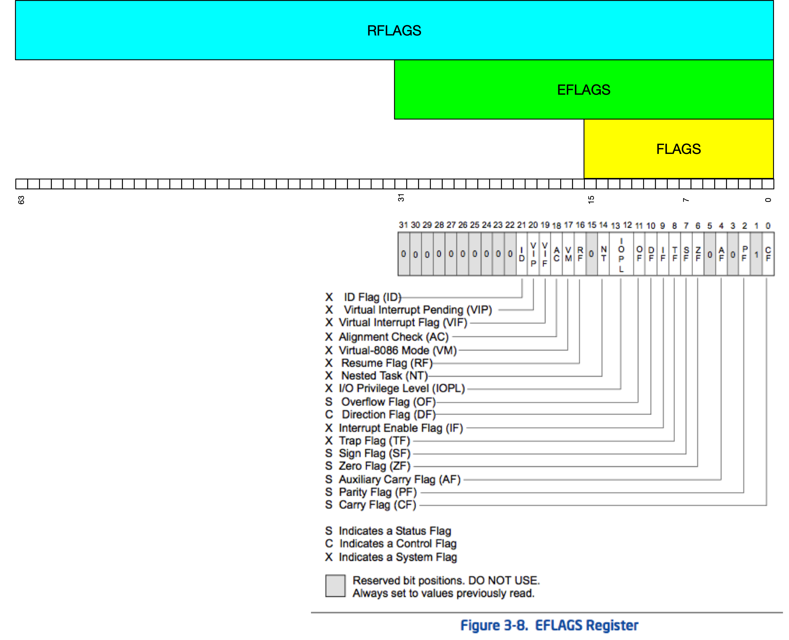
This Class
O
F
S
F
Z
F
A
F
P
F
C
F
Boolean operations modify most of the yellow status flags

Slide 5
16
AND - Bitwise AND
C binary operator "&" (not &&, that's logical AND)
Destination operand can be r/mX or register
Source operand can be r/mX or register or immediate (No source and destination as r/mXs)
and al, bl
and al, 0x42
 | 00110011b (al - 0x33)
AND | 01010101b (bl - 0x55)
result | 00010001b (al - 0x11)
 | 00110011b (al - 0x33)
AND | 01000010b (imm - 0x42)
result | 00000010b (al - 0x02)
Book page 75

Slide 6
17
OR - Bitwise OR
C binary operator "|" (not ||, that's logical OR)
Destination operand can be r/mX or register
Source operand can be r/mX or register or immediate (No source and destination as r/mXs)
or al, bl
or al, 0x42
 | 00110011b (al - 0x33)
OR | 01010101b (bl - 0x55)
result | 01110111b (al - 0x77)
 | 00110011b (al - 0x33)
OR | 01000010b (imm - 0x42)
result | 01110011b (al - 0x73)
Book page 76

Slide 7
18
XOR - Bitwise Exclusive OR
C binary operator "^"
Destination operand can be r/mX or register
Source operand can be r/mX or register or immediate (No source and destination as r/mXs)
FYI XOR is commonly used to zero a register, by XORing it with itself, because it’s faster than a MOV
xor al, al
xor al, 0x42
 | 00110011b (al - 0x33)
XOR | 00110011b (al - 0x33)
result | 00000000b (al - 0x00)
 | 00110011b (al - 0x33)
OR | 01000010b (imm - 0x42)
result | 01110001b (al - 0x71)
Book page 77

Slide 8
NOT - One's Complement Negation
19
C binary operator "~" (not !, that's logical NOT)
Single source/destination operand can be r/mX
not rax
RAX | 11111000000110101010000111101110`010110000001001010001111010100101010b
result | 00000111111001010101111000010001`101001111110110101110000101011010101b (RAX = 0x7E55E11A7ED70AD5!)
Book page 74

Slide 9

NOT - One's Complement Negation
19
C binary operator "~" (not !, that's logical NOT)
Single source/destination operand can be r/mX
not rax
RAX | 11111000000110101010000111101110`01011000000100101000111101010010b
result | 00000111111001010101111000010001`10100111111011010111000010101101b (RAX = 0x7E55E11A7ED70AD!)
Book page 74

Slide 10

👁
STOP
&&
STEP THROUGH
THE ASSEMBLY
&&
CHECK YOUR UNDERSTANDING

Slide 11
BooleanBecause.c Takeaways
C binary operators correspond 1:1 to assembly instructions
#include <stdio.h>
#define uint64 unsigned long long
unsigned long long main() {
unsigned int i = 0x50da;
unsigned int j = 0xc0ffee;
uint64 k = 0x7ee707a11ed;
k ^= ~(i & j) | 0x7ab00;
return k;
}
main:
0000000140001000 sub rsp,18h
0000000140001004 mov dword ptr [rsp+4],50DAh
000000014000100C mov dword ptr [rsp],0C0FFEEh
0000000140001013 mov rax,7EE707A11EDh
000000014000101D mov qword ptr [rsp+8],rax
0000000140001022 mov eax,dword ptr [rsp]
0000000140001025 mov ecx,dword ptr [rsp+4]
0000000140001029 and ecx,eax
000000014000102B mov eax,ecx
000000014000102D not eax
000000014000102F or eax,7AB00h
0000000140001034 mov eax,eax
0000000140001036 mov rcx,qword ptr [rsp+8]
000000014000103B xor rcx,rax
000000014000103E mov rax,rcx
0000000140001041 mov qword ptr [rsp+8],rax
0000000140001046 mov rax,qword ptr [rsp+8]
000000014000104B add rsp,18h
000000014000104F ret

Slide 12
Instructions we now know (19)
NOP
PUSH/POP
CALL/RET
MOV
ADD/SUB
IMUL
MOVZX/MOVSX
LEA
JMP/Jcc (family)
CMP
AND/OR/XOR/NOT

Slide 13

10
14
5
7
16
17
8
13
6
18
imul
9
14
movsx
11
not
19
14
2
15
3
4
12
1

